Slide 1
37-4
This work is licensed under a Creative Commons Attribution-ShareAlike 4.0 International License.
Please add this statement to all the videos you create.
English Bible quotes are from the World English Bible US, which is in the public domain.
Notes:
Ch
37 People reject Jesus
1. Jesus is the Bread of Life- John 6:22-71 (Left Top)
2. Officers sent to seize Jesus - John 7:1-53 (Right Top)
3. Woman accused of adultery - John 8:1-12 (Center)
4. Jesus talks to angry Pharisees - John 8:13-59 (Right near Bottom)
5. Blind man cured - John 9:1-41 (Right Bottom)
6. The Good Shepherd - John 10:1-21 (Left Bottom)
7. Jewish leaders try to stone Jesus - John 10:22-42 (Left Center)

Slide 2
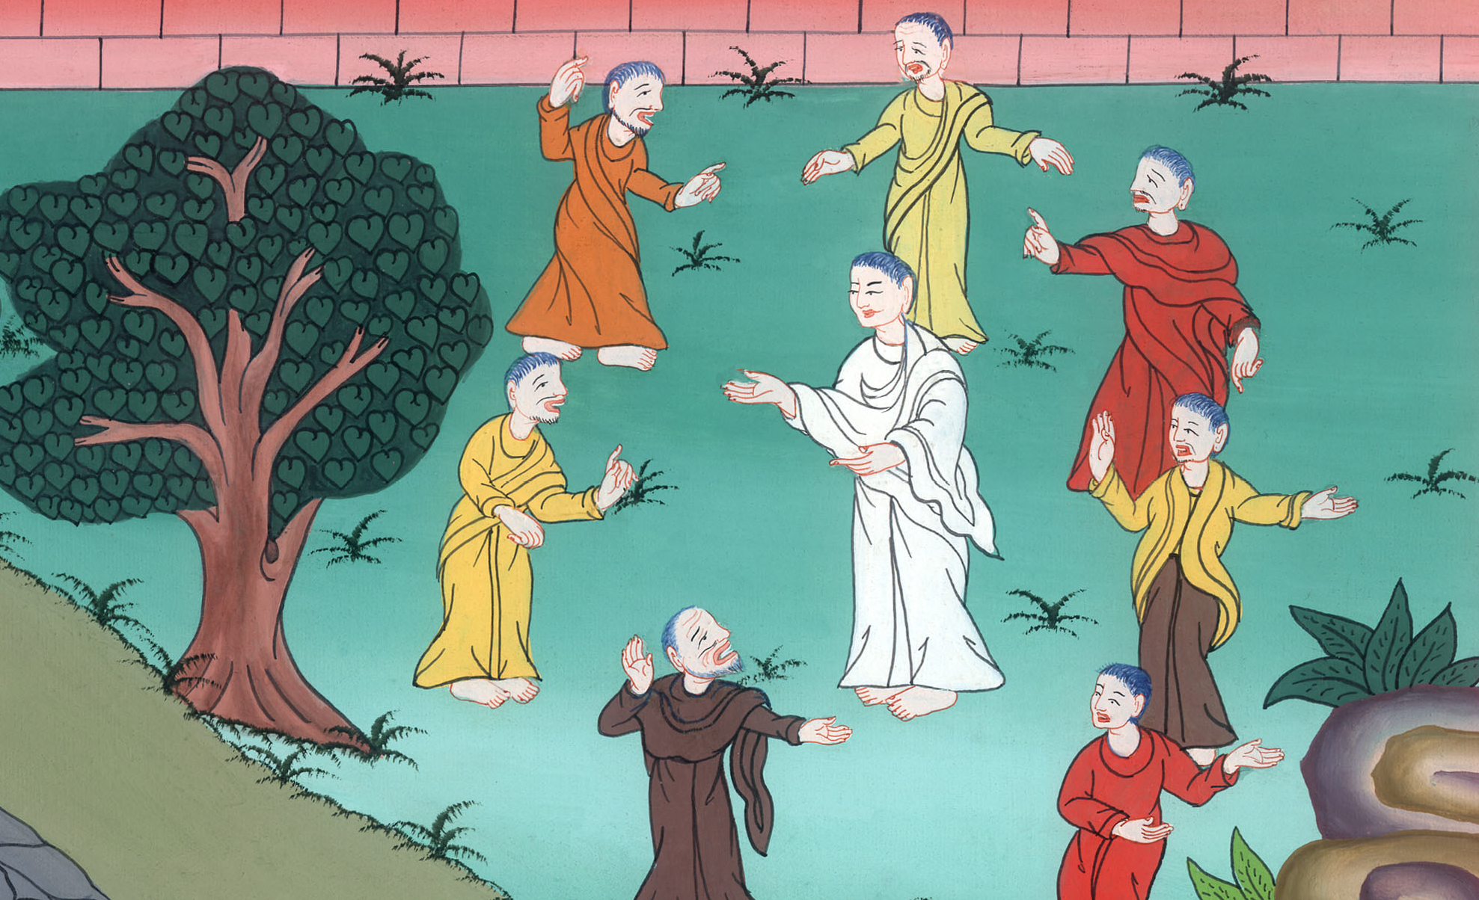
My Father who Sent Me –
John 8:19-59

Slide 3
My Father who Sent Me –
John 8:19-59

Slide 4
My Father who Sent Me –
John 8:19-59

Slide 5
The next day the Pharisees argued with Jesus 19They said therefore to him, “Where is your Father?”
Jesus answered, “You know neither me nor my Father. If you knew me, you would know my Father also.”

Slide 6
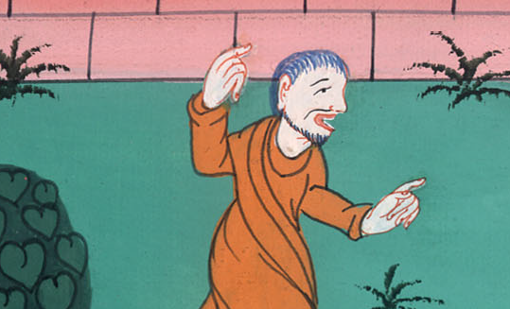
John 8:19

Slide 7
23He said to them, “You are from beneath. I am from above. You are of this world. I am not of this world.

Slide 8
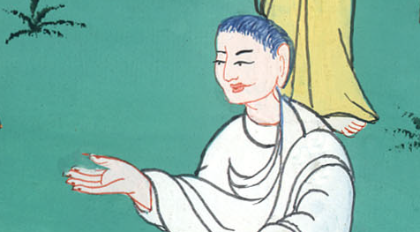
John 8:23

Slide 9
24I said therefore to you that you will die in your sins; for unless you believe that I am he, you will die in your sins.”

Slide 10
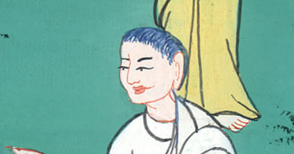
John 8:24

Slide 11
25They said therefore to him, “Who are you?”
Jesus said to them, “Just what I have been saying to you from the beginning.
27They didn’t understand that he spoke to them about the Father.

Slide 12
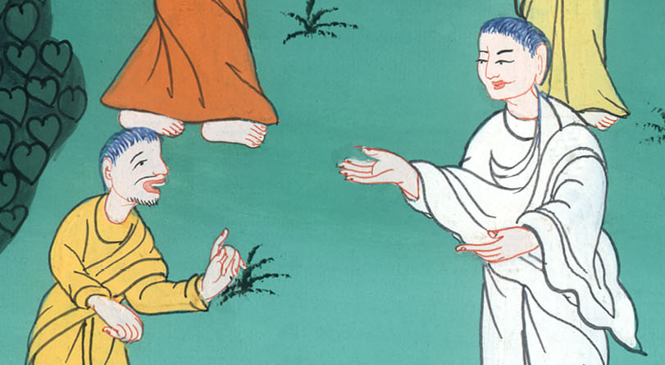
John 8:25,27

Slide 13
29He who sent me is with me. The Father hasn’t left me alone, for I always do the things that are pleasing to him.”
30As he spoke these things, many believed in him.

Slide 14
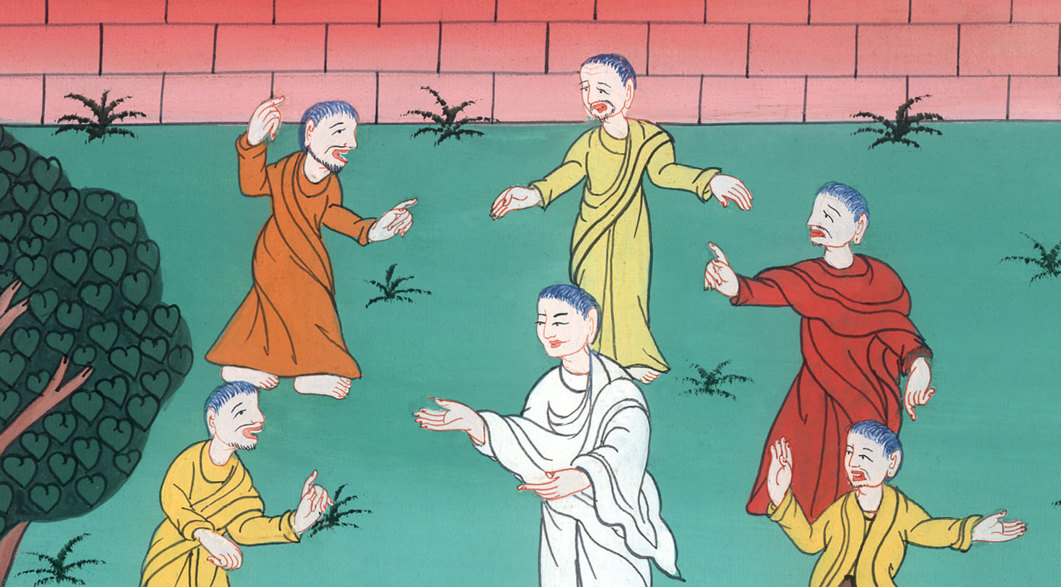
John 8:29,30

Slide 15
31Jesus therefore said to those Jews who had believed him, “If you remain in my word, then you are truly my disciples. 32You will know the truth, and the truth will make you free.”

Slide 16
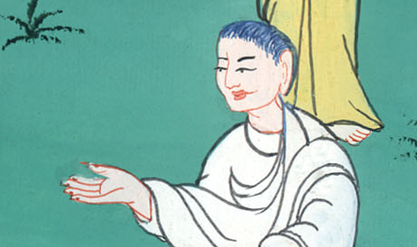
John 8:31,32

Slide 17
33They answered him, “We are Abraham’s offspring, and have never been in bondage to anyone. How do you say, ‘You will be made free’?”

Slide 18
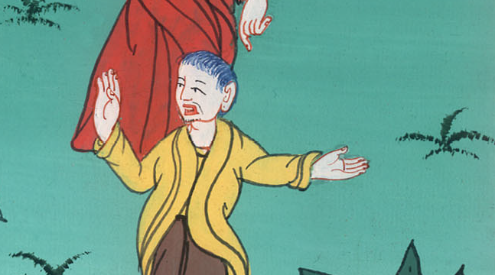
John 8:33

Slide 19
34Jesus answered them, “Most certainly I tell you, everyone who commits sin is the bondservant of sin.

Slide 20
John 8:34

Slide 21
35A bondservant doesn’t live in the house forever. A son remains forever. 36If therefore the Son makes you free, you will be free indeed.

Slide 22
John 8:35,36

Slide 23
42Therefore Jesus said to them, “If God were your father, you would love me, for I came out and have come from God. For I haven’t come of myself, but he sent me.

Slide 24
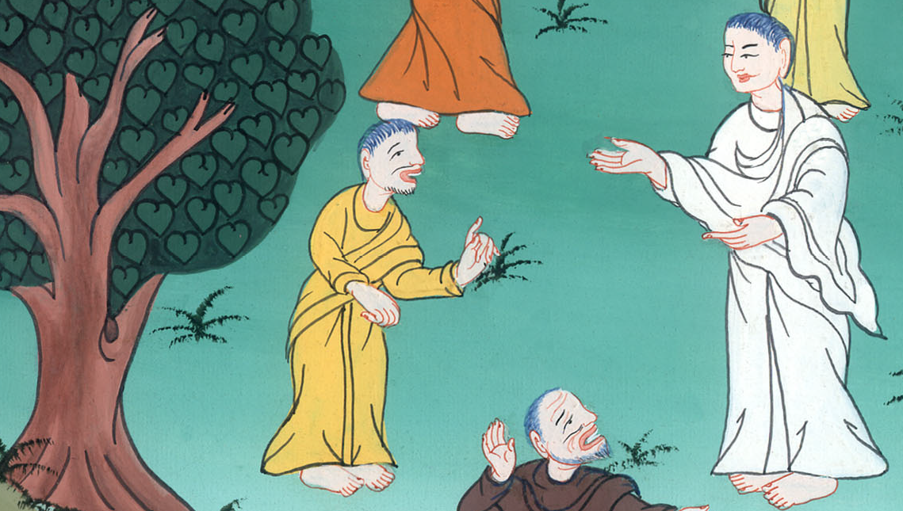
John 8:42

Slide 25
47He who is of God hears the words of God. For this cause you don’t hear, because you are not of God.” 51Most certainly, I tell you, if a person keeps my word, he will never see death.”

Slide 26
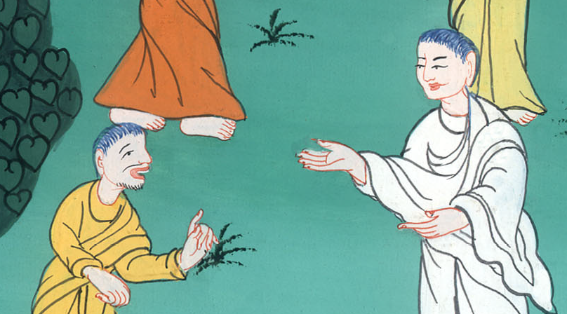
John 8:47,51

Slide 27
52Then the Jews said to him, “Now we know that you have a demon. Abraham died, as did the prophets; and you say, ‘If a man keeps my word, he will never taste of death.’

Slide 28
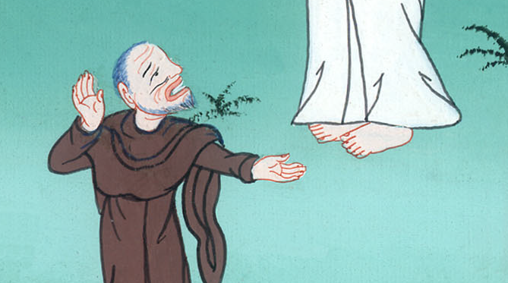
John 8:52

Slide 29
53Are you greater than our father Abraham, who died? The prophets died. Who do you make yourself out to be?”

Slide 30
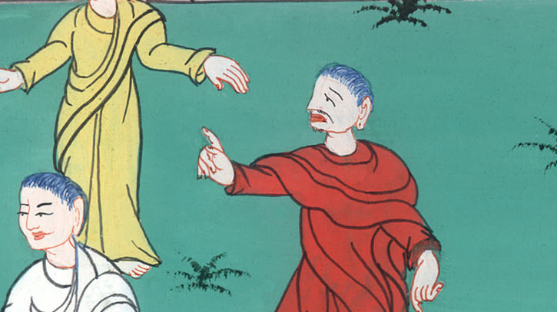
John 8:53

Slide 31
58Jesus said to them, “Most certainly, I tell you, before Abraham came into existence, I AM.”

Slide 32
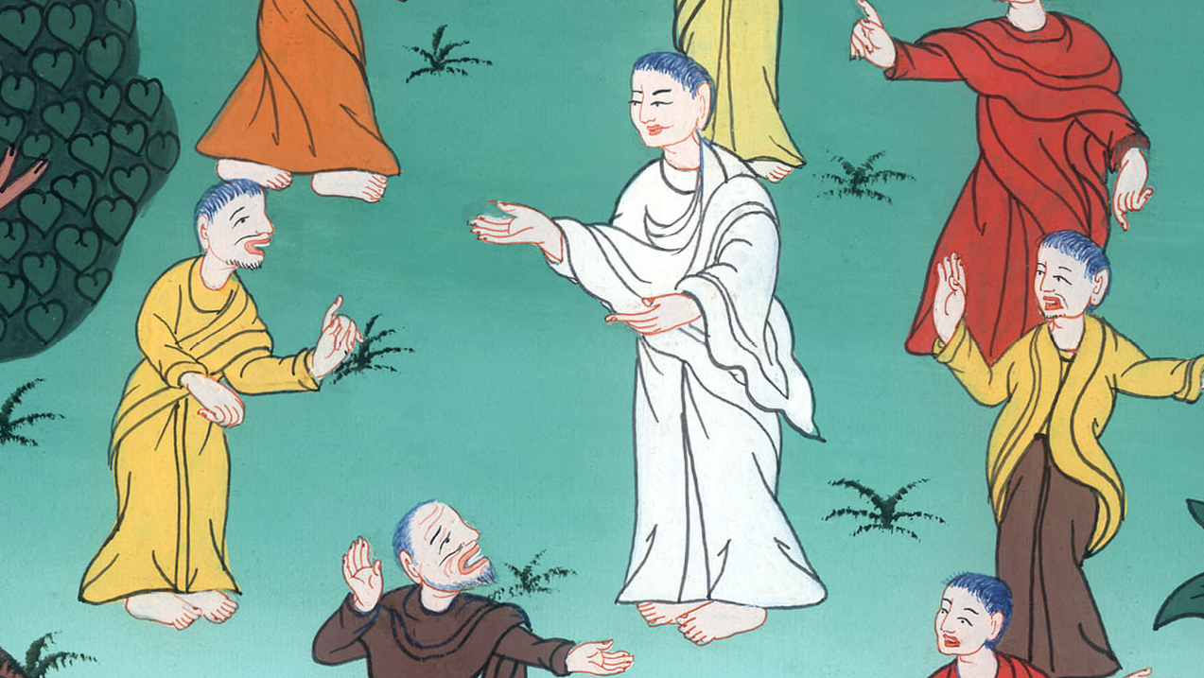
John 8:58

Slide 33
59Therefore they took up stones to throw at him, but Jesus hid himself and went out of the temple, having gone through the middle of them, and so passed by.

Slide 34
John 8:59

