Slide 1
37-5
This work is licensed under a Creative Commons Attribution-ShareAlike 4.0 International License.
Please add this statement to all the videos you create.
English Bible quotes are from the World English Bible US, which is in the public domain.
Notes:
Ch
37 People reject Jesus
1. Jesus is the Bread of Life- John 6:22-71 (Left Top)
2. Officers sent to seize Jesus - John 7:1-53 (Right Top)
3. Woman accused of adultery - John 8:1-12 (Center)
4. Jesus talks to angry Pharisees - John 8:13-59 (Right near Bottom)
5. Blind man cured - John 9:1-41 (Right Bottom)
6. The Good Shepherd - John 10:1-21 (Left Bottom)
7. Jewish leaders try to stone Jesus - John 10:22-42 (Left Center)

Slide 2
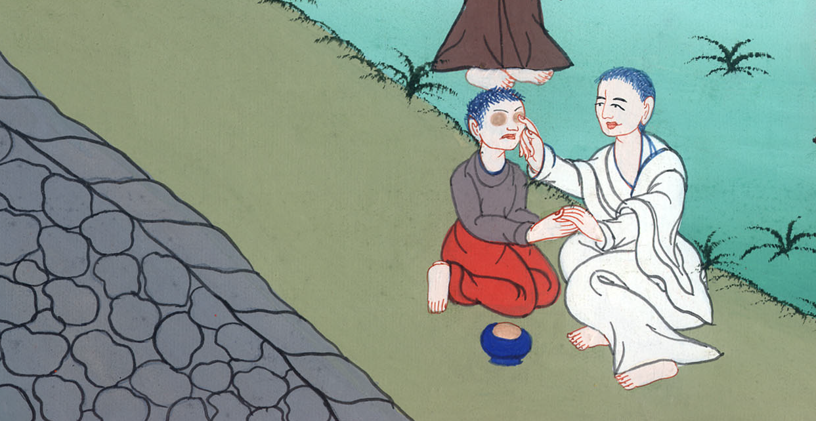

Slide 3
Blind man cured - John 9:1-41

Slide 4
Blind man cured - John 9:1-41

Slide 5
1As he passed by, he saw a man blind from birth. 2His disciples asked him, “Rabbi, who sinned, this man or his parents, that he was born blind?”

Slide 6
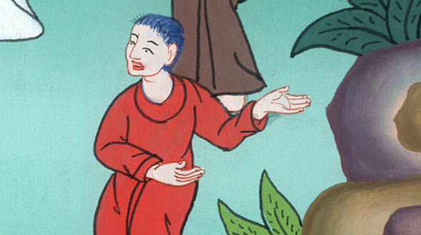
John 9:1,2

Slide 7
3Jesus answered, “This man didn’t sin, nor did his parents, but that the works of God might be revealed in him.

Slide 8
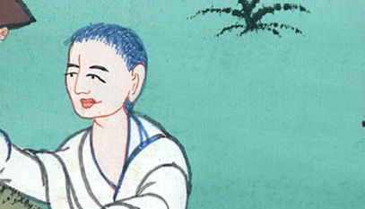
John 9:3

Slide 9
6When he had said this, he spat on the ground, made mud with the saliva, anointed the blind man’s eyes with the mud,

Slide 10
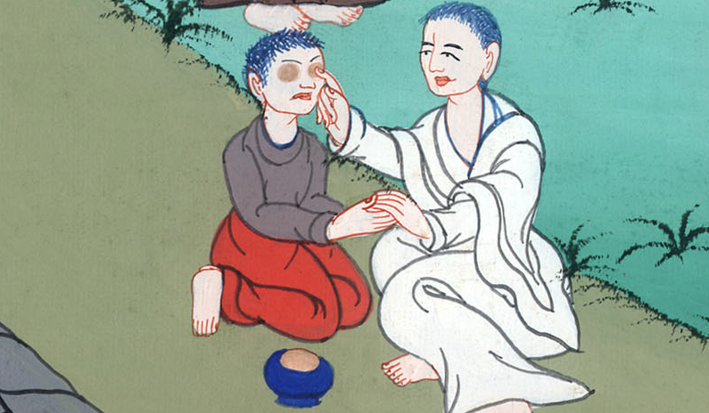
John 9:6

Slide 11
7and said to him, “Go, wash in the pool of Siloam” (which means “Sent”). So he went away, washed, and came back seeing.

Slide 12
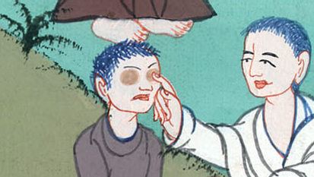
John 9:7

Slide 13
8Therefore the neighbors and those who saw that he was blind before said, “Isn’t this he who sat and begged?”

Slide 14
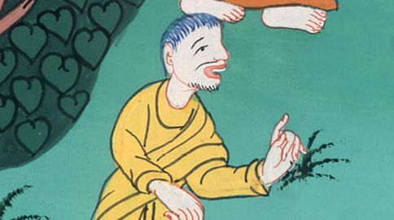
John 9:8

Slide 15
9Others were saying, “It is he.” Still others were saying, “He looks like him.”
He said, “I am he.”
10They therefore were asking him, “How were your eyes opened?”

Slide 16
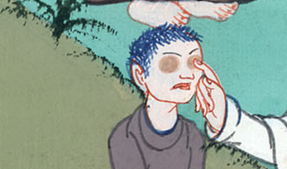
John 9:9,10

Slide 17
11He answered, “A man called Jesus made mud, anointed my eyes, and said to me, ‘Go to the pool of Siloam and wash.’ So I went away and washed, and I received sight.”

Slide 18
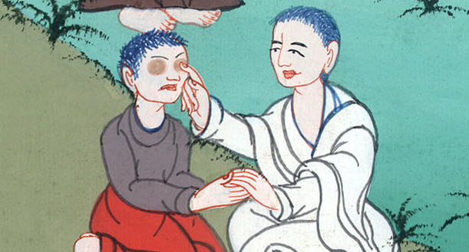
John 9:11

Slide 19
12Then they asked him, “Where is he?”
He said, “I don’t know.”
13They brought him who had been blind to the Pharisees.

Slide 20
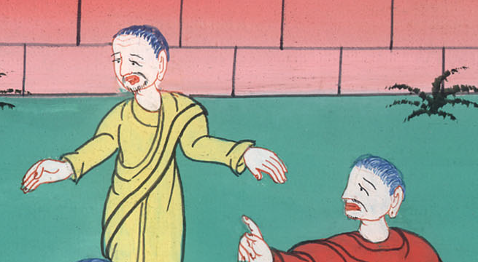
John 9:12,13

Slide 21
15Again therefore the Pharisees also asked him how he received his sight. He said to them, “He put mud on my eyes, I washed, and I see.”

Slide 22
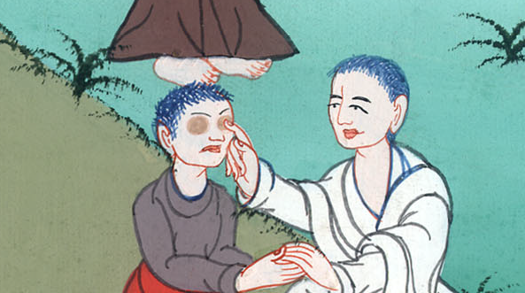
John 9:15

Slide 23
18The Jews therefore didn’t believe concerning him, that he had been blind and had received his sight, until they called the parents of him who had received his sight, 19and asked them, “Is this your son, whom you say was born blind? How then does he now see?”

Slide 24
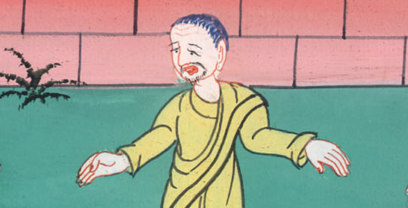
John 9:18,19

Slide 25
20His parents answered them, “We know that this is our son, and that he was born blind; 21but how he now sees, we don’t know; or who opened his eyes, we don’t know. He is of age. Ask him. He will speak for himself.”

Slide 26
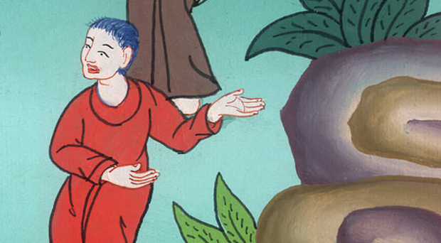
John 9:20,21

Slide 27
26They said to him again, “What did he do to you? How did he open your eyes?” 25He therefore answered, “I don’t know if he is a sinner. One thing I do know: that though I was blind, now I see.”

Slide 28
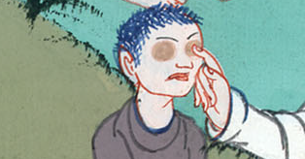
John 9:26,25

Slide 29
27…“I told you already, and you didn’t listen. Why do you want to hear it again? You don’t also want to become his disciples, do you?”

Slide 30
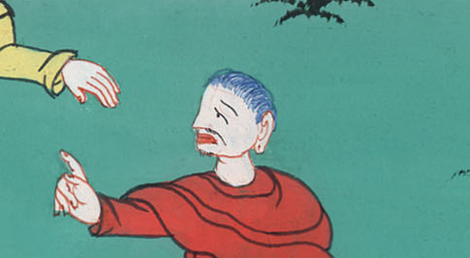
John 9:27

Slide 31
34They answered him, “You were altogether born in sins, and do you teach us?” Then they threw him out.

Slide 32
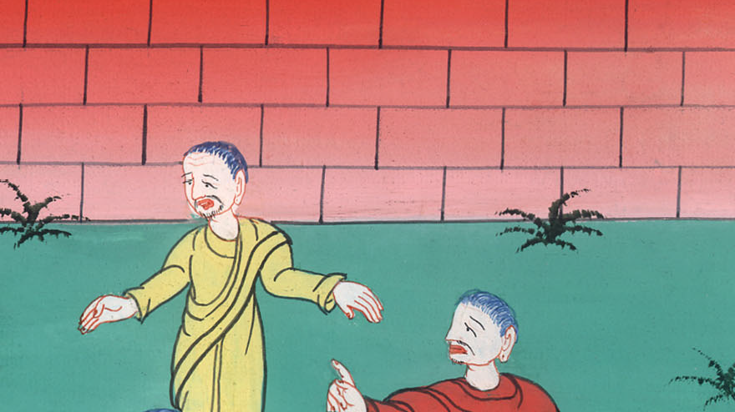
John 9:34

Slide 33
35Jesus heard that they had thrown him out, and finding him, he said, “Do you believe in the Son of God?”
36He answered, “Who is he, Lord, that I may believe in him?”

Slide 34
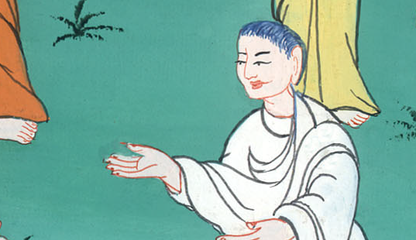
John 9:35,36

Slide 35
37Jesus said to him, “You have both seen him, and it is he who speaks with you.”
38He said, “Lord, I believe!” and he worshiped him.

Slide 36
John 9:37,38

