Slide 1
37-6
This work is licensed under a Creative Commons Attribution-ShareAlike 4.0 International License.
Please add this statement to all the videos you create.
English Bible quotes are from the World English Bible US, which is in the public domain.
Notes:
Ch
37 People reject Jesus
1. Jesus is the Bread of Life- John 6:22-71 (Left Top)
2. Officers sent to seize Jesus - John 7:1-53 (Right Top)
3. Woman accused of adultery - John 8:1-12 (Center)
4. Jesus talks to angry Pharisees - John 8:13-59 (Right near Bottom)
5. Blind man cured - John 9:1-41 (Right Bottom)
6. The Good Shepherd - John 10:1-21 (Left Bottom)
7. Jewish leaders try to stone Jesus - John 10:22-42 (Left Center)

Slide 2
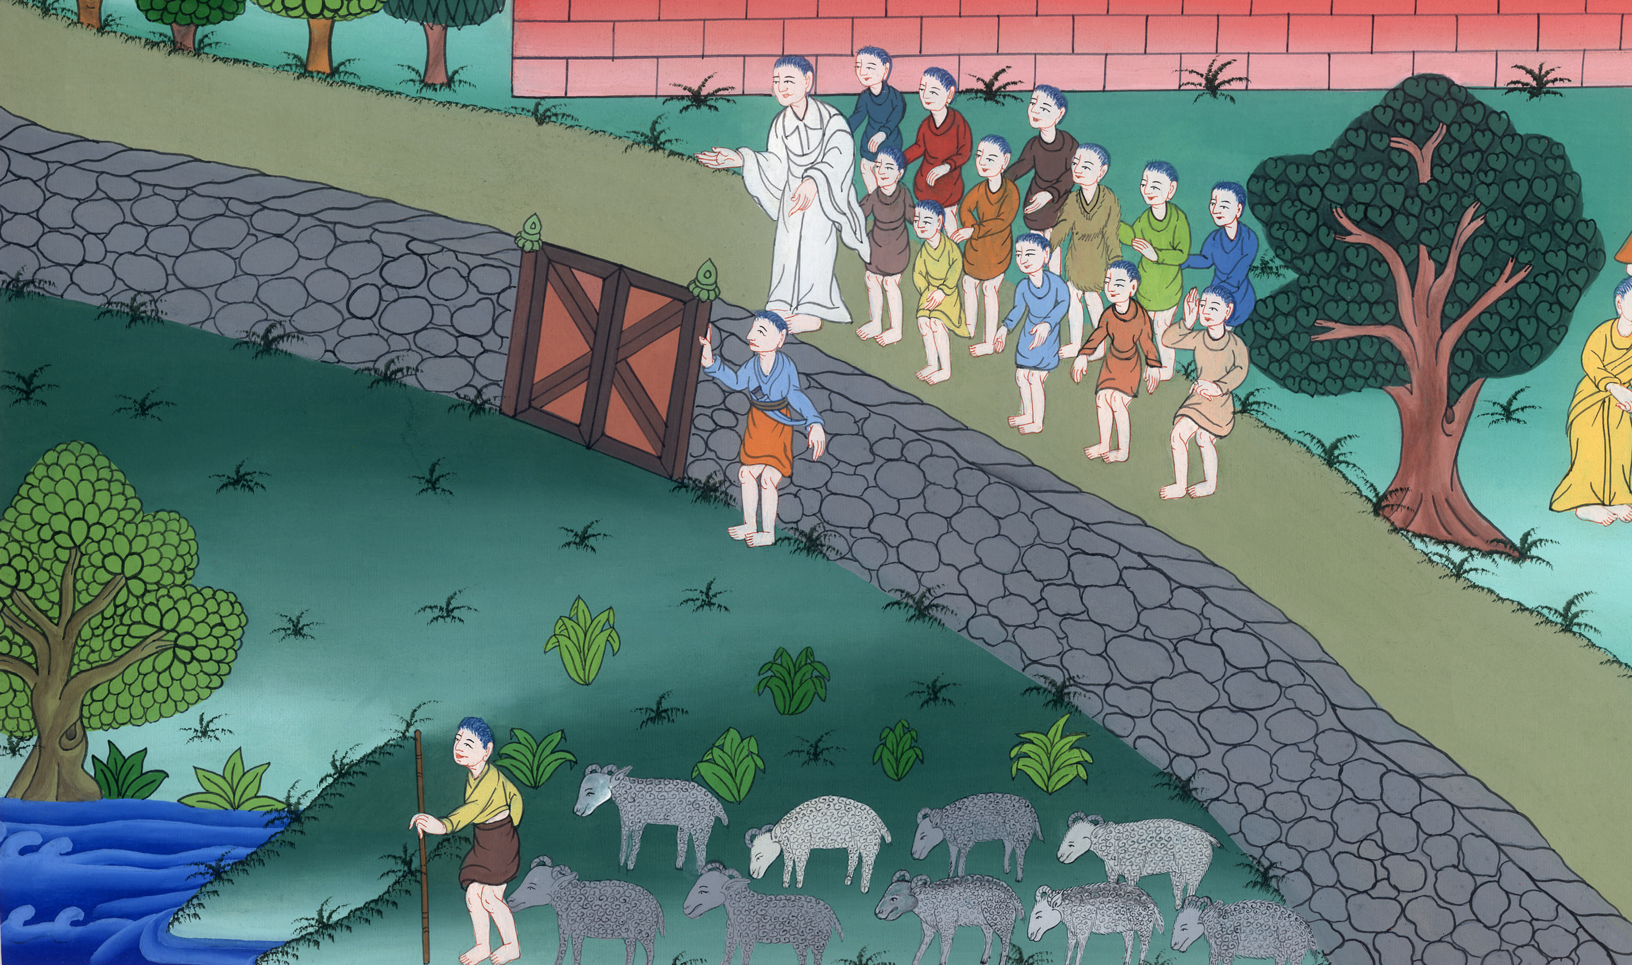
The Good Shepherd - John 10:1-21

Slide 3
The Good Shepherd - John 10:1-21

Slide 4
The Good Shepherd - John 10:1-21

Slide 5
(The Pharisees were arguing with Jesus because he healed a blind man. Jesus continued saying) 1 “Most certainly, I tell you,

Slide 6
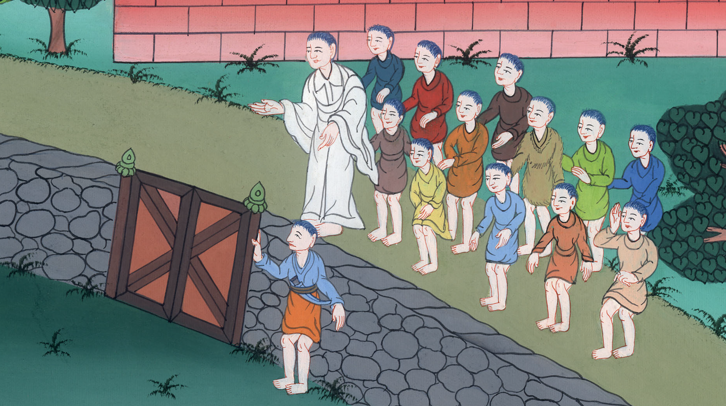
John 10:1

Slide 7
one who doesn’t enter by the door into the sheep fold, but climbs up some other way, is a thief and a robber.

Slide 8
John 10:1

Slide 9
2But one who enters in by the door is the shepherd of the sheep. 3The gatekeeper opens the gate for him, and the sheep listen to his voice. He calls his own sheep by name and leads them out.

Slide 10
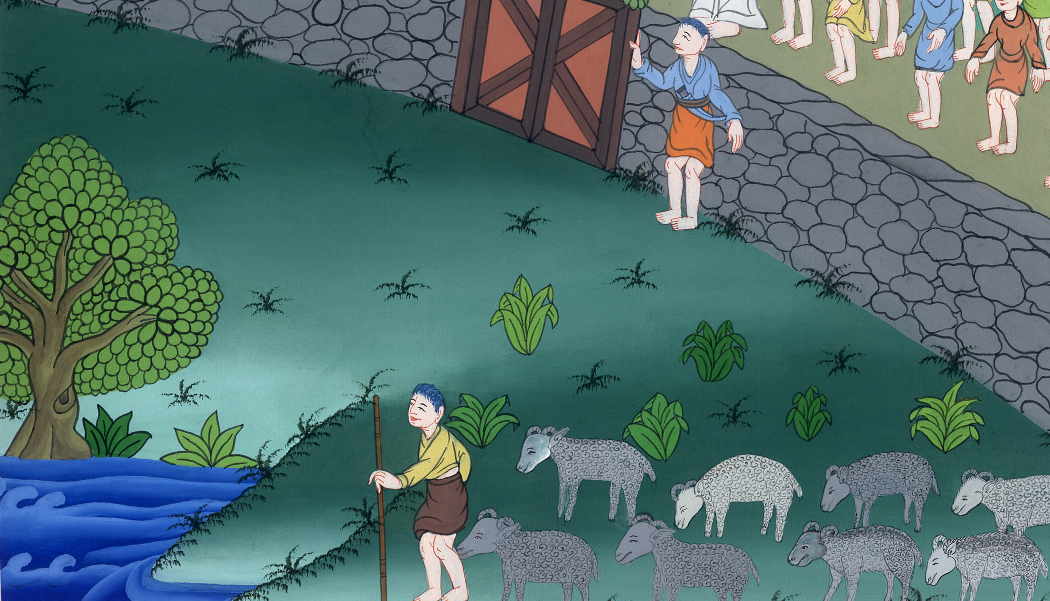
John 10:2,3

Slide 11
4Whenever he brings out his own sheep, he goes before them; and the sheep follow him, for they know his voice.

Slide 12
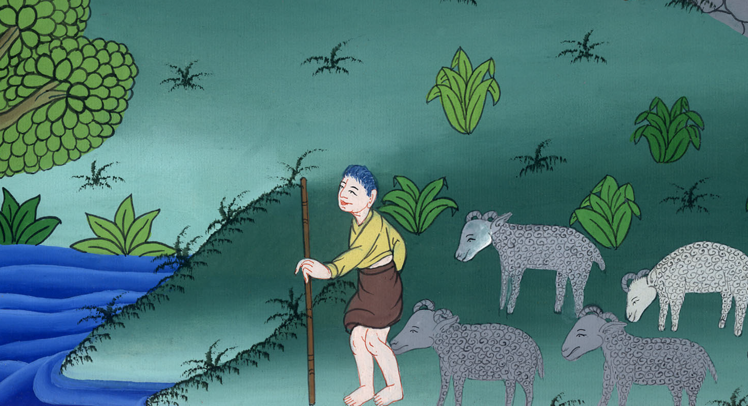
John 10:4

Slide 13
5They will by no means follow a stranger, but will flee from him; for they don’t know the voice of strangers.” 6Jesus spoke this parable to them, but they didn’t understand what he was telling them.

Slide 14
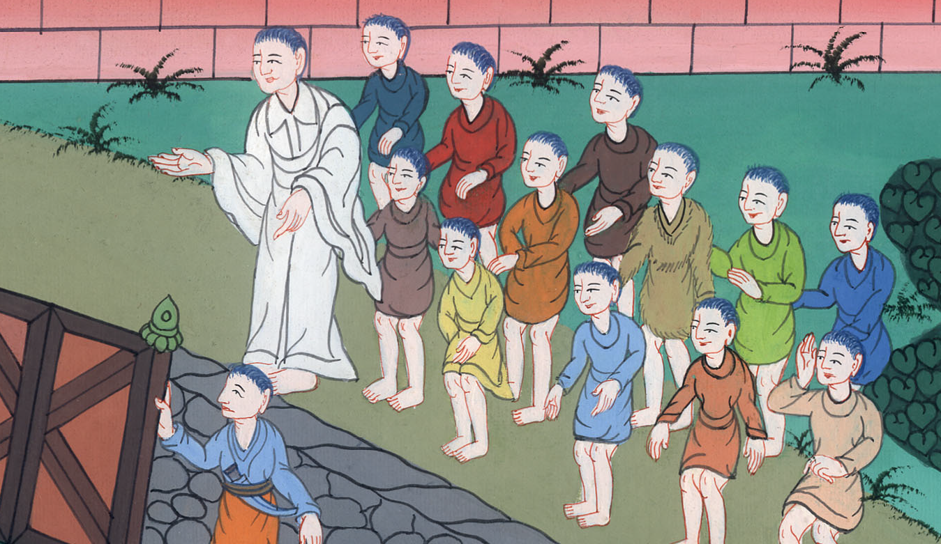
John 10:5,6

Slide 15
7Jesus therefore said to them again, “Most certainly, I tell you, I am the sheep’s door. 8All who came before me are thieves and robbers, but the sheep didn’t listen to them.

Slide 16
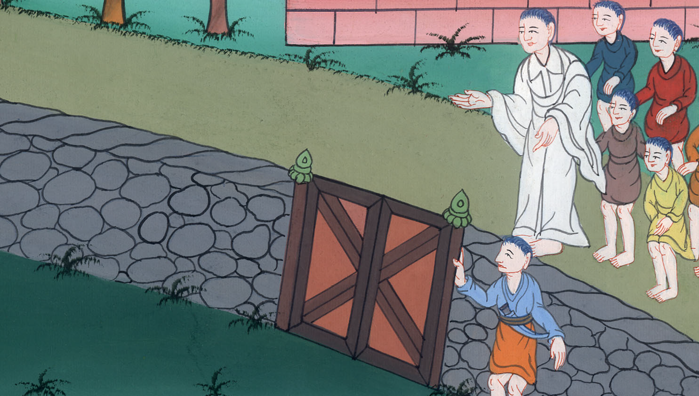
John 10:7,8

Slide 17
9I am the door. If anyone enters in by me, he will be saved, and will go in and go out and will find pasture.

Slide 18
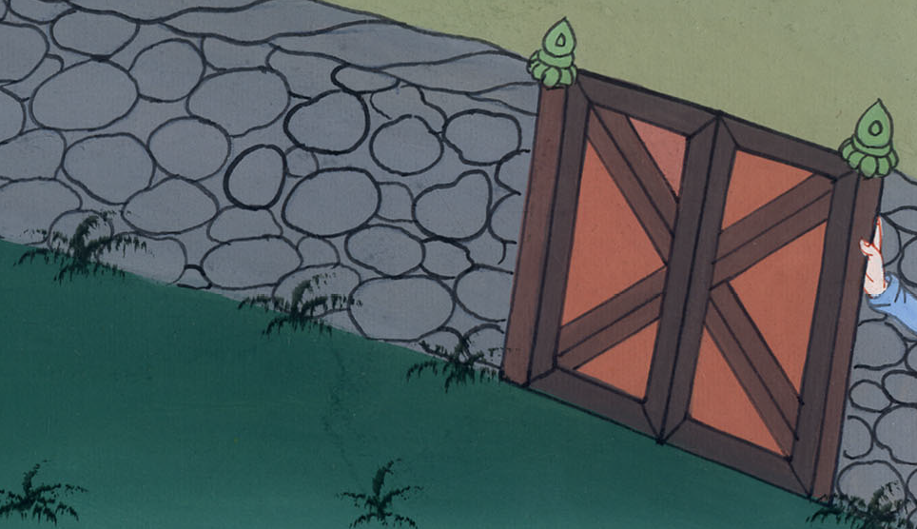
John 10:9

Slide 19
10The thief only comes to steal, kill, and destroy. I came that they may have life, and may have it abundantly.

Slide 20
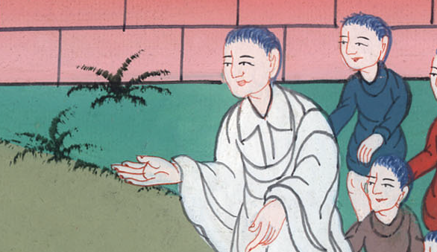
John 10:10

Slide 21
11 “I am the good shepherd. The good shepherd lays down his life for the sheep.

Slide 22
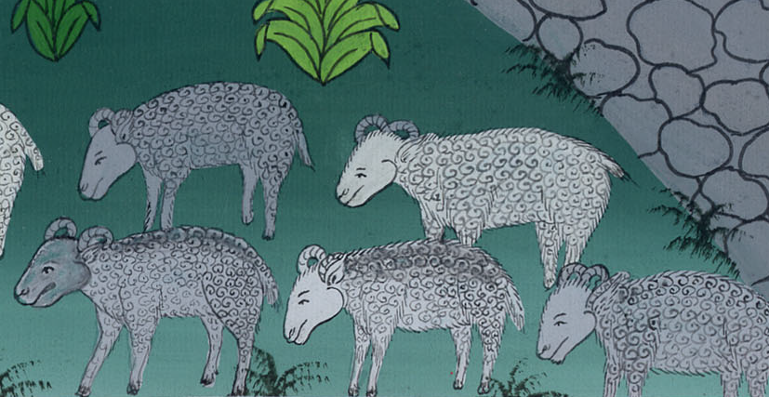
John 10:11

Slide 23
12He who is a hired hand, and not a shepherd, who doesn’t own the sheep, sees the wolf coming, leaves the sheep, and flees. The wolf snatches the sheep and scatters them. 13The hired hand flees because he is a hired hand and doesn’t care for the sheep.

Slide 24
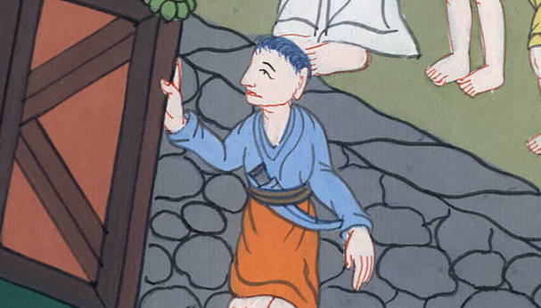
John 10:12,13

Slide 25
14I am the good shepherd. I know my own, and I’m known by my own; 15even as the Father knows me, and I know the Father. I lay down my life for the sheep.

Slide 26
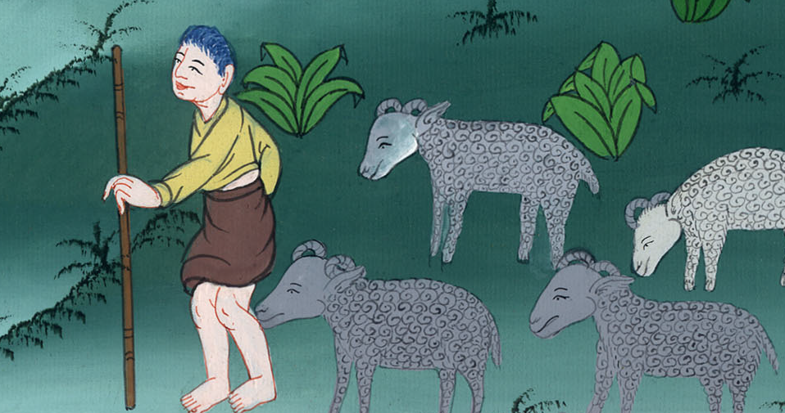
John 10:14,15

Slide 27
16I have other sheep which are not of this fold. I must bring them also, and they will hear my voice. They will become one flock with one shepherd.

Slide 28
John 10:16

