Slide 1
37-7
This work is licensed under a Creative Commons Attribution-ShareAlike 4.0 International License.
Please add this statement to all the videos you create.
English Bible quotes are from the World English Bible US, which is in the public domain.
Notes:
Ch
37 People reject Jesus
1. Jesus is the Bread of Life- John 6:22-71 (Left Top)
2. Officers sent to seize Jesus - John 7:1-53 (Right Top)
3. Woman accused of adultery - John 8:1-12 (Center)
4. Jesus talks to angry Pharisees - John 8:13-59 (Right near Bottom)
5. Blind man cured - John 9:1-41 (Right Bottom)
6. The Good Shepherd - John 10:1-21 (Left Bottom)
7. Jewish leaders try to stone Jesus - John 10:22-42 (Left Center)

Slide 2
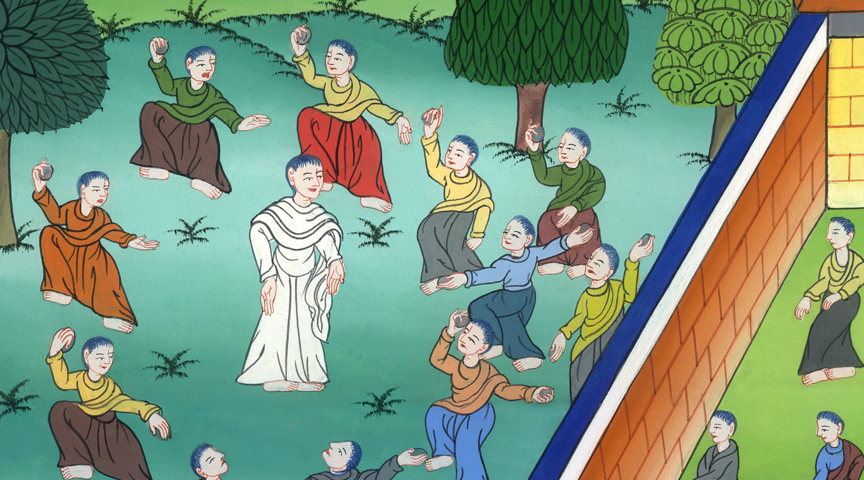
Jewish leaders try to stone Jesus - John 10:22-42

Slide 3
Jewish leaders try to stone Jesus - John 10:22-42

Slide 4
Jewish leaders try to stone Jesus - John 10:22-42

Slide 5
23… Jesus was walking in the temple, in Solomon’s porch. 24The Jews therefore came around him and said to him, “How long will you hold us in suspense? If you are the Christ, tell us plainly.”

Slide 6
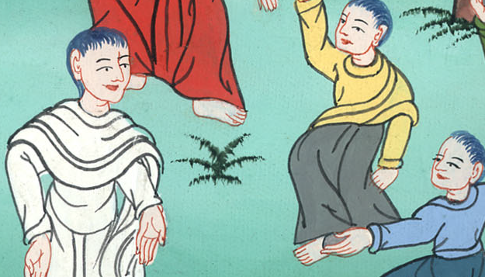
John 10:23,24

Slide 7
25Jesus answered them, “I told you, and you don’t believe. The works that I do in my Father’s name, these testify about me. 26But you don’t believe, because you are not of my sheep, as I told you.

Slide 8
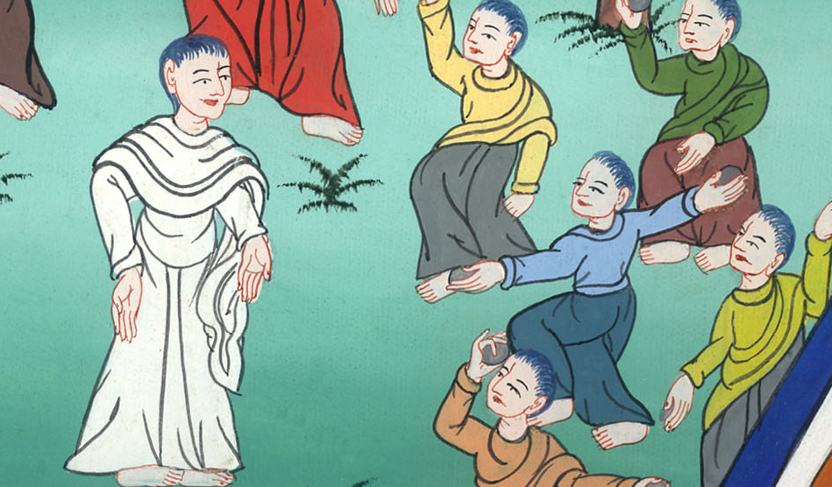
John 10:25,26

Slide 9
27My sheep hear my voice, and I know them, and they follow me. 28I give eternal life to them. They will never perish, and no one will snatch them out of my hand.

Slide 10
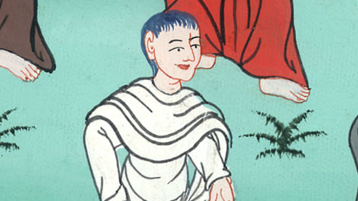
John 10:27,28

Slide 11
29My Father who has given them to me is greater than all. No one is able to snatch them out of my Father’s hand. 30I and the Father are one.”

Slide 12
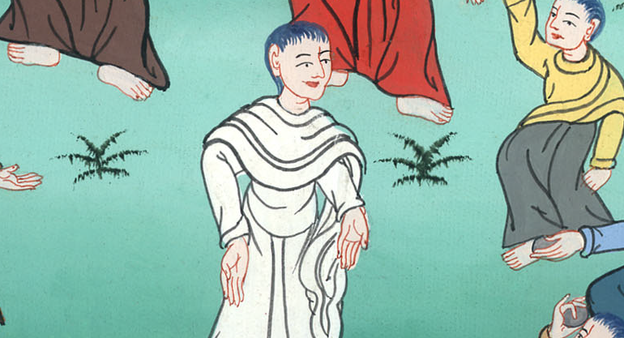
John 10:29,30

Slide 13
31Therefore the Jews took up stones again to stone him. 32Jesus answered them, “I have shown you many good works from my Father. For which of those works do you stone me?”

Slide 14
John 10:31,32

Slide 15
33The Jews answered him, “We don’t stone you for a good work, but for blasphemy, because you, being a man, make yourself God.”

Slide 16
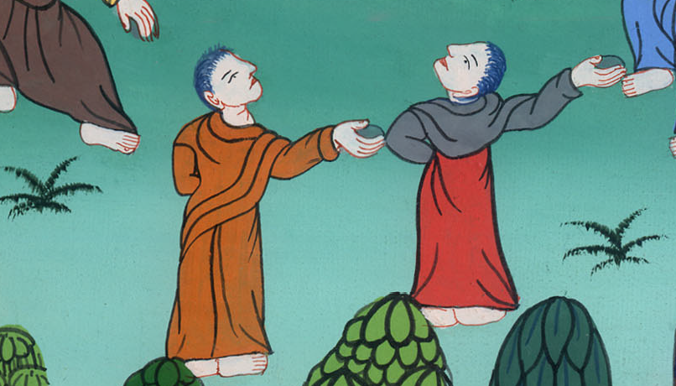
John 10:33

Slide 17
36do you say of him whom the Father sanctified and sent into the world, ‘You blaspheme,’ because I said, ‘I am the Son of God?’

Slide 18
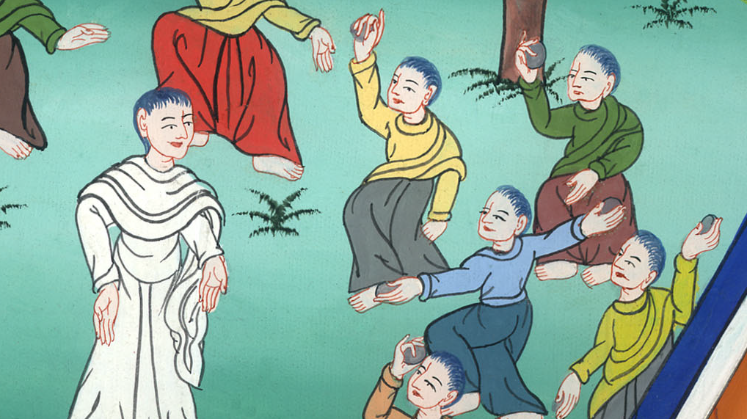
John 10:36

Slide 19
37If I don’t do the works of my Father, don’t believe me. 38But if I do them, though you don’t believe me, believe the works, that you may know and believe that the Father is in me, and I in the Father.”

Slide 20
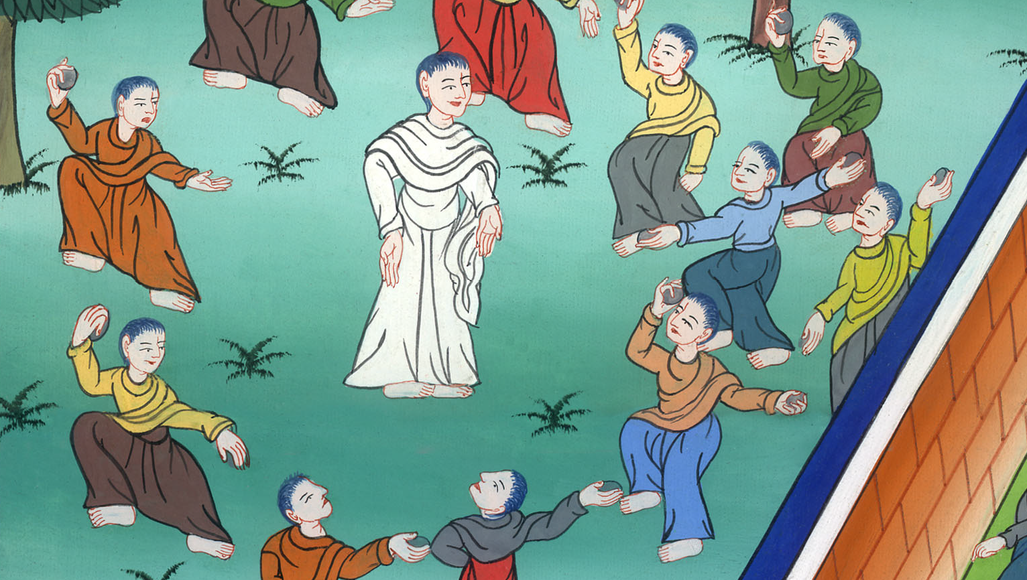
John 10:37,38

Slide 21
39They sought again to seize him, and he went out of their hand. 40He went away again beyond the Jordan 42Many believed in him there.

Slide 22
John 10:39,40,42

