Slide 1
38-1
This work is licensed under a Creative Commons Attribution-ShareAlike 4.0 International License.
Please add this statement to all the videos you create.
English Bible quotes are from the World English Bible US, which is in the public domain.
Notes:
Ch
38 The Teachings of Jesus
1. Eating with unclean hands - Matt 15:1-20; Mark 7:1-23 (Left Top)
2. Deaf Man healed - Mark 7:31-37 (Center Top)
3. Healing and feeding 4000 - Matthew 15:29-39; Mark 8:1-10 (Center)
4. Pharisees ask for a sign - Matt 16:1-4; Mark 8:11-13; Matt 12:38-42; Luke 11:29-
32 (Right Top)
5. Yeast of the Pharisees - Matt 16:5-12; Mark 8:14-21 (Right Bottom)
6. You are the Christ - Matt 16:13-20; Mark 8:27-30; Luke 9:18-21 (Left Bottom)
7. Carry your Cross - Matt 16:21-28; Mark 8:31-38; Luke 9:22-27 (Left near
Bottom)

Slide 2
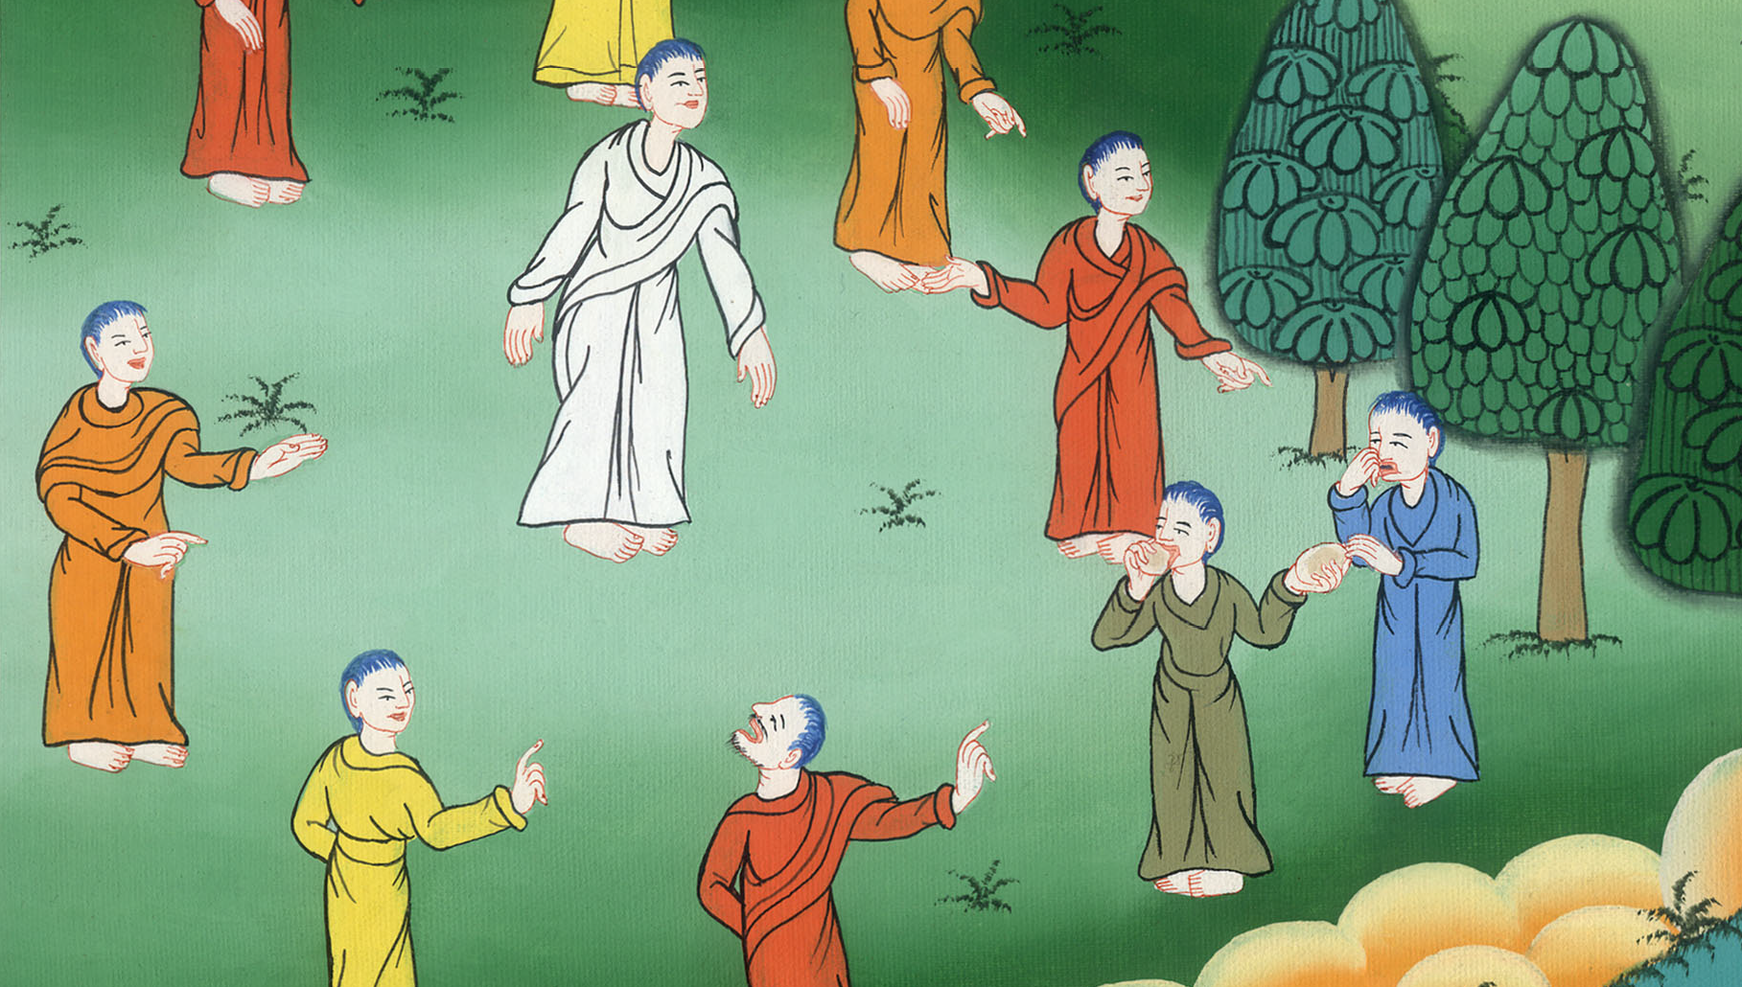
What Makes People Unclean –
Mark 7:1-23

Slide 3
38 The Teachings of Jesus
What Makes People Unclean - Mark 7:1-23

Slide 4
What Makes People Unclean –
Mark 7:1-23

Slide 5
1Then the Pharisees and some of the scribes gathered together to him, having come from Jerusalem. 2Now when they saw some of his disciples eating bread with defiled, that is unwashed, hands, they found fault.

Slide 6
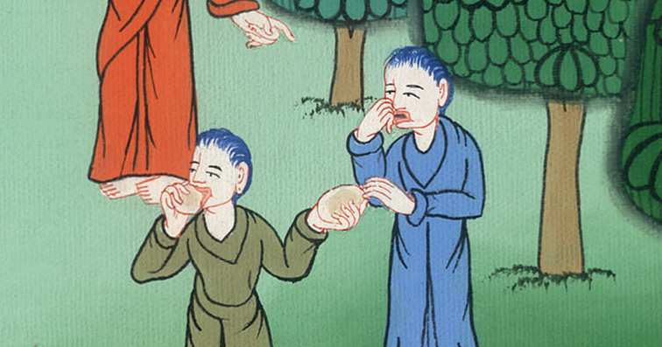
Mark 7:1,2

Slide 7
3(For the Pharisees and all the Jews don’t eat unless they wash their hands and forearms, holding to the tradition of the elders.

Slide 8
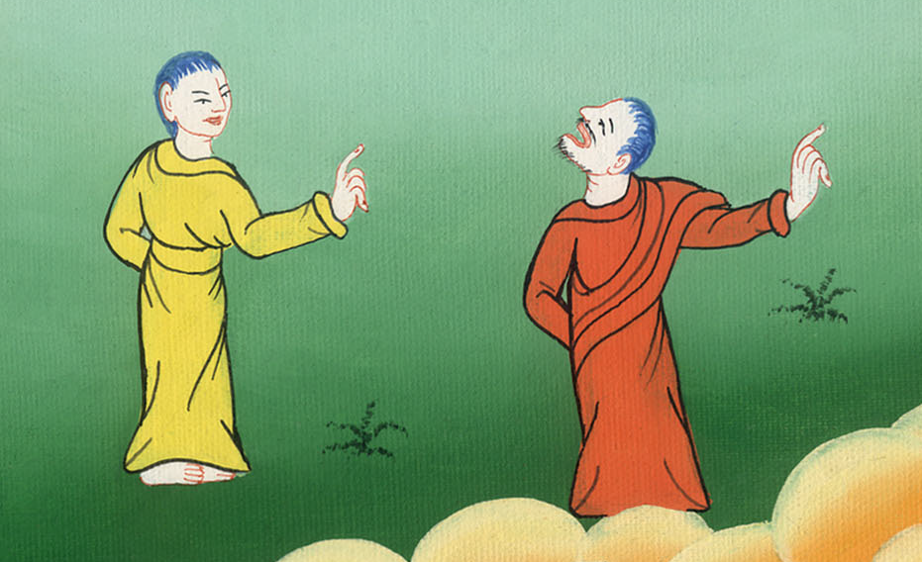
Mark 7:3

Slide 9
4They don’t eat when they come from the marketplace unless they bathe themselves, and there are many other things which they have received to hold to: washings of cups, pitchers, bronze vessels, and couches.)

Slide 10
Mark 7:4

Slide 11
5The Pharisees and the scribes asked him, “Why don’t your disciples walk according to the tradition of the elders, but eat their bread with unwashed hands?”

Slide 12
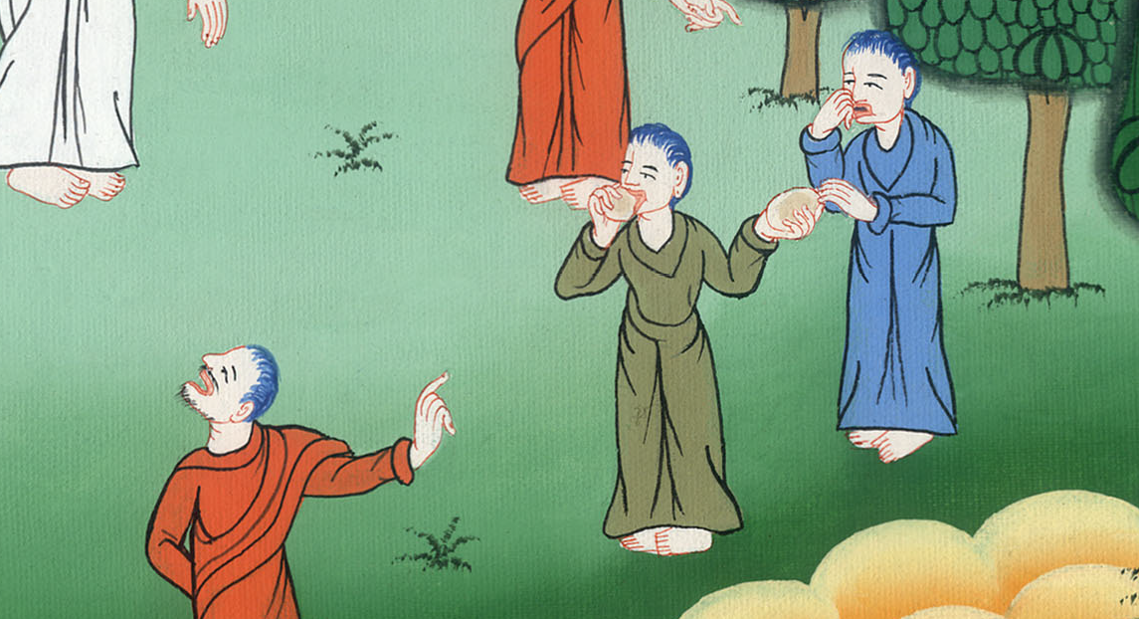
Mark 7:5

Slide 13
8 “For you set aside the commandment of God, and hold tightly to the tradition of men—the washing of pitchers and cups, and you do many other such things.” 9He said to them, “Full well do you reject the commandment of God, that you may keep your tradition.

Slide 14
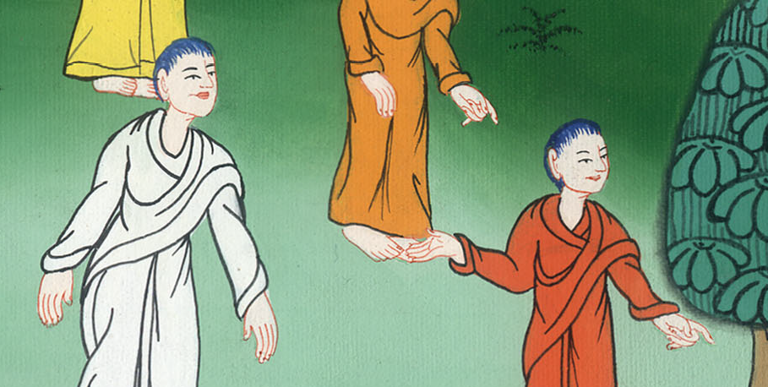
Mark 7:8,9

Slide 15
14He called all the multitude to himself and said to them, “Hear me, all of you, and understand. 15There is nothing from outside of the man that going into him can defile him; but the things which proceed out of the man are those that defile the man. 16If anyone has ears to hear, let him hear!”

Slide 16
Mark 7:14-16

Slide 17
17When he had entered into a house away from the multitude, his disciples asked him about the parable. 18He said to them, “Are you also without understanding? Don’t you perceive that whatever goes into the man from outside can’t defile him,

Slide 18
Mark 7:17,18

Slide 19
19because it doesn’t go into his heart, but into his stomach, then into the latrine, making all foods clean?”

Slide 20
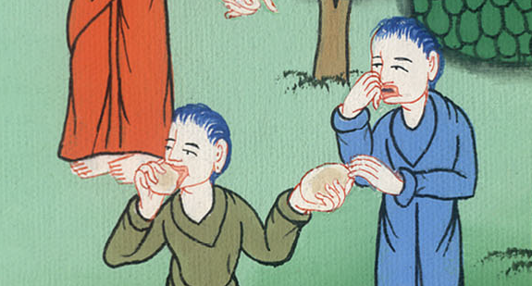
Mark 7:19

Slide 21
20He said, “That which proceeds out of the man, that defiles the man.

Slide 22
Mark 7:20

Slide 23
21For from within, out of the hearts of men, proceed evil thoughts, adulteries, sexual sins, murders, thefts, 22covetings, wickedness, deceit, lustful desires, an evil eye, blasphemy, pride, and foolishness.

Slide 24
Mark 7:21,22

Slide 25
23All these evil things come from within and defile the man.”

Slide 26
Mark 7:23

