Slide 1
38-2
This work is licensed under a Creative Commons Attribution-ShareAlike 4.0 International License.
Please add this statement to all the videos you create.
English Bible quotes are from the World English Bible US, which is in the public domain.
Notes:
Ch
38 The Teachings of Jesus
1. Eating with unclean hands - Matt 15:1-20; Mark 7:1-23 (Left Top)
2. Deaf Man healed - Mark 7:31-37 (Center Top)
3. Healing and feeding 4000 - Matthew 15:29-39; Mark 8:1-10 (Center)
4. Pharisees ask for a sign - Matt 16:1-4; Mark 8:11-13; Matt 12:38-42; Luke 11:29-
32 (Right Top)
5. Yeast of the Pharisees - Matt 16:5-12; Mark 8:14-21 (Right Bottom)
6. You are the Christ - Matt 16:13-20; Mark 8:27-30; Luke 9:18-21 (Left Bottom)
7. Carry your Cross - Matt 16:21-28; Mark 8:31-38; Luke 9:22-27 (Left near
Bottom)

Slide 2
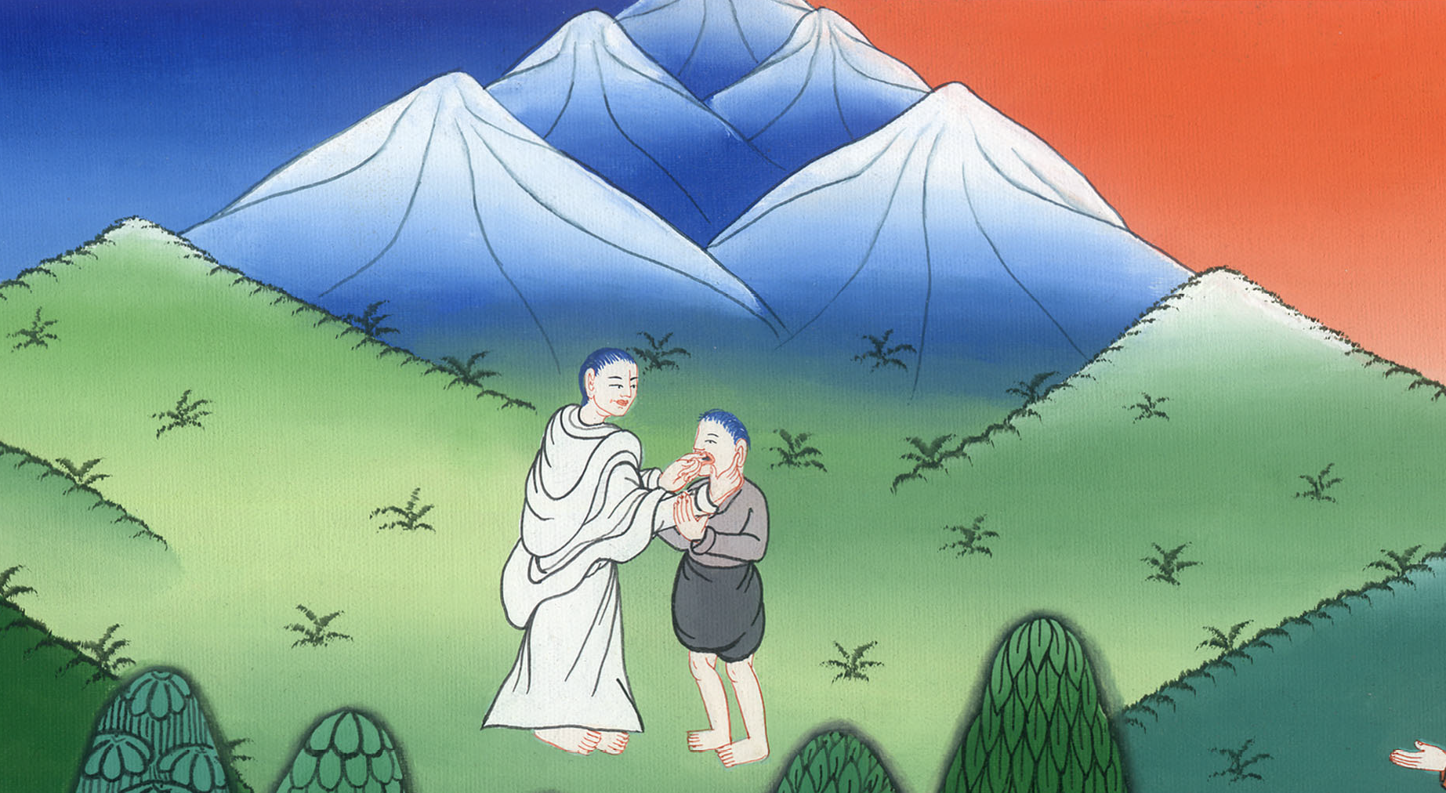
Deaf and Dumb Man healed –
Mark 7:31-37

Slide 3
Deaf and Dumb Man healed - Mark 7:31-37

Slide 4
Deaf and Dumb Man healed –
Mark 7:31-37

Slide 5
(One day) 32They brought to him one who was deaf and had an impediment in his speech. They begged him to lay his hand on him.

Slide 6
མར་ཀུ 7:32

Slide 7
33He took him aside from the multitude privately and put his fingers into his ears; and he spat and touched his tongue.

Slide 8
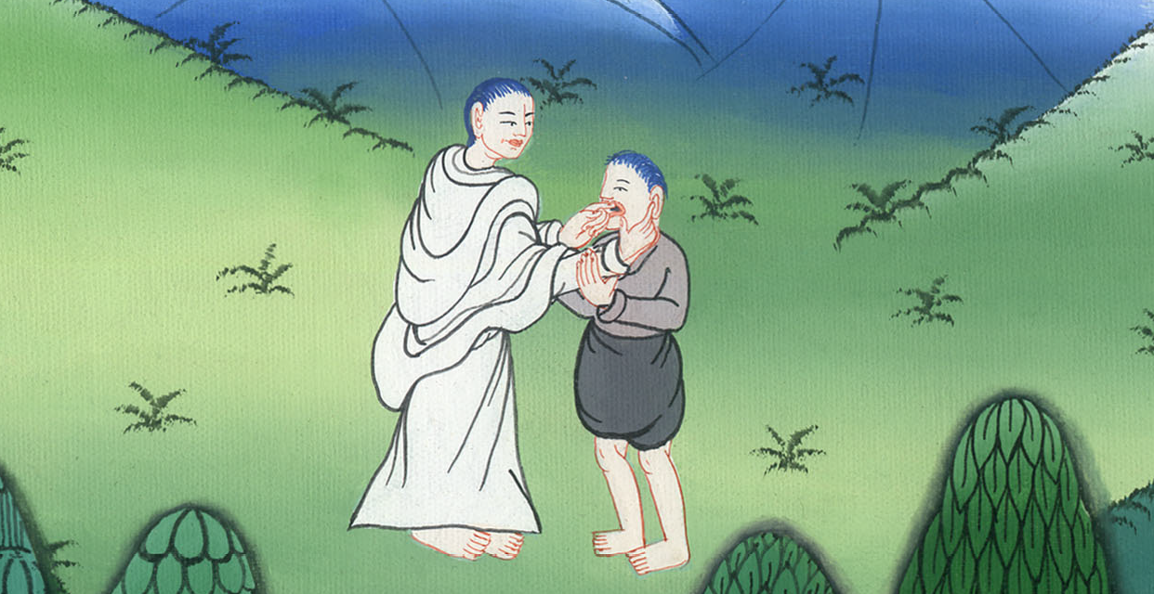
མར་ཀུ 7:33

Slide 9
34Looking up to heaven, he sighed, and said to him, “Ephphatha!” that is, “Be opened!” (in Hebrew)

Slide 10
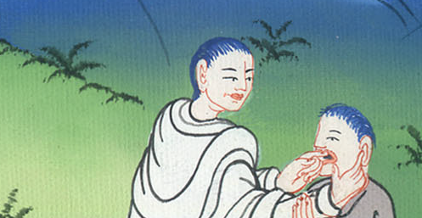
མར་ཀུ 7:34

Slide 11
35Immediately his ears were opened, and the impediment of his tongue was released, and he spoke clearly.

Slide 12
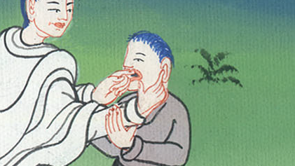
མར་ཀུ 7:35

Slide 13
36He commanded them that they should tell no one, but the more he commanded them, so much the more widely they proclaimed it.

Slide 14
མར་ཀུ 7:36

Slide 15
37They were astonished beyond measure, saying, “He has done all things well. He makes even the deaf hear and the mute speak!”

Slide 16
མར་ཀུ 7:37

