Slide 1
38-3
This work is licensed under a Creative Commons Attribution-ShareAlike 4.0 International License.
Please add this statement to all the videos you create.
English Bible quotes are from the World English Bible US, which is in the public domain.
Notes:
Ch
38 The Teachings of Jesus
1. Eating with unclean hands - Matt 15:1-20; Mark 7:1-23 (Left Top)
2. Deaf Man healed - Mark 7:31-37 (Center Top)
3. Healing and feeding 4000 - Matthew 15:29-39; Mark 8:1-10 (Center)
4. Pharisees ask for a sign - Matt 16:1-4; Mark 8:11-13; Matt 12:38-42; Luke 11:29-
32 (Right Top)
5. Yeast of the Pharisees - Matt 16:5-12; Mark 8:14-21 (Right Bottom)
6. You are the Christ - Matt 16:13-20; Mark 8:27-30; Luke 9:18-21 (Left Bottom)
7. Carry your Cross - Matt 16:21-28; Mark 8:31-38; Luke 9:22-27 (Left near
Bottom)

Slide 2
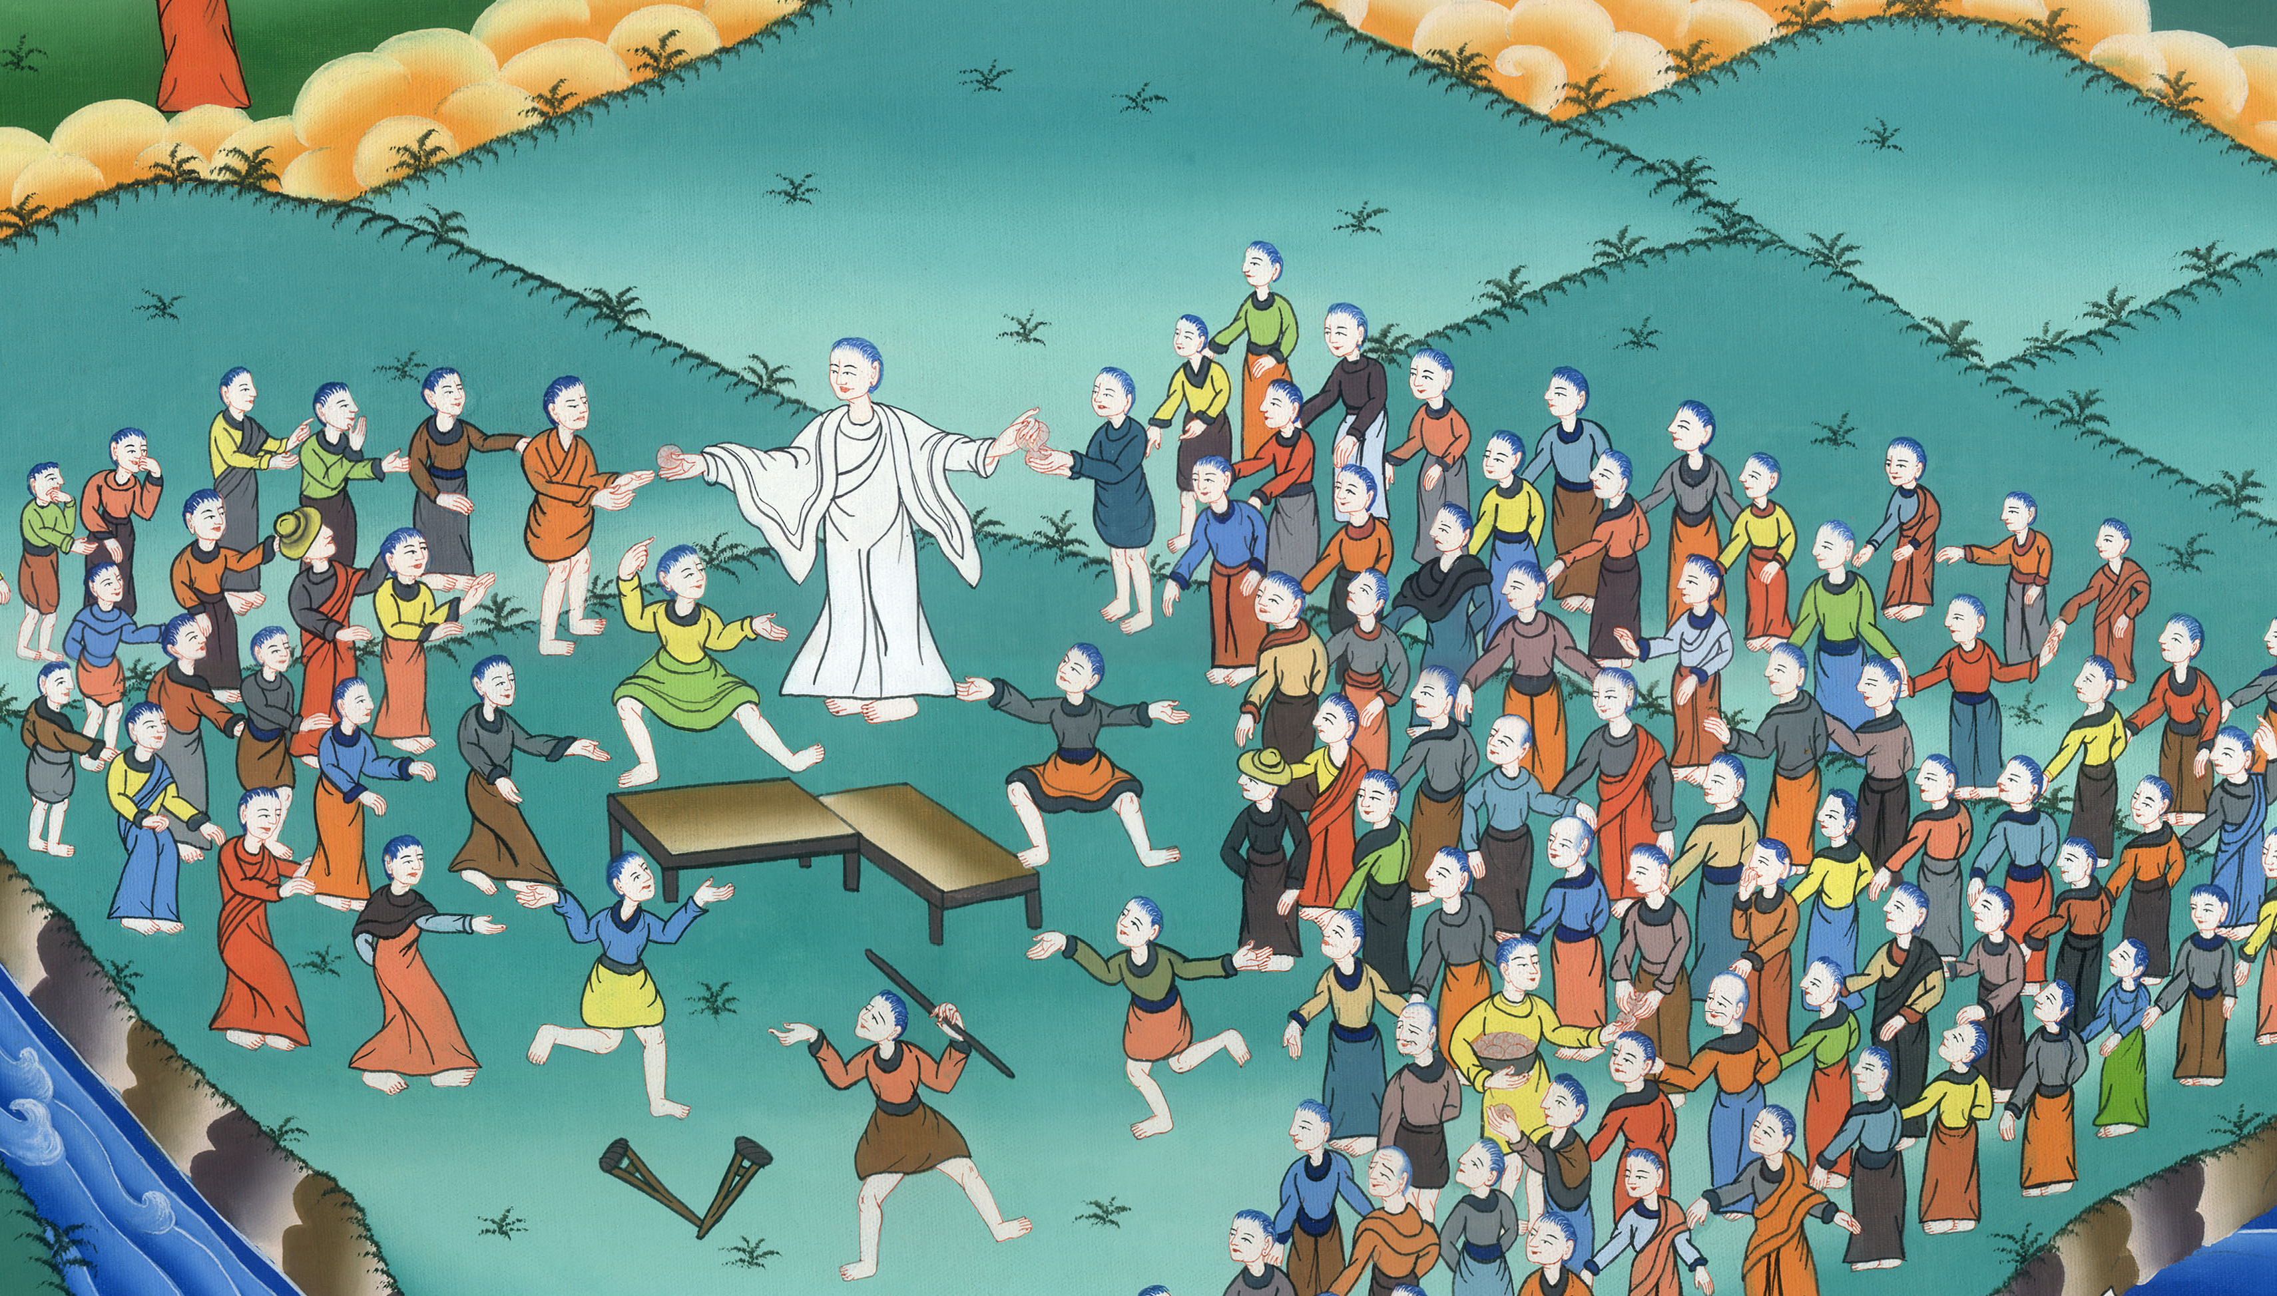
Healing and feeding 4000 - Matthew 15:29-39

Slide 3
Healing and feeding 4000 - Matthew 15:29-39

Slide 4
Healing and feeding 4000 - Matthew 15:29-39

Slide 5
29Jesus departed from there and came near to the sea of Galilee; and he went up on the mountain and sat there.

Slide 6
Matthew 15:29

Slide 7
30Great multitudes came to him, having with them the lame, blind, mute, maimed, and many others, and they put them down at his feet. He healed them,

Slide 8
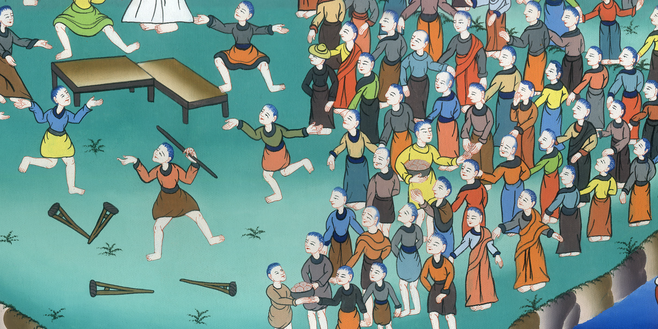
Matthew 15:30

Slide 9
31so that the multitude wondered when they saw the mute speaking, the injured healed, the lame walking, and the blind seeing—and they glorified the God of Israel.

Slide 10
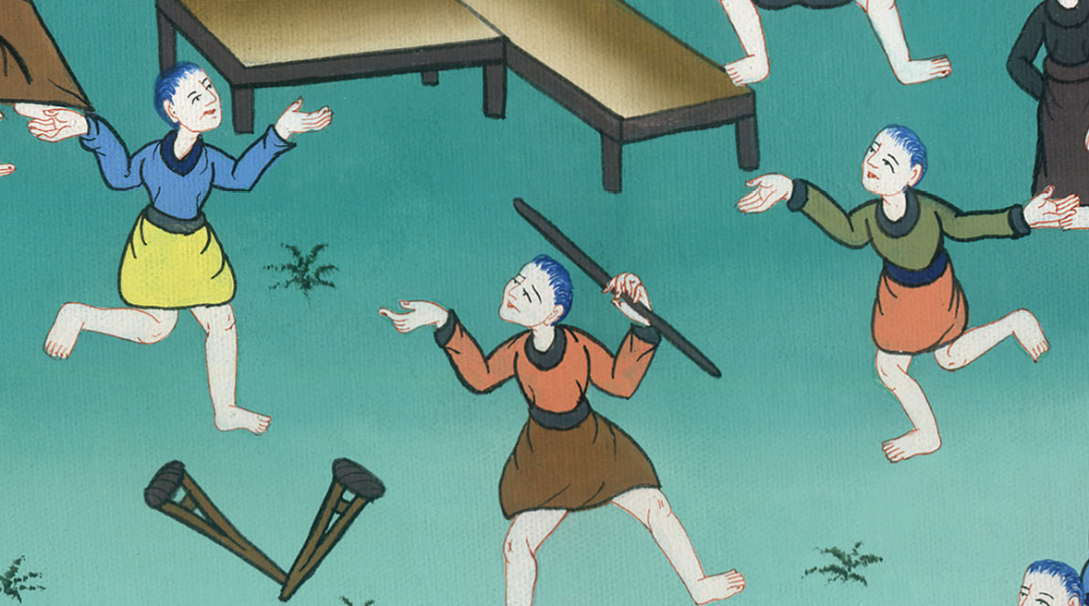
Matthew 15:31

Slide 11
32Jesus summoned his disciples and said, “I have compassion on the multitude, because they have continued with me now three days and have nothing to eat. I don’t want to send them away fasting, or they might faint on the way.”

Slide 12
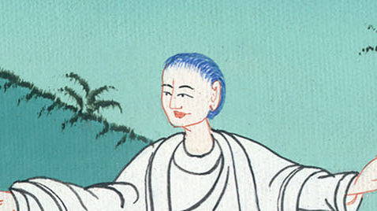
Matthew 15:32

Slide 13
33The disciples said to him, “Where could we get so many loaves in a deserted place as to satisfy so great a multitude?”

Slide 14
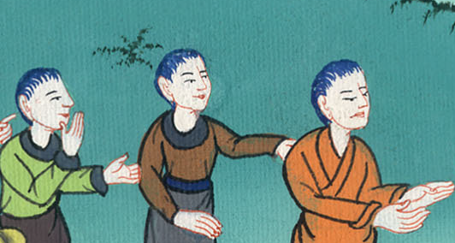
Matthew 15:33

Slide 15
34Jesus said to them, “How many loaves do you have?”
They said, “Seven, and a few small fish.”
35He commanded the multitude to sit down on the ground;

Slide 16
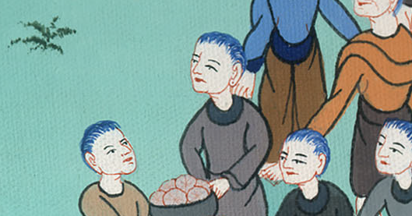
Matthew 15:34,35

Slide 17
36and he took the seven loaves and the fish. He gave thanks and broke them, and gave to the disciples, and the disciples to the multitudes.

Slide 18
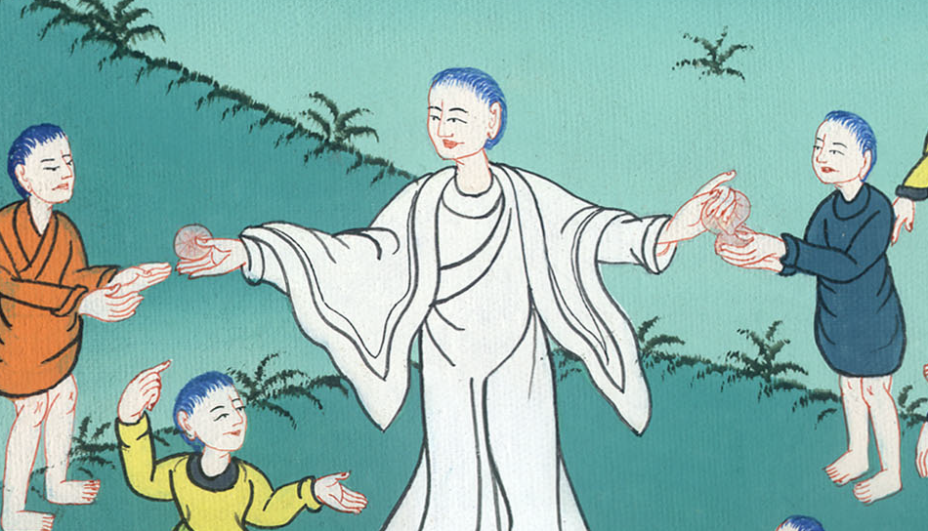
Matthew 15:36

Slide 19
37They all ate and were filled. They took up seven baskets full of the broken pieces that were left over.

Slide 20
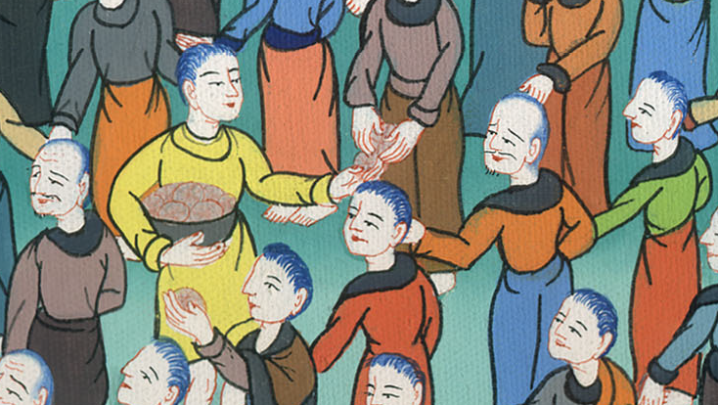
Matthew 15:37

Slide 21
38Those who ate were four thousand men, in addition to women and children. 39Then he sent away the multitudes, got into the boat, and came into the borders of Magdala.

Slide 22
Matthew 15:38,39

