Slide 1
38-4
This work is licensed under a Creative Commons Attribution-ShareAlike 4.0 International License.
Please add this statement to all the videos you create.
English Bible quotes are from the World English Bible US, which is in the public domain.
Notes:
Ch
38 The Teachings of Jesus
1. Eating with unclean hands - Matt 15:1-20; Mark 7:1-23 (Left Top)
2. Deaf Man healed - Mark 7:31-37 (Center Top)
3. Healing and feeding 4000 - Matthew 15:29-39; Mark 8:1-10 (Center)
4. Pharisees ask for a sign - Matt 16:1-4; Mark 8:11-13; Matt 12:38-42; Luke 11:29-
32 (Right Top)
5. Yeast of the Pharisees - Matt 16:5-12; Mark 8:14-21 (Right Bottom)
6. You are the Christ - Matt 16:13-20; Mark 8:27-30; Luke 9:18-21 (Left Bottom)
7. Carry your Cross - Matt 16:21-28; Mark 8:31-38; Luke 9:22-27 (Left near
Bottom)

Slide 2
Pharisees ask for a sign –
Matt 16:1-4; Mark 8:11-13; Matt 12:38-42; Luke 11:29-32

Slide 3
Pharisees ask for a sign - Matt 16:1-4; Mark 8:11-13; Matt 12:38-42; Luke 11:29-32

Slide 4
Pharisees ask for a sign –
Matt 16:1-4; Mark 8:11-13; Matt 12:38-42; Luke 11:29-32

Slide 5
Matt 16 1The Pharisees and Sadducees came, and testing him, asked him to show them a sign from heaven.

Slide 6
Matthew 16:1

Slide 7
mark 8
12He sighed deeply in his spirit and said, “Why does this generation seek a sign? Most certainly I tell you, no sign will be given to this generation.”

Slide 8
Mark 8:12

Slide 9
Mathew 16:2 But he answered them, “When it is evening, you say, ‘It will be fair weather, for the sky is red.’

Slide 10
Matthew 16:2

Slide 11
3In the morning, ‘It will be foul weather today, for the sky is red and threatening.’ Hypocrites! You know how to discern the appearance of the sky, but you can’t discern the signs of the times!

Slide 12
Matthew 16:3

Slide 13
Matt 1239But he answered them, “An evil and adulterous generation seeks after a sign, but no sign will be given to it but the sign of Jonah the prophet.

Slide 14
Matthew 12:39

Slide 15
40For as Jonah was three days and three nights in the belly of the huge fish, so will the Son of Man be three days and three nights in the heart of the earth.

Slide 16
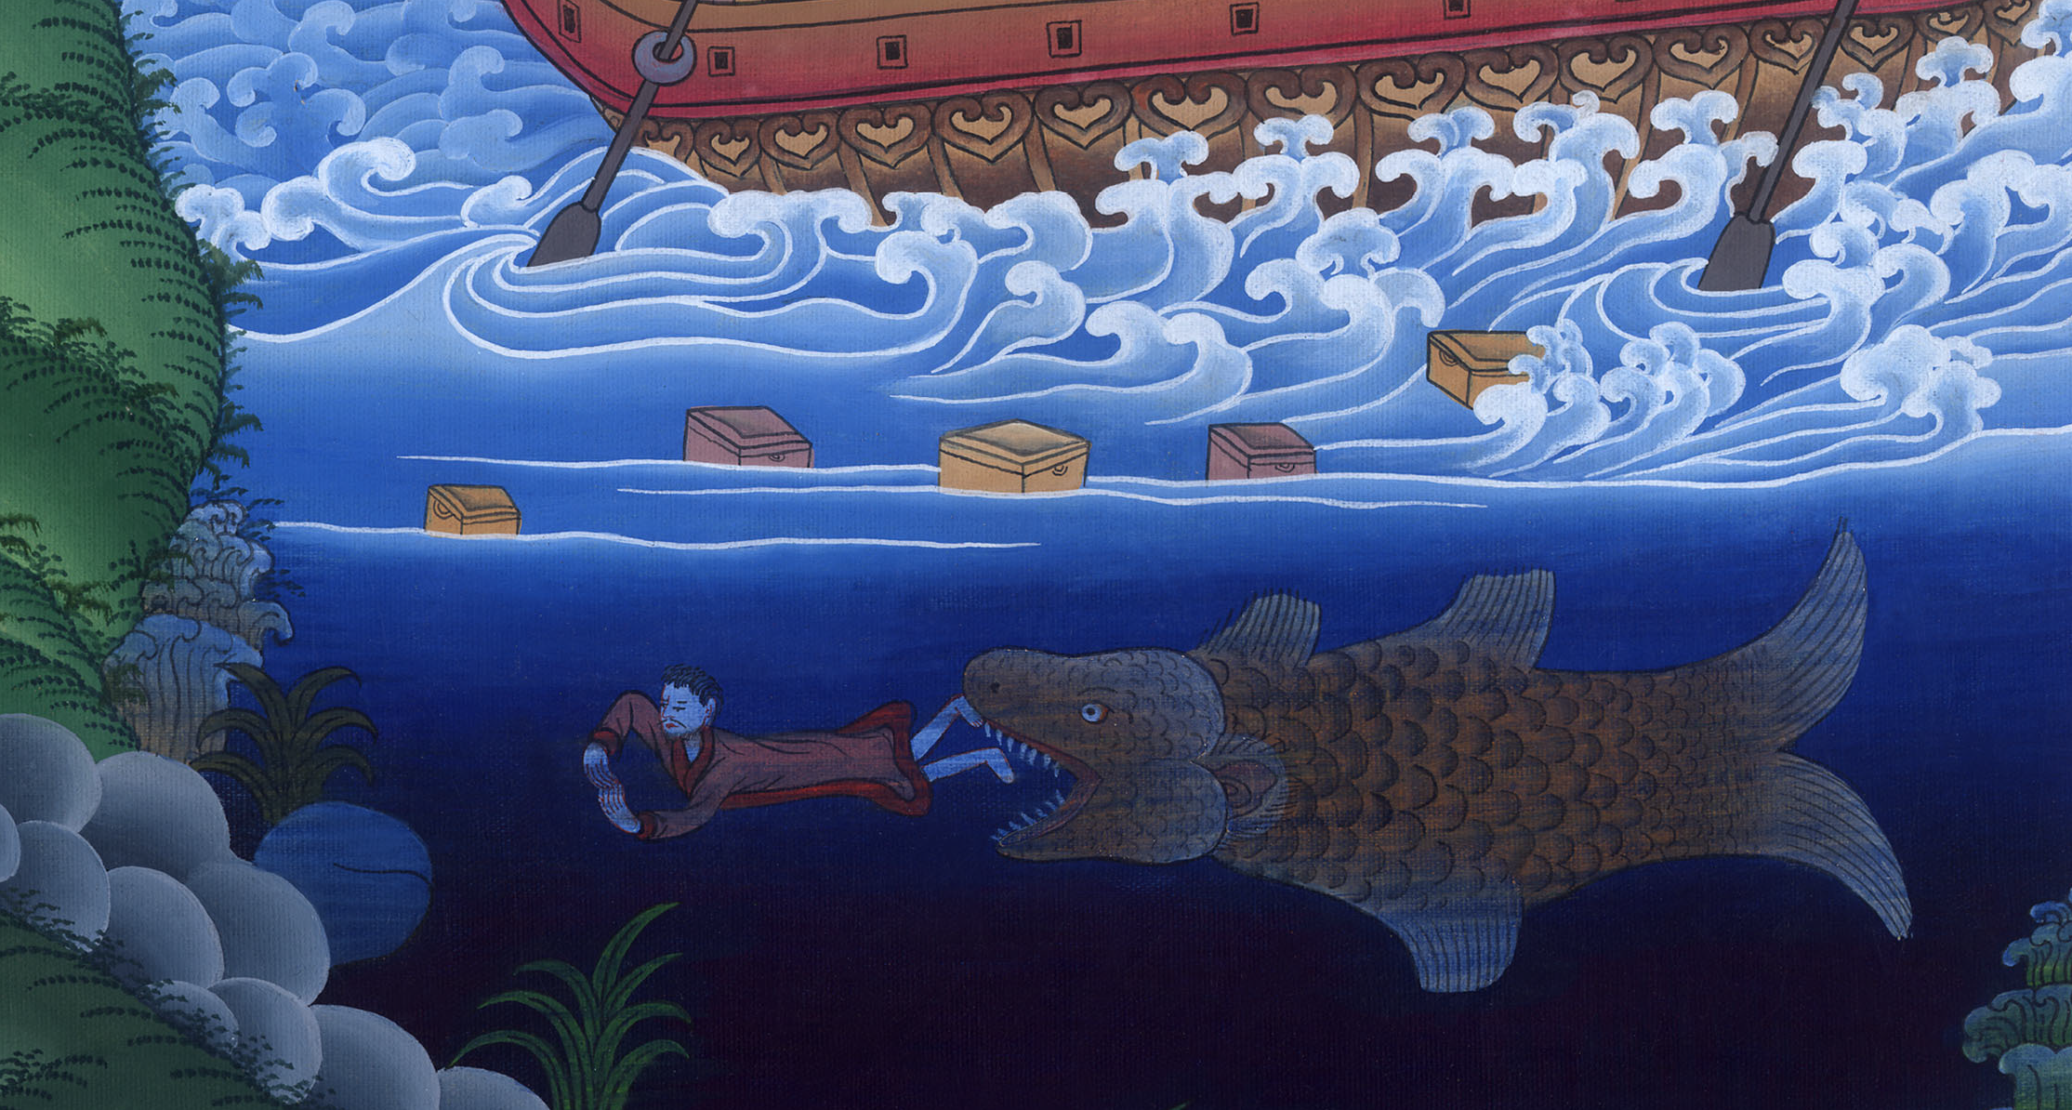
Matthew 12:40

Slide 17
Luke 11
30For even as Jonah became a sign to the Ninevites, so the Son of Man will also be to this generation.

Slide 18
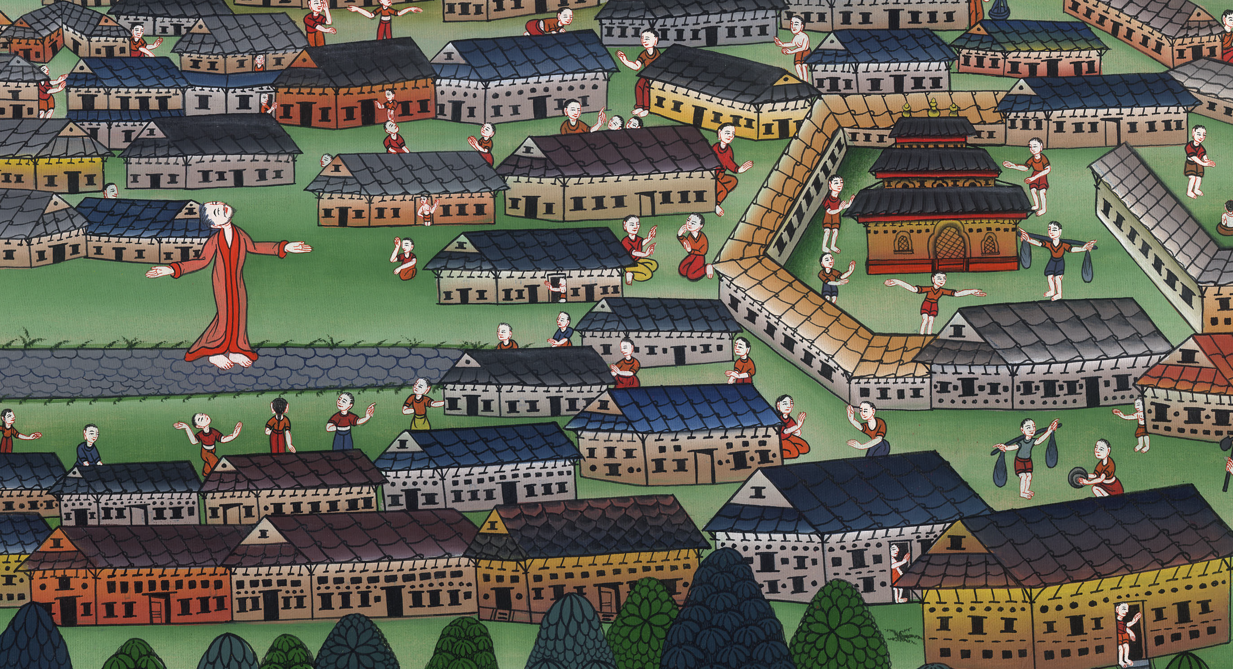
Luke 11:30

Slide 19
32The men of Nineveh will stand up in the judgment with this generation, and will condemn it, for they repented at the preaching of Jonah; and behold, one greater than Jonah is here.

Slide 20
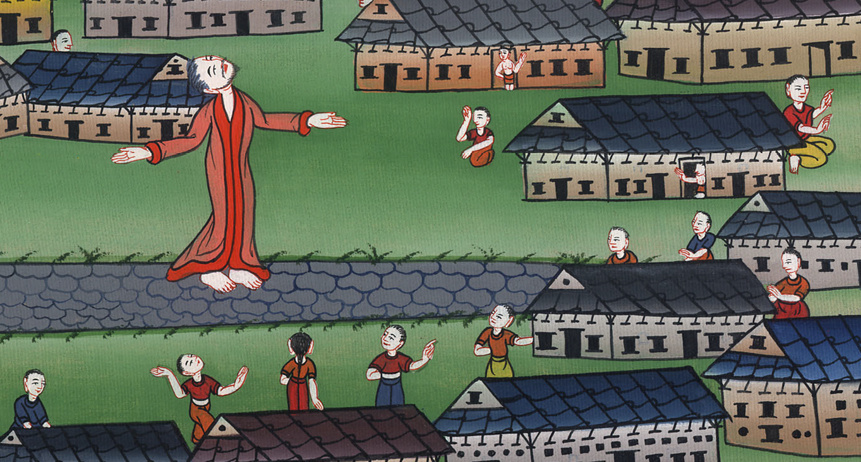
Luke 11:32

Slide 21
Mark 8 13He left them, and again entering into the boat, departed to the other side.

Slide 22
Mark 8:13

