Slide 1
38-5
This work is licensed under a Creative Commons Attribution-ShareAlike 4.0 International License.
Please add this statement to all the videos you create.
English Bible quotes are from the World English Bible US, which is in the public domain.
Notes:
Ch
38 The Teachings of Jesus
1. Eating with unclean hands - Matt 15:1-20; Mark 7:1-23 (Left Top)
2. Deaf Man healed - Mark 7:31-37 (Center Top)
3. Healing and feeding 4000 - Matthew 15:29-39; Mark 8:1-10 (Center)
4. Pharisees ask for a sign - Matt 16:1-4; Mark 8:11-13; Matt 12:38-42; Luke 11:29-
32 (Right Top)
5. Yeast of the Pharisees - Matt 16:5-12; Mark 8:14-21 (Right Bottom)
6. You are the Christ - Matt 16:13-20; Mark 8:27-30; Luke 9:18-21 (Left Bottom)
7. Carry your Cross - Matt 16:21-28; Mark 8:31-38; Luke 9:22-27 (Left near
Bottom)

Slide 2
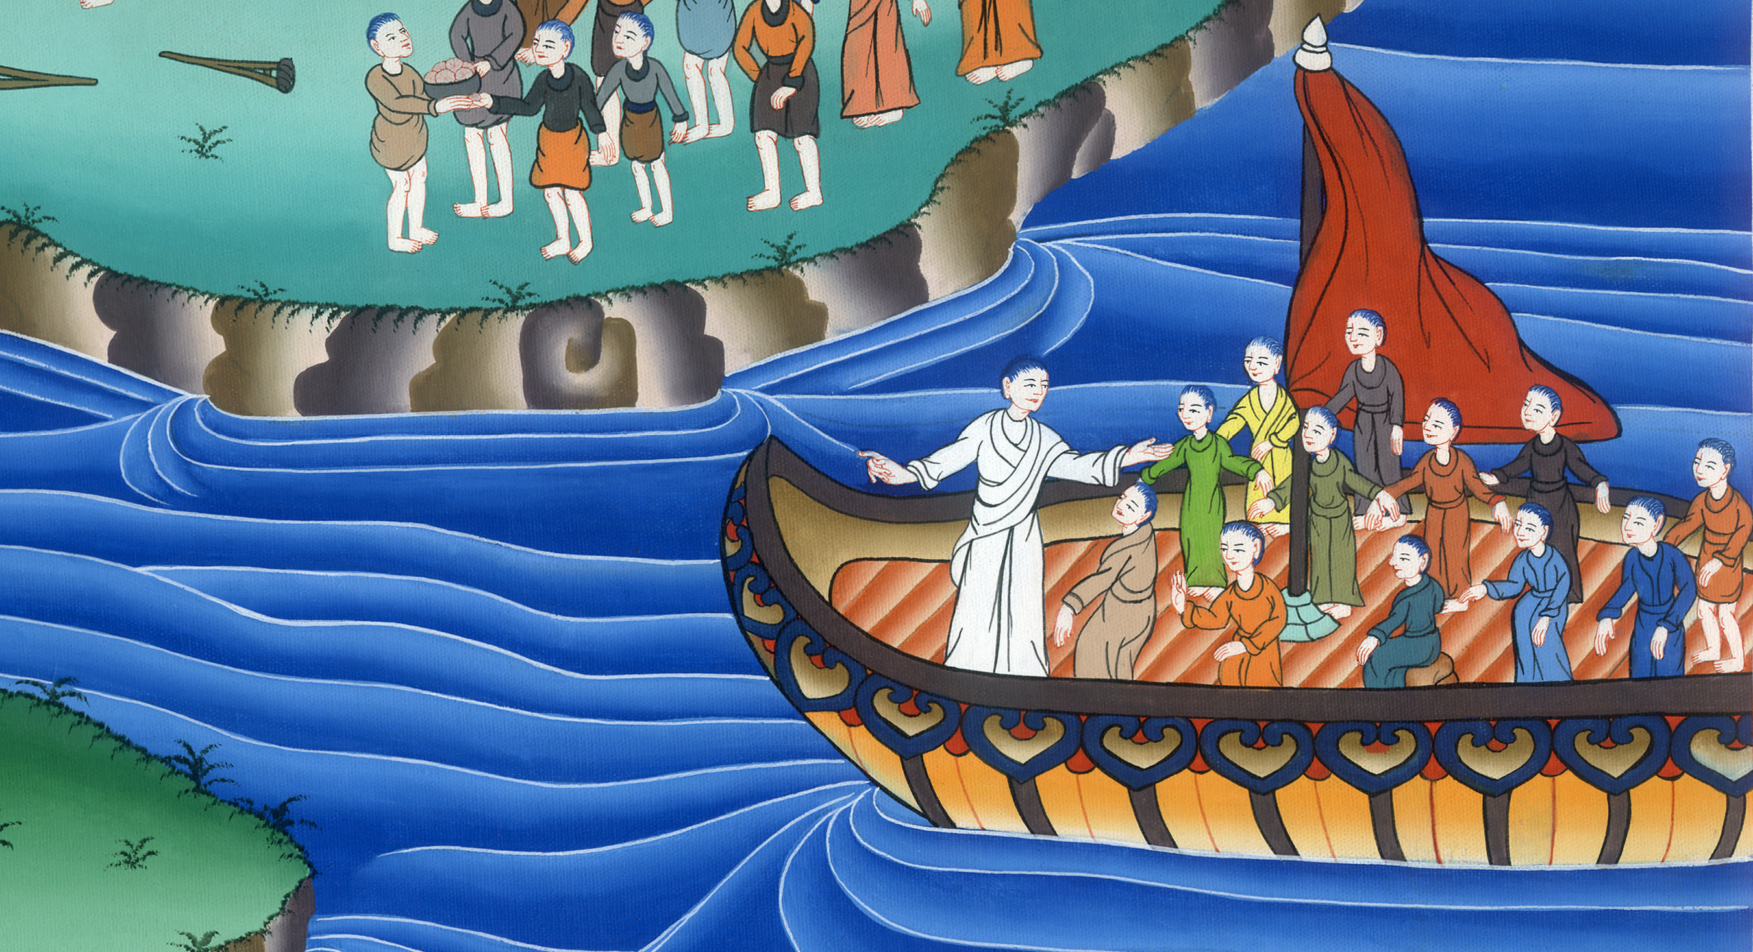
Yeast of the Pharisees - Matt 16:5-12; Mark 8:14-21

Slide 3
Yeast of the Pharisees - Matt 16:5-12; Mark 8:14-21

Slide 4
Yeast of the Pharisees - Matthew 16:5-12; Mark 8:14-21

Slide 5
Matthew 16:5 The disciples came to the other side and had forgotten to take bread.

Slide 6
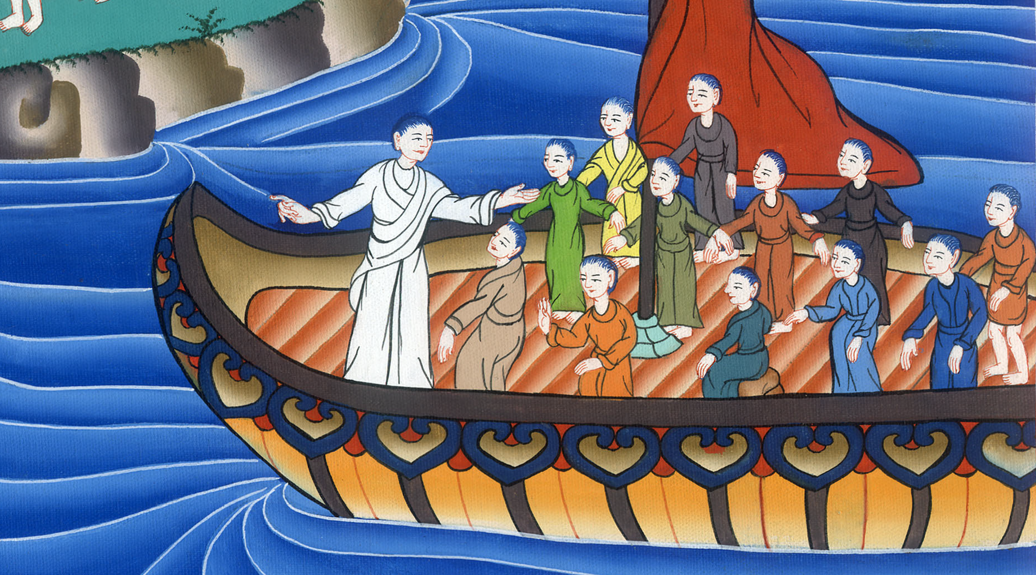
Matthew 16:5

Slide 7
6Jesus said to them, “Take heed and beware of the yeast of the Pharisees and Sadducees.”

Slide 8
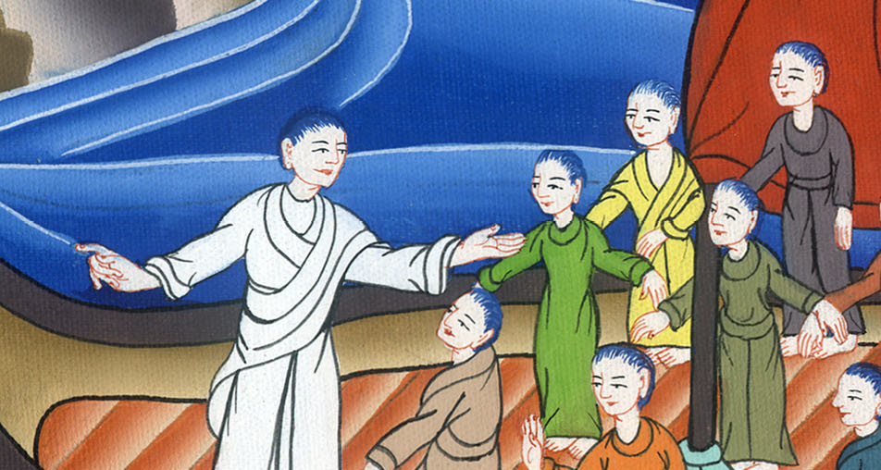
Matthew 16:6

Slide 9
7They reasoned among themselves, saying, “We brought no bread.”

Slide 10
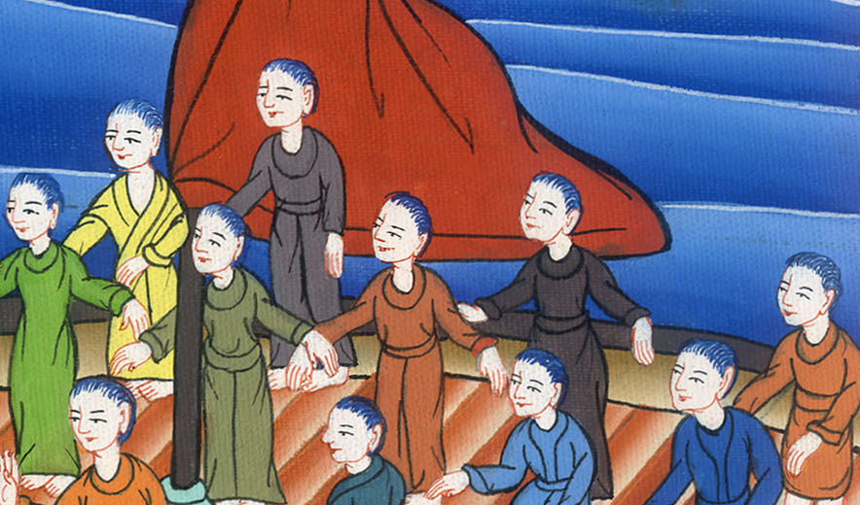
Matthew 16:7

Slide 11
8Jesus, perceiving it, said, “Why do you reason among yourselves, you of little faith, because you have brought no bread?

Slide 12
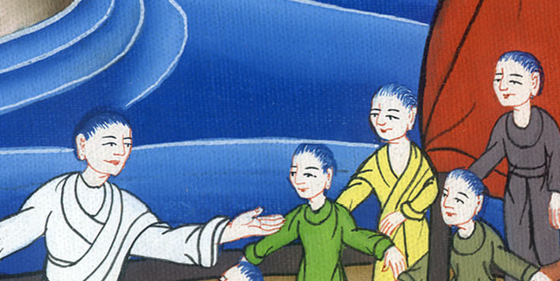
Matthew 16:8

Slide 13
9Don’t you yet perceive or remember the five loaves for the five thousand, and how many baskets you took up

Slide 14
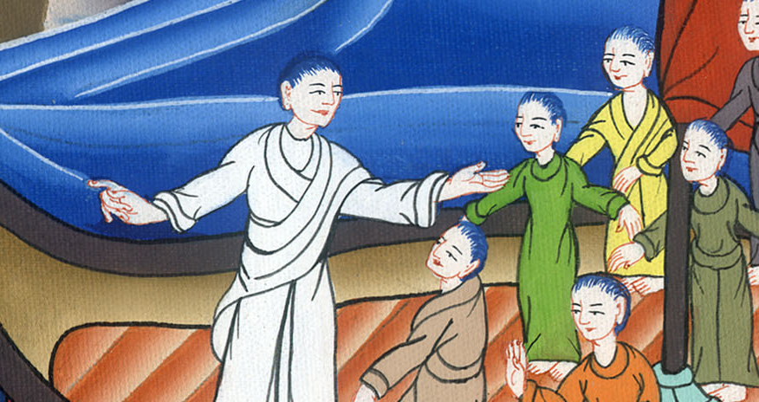
Matthew 16:9

Slide 15
10or the seven loaves for the four thousand, and how many baskets you took up?

Slide 16
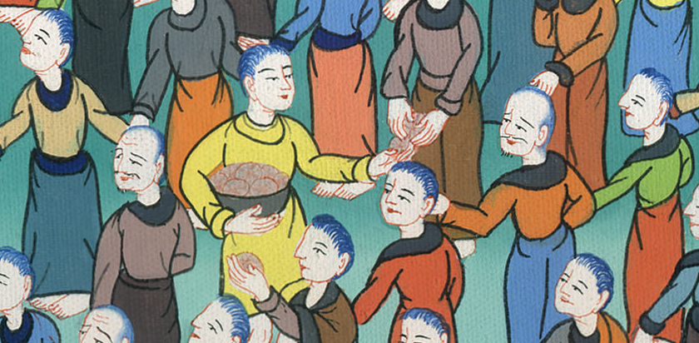
Matthew 16:10

Slide 17
11How is it that you don’t perceive that I didn’t speak to you concerning bread? But beware of the yeast of the Pharisees and Sadducees.”

Slide 18
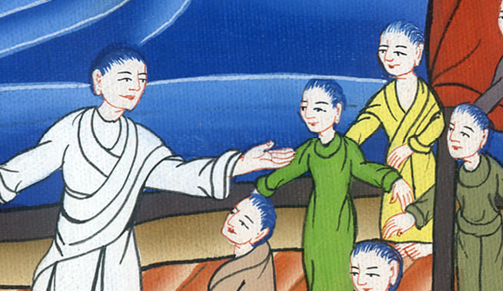
Matthew 16:11

Slide 19
12Then they understood that he didn’t tell them to beware of the yeast of bread, but of the teaching of the Pharisees and Sadducees.

Slide 20
Matthew 16:12

