Slide 1
38-6
This work is licensed under a Creative Commons Attribution-ShareAlike 4.0 International License.
Please add this statement to all the videos you create.
English Bible quotes are from the World English Bible US, which is in the public domain.
Notes:
Ch
38 The Teachings of Jesus
1. Eating with unclean hands - Matt 15:1-20; Mark 7:1-23 (Left Top)
2. Deaf Man healed - Mark 7:31-37 (Center Top)
3. Healing and feeding 4000 - Matthew 15:29-39; Mark 8:1-10 (Center)
4. Pharisees ask for a sign - Matt 16:1-4; Mark 8:11-13; Matt 12:38-42; Luke 11:29-
32 (Right Top)
5. Yeast of the Pharisees - Matt 16:5-12; Mark 8:14-21 (Right Bottom)
6. You are the Christ - Matt 16:13-20; Mark 8:27-30; Luke 9:18-21 (Left Bottom)
7. Carry your Cross - Matt 16:21-28; Mark 8:31-38; Luke 9:22-27 (Left near
Bottom)

Slide 2
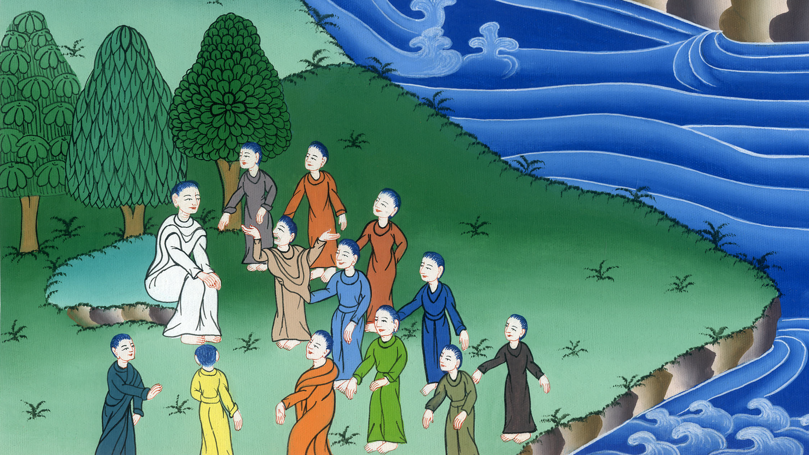
You are the Christ - Matt 16:13-20

Slide 3
You are the Christ - Matt 16:13-20

Slide 4
You are the Christ - Matthew 16:13-20

Slide 5
13Now when Jesus came into the parts of Caesarea Philippi, he asked his disciples, saying, “Who do men say that I, the Son of Man, am?”

Slide 6
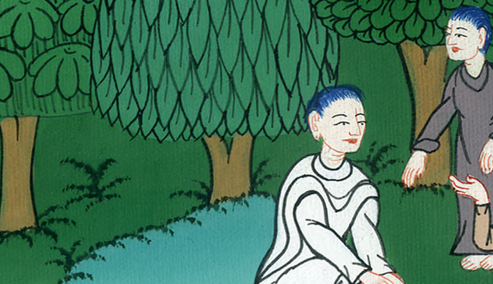
Matthew 16:13

Slide 7
14They said, “Some say John the Baptizer, some, Elijah, and others, Jeremiah or one of the prophets.”

Slide 8
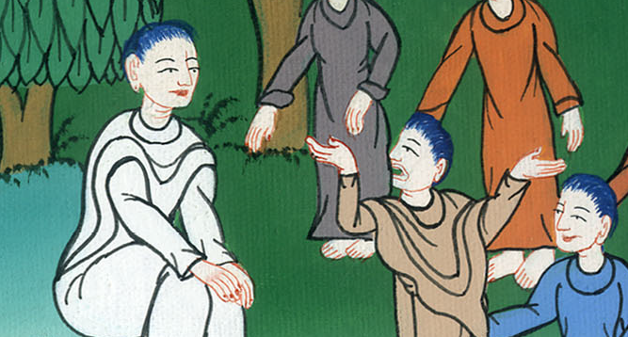
Matthew 16:14

Slide 9
15He said to them, “But who do you say that I am?”
16Simon Peter answered, “You are the Christ, the Son of the living God.”

Slide 10
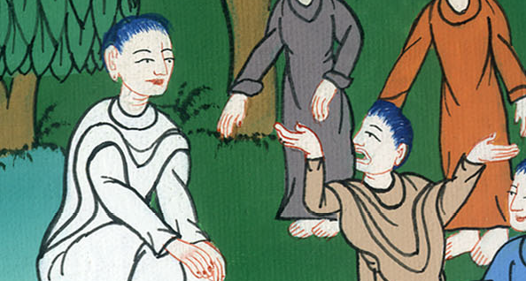
Matthew 16:15,16

Slide 11
17Jesus answered him, “Blessed are you, Simon Bar Jonah, for flesh and blood has not revealed this to you, but my Father who is in heaven.

Slide 12
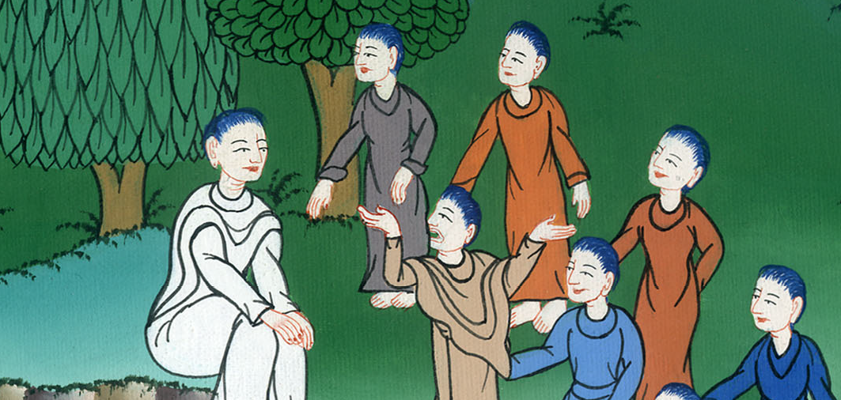
Matthew 16:17

Slide 13
18I also tell you that you are Peter, and on this rock I will build my assembly, and the gates of Hades will not prevail against it.

Slide 14
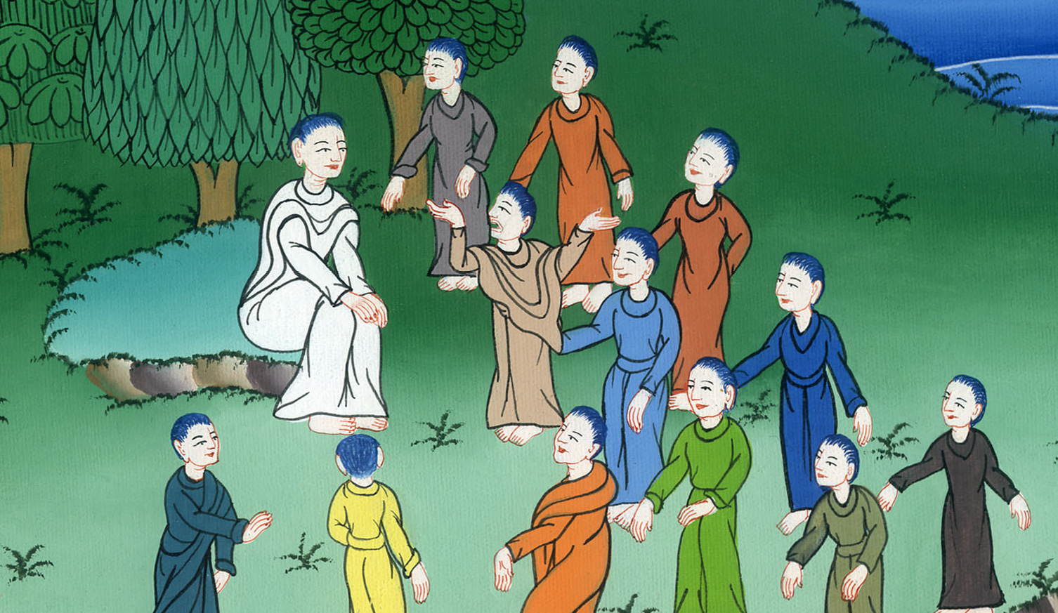
Matthew 16:18

Slide 15
19I will give to you the keys of the Kingdom of Heaven, and whatever you bind on earth will have been bound in heaven; and whatever you release on earth will have been released in heaven.”

Slide 16
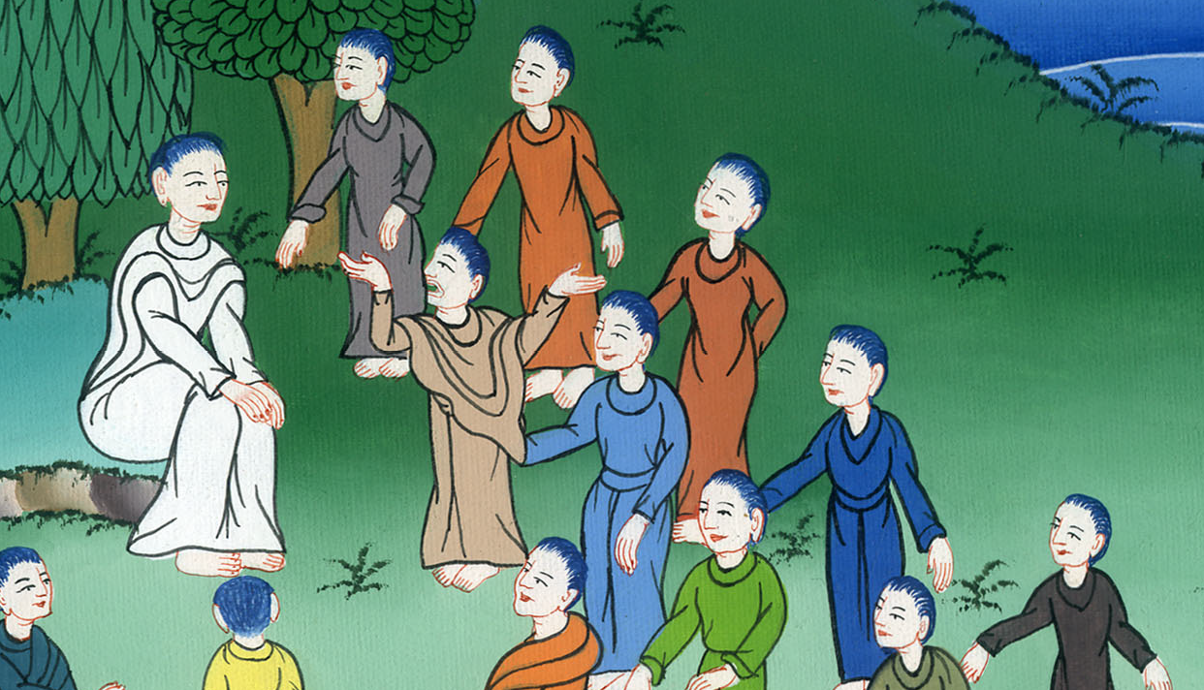
Matthew 16:19

Slide 17
20Then he commanded the disciples that they should tell no one that he was Jesus the Christ.

Slide 18
Matthew 16:20

