Slide 1
38-7
This work is licensed under a Creative Commons Attribution-ShareAlike 4.0 International License.
Please add this statement to all the videos you create.
English Bible quotes are from the World English Bible US, which is in the public domain.
Notes:
Ch
38 The Teachings of Jesus
1. Eating with unclean hands - Matt 15:1-20; Mark 7:1-23 (Left Top)
2. Deaf Man healed - Mark 7:31-37 (Center Top)
3. Healing and feeding 4000 - Matthew 15:29-39; Mark 8:1-10 (Center)
4. Pharisees ask for a sign - Matt 16:1-4; Mark 8:11-13; Matt 12:38-42; Luke 11:29-
32 (Right Top)
5. Yeast of the Pharisees - Matt 16:5-12; Mark 8:14-21 (Right Bottom)
6. You are the Christ - Matt 16:13-20; Mark 8:27-30; Luke 9:18-21 (Left Bottom)
7. Carry your Cross - Matt 16:21-28; Mark 8:31-38; Luke 9:22-27 (Left near
Bottom)

Slide 2
མད་ཐཱ། 16
ཡེ་ཤུས་དགྲོང་བར་འགྱུར་བའི་སྐོར་ལུང་བསྟན་གནང་བ།

Slide 3
Carry your Cross - Matt 16:21-28

Slide 4
Carry your Cross - Matthew 16:21-28

Slide 5
21From that time, Jesus began to show his disciples that he must go to Jerusalem

Slide 6
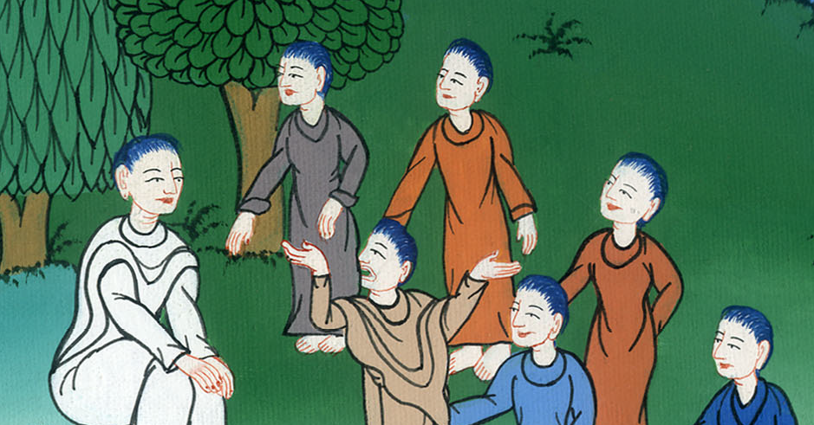
Matthew 16:21

Slide 7
and suffer many things from the elders, chief priests, and scribes, and be killed, and the third day be raised up.

Slide 8
Matthew 16:21

Slide 9
22Peter took him aside and began to rebuke him, saying, “Far be it from you, Lord! This will never be done to you.”

Slide 10
Matthew 16:22

Slide 11
23But he turned and said to Peter, “Get behind me, Satan! You are a stumbling block to me, for you are not setting your mind on the things of God, but on the things of men.”

Slide 12
Matthew 16:23

Slide 13
24Then Jesus said to his disciples, “If anyone desires to come after me, let him deny himself, take up his cross (every day), and follow me.

Slide 14
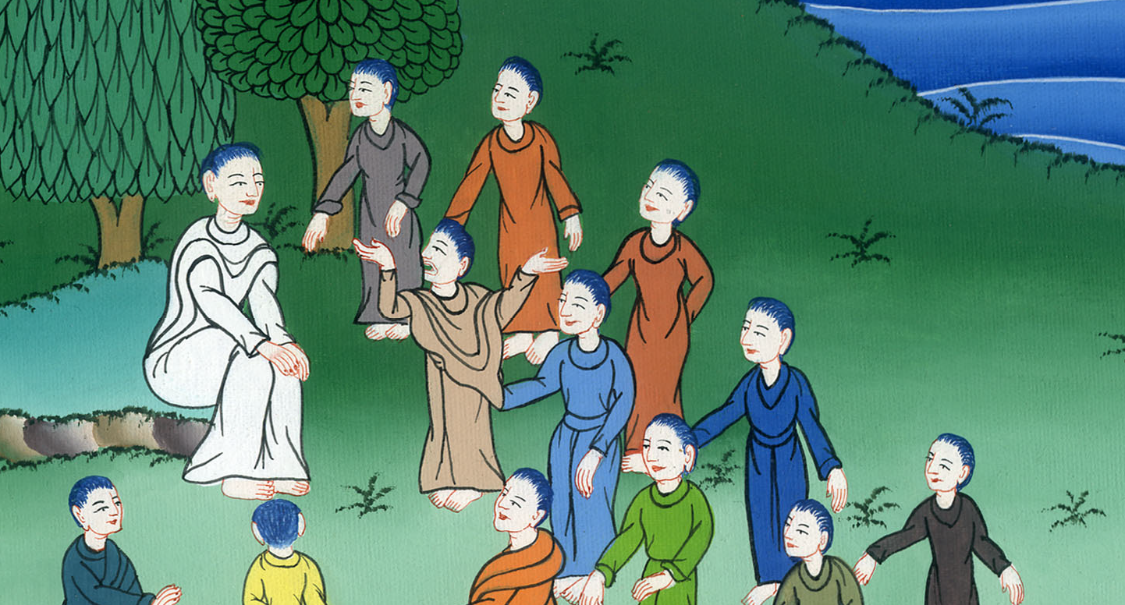
Matthew 16:24

Slide 15
25For whoever desires to save his life will lose it, and whoever will lose his life for my sake will find it.

Slide 16
Matthew 16:25

Slide 17
26 For what will it profit a man if he gains the whole world and forfeits his life? Or what will a man give in exchange for his life?

Slide 18
Matthew 16:26

Slide 19
27For the Son of Man will come in the glory of his Father with his angels, and then he will render to everyone according to his deeds.

Slide 20
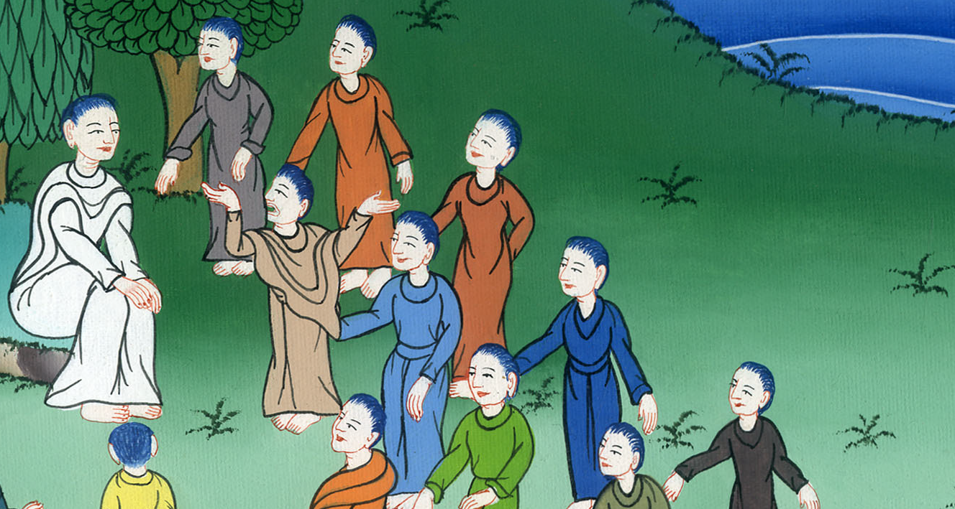
Matthew 16:27

Slide 21
28Most certainly I tell you, there are some standing here who will in no way taste of death until they see the Son of Man coming in his Kingdom.”

Slide 22
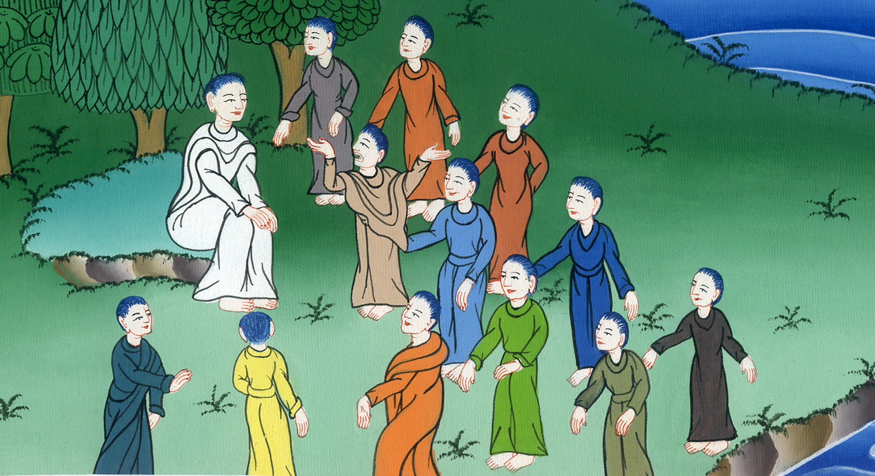
Matthew 16:28

