Slide 1
39-2
This work is licensed under a Creative Commons Attribution-ShareAlike 4.0 International License.
Please add this statement to all the videos you create.
English Bible quotes are from the World English Bible US, which is in the public domain.
Notes:
Ch
39 The Transfiguration
1. The Transfiguration - Matt 17:1-13; Mark 9:2-13; Luke 9:28-36 (Left Top)
2. The Boy with an evil spirit - Matt 17:14-23; Mark 9:14-32; Luke 9:37-45 (Right
Top)
3. Jesus and Peter pay tax - Matt 17:24-27 (Right Center)
4. Who is the greatest? - Matt 18:1-4; Mark 9:33-40; Luke 9:46-50 (Right Bottom)
5. Towards Jerusalem - Luke 9:51-62 (Left Bottom)
6. 72 sent out - Luke 10:1-24 (Left Center)

Slide 2
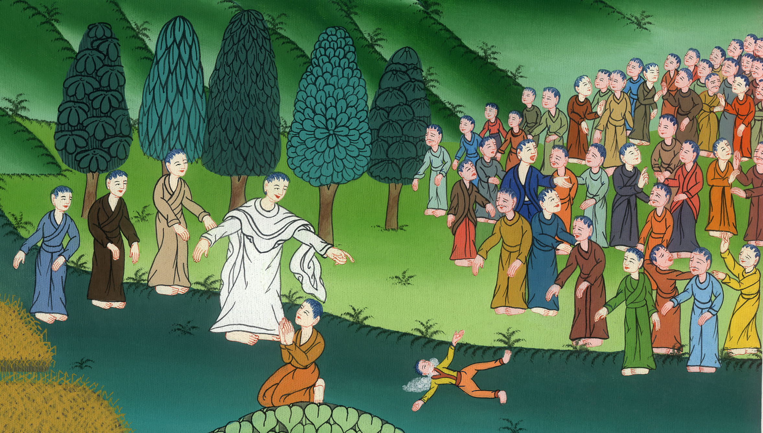
The Boy with an evil spirit - Mark 9:14-32

Slide 3
The Boy with an evil spirit - Mark 9:14-32

Slide 4
The Boy with an evil spirit - Mark 9:14-32

Slide 5
14Coming to the disciples, he saw a great multitude around them, and scribes questioning them.

Slide 6
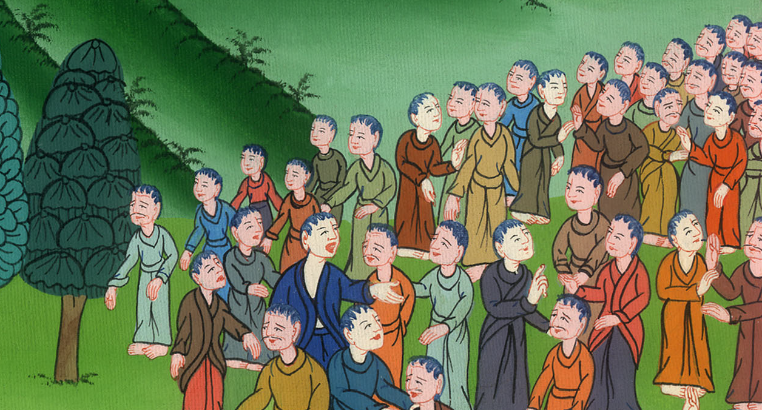
Mark 9:14

Slide 7
15Immediately all the multitude, when they saw him, were greatly amazed, and running to him, greeted him. 16He asked the scribes, “What are you asking them?”

Slide 8
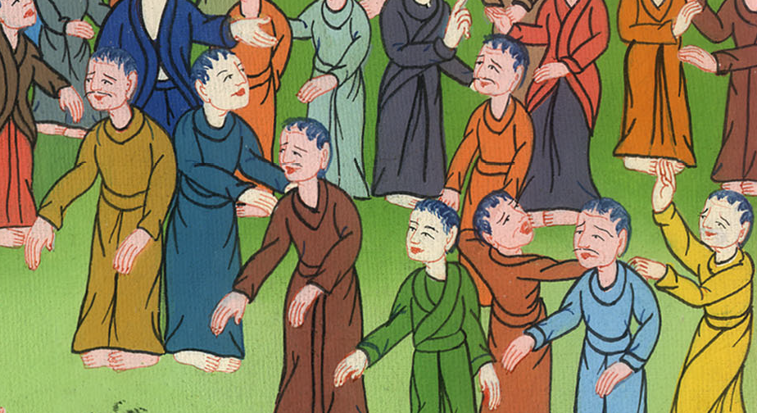
Mark 9:15,16

Slide 9
17One of the multitude answered, “Teacher, I brought to you my son, who has a mute spirit;

Slide 10
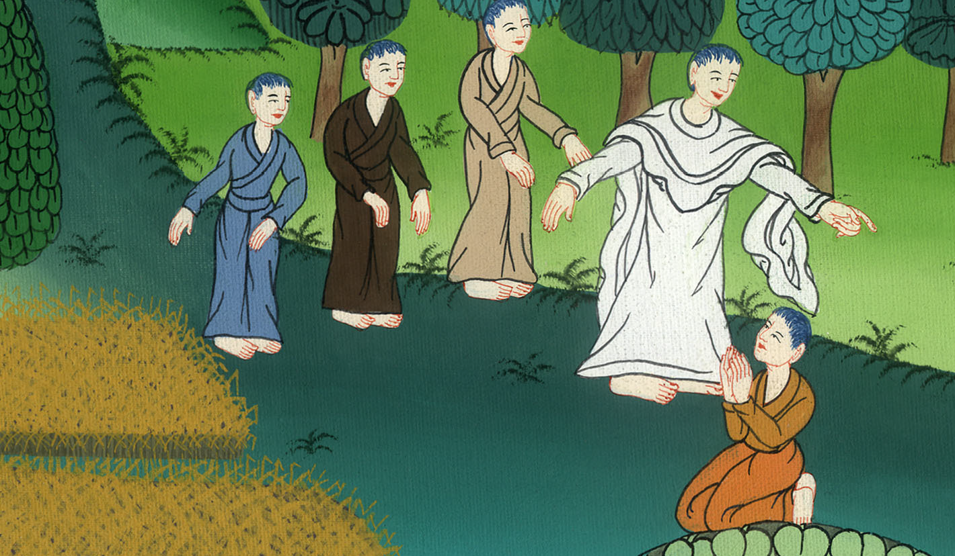
Mark 9:17

Slide 11
18and wherever it seizes him, it throws him down; and he foams at the mouth, grinds his teeth, and becomes rigid. I asked your disciples to cast it out, and they weren’t able.”

Slide 12
Mark 9:18

Slide 13
19He answered him, “Unbelieving generation, how long shall I be with you? How long shall I bear with you? Bring him to me.”

Slide 14
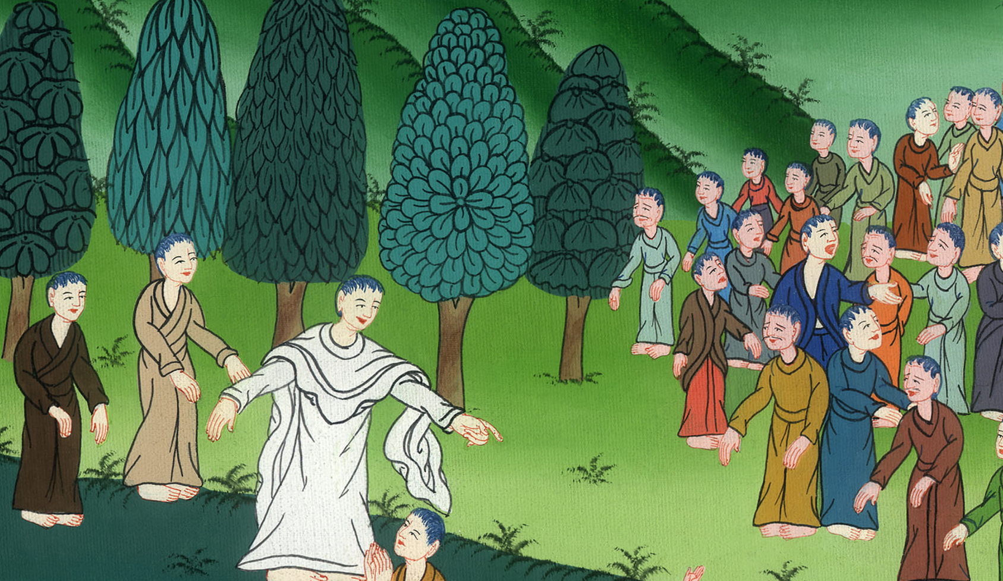
Mark 9:19

Slide 15
20They brought him to him, and when he saw him, immediately the spirit convulsed him and he fell on the ground, wallowing and foaming at the mouth.

Slide 16
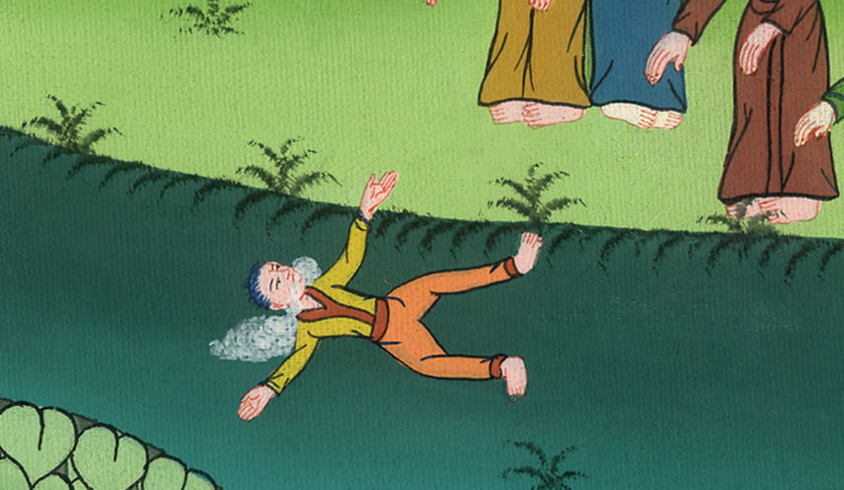
Mark 9:20

Slide 17
21He asked his father, “How long has it been since this has been happening to him?”

Slide 18
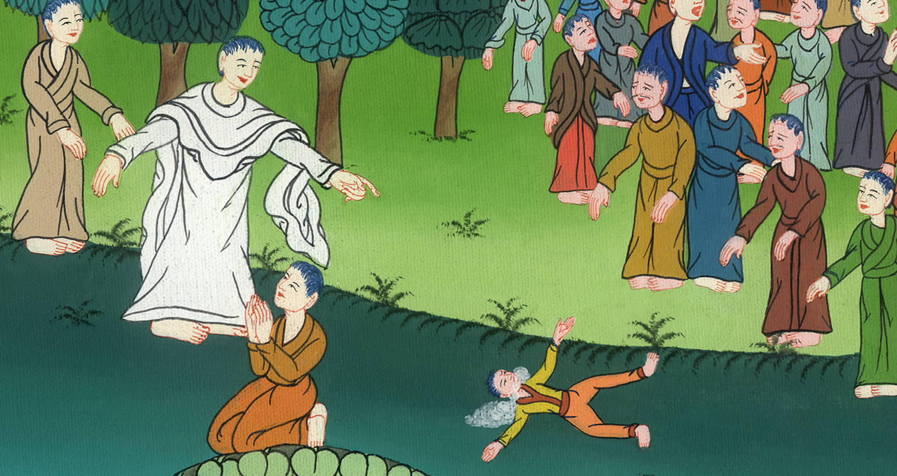
Mark 9:21

Slide 19
22Often it has cast him both into the fire and into the water to destroy him. But if you can do anything, have compassion on us and help us.”

Slide 20
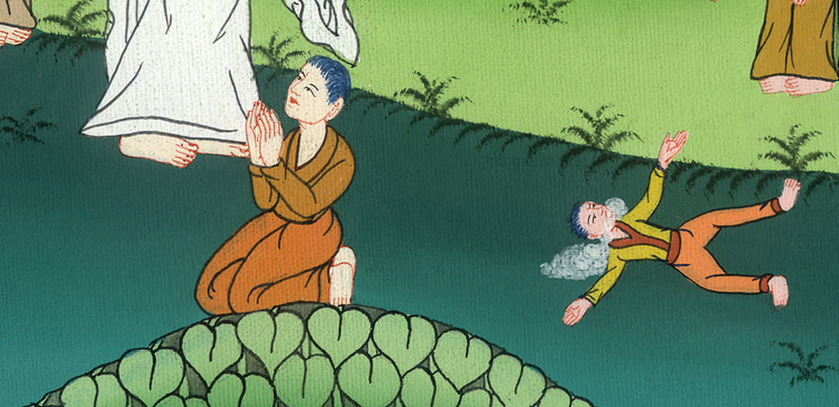
Mark 9:22

Slide 21
23Jesus said to him, “If you can believe, all things are possible to him who believes.”
24Immediately the father of the child cried out with tears, “I believe. Help my unbelief!”

Slide 22
Mark 9:23,24

Slide 23
25When Jesus saw that a multitude came running together, he rebuked the unclean spirit, saying to him, “You mute and deaf spirit, I command you, come out of him, and never enter him again!”

Slide 24
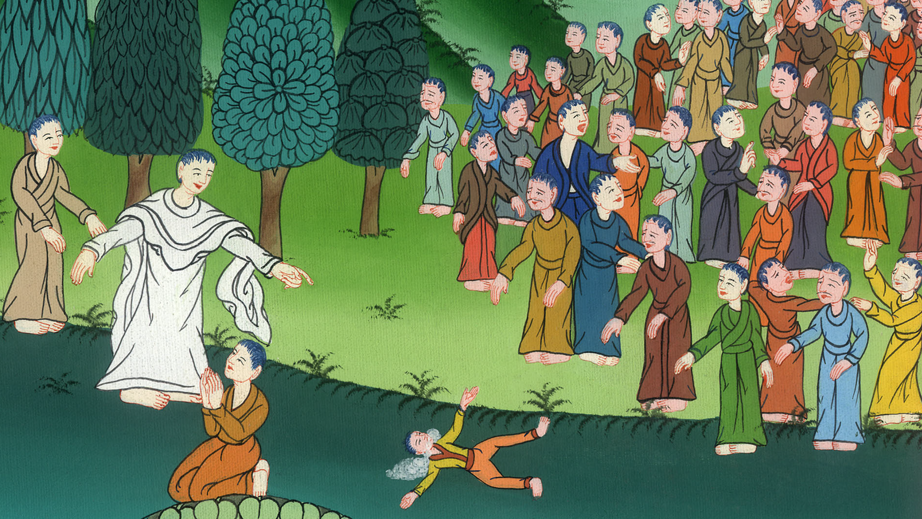
Mark 9:25

Slide 25
26After crying out and convulsing him greatly, it came out of him. The boy became like one dead, so much that most of them said, “He is dead.” 27But Jesus took him by the hand and raised him up; and he arose.

Slide 26
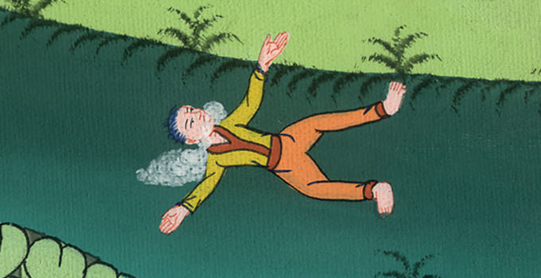
Mark 9:26,27

Slide 27
28When he had come into the house, his disciples asked him privately, “Why couldn’t we cast it out?”

Slide 28
Mark 9:28

Slide 29
29He said to them, “This kind can come out by nothing but by prayer and fasting.”

Slide 30
Mark 9:29

Slide 31
30They went out from there and passed through Galilee. He didn’t want anyone to know it,

Slide 32
Mark 9:30

Slide 33
31for he was teaching his disciples, and said to them, “The Son of Man is being handed over to the hands of men, and they will kill him; and when he is killed, on the third day he will rise again.”

Slide 34
Mark 9:31

Slide 35
32But they didn’t understand the saying, and were afraid to ask him.

Slide 36
Mark 9:32

