Slide 1
39-3
This work is licensed under a Creative Commons Attribution-ShareAlike 4.0 International License.
Please add this statement to all the videos you create.
English Bible quotes are from the World English Bible US, which is in the public domain.
Notes:
Ch
39 The Transfiguration
1. The Transfiguration - Matt 17:1-13; Mark 9:2-13; Luke 9:28-36 (Left Top)
2. The Boy with an evil spirit - Matt 17:14-23; Mark 9:14-32; Luke 9:37-45 (Right
Top)
3. Jesus and Peter pay tax - Matt 17:24-27 (Right Center)
4. Who is the greatest? - Matt 18:1-4; Mark 9:33-40; Luke 9:46-50 (Right Bottom)
5. Towards Jerusalem - Luke 9:51-62 (Left Bottom)
6. 72 sent out - Luke 10:1-24 (Left Center)

Slide 2
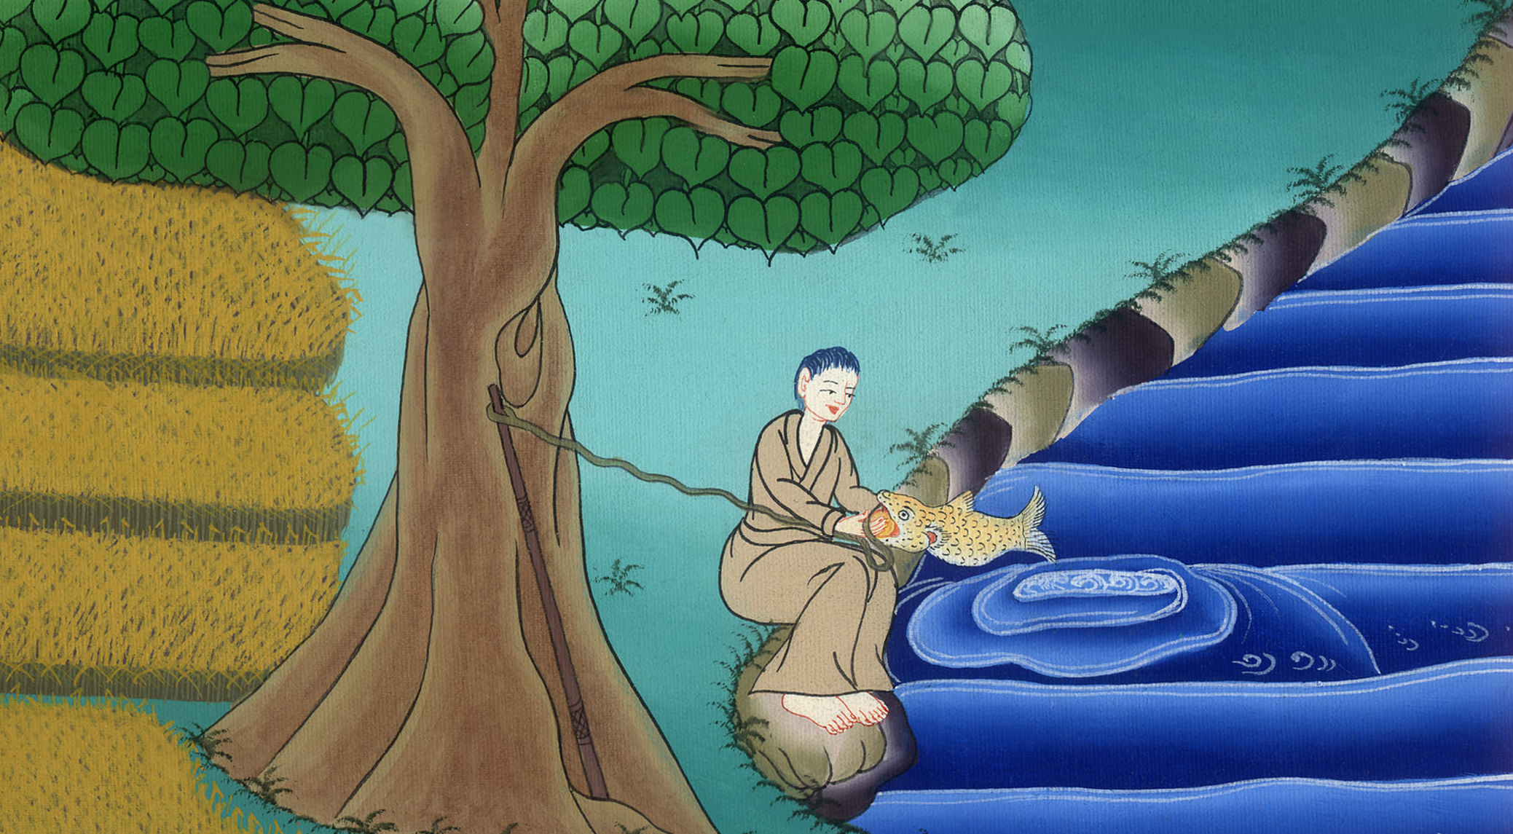
Jesus and Peter pay tax –
Matthew 17:24-27
Who is the greatest? –
Mark 9:33-40

Slide 3
Jesus and Peter pay tax - Matt 17:24-27
Who is the greatest? - Mark 9:33-40

Slide 4
Jesus and Peter pay tax –
Matthew 17:24-27
Who is the greatest? –
Mark 9:33-40

Slide 5
Matthew 17:24When they had come to Capernaum, those who collected the didrachma coins came to Peter, and said, “Doesn’t your teacher pay the didrachma?

Slide 6
Matthew 17:24

Slide 7
25He said, “Yes.”
When he came into the house, Jesus anticipated him, saying, “What do you think, Simon? From whom do the kings of the earth receive toll or tribute? From their children, or from strangers?”

Slide 8
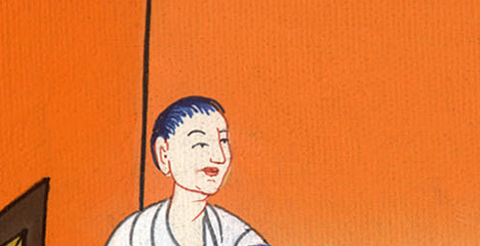
Matthew 17:25

Slide 9
26Peter said to him, “From strangers.”
Jesus said to him, “Therefore the children are exempt.

Slide 10
Matthew 17:26

Slide 11
27But, lest we cause them to stumble, go to the sea, cast a hook, and take up the first fish that comes up. When you have opened its mouth, you will find a stater coin. Take that, and give it to them for me and you.”

Slide 12
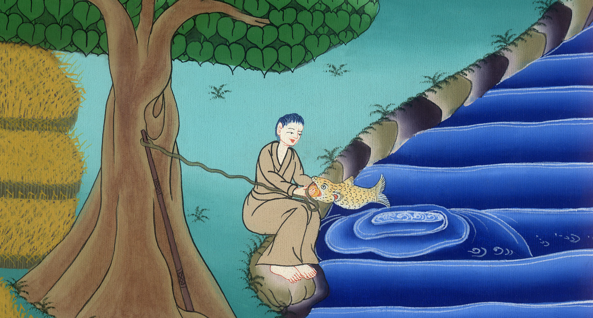
Matthew 17:27

Slide 13
It happened just like this

Slide 15
Mark 933He came to Capernaum, and when he was in the house he asked them, “What were you arguing among yourselves on the way?”

Slide 16
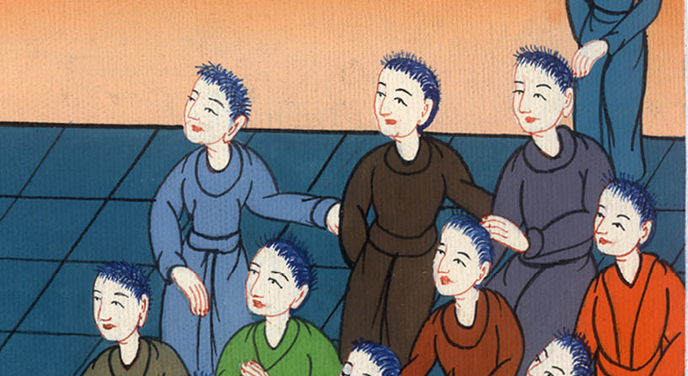
Mark 9:33

Slide 17
34But they were silent, for they had disputed with one another on the way about who was the greatest.

Slide 18
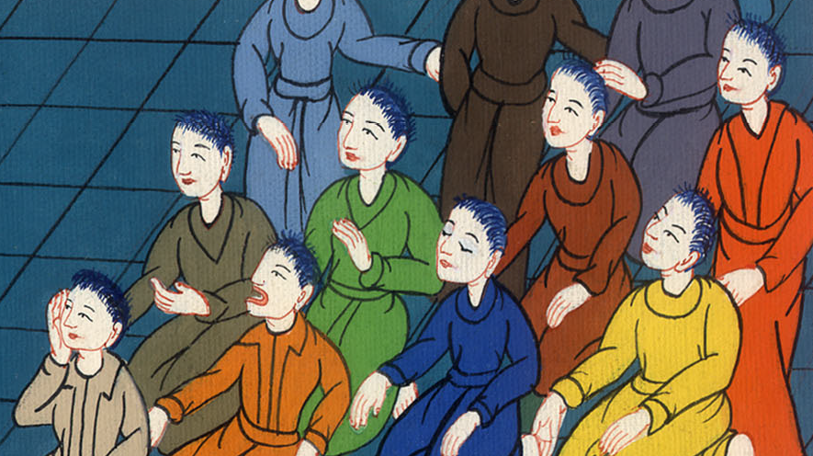
Mark 9:34

Slide 19
35He sat down and called the twelve; and he said to them, “If any man wants to be first, he shall be last of all, and servant of all.”

Slide 20
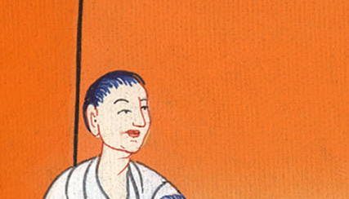
Mark 9:35

Slide 21
36He took a little child and set him in the middle of them. Taking him in his arms, he said to them,

Slide 22
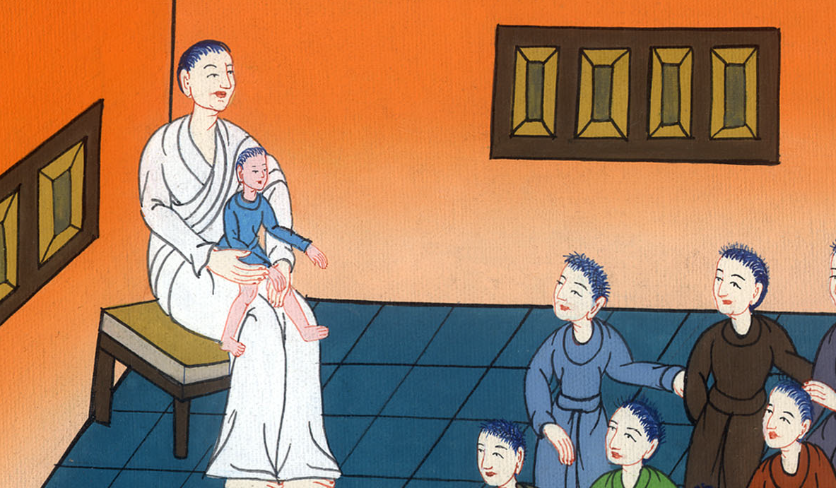
Mark 9:36

Slide 23
37“Whoever receives one such little child in my name receives me; and whoever receives me, doesn’t receive me, but him who sent me.”

Slide 24
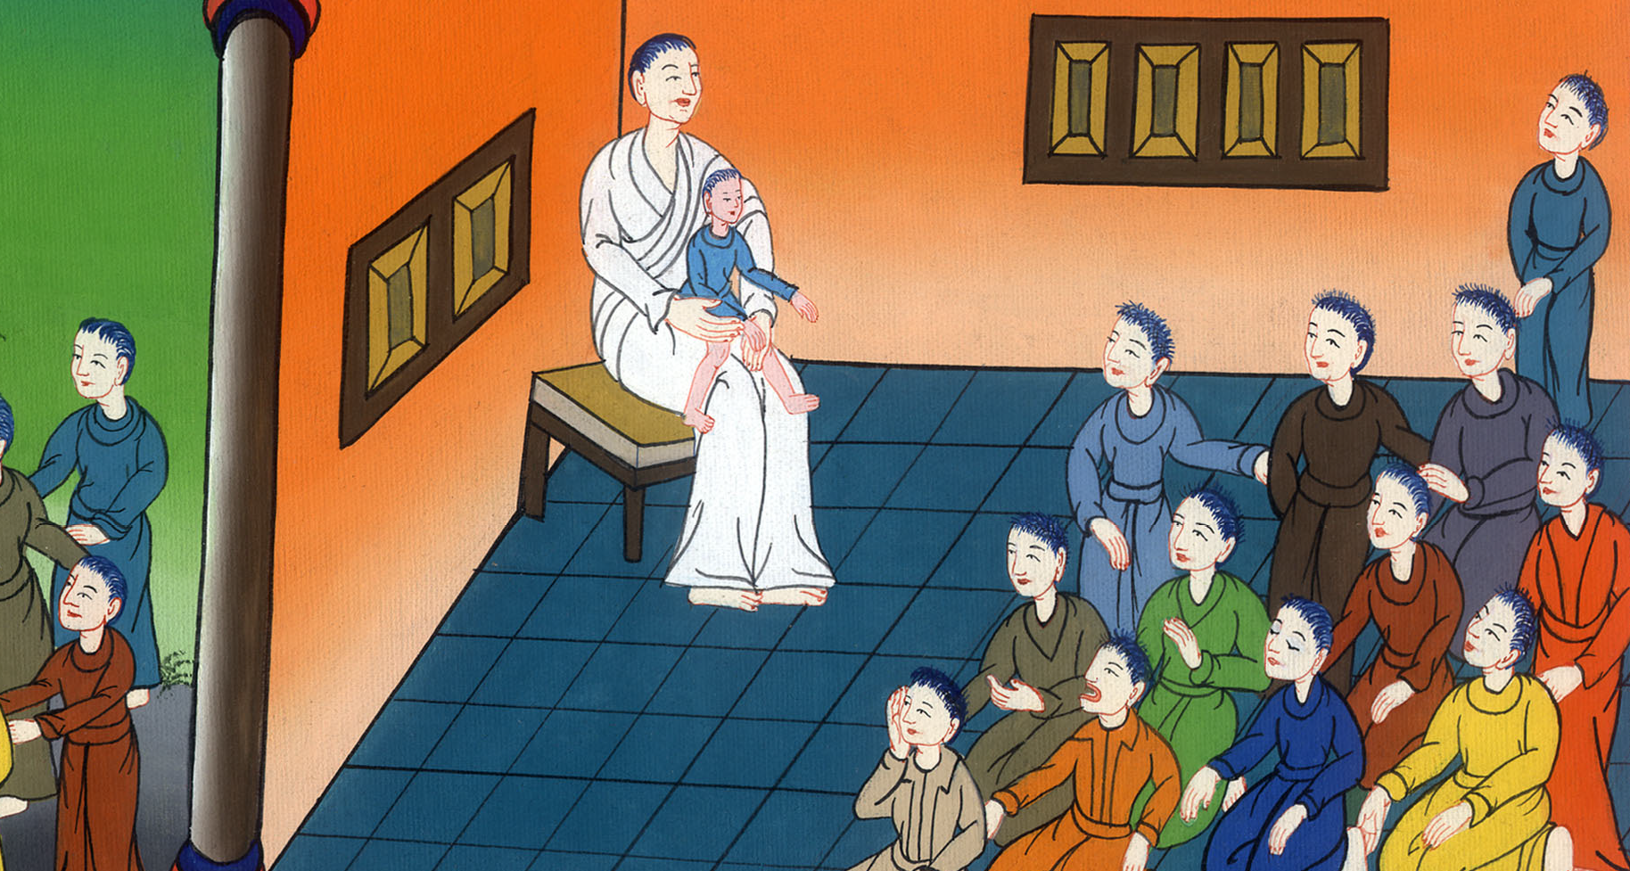
Mark 9:37

