Slide 1
39-4
This work is licensed under a Creative Commons Attribution-ShareAlike 4.0 International License.
Please add this statement to all the videos you create.
English Bible quotes are from the World English Bible US, which is in the public domain.
Notes:
Ch
39 The Transfiguration
1. The Transfiguration - Matt 17:1-13; Mark 9:2-13; Luke 9:28-36 (Left Top)
2. The Boy with an evil spirit - Matt 17:14-23; Mark 9:14-32; Luke 9:37-45 (Right
Top)
3. Jesus and Peter pay tax - Matt 17:24-27 (Right Center)
4. Who is the greatest? - Matt 18:1-4; Mark 9:33-40; Luke 9:46-50 (Right Bottom)
5. Towards Jerusalem - Luke 9:51-62 (Left Bottom)
6. 72 sent out - Luke 10:1-24 (Left Center)

Slide 2
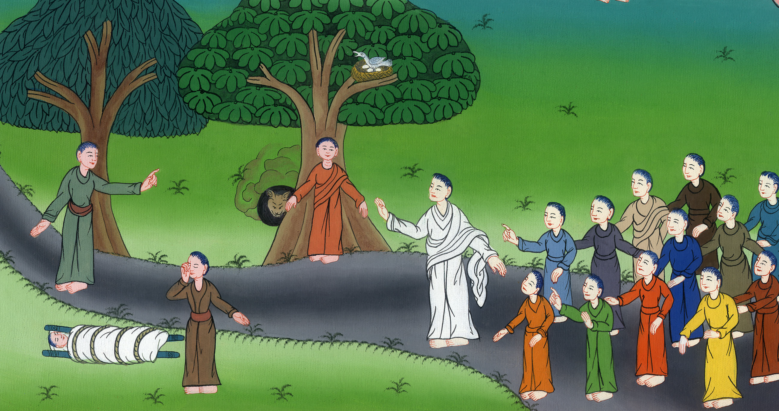
The Cost of Following Jesus-
Luke 9:51-62

Slide 3
The Cost of Following Jesus- Luke 9:51-62

Slide 4
The Cost of Following Jesus-
Luke 9:51-62

Slide 5
51It came to pass, when the days were near that he should be taken up, he intently set his face to go to Jerusalem

Slide 6
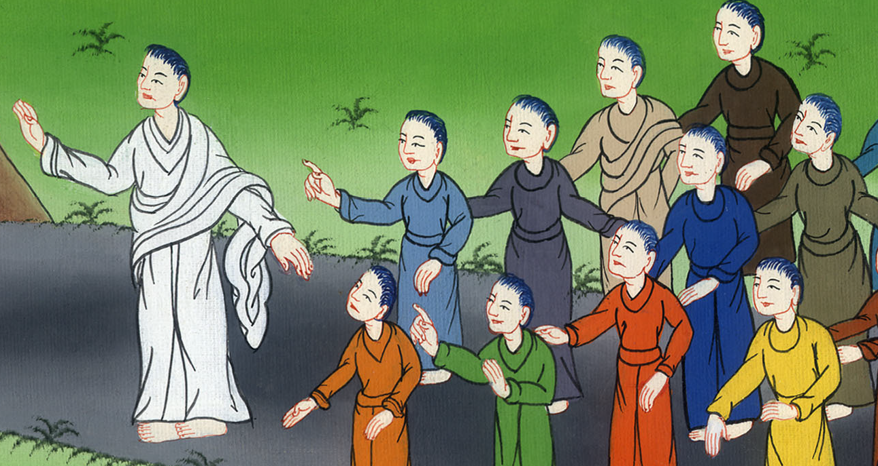
Luke 9:51

Slide 7
52and sent messengers before his face. They went and entered into a village of the Samaritans, so as to prepare for him. 53They didn’t receive him, because he was traveling with his face set toward Jerusalem.

Slide 8
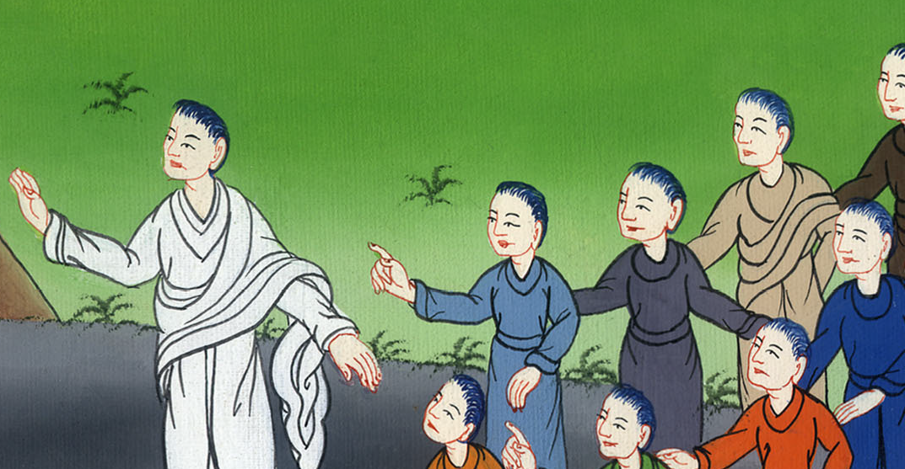
Luke 9:52,53

Slide 9
54When his disciples, James and John, saw this, they said, “Lord, do you want us to command fire to come down from the sky and destroy them, just as Elijah did?”

Slide 10
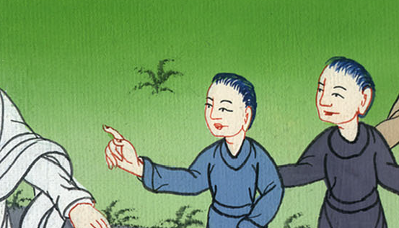
Luke 9:54

Slide 11
55But he turned and rebuked them, “You don’t know of what kind of spirit you are. 56For the Son of Man didn’t come to destroy men’s lives, but to save them.”
They went to another village.

Slide 12
Luke 9:55,56

Slide 13
57As they went on the way, a certain man said to him, “I want to follow you wherever you go, Lord.”

Slide 14
Luke 9:57

Slide 15
58Jesus said to him, “The foxes have holes and the birds of the sky have nests, but the Son of Man has no place to lay his head.”

Slide 16
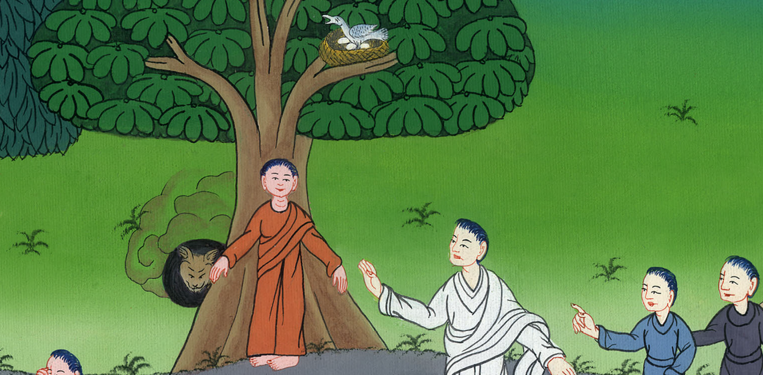
Luke 9:58

Slide 17
59He said to another, “Follow me!”
But he said, “Lord, allow me first to go and bury my father.”

Slide 18
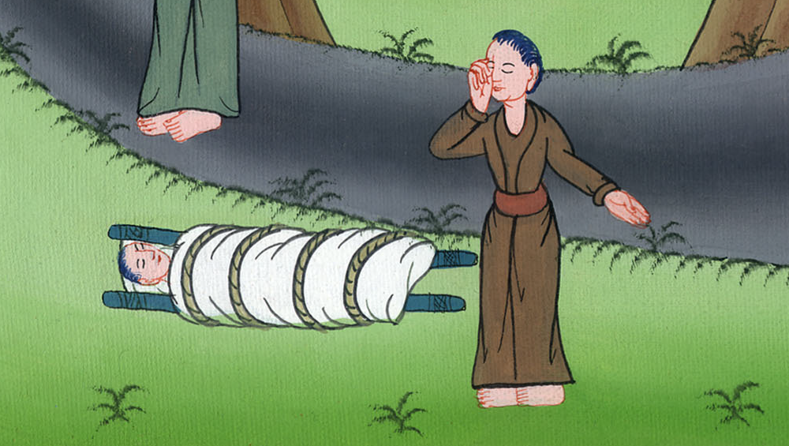
Luke 9:59

Slide 19
60But Jesus said to him, “Leave the dead to bury their own dead, but you go and announce God’s Kingdom.”

Slide 20
Luke 9:60

Slide 21
61Another also said, “I want to follow you, Lord, but first allow me to say good-bye to those who are at my house.”

Slide 22
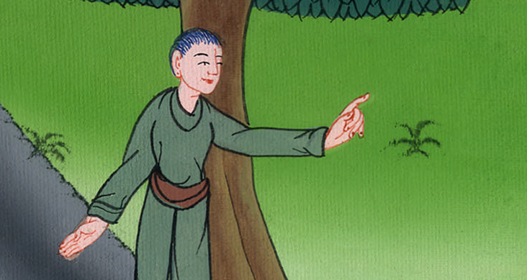
Luke 9:61

Slide 23
62But Jesus said to him, “No one, having put his hand to the plow and looking back, is fit for God’s Kingdom.”

Slide 24
Luke 9:62

