Slide 1
39-5
This work is licensed under a Creative Commons Attribution-ShareAlike 4.0 International License.
Please add this statement to all the videos you create.
English Bible quotes are from the World English Bible US, which is in the public domain.
Notes:
Ch
39 The Transfiguration
1. The Transfiguration - Matt 17:1-13; Mark 9:2-13; Luke 9:28-36 (Left Top)
2. The Boy with an evil spirit - Matt 17:14-23; Mark 9:14-32; Luke 9:37-45 (Right
Top)
3. Jesus and Peter pay tax - Matt 17:24-27 (Right Center)
4. Who is the greatest? - Matt 18:1-4; Mark 9:33-40; Luke 9:46-50 (Right Bottom)
5. Towards Jerusalem - Luke 9:51-62 (Left Bottom)
6. 72 sent out - Luke 10:1-24 (Left Center)

Slide 2
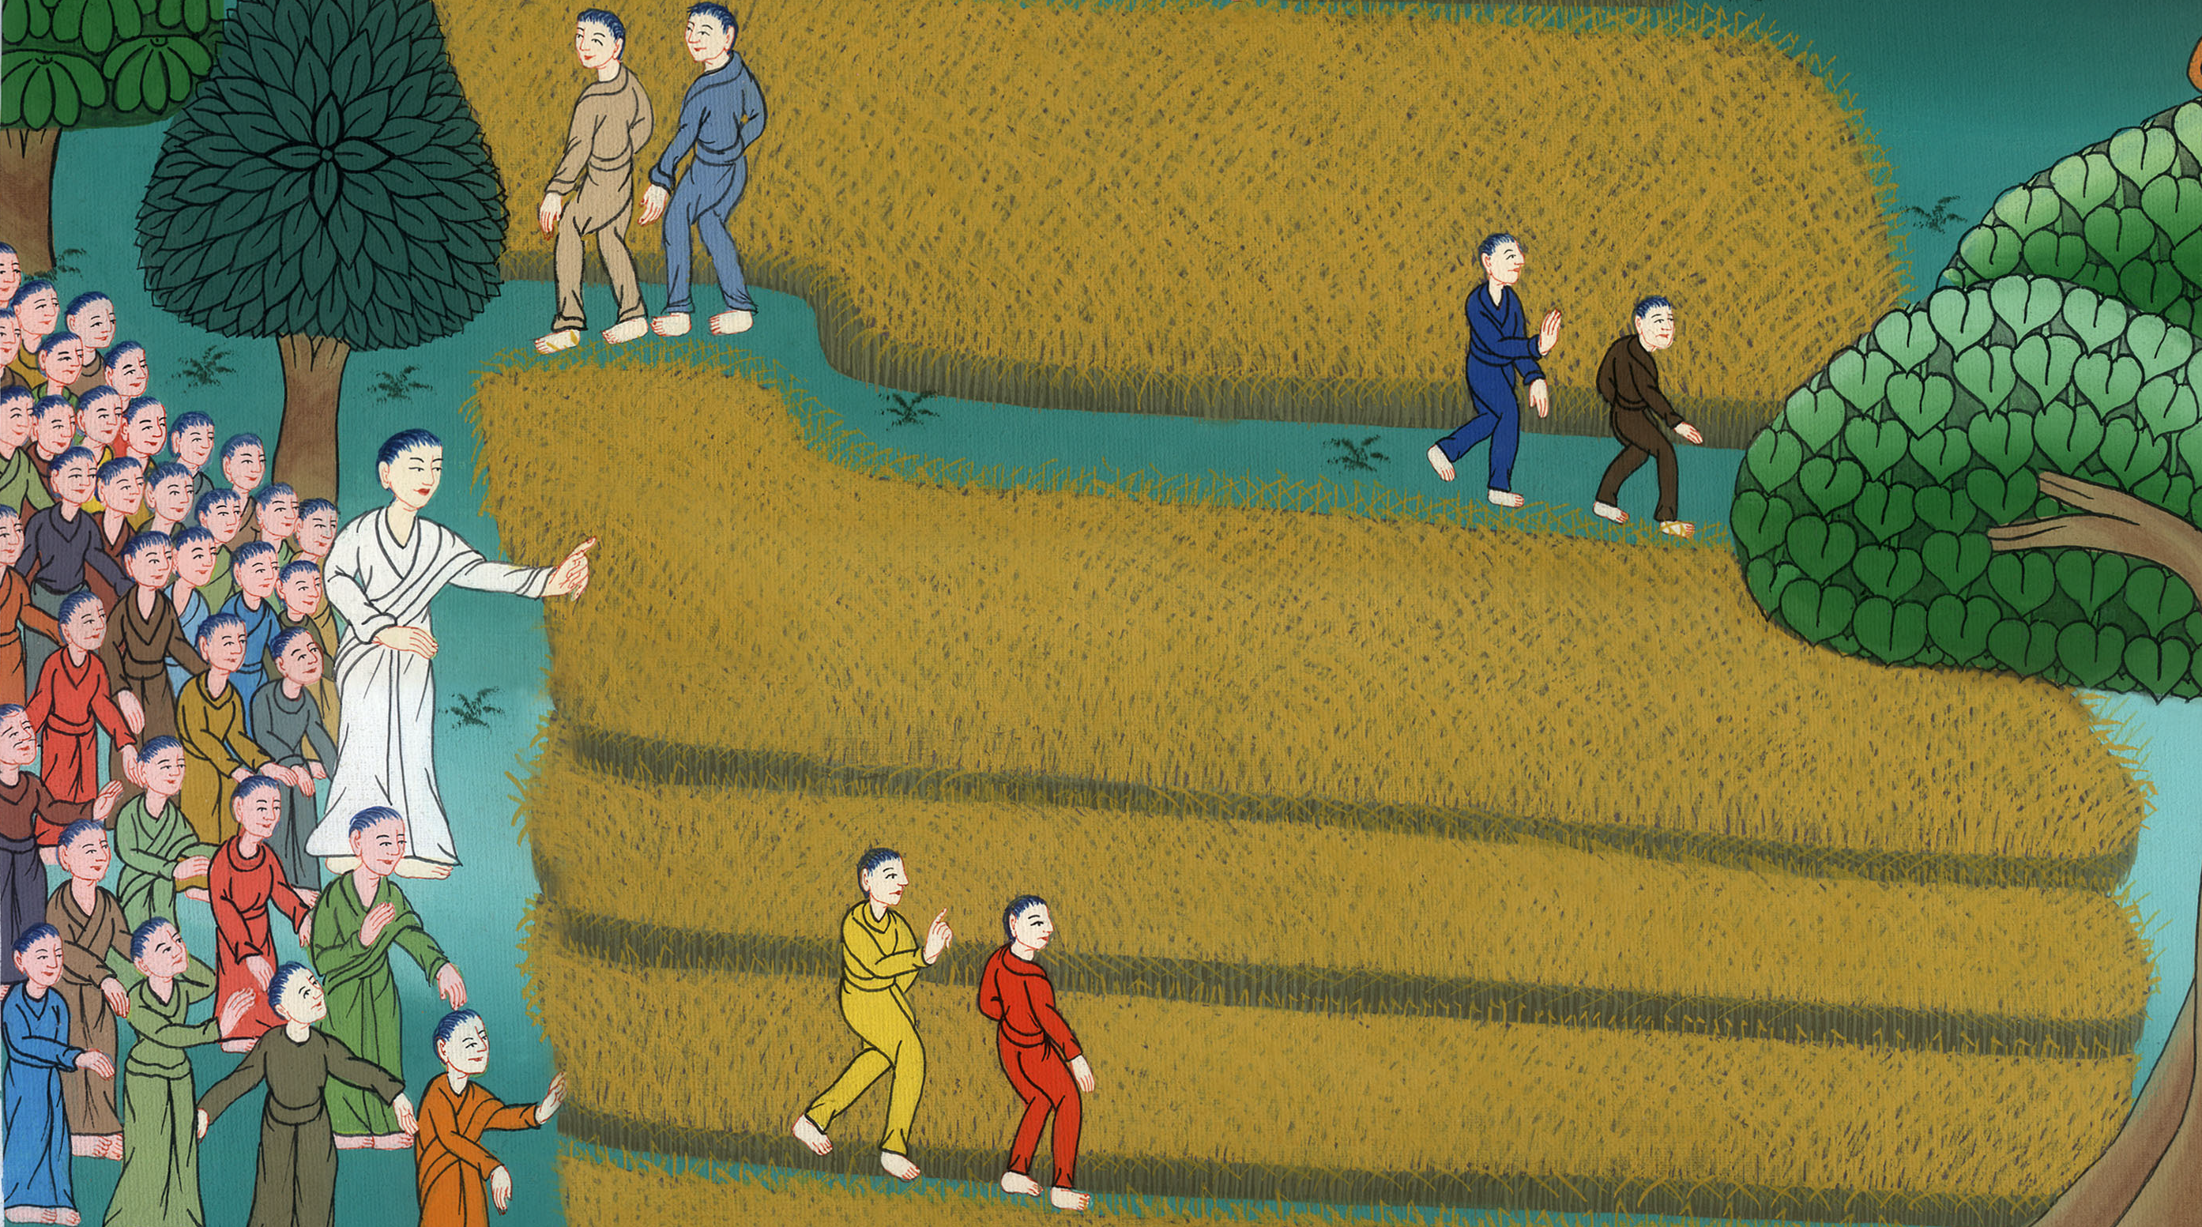
72 sent out - Luke 10:1-24

Slide 3
72 sent out - Luke 10:1-24

Slide 4
72 sent out - Luke 10:1-24

Slide 5
1Now after these things, the Lord also appointed seventy others, and sent them two by two ahead of him into every city and place where he was about to come.

Slide 6
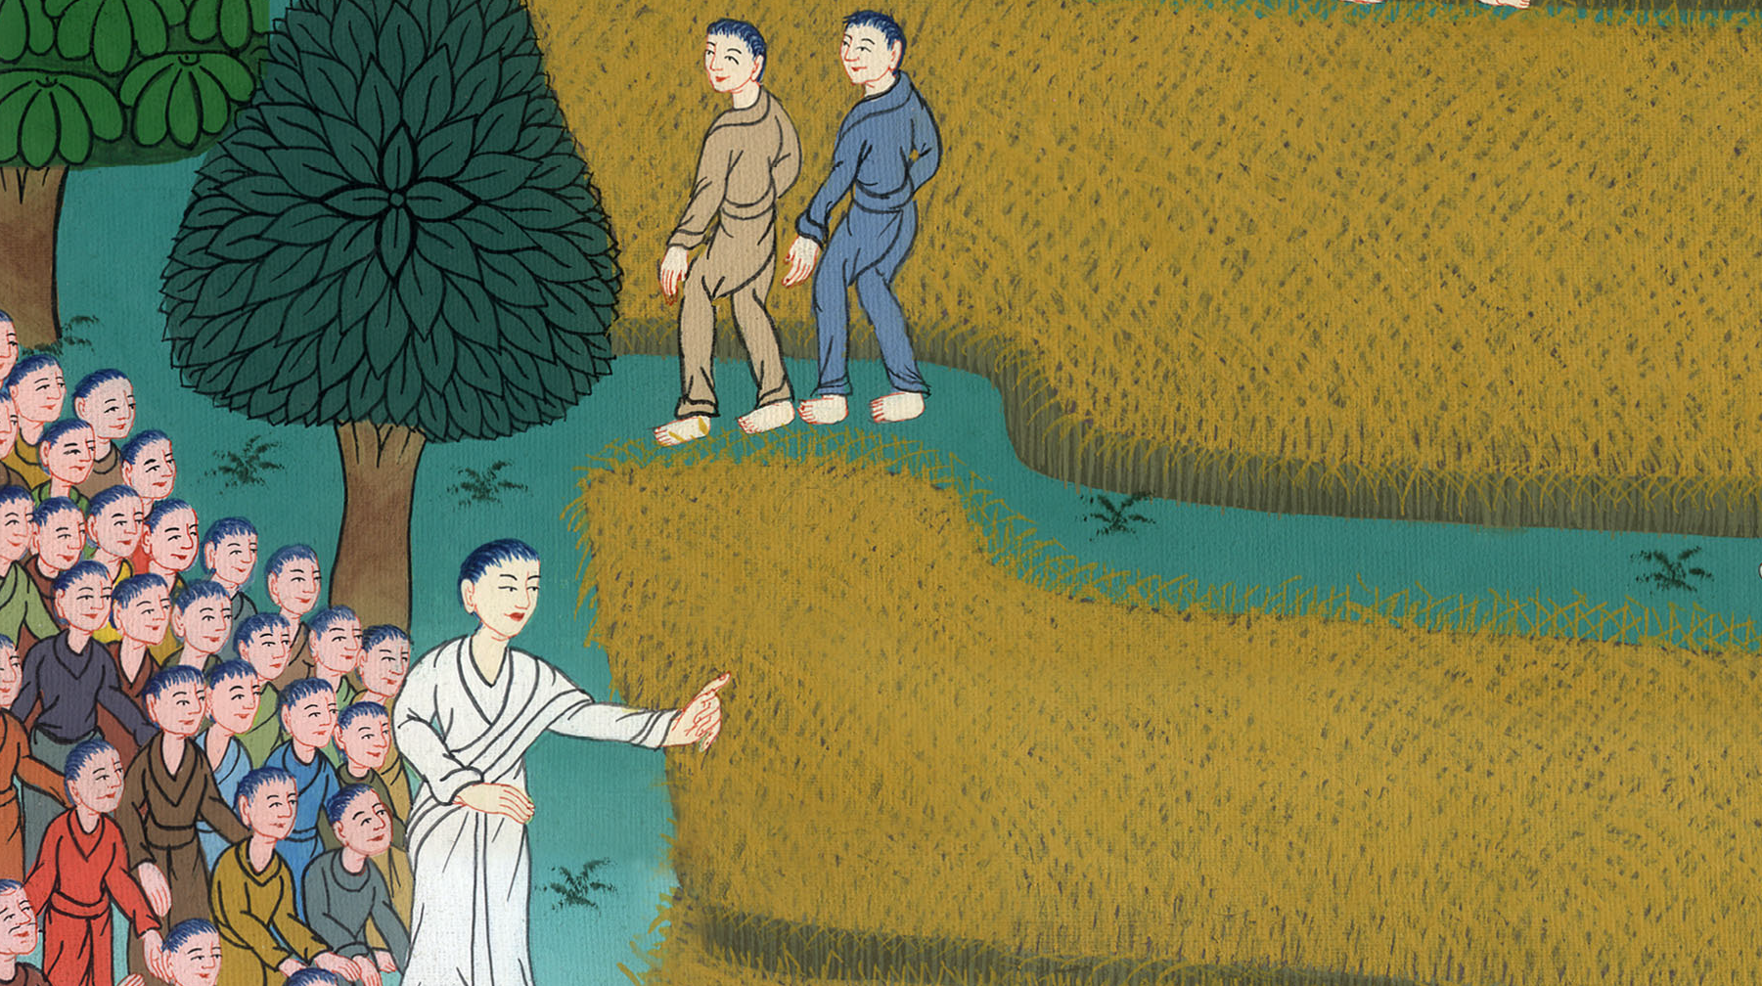
Luke 10:1

Slide 7
2Then he said to them, “The harvest is indeed plentiful, but the laborers are few. Pray therefore to the Lord of the harvest, that he may send out laborers into his harvest.

Slide 8
Luke 10:2

Slide 9
3Go your ways. Behold, I send you out as lambs among wolves. 4Carry no purse, nor wallet, nor sandals. Greet no one on the way.

Slide 10
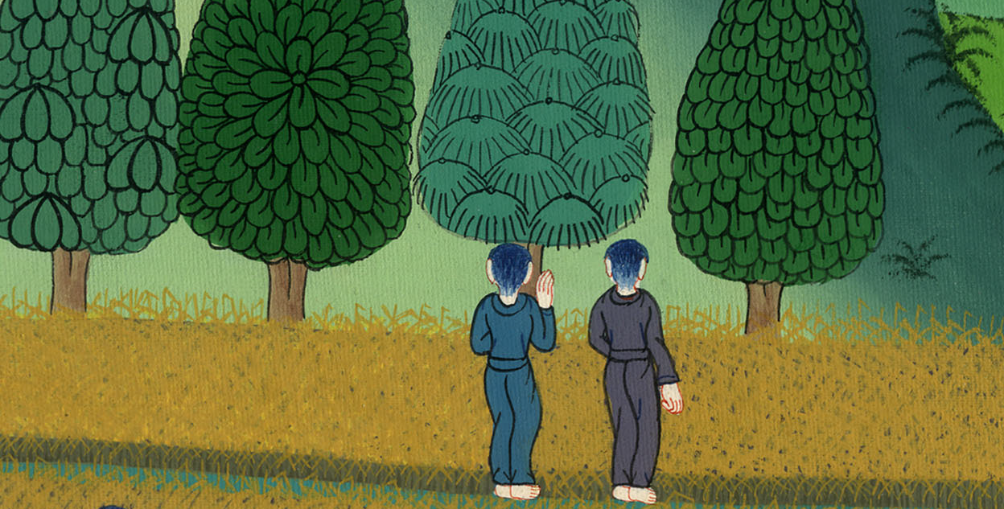
Luke 10:3,4

Slide 11
5Into whatever house you enter, first say, ‘Peace be to this house.’ 6If a son of peace is there, your peace will rest on him; but if not, it will return to you.

Slide 12
Luke 10:5,6

Slide 13
7Remain in that same house, eating and drinking the things they give, for the laborer is worthy of his wages. Don’t go from house to house.

Slide 14
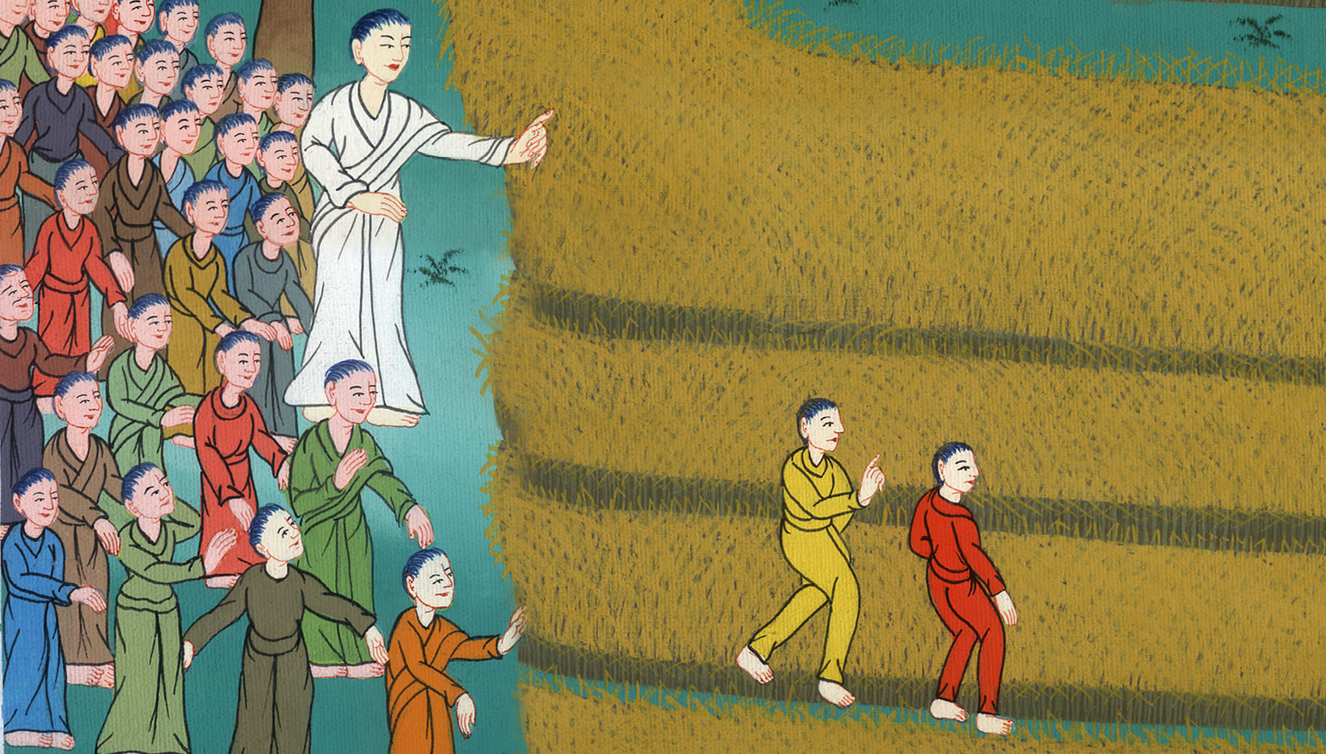
Luke 10:7

Slide 15
8Into whatever city you enter and they receive you, eat the things that are set before you. 9Heal the sick who are there and tell them, ‘God’s Kingdom has come near to you.’

Slide 16
Luke 10:8,9

Slide 17
10But into whatever city you enter and they don’t receive you, go out into its streets and say, 11‘Even the dust from your city that clings to us, we wipe off against you.

Slide 18
Luke 10:10,11

Slide 19
…We do it to warn you. But here is what you can be sure of. God’s kingdom has come near.’

Slide 20
Luke 10:11

Slide 21
12I tell you, it will be more tolerable in that day for Sodom than for that city.

Slide 22
Luke 10:12

Slide 23
16Whoever listens to you listens to me, and whoever rejects you rejects me. Whoever rejects me rejects him who sent me.”

Slide 24
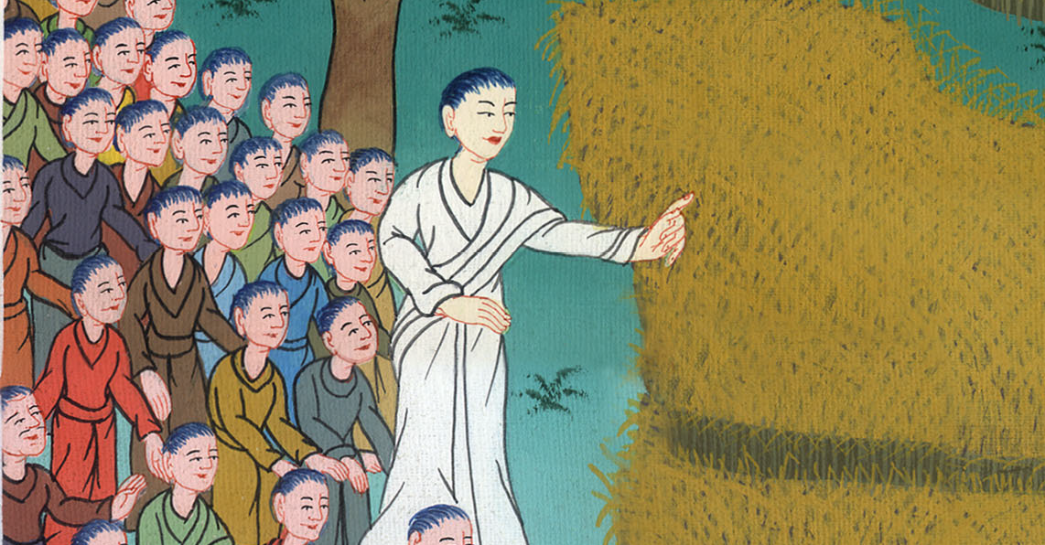
Luke 10:16

Slide 25
17The seventy returned with joy, saying, “Lord, even the demons are subject to us in your name!”

Slide 26
Luke 10:17

Slide 27
21In that same hour, Jesus rejoiced in the Holy Spirit, and said, “I thank you, O Father,

Slide 28
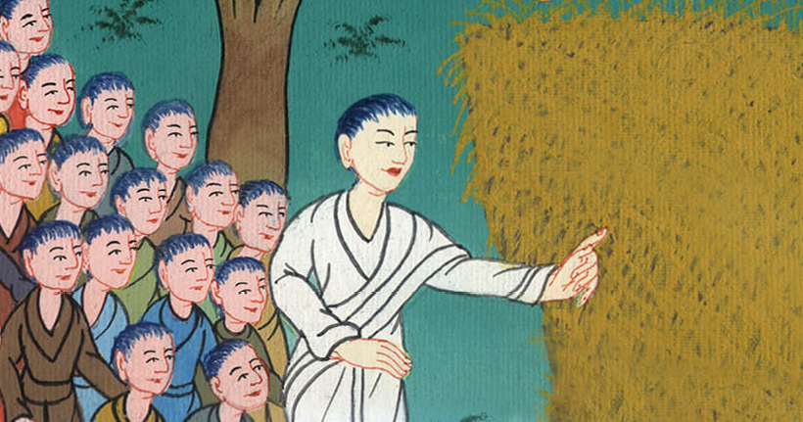
Luke 10:21

Slide 29
21… Lord of heaven and earth, that you have hidden these things from the wise and understanding, and revealed them to little children. Yes, Father, for so it was well-pleasing in your sight.”

Slide 30
Luke 10:21

