Slide 1
40-1
This work is licensed under a Creative Commons Attribution 4.0 International License.
Please add this statement to all the videos you create.
English Bible quotes are from the World English Bible US, which is in the public domain.
Notes:
Ch
40 Mary and Martha
1. Mary and Martha - Luke 10:38-42 (Left Top)
2. Pharisees and Lawyers accused - Luke 11:37-54 (Right Top)
3. Crippled Woman healed - Luke 13:10-17 (Right Center)
4. The ten lepers - Luke 17:11-19 (Bottom)
5. Jesus welcomes the children - Matt 19:13-15; Mark 10:13-16; Luke 18:15-17
(Left Center)

Slide 2
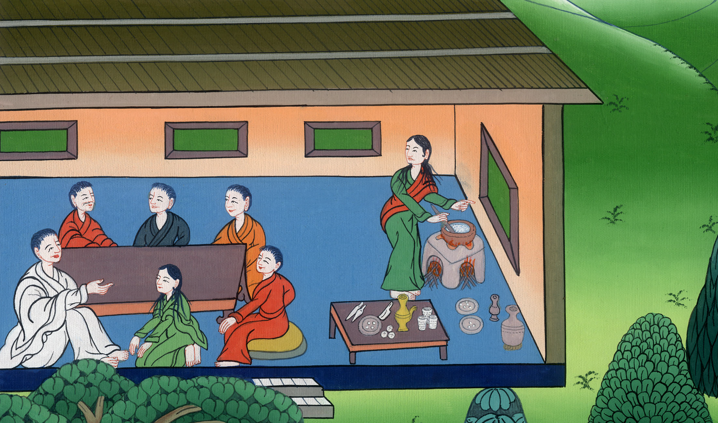
Mary and Martha - Luke 10:38-42

Slide 3
Mary and Martha - Luke 10:38-42

Slide 4
Mary and Martha - Luke 10:38-42

Slide 5
38As they went on their way, he entered into a certain village, and a certain woman named Martha received him into her house.

Slide 6
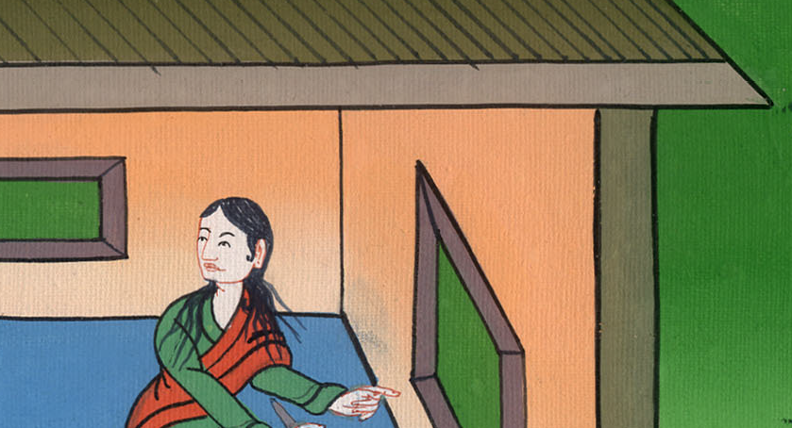
Luke 10:38

Slide 7
39She had a sister called Mary, who also sat at Jesus’ feet and heard his word.

Slide 8
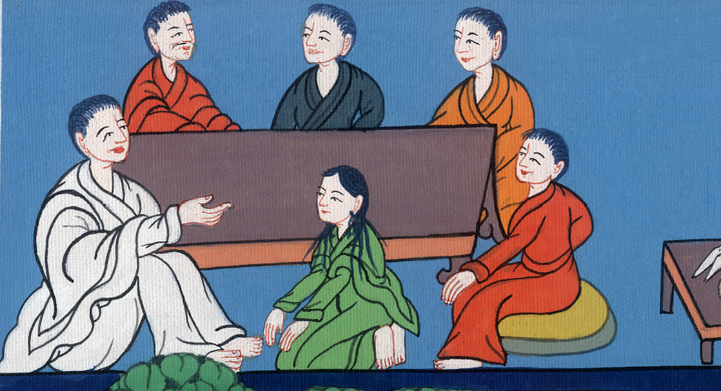
Luke 10:39

Slide 9
40But Martha was distracted with much serving, and she came up to him, and said,

Slide 10
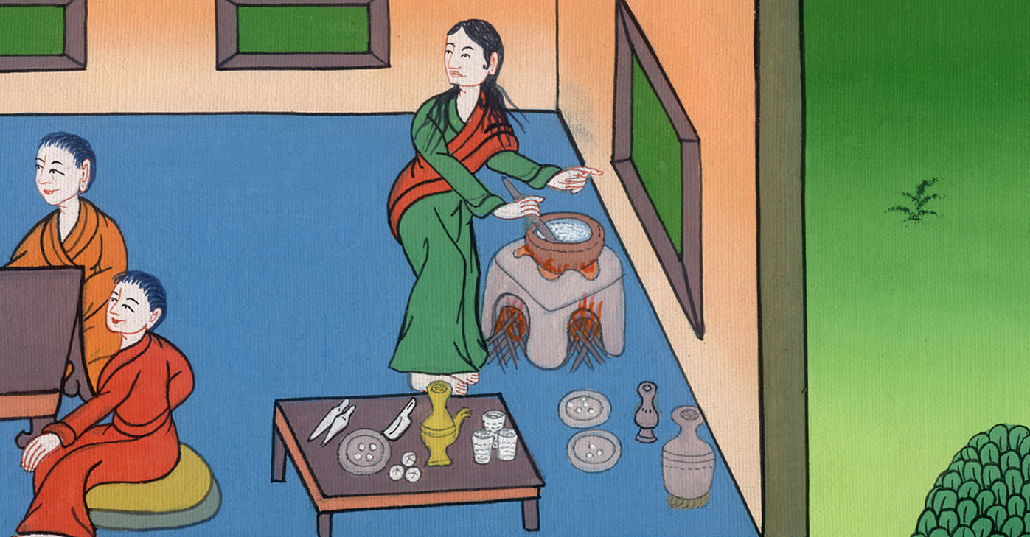
Luke 10:40

Slide 11
“Lord, don’t you care that my sister left me to serve alone? Ask her therefore to help me.”

Slide 12
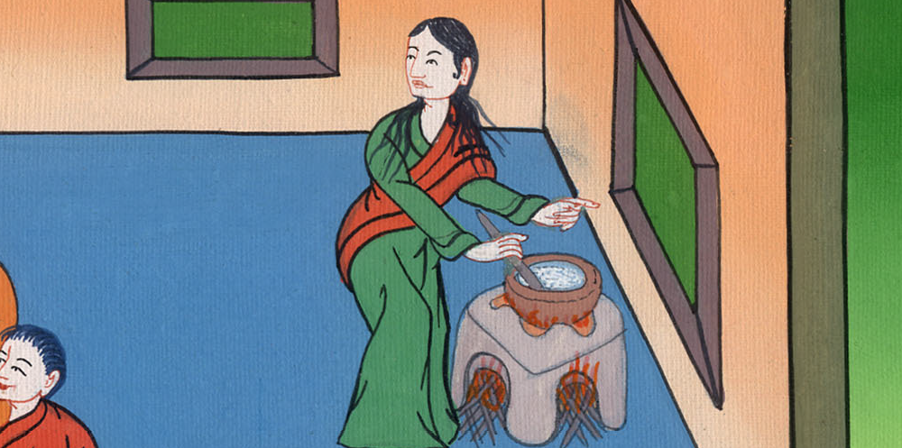
Luke 10:40

Slide 13
41Jesus answered her, “Martha, Martha, you are anxious and troubled about many things,

Slide 14
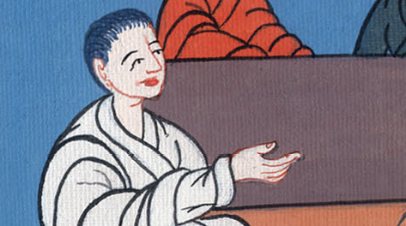
Luke 10:41

Slide 15
42but one thing is needed. Mary has chosen the good part, which will not be taken away from her.”

Slide 16
Luke 10:42

Slide 17
Spending time with Jesus and listening to him, is better than working on serving

