Slide 1
40-2
This work is licensed under a Creative Commons Attribution 4.0 International License.
Please add this statement to all the videos you create.
English Bible quotes are from the World English Bible US, which is in the public domain.
Notes:
Ch
40 Mary and Martha
1. Mary and Martha - Luke 10:38-42 (Left Top)
2. Pharisees and Lawyers accused - Luke 11:37-54 (Right Top)
3. Crippled Woman healed - Luke 13:10-17 (Right Center)
4. The ten lepers - Luke 17:11-19 (Bottom)
5. Jesus welcomes the children - Matt 19:13-15; Mark 10:13-16; Luke 18:15-17
(Left Center)

Slide 2
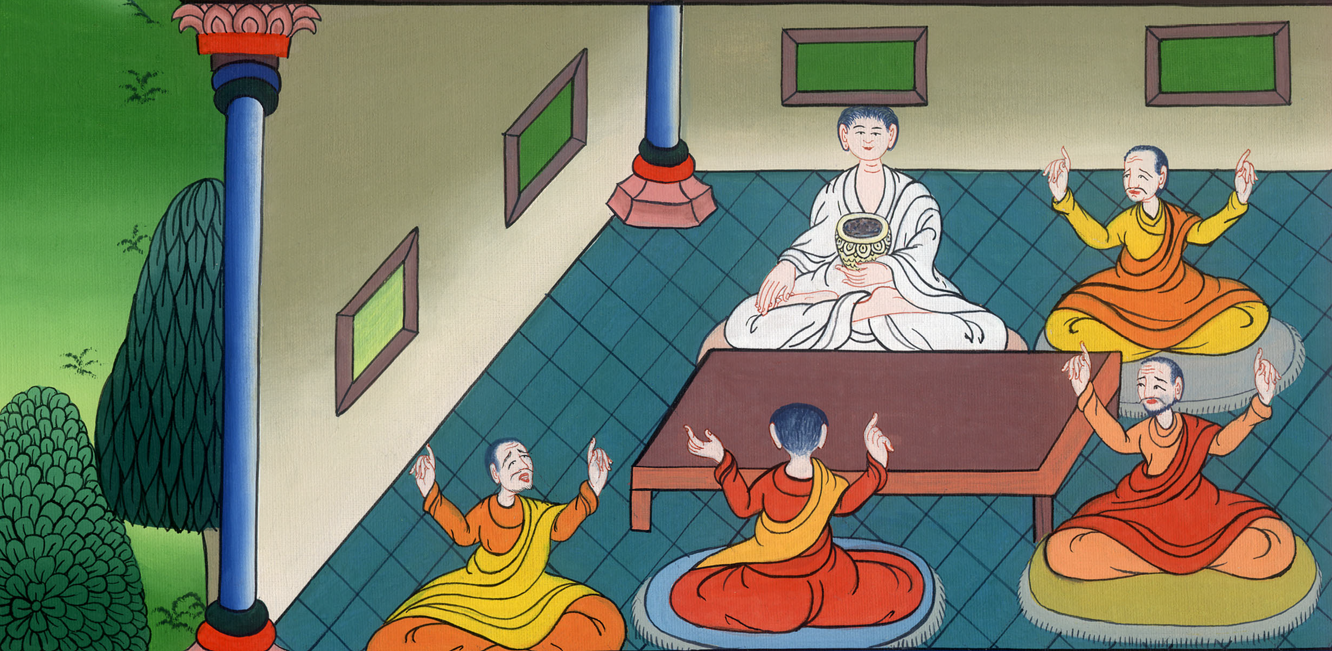
Pharisees and Lawyers accused - Luke 11:37-54

Slide 3
Pharisees and Lawyers accused - Luke 11:37-54

Slide 4
Pharisees and Lawyers accused - Luke 11:37-54

Slide 5
37(One day), a certain Pharisee asked him to dine with him. He went in and sat at the table.

Slide 6
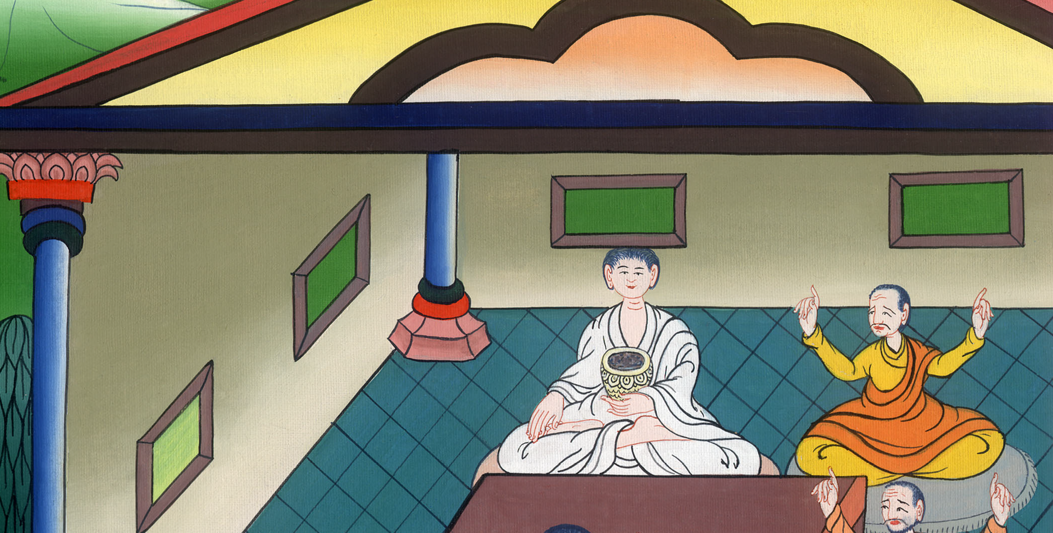
Luke 11:37

Slide 7
38When the Pharisee saw it, he marveled that he had not first washed himself before dinner.

Slide 8
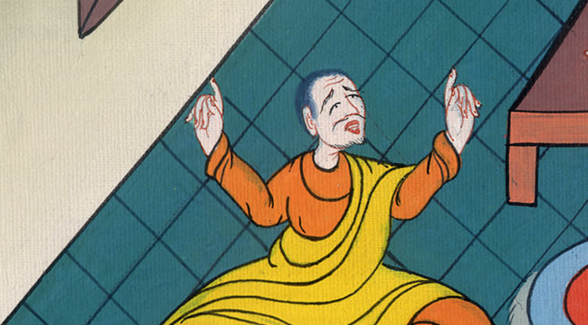
Luke 11:38

Slide 9
39The Lord said to him, “Now you Pharisees cleanse the outside of the cup and of the platter, but your inward part is full of extortion and wickedness.

Slide 10
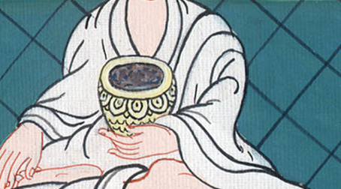
Luke 11:39

Slide 11
40You foolish ones, didn’t he who made the outside make the inside also? 41But give for gifts to the needy those things which are within, and behold, all things will be clean to you.

Slide 12
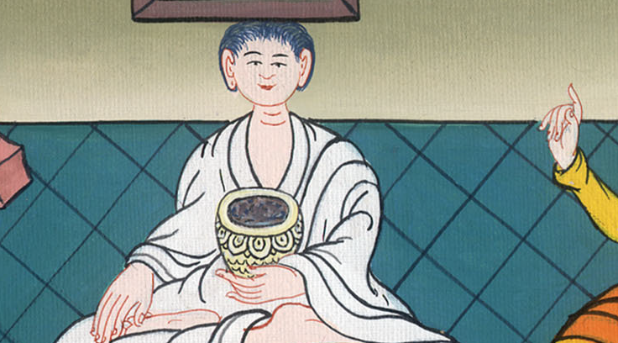
Luke 11:40,41

Slide 13
42But woe to you Pharisees! For you tithe mint and rue and every herb, but you bypass justice and God’s love. You ought to have done these, and not to have left the other undone.

Slide 14
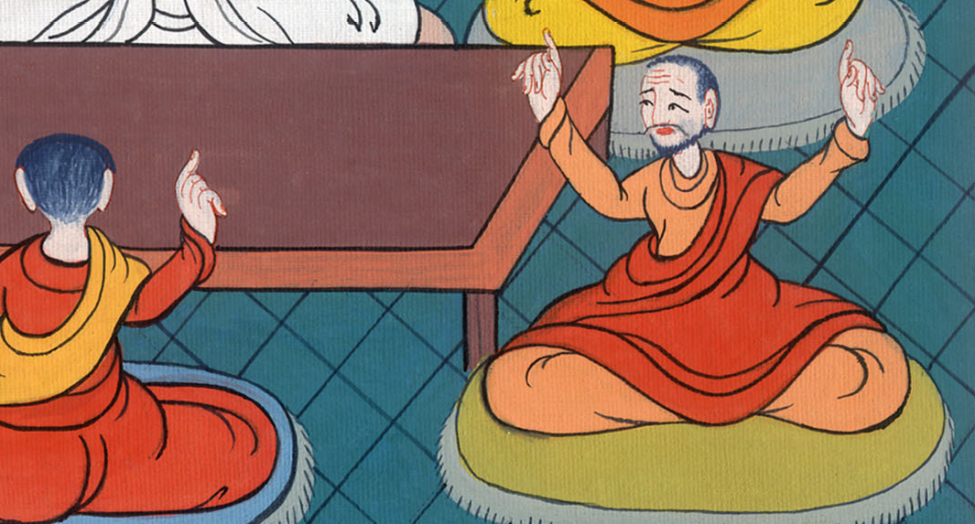
Luke 11:42

Slide 15
43Woe to you Pharisees! For you love the best seats in the synagogues and the greetings in the marketplaces.

Slide 16
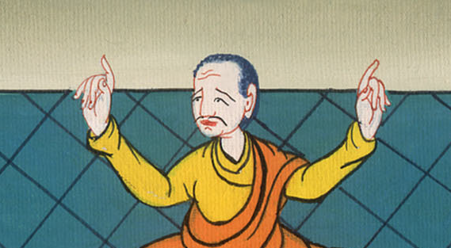
Luke 11:43

Slide 17
45One of the lawyers answered him, “Teacher, in saying this you insult us also.”

Slide 18
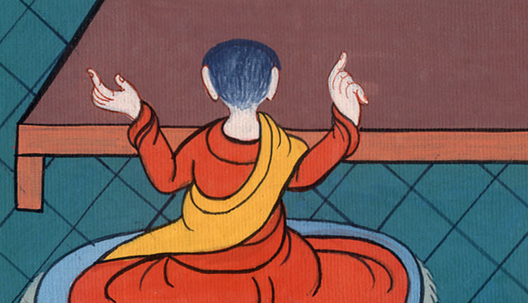
Luke 11:45

Slide 19
46He said, “Woe to you lawyers also! For you load men with burdens that are difficult to carry, and you yourselves won’t even lift one finger to help carry those burdens.

Slide 20
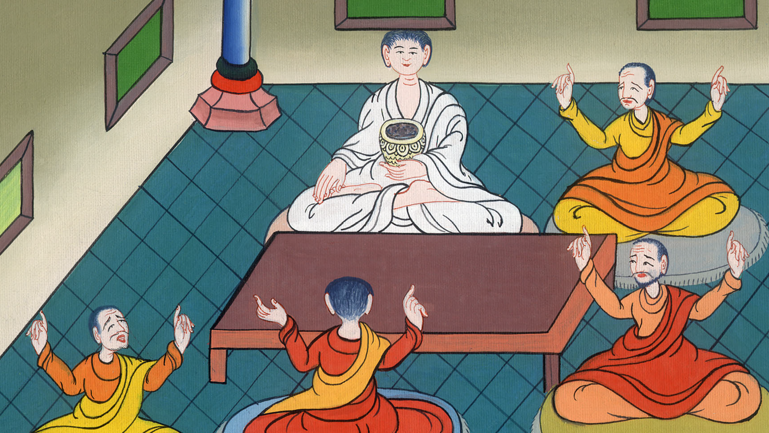
Luke 11:46

Slide 21
52Woe to you lawyers! For you took away the key of knowledge. You didn’t enter in yourselves, and those who were entering in, you hindered.”

Slide 22
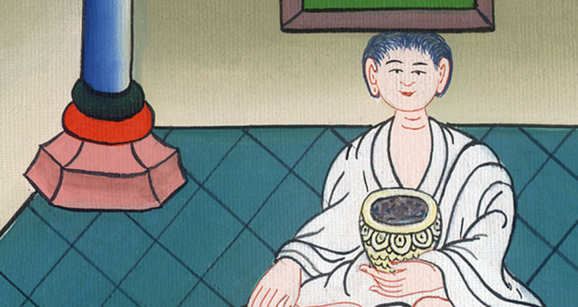
Luke 11:52

Slide 23
53As he said these things to them, the scribes and the Pharisees began to be terribly angry, and to draw many things out of him, 54lying in wait for him, and seeking to catch him in something he might say, that they might accuse him.

Slide 24
Luke 11:53,54

