Slide 1
40-3
This work is licensed under a Creative Commons Attribution 4.0 International License.
Please add this statement to all the videos you create.
English Bible quotes are from the World English Bible US, which is in the public domain.
Notes:
Ch
0 Mary and Martha
1. Mary and Martha - Luke 10:38-42 (Left Top)
2. Pharisees and Lawyers accused - Luke 11:37-54 (Right Top)
3. Crippled Woman healed - Luke 13:10-17 (Right Center)
4. The ten lepers - Luke 17:11-19 (Bottom)
5. Jesus welcomes the children - Matt 19:13-15; Mark 10:13-16; Luke 18:15-17
(Left Center)

Slide 2
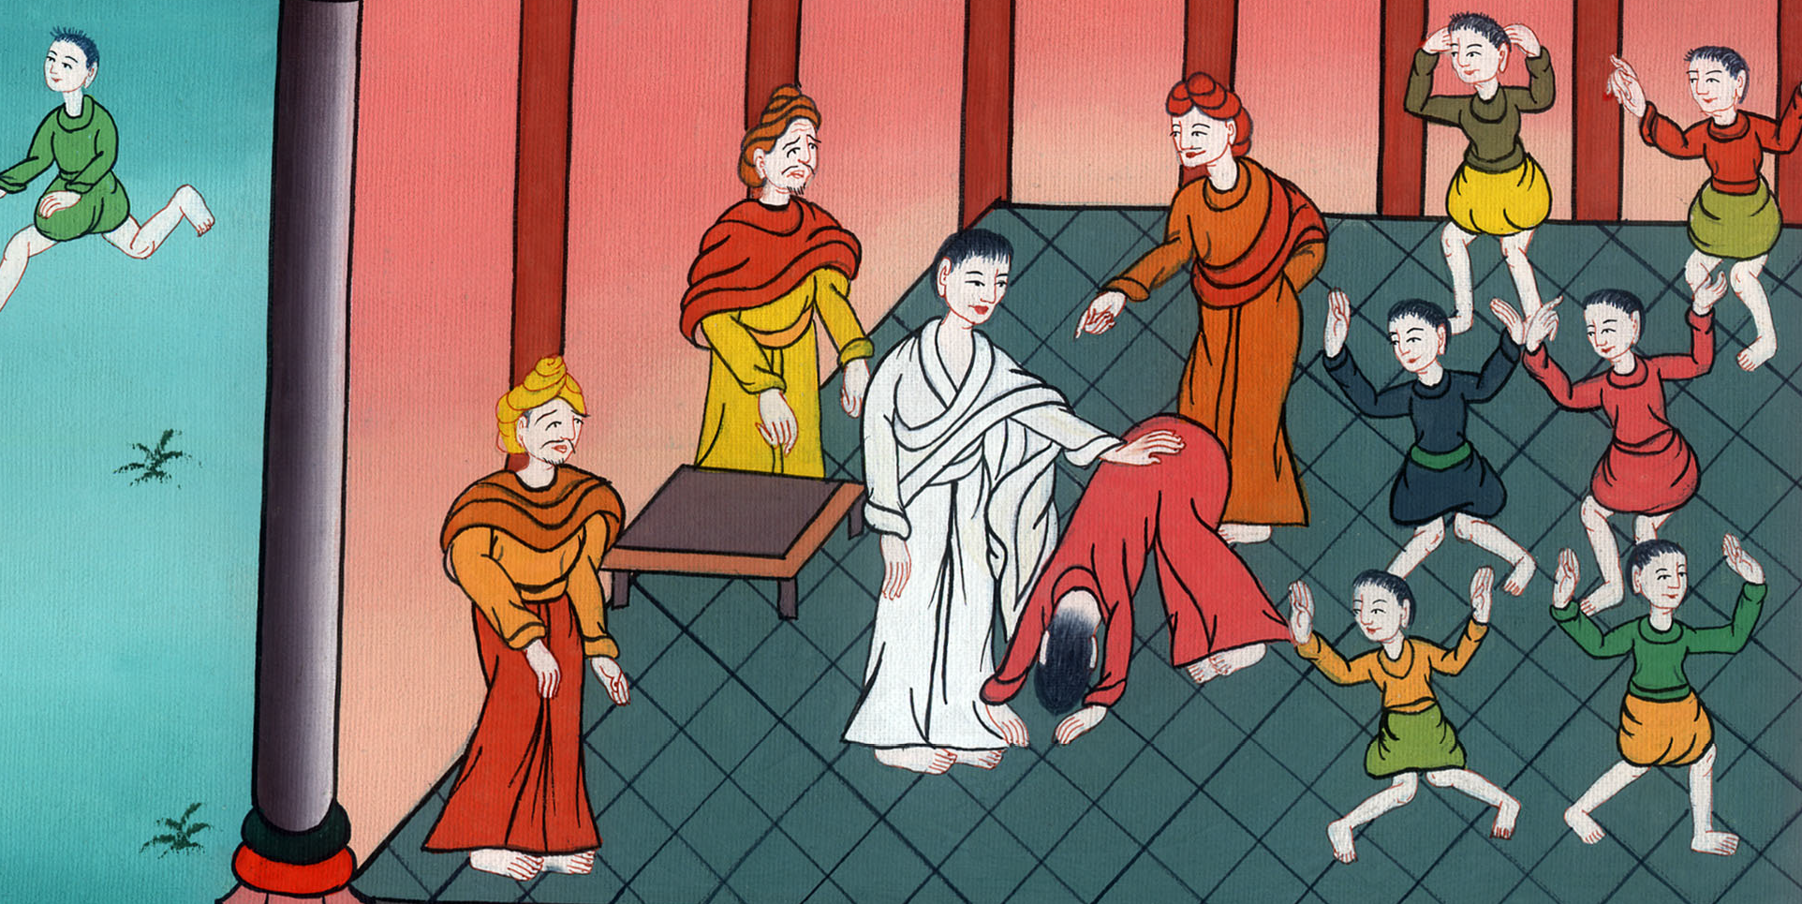
Crippled Woman healed –
Luke 13:10-17

Slide 3
Crippled Woman healed - Luke 13:10-17

Slide 4
Crippled Woman healed –
Luke 13:10-17

Slide 5
10(Jesus) was teaching in one of the synagogues on the Sabbath day.

Slide 6
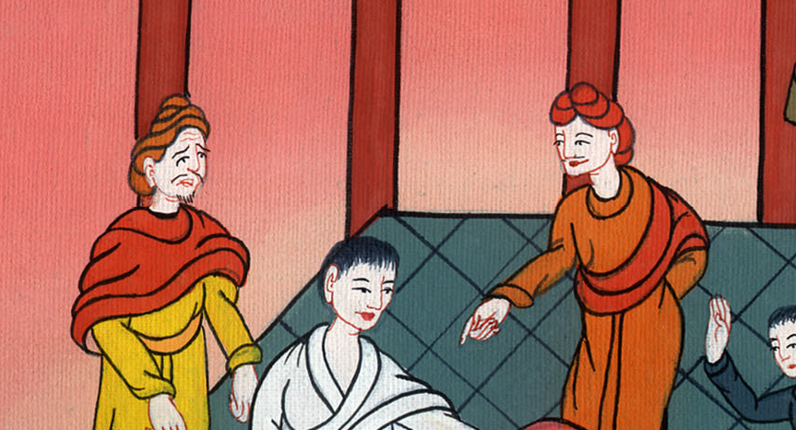
Luke 13:10

Slide 7
11Behold, there was a woman who had a spirit of infirmity eighteen years. She was bent over and could in no way straighten herself up.

Slide 8
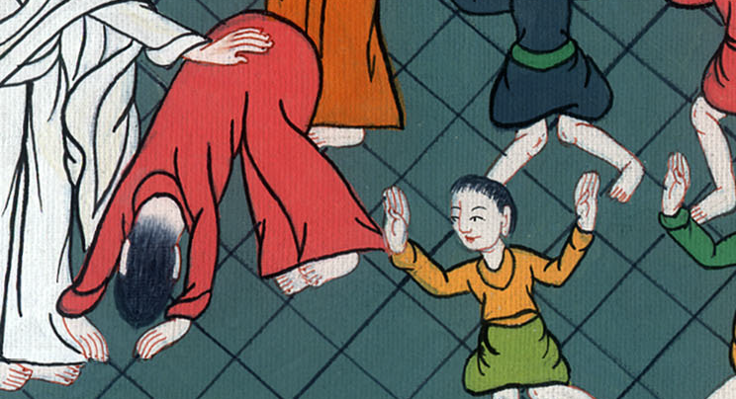
Luke 13:11

Slide 9
12When Jesus saw her, he called her and said to her, “Woman, you are freed from your infirmity.”

Slide 10
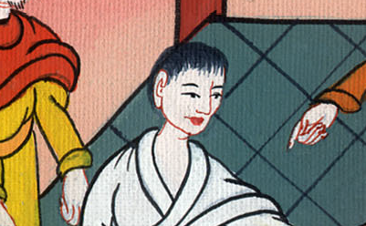
Luke 13:12

Slide 11
13He laid his hands on her, and immediately she stood up straight and glorified God.

Slide 12
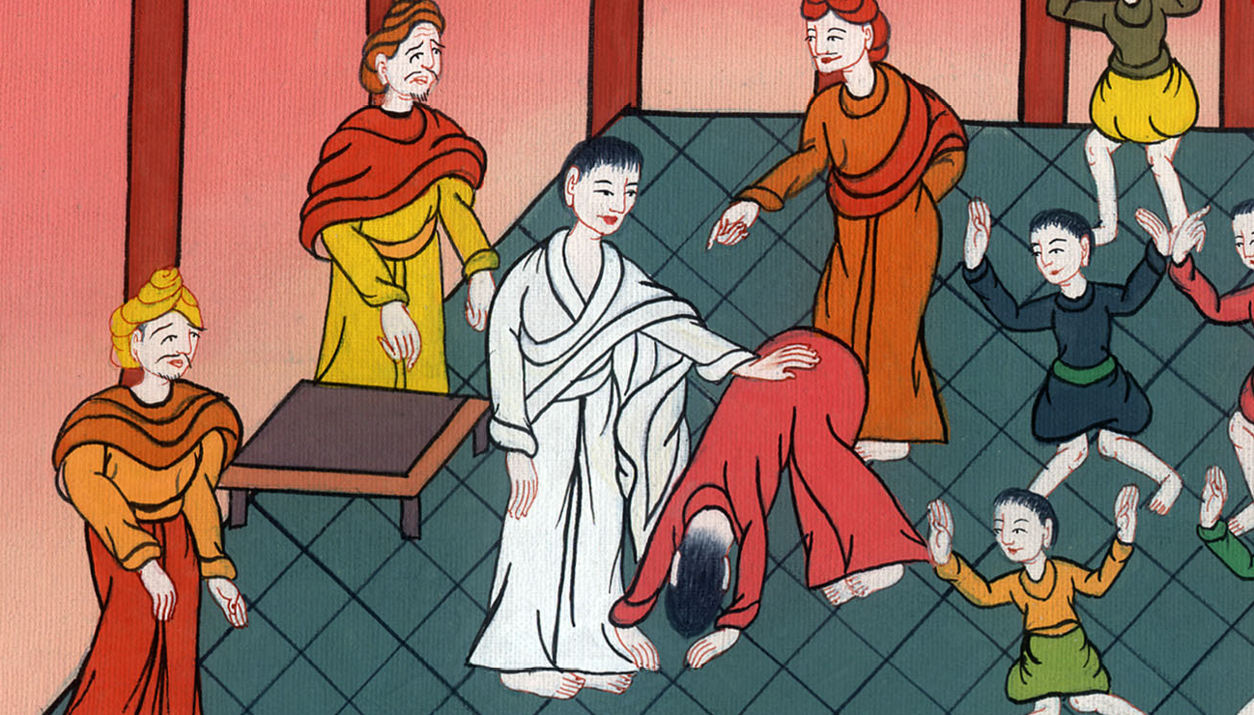
Luke 13:13

Slide 13
14The ruler of the synagogue, being indignant because Jesus had healed on the Sabbath, said to the multitude, “There are six days in which men ought to work. Therefore come on those days and be healed, and not on the Sabbath day!”

Slide 14
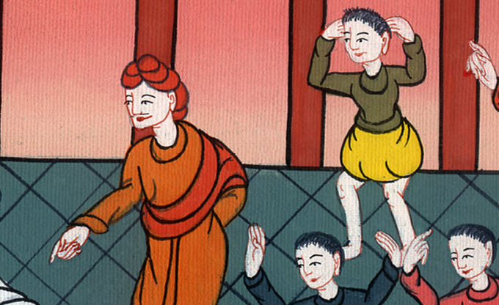
Luke 13:14

Slide 15
15Therefore the Lord answered him, “You hypocrites! Doesn’t each one of you free his ox or his donkey from the stall on the Sabbath and lead him away to water?

Slide 16
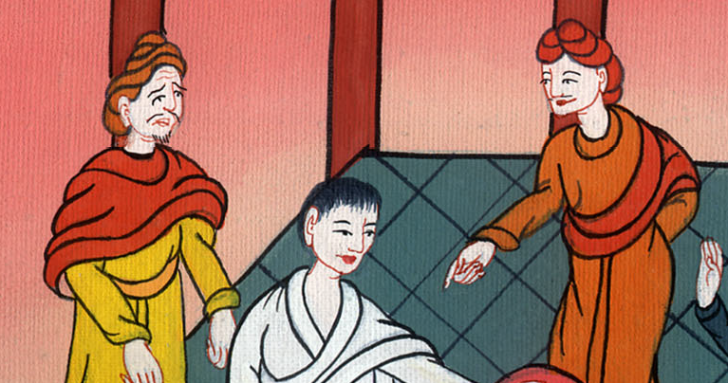
Luke 13:15

Slide 17
16Ought not this woman, being a daughter of Abraham whom Satan had bound eighteen long years, be freed from this bondage on the Sabbath day?”

Slide 18
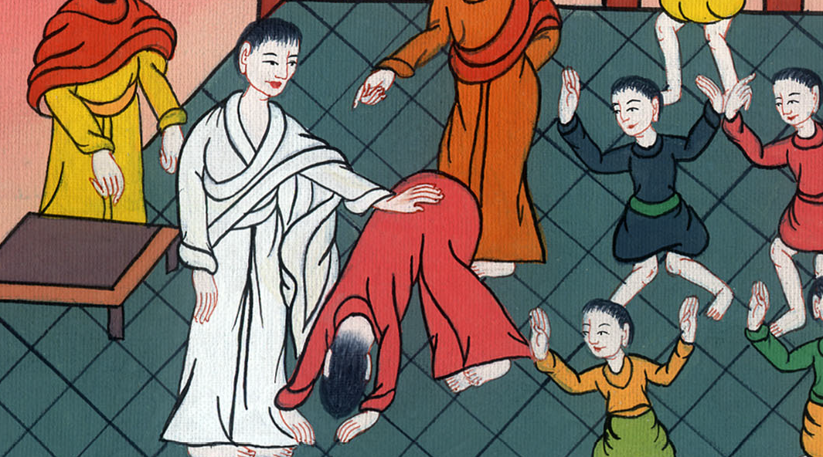
Luke 13:16

Slide 19
17As he said these things, all his adversaries were disappointed; and all the multitude rejoiced for all the glorious things that were done by him.

Slide 20
Luke 13:17

