Slide 1
40-4
This work is licensed under a Creative Commons Attribution 4.0 International License.
Please add this statement to all the videos you create.
English Bible quotes are from the World English Bible US, which is in the public domain.
Notes:
Ch
40 Mary and Martha
1. Mary and Martha - Luke 10:38-42 (Left Top)
2. Pharisees and Lawyers accused - Luke 11:37-54 (Right Top)
3. Crippled Woman healed - Luke 13:10-17 (Right Center)
4. The ten lepers - Luke 17:11-19 (Bottom)
5. Jesus welcomes the children - Matt 19:13-15; Mark 10:13-16; Luke 18:15-17
(Left Center)

Slide 2
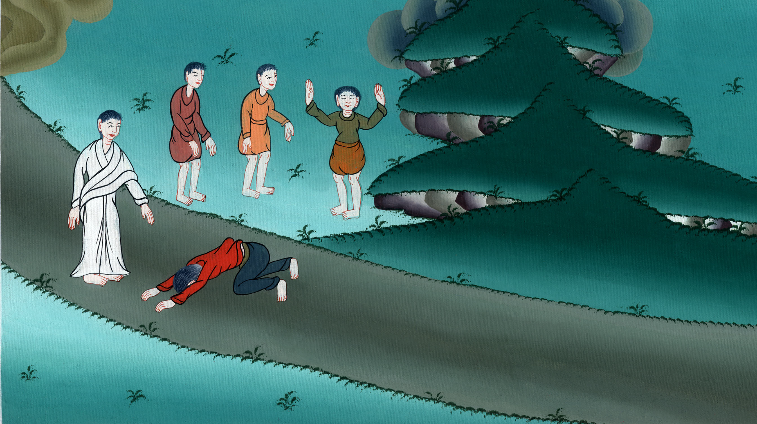
The ten lepers - Luke 17:11-19

Slide 3
The ten lepers - Luke 17:11-19

Slide 4
The ten lepers - Luke 17:11-19

Slide 5
11As he was on his way to Jerusalem, he was passing along the borders of Samaria and Galilee.

Slide 6
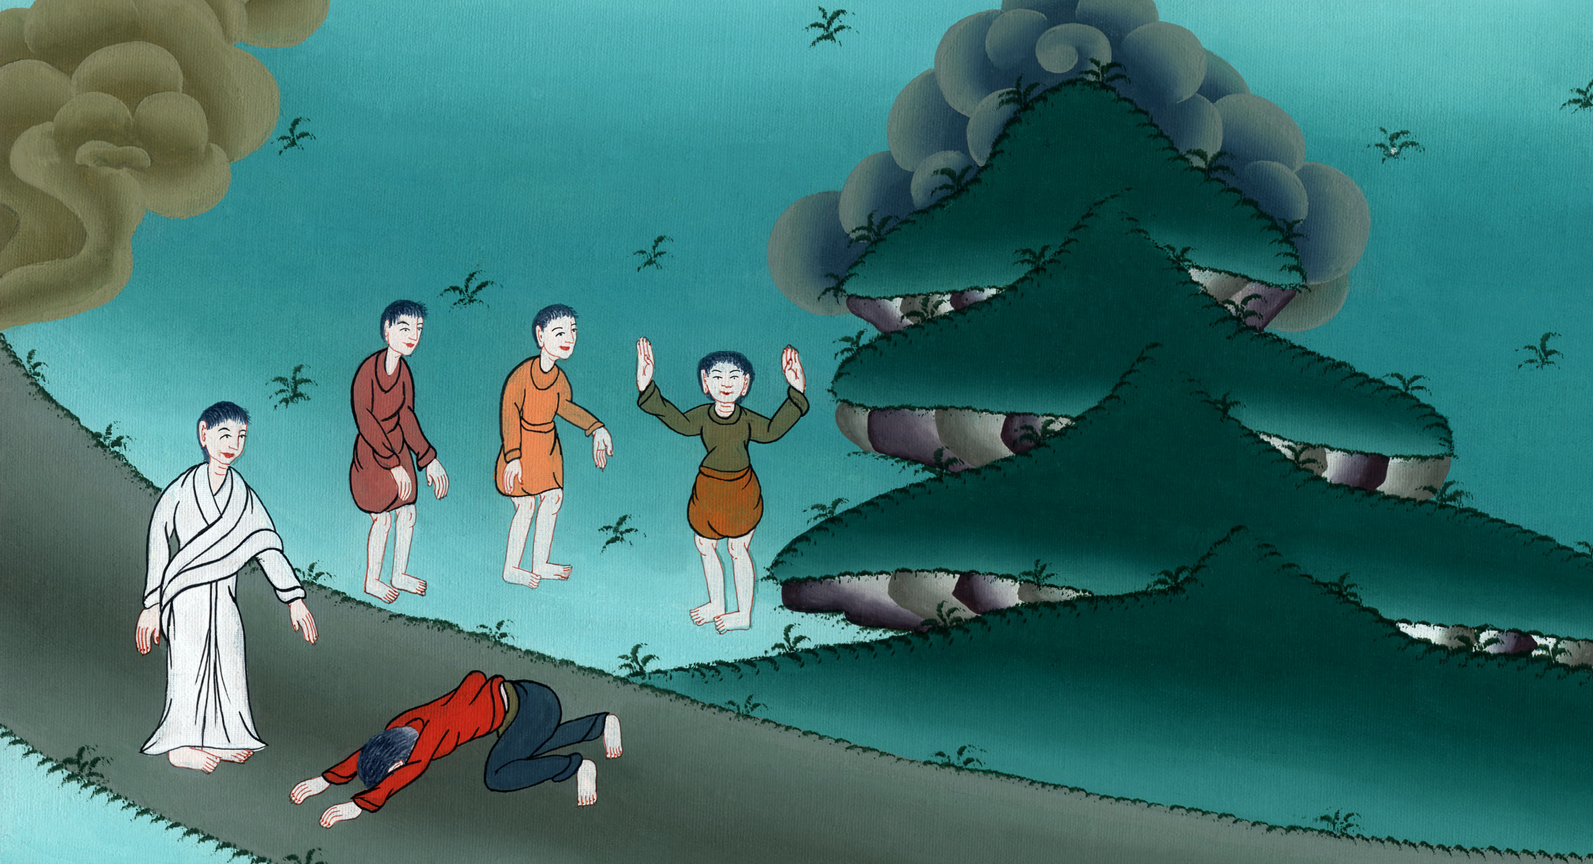
Luke 17:11

Slide 7
12As he entered into a certain village, ten men who were lepers met him, who stood at a distance.

Slide 8
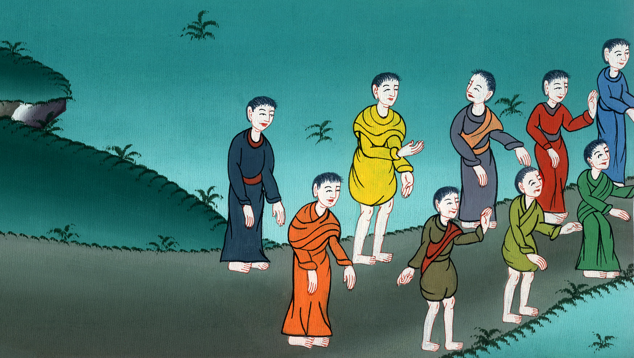
Luke 17:12

Slide 9
13They lifted up their voices, saying, “Jesus, Master, have mercy on us!”

Slide 10
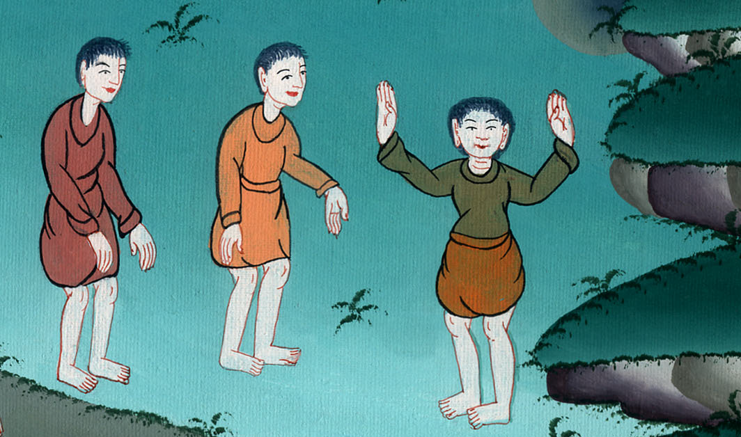
Luke 17:13

Slide 11
14When he saw them, he said to them, “Go and show yourselves to the priests.” As they went, they were cleansed.

Slide 12
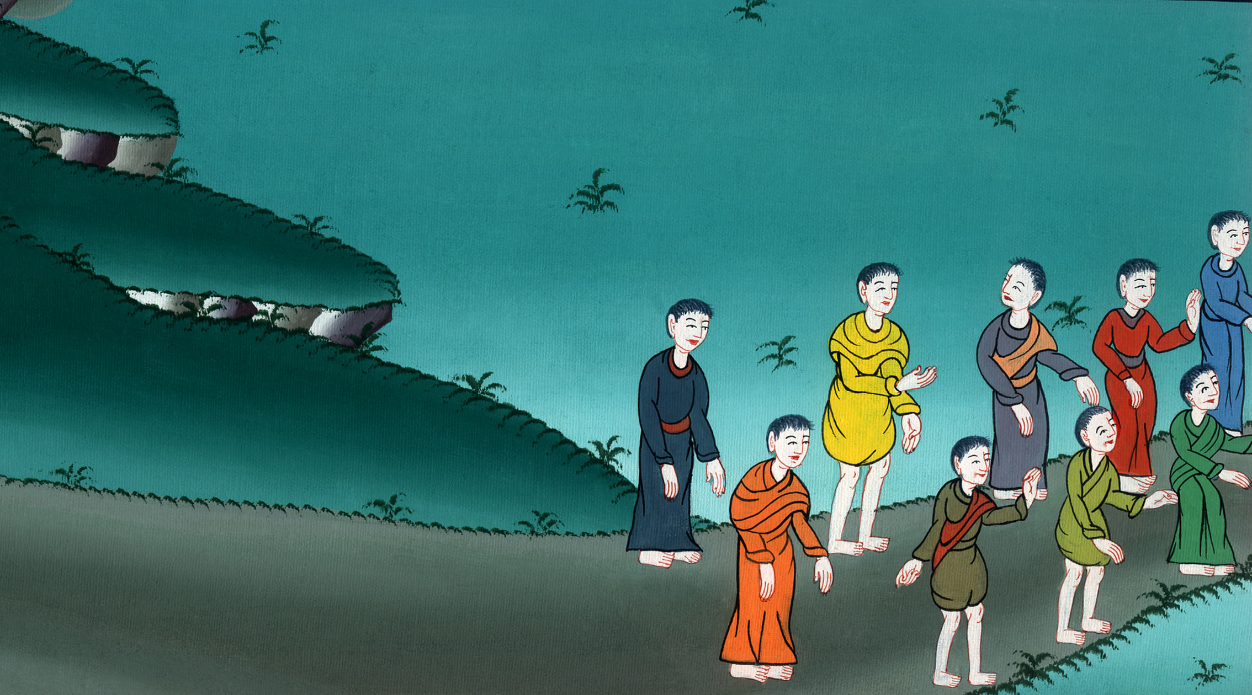
Luke 17:14

Slide 13
15One of them, when he saw that he was healed, turned back, glorifying God with a loud voice. 16He fell on his face at Jesus’ feet, giving him thanks; and he was a Samaritan.

Slide 14
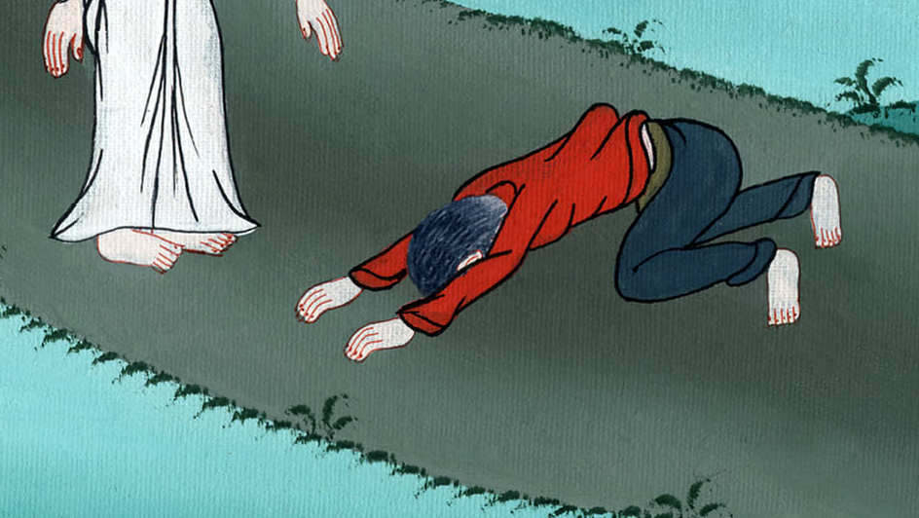
Luke 17:15,16

Slide 15
17Jesus answered, “Weren’t the ten cleansed? But where are the nine? 18Were there none found who returned to give glory to God, except this foreigner?”

Slide 16
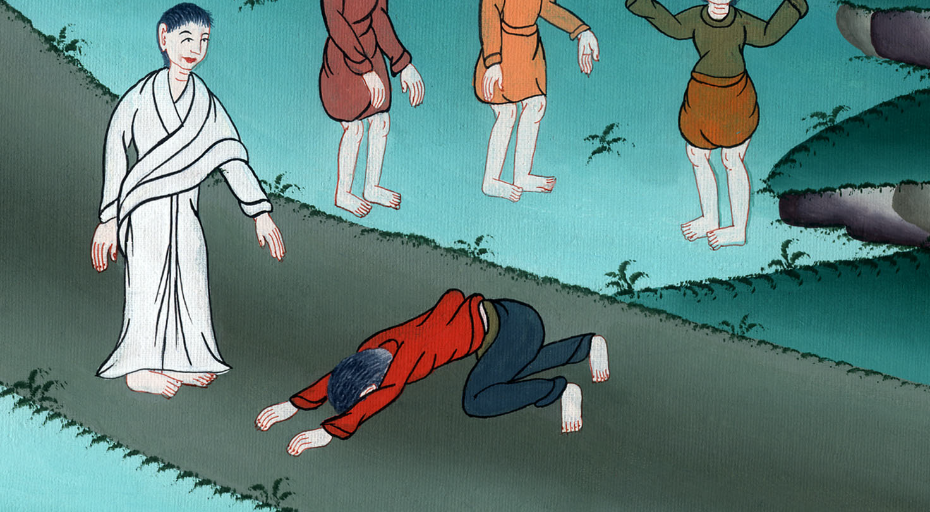
Luke 17:17,18

Slide 17
19Then he said to him, “Get up, and go your way. Your faith has healed you.”

Slide 18
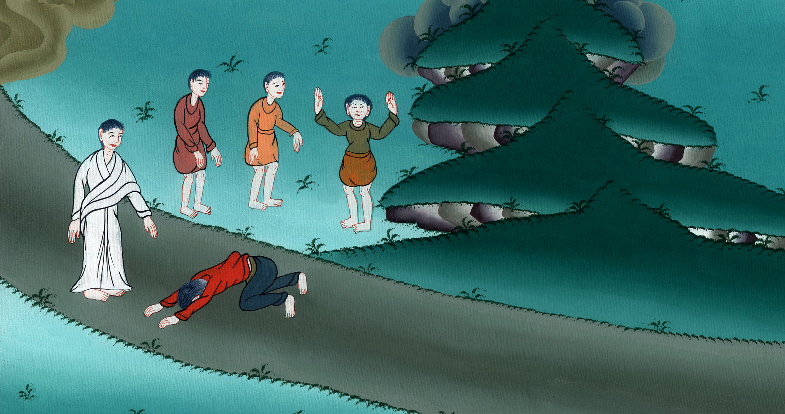
Luke 17:19

Slide 19
matt 1913Then little children were brought to him that he should lay his hands on them and pray; and the disciples rebuked them.

Slide 20
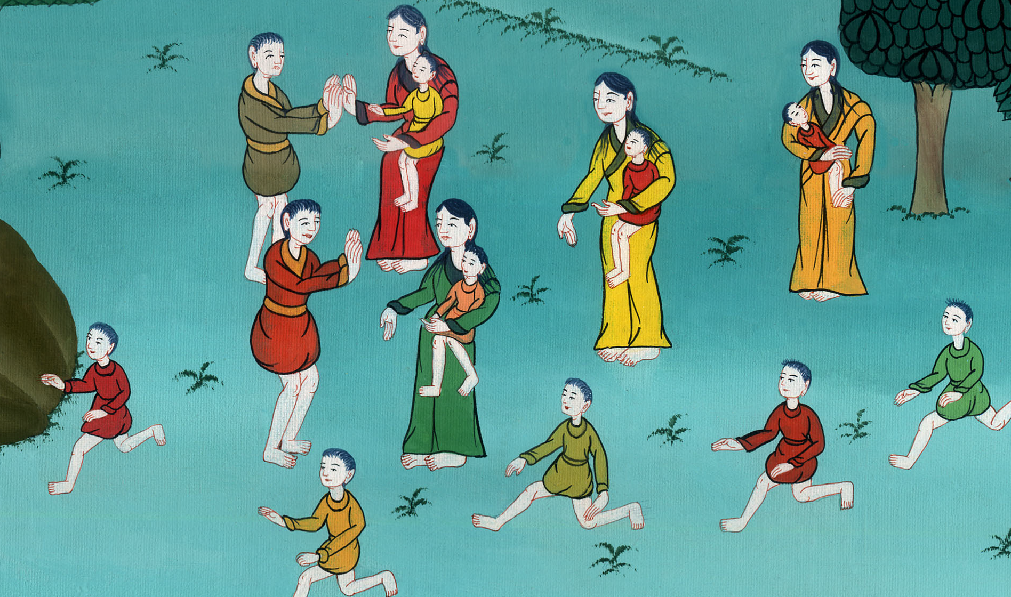
Matthew 19:13

Slide 21
14But Jesus said, “Allow the little children, and don’t forbid them to come to me; for the Kingdom of Heaven belongs to ones like these.”

Slide 22
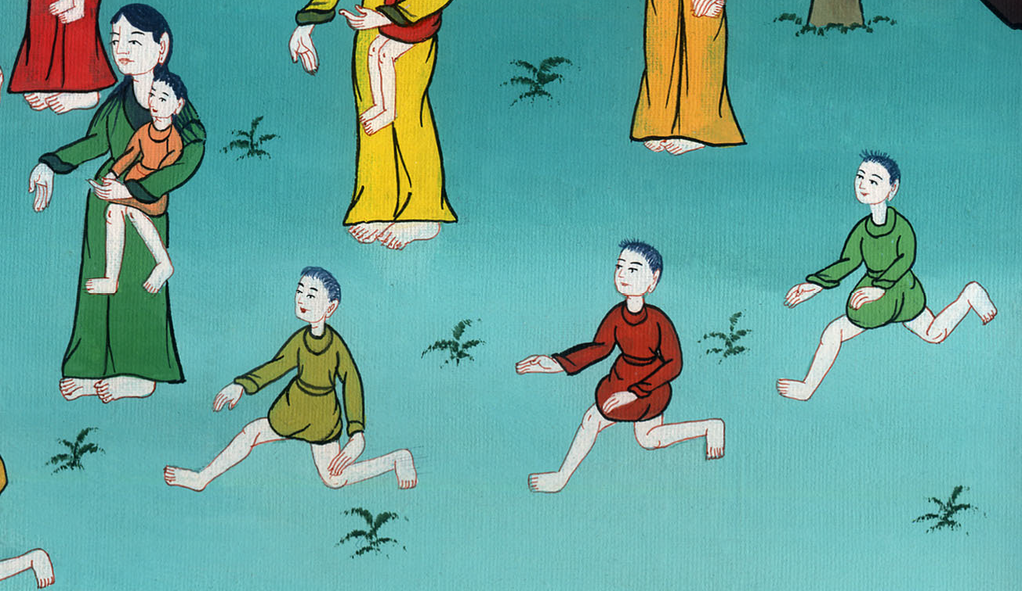
Matthew 19:14

Slide 23
Mark 10:15Most certainly I tell you, whoever will not receive God’s Kingdom like a little child, he will in no way enter into it.”

Slide 24
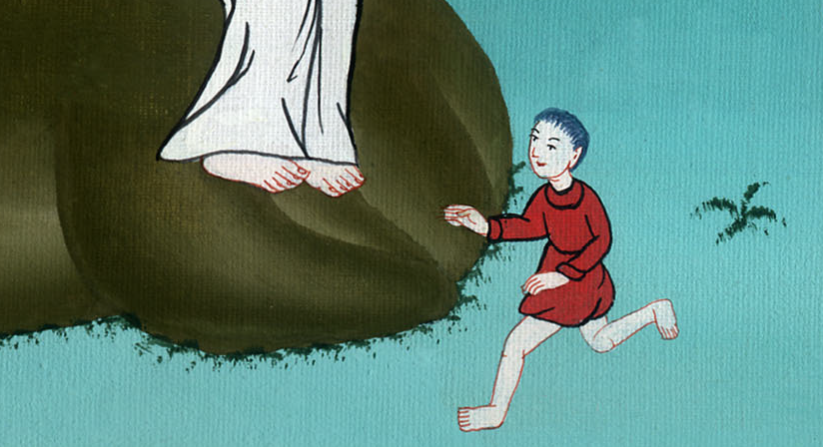
Mark 10:15

Slide 25
16He took them in his arms and blessed them, laying his hands on them.

Slide 26
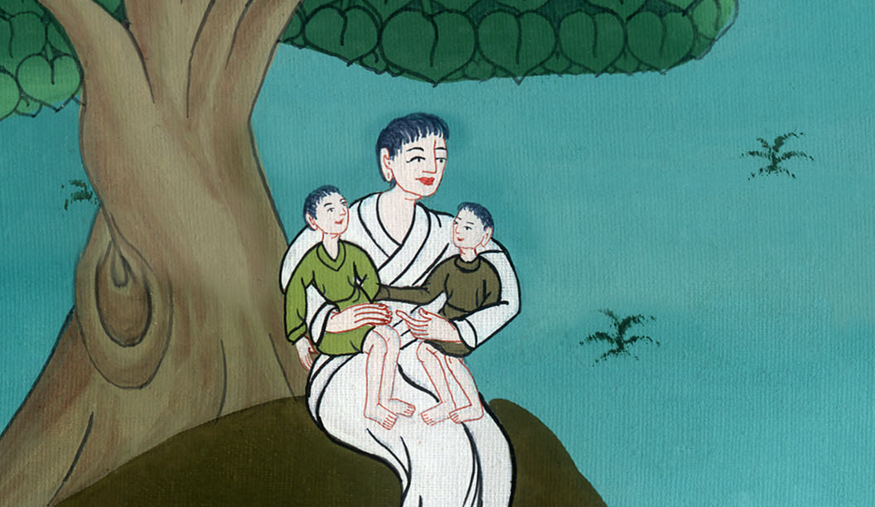
Mark 10:16

