Slide 1
41-1
This work is licensed under a Creative Commons Attribution-ShareAlike 4.0 International License.
Please add this statement to all the videos you create.
English Bible quotes are from the World English Bible US, which is in the public domain.
Notes:
Ch
41 The Rich Young Man
1. The rich young man - Matt 19:16-29; Mark 10:17-30; Luke 18:18-30 (Left Top)
2. James and John make their request - Matt 20:20-28; Mark 10:35-45 (Right Top)
3. Zacchaeus - Luke 19:1-10 (Right Center)
4. Resurrection of Lazarus - John 11:1-44 (Right Bottom)
5. Jesus anointed at Bethany - Matt 26:6-13; Mark 14:3-9; John 12:1-11 (Left
Bottom)
6. Triumphal entry - Matt 21:1-11; Mark 11:1-11; Luke 19:29-44; John 12:12-19
(Left Center)

Slide 2
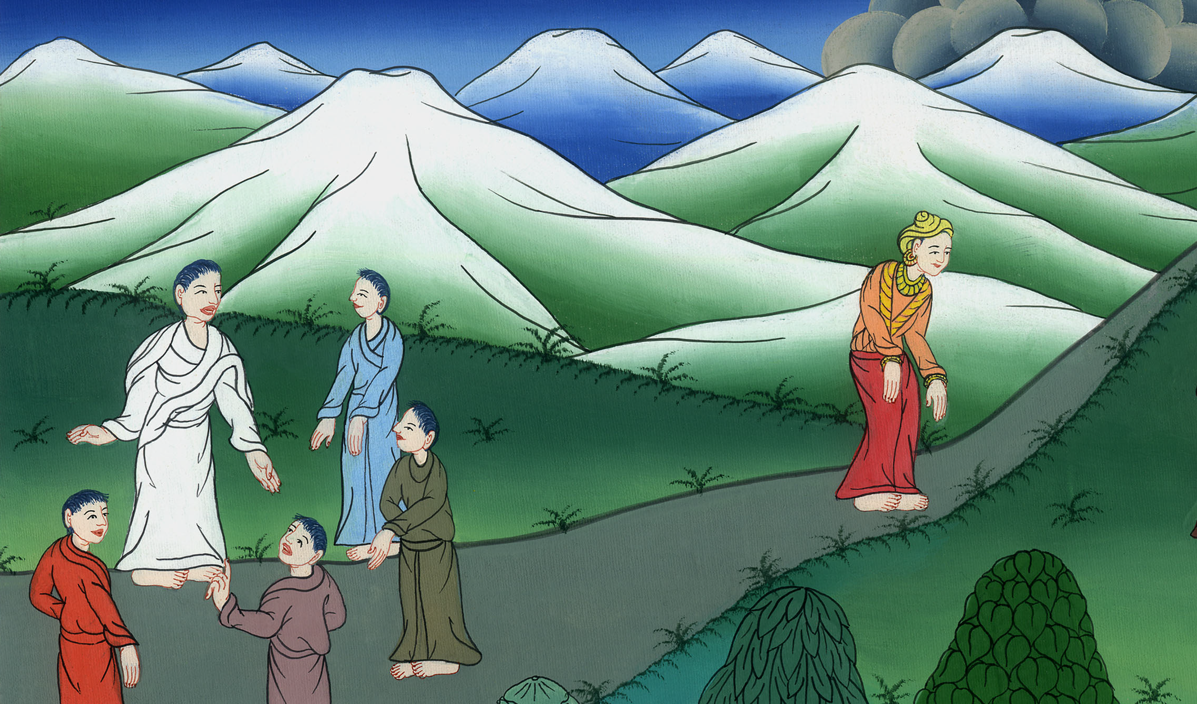
The rich young man Mark 10:17-30

Slide 3
The rich young man Mark 10:17-30

Slide 4
The rich young man Mark 10:17-30

Slide 5
17As he was going out into the way, one ran to him, knelt before him, and asked him, “Good Teacher, what shall I do that I may inherit eternal life?”

Slide 6
Mark 10:17

Slide 7
18Jesus said to him, “Why do you call me good? No one is good except one—God.

Slide 8
Mark 10:18

Slide 9
19You know the commandments: ‘Do not murder,’ ‘Do not commit adultery,’ ‘Do not steal,’ ‘Do not give false testimony,’ ‘Do not defraud,’ ‘Honor your father and mother.’”

Slide 10
Mark 10:19

Slide 11
20He said to him, “Teacher, I have observed all these things from my youth.”

Slide 12
Mark 10:20

Slide 13
21Jesus looking at him loved him, and said to him, “One thing you lack. Go, sell whatever you have and give to the poor, and you will have treasure in heaven; and come, follow me, taking up the cross.”

Slide 14
Mark 10:21

Slide 15
22But his face fell at that saying, and he went away sorrowful, for he was one who had great possessions.
23Jesus looked around and said to his disciples, “How difficult it is for those who have riches to enter into God’s Kingdom!”

Slide 16
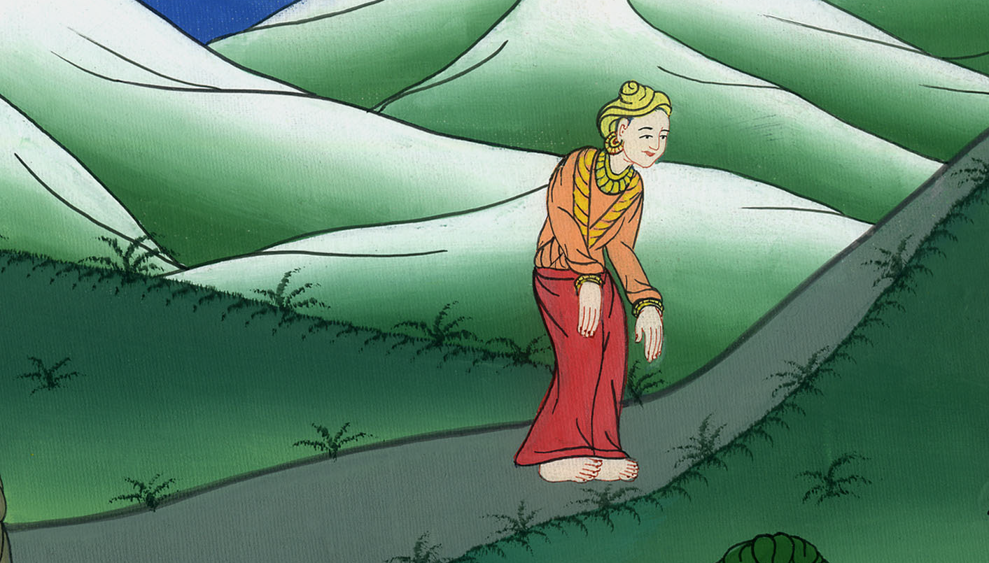
Mark 10:22,23

Slide 17
24The disciples were amazed at his words. But Jesus answered again, “Children, how hard it is for those who trust in riches to enter into God’s Kingdom!

Slide 18
Mark 10:24

Slide 19
25It is easier for a camel to go through a needle’s eye than for a rich man to enter into God’s Kingdom.”

Slide 20
Mark 10:25

Slide 21
26They were exceedingly astonished, saying to him, “Then who can be saved?”
27Jesus, looking at them, said, “With men it is impossible, but not with God, for all things are possible with God.”

Slide 22
Mark 10:26,27

Slide 23
28Peter began to tell him, “Behold, we have left all and have followed you.”

Slide 24
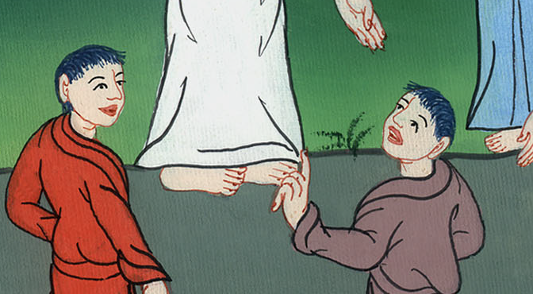
Mark 10:28

Slide 25
29Jesus said, “Most certainly I tell you, there is no one who has left house, or brothers, or sisters, or father, or mother, or wife, or children, or land, for my sake, and for the sake of the Good News,

Slide 26
Mark 10:29

Slide 27
30but he will receive one hundred times more now in this time: houses, brothers, sisters, mothers, children, and land, with persecutions; and in the age to come eternal life.

Slide 28
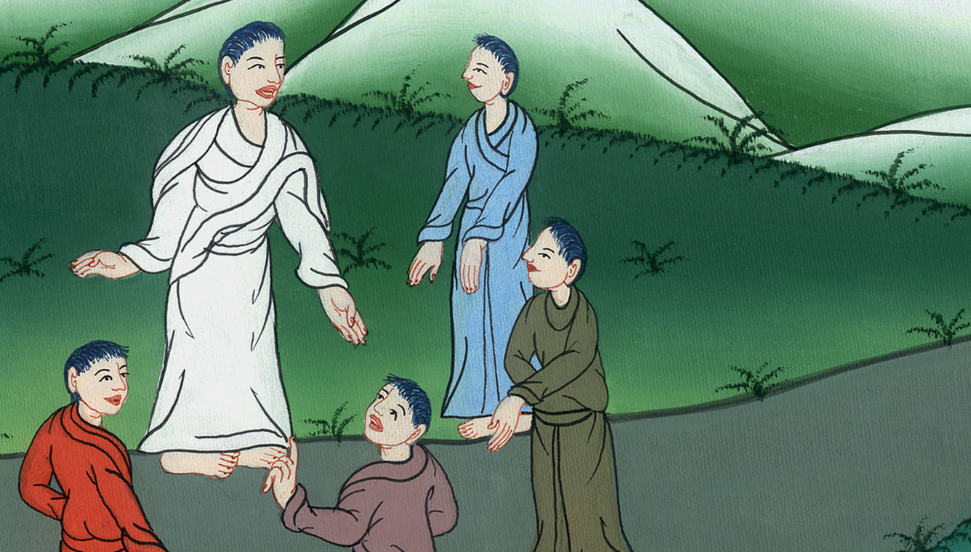
Mark 10:30

Slide 29
31But many who are first will be last, and the last first.”

Slide 30
Mark 10:31

