Slide 1
41-2
This work is licensed under a Creative Commons Attribution-ShareAlike 4.0 International License.
Please add this statement to all the videos you create.
English Bible quotes are from the World English Bible US, which is in the public domain.
Notes:
41 The Rich Young Man
1. The rich young man - Matt 19:16-29; Mark 10:17-30; Luke 18:18-30 (Left Top)
2. James and John make their request - Matt 20:20-28; Mark 10:35-45 (Right Top)
3. Zacchaeus - Luke 19:1-10 (Right Center)
4. Resurrection of Lazarus - John 11:1-44 (Right Bottom)
5. Jesus anointed at Bethany - Matt 26:6-13; Mark 14:3-9; John 12:1-11 (Left
Bottom)
6. Triumphal entry - Matt 21:1-11; Mark 11:1-11; Luke 19:29-44; John 12:12-19
(Left Center)

Slide 2
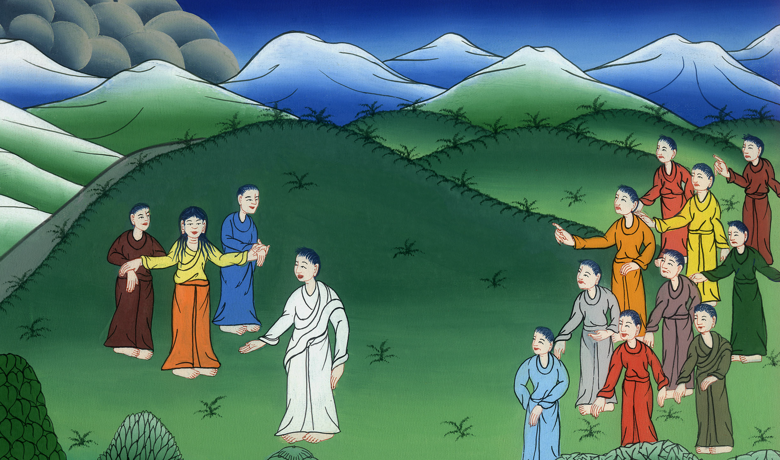
James and John make their request - Matthew 20:20-28; Mark 10:35-45

Slide 3
James and John make their request - Matthew 20:20-28; Mark 10:35-45

Slide 4
James and John make their request - Matthew 20:20-28; Mark 10:35-45

Slide 5
Jesus was teaching 31But many who are first will be last, and the last first.”

Slide 6
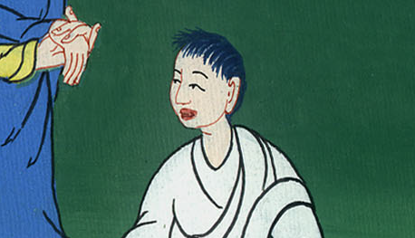
Mark 10:31

Slide 7
(some time later James and John came to Jesus with their mother)Matt 20 20Then the mother of the sons of Zebedee came to him with her sons, kneeling and asking a certain thing of him.

Slide 8
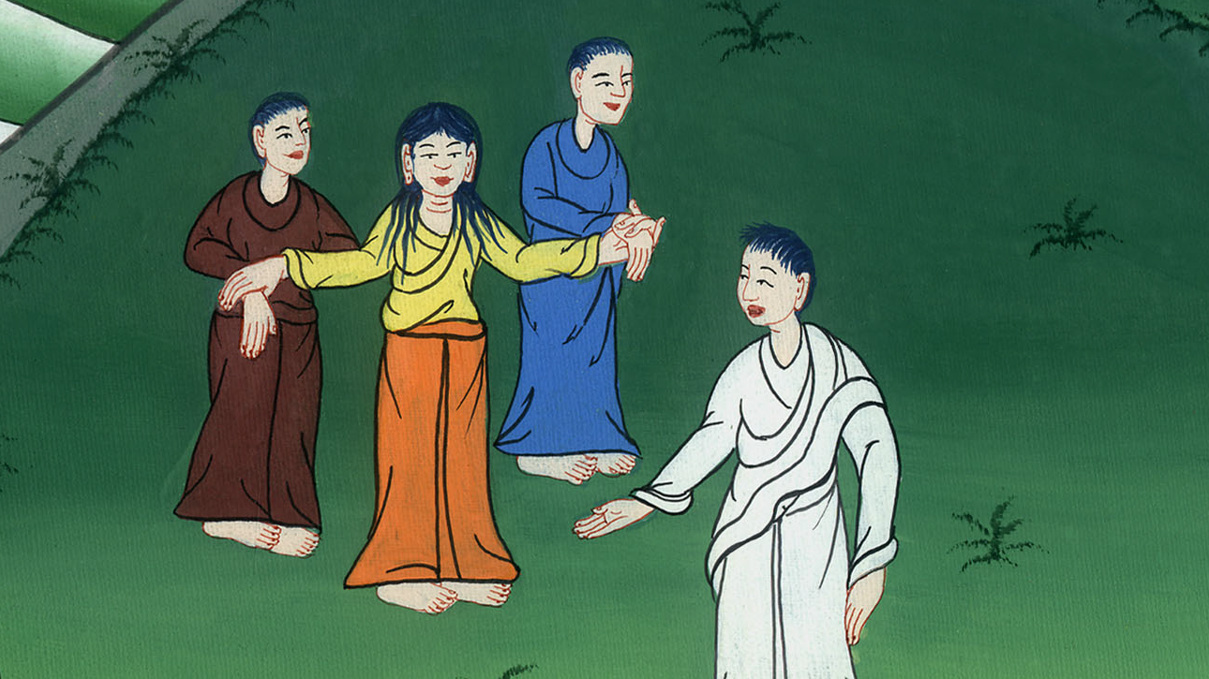
Matthew 20:20

Slide 9
21He said to her, “What do you want?”
She said to him, “Command that these, my two sons, may sit, one on your right hand and one on your left hand, in your Kingdom.”

Slide 10
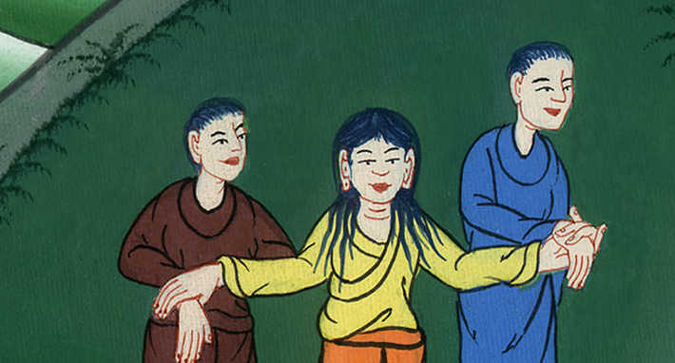
Matthew 20:21

Slide 11
22But Jesus answered, “You don’t know what you are asking. Are you able to drink the cup that I am about to drink, and be baptized with the baptism that I am baptized with?”

Slide 12
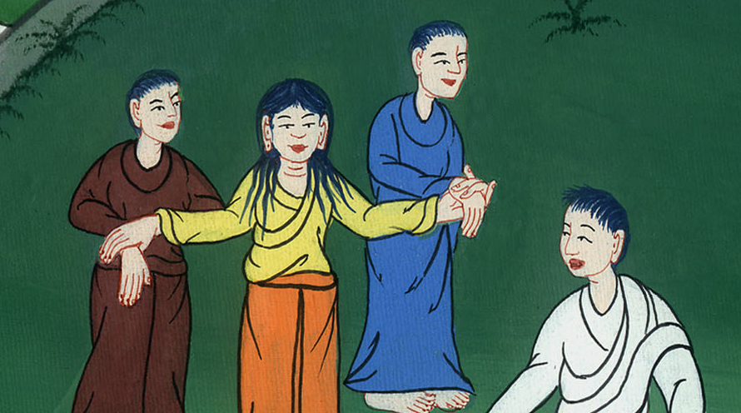
Matthew 20:22

Slide 13
23Jesus said to them, “You will certainly drink from my cup. But it is not for me to say who will sit at my right or left hand. These places belong to those my Father has prepared them for.” They said to him, “We are able.”

Slide 14
Matthew 20:23

Slide 15
Mark 10 41When the ten heard it, they began to be indignant toward James and John.

Slide 16
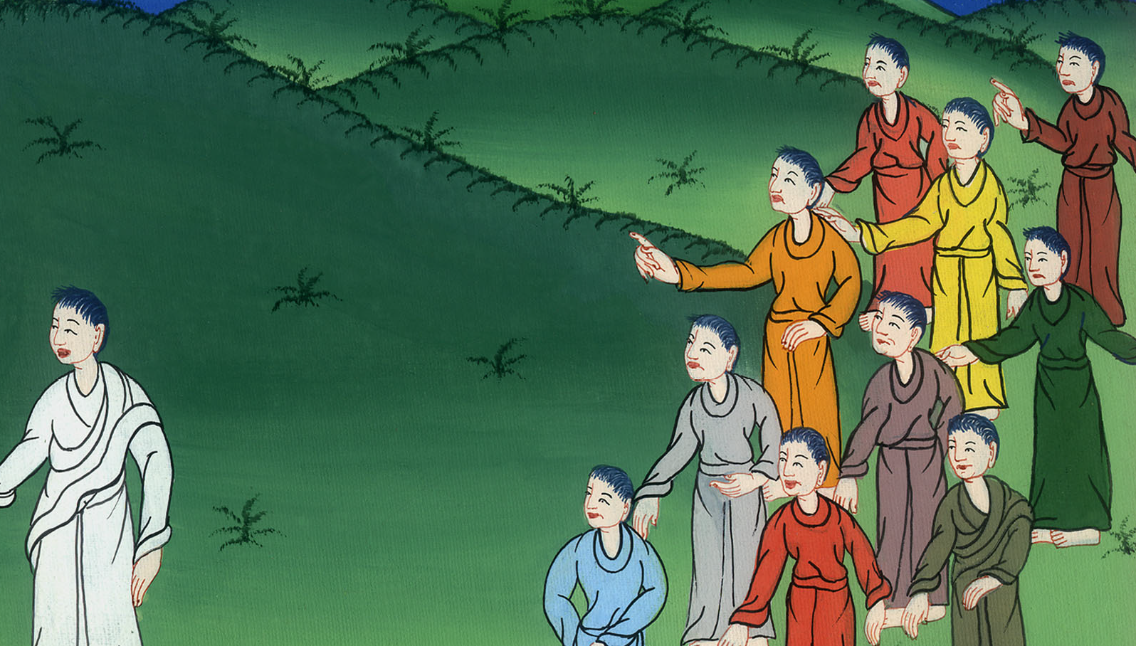
Mark 10:41

Slide 17
42Jesus summoned them and said to them, “You know that they who are recognized as rulers over the nations lord it over them, and their great ones exercise authority over them.

Slide 18
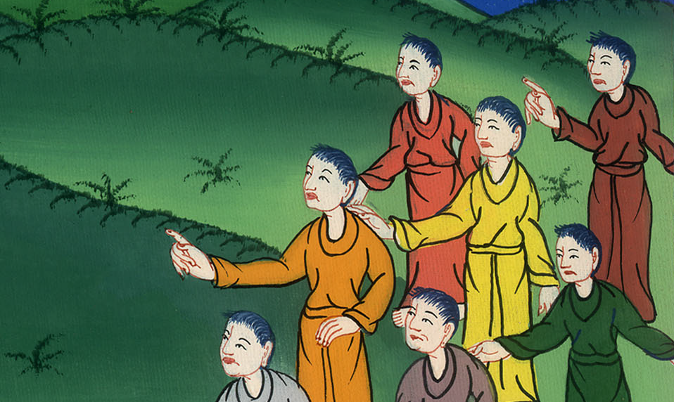
Mark 10:42

Slide 19
43But it shall not be so among you, but whoever wants to become great among you shall be your servant.

Slide 20
Mark 10:43,44

Slide 21
45For the Son of Man also came not to be served but to serve, and to give his life as a ransom for many.”

Slide 22
Mark 10:45

