Slide 1
41-3
This work is licensed under a Creative Commons Attribution-ShareAlike 4.0 International License.
Please add this statement to all the videos you create.
English Bible quotes are from the World English Bible US, which is in the public domain.
Notes:
Ch
41 The Rich Young Man
1. The rich young man - Matt 19:16-29; Mark 10:17-30; Luke 18:18-30 (Left Top)
2. James and John make their request - Matt 20:20-28; Mark 10:35-45 (Right Top)
3. Zacchaeus - Luke 19:1-10 (Right Center)
4. Resurrection of Lazarus - John 11:1-44 (Right Bottom)
5. Jesus anointed at Bethany - Matt 26:6-13; Mark 14:3-9; John 12:1-11 (Left
Bottom)
6. Triumphal entry - Matt 21:1-11; Mark 11:1-11; Luke 19:29-44; John 12:12-19
(Left Center)

Slide 2
Zacchaeus –
Luke 19:1-10

Slide 3
Zacchaeus –
Luke 19:1-10

Slide 4
Zacchaeus –
Luke 19:1-10

Slide 5
1He entered and was passing through Jericho. 2There was a man named Zacchaeus. He was a chief tax collector, and he was rich.

Slide 6
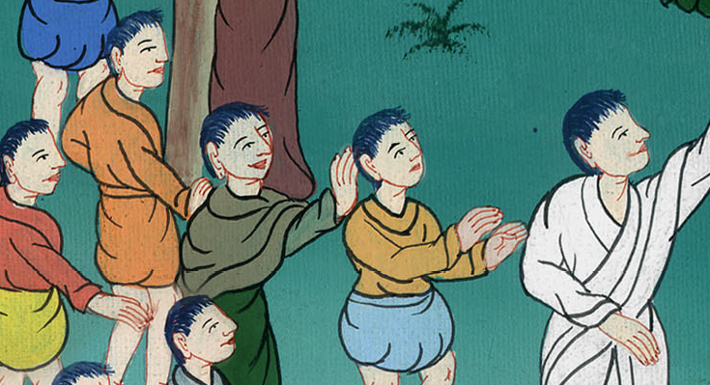
Luke 19:1,2

Slide 7
3He was trying to see who Jesus was, and couldn’t because of the crowd, because he was short.

Slide 8
Luke 19:3

Slide 9
4He ran on ahead and climbed up into a sycamore tree to see him, for he was going to pass that way.

Slide 10
Luke 19:4

Slide 11
5When Jesus came to the place, he looked up and saw him, and said to him, “Zacchaeus, hurry and come down, for today I must stay at your house.” 6He hurried, came down, and received him joyfully.

Slide 12
Luke 19:5,6

Slide 13
7When they saw it, they all murmured, saying, “He has gone in to lodge with a man who is a sinner.”

Slide 14
Luke 19:7

Slide 15
8Zacchaeus stood and said to the Lord, “Behold, Lord, half of my goods I give to the poor. If I have wrongfully exacted anything of anyone, I restore four times as much.”

Slide 16
Luke 19:8

Slide 17
9Jesus said to him, “Today, salvation has come to this house, because he also is a son of Abraham.

Slide 18
Luke 19:9

Slide 19
10For the Son of Man came to seek and to save that which was lost.”

Slide 20
Luke 19:10

