Slide 1
41-4
This work is licensed under a Creative Commons Attribution-ShareAlike 4.0 International License.
Please add this statement to all the videos you create.
English Bible quotes are from the World English Bible US, which is in the public domain.
Notes:
Ch
41 The Rich Young Man
1. The rich young man - Matt 19:16-29; Mark 10:17-30; Luke 18:18-30 (Left Top)
2. James and John make their request - Matt 20:20-28; Mark 10:35-45 (Right Top)
3. Zacchaeus - Luke 19:1-10 (Right Center)
4. Resurrection of Lazarus - John 11:1-44 (Right Bottom)
5. Jesus anointed at Bethany - Matt 26:6-13; Mark 14:3-9; John 12:1-11 (Left
Bottom)
6. Triumphal entry - Matt 21:1-11; Mark 11:1-11; Luke 19:29-44; John 12:12-19
(Left Center)

Slide 2
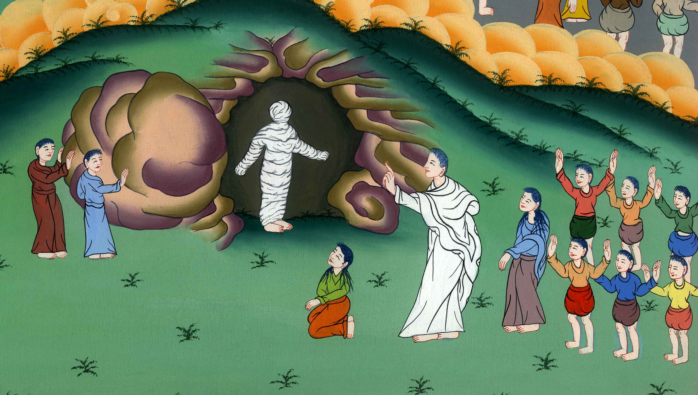
Resurrection of Lazarus –
John 11:1-44

Slide 3
Resurrection of Lazarus - John 11:1-44

Slide 4
Resurrection of Lazarus –
John 11:1-44

Slide 5
1Now a certain man was sick, Lazarus from Bethany, of the village of Mary and her sister, Martha.

Slide 6
John 11:1

Slide 7
2It was that Mary who had anointed the Lord with ointment and wiped his feet with her hair, whose brother Lazarus was sick. 3The sisters therefore sent to him, saying, “Lord, behold, he for whom you have great affection is sick.”

Slide 8
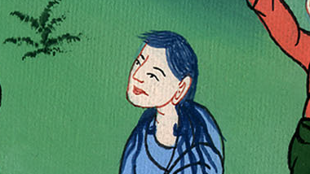
John 11:2,3

Slide 9
4But when Jesus heard it, he said, “This sickness is not to death, but for the glory of God, that God’s Son may be glorified by it.”

Slide 10
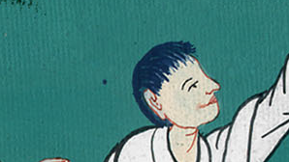
John 11:4

Slide 11
5Now Jesus loved Martha, and her sister, and Lazarus. 6When therefore he heard that he was sick, he stayed two days in the place where he was.

Slide 12
John 11:5,6

Slide 13
7Then after this he said to the disciples, “Let’s go into Judea again.”
8The disciples asked him, “Rabbi, the Jews were just trying to stone you. Are you going there again?”

Slide 14
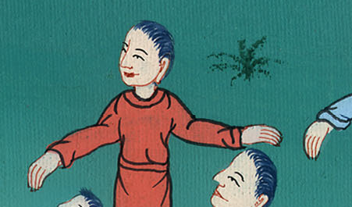
John 11:7,8

Slide 15
9Jesus answered, “Aren’t there twelve hours of daylight? If a man walks in the day, he doesn’t stumble, because he sees the light of this world. 10But if a man walks in the night, he stumbles, because the light isn’t in him.”

Slide 16
John 11:9,10

Slide 17
11He said these things, and after that, he said to them, “Our friend Lazarus has fallen asleep, but I am going so that I may awake him out of sleep.”

Slide 18
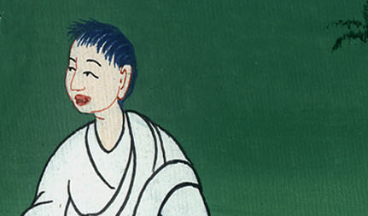
John 11:11

Slide 19
12The disciples therefore said, “Lord, if he has fallen asleep, he will recover.”
13Now Jesus had spoken of his death, but they thought that he spoke of taking rest in sleep.

Slide 20
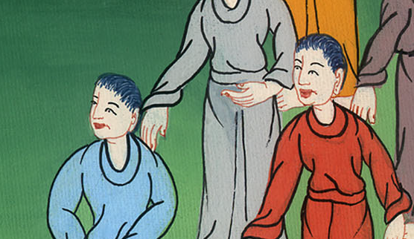
John 11:12,13

Slide 21
14So Jesus said to them plainly then, “Lazarus is dead. 15I am glad for your sakes that I was not there, so that you may believe. Nevertheless, let’s go to him.”

Slide 22
John 11:14,15

Slide 23
17So when Jesus came, he found that he had been in the tomb four days already.

Slide 24
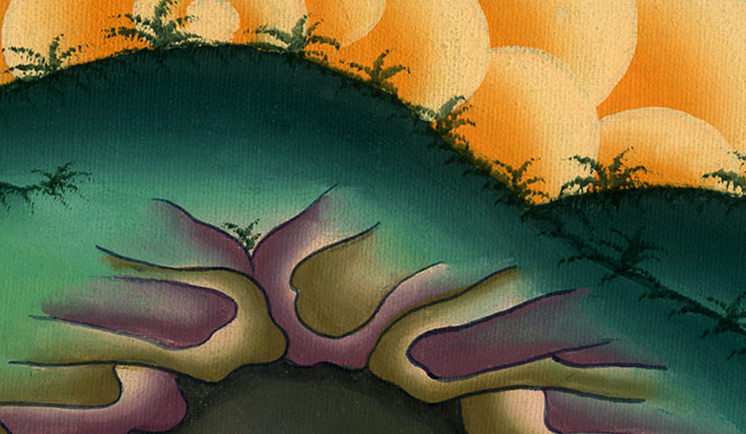
John 11:17

Slide 25
19Many of the Jews had joined the women around Martha and Mary, to console them concerning their brother. 20Then when Martha heard that Jesus was coming, she went and met him, but Mary stayed in the house.

Slide 26
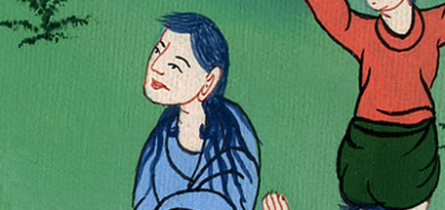
John 11:19,20

Slide 27
21Therefore Martha said to Jesus, “Lord, if you would have been here, my brother wouldn’t have died. 22Even now I know that whatever you ask of God, God will give you.”

Slide 28
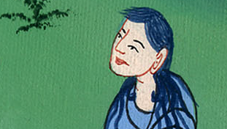
John 11:21,22

Slide 29
23Jesus said to her, “Your brother will rise again.”
24Martha said to him, “I know that he will rise again in the resurrection at the last day.”

Slide 30
John 11:23,24

Slide 31
25Jesus said to her, “I am the resurrection and the life. He who believes in me will still live, even if he dies. 26Whoever lives and believes in me will never die. Do you believe this?”

Slide 32
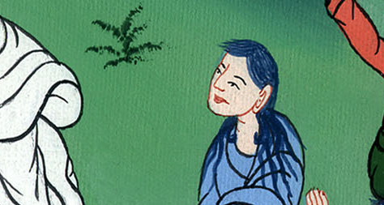
John 11:25,26

Slide 33
27She said to him, “Yes, Lord. I have come to believe that you are the Christ, God’s Son, he who comes into the world.”

Slide 34
John 11:27

Slide 35
28When she had said this, she went away and called Mary, her sister, secretly, saying, “The Teacher is here and is calling you.”

Slide 36
John 11:28

Slide 37
29When she heard this, she arose quickly and went to him. 31Then the Jews who were with her in the house and were consoling her, when they saw Mary, that she rose up quickly and went out, followed her, saying, “She is going to the tomb to weep there.”

Slide 38
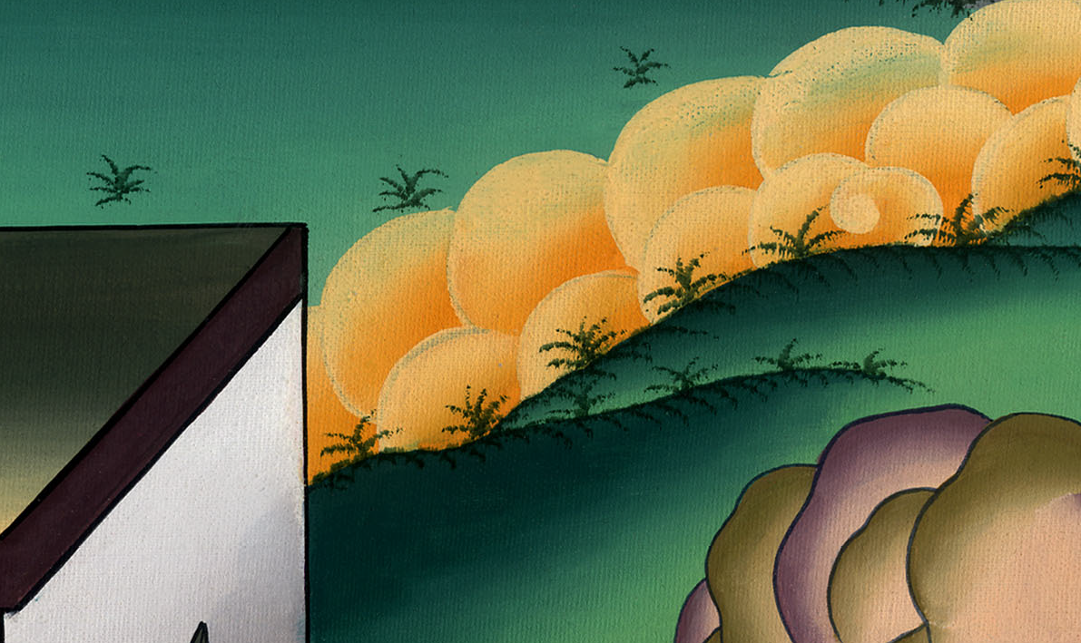
John 11:29,31

Slide 39
32Therefore when Mary came to where Jesus was and saw him, she fell down at his feet, saying to him, “Lord, if you would have been here, my brother wouldn’t have died.”

Slide 40
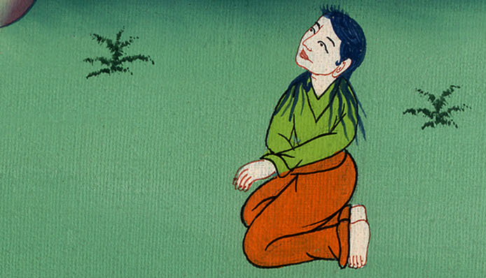
John 11:32

Slide 41
33When Jesus therefore saw her weeping, and the Jews weeping who came with her, he groaned in the spirit and was troubled, 34and said, “Where have you laid him?”
They told him, “Lord, come and see.”

Slide 42
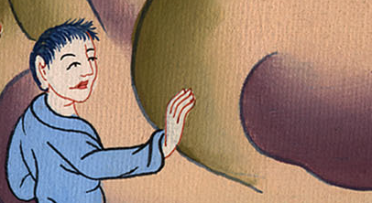
John 11:33,34

Slide 43
35Jesus wept.

Slide 44
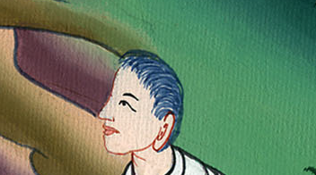
John 11:35

Slide 45
36The Jews therefore said, “See how much affection he had for him!” 37Some of them said, “Couldn’t this man, who opened the eyes of him who was blind, have also kept this man from dying?”

Slide 46
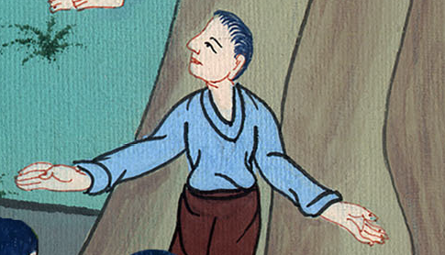
John 11:36,37

Slide 47
38Jesus therefore, again groaning in himself, came to the tomb. Now it was a cave, and a stone lay against it.

Slide 48
John 11:38

Slide 49
39Jesus said, “Take away the stone.”
Martha, the sister of him who was dead, said to him, “Lord, by this time there is a stench, for he has been dead four days.”

Slide 50
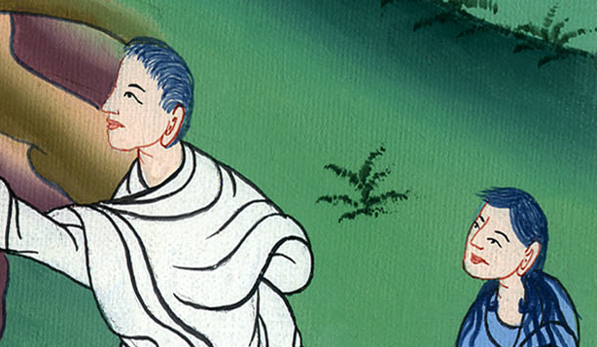
John 11:39

Slide 51
40Jesus said to her, “Didn’t I tell you that if you believed, you would see God’s glory?”

Slide 52
John 11:40

Slide 53
41So they took away the stone from the place where the dead man was lying. Jesus lifted up his eyes and said, “Father, I thank you that you listened to me.

Slide 54
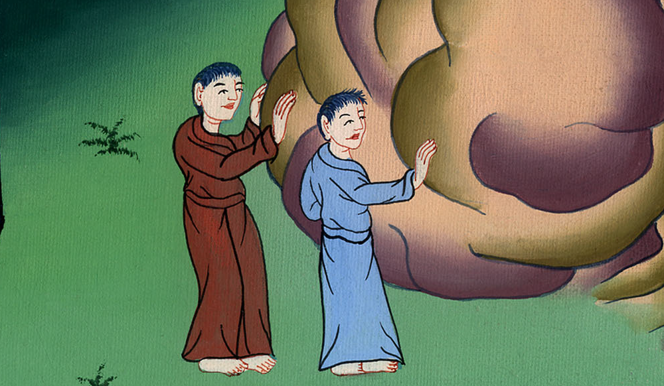
John 11:41

Slide 55
42I know that you always listen to me, but because of the multitude standing around I said this, that they may believe that you sent me.”

Slide 56
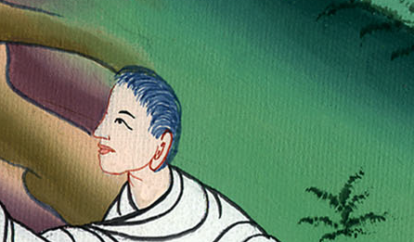
John 11:42

Slide 57
43When he had said this, he cried with a loud voice, “Lazarus, come out!”

Slide 58
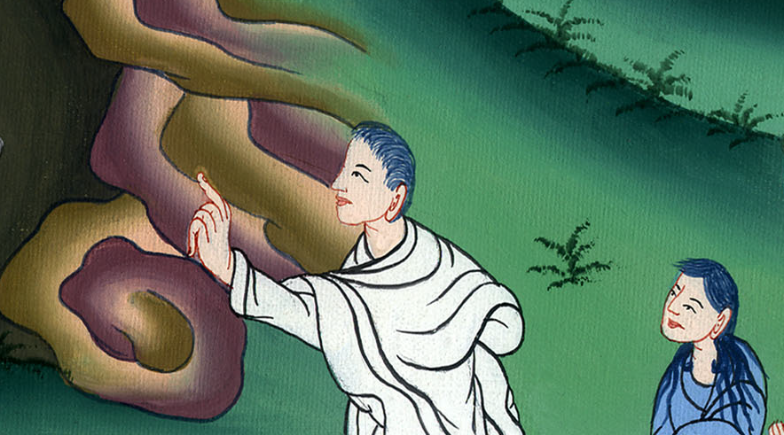
John 11:43

Slide 59
44He who was dead came out, bound hand and foot with wrappings, and his face was wrapped around with a cloth.

Slide 60
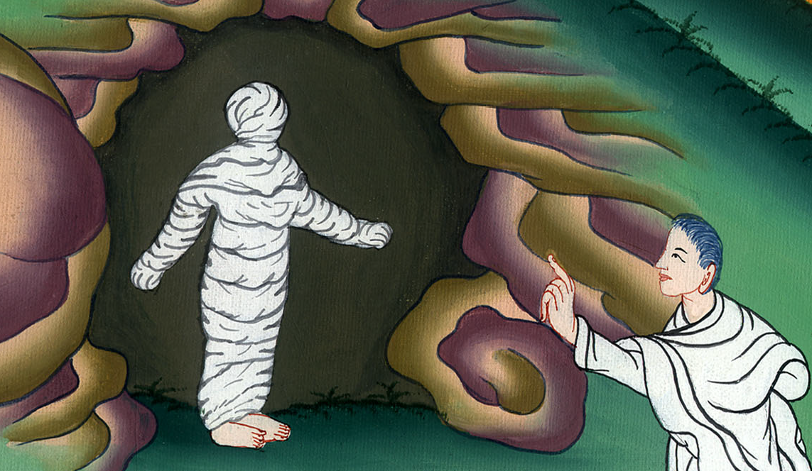
John 11:44

Slide 61
Jesus said to them, “Free him, and let him go.”

Slide 62
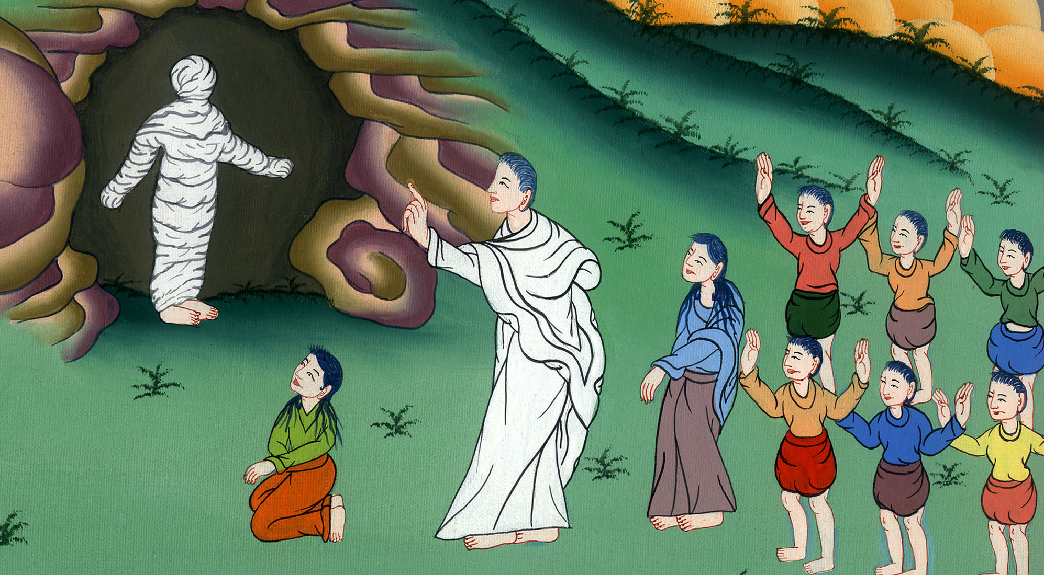
ཡོ་ཧ་ནན། 11:44

