Slide 1
41-5
This work is licensed under a Creative Commons Attribution-ShareAlike 4.0 International License.
Please add this statement to all the videos you create.
English Bible quotes are from the World English Bible US, which is in the public domain.
Notes:
Ch
41 The Rich Young Man
1. The rich young man - Matt 19:16-29; Mark 10:17-30; Luke 18:18-30 (Left Top)
2. James and John make their request - Matt 20:20-28; Mark 10:35-45 (Right Top)
3. Zacchaeus - Luke 19:1-10 (Right Center)
4. Resurrection of Lazarus - John 11:1-44 (Right Bottom)
5. Jesus anointed at Bethany - Matt 26:6-13; Mark 14:3-9; John 12:1-11 (Left
Bottom)
6. Triumphal entry - Matt 21:1-11; Mark 11:1-11; Luke 19:29-44; John 12:12-19
(Left Center)

Slide 2
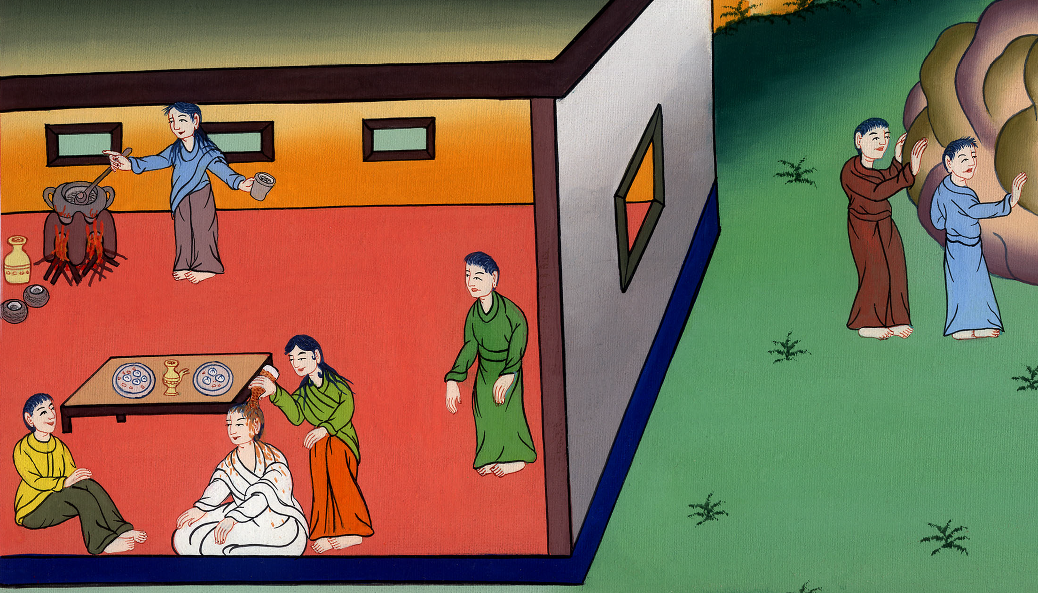
Jesus anointed at Bethany –
John 12:1-11

Slide 3
Jesus anointed at Bethany - John 12:1-11

Slide 4
Jesus anointed at Bethany –
John 12:1-11

Slide 5
1Then, six days before the Passover, Jesus came to Bethany, where Lazarus was, who had been dead, whom he raised from the dead.

Slide 6
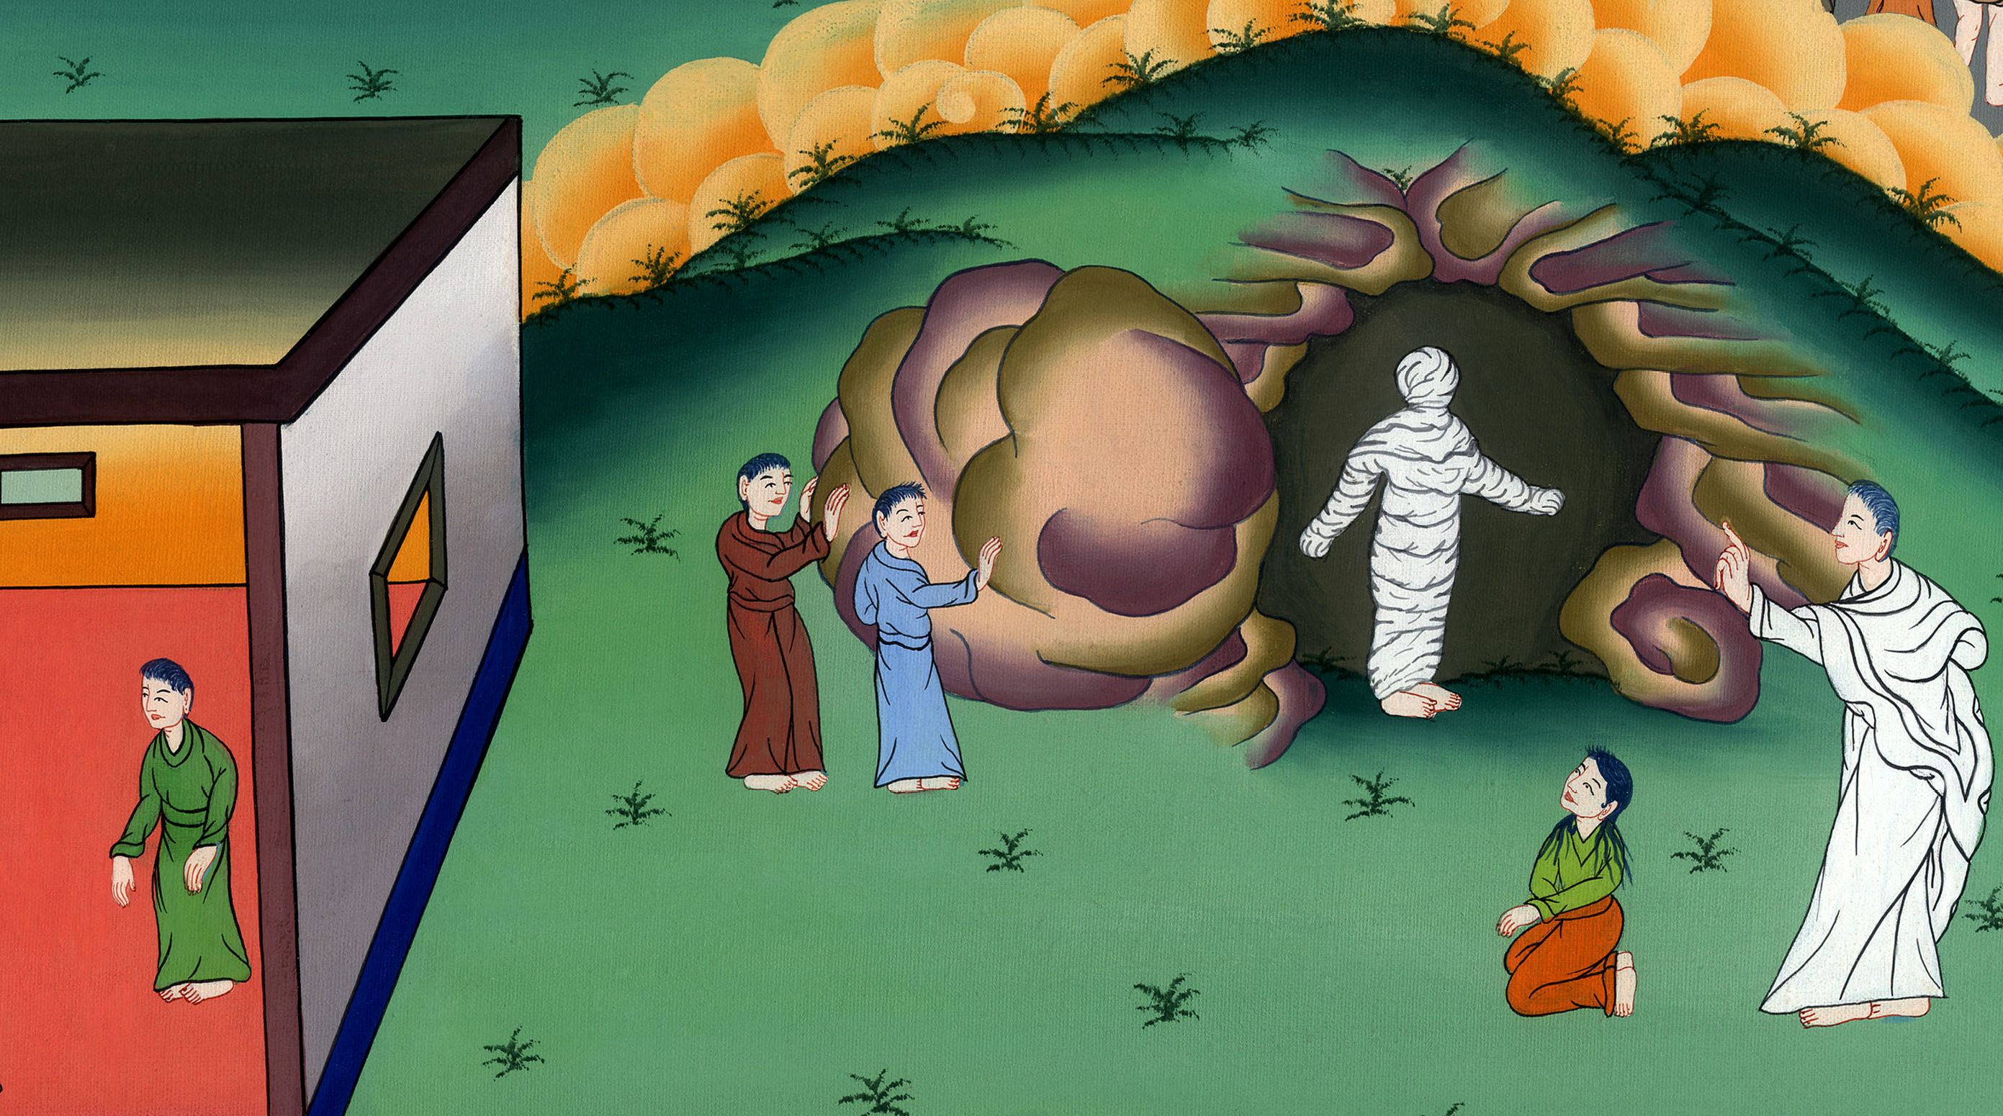
John 12:1

Slide 7
Explain about Passover feast

Slide 8


Slide 9
2So they made him a supper there. Martha served, but Lazarus was one of those who sat at the table with him.

Slide 10
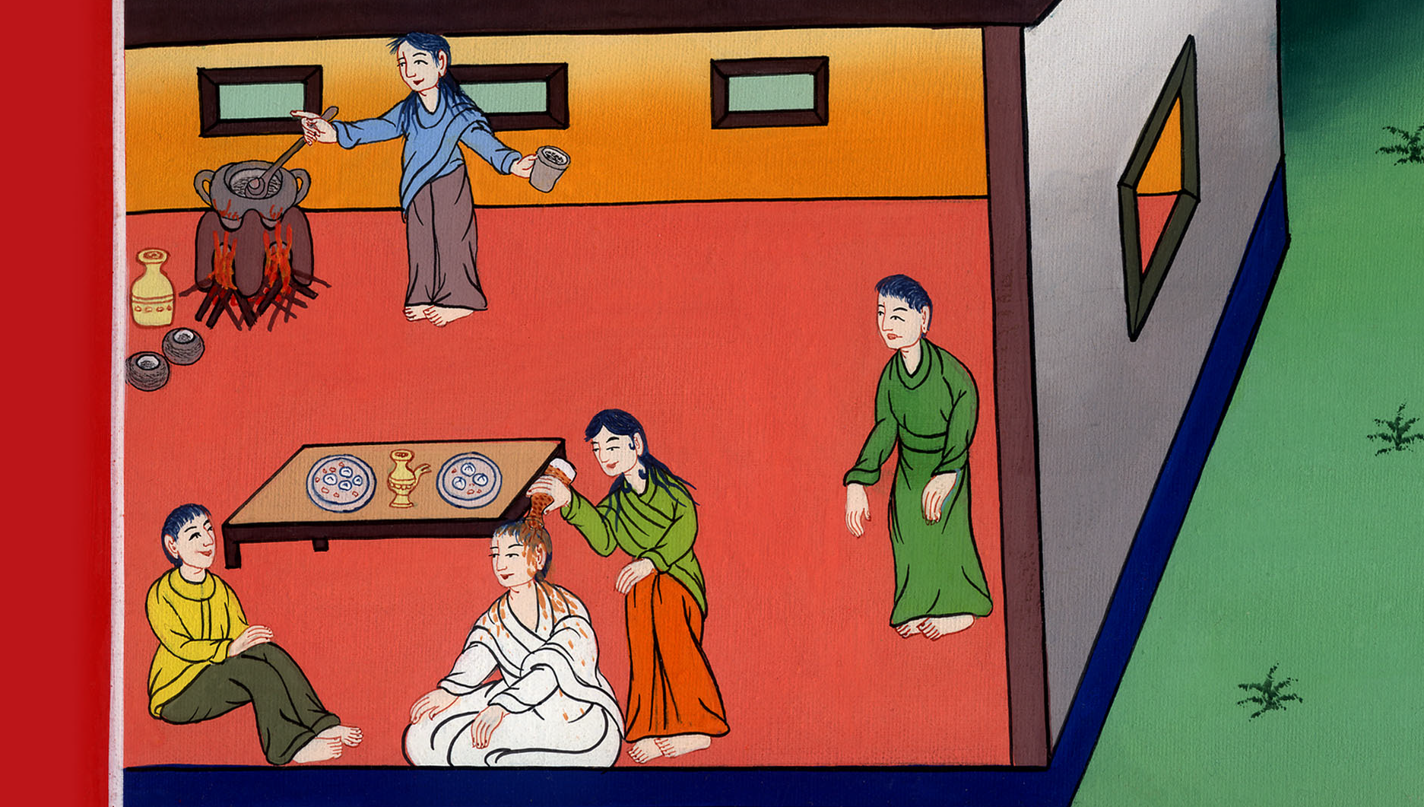
John 12:2

Slide 11
3Therefore Mary took a pound of ointment of pure nard, very precious, and anointed Jesus’s feet and wiped his feet with her hair. The house was filled with the fragrance of the ointment.

Slide 12
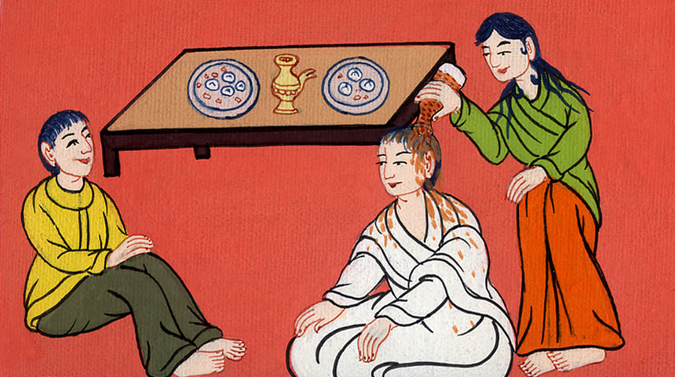
John 12:3

Slide 13
4Then Judas Iscariot, Simon’s son, one of his disciples, who would betray him, said,

Slide 14
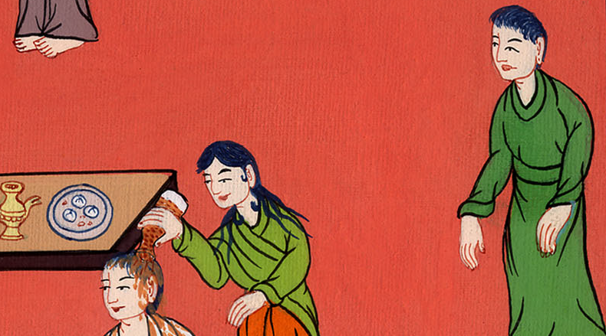
John 12:4

Slide 15
Judas said, 5“Why wasn’t this ointment sold for three hundred denarii and given to the poor?”

Slide 16
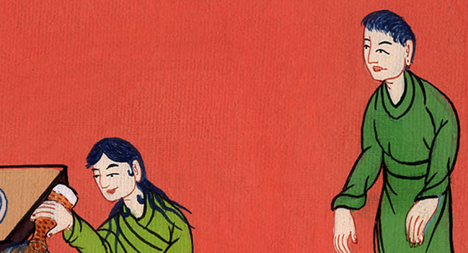
John 12:5

Slide 17
6Now he said this, not because he cared for the poor, but because he was a thief, and having the money box, used to steal what was put into it.

Slide 18

John 12:6

Slide 19
7But Jesus said, “Leave her alone. She has kept this for the day of my burial. 8For you always have the poor with you, but you don’t always have me.”

Slide 20
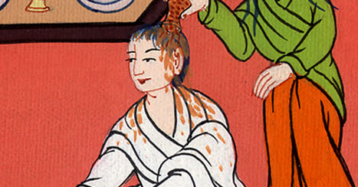
John 12:7,8

Slide 21
9A large crowd therefore of the Jews learned that he was there; and they came, not for Jesus’ sake only, but that they might see Lazarus also, whom he had raised from the dead.

Slide 22
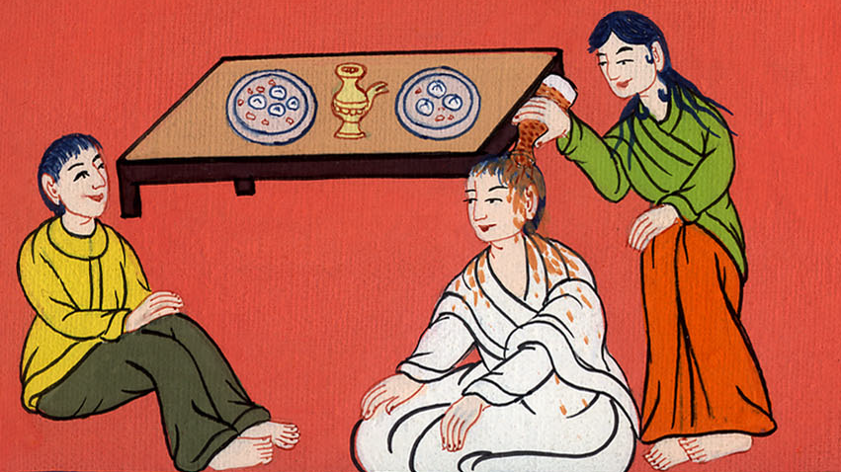
John 12:9

Slide 23
10But the chief priests conspired to put Lazarus to death also, 11because on account of him many of the Jews went away and believed in Jesus.

Slide 24
John 12:10,11

