Slide 1
41-6
This work is licensed under a Creative Commons Attribution-ShareAlike 4.0 International License.
Please add this statement to all the videos you create.
English Bible quotes are from the World English Bible US, which is in the public domain.
Notes:
Ch
41 The Rich Young Man
1. The rich young man - Matt 19:16-29; Mark 10:17-30; Luke 18:18-30 (Left Top)
2. James and John make their request - Matt 20:20-28; Mark 10:35-45 (Right Top)
3. Zacchaeus - Luke 19:1-10 (Right Center)
4. Resurrection of Lazarus - John 11:1-44 (Right Bottom)
5. Jesus anointed at Bethany - Matt 26:6-13; Mark 14:3-9; John 12:1-11 (Left
Bottom)
6. Triumphal entry - Matt 21:1-11; Mark 11:1-11; Luke 19:29-44; John 12:12-19
(Left Center)

Slide 2
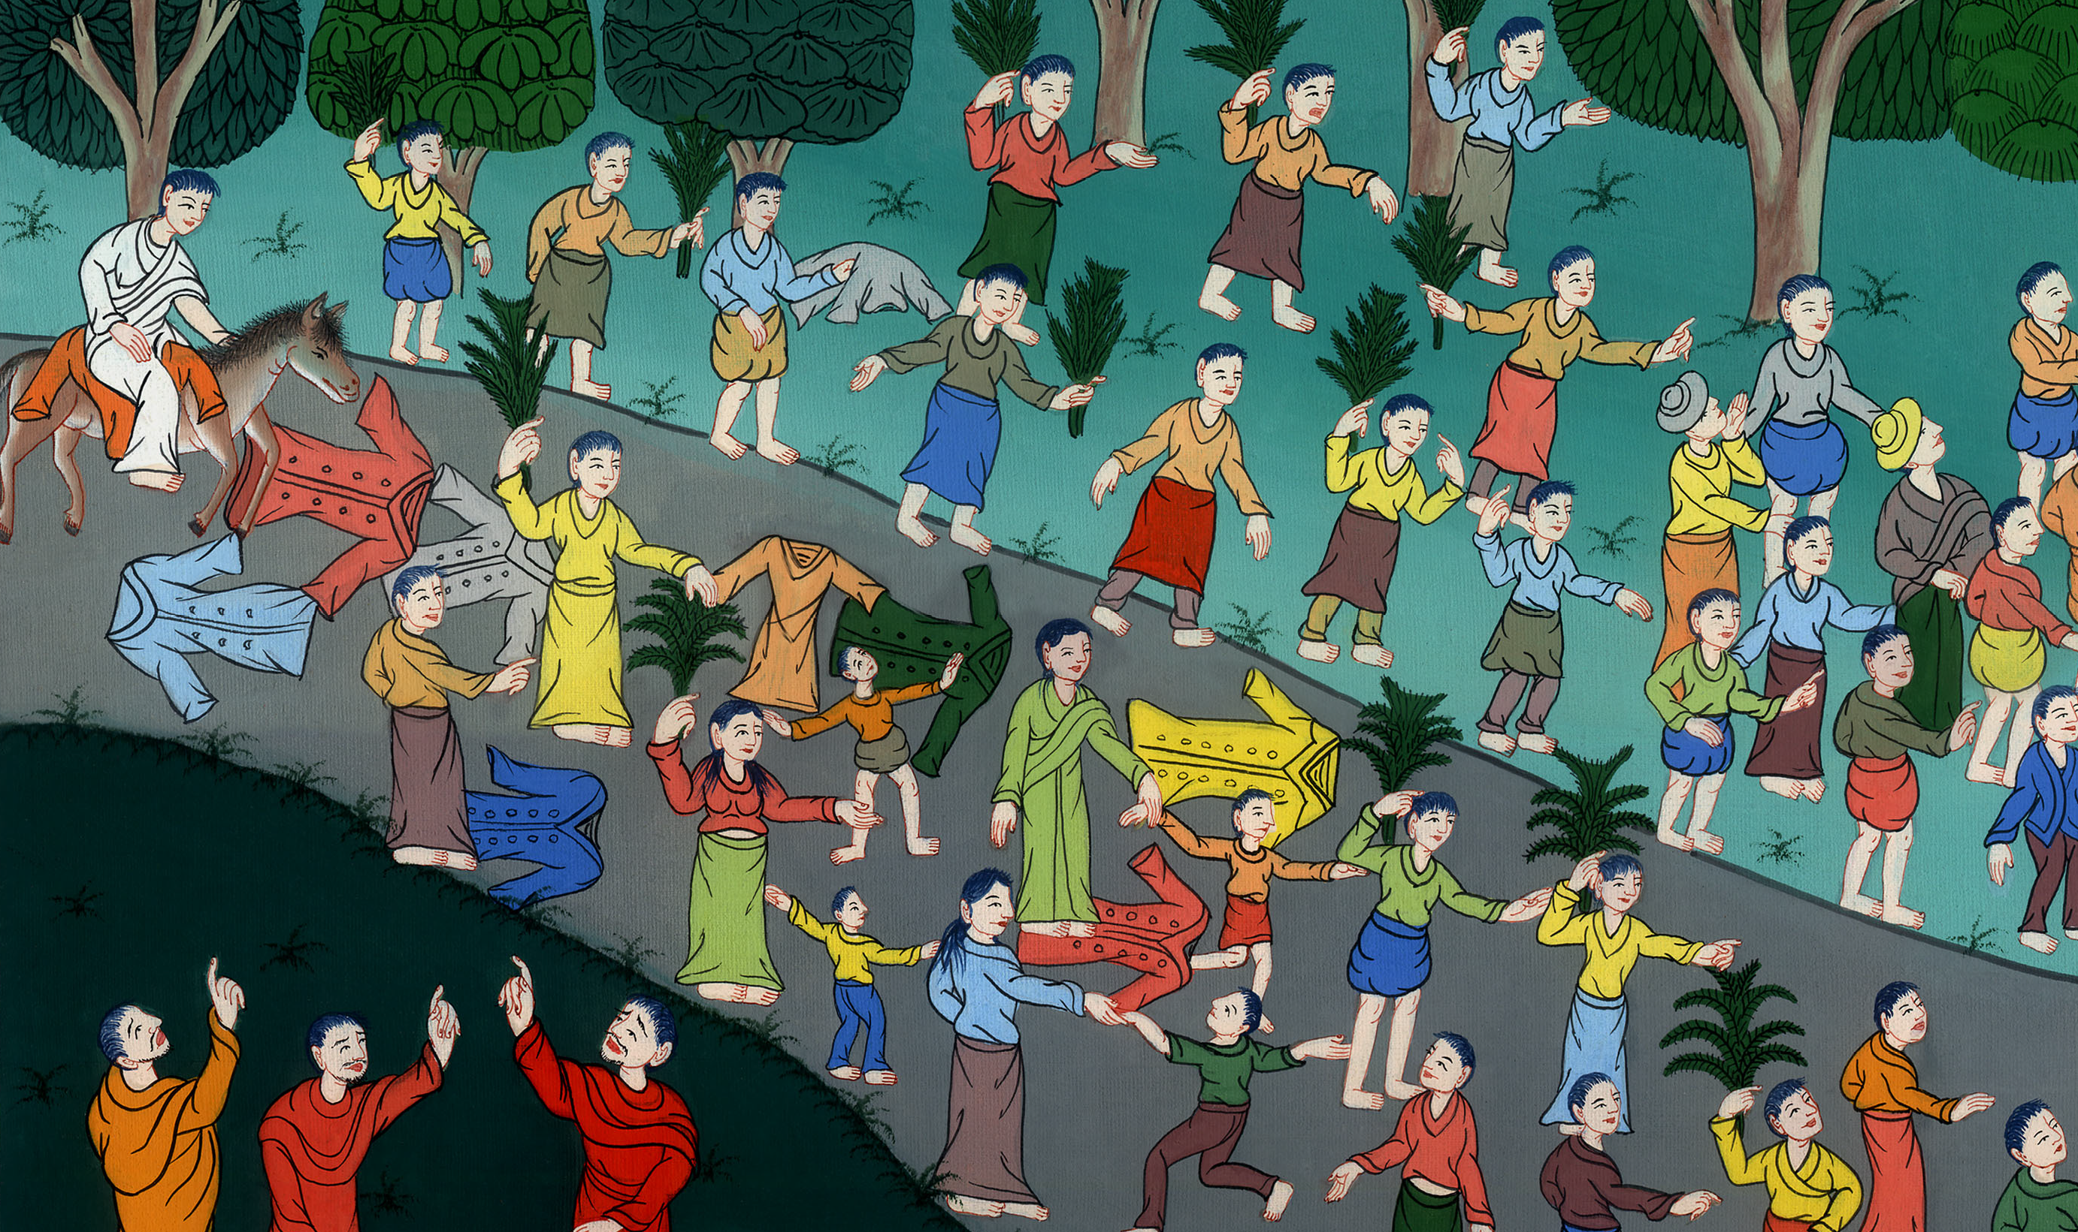
Triumphal entry - Mark 11:1-11

Slide 3
Triumphal entry - Mark 11:1-11

Slide 4
Triumphal entry - Mark 11:1-11

Slide 5
1When they came near to Jerusalem, to Bethsphage and Bethany, at the Mount of Olives, he sent two of his disciples

Slide 6
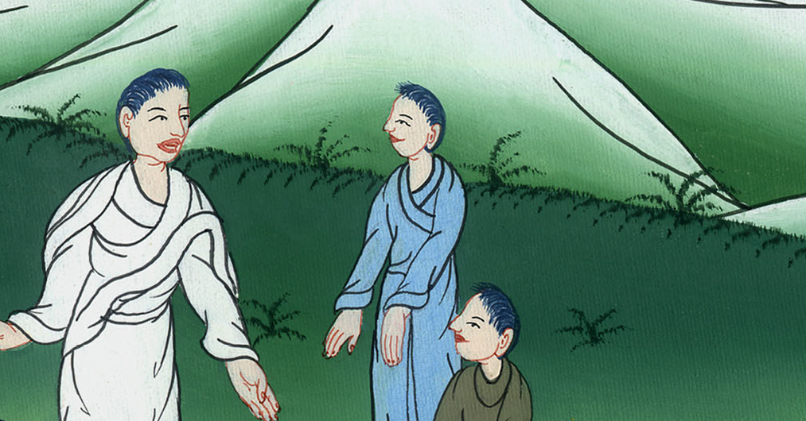
Mark 11:1

Slide 7
2and said to them, “Go your way into the village that is opposite you. Immediately as you enter into it, you will find a young donkey tied, on which no one has sat. Untie him and bring him.

Slide 8
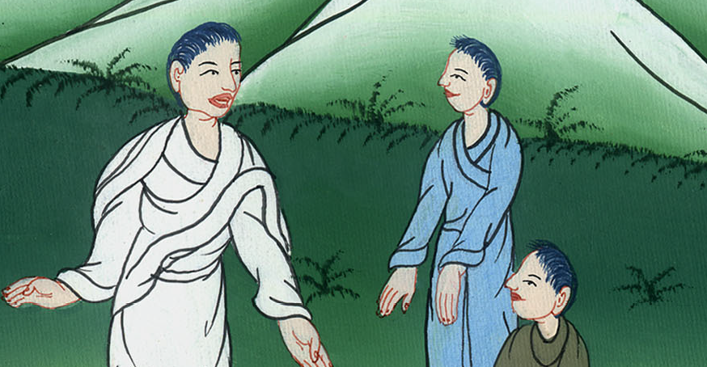
Mark 11:2

Slide 9
3If anyone asks you, ‘Why are you doing this?’ say, ‘The Lord needs him;’ and immediately he will send him back here.”

Slide 10
Mark 11:3

Slide 11
4They went away, and found a young donkey tied at the door outside in the open street, and they untied him.

Slide 12
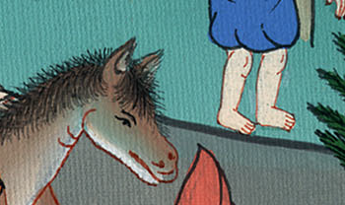
Mark 11:4

Slide 13
5Some of those who stood there asked them, “What are you doing, untying the young donkey?” 6They said to them just as Jesus had said, and they let them go.

Slide 14
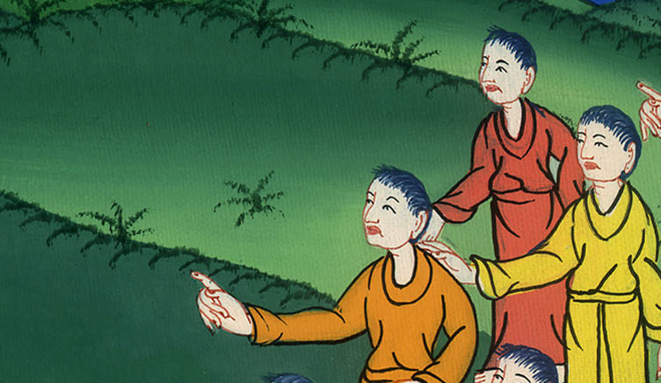
Mark 11:5,6

Slide 15
7They brought the young donkey to Jesus and threw their garments on it, and Jesus sat on it.

Slide 16
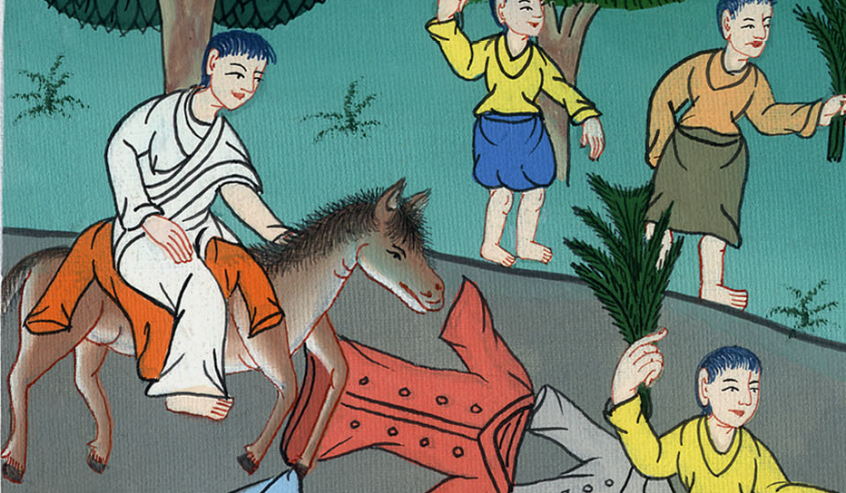
Mark 11:7

Slide 17
8Many spread their garments on the way, and others were cutting down branches from the trees and spreading them on the road.

Slide 18
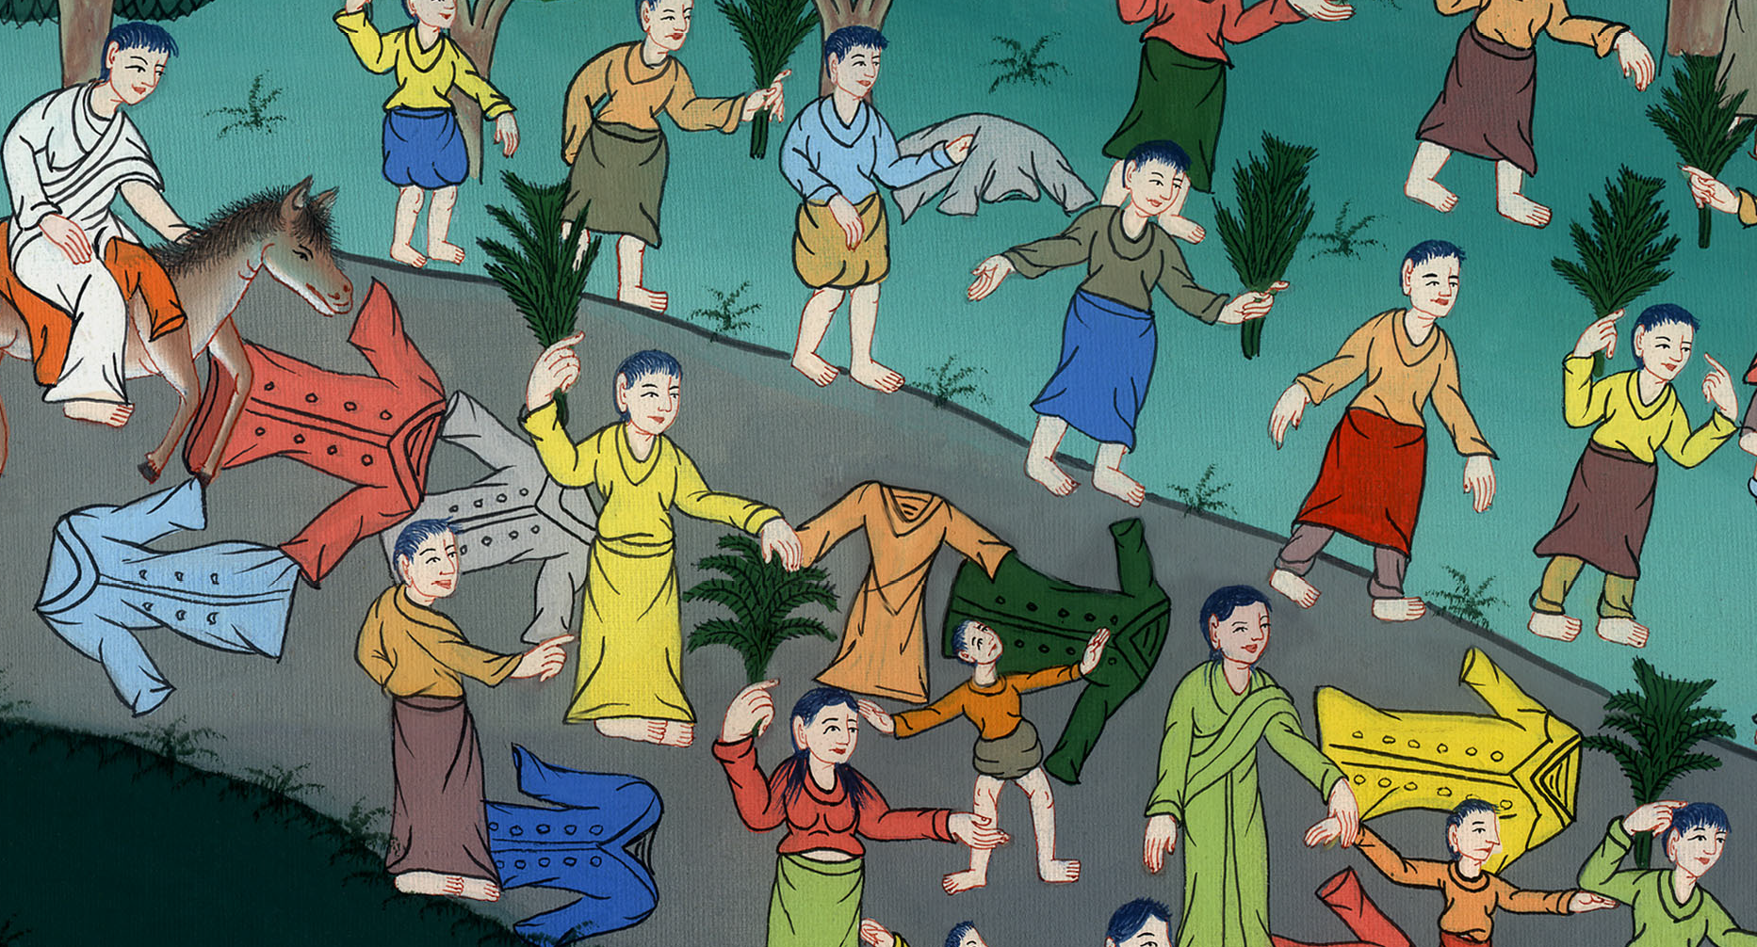
Mark 11:8

Slide 19
9Those who went in front and those who followed cried out, “Hosanna! Blessed is he who comes in the name of the Lord!

Slide 20
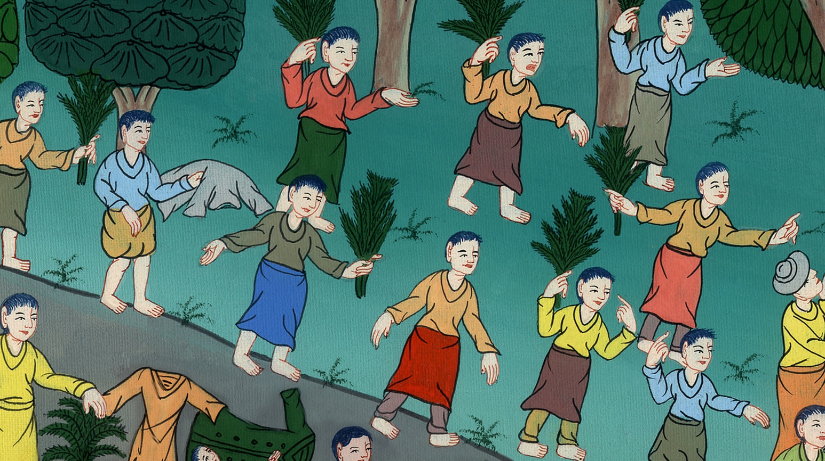
Mark 11:9

Slide 21
10Blessed is the kingdom of our father David that is coming in the name of the Lord! Hosanna in the highest!”

Slide 22
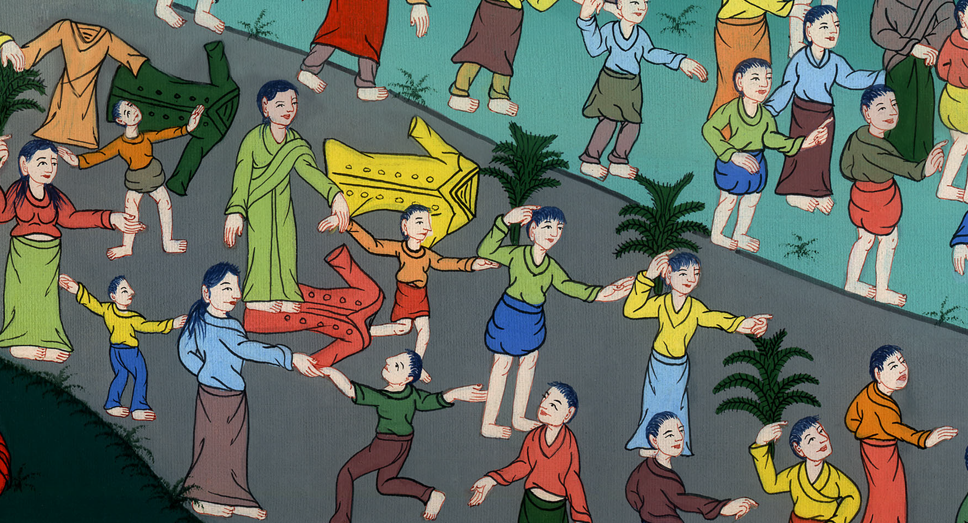
Mark 11:10

Slide 23
10When he had come into Jerusalem, all the city was stirred up, saying, “Who is this?”
11The multitudes said, “This is the prophet, Jesus, from Nazareth of Galilee.”

Slide 24
Mark 21:10,11

