Slide 1
42-1
This work is licensed under a Creative Commons Attribution-ShareAlike 4.0 International License.
Please add this statement to all the videos you create.
English Bible quotes are from the World English Bible US, which is in the public domain.
Notes:
42 Temple Merchants
1. Temple Merchants - Matt 21:12-17; Mark 11:15-19; Luke 19:45-48 (Left Top)
2. Paying Taxes - Matt 22:15-22; Mark 12:13-17; Luke 20:20-26 (Right Top)
3. The Widow’s Mite - Mark 12:41-44; Luke 21:1-4 (Right Top)
4. Fig Tree - Matt 21:18-22; Mark 11:12-14, 20-26; (John 15:1-17) (Right Center)
5. Judas agrees to betray Jesus – Matt 26:14-16; Luke 21:37-22:6 (Right Bottom)
6. The last Supper – Luke 22:7-27; John 13:1-17:26; Luke 22:31-39 (Left Bottom)

Slide 2
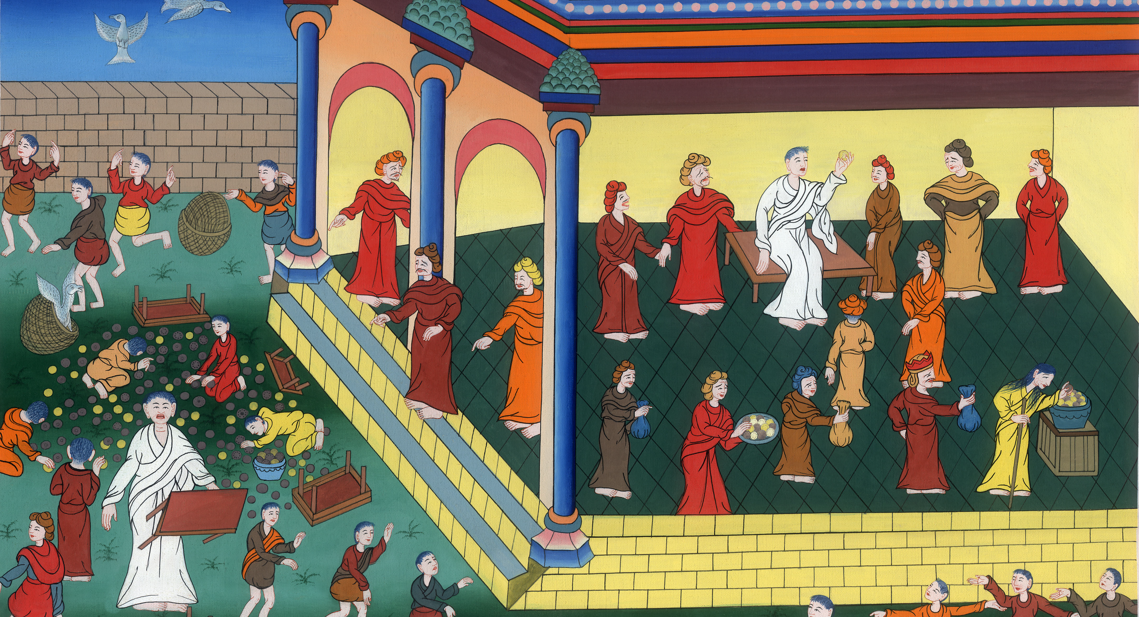
Temple Merchants
Jesus Clears Out the Temple Courtyard- Matt 21:12-17; Mark 11:15-19; Luke 19:45-48

Slide 3
Temple Merchants
Jesus Clears Out the Temple Courtyard- Matt 21:12-17; Mark 11:15-19; Luke 19:45-48

Slide 4
Temple Merchants
Jesus Clears Out the Temple Courtyard- Matt 21:12-17; Mark 11:15-19; Luke 19:45-48

Slide 5
Mark 11:15When Jesus reached Jerusalem, he entered the temple courtyard. He began to drive out those who were buying and selling there.

Slide 6
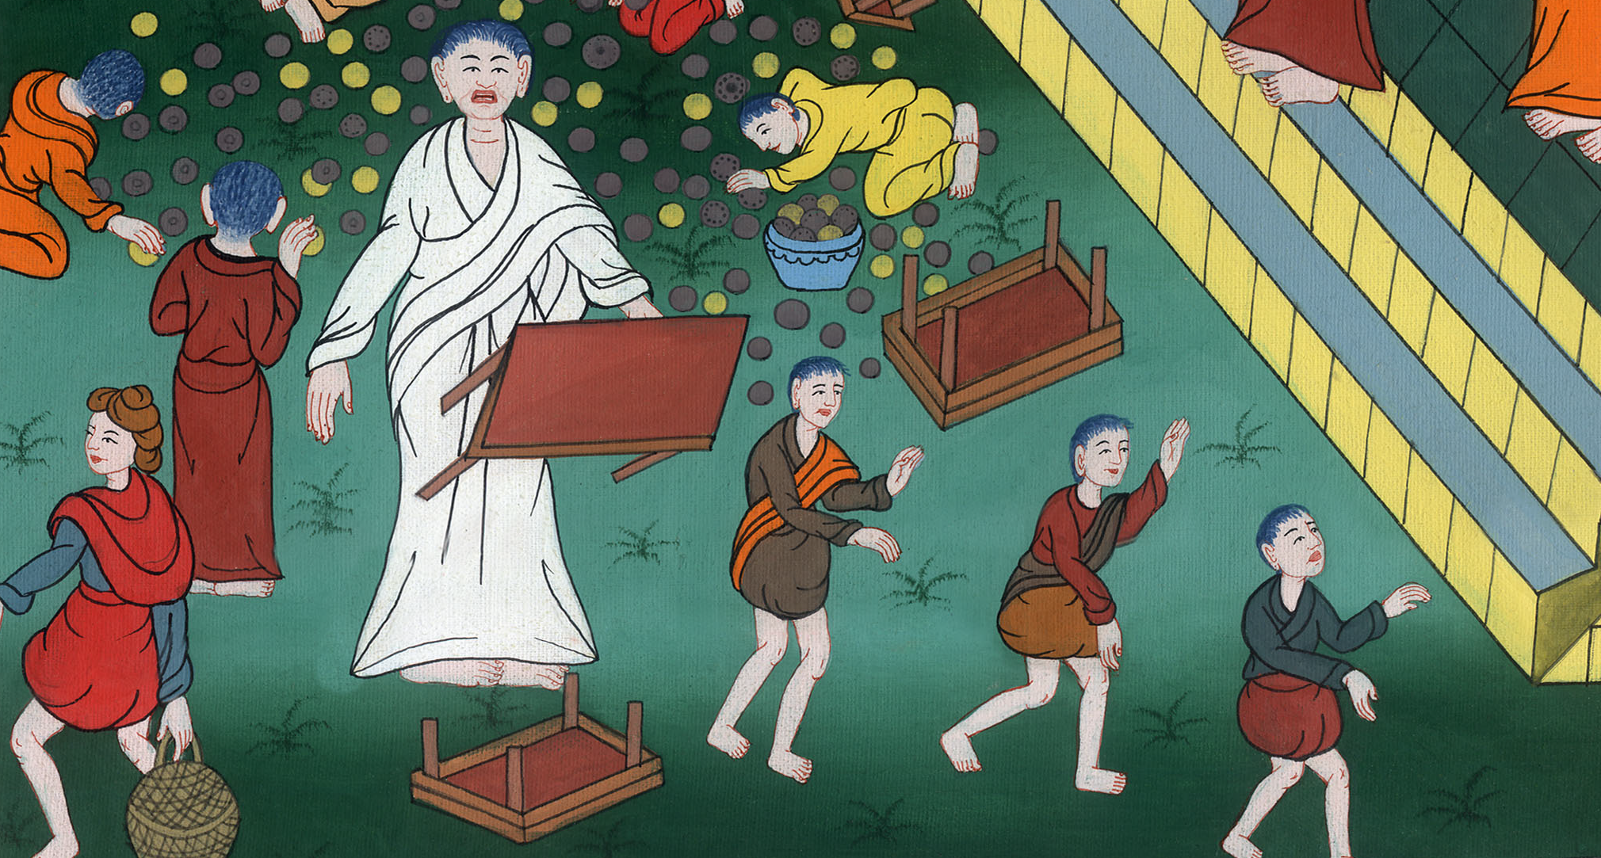
Mark 11:15

Slide 7
He turned over the tables of the people who were exchanging money. He also turned over the benches of those who were selling doves.

Slide 8
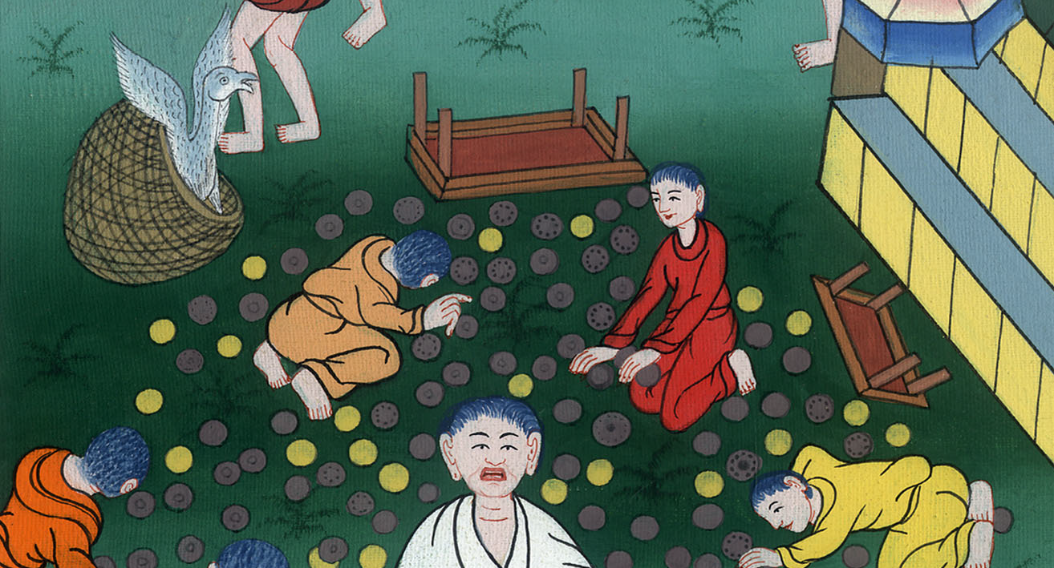
Mark 11:15

Slide 9
16He would not allow anyone to carry items for sale through the temple courtyard.

Slide 10
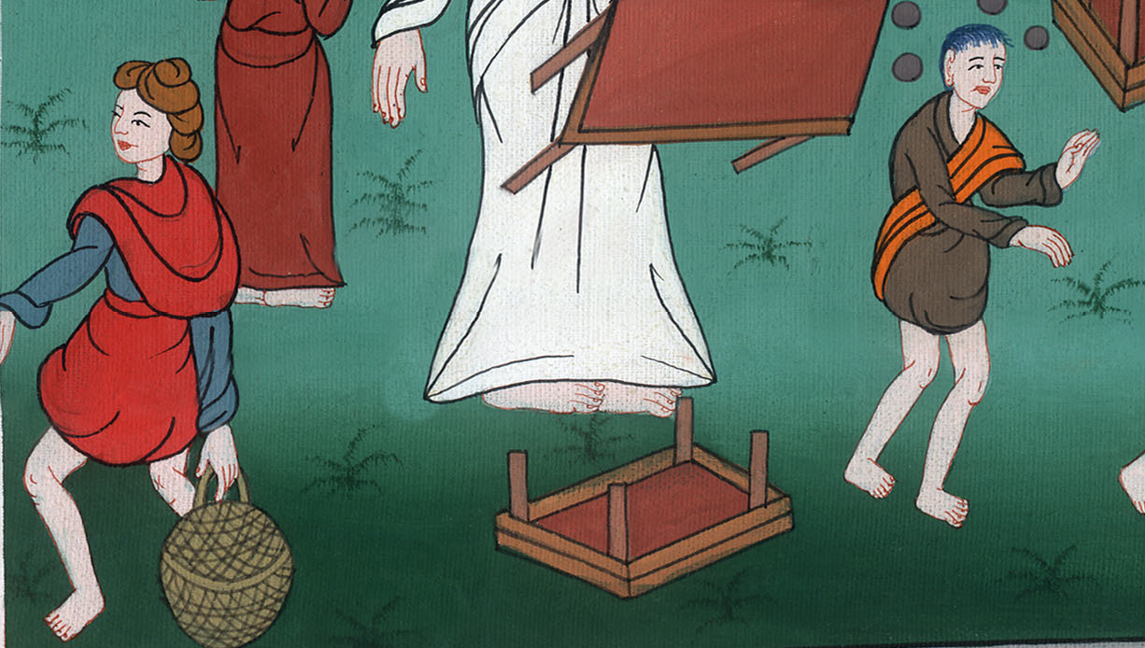
Mark 11:16

Slide 11
17Then he taught them. He told them, “It is written that the Lord said, ‘My house will be called a house where people from all nations can pray.’ But you have made it a ‘den for robbers.’ ”

Slide 12
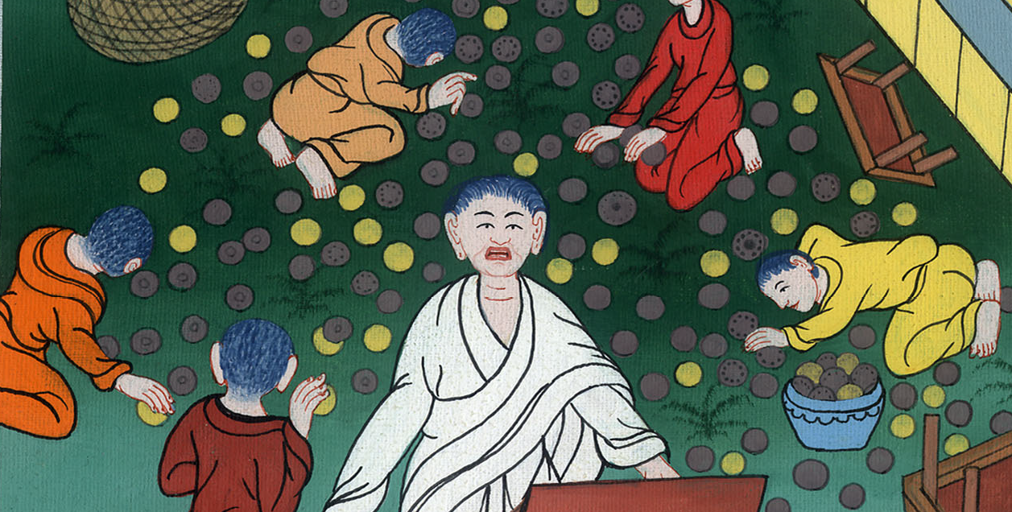
Mark 11:17

Slide 13
18The chief priests and the teachers of the law heard about this. They began looking for a way to kill Jesus. They were afraid of him, because the whole crowd was amazed at his teaching.

Slide 14
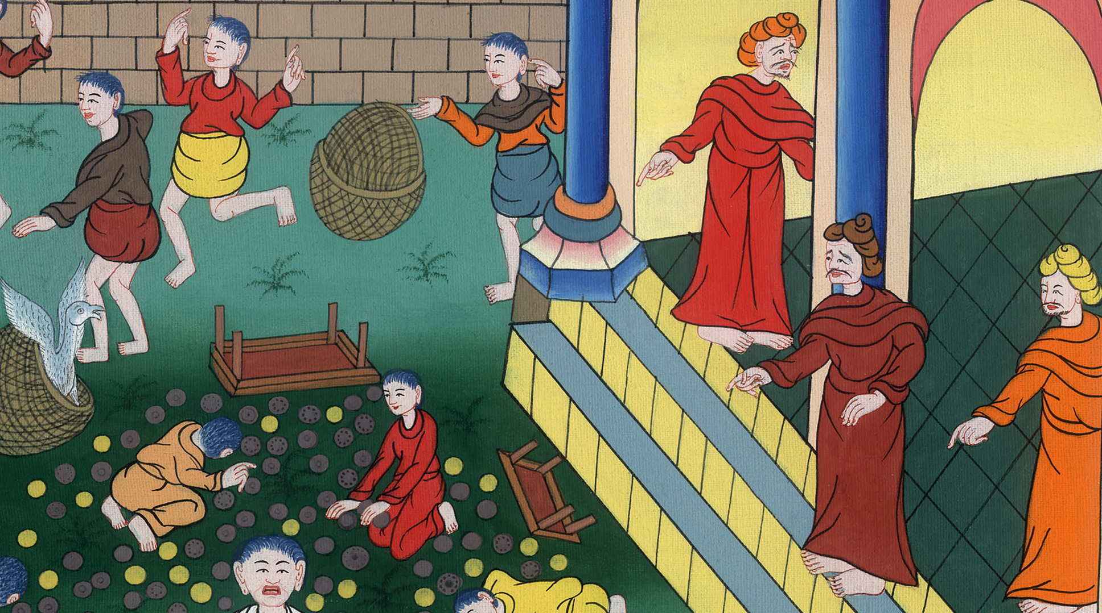
Mark 11:18

Slide 15
mark 1213Later the religious leaders sent some of the Pharisees and Herodians to Jesus. They wanted to trap him with his own words.

Slide 16
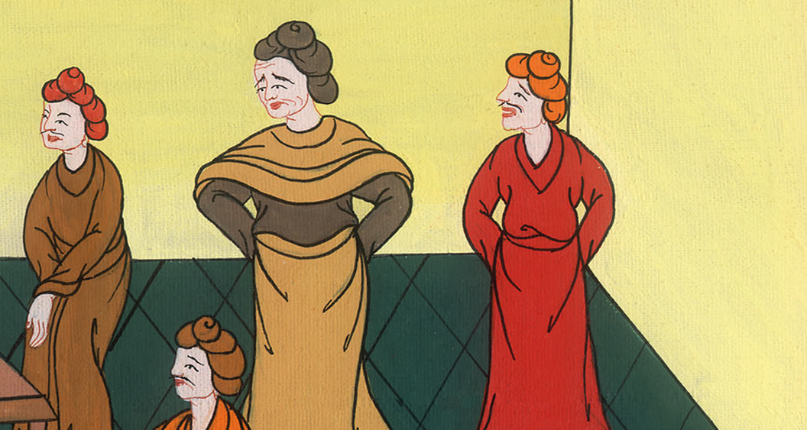
Mark 12:13

Slide 17
14They came to him and said, “Teacher, we know that you are a man of honor. You don’t let other people tell you what to do or say. You don’t care how important they are. But you teach the way of God truthfully. Is it right to pay the royal tax to Caesar or not?

Slide 18
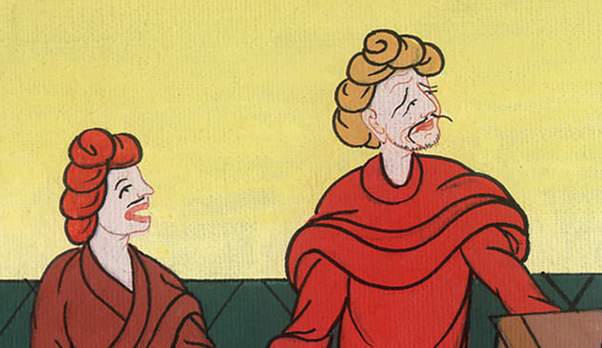
Mark 12:14

Slide 19
15Should we pay or shouldn’t we?”
But Jesus knew what they were trying to do. So he asked, “Why are you trying to trap me? Bring me a silver coin. Let me look at it.”

Slide 20
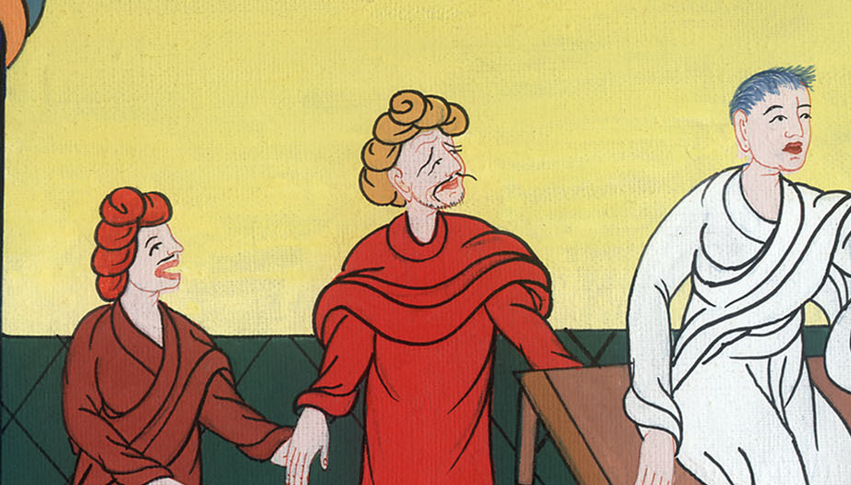
Mark 12:15

Slide 21
16They brought the coin. He asked them, “Whose picture is this? And whose words?”
“Caesar’s,” they replied.

Slide 22
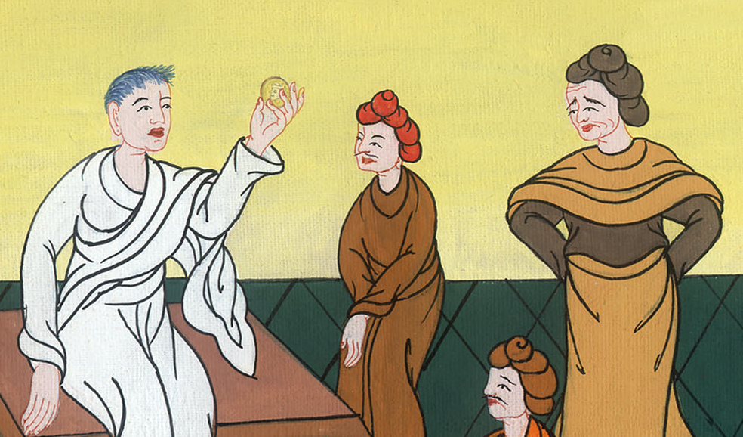
Mark 12:16

Slide 23
17Then Jesus said to them, “Give back to Caesar what belongs to Caesar. And give back to God what belongs to God.”
They were amazed at him.

Slide 24
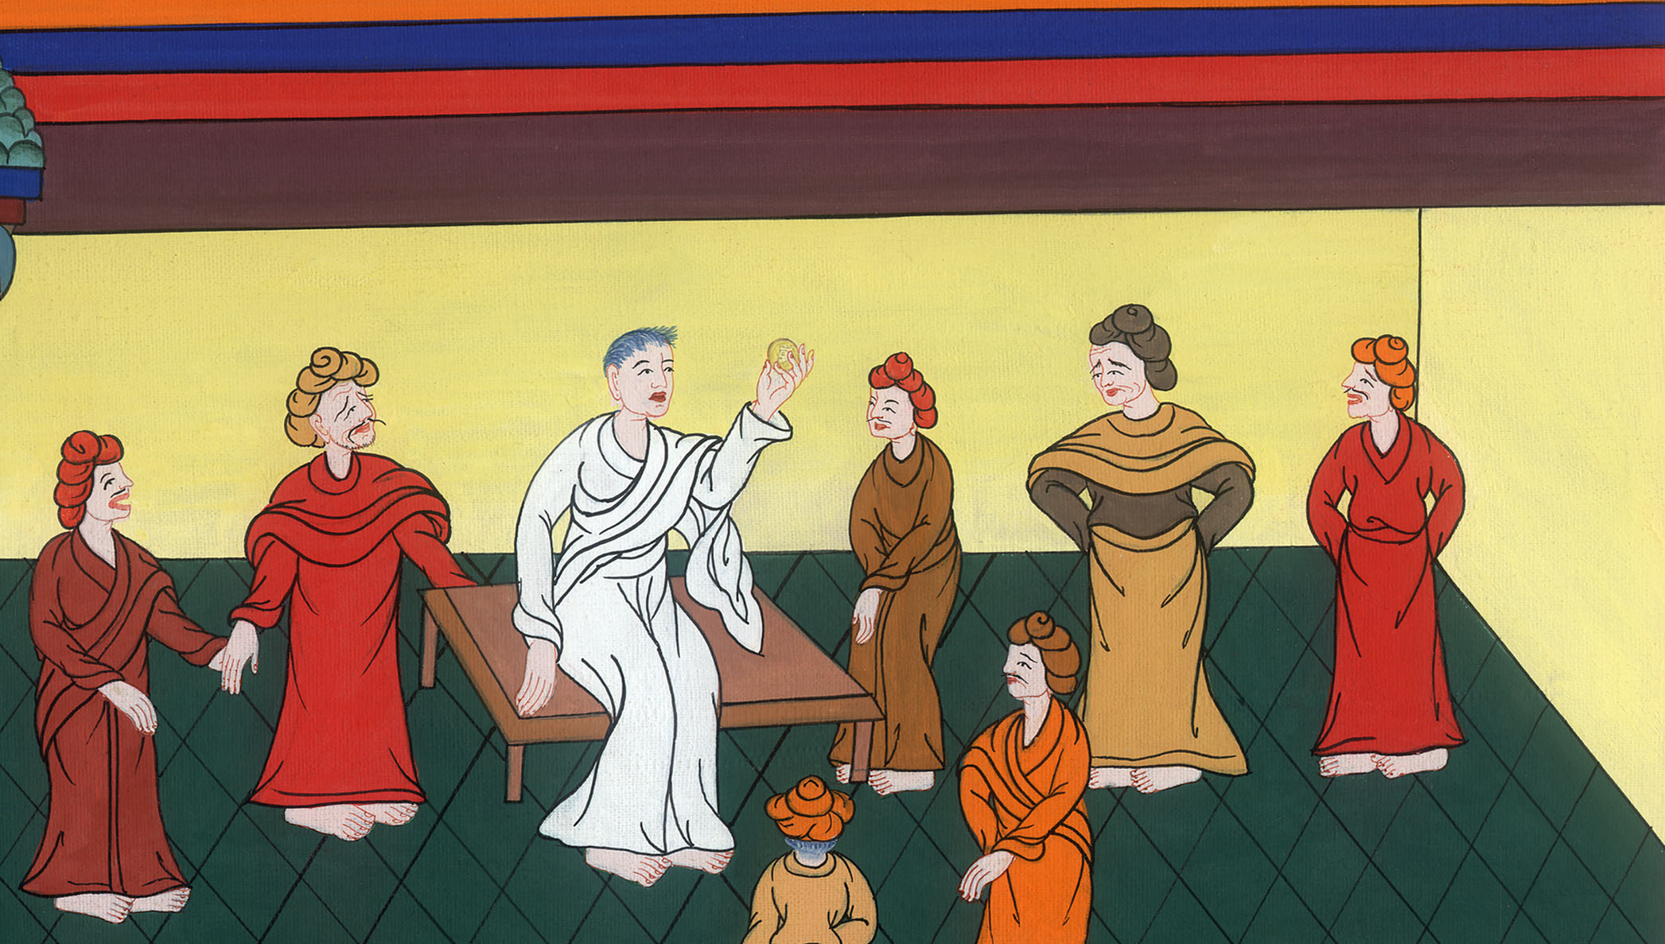
Mark 12:17

