Slide 1
42-2
This work is licensed under a Creative Commons Attribution-ShareAlike 4.0 International License.
Please add this statement to all the videos you create.
English Bible quotes are from the World English Bible US, which is in the public domain.
Notes:
Ch
42 Temple Merchants
1. Temple Merchants - Matt 21:12-17; Mark 11:15-19; Luke 19:45-48 (Left Top)
2. Paying Taxes - Matt 22:15-22; Mark 12:13-17; Luke 20:20-26 (Right Top)
3. The Widow’s Mite - Mark 12:41-44; Luke 21:1-4 (Right Top)
4. Fig Tree - Matt 21:18-22; Mark 11:12-14, 20-26; (John 15:1-17) (Right Center)
5. Judas agrees to betray Jesus – Matt 26:14-16; Luke 21:37-22:6 (Right Bottom)
6. The last Supper – Luke 22:7-27; John 13:1-17:26; Luke 22:31-39 (Left Bottom)

Slide 2
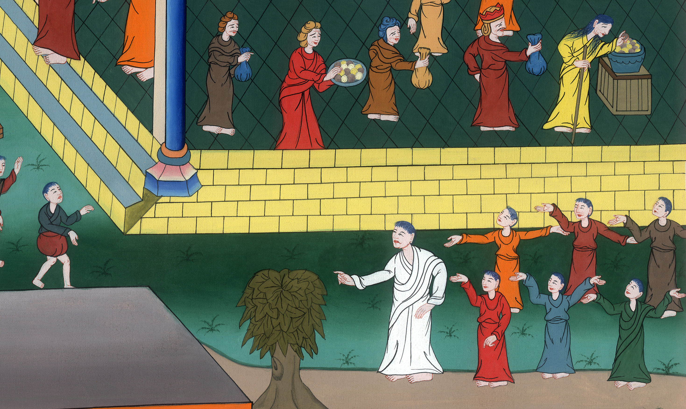
The Widow’s Mite –
Mark 12:41-44; Luke 21:1-4
Fig Tree –
Matt 21:18-22; Mark 11:12-14, 20-26; (John 15:1-17)

Slide 3
The Widow’s Mite - Mark 12:41-44; Luke 21:1-4 Fig Tree - Matt 21:18-22; Mark 11:12-14, 20-26; (John 15:1-17)

Slide 4
The Widow’s Mite –
Mark 12:41-44; Luke 21:1-4
Fig Tree –
Matt 21:18-22; Mark 11:12-14, 20-26; (John 15:1-17)

Slide 5
Mark 12:41Jesus sat down opposite the treasury and saw how the multitude cast money into the treasury. Many who were rich cast in much.

Slide 6
Mark 12:41

Slide 7
42A poor widow came and she cast in two small brass coins, which equal a quadrans coin.

Slide 8
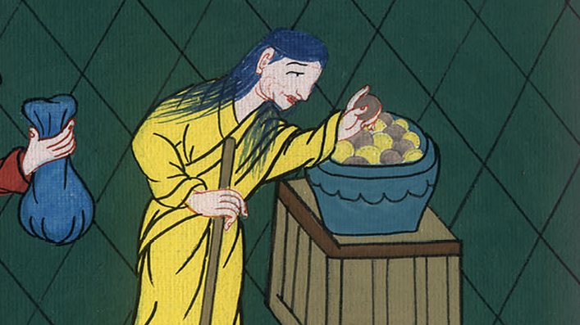
Mark 12:42

Slide 9
43He called his disciples to himself and said to them, “Most certainly I tell you, this poor widow gave more than all those who are giving into the treasury,

Slide 10
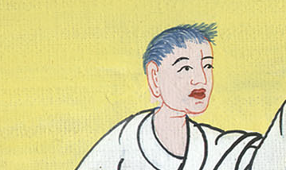
Mark 12:43

Slide 11
44for they all gave out of their abundance, but she, out of her poverty, gave all that she had to live on.”

Slide 12
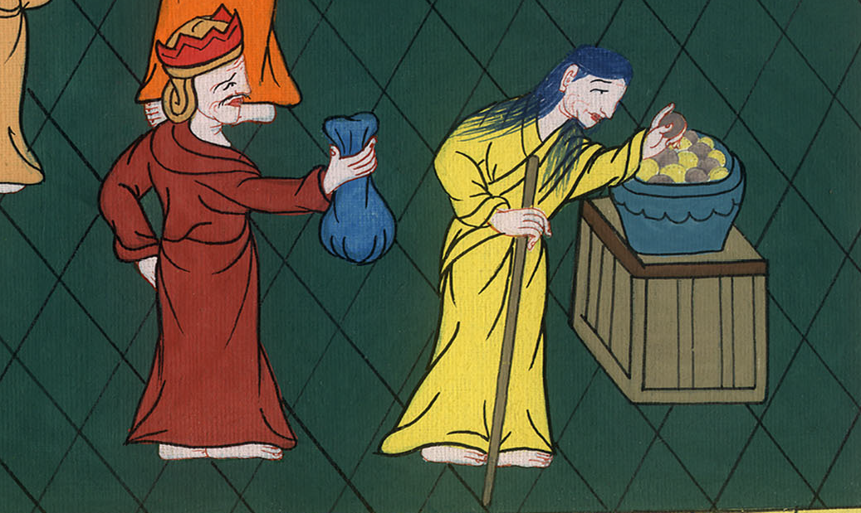
Mark 12:44

Slide 13
mark 1112The next day, when they had come out from Bethany, he was hungry.

Slide 14
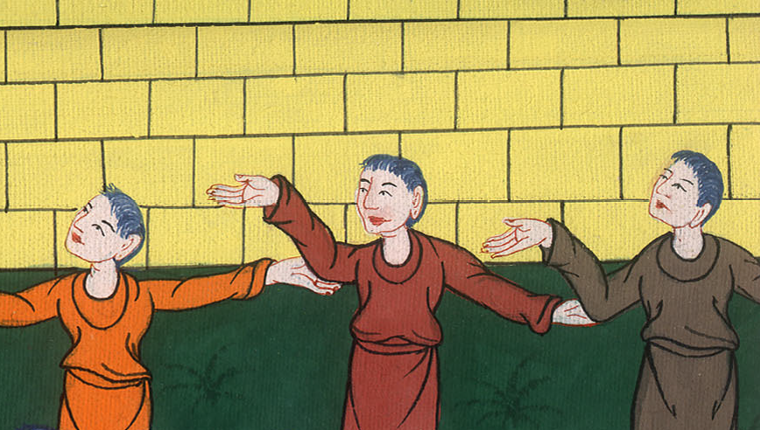
Mark 11:12

Slide 15
13Seeing a fig tree afar off having leaves, he came to see if perhaps he might find anything on it. When he came to it, he found nothing but leaves, for it was not the season for figs.

Slide 16
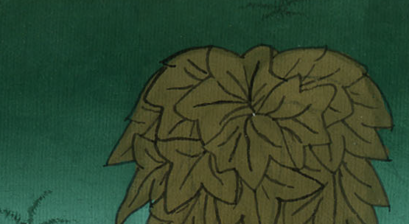
Mark 11:13

Slide 17
14Jesus told it, “May no one ever eat fruit from you again!” and his disciples heard it.

Slide 18
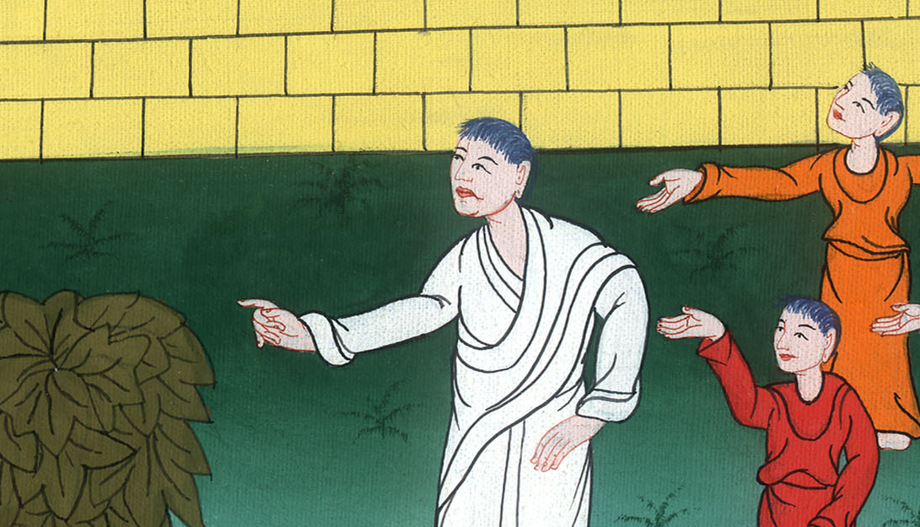
Mark 11:14

Slide 19
The next day 20As they passed by in the morning, they saw the fig tree withered away from the roots.

Slide 20
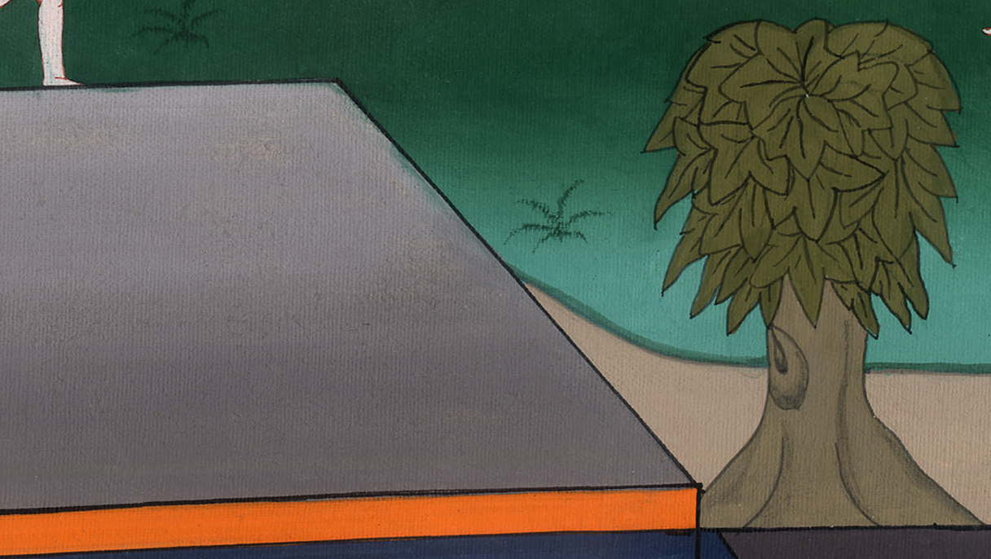
Mark 11:20

Slide 21
21Peter, remembering, said to him, “Rabbi, look! The fig tree which you cursed has withered away.”
22Jesus answered them, “Have faith in God.

Slide 22
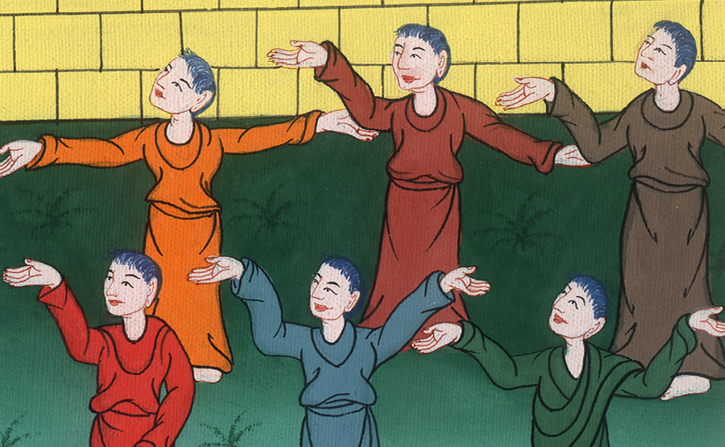
Mark 11:21,22

Slide 23
23For most certainly I tell you, whoever may tell this mountain, ‘Be taken up and cast into the sea,’ and doesn’t doubt in his heart, but believes that what he says is happening, he shall have whatever he says.

Slide 24
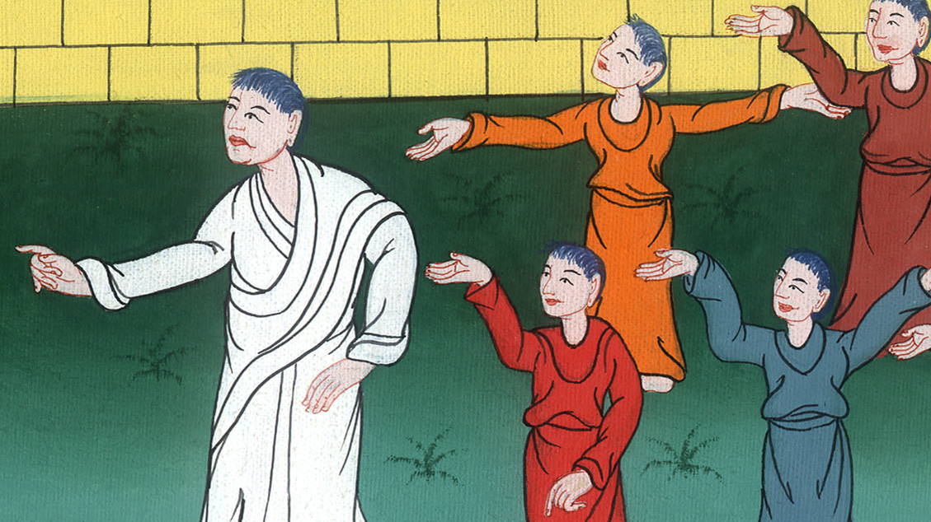
Mark 11:23

Slide 25
24Therefore I tell you, all things whatever you pray and ask for, believe that you have received them, and you shall have them.

Slide 26
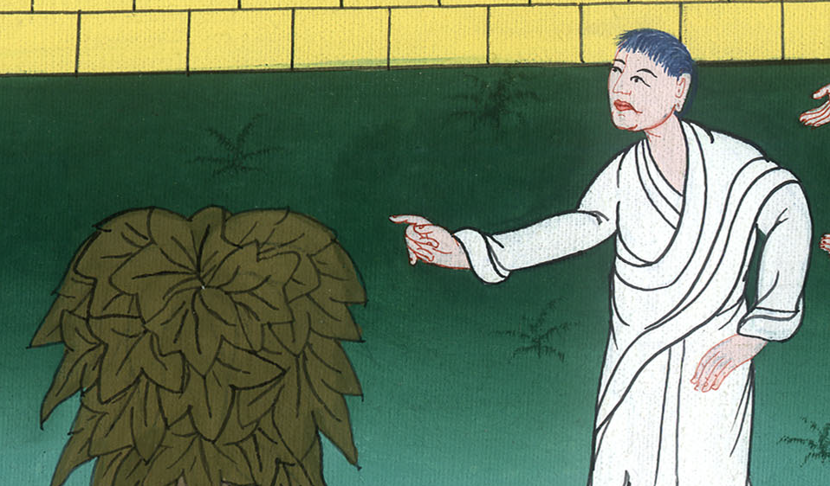
Mark 11:24

Slide 27
25Whenever you stand praying, forgive, if you have anything against anyone; so that your Father, who is in heaven, may also forgive you your transgressions.

Slide 28
Mark 11:25

