Slide 1
42-3
This work is licensed under a Creative Commons Attribution-ShareAlike 4.0 International License.
Please add this statement to all the videos you create.
English Bible quotes are from the World English Bible US, which is in the public domain.
Notes:
Ch
42 Temple Merchants
1. Temple Merchants - Matt 21:12-17; Mark 11:15-19; Luke 19:45-48 (Left Top)
2. Paying Taxes - Matt 22:15-22; Mark 12:13-17; Luke 20:20-26 (Right Top)
3. The Widow’s Mite - Mark 12:41-44; Luke 21:1-4 (Right Top)
4. Fig Tree - Matt 21:18-22; Mark 11:12-14, 20-26; (John 15:1-17) (Right Center)
5. Judas agrees to betray Jesus – Matt 26:14-16; Luke 21:37-22:6 (Right Bottom)
6. The last Supper – Luke 22:7-27; John 13:1-17:26; Luke 22:31-39 (Left Bottom)

Slide 2
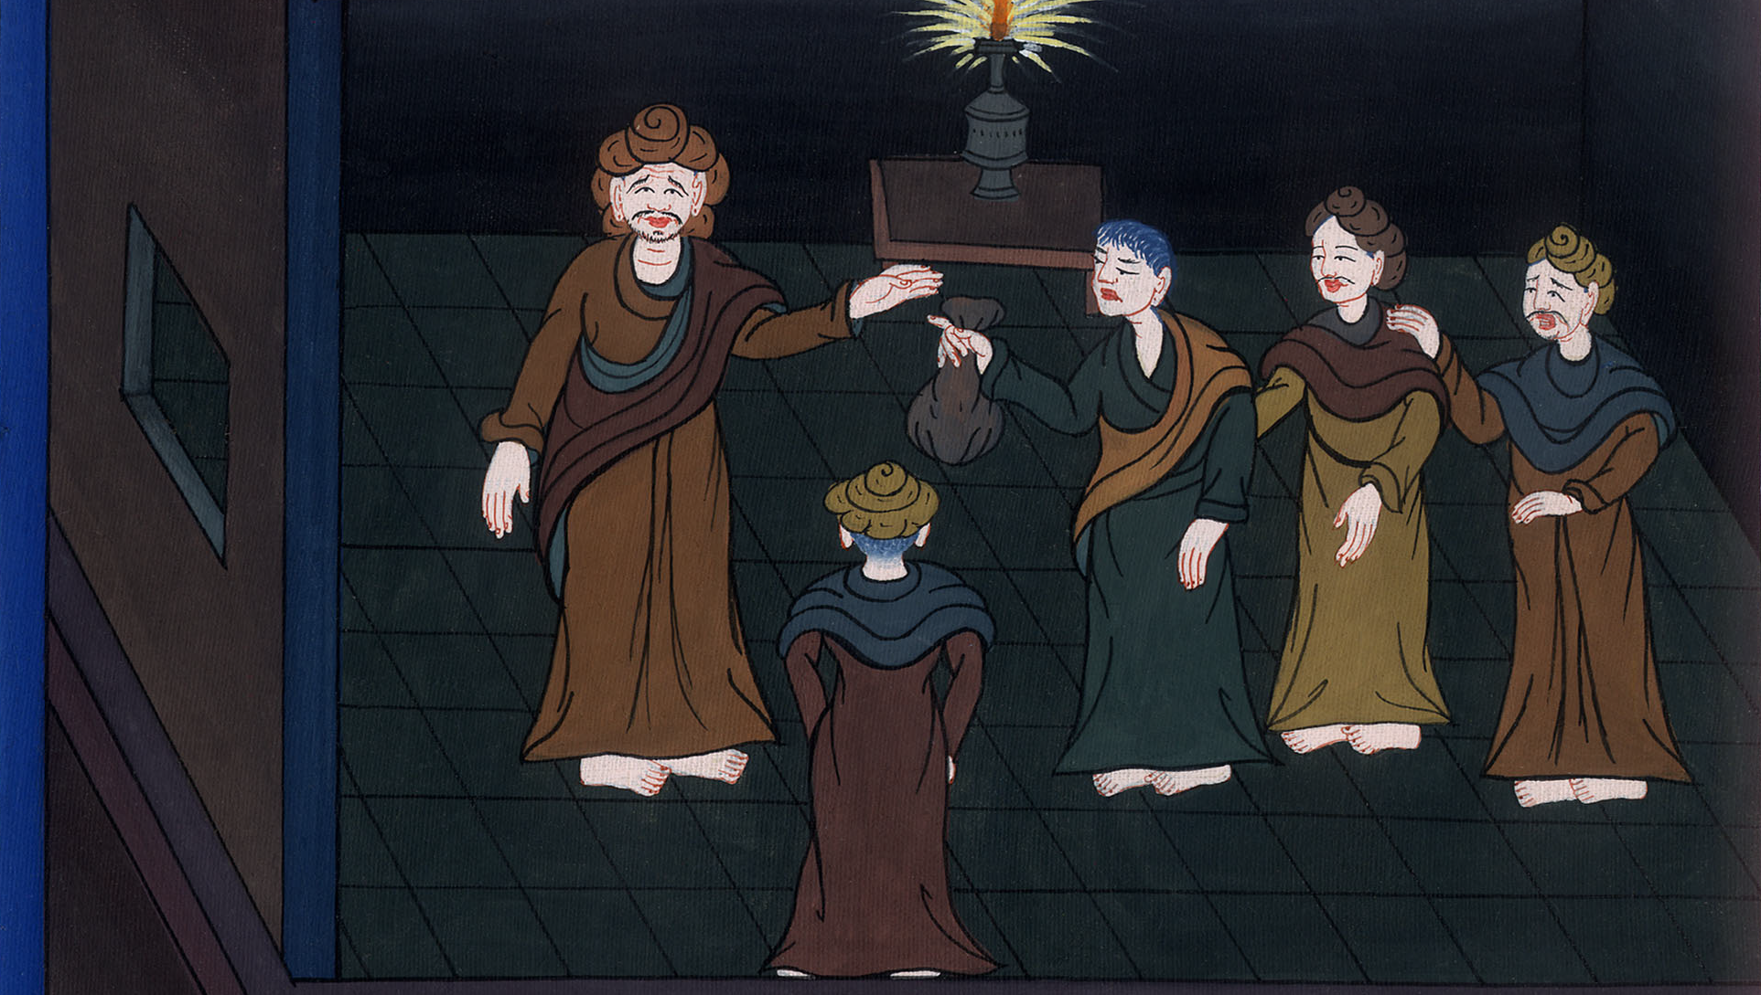
Judas agrees to betray Jesus –
Matthew 26:14-16; Luke 21:37-22:6

Slide 3
Judas agrees to betray Jesus – Matt 26:14-16; Luke 21:37-22:6

Slide 4
Judas agrees to betray Jesus –
Matthew 26:14-16; Luke 21:37-22:6

Slide 5
luke 2137Every day Jesus was teaching in the temple, and every night he would go out and spend the night on the mountain that is called Olivet.

Slide 6
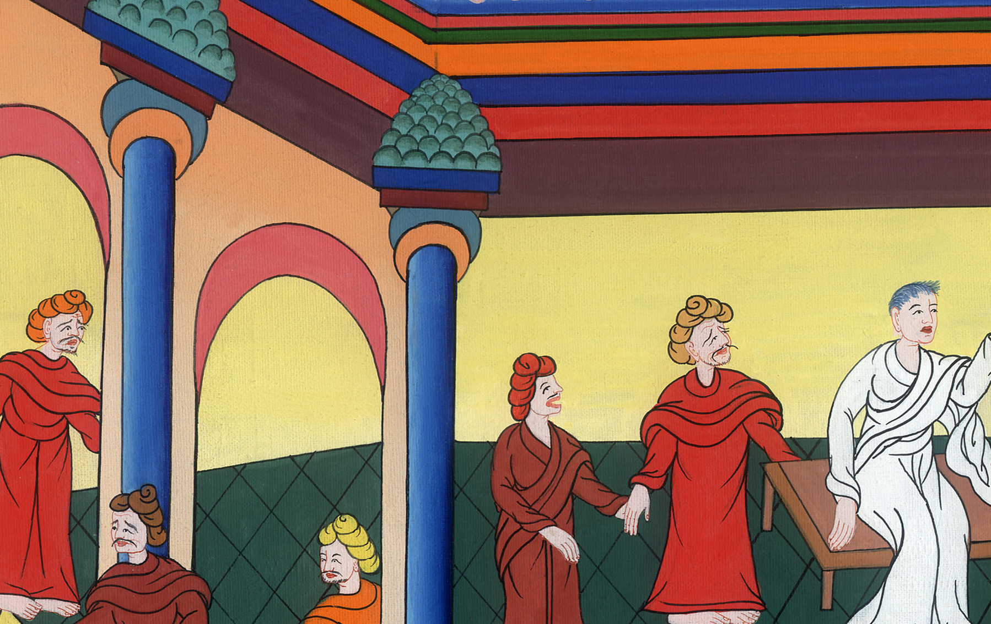
Luke 21:37

Slide 7
38All the people came early in the morning to him in the temple to hear him.

Slide 8
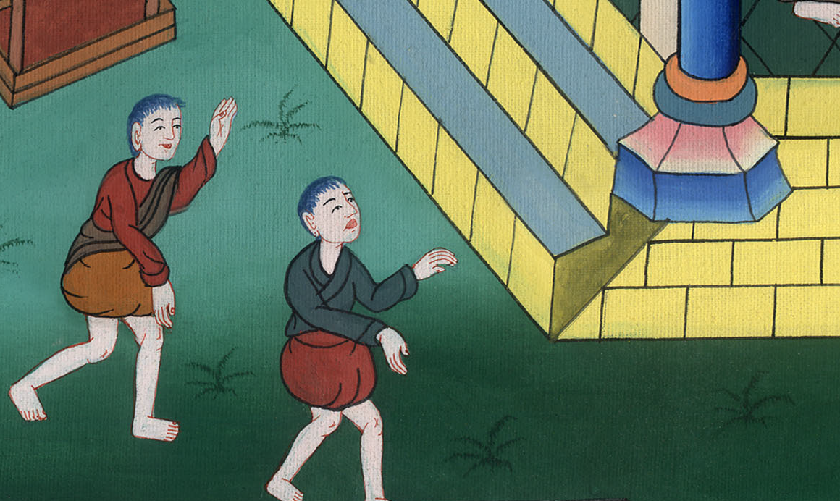
Luke 21:38

Slide 9
1Now the feast of unleavened bread, which is called the Passover, was approaching.

Slide 10
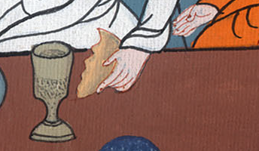
Luke 22:1

Slide 11
2The chief priests and the scribes sought how they might put him to death, for they feared the people.

Slide 12
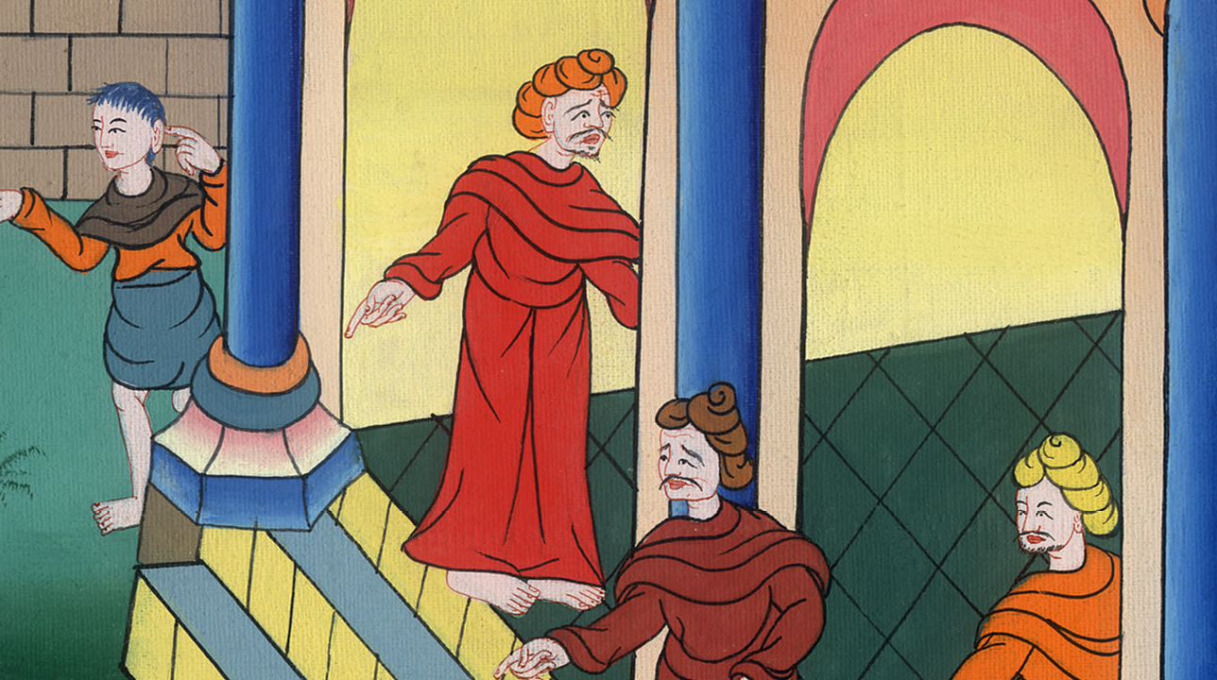
Luke 22:2

Slide 13
3Satan entered into Judas, who was also called Iscariot, who was counted with the twelve.

Slide 14
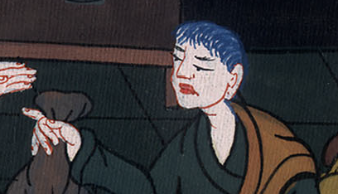
Luke 22:3

Slide 15
4He went away and talked with the chief priests and captains about how he might deliver him to them.

Slide 16
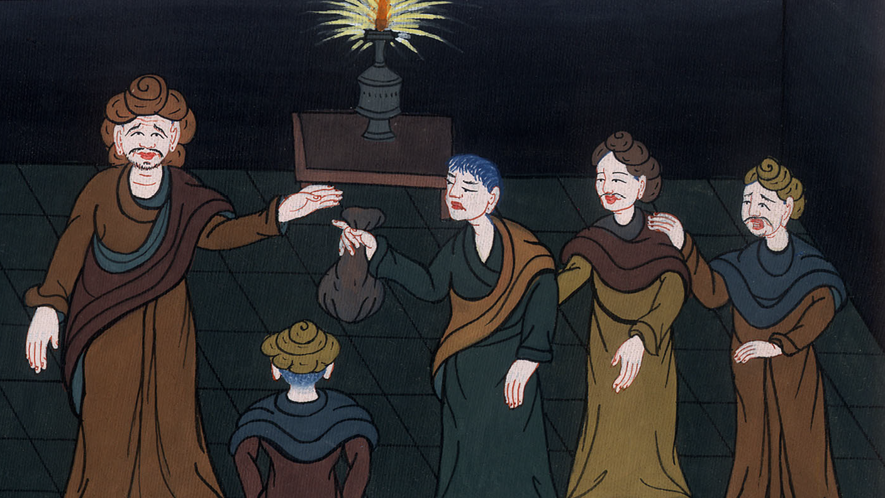
Luke 22:4

Slide 17
Matt 15and said, “What are you willing to give me if I deliver him to you?” So they weighed out for him thirty pieces of silver.

Slide 18
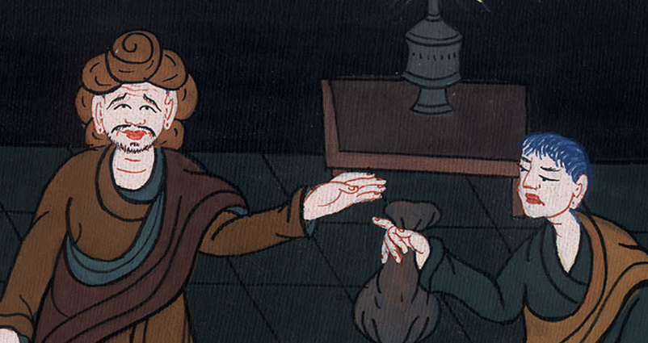
Matthew 26:15

Slide 19
Luke 22:6He consented and sought an opportunity to deliver him to them in the absence of the multitude.

Slide 20
Luke 22:6

