Slide 1
42-4
This work is licensed under a Creative Commons Attribution-ShareAlike 4.0 International License.
Please add this statement to all the videos you create.
English Bible quotes are from the World English Bible US, which is in the public domain.
Notes:
ch

Slide 2
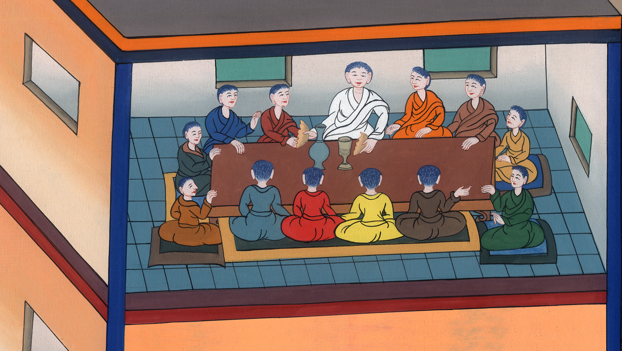
The last Supper –
Luke 22:7-27; John 13:1-17:26; Luke 22:31-39

Slide 3
The last Supper – Luke 22:7-27; John 13:1-17:26; Luke 22:31-39
John
Notes:
42 Temple Merchants
1. Temple Merchants - Matt 21:12-17; Mark 11:15-19; Luke 19:45-48 (Left Top)
2. Paying Taxes - Matt 22:15-22; Mark 12:13-17; Luke 20:20-26 (Right Top)
3. The Widow’s Mite - Mark 12:41-44; Luke 21:1-4 (Right Top)
4. Fig Tree - Matt 21:18-22; Mark 11:12-14, 20-26; (John 15:1-17) (Right Center)
5. Judas agrees to betray Jesus – Matt 26:14-16; Luke 21:37-22:6 (Right Bottom)
6(Left Bottom)

Slide 4
The last Supper –
Luke 22:7-27; John 13:1-17:26; Luke 22:31-39

Slide 5
7The day of unleavened bread came, on which the Passover must be sacrificed.
John

Slide 6
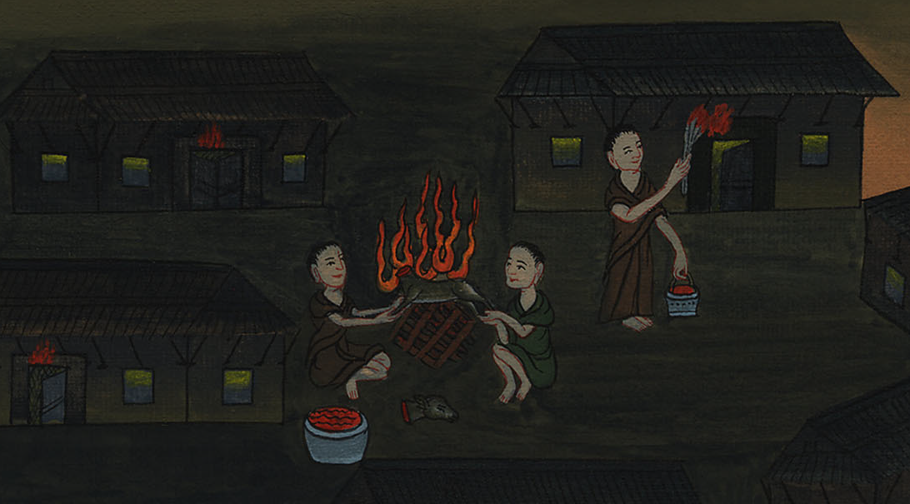
Luke 22:7

Slide 7
8Jesus sent Peter and John, saying, “Go and prepare the Passover for us, that we may eat.”
9They said to him, “Where do you want us to prepare?”
John

Slide 8
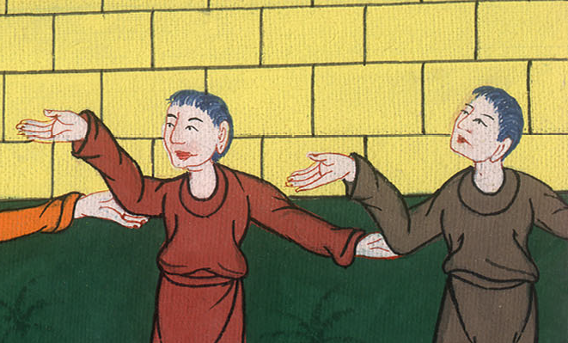
Luke 22:8,9

Slide 9
10He said to them, “Behold, when you have entered into the city, a man carrying a pitcher of water will meet you. Follow him into the house which he enters.
John

Slide 10
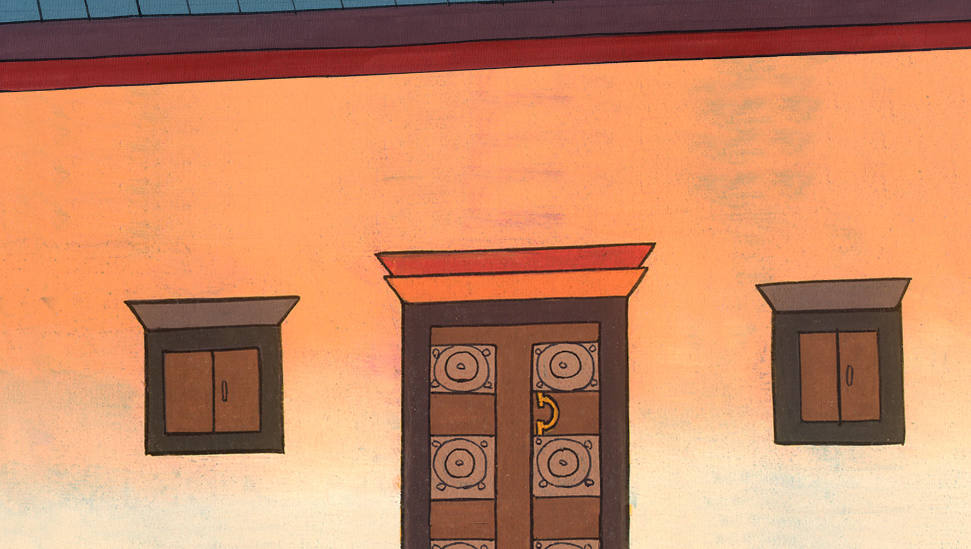
Luke 22:10

Slide 11
11Tell the master of the house, ‘The Teacher says to you, “Where is the guest room, where I may eat the Passover with my disciples?”’
John

Slide 12
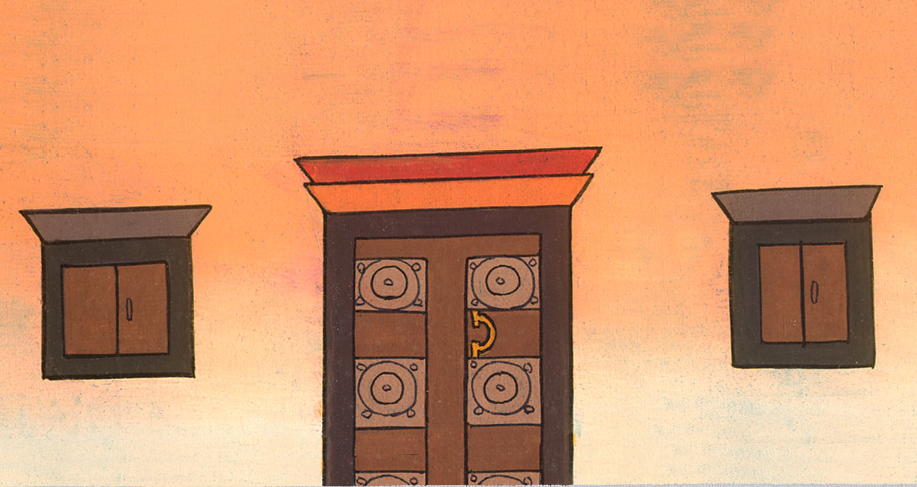
Luke 22:11

Slide 13
12He will show you a large, furnished upper room. Make preparations there.”
John

Slide 14
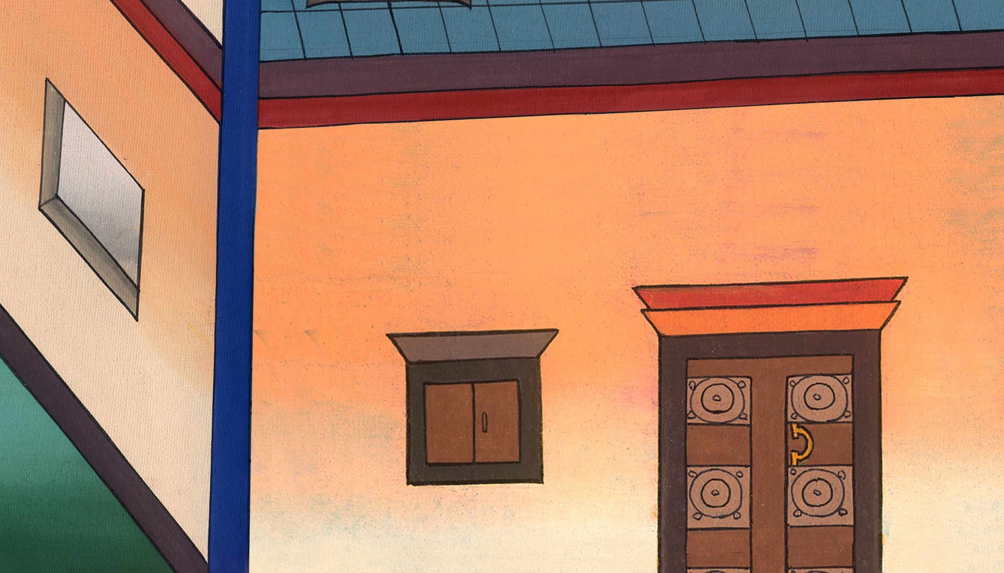
Luke 22:12

Slide 15
13They went, found things as Jesus had told them, and they prepared the Passover.
John

Slide 16
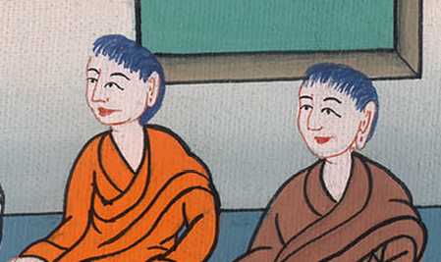
Luke 22:13

Slide 17
14When the hour had come, he sat down with the twelve apostles.
John

Slide 18
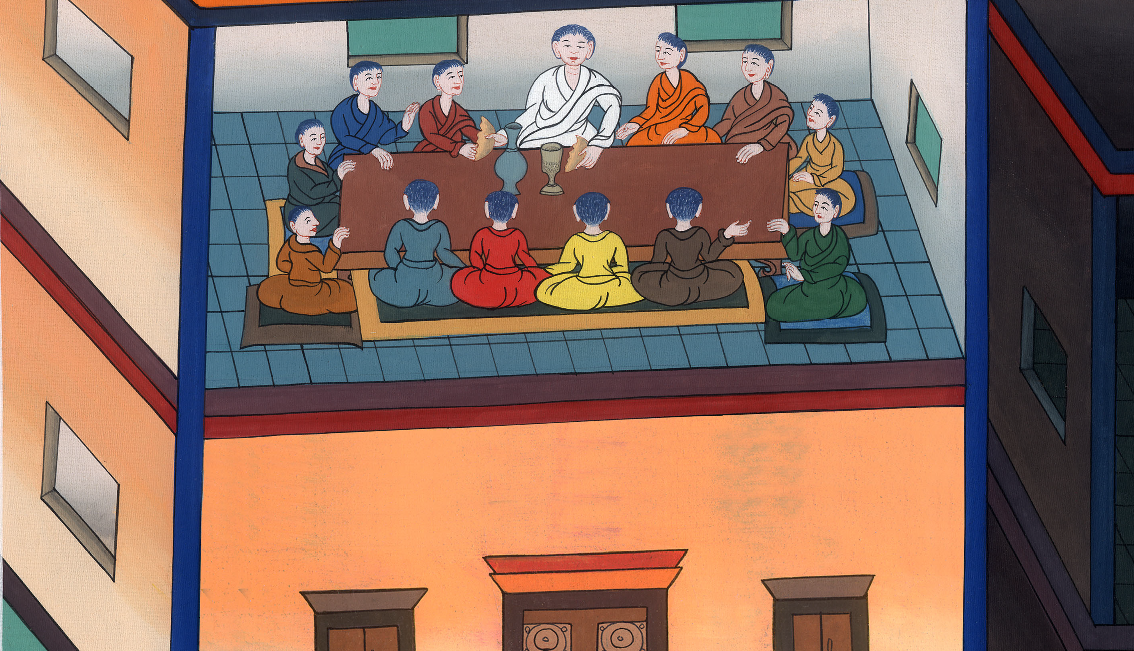
Luke 22:14

Slide 19
15He said to them, “I have earnestly desired to eat this Passover with you before I suffer,
John

Slide 20
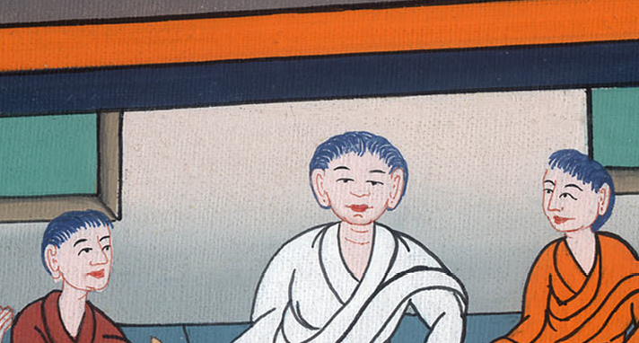
Luke 22:15

Slide 21
16for I tell you, I will no longer by any means eat of it until it is fulfilled in God’s Kingdom.”
John

Slide 22
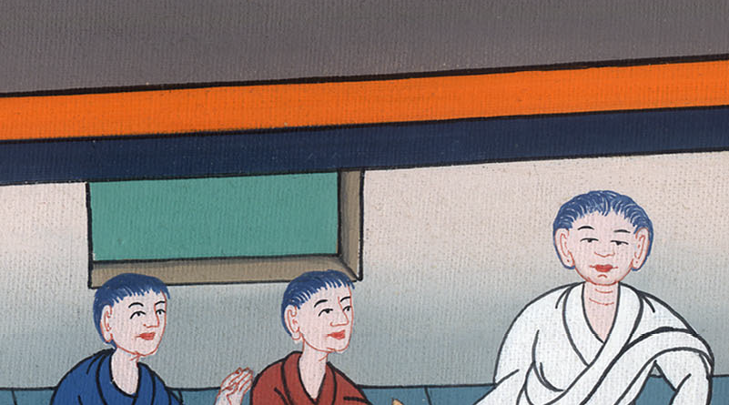
Luke 22:16

Slide 23
John 13:3Jesus, knowing that the Father had given all things into his hands, and that he came from God and was going to God
John

Slide 24
ཡོ་ཧ་ནན། 13:3

Slide 25
Luke 22:19He took bread, and when he had given thanks, he broke and gave it to them, saying, “This is my body which is given for you. Do this in memory of me.”
John

Slide 26
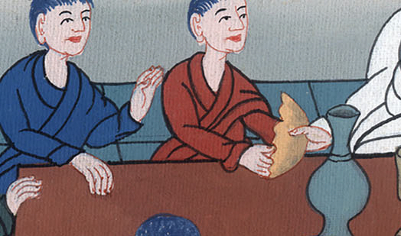
Luke 22:19

Slide 27
20Likewise, he took the cup after supper, saying, “This cup is the new covenant in my blood, which is poured out for you.
John

Slide 28
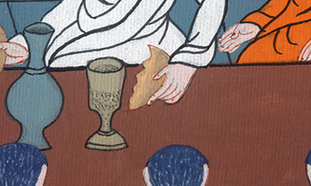
Luke 22:20

Slide 29
21But behold, the hand of him who betrays me is with me on the table.
John

Slide 30
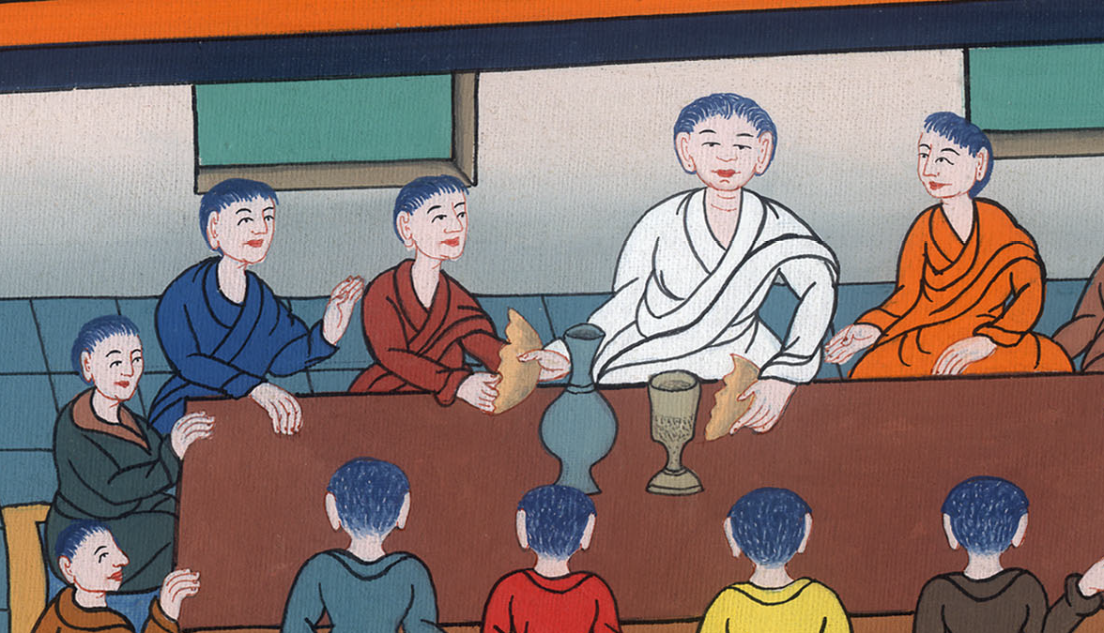
Luke 22:21

Slide 31
22The Son of Man indeed goes as it has been determined, but woe to that man through whom he is betrayed!”
John

Slide 32
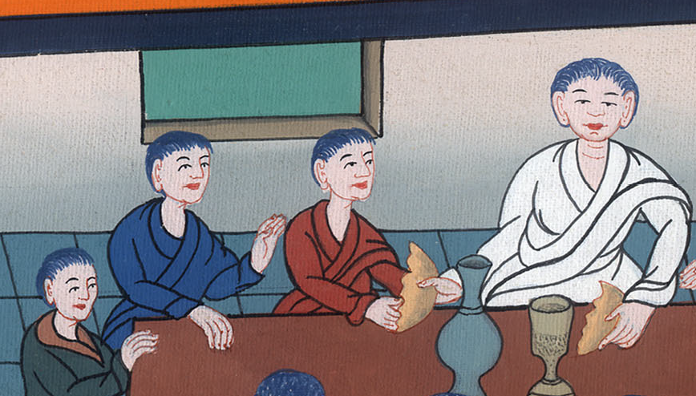
Luke 22:22

Slide 33
(John asked Jesus who it was) John 13:26Jesus therefore answered, “It is he to whom I will give this piece of bread when I have dipped it.” So when he had dipped the piece of bread, he gave it to Judas, the son of Simon Iscariot.
John

Slide 34
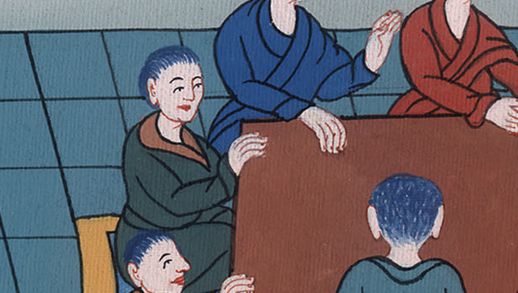
John 13:26

Slide 35
Then Jesus said to him, “What you do, do quickly.”
28Now nobody at the table knew why he said this to him. 30Therefore having received that morsel, he went out immediately. It was night.
John

Slide 36
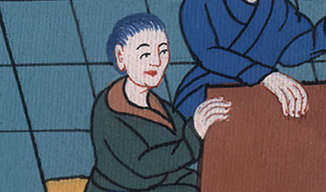
John 13:27,28,30

Slide 37
33Little children, I will be with you a little while longer. You will seek me, and as I said to the Jews, ‘Where I am going, you can’t come,’ so now I tell you.
John

Slide 38
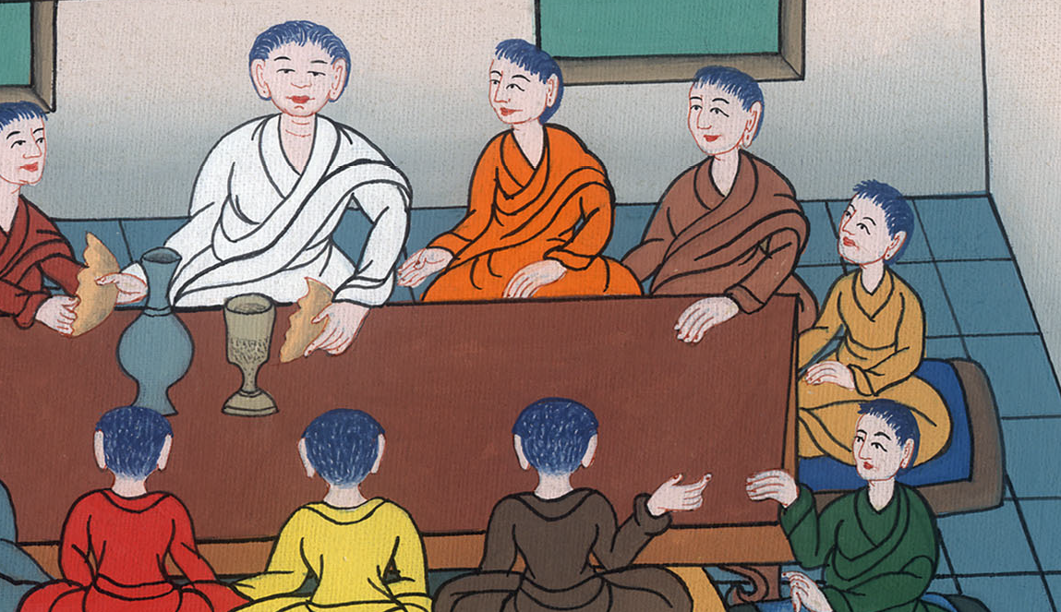
John 13:33

Slide 39
37Peter said to him, “Lord, why can’t I follow you now? I will lay down my life for you.”
John

Slide 40
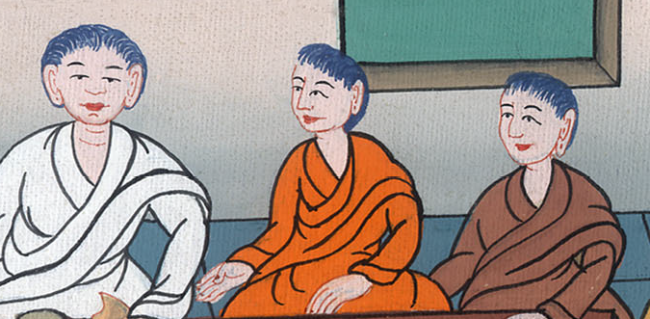
John 13:37

Slide 41
38Jesus answered him, “Will you lay down your life for me? Most certainly I tell you, the rooster won’t crow (twice) until you have denied me three times.
John

Slide 42
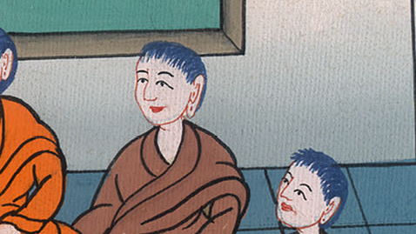
John 13:38

Slide 43
luke 22 32but I prayed for you, that your faith wouldn’t fail. You, when once you have turned again, establish your brothers.”
John

Slide 44
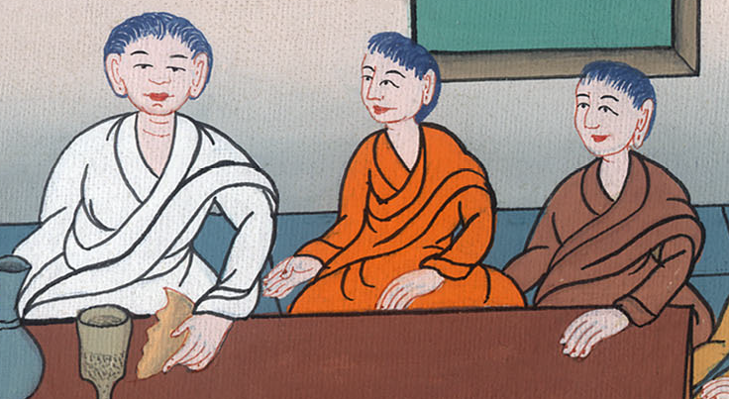
Luke 22:32

Slide 45
John 15 12 “This is my commandment, that you love one another, even as I have loved you. 13Greater love has no one than this, that someone lay down his life for his friends.
John

Slide 46
John 14:12

Slide 47
Luke:22 37For I tell you that this which is written must still be fulfilled in me: ‘He was counted with transgressors.’ For that which concerns me is being fulfilled.”
John

Slide 48
Luke 22:37

