Slide 1
43-1
This work is licensed under a Creative Commons Attribution-ShareAlike 4.0 International License.
Please add this statement to all the videos you create.
English Bible quotes are from the World English Bible US, which is in the public domain.
Notes:
Ch
43 Garden of Gethsemane
1. Garden of Gethsemane - Matt 26:36-46; Mark 14:32-42; Luke 22:39-46; John 18:1 (Left
Top)
2. Arrest of Jesus - Matt 26:47-56; Mark 14:43-52; Luke 22:47-53; John 18:2-11 (Right
Top)
3. Peter’s Denial - Matt 26:57-75; Mark 14:53-72; Luke 22:63 - 23:1; John 18:12-27
(Right Middle)
4. Jesus taken to Pilate, Judas Hangs - Matt 27:1-11; Luke 23:1-7; John 18:28-38 (Right
Bottom)
5. Jesus before Herod - Luke 23:8-12 (Left Bottom)
6. Jesus is scourged - Luke 23:13-16; John 19:1-3 (Left Center)
7. Jesus before Pilot - John 19:4-15; Matt 27:15-26, 31 (Center)

Slide 2
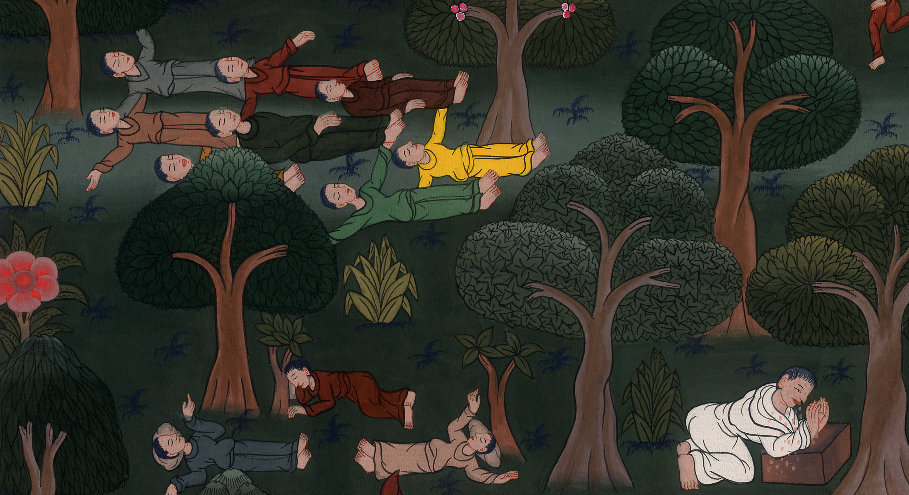
Garden of Gethsemane - Matthew 26:36-46; Mark 14:32-42; Luke 22:39-46; John 18:1

Slide 3
Garden of Gethsemane - Matthew 26:36-46; Mark 14:32-42; Luke 22:39-46; John 18:1
John

Slide 4
Garden of Gethsemane - Matthew 26:36-46; Mark 14:32-42; Luke 22:39-46; John 18:1

Slide 5
36Then Jesus came with them to a place called Gethsemane, and said to his disciples, “Sit here, while I go there and pray.”
John

Slide 6
Matthew 26:36

Slide 7
37He took with him Peter and the two sons of Zebedee, and began to be sorrowful and severely troubled.
John

Slide 8
Matthew 26:37

Slide 9
38Then he said to them, “My soul is exceedingly sorrowful, even to death. Stay here and watch with me.”
John

Slide 10
Matthew 26:38

Slide 11
39He went forward a little, fell on his face, and prayed, saying, “My Father, if it is possible, let this cup pass away from me; nevertheless, not what I desire, but what you desire.”
John

Slide 12
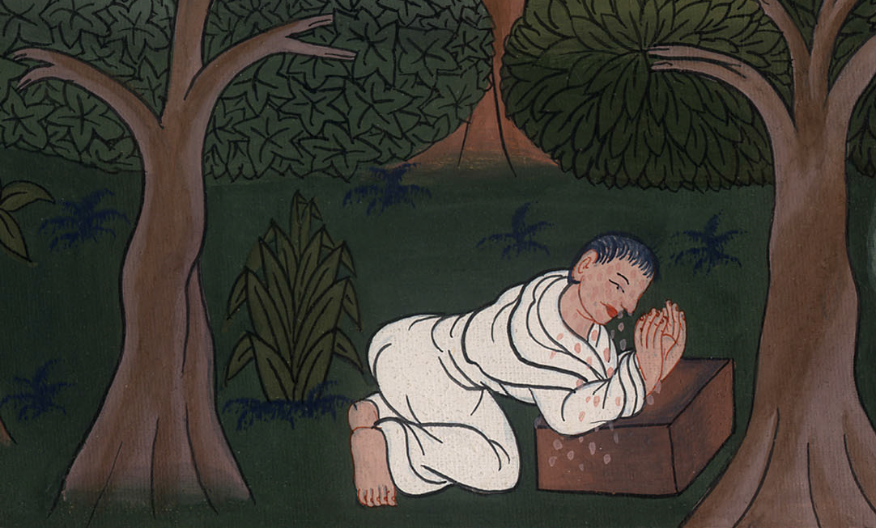
Matthew 26:39

Slide 13
43An angel from heaven appeared to him, strengthening him.
John

Slide 14
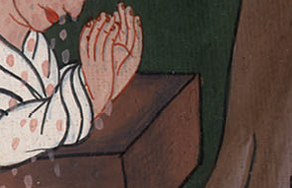
Luke 22:43

Slide 15
44Being in agony, he prayed more earnestly. His sweat became like great drops of blood falling down on the ground.
John

Slide 16
Luke 22:44

Slide 17
Matthew 26:40He came to the disciples and found them sleeping, and said to Peter, “What, couldn’t you watch with me for one hour?
John

Slide 18
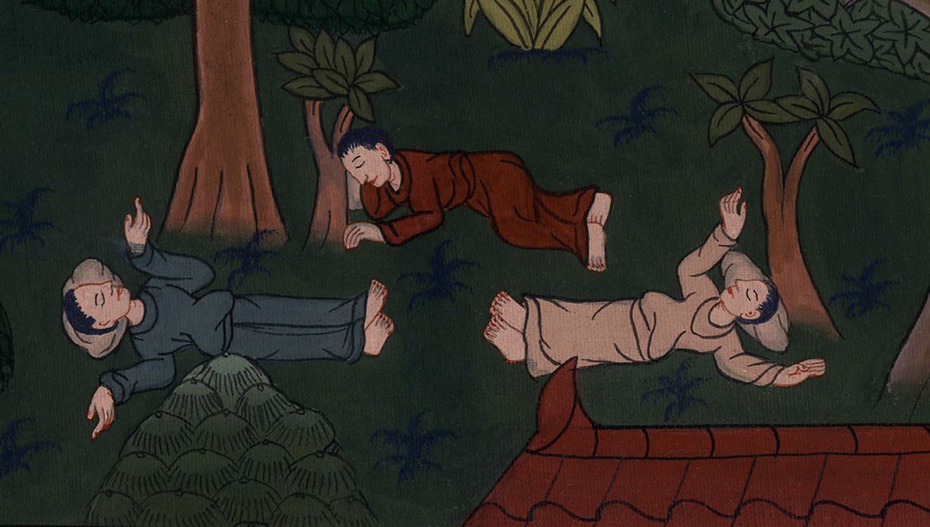
Matthew 26:40

Slide 19
41Watch and pray, that you don’t enter into temptation. The spirit indeed is willing, but the flesh is weak.”
John

Slide 20
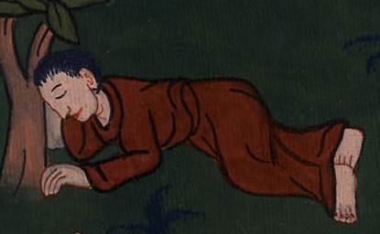
Matthew 26:41

Slide 21
42Again, a second time he went away and prayed, saying, “My Father, if this cup can’t pass away from me unless I drink it, your desire be done.”
John

Slide 22
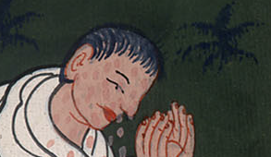
Matthew 26:42

Slide 23
43He came again and found them sleeping, for their eyes were heavy. 44He left them again, went away, and prayed a third time, saying the same words.
John

Slide 24
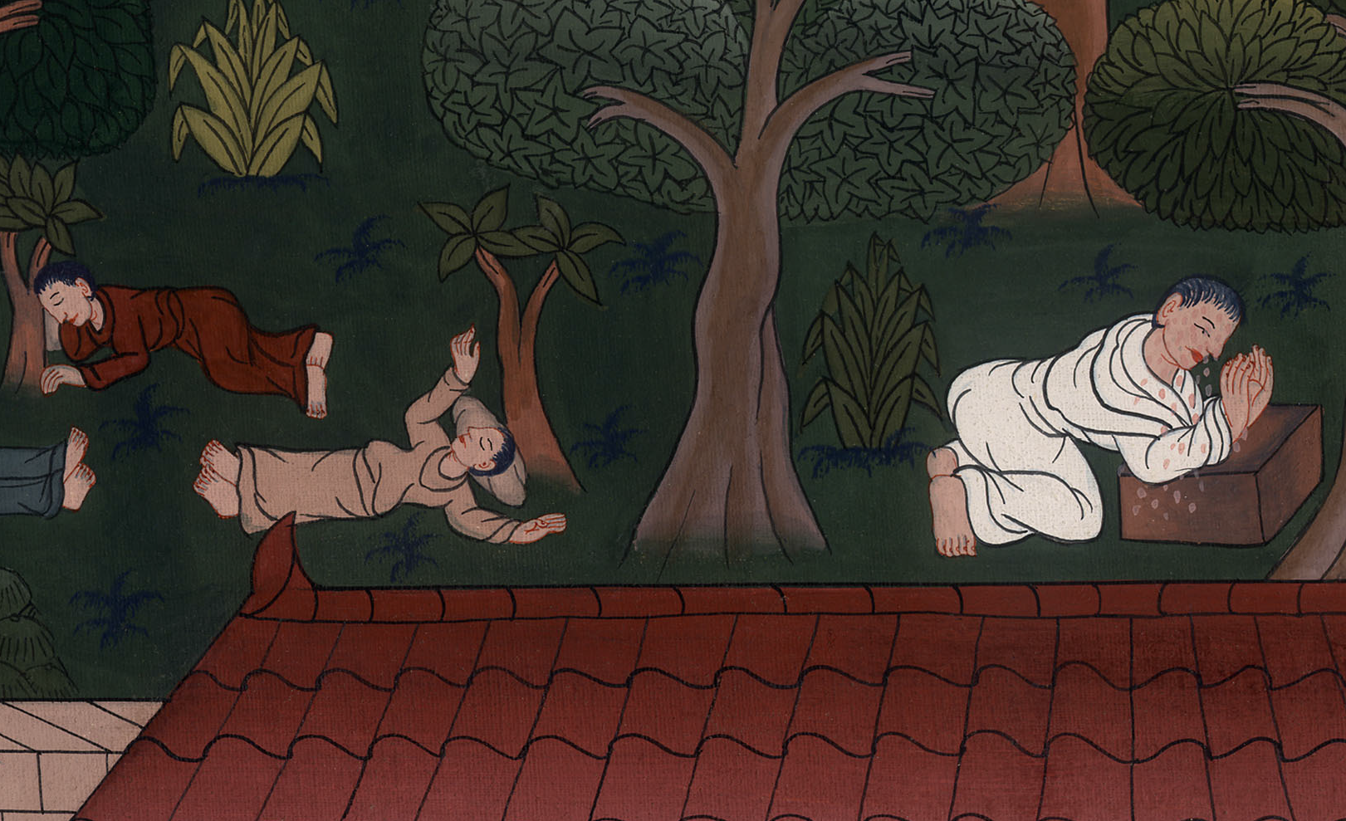
Matthew 26:43,44

Slide 25
45Then he came to his disciples and said to them, “Are you still sleeping and resting? Behold, the hour is at hand, and the Son of Man is betrayed into the hands of sinners.
John

Slide 26
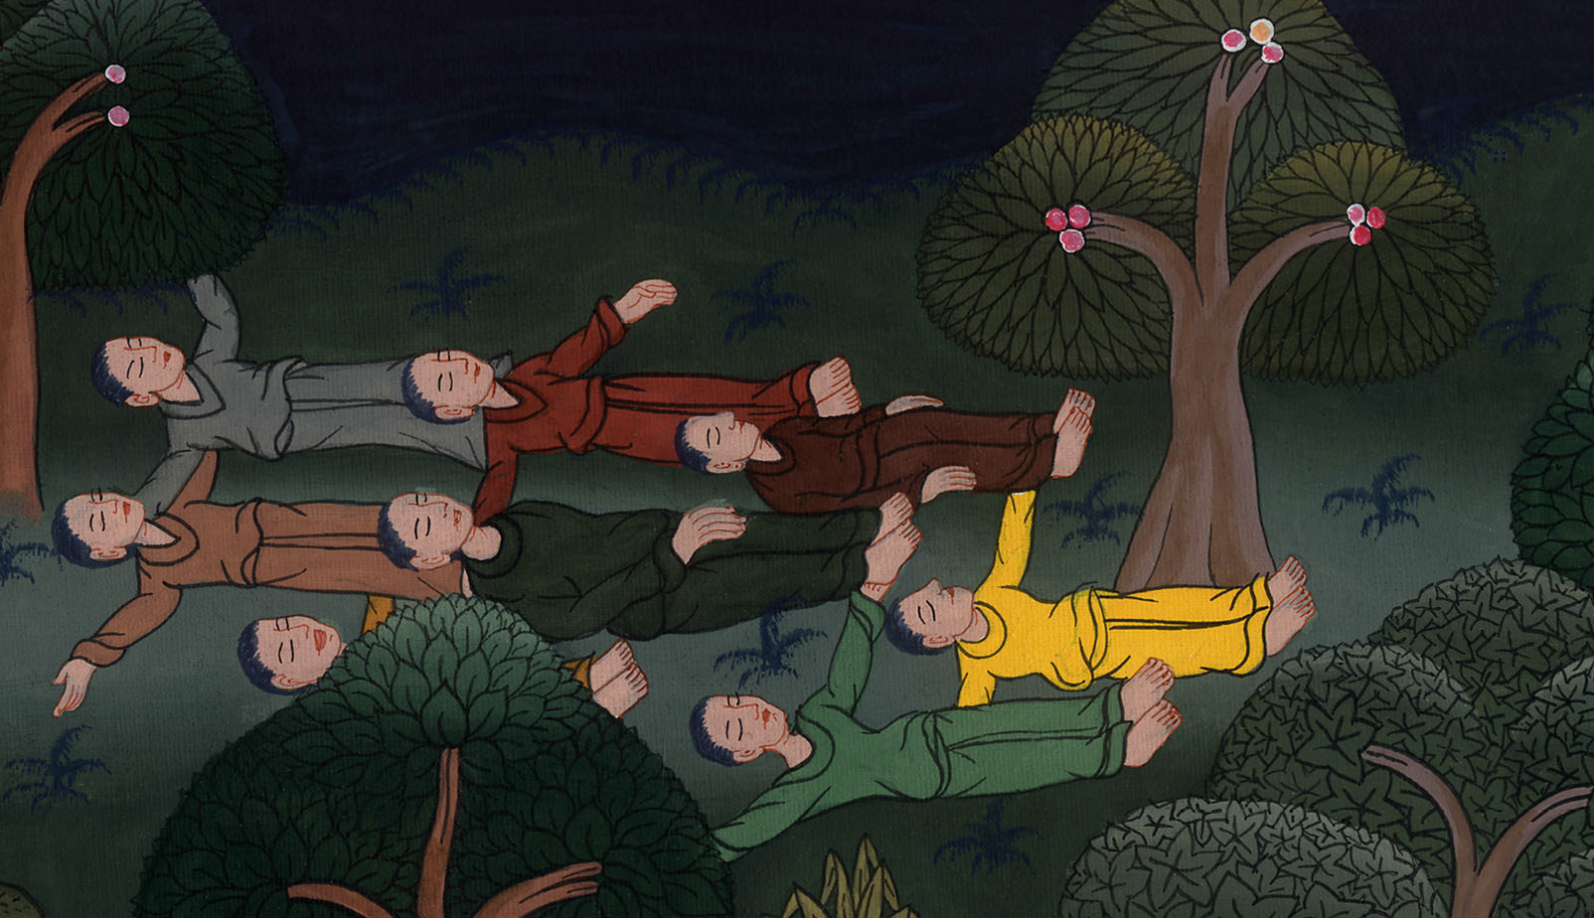
Matthew 26:45

Slide 27
46Arise, let’s be going. Behold, he who betrays me is at hand.”
John

Slide 28
Matthew 26:46

