Slide 1
43-2
This work is licensed under a Creative Commons Attribution-ShareAlike 4.0 International License.
Please add this statement to all the videos you create.
English Bible quotes are from the World English Bible US, which is in the public domain.
Notes:
Ch
43 Garden of Gethsemane
1. Garden of Gethsemane - Matt 26:36-46; Mark 14:32-42; Luke 22:39-46; John 18:1 (Left
Top)
2. Arrest of Jesus - Matt 26:47-56; Mark 14:43-52; Luke 22:47-53; John 18:2-11 (Right
Top)
3. Peter’s Denial - Matt 26:57-75; Mark 14:53-72; Luke 22:63 - 23:1; John 18:12-27
(Right Middle)
4. Jesus taken to Pilate, Judas Hangs - Matt 27:1-11; Luke 23:1-7; John 18:28-38 (Right
Bottom)
5. Jesus before Herod - Luke 23:8-12 (Left Bottom)
6. Jesus is scourged - Luke 23:13-16; John 19:1-3 (Left Center)
7. Jesus before Pilot - John 19:4-15; Matt 27:15-26, 31 (Center)

Slide 2
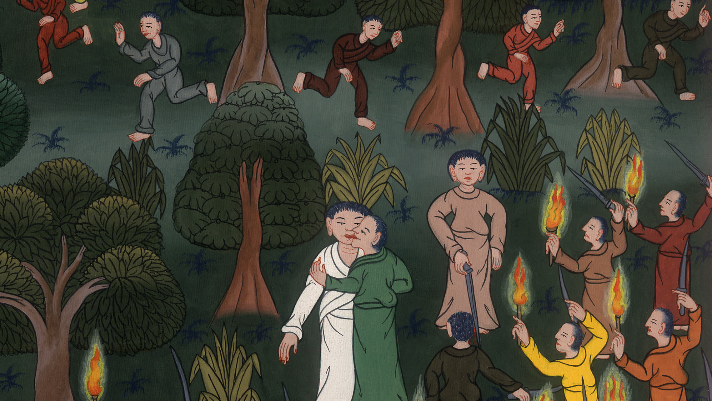
Arrest of Jesus –
Matthew 26:47-56; Mark 14:43-52; Luke 22:47-53; John 18:2-11

Slide 3
Arrest of Jesus - Matthew 26:47-56; Mark 14:43-52; Luke 22:47-53; John 18:2-11
John

Slide 4
Arrest of Jesus –
Matthew 26:47-56; Mark 14:43-52; Luke 22:47-53; John 18:2-11

Slide 5
(After praying the third time, Jesus came back to the disciples and said) Matthew 46Arise, let’s be going. Behold, he who betrays me is at hand.”
John

Slide 6
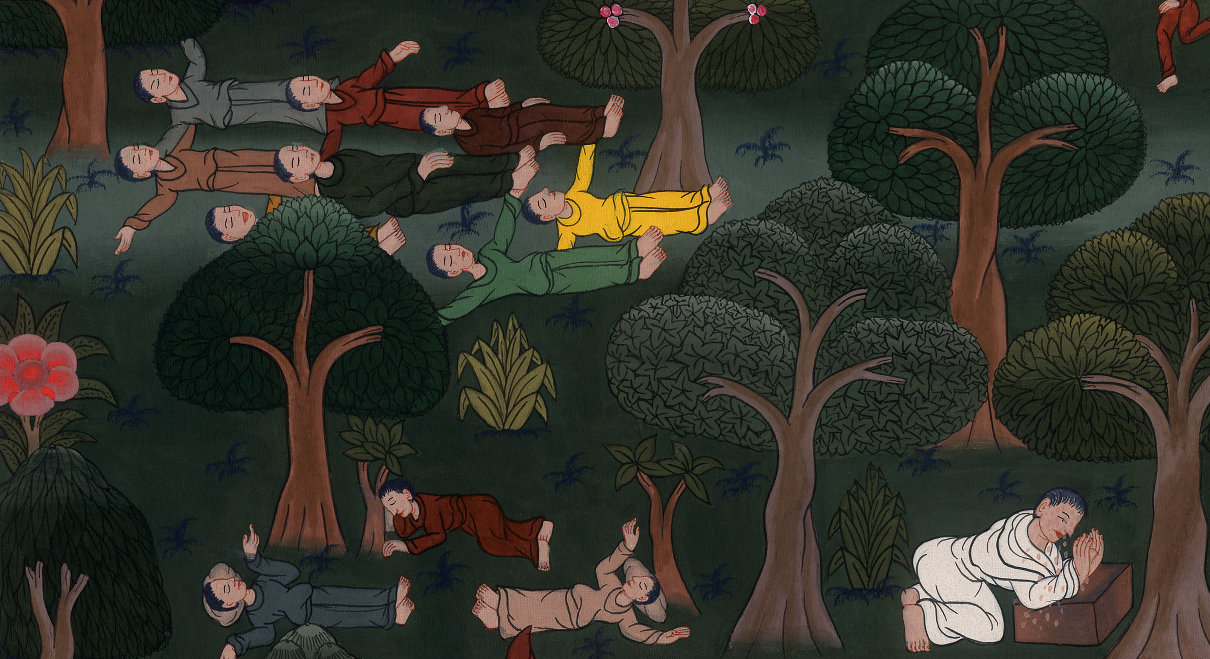
Matthew 26:46

Slide 7
Matt 26:47While he was still speaking, behold, Judas, one of the twelve, came, and with him a great multitude with swords and clubs, from the chief priests and elders of the people.
John

Slide 8
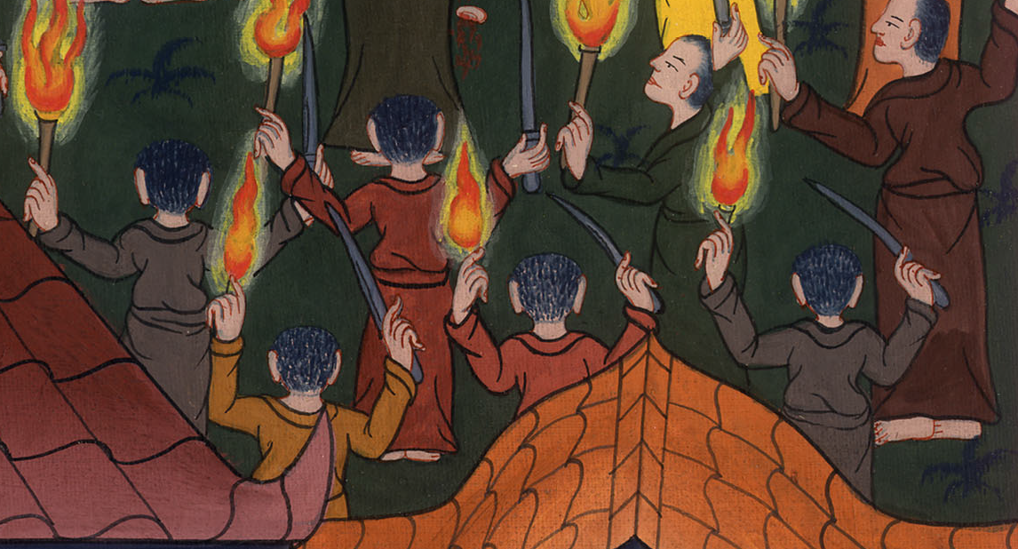
Matthew 26:47

Slide 9
48Now he who betrayed him had given them a sign, saying, “Whoever I kiss, he is the one. Seize him.” 49Immediately he came to Jesus, and said, “Greetings, Rabbi!” and kissed him.
John

Slide 10
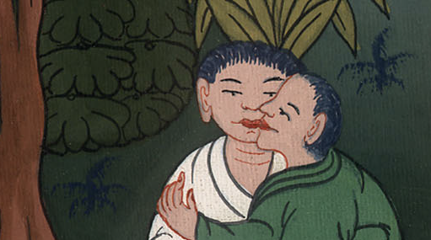
Matthew 26:48,49

Slide 11
50Jesus said to him, “Friend, why are you here?”
Then they came and laid hands on Jesus, and took him.
John

Slide 12
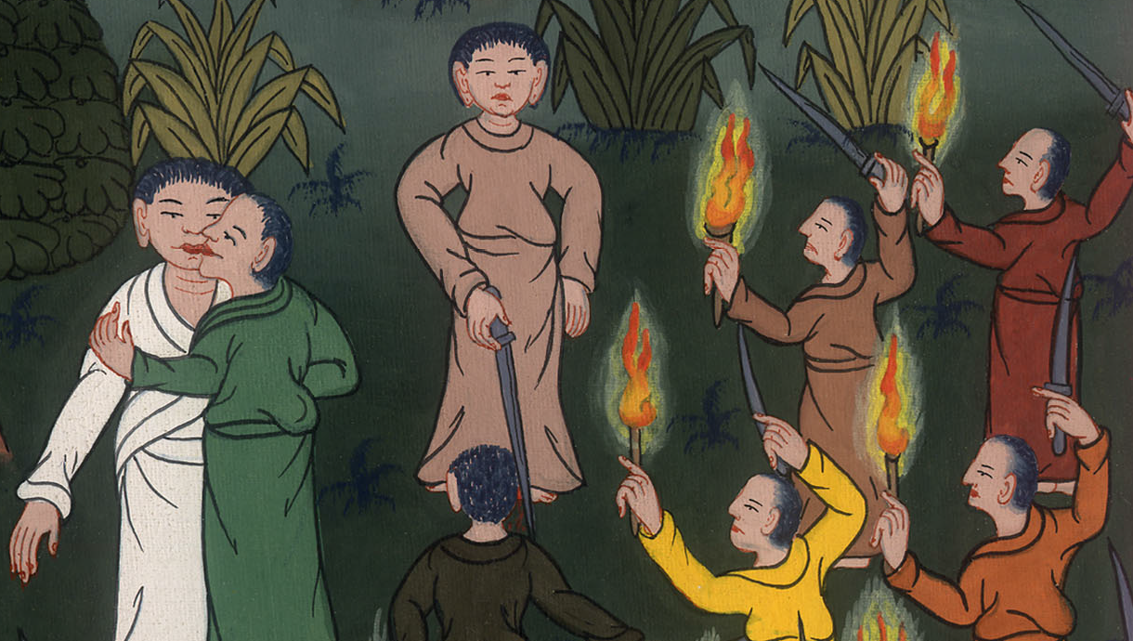
Matthew 26:50

Slide 13
49When those who were around him saw what was about to happen, they said to him, “Lord, shall we strike with the sword?” 50A certain one of them struck the servant of the high priest, and cut off his right ear.
John

Slide 14
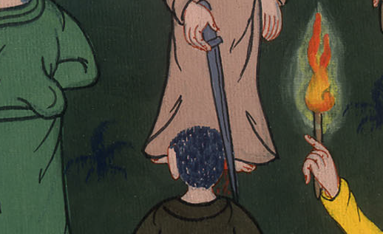
Luke 22:49,50

Slide 15
51But Jesus answered, “Let me at least do this”—and he touched his ear and healed him.
John

Slide 16
Luke 22:51

Slide 17
Matt 26:53Or do you think that I couldn’t ask my Father, and he would even now send me more than twelve legions of angels? 54How then would the Scriptures be fulfilled that it must be so?”
John

Slide 18
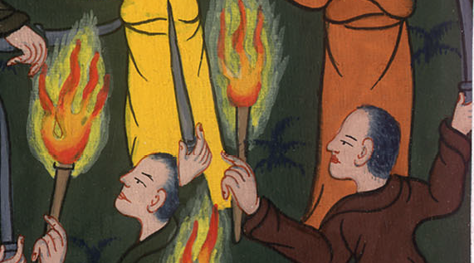
Matthew 26:53,54

Slide 19
55In that hour Jesus said to the multitudes, “Have you come out as against a robber with swords and clubs to seize me? I sat daily in the temple teaching, and you didn’t arrest me.
John

Slide 20
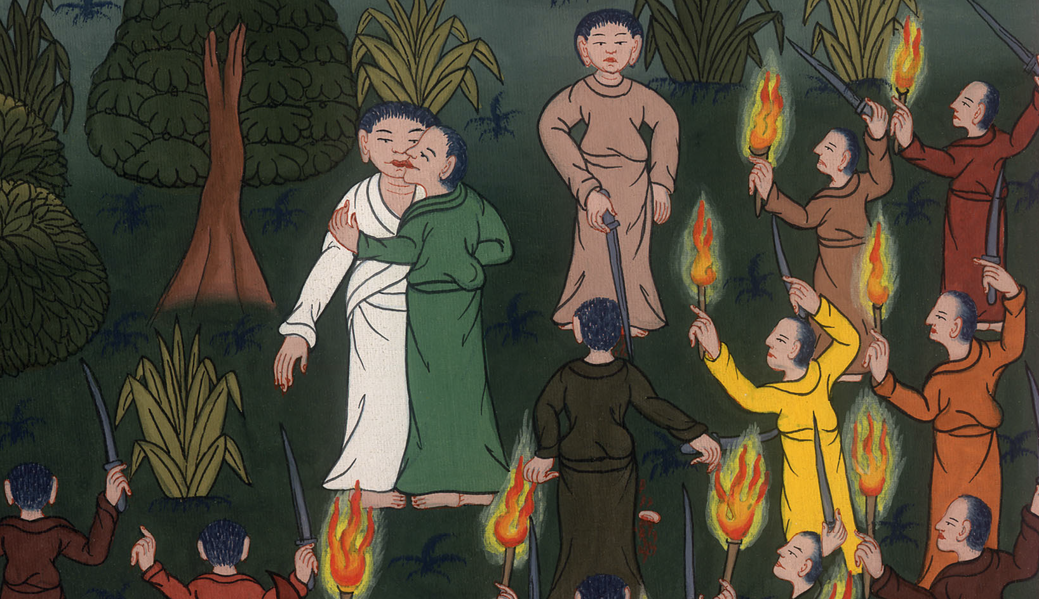
Matthew 26:55

Slide 21
56But all this has happened that the Scriptures of the prophets might be fulfilled.”
Then all the disciples left him and fled.
John

Slide 22
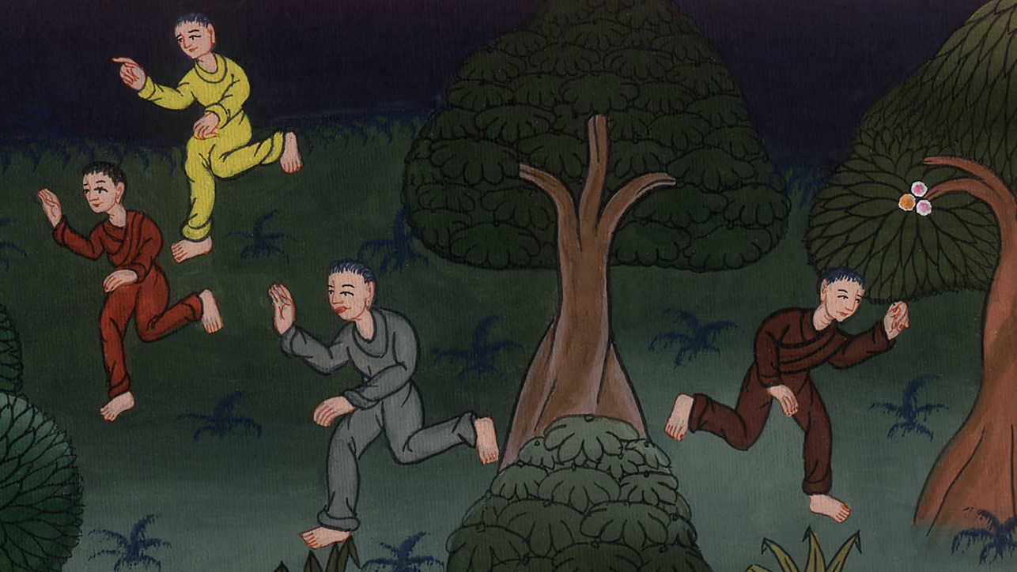
Matthew 26:56

