Slide 1
43-3
This work is licensed under a Creative Commons Attribution-ShareAlike 4.0 International License.
Please add this statement to all the videos you create.
English Bible quotes are from the World English Bible US, which is in the public domain.
Notes:
Ch
43 Garden of Gethsemane
1. Garden of Gethsemane - Matt 26:36-46; Mark 14:32-42; Luke 22:39-46; John 18:1 (Left
Top)
2. Arrest of Jesus - Matt 26:47-56; Mark 14:43-52; Luke 22:47-53; John 18:2-11 (Right
Top)
3. Peter’s Denial - Matt 26:57-75; Mark 14:53-72; Luke 22:63 - 23:1; John 18:12-27
(Right Middle)
4. Jesus taken to Pilate, Judas Hangs - Matt 27:1-11; Luke 23:1-7; John 18:28-38 (Right
Bottom)
5. Jesus before Herod - Luke 23:8-12 (Left Bottom)
6. Jesus is scourged - Luke 23:13-16; John 19:1-3 (Left Center)
7. Jesus before Pilot - John 19:4-15; Matt 27:15-26, 31 (Center)

Slide 2
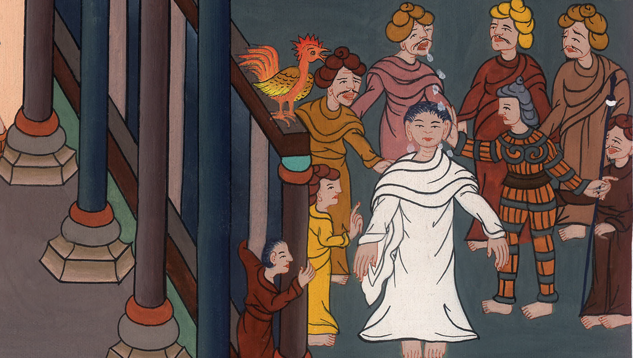
Peter’s Denial –
Matthew 26:57-75; Mark 14:53-72; Luke 22:63 - 23:1; John 18:12-27

Slide 3
Peter’s Denial - Matthew 26:57-75; Mark 14:53-72; Luke 22:63 - 23:1; John 18:12-27
John

Slide 4
Peter’s Denial –
Matthew 26:57-75; Mark 14:53-72; Luke 22:63 - 23:1; John 18:12-27

Slide 5
Mark 14:53They led Jesus away to the high priest. All the chief priests, the elders, and the scribes came together with him.
John

Slide 6
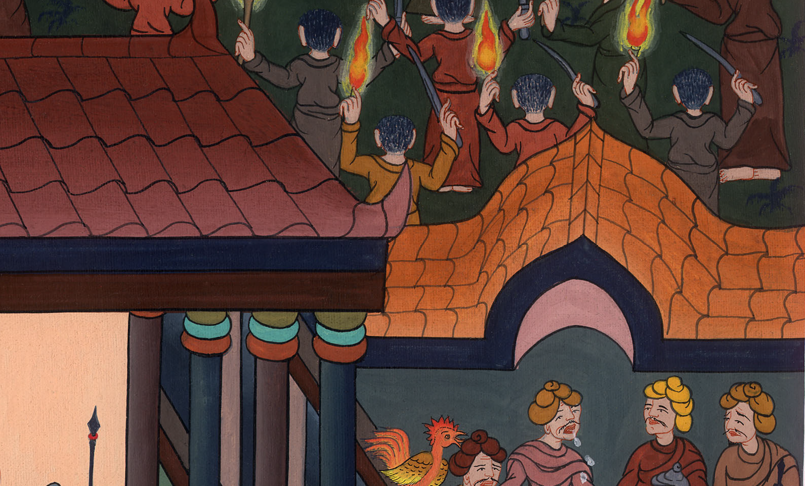
Mark 14:53

Slide 7
54Peter had followed him from a distance, until he came into the court of the high priest. He was sitting with the officers, and warming himself in the light of the fire.
John

Slide 8
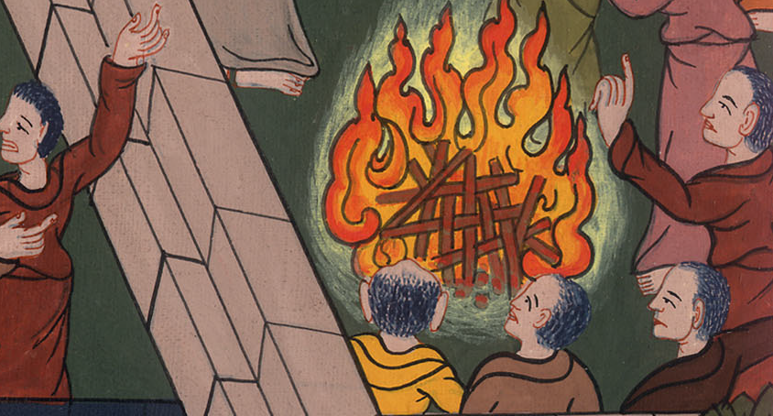
Mark 14:54

Slide 9
55Now the chief priests and the whole council sought witnesses against Jesus to put him to death, and found none.
John

Slide 10
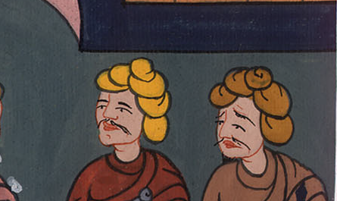
Mark 14:55

Slide 11
56For many gave false testimony against him, and their testimony didn’t agree with each other.
John

Slide 12
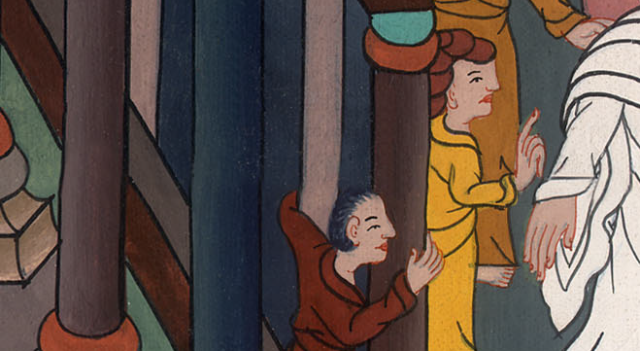
Mark 14:56

Slide 13
58“We heard him say, ‘I will destroy this temple that is made with hands, and in three days I will build another made without hands.’”
John

Slide 14
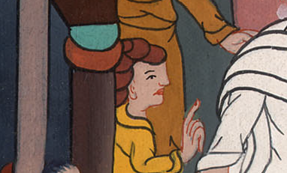
Mark 14:58

Slide 15
60The high priest stood up in the middle, and asked Jesus, “Have you no answer? What is it which these testify against you?”
John

Slide 16
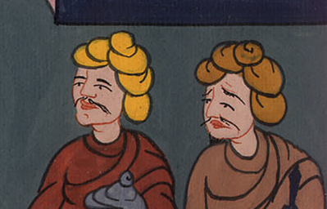
Mark 14:60

Slide 17
61But he stayed quiet, and answered nothing. Again the high priest asked him, “Are you the Christ, the Son of the Blessed?”
John

Slide 18
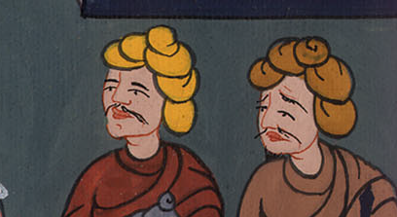
Mark 14:61

Slide 19
62Jesus said, “I am. You will see the Son of Man sitting at the right hand of Power, and coming with the clouds of the sky.”
John

Slide 20
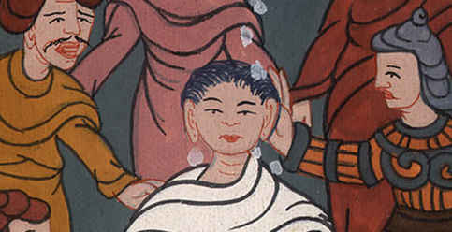
Mark 14:62

Slide 21
63The high priest tore his clothes and said, “What further need have we of witnesses? 64You have heard the blasphemy! What do you think?” They all condemned him to be worthy of death.
John

Slide 22
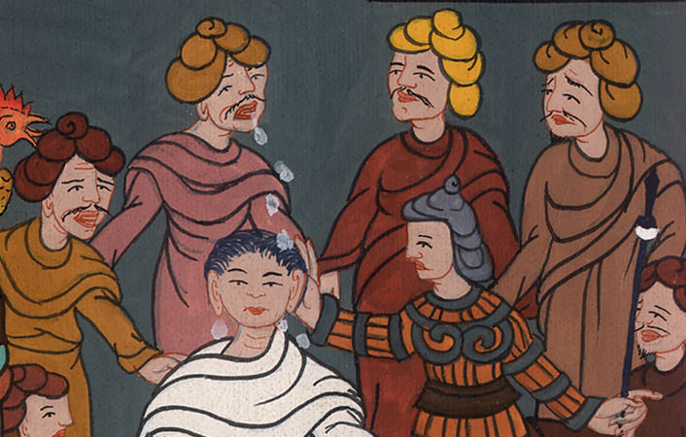
Mark 14:63,64

Slide 23
65Some began to spit on him, and to cover his face, and to beat him with fists, and to tell him, “Prophesy!” The officers struck him with the palms of their hands.
John

Slide 24
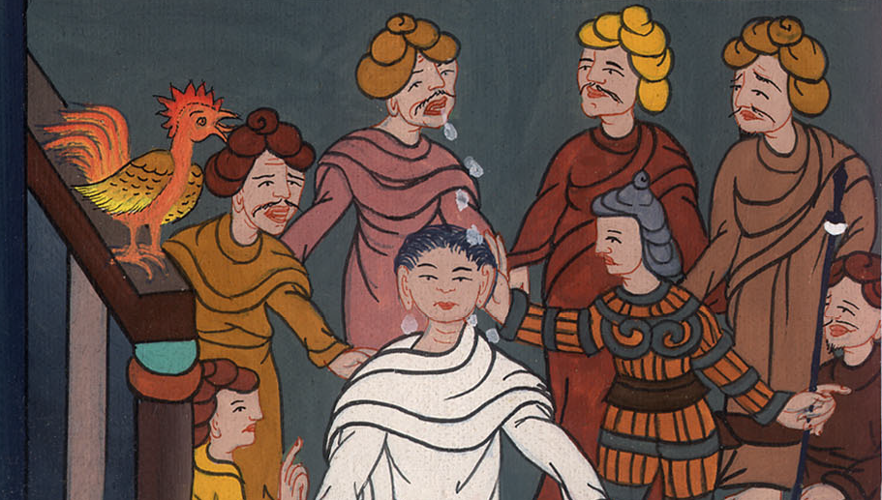
Mark 14:65

Slide 25
66As Peter was in the courtyard below, one of the maids of the high priest came, 67and seeing Peter warming himself, she looked at him and said, “You were also with the Nazarene, Jesus!”
John

Slide 26
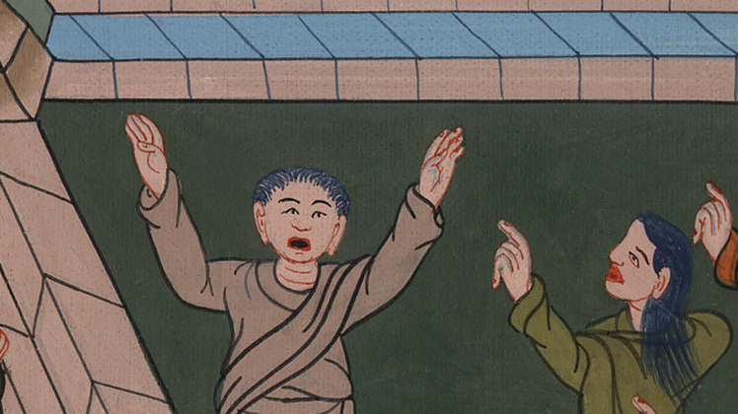
མར་ཀུ 14:66,67

Slide 27
68But he denied it, saying, “I neither know nor understand what you are saying.” He went out on the porch, and the rooster crowed.
John

Slide 28
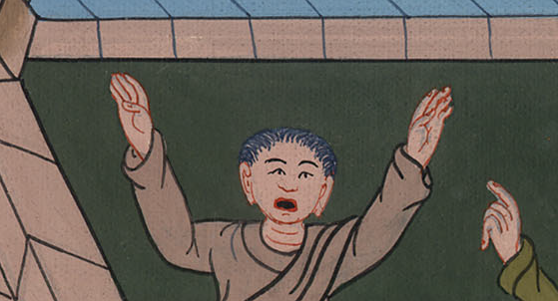
མར་ཀུ 14:68

Slide 29
69The maid saw him and began again to tell those who stood by, “This is one of them.”
John

Slide 30
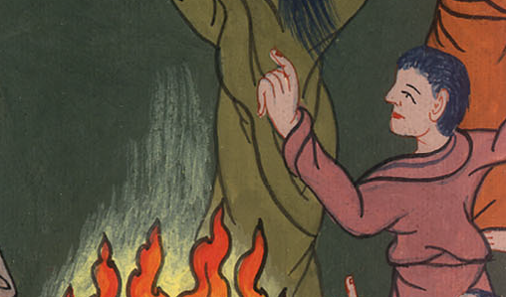
མར་ཀུ 14:69

Slide 31
70But he again denied it. After a little while again those who stood by said to Peter, “You truly are one of them, for you are a Galilean, and your speech shows it.”
John

Slide 32
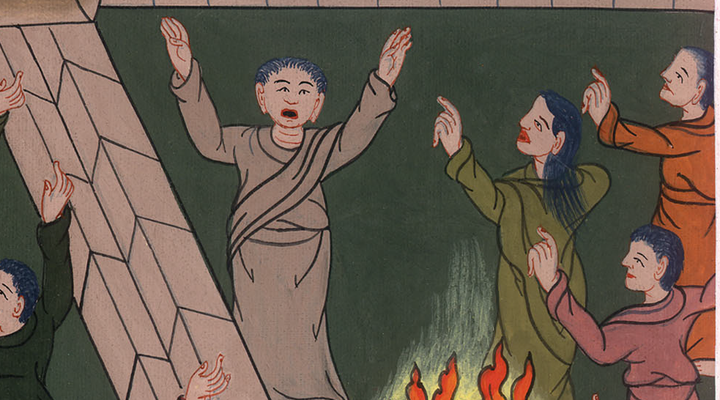
མར་ཀུ 14:70

Slide 33
71But he began to curse and to swear, “I don’t know this man of whom you speak!”
72The rooster crowed the second time.
John

Slide 34
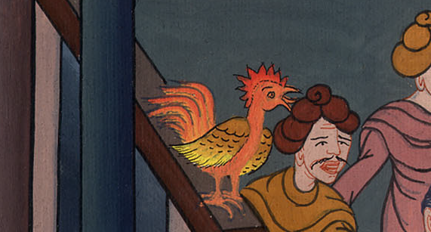
མར་ཀུ 14:71,72

Slide 35
Peter remembered the words that Jesus said to him, “Before the rooster crows twice, you will deny me three times.” When he thought about that, he wept.
John

Slide 36
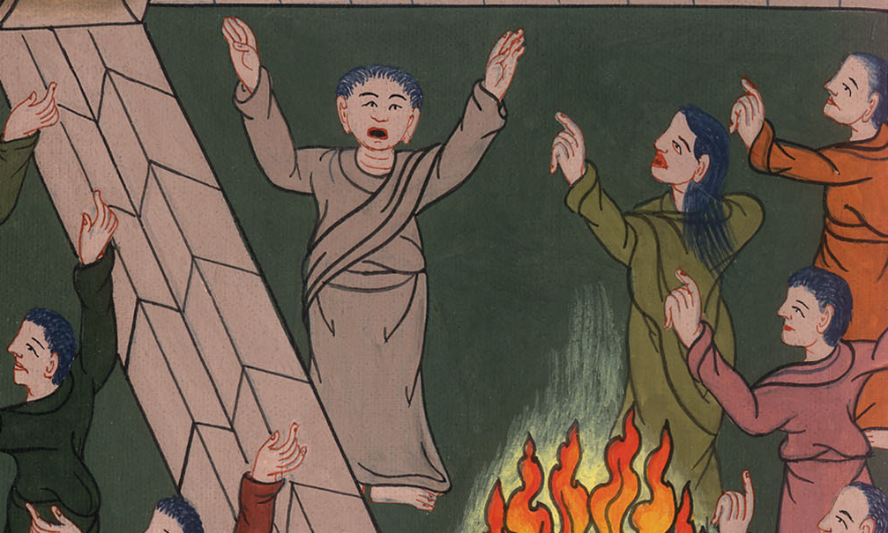
མར་ཀུ 14:72

