Slide 1
43-4
This work is licensed under a Creative Commons Attribution-ShareAlike 4.0 International License.
Please add this statement to all the videos you create.
English Bible quotes are from the World English Bible US, which is in the public domain.
Notes:
Ch
43 Garden of Gethsemane
1. Garden of Gethsemane - Matt 26:36-46; Mark 14:32-42; Luke 22:39-46; John 18:1 (Left
Top)
2. Arrest of Jesus - Matt 26:47-56; Mark 14:43-52; Luke 22:47-53; John 18:2-11 (Right
Top)
3. Peter’s Denial - Matt 26:57-75; Mark 14:53-72; Luke 22:63 - 23:1; John 18:12-27
(Right Middle)
4. Jesus taken to Pilate, Judas Hangs - Matt 27:1-11; Luke 23:1-7; John 18:28-38 (Right
Bottom)
5. Jesus before Herod - Luke 23:8-12 (Left Bottom)
6. Jesus is scourged - Luke 23:13-16; John 19:1-3 (Left Center)
7. Jesus before Pilot - John 19:4-15; Matt 27:15-26, 31 (Center)

Slide 2
Jesus taken to Pilate, Judas Hangs –
Matthew 27:1-11; Luke 23:1-7; John 18:28-38

Slide 3
Jesus taken to Pilate, Judas Hangs - Matthew 27:1-11; Luke 23:1-7; John 18:28-38
John

Slide 4
Jesus taken to Pilate, Judas Hangs –
Matthew 27:1-11; Luke 23:1-7; John 18:28-38

Slide 5
LUKE 23
(After deciding that Jesus must be sentenced to death) 1The whole company of them rose up and brought him before Pilate. .
John

Slide 6
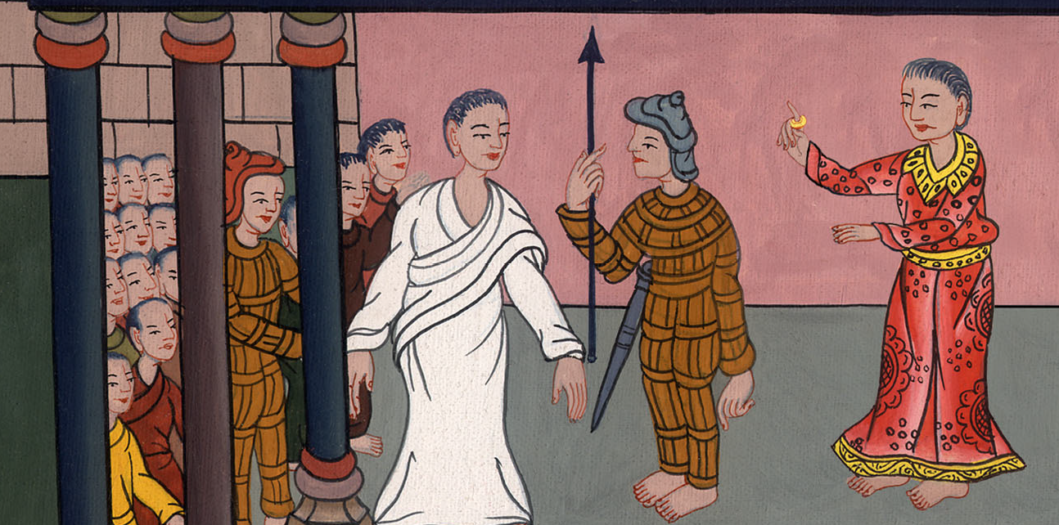
Luke 23:1

Slide 7
2They began to accuse him, saying, “We found this man perverting the nation, forbidding paying taxes to Caesar, and saying that he himself is Christ, a king.”
John

Slide 8
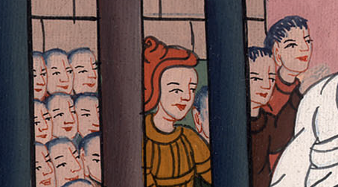
Luke 23:2

Slide 9
3Pilate asked him, “Are you the King of the Jews?”
He answered him, “So you say.”
John

Slide 10
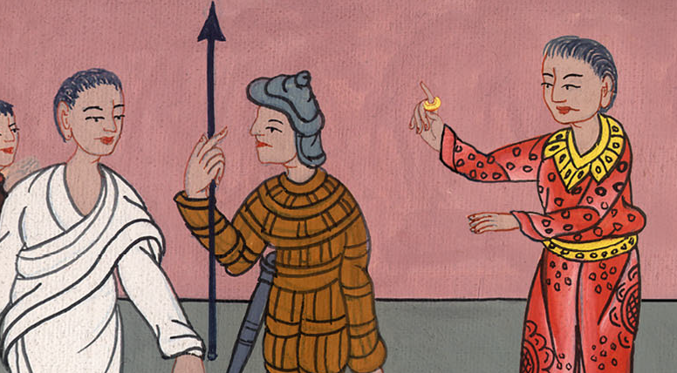
Luke 23:3

Slide 11
John 18: 36Jesus answered, “My Kingdom is not of this world. If my Kingdom were of this world, then my servants would fight, that I wouldn’t be delivered to the Jews. But now my Kingdom is not from here.”
John

Slide 12
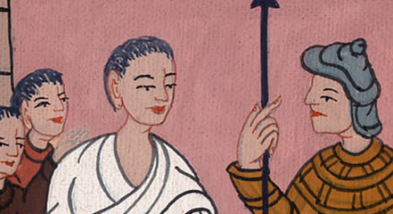
John 18:36

Slide 13
37Pilate therefore said to him, “Are you a king then?”
Jesus answered, “You say that I am a king. For this reason I have been born, and for this reason I have come into the world, that I should testify to the truth. Everyone who is of the truth listens to my voice.”
John

Slide 14
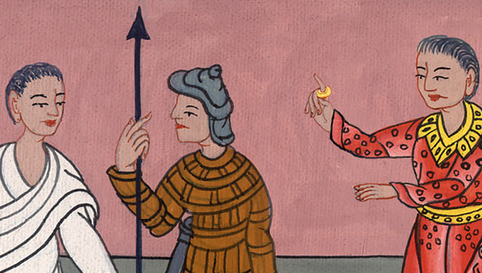
John 18:37

Slide 15
38Pilate said to him, “What is truth?”
When he had said this, he went out again to the Jews, and said to them, “I find no basis for a charge against him.
John

Slide 16
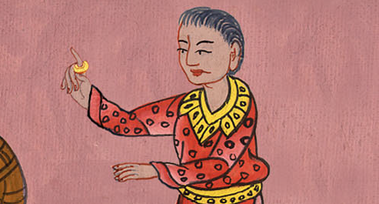
John 18:38

Slide 17
Luke23: 5But they insisted, saying, “He stirs up the people, teaching throughout all Judea, beginning from Galilee even to this place.”
John

Slide 18
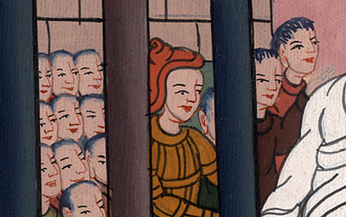
Luke 23:5

Slide 19
6But when Pilate heard Galilee mentioned, he asked if the man was a Galilean.
John

Slide 20
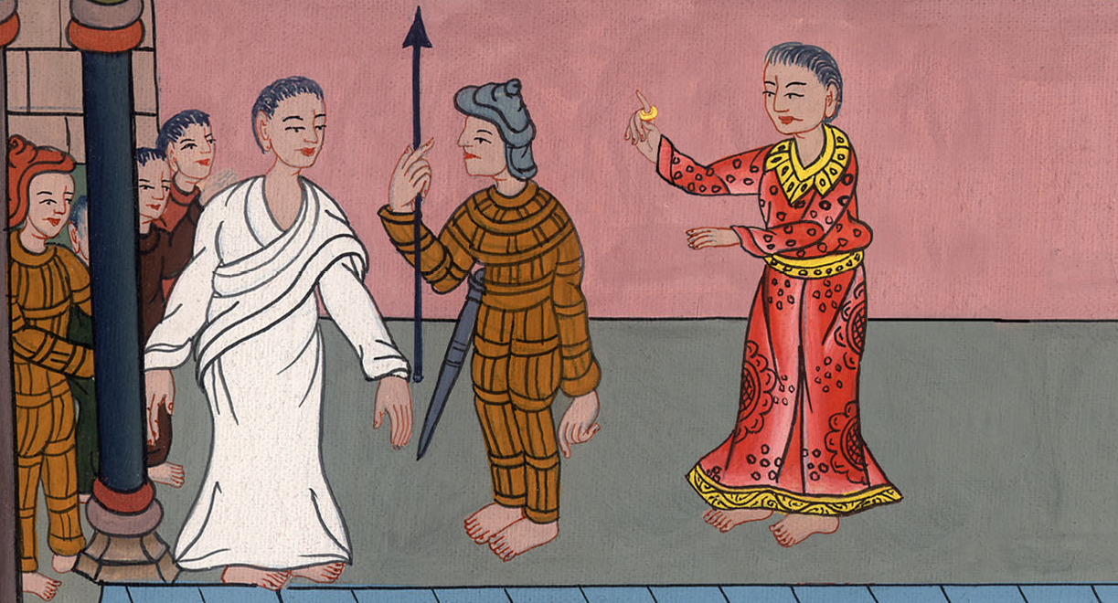
Luke 23:6

Slide 21
Matt 27: 3Then Judas, who betrayed him, when he saw that Jesus was condemned, felt remorse, and brought back the thirty pieces of silver to the chief priests and elders,
John

Slide 22
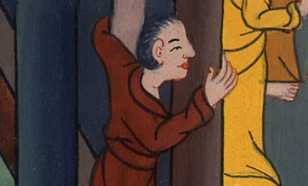
Matthew 27:3

Slide 23
4saying, “I have sinned in that I betrayed innocent blood.”
But they said, “What is that to us? You see to it.”
John

Slide 24
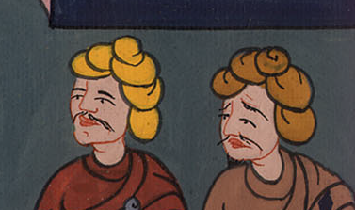
Matthew 27:4

Slide 25
5He threw down the pieces of silver in the sanctuary and departed. Then he went away and hanged himself.
John

Slide 26
Matthew 27:5

