Slide 1
43-5
This work is licensed under a Creative Commons Attribution-ShareAlike 4.0 International License.
Please add this statement to all the videos you create.
English Bible quotes are from the World English Bible US, which is in the public domain.
Notes:
Ch
43 Garden of Gethsemane
1. Garden of Gethsemane - Matt 26:36-46; Mark 14:32-42; Luke 22:39-46; John 18:1 (Left
Top)
2. Arrest of Jesus - Matt 26:47-56; Mark 14:43-52; Luke 22:47-53; John 18:2-11 (Right
Top)
3. Peter’s Denial - Matt 26:57-75; Mark 14:53-72; Luke 22:63 - 23:1; John 18:12-27
(Right Middle)
4. Jesus taken to Pilate, Judas Hangs - Matt 27:1-11; Luke 23:1-7; John 18:28-38 (Right
Bottom)
5. Jesus before Herod - Luke 23:8-12 (Left Bottom)
6. Jesus is scourged - Luke 23:13-16; John 19:1-3 (Left Center)
7. Jesus before Pilot - John 19:4-15; Matt 27:15-26, 31 (Center)

Slide 2
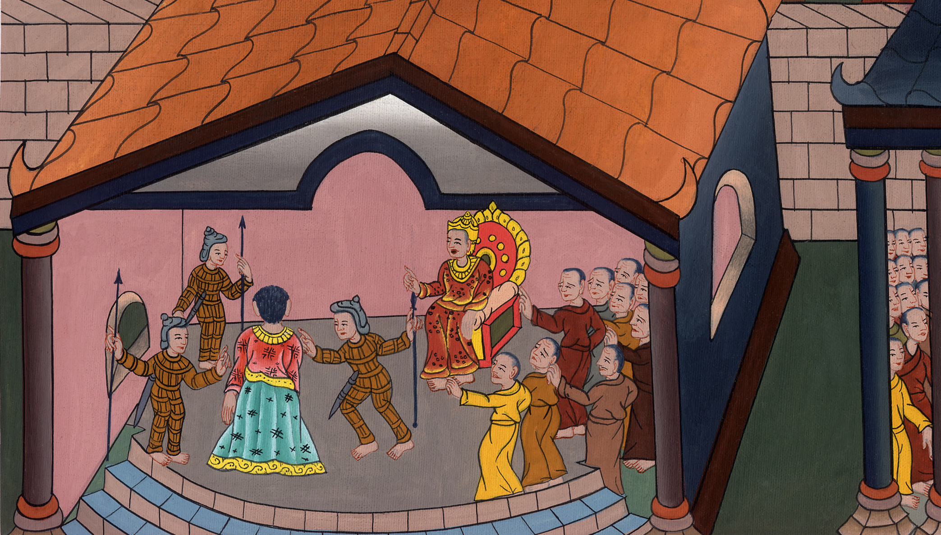
Jesus before Herod –
Luke 23:8-16 John 19:1-3

Slide 3
Jesus before Herod - Luke 23:8-16 John 19:1-3
John

Slide 4
Jesus before Herod –
Luke 23:8-16 John 19:1-3

Slide 5
(Because Jesus was under the authority of King Herod, Pilate sent Jesus to him.
John

Slide 6
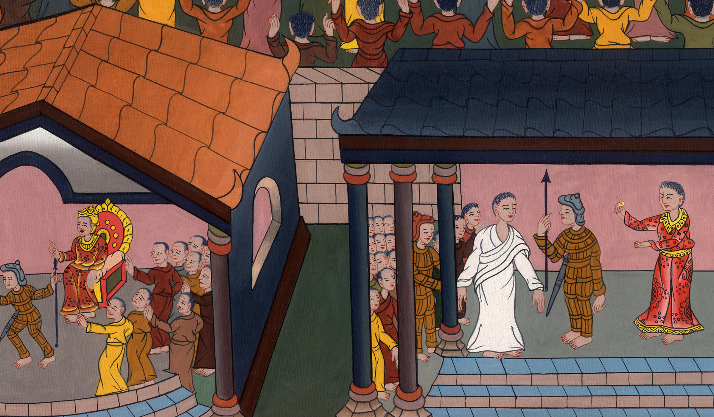
Luke 23:7

Slide 7
8Now when Herod saw Jesus, he was exceedingly glad, for he had wanted to see him for a long time, because he had heard many things about him. He hoped to see some miracle done by him.
John

Slide 8
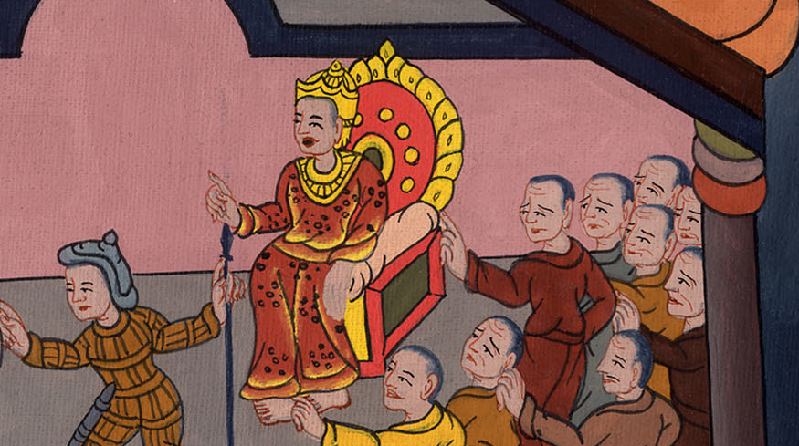
Luke 23:8

Slide 9
9He questioned him with many words, but he gave no answers.
John

Slide 10
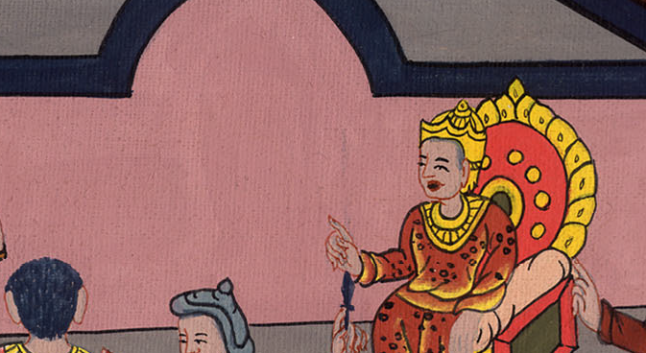
Luke 23:9

Slide 11
10The chief priests and the scribes stood, vehemently accusing him.
John

Slide 12
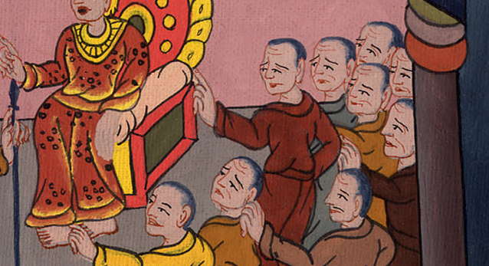
Luke 23:10

Slide 13
11Herod with his soldiers humiliated him and mocked him. Dressing him in luxurious clothing, they sent him back to Pilate.
John

Slide 14
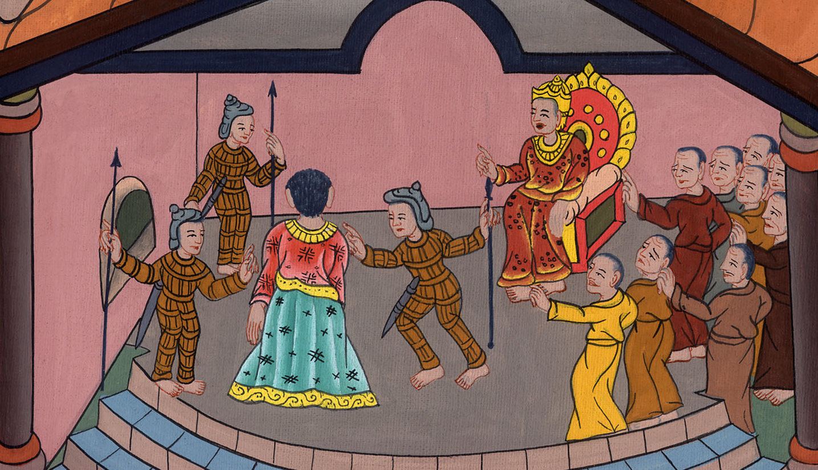
Luke 23:11

Slide 15
13Pilate called together the chief priests, the rulers, and the people,
John

Slide 16
Luke 23:13

Slide 17
14and said to them, “You brought this man to me as one that perverts the people, and behold, having examined him before you, I found no basis for a charge against this man concerning those things of which you accuse him.
John

Slide 18
Luke 23:14

Slide 19
15Neither has Herod, for I sent you to him, and see, nothing worthy of death has been done by him.
John

Slide 20
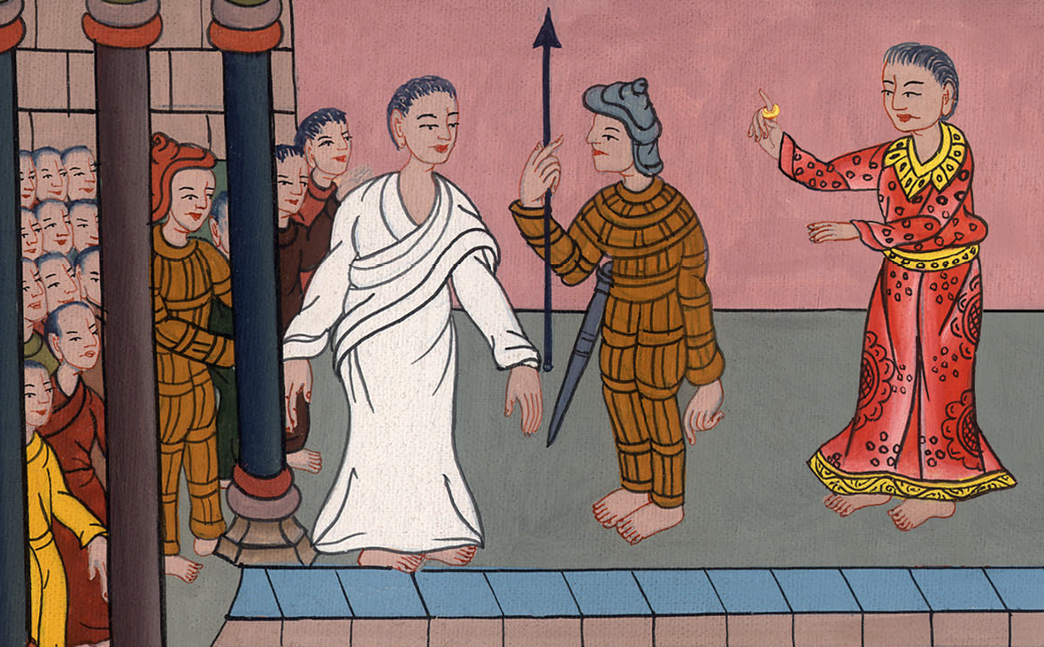
Luke 23:15

Slide 21
16I will therefore chastise him and release him.” JOHN 19
1So Pilate then took Jesus and flogged him.
John

Slide 22
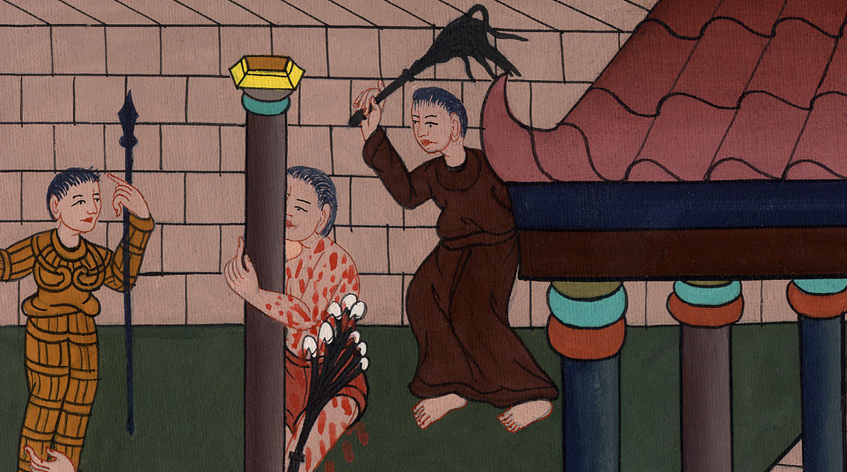
Luke 23:16, John 19:1

Slide 23
2The soldiers twisted thorns into a crown and put it on his head, and dressed him in a purple garment.
John

Slide 24
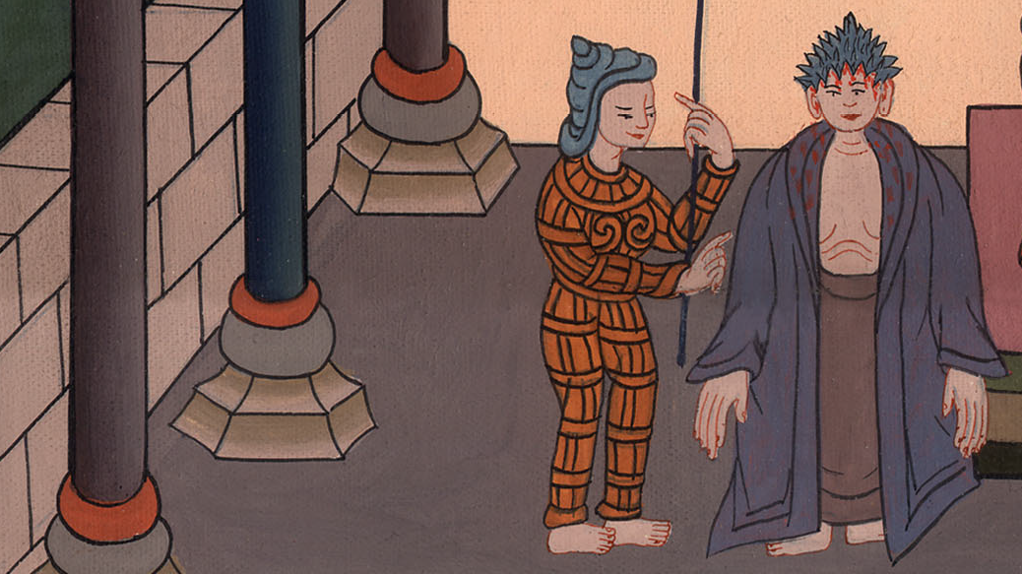
John 19:2

Slide 25
3They kept saying, “Hail, King of the Jews!” and they kept slapping him
John

Slide 26
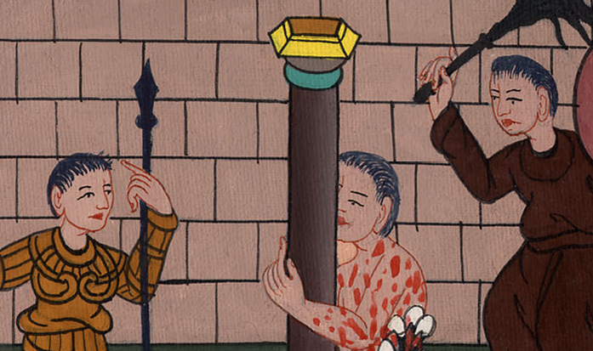
John 19:3

