Slide 1
43-6
This work is licensed under a Creative Commons Attribution-ShareAlike 4.0 International License.
Please add this statement to all the videos you create.
English Bible quotes are from the World English Bible US, which is in the public domain.
Notes:
Ch
43 Garden of Gethsemane
1. Garden of Gethsemane - Matt 26:36-46; Mark 14:32-42; Luke 22:39-46; John 18:1 (Left
Top)
2. Arrest of Jesus - Matt 26:47-56; Mark 14:43-52; Luke 22:47-53; John 18:2-11 (Right
Top)
3. Peter’s Denial - Matt 26:57-75; Mark 14:53-72; Luke 22:63 - 23:1; John 18:12-27
(Right Middle)
4. Jesus taken to Pilate, Judas Hangs - Matt 27:1-11; Luke 23:1-7; John 18:28-38 (Right
Bottom)
5. Jesus before Herod - Luke 23:8-12 (Left Bottom)
6. Jesus is scourged - Luke 23:13-16; John 19:1-3 (Left Center)
7. Jesus before Pilot - John 19:4-15; Matt 27:15-26, 31 (Center)

Slide 2
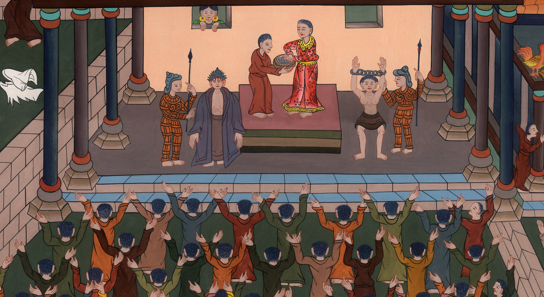
Jesus again before Pilate –
John 19:4-15; Matthew 27:15-26, 31

Slide 3
Jesus again before Pilate - John 19:4-15; Matthew 27:15-26, 31
John

Slide 4
Jesus again before Pilate –
John 19:4-15; Matthew 27:15-26, 31

Slide 5
(Jesus was sent from Herod back to Pilate.)Matt 2719While he was sitting on the judgment seat, his wife sent to him, saying,
John

Slide 6
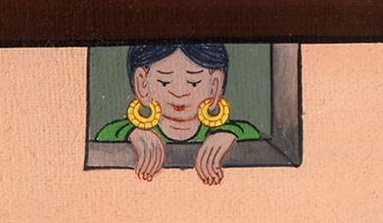
Matthew 27:19

Slide 7
“Have nothing to do with that righteous man, for I have suffered many things today in a dream because of him.”
John

Slide 8
Matthew 27:19

Slide 9
John 19:12At this, Pilate was seeking to release him,
John

Slide 10
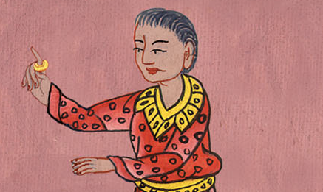
John 19:12

Slide 11
John 4Then Pilate went out again, and said to them, “Behold, I bring him out to you, that you may know that I find no basis for a charge against him.”
John

Slide 12
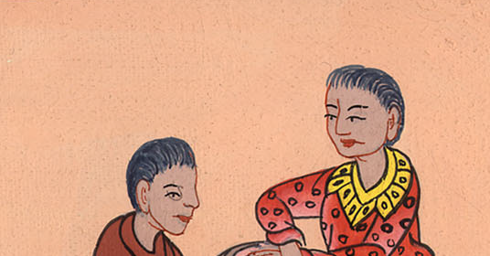
John 19:4

Slide 13
5Jesus therefore came out, wearing the crown of thorns and the purple garment. Pilate said to them, “Behold, the man!”
John

Slide 14
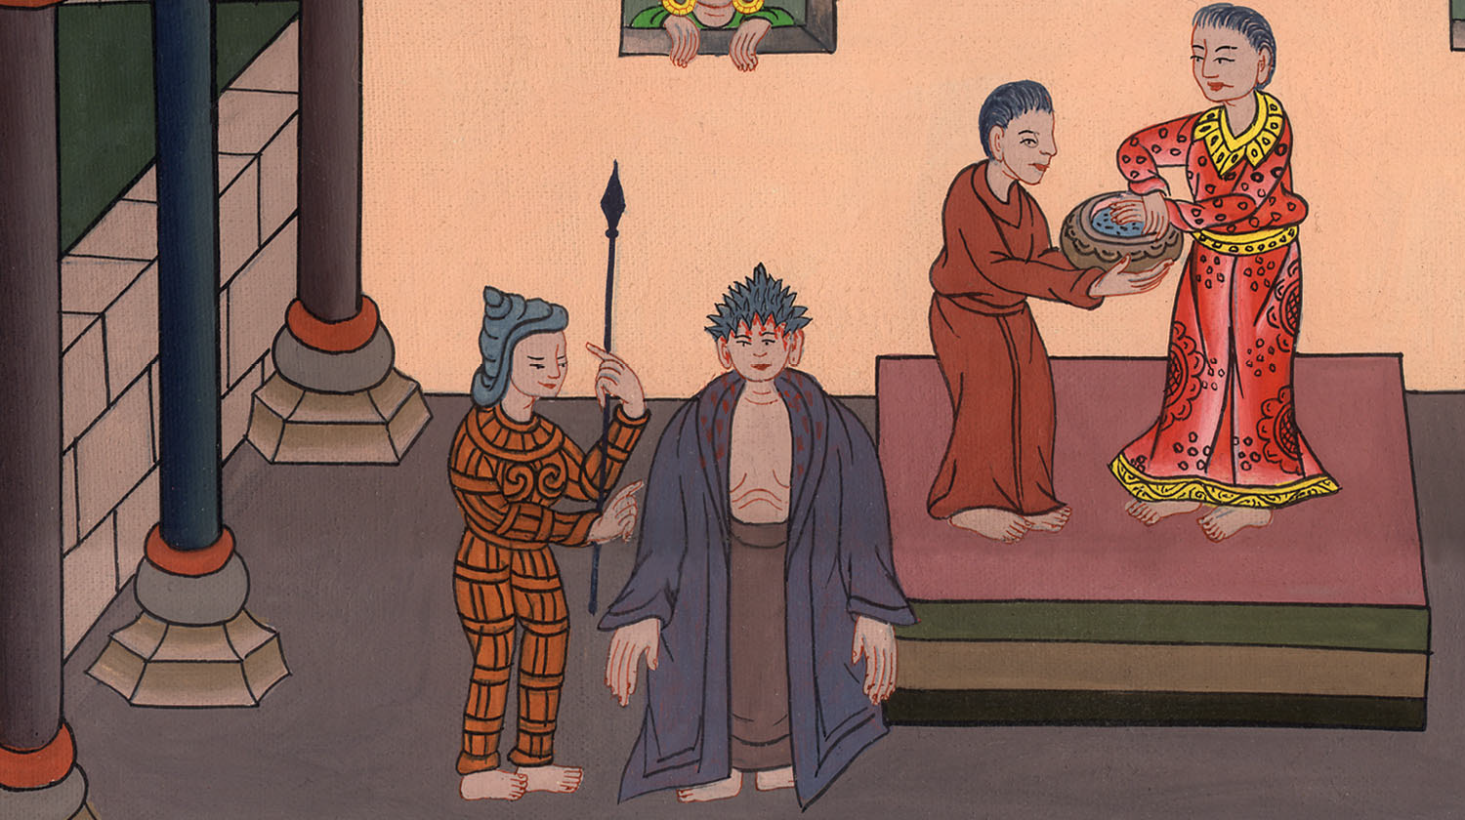
John 19:5

Slide 15
6When therefore the chief priests and the officers saw him, they shouted, saying, “Crucify! Crucify!”
John

Slide 16
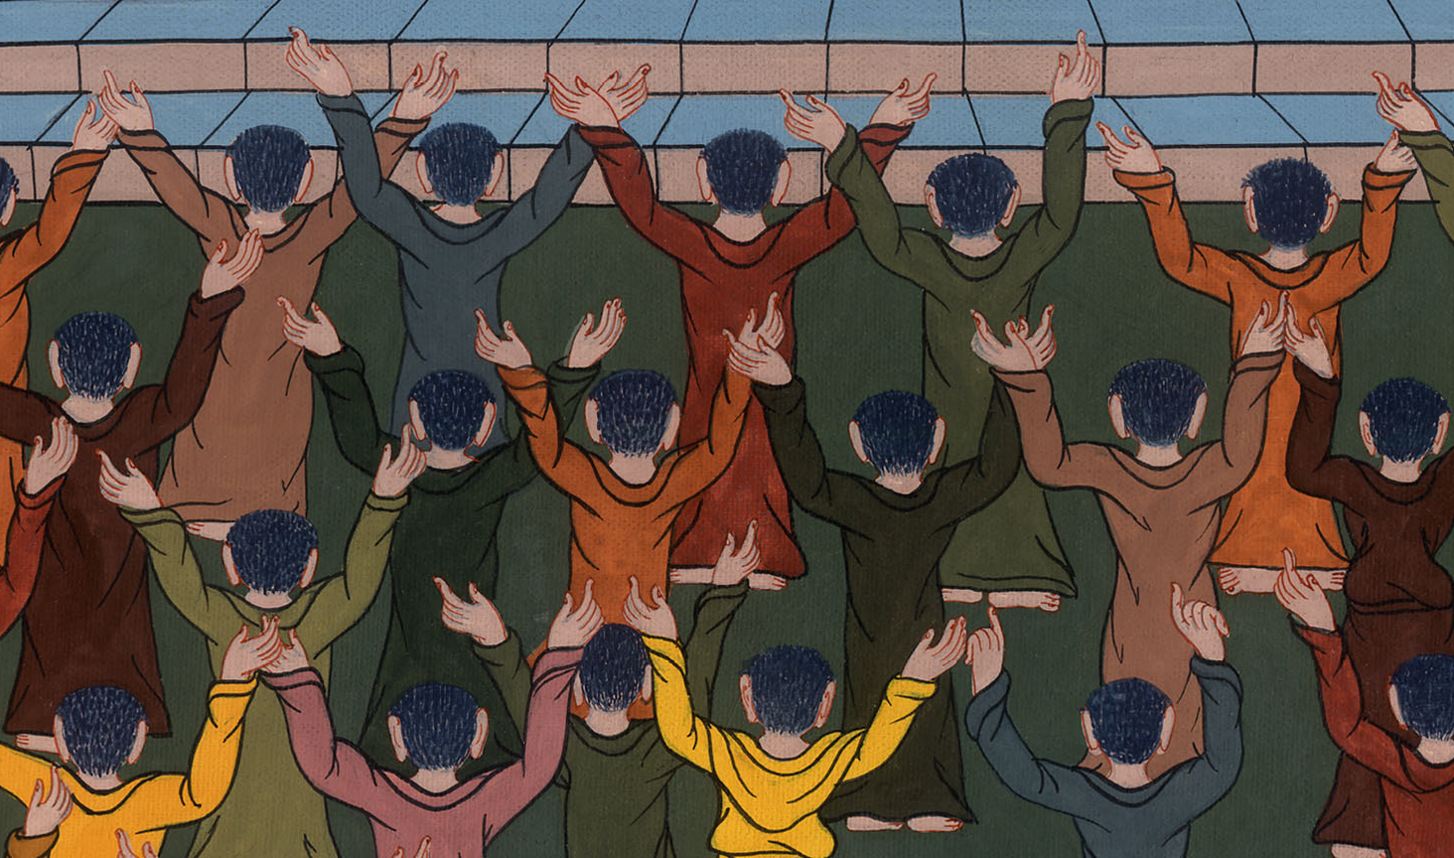
John 19:6

Slide 17
Pilate said to them, “Take him yourselves and crucify him, for I find no basis for a charge against him.”
John

Slide 18
John 19:6

Slide 19
7The Jews answered him, “We have a law, and by our law he ought to die, because he made himself the Son of God.”
John

Slide 20
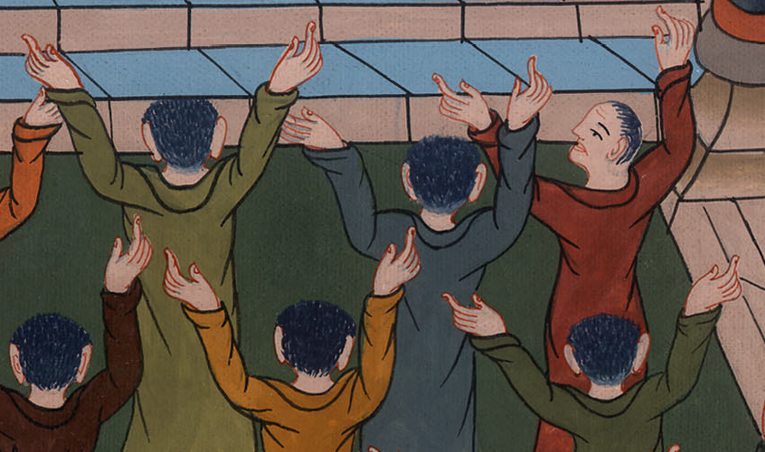
John 19:7

Slide 21
8When therefore Pilate heard this saying, he was more afraid. 9He entered into the Praetorium again, and said to Jesus, “Where are you from?” But Jesus gave him no answer.
John

Slide 22
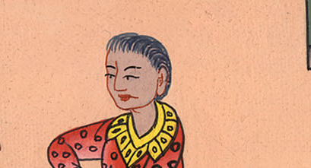
John 19:8,9

Slide 23
10Pilate therefore said to him, “Aren’t you speaking to me? Don’t you know that I have power to release you and have power to crucify you?”
John

Slide 24
John 19:10

Slide 25
11Jesus answered, “You would have no power at all against me, unless it were given to you from above. Therefore he who delivered me to you has greater sin.”
John

Slide 26
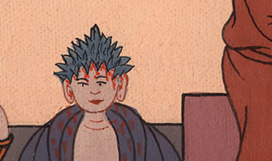
John 19:11

Slide 27
MATTHEW 27
15Now at the feast the governor was accustomed to release to the multitude one prisoner whom they desired.
John

Slide 28
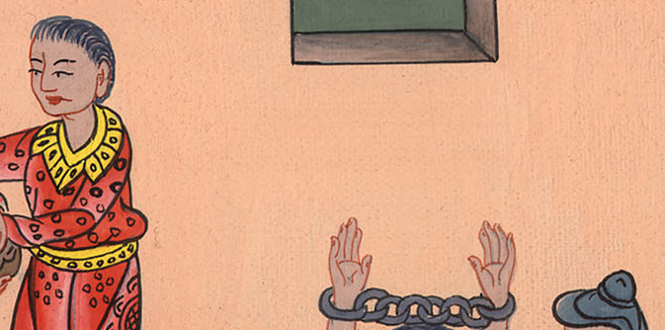
Matthew 27:15

Slide 29
16They had then a notable prisoner called Barabbas.
John

Slide 30
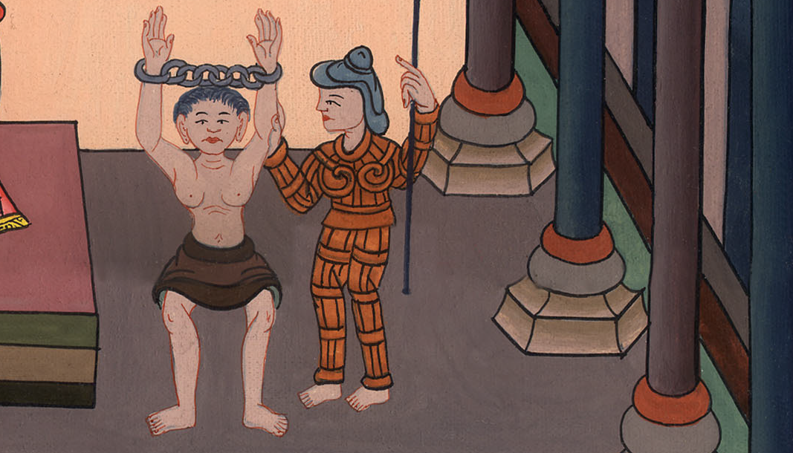
Matthew 27:16

Slide 31
20Now the chief priests and the elders persuaded the multitudes to ask for Barabbas and destroy Jesus.
John

Slide 32
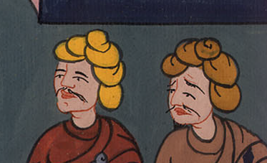
Matthew 27:20

Slide 33
21But the governor answered them, “Which of the two do you want me to release to you?”
They said, “Barabbas!”
John

Slide 34
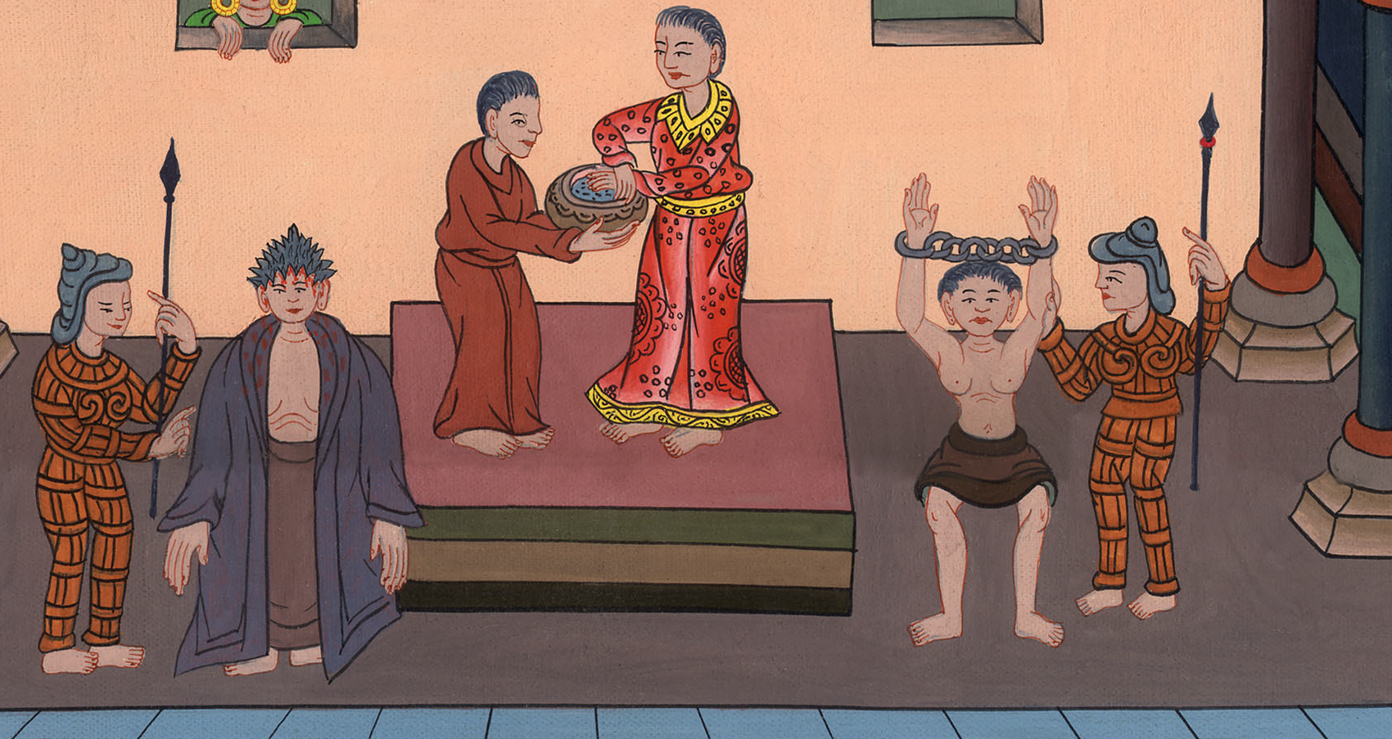
Matthew 27:21

Slide 35
22Pilate said to them, “What then shall I do to Jesus who is called Christ?”
They all said to him, “Let him be crucified!”
John

Slide 36
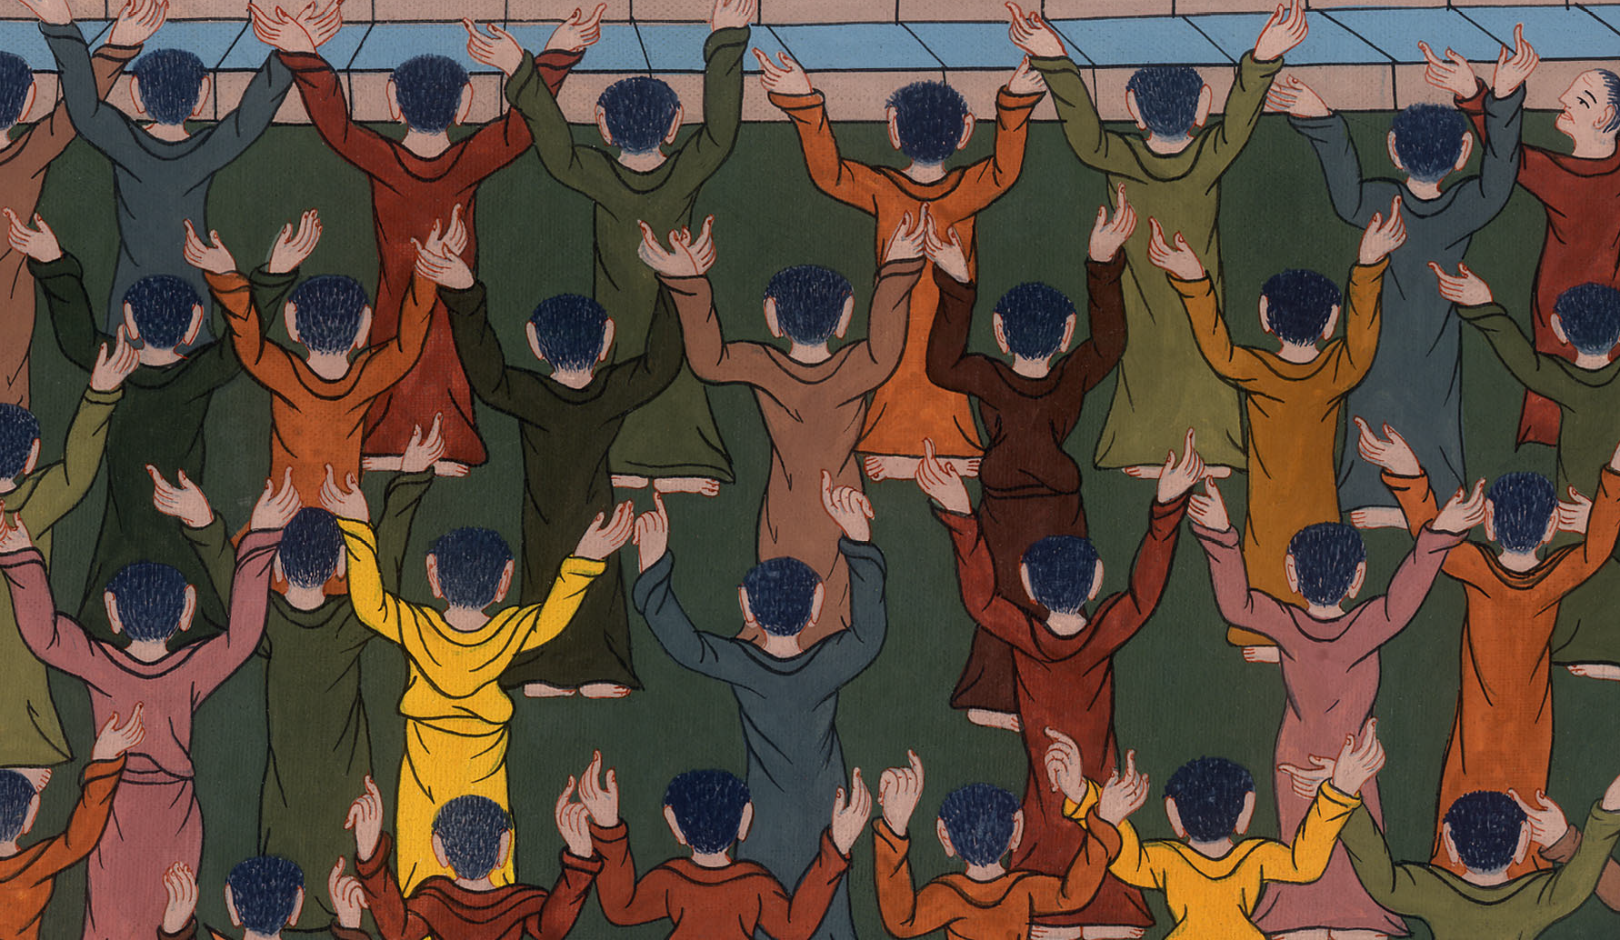
Matthew 27:22

Slide 37
23But the governor said, “Why? What evil has he done?”
But they cried out exceedingly, saying, “Let him be crucified!”
John

Slide 38
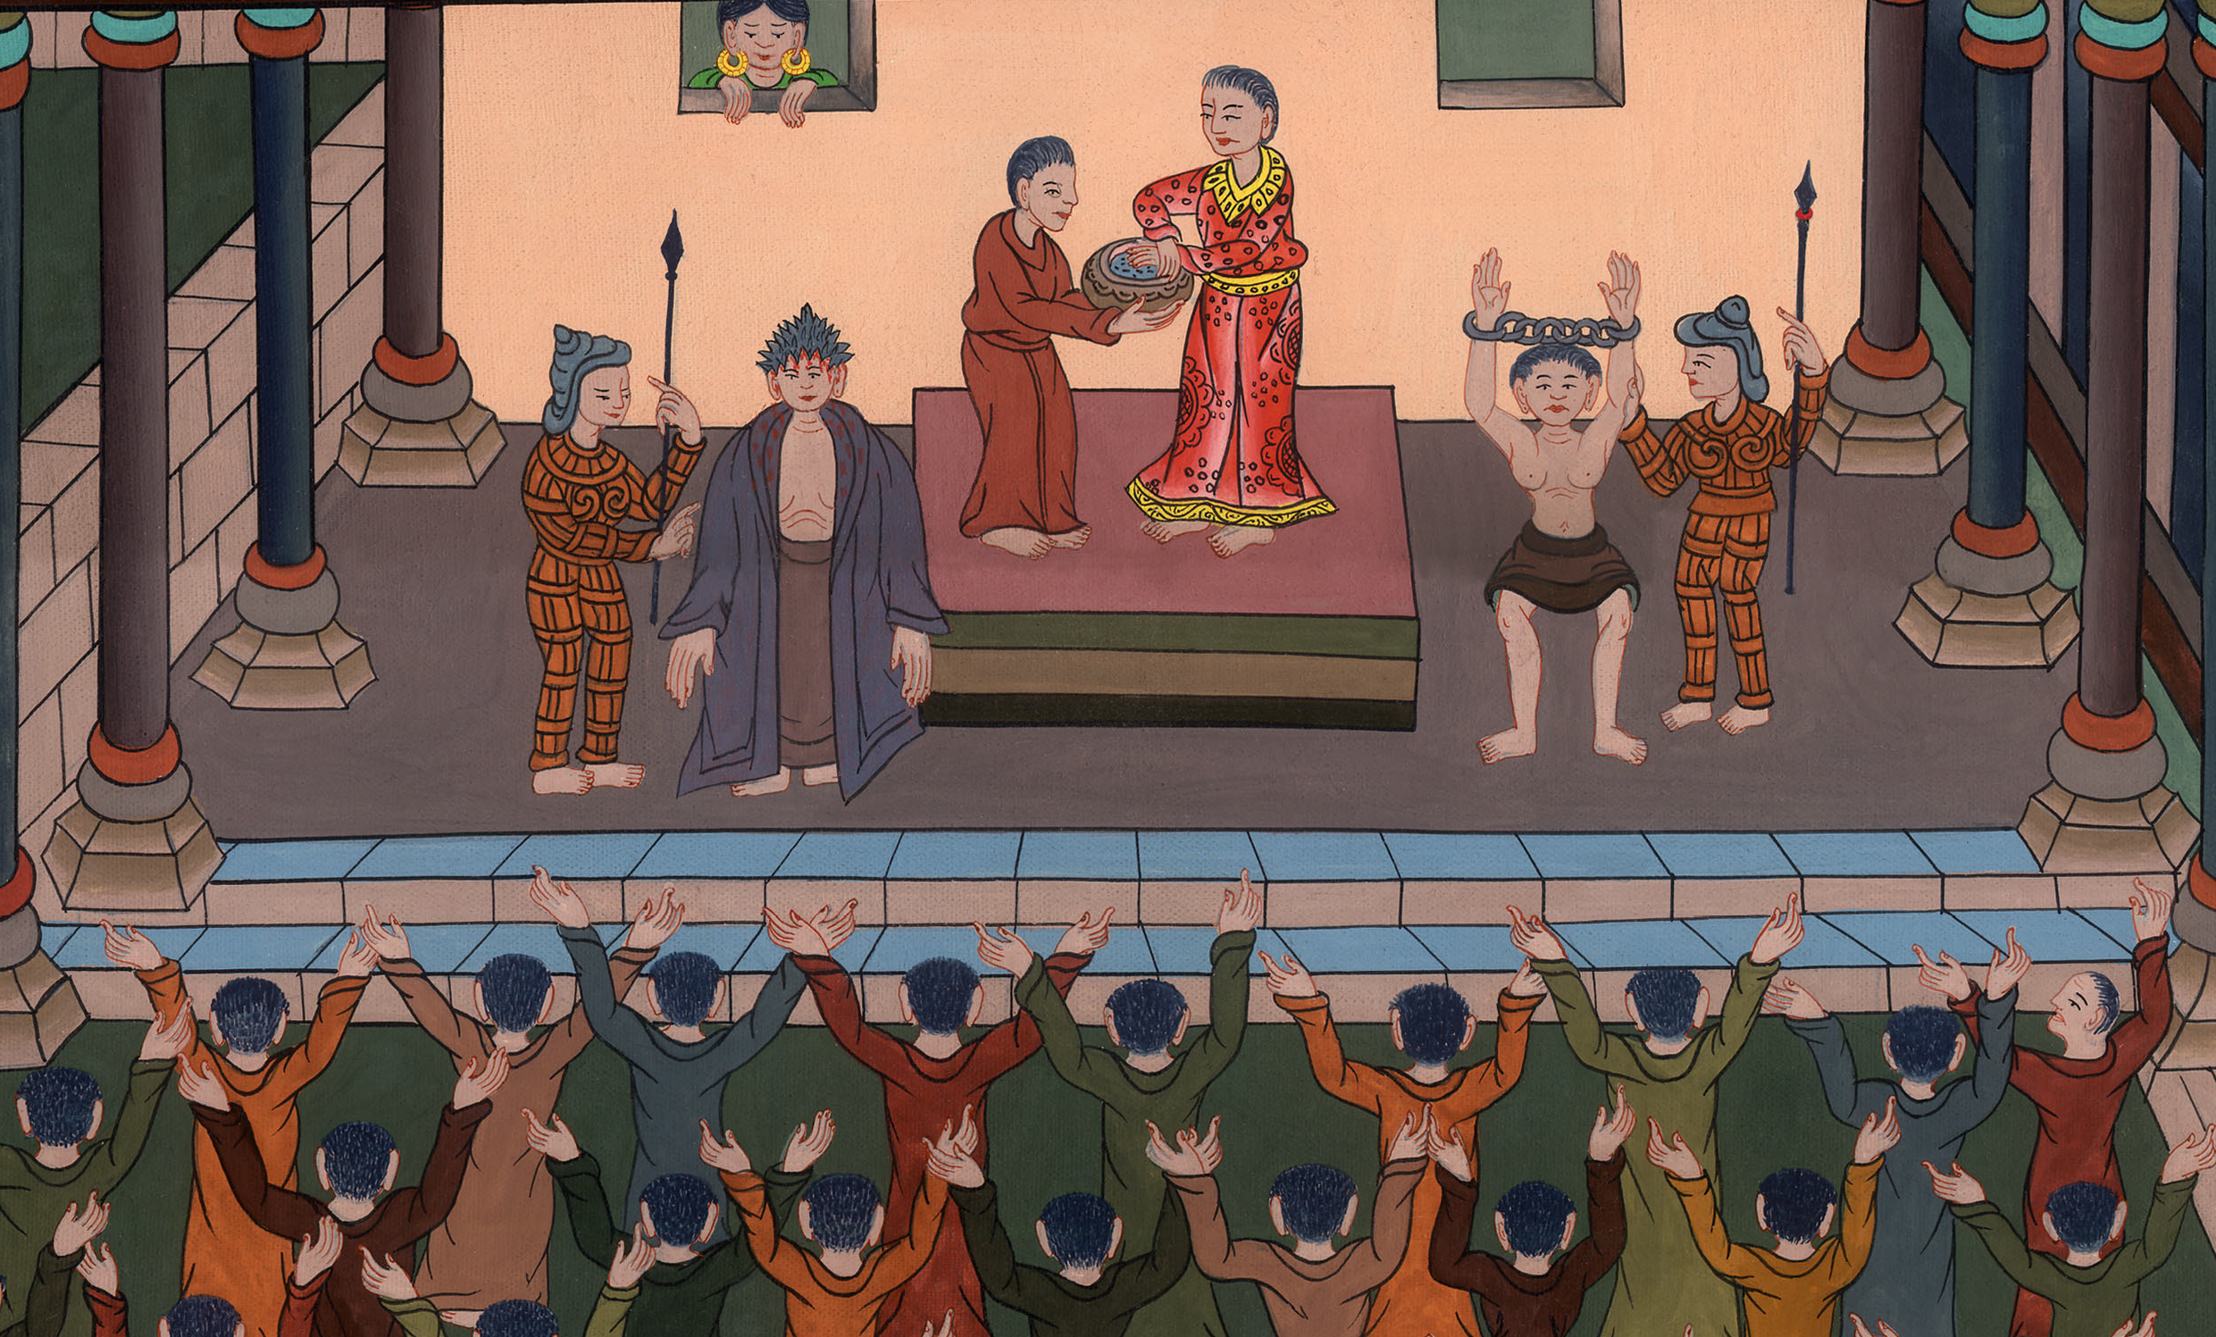
Matthew 27:23

Slide 39
24So when Pilate saw that nothing was being gained, but rather that a disturbance was starting, he took water and washed his hands before the multitude, saying, “I am innocent of the blood of this righteous person. You see to it.”
John

Slide 40
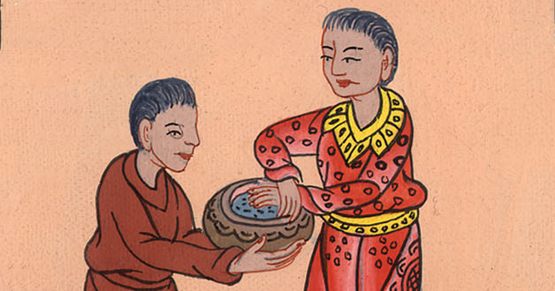
Matthew 27:24

Slide 41
25All the people answered, “May his blood be on us and on our children!”
John

Slide 42
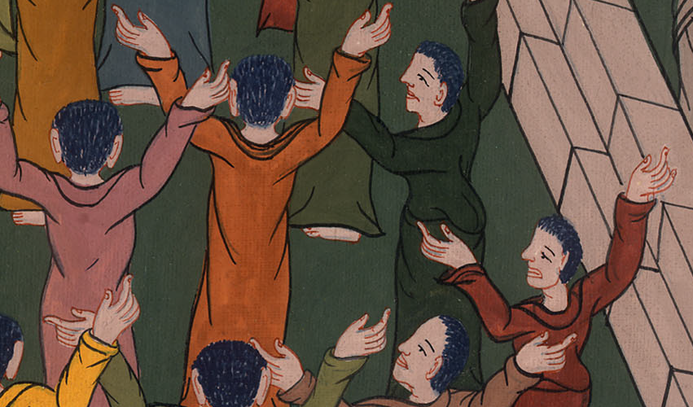
Matthew 27:25

Slide 43
John 19 16So then he delivered him to them to be crucified.
John

Slide 44
John 19:16

