Slide 1
44-1
This work is licensed under a Creative Commons Attribution-ShareAlike 4.0 International License.
Please add this statement to all the videos you create.
English Bible quotes are from the World English Bible US, which is in the public domain.
Notes:
Ch
44 The Crucifixion
1. Carrying the cross - Luke 23:26-32 (Left Top)
2. The Crucifixion – Luke 23:33-49; John 19:17-37 (Center)
3. Curtain torn in two - Matt 27:51-54 (Right Top)
4. Putting the body in the tomb – John 19:38-42; Matt 27:61-66 (Bottom)

Slide 2
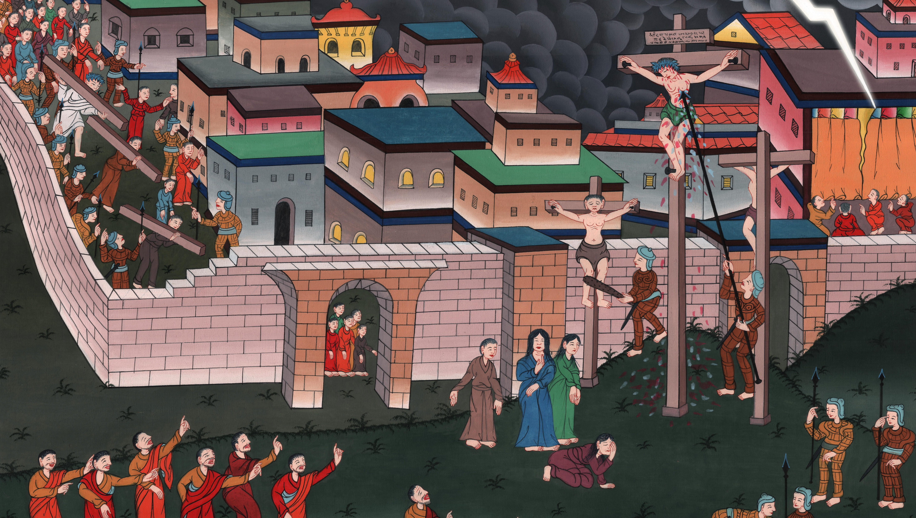
Carrying the cross –
Luke 23:26-32
The Crucifixion –
Luke 23:33-49; John 19:17-37

Slide 3
Carrying the cross - Luke 23:26-32 The Crucifixion – Luke 23:33-49; John 19:17-37
John

Slide 4
Carrying the cross –
Luke 23:26-32
The Crucifixion –
Luke 23:33-49; John 19:17-37

Slide 5
John 19:16 So they took Jesus and led him away. 17He went out, bearing his cross, to the place called “The Place of a Skull”, which is called in Hebrew, “Golgotha”,
John

Slide 6
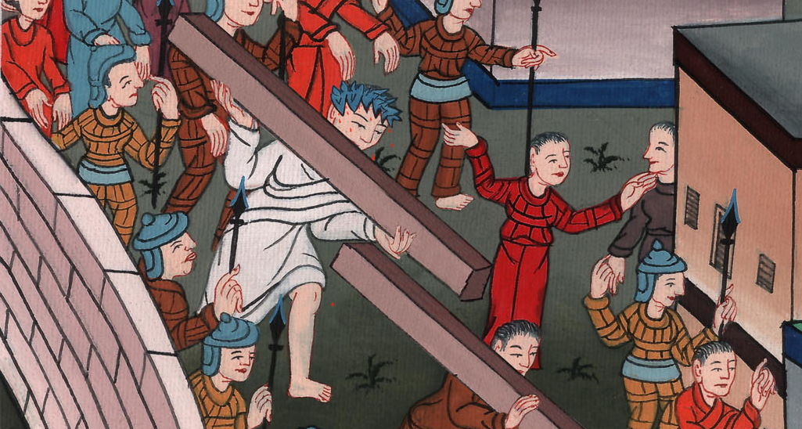
John 19:16,17

Slide 7
luke 23:26When they led him away, they grabbed one Simon of Cyrene, coming from the country, and laid the cross on him to carry it after Jesus.
John

Slide 8
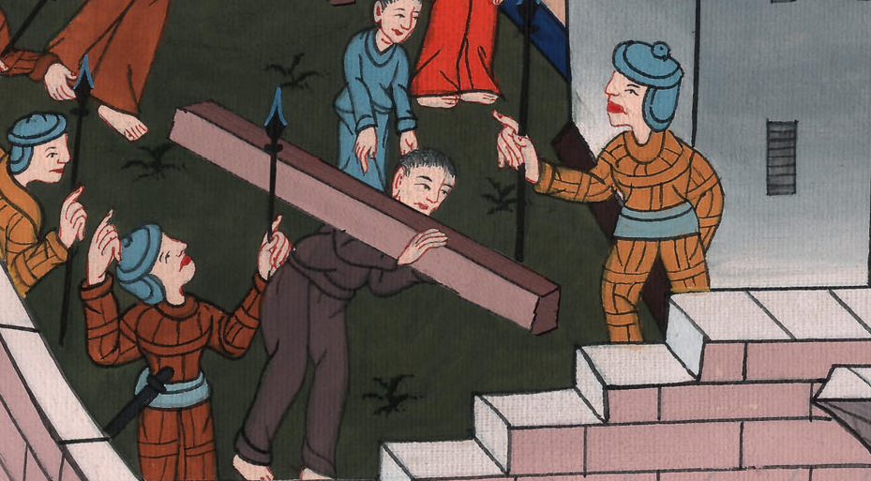
Luke 23:26

Slide 9
27A great multitude of the people followed him, including women who also mourned and lamented him.
John

Slide 10
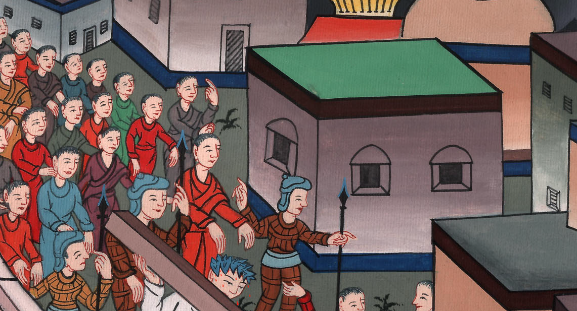
Luke 23:27

Slide 11
32There were also others, two criminals, led with him to be put to death.
John

Slide 12
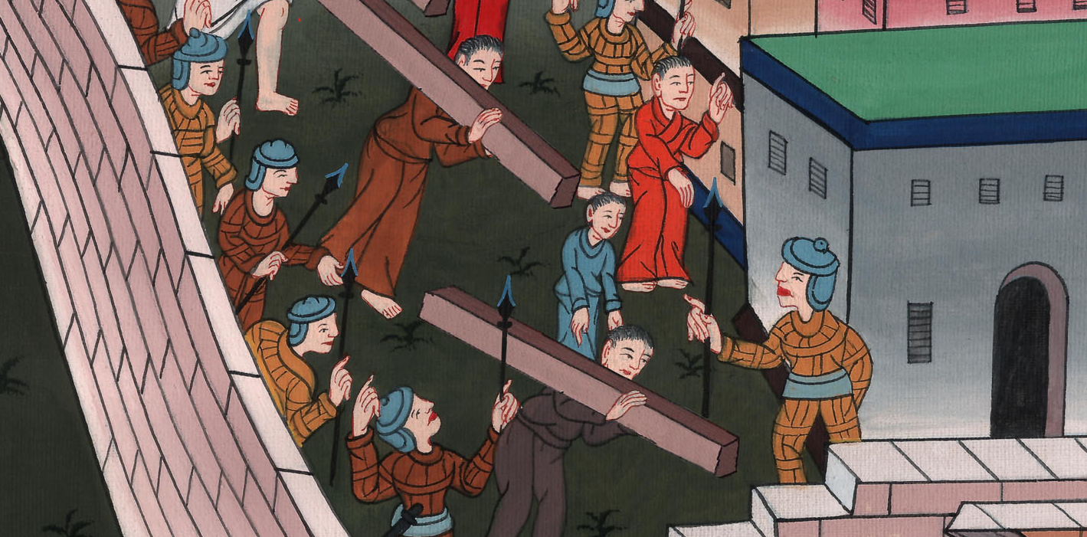
Luke 23:32

Slide 13
33When they came to the place that is called “The Skull”, they crucified him there with the criminals, one on the right and the other on the left.
John

Slide 14
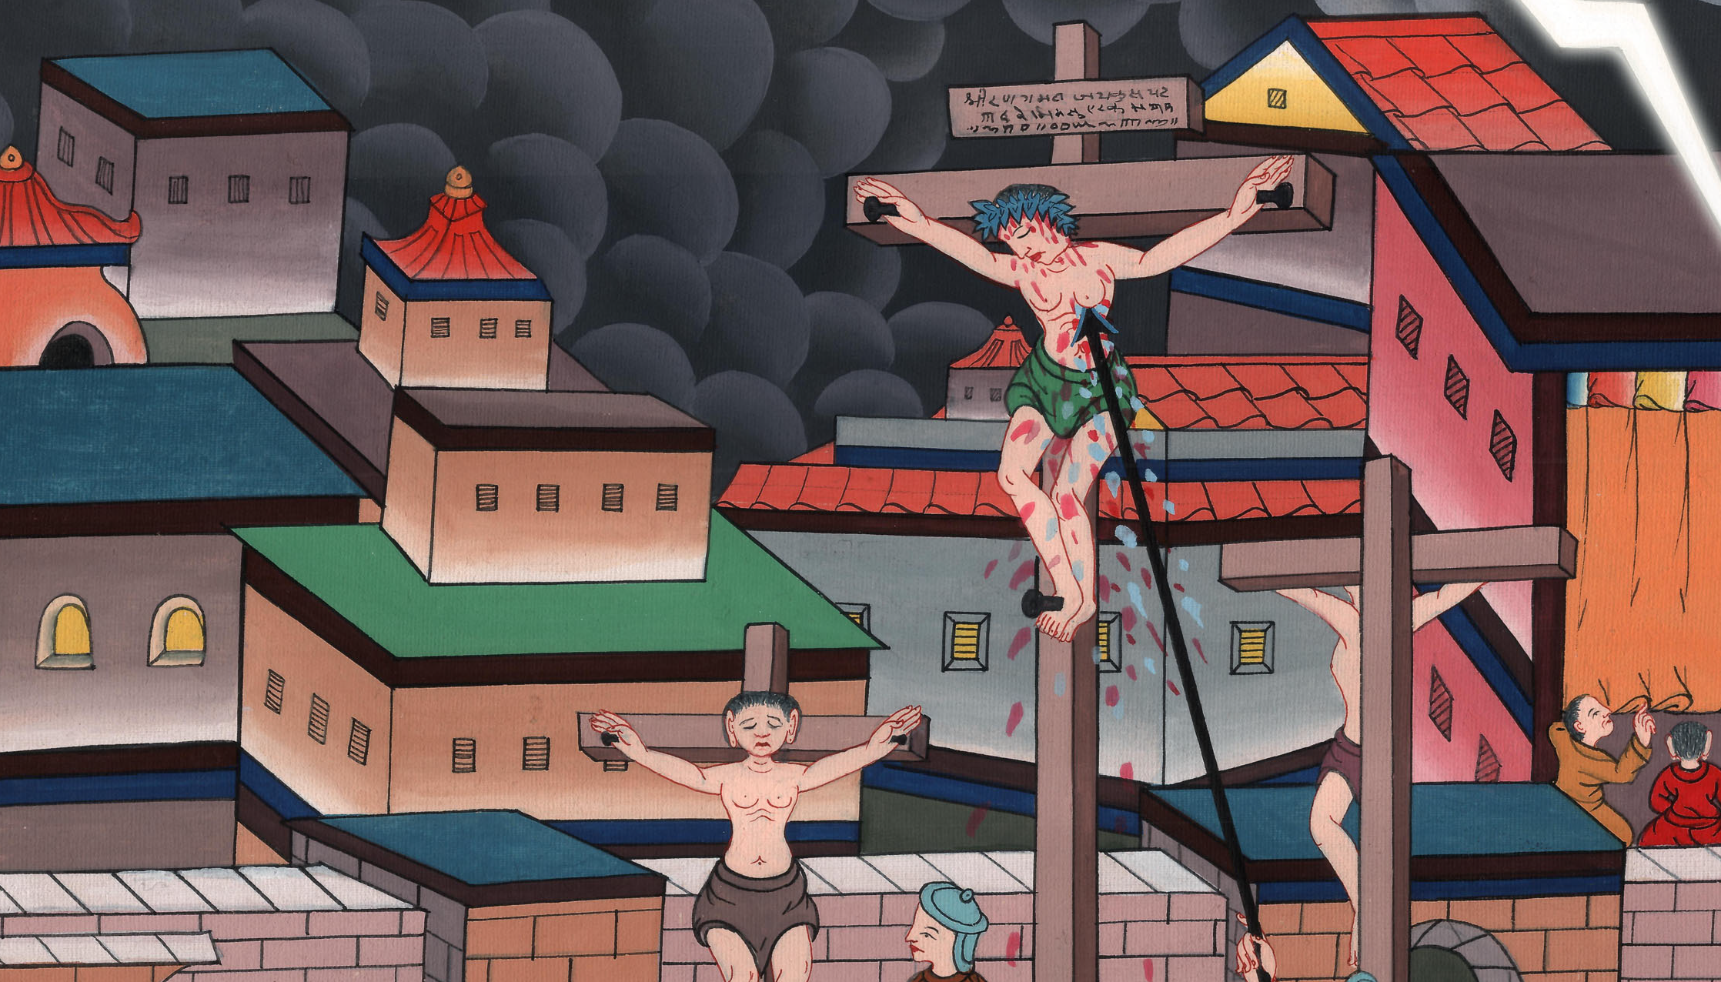
Luke 23:33

Slide 15
34Jesus said, “Father, forgive them, for they don’t know what they are doing.”
John

Slide 16
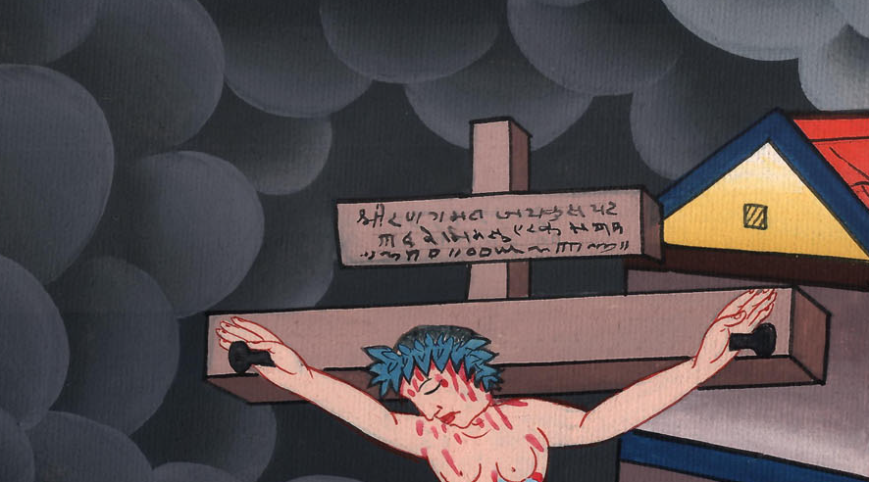
Luke 23:34

Slide 17
34 Dividing his garments among them, they cast lots.
John

Slide 18
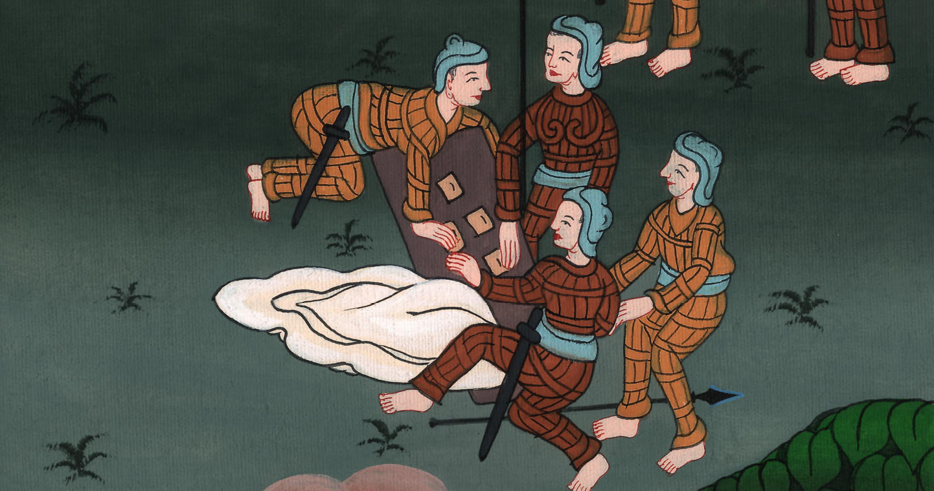
Luke 23:34

Slide 19
35The people stood watching. The rulers with them also scoffed at him, saying, “He saved others. Let him save himself, if this is the Christ of God, his chosen one!”
John

Slide 20
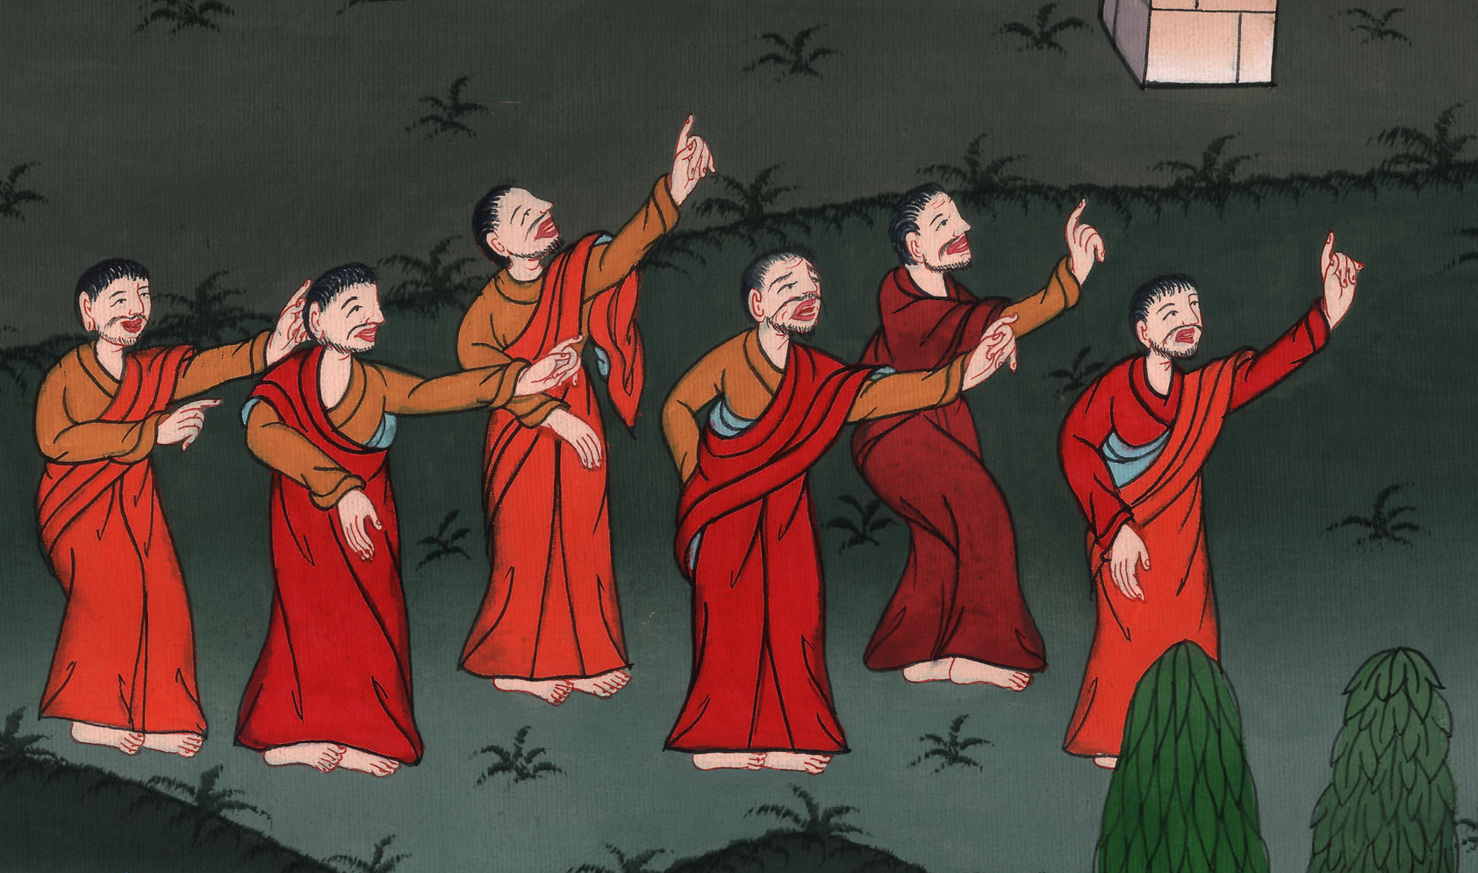
Luke 23:35

Slide 21
John 19:19Pilate wrote a title also, and put it on the cross. There was written, “JESUS OF NAZARETH, THE KING OF THE JEWS.”
John

Slide 22
John 19:19

Slide 23
25But standing by Jesus’ cross were his mother, … 26Therefore when Jesus saw his mother, and the disciple whom he loved standing there, he said to his mother, “Woman, behold, your son!”
John

Slide 24
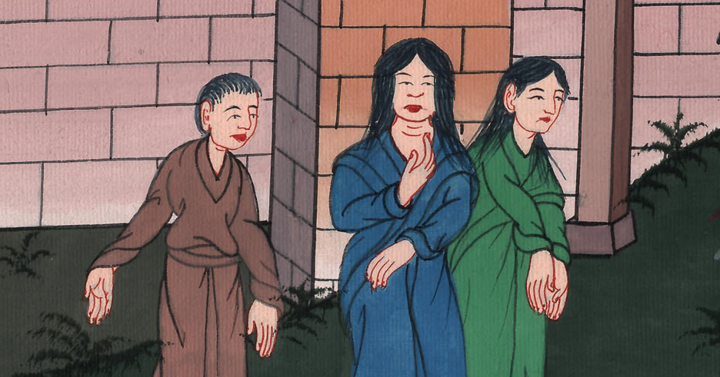
John 19:25,26

Slide 25
27Then he said to the disciple, “Behold, your mother!” From that hour, the disciple took her to his own home.
John

Slide 26
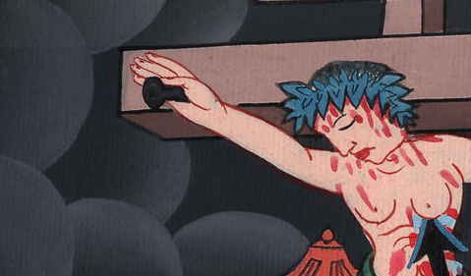
John 19:27

Slide 27
luke 23 39One of the criminals who was hanged insulted him, saying, “If you are the Christ, save yourself and us!”
John

Slide 28
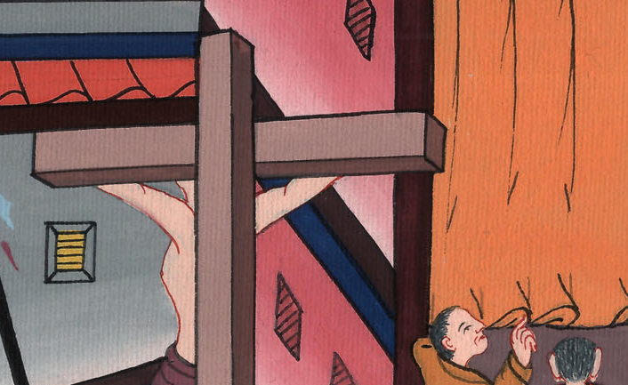
Luke 23:39

Slide 29
40But the other answered, and rebuking him said, “Don’t you even fear God, seeing you are under the same condemnation?
John

Slide 30
Luke 23:40

Slide 31
1And we indeed justly, for we receive the due reward for our deeds, but this man has done nothing wrong.”
John

Slide 32
Luke 23:41

Slide 33
42He said to Jesus, “Lord, remember me when you come into your Kingdom.”
John

Slide 34
Luke 23:42

Slide 35
43Jesus said to him, “Assuredly I tell you, today you will be with me in Paradise.”
John

Slide 36
Luke 23:43

Slide 37
4It was now about the sixth hour, and darkness came over the whole land until the ninth hour. 45The sun was darkened,. …
John

Slide 38
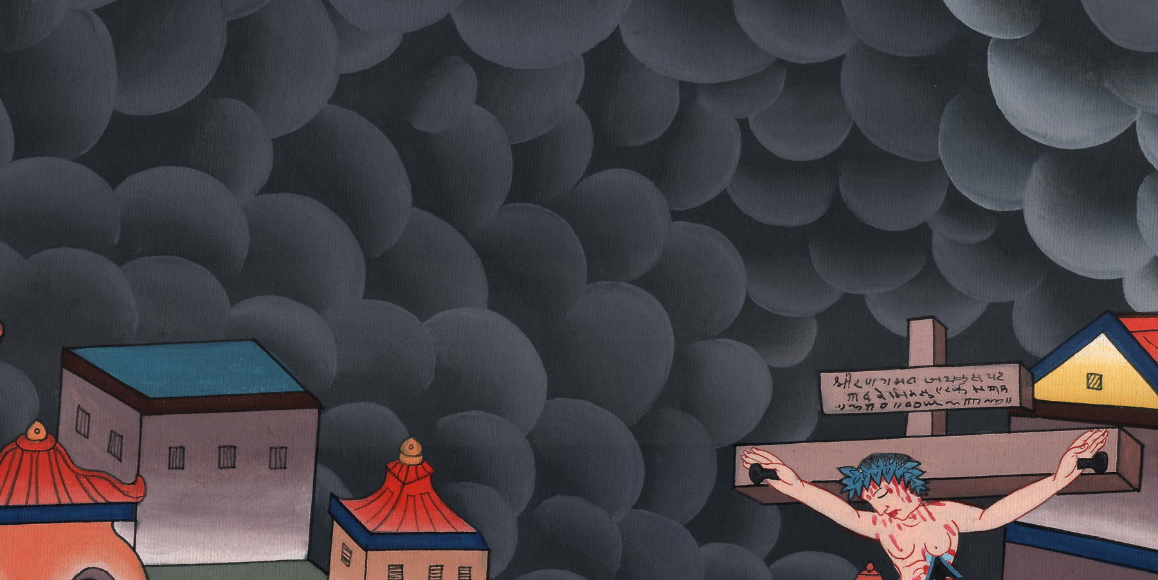
Luke 23:44,45

Slide 39
John 19 28After this, Jesus, seeing that all things were now finished, that the Scripture might be fulfilled, said, “I am thirsty!”
John

Slide 40
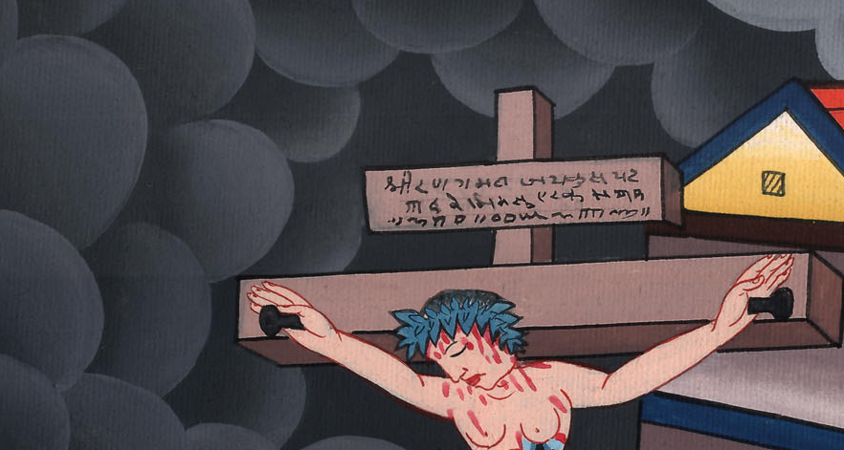
John 19:28

Slide 41
29Now a vessel full of vinegar was set there; so they put a sponge full of the vinegar on hyssop, and held it at his mouth.
John

Slide 42
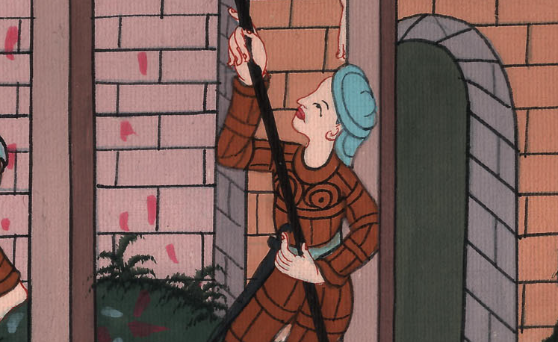
John 19:29

Slide 43
Matt 27 46About the ninth hour Jesus cried with a loud voice, saying, “Eli, Eli, lima sabachthani?” That is, “My God, my God, why have you forsaken me?”
John

Slide 44
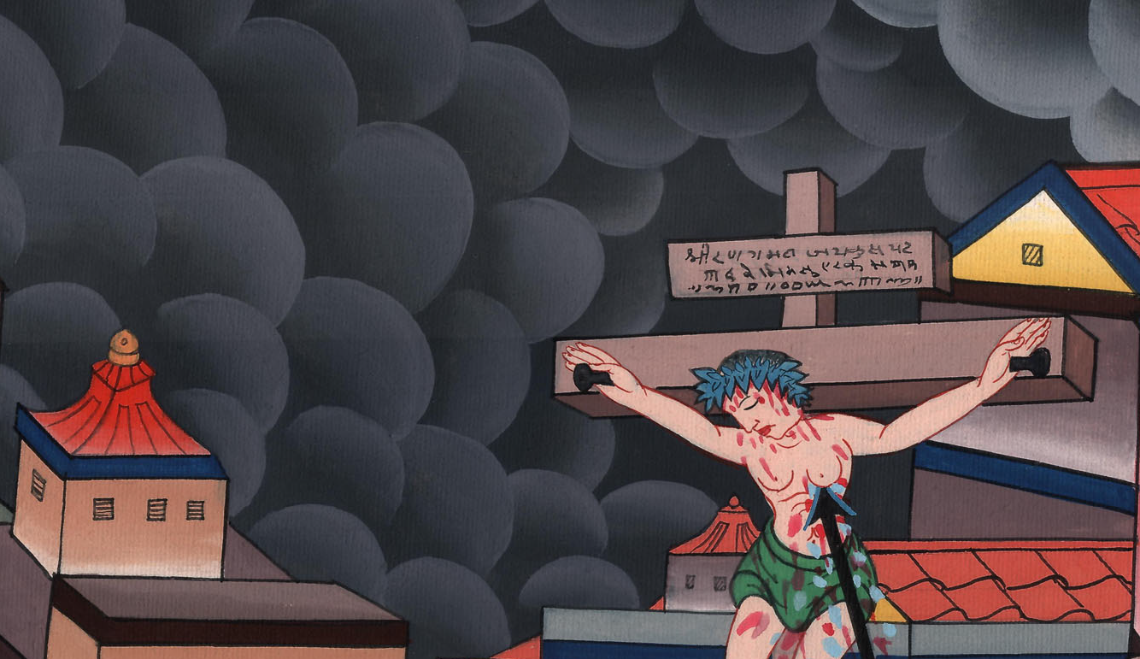
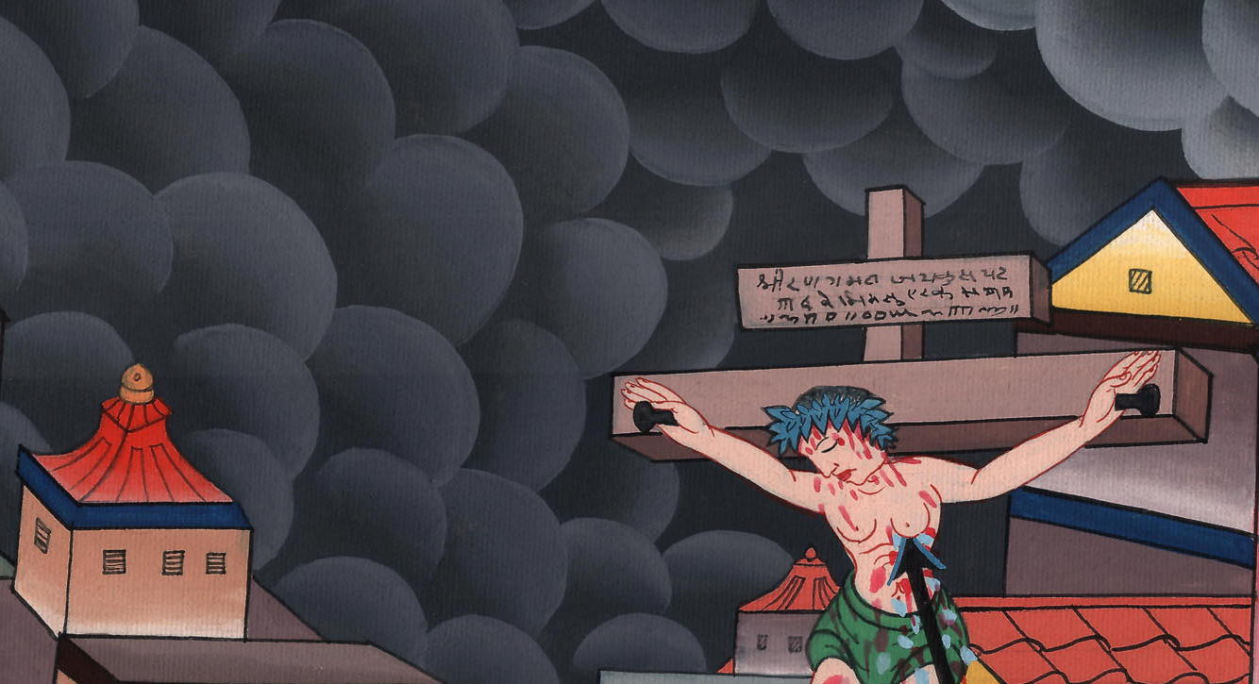
Matthew 27:46

Slide 45
luke 23 46Jesus, crying with a loud voice, said, “Father, into your hands I commit my spirit!” Having said this, he breathed his last.
John

Slide 46
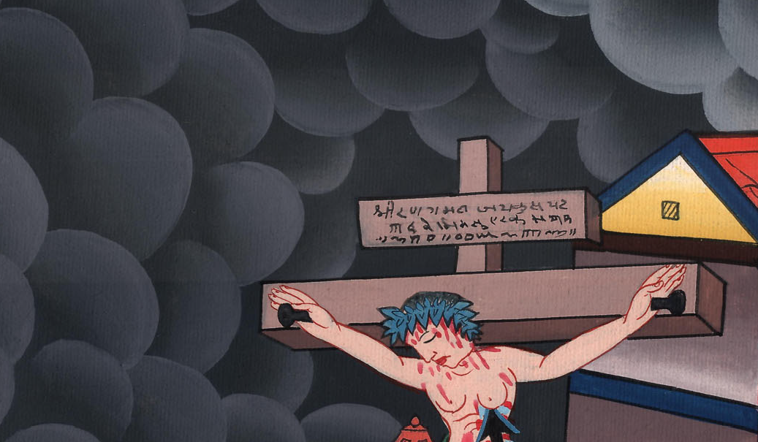
Luke 23:46

