Slide 1
44-2
This work is licensed under a Creative Commons Attribution-ShareAlike 4.0 International License.
Please add this statement to all the videos you create.
English Bible quotes are from the World English Bible US, which is in the public domain.
Notes:
Ch
44 The Crucifixion
1. Carrying the cross - Luke 23:26-32 (Left Top)
2. The Crucifixion – Luke 23:33-49; John 19:17-37 (Center)
3. Curtain torn in two - Matt 27:51-54 (Right Top)
4. Putting the body in the tomb – John 19:38-42; Matt 27:61-66

Slide 2
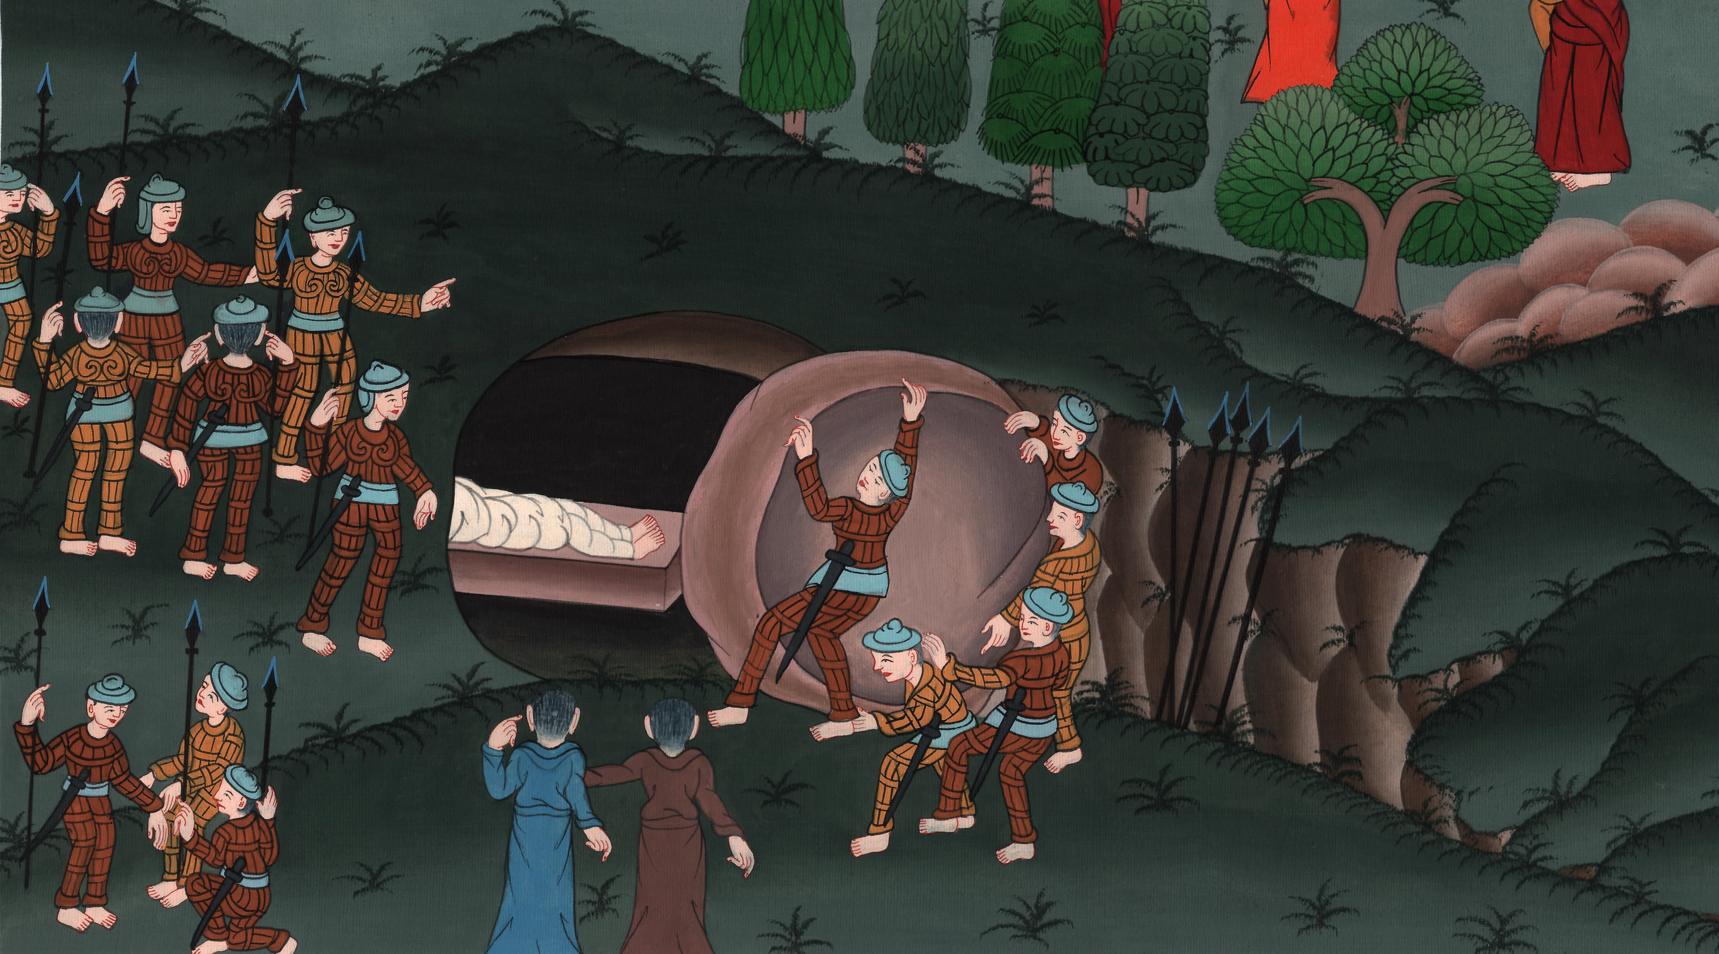
Putting the body in the tomb – John 19:38-42; Matt 27:45-66

Slide 3
Putting the body in the tomb – John 19:38-42; Matt 27:45-66
Here is more of what happened when Jesus died.
John

Slide 4
Putting the body in the tomb – John 19:38-42; Matt 27:45-66

Slide 5
Matt 2751Behold, the veil of the temple was torn in two from the top to the bottom. The earth quaked and the rocks were split.
John

Slide 6
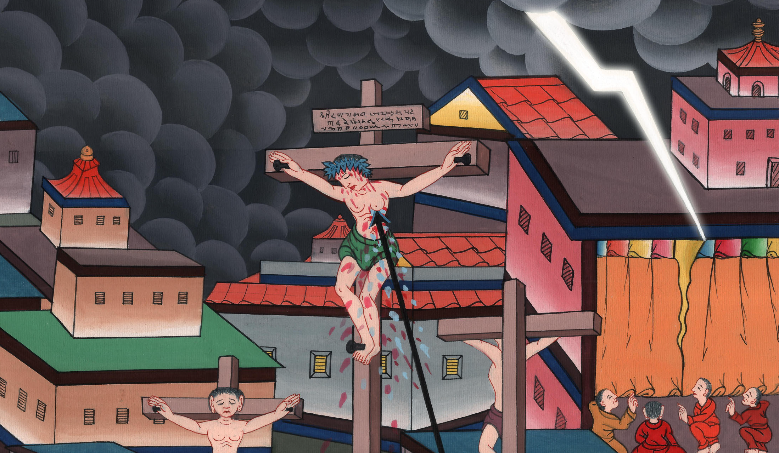
Matthew 27:51

Slide 7
52The tombs were opened, and many bodies of the saints who had fallen asleep were raised;
John

Slide 8
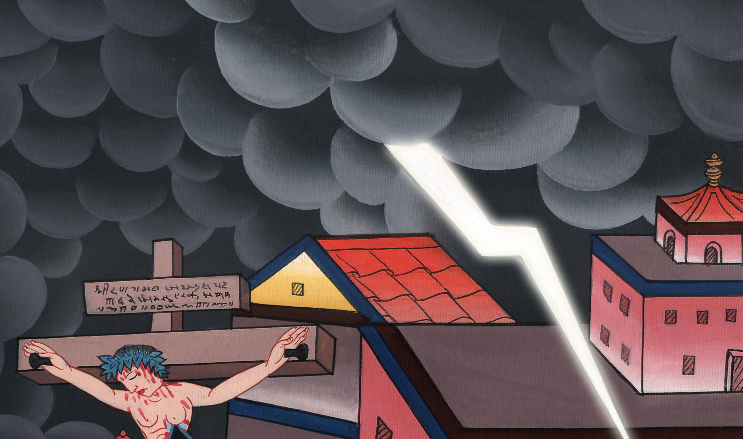
Matthew 27:52

Slide 9
54Now the centurion and those who were with him watching Jesus, when they saw the earthquake and the things that were done, were terrified, saying, “Truly this was the Son of God!”
John

Slide 10
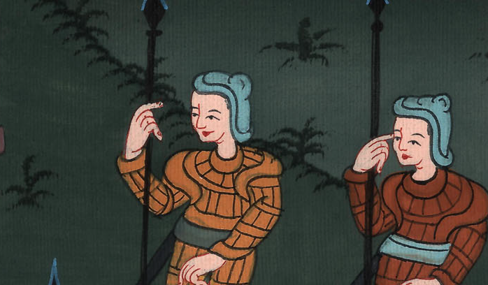
Matthew 27:54

Slide 11
Luke 23: 48All the multitudes that came together to see this, when they saw the things that were done, returned home beating their breasts.
John

Slide 12
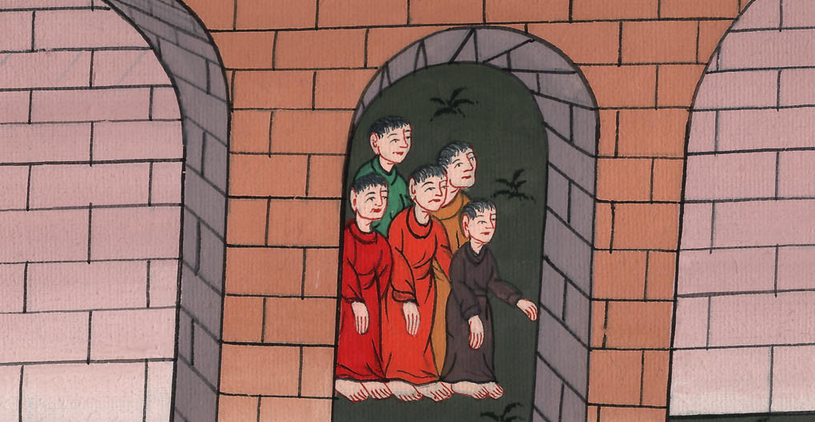
Luke 27:48

Slide 13
49All his acquaintances and the women who followed with him from Galilee stood at a distance, watching these things.
John

Slide 14
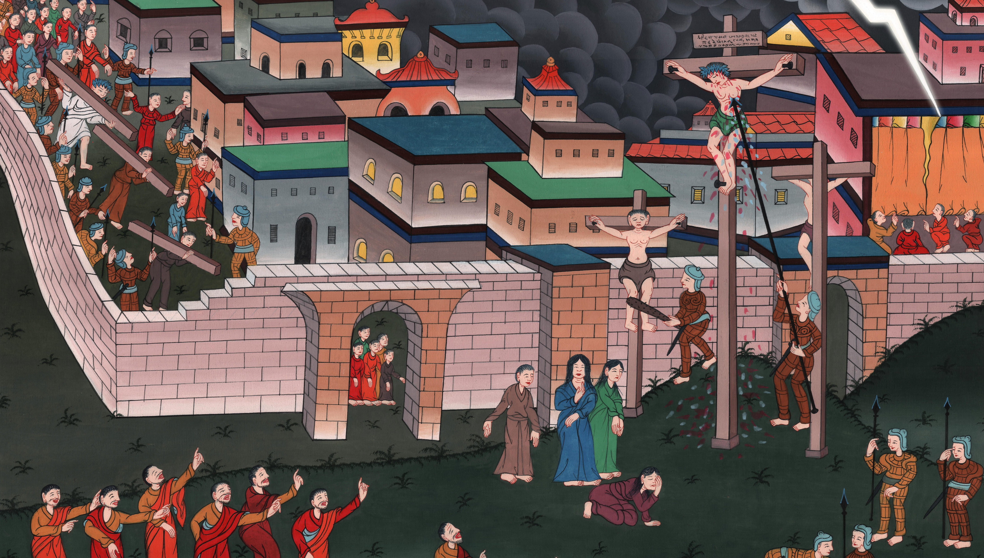
Luke 27:49

Slide 15
John 19 31Therefore the Jews, because it was the Preparation Day, so that the bodies wouldn’t remain on the cross on the Sabbath (for that Sabbath was a special one), asked of Pilate that their legs might be broken and that they might be taken away.
John

Slide 16
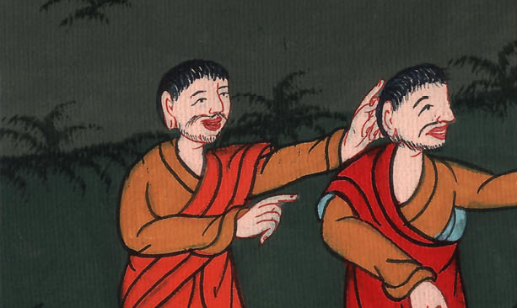
John 19:31

Slide 17
32(so that they would die more quickly) Therefore the soldiers came and broke the legs of the first and of the other who was crucified with him;
John

Slide 18
John 19:32

Slide 19
33but when they came to Jesus and saw that he was already dead, they didn’t break his legs.
John

Slide 20
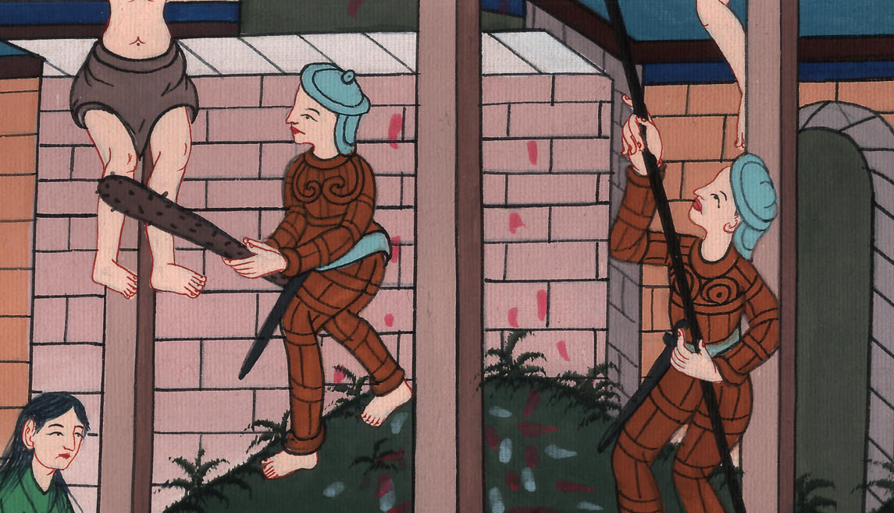
John 19:33

Slide 21
34However, one of the soldiers pierced his side with a spear, and immediately blood and water came out.
John

Slide 22
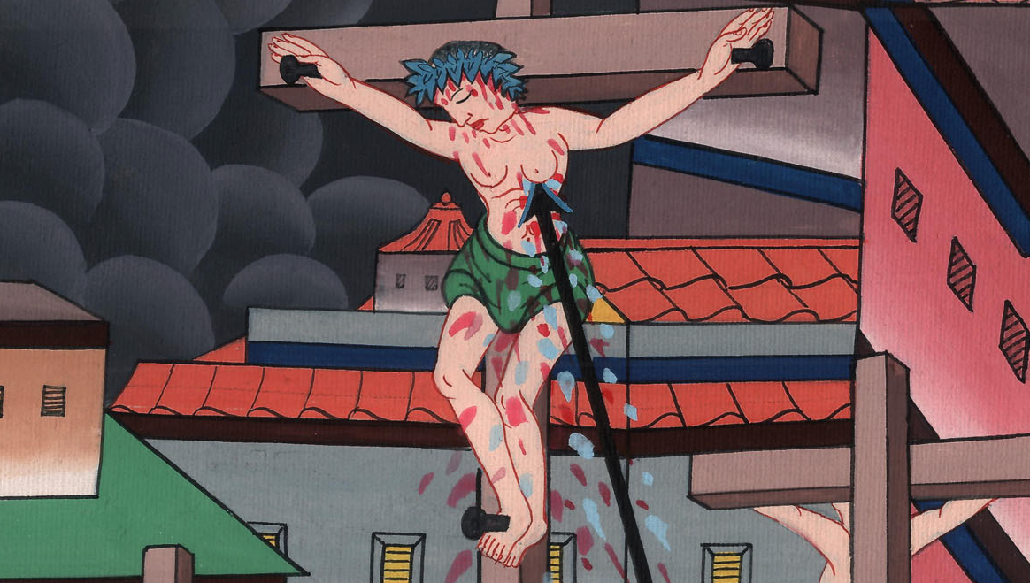
John 19:34

Slide 23
36For these things happened that the Scripture might be fulfilled, “A bone of him will not be broken.” 37Again another Scripture says, “They will look on him whom they pierced.”
John

Slide 24
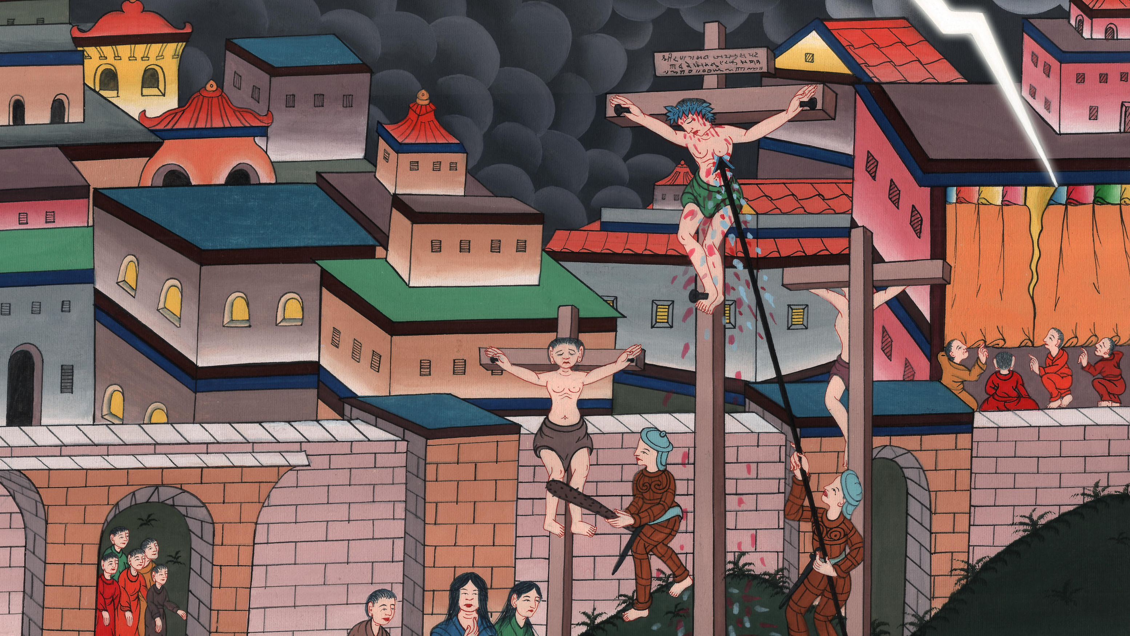
John 19:36,37

Slide 25
Matt 27 57When evening had come, a rich man from Arimathaea named Joseph, who himself was also Jesus’ disciple, came.
John

Slide 26
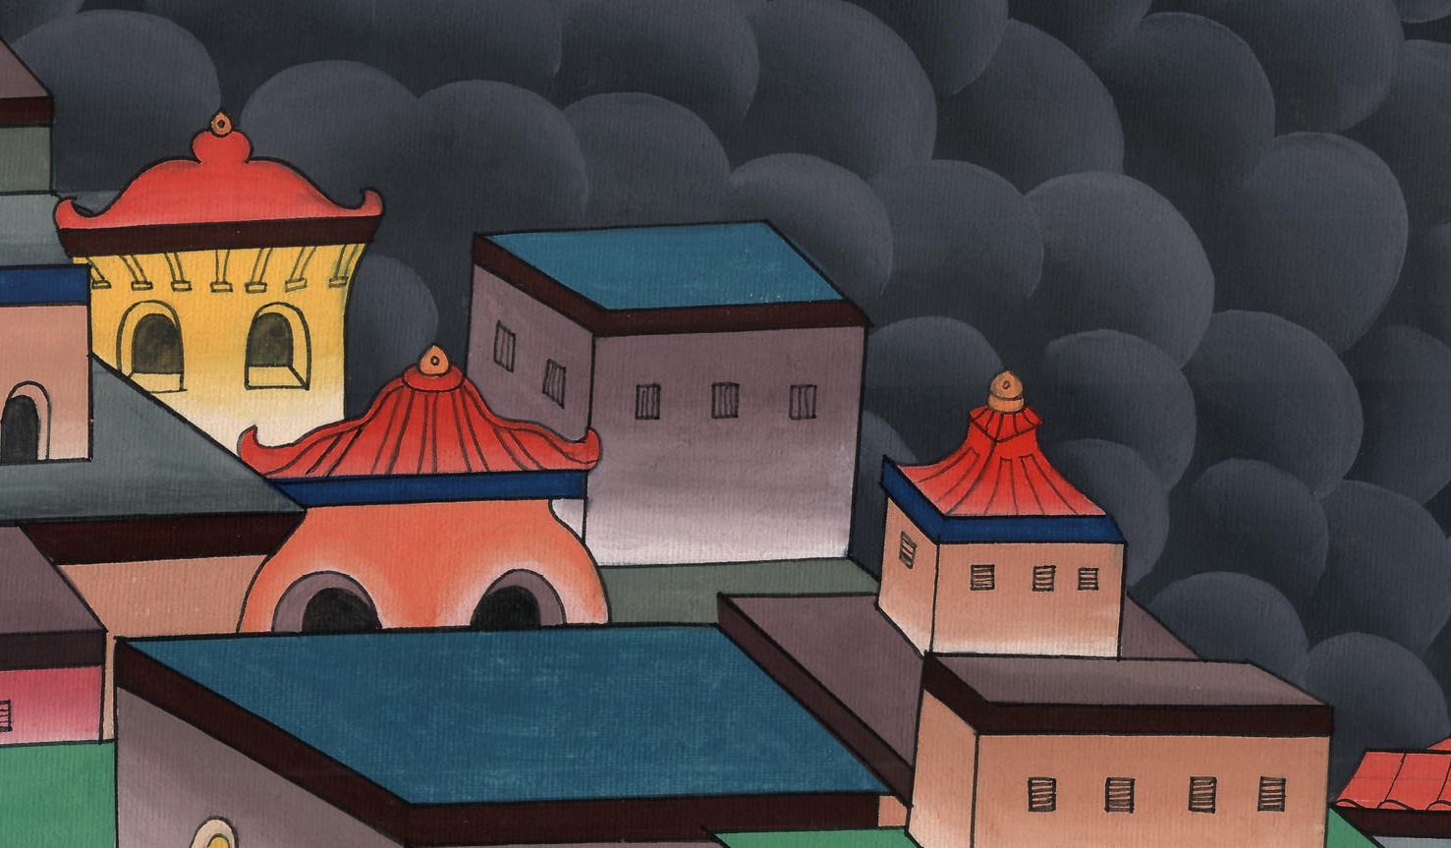
Matthew 27:57

Slide 27
58This man went to Pilate and asked for Jesus’ body. Then Pilate commanded the body to be given up.
John

Slide 28
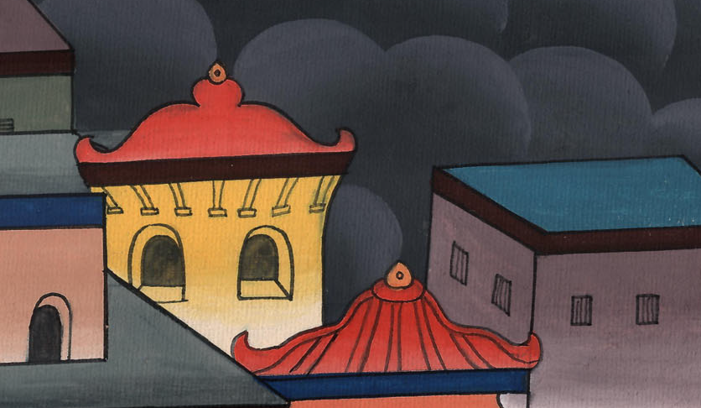
Matthew 27:58

Slide 29
59Joseph took the body and wrapped it in a clean linen cloth
John

Slide 30
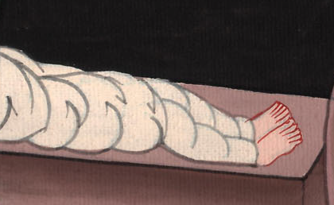
Matthew 27:59

Slide 31
60and laid it in his own new tomb, which he had cut out in the rock. Then he rolled a large stone against the door of the tomb, and departed.
John

Slide 32
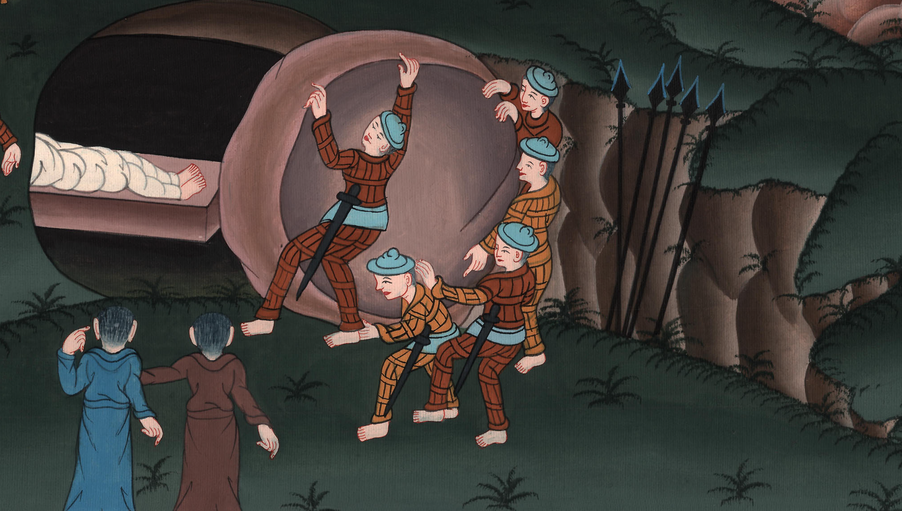
Matthew 27:59,60

Slide 33
61Mary Magdalene was there, and the other Mary, sitting opposite the tomb.
John

Slide 34
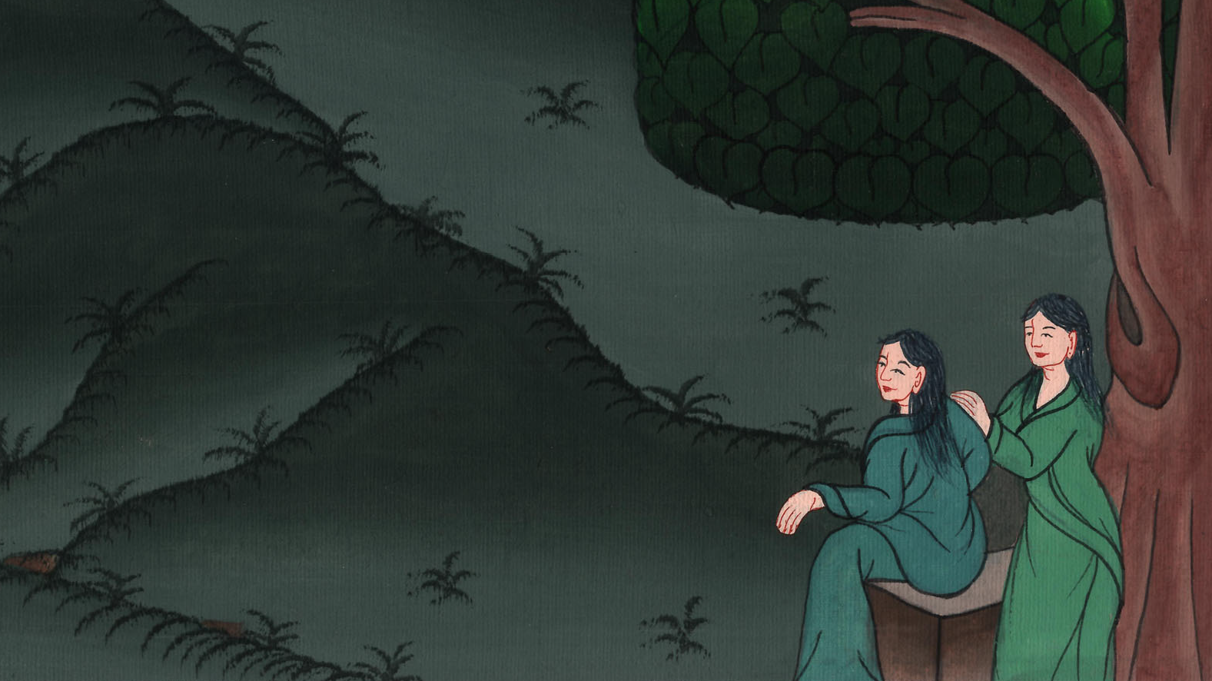
Matthew 27:61

Slide 35
62Now on the next day, which was the day after the Preparation Day, the chief priests and the Pharisees were gathered together to Pilate,
John

Slide 36
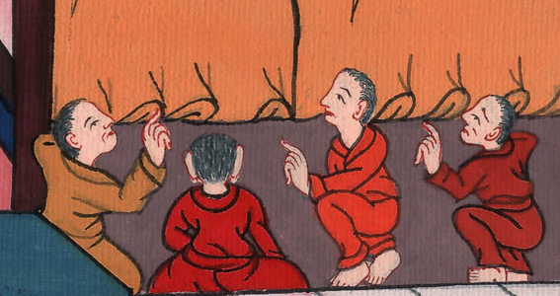
Matthew 27:62

Slide 37
63saying, “Sir, we remember what that deceiver said while he was still alive: ‘After three days I will rise again.’
John

Slide 38
Matthew 27:63

Slide 39
64Command therefore that the tomb be made secure until the third day, lest perhaps his disciples come at night and steal him away, and tell the people, ‘He is risen from the dead;’ and the last deception will be worse than the first.”
John

Slide 40
Matthew 27:64

Slide 41
65Pilate said to them, “You have a guard. Go, make it as secure as you can.”
John

Slide 42
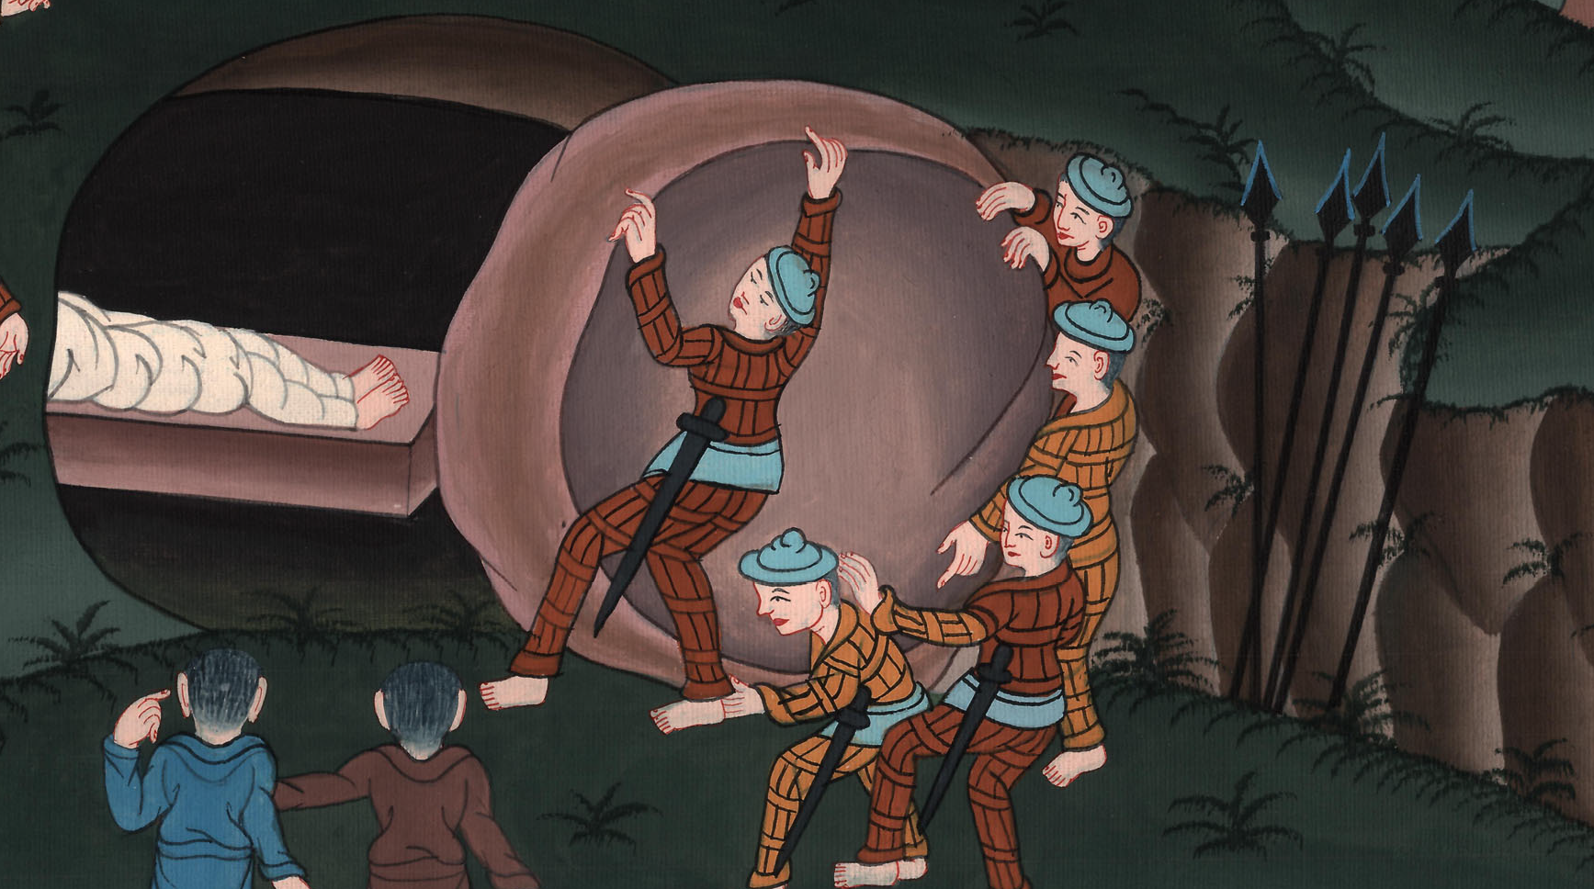
Matthew 27:65

Slide 43
66So they went with the guard and made the tomb secure, sealing the stone.
John

Slide 44
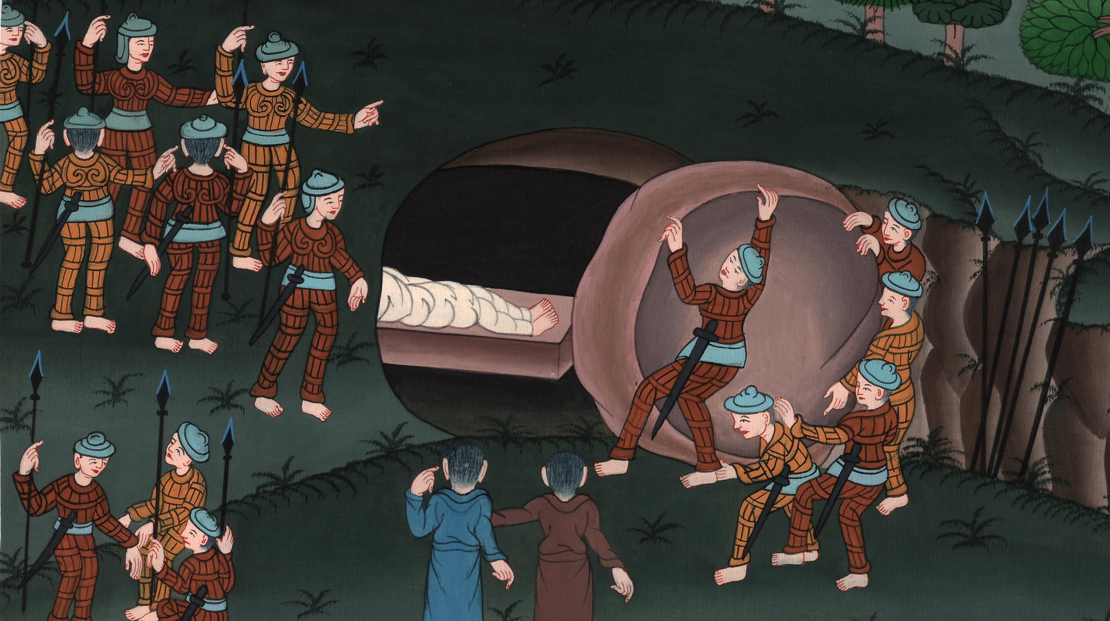
Matthew 27:66

