Slide 1
45-1
This work is licensed under a Creative Commons Attribution-ShareAlike 4.0 International License.
Please add this statement to all the videos you create.
English Bible quotes are from the World English Bible US, which is in the public domain.
Notes:
Ch
45 Empty Tomb
1. Empty Tomb - Matt 28:1-8, 11-15; Mark 16:1-11; Luke 24:1-11 (Left Top)
2. Mary Magdalene meets Jesus - John 20:1-18 (Right Top)
3. Road to Emmaus - Luke 24:13-35 (Right Bottom)
4. Jesus & Disciples - Matt 28:16-20; Mrk 16:14-19; Luke 24:36-49; John 20:24-31
(Left Bottom)
5. Sea of Galilee - John 21:1-25 (Center)

Slide 2
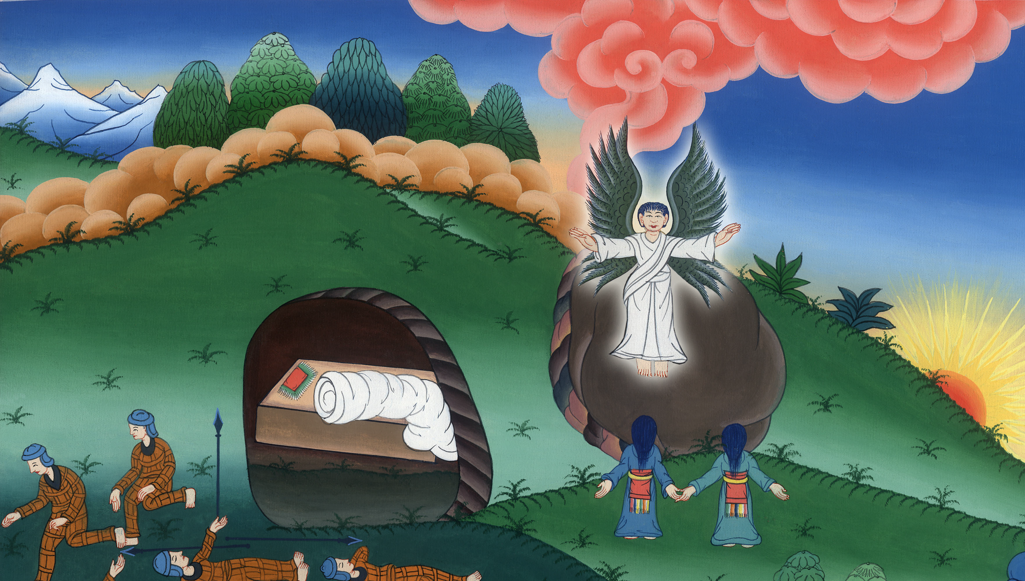
The Empty Tomb - Matthew 28:1-8, 11-15; Mark 16:1-11; Luke 24:1-11

Slide 3
1. The Empty Tomb - Matthew 28:1-8, 11-15; Mark 16:1-11; Luke 24:1-11
John

Slide 4
The Empty Tomb - Matthew 28:1-8, 11-15; Mark 16:1-11; Luke 24:1-11

Slide 5
Matthew 28:1Now after the Sabbath, as it began to dawn on the first day of the week, Mary Magdalene and the other Mary came to see the tomb.
John

Slide 6
Matthew 28:1

Slide 7
2Behold, there was a great earthquake, for an angel of the Lord descended from the sky and came and rolled away the stone from the door and sat on it.
John

Slide 8
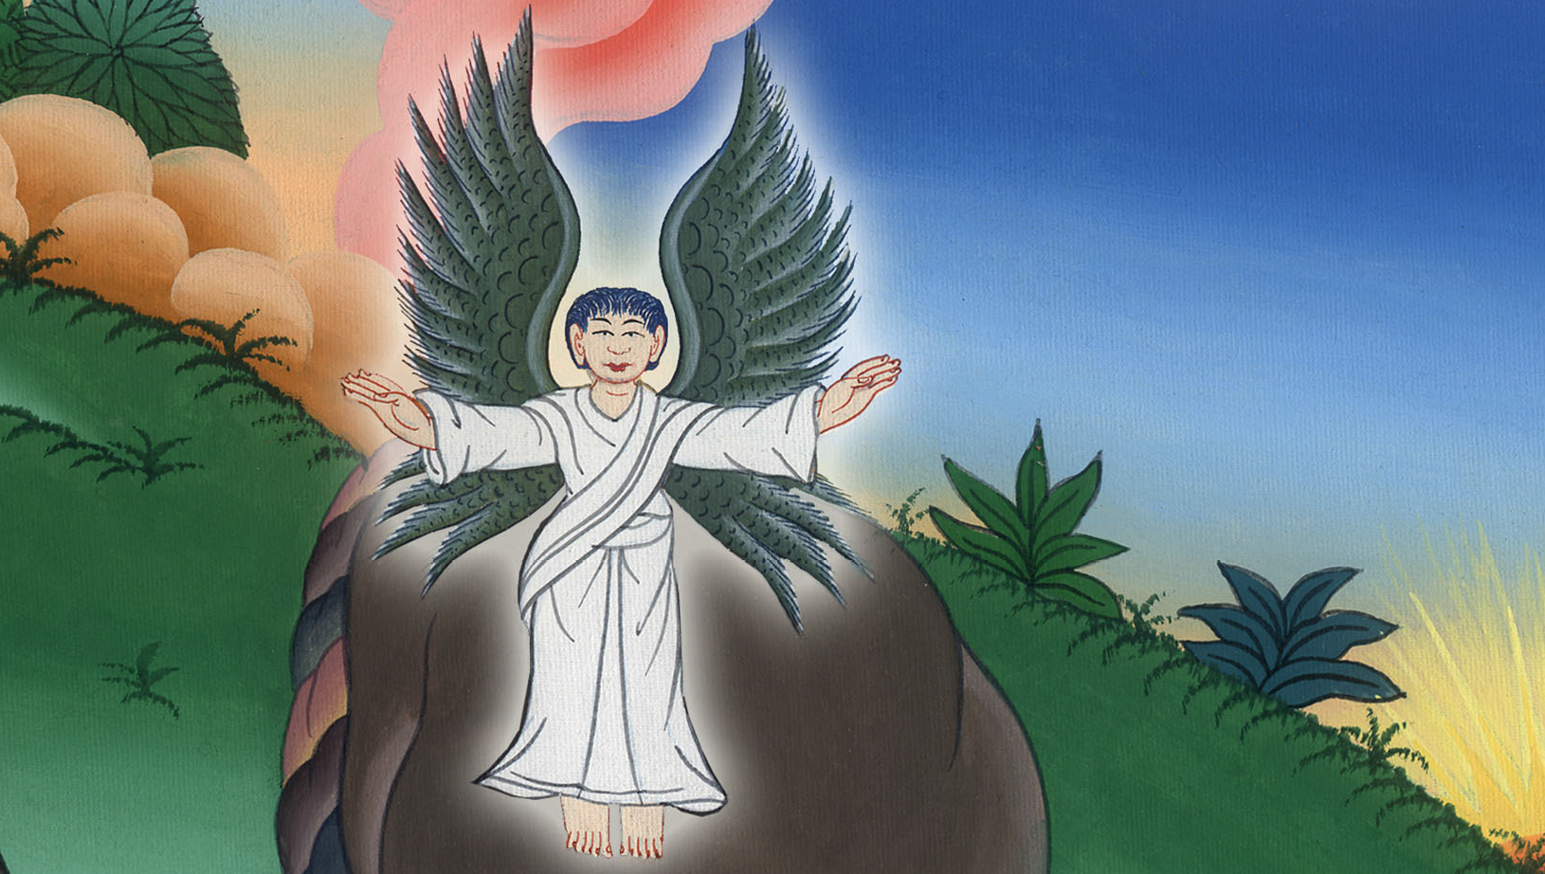
Matthew 28:2

Slide 9
3His appearance was like lightning, and his clothing white as snow.
John

Slide 10
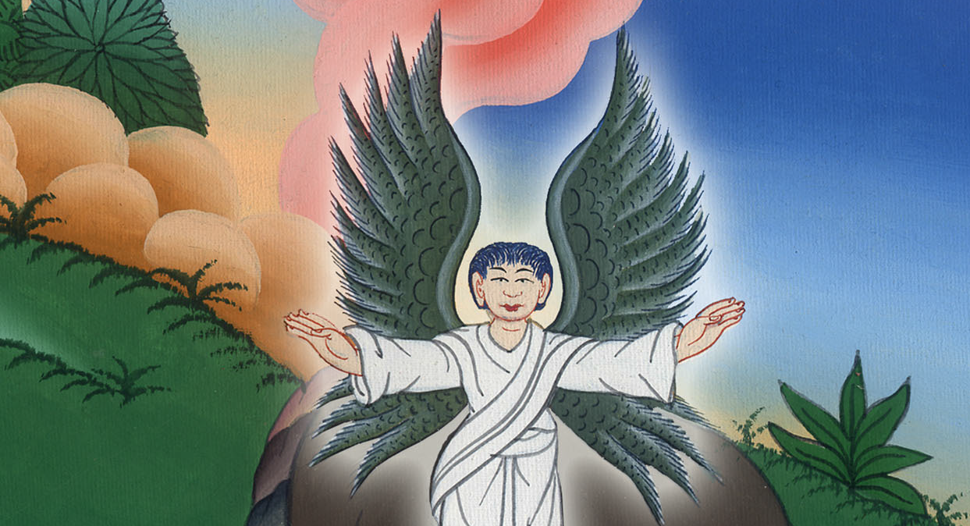
Matthew 28:3

Slide 11
4For fear of him, the guards shook, and became like dead men.
John

Slide 12
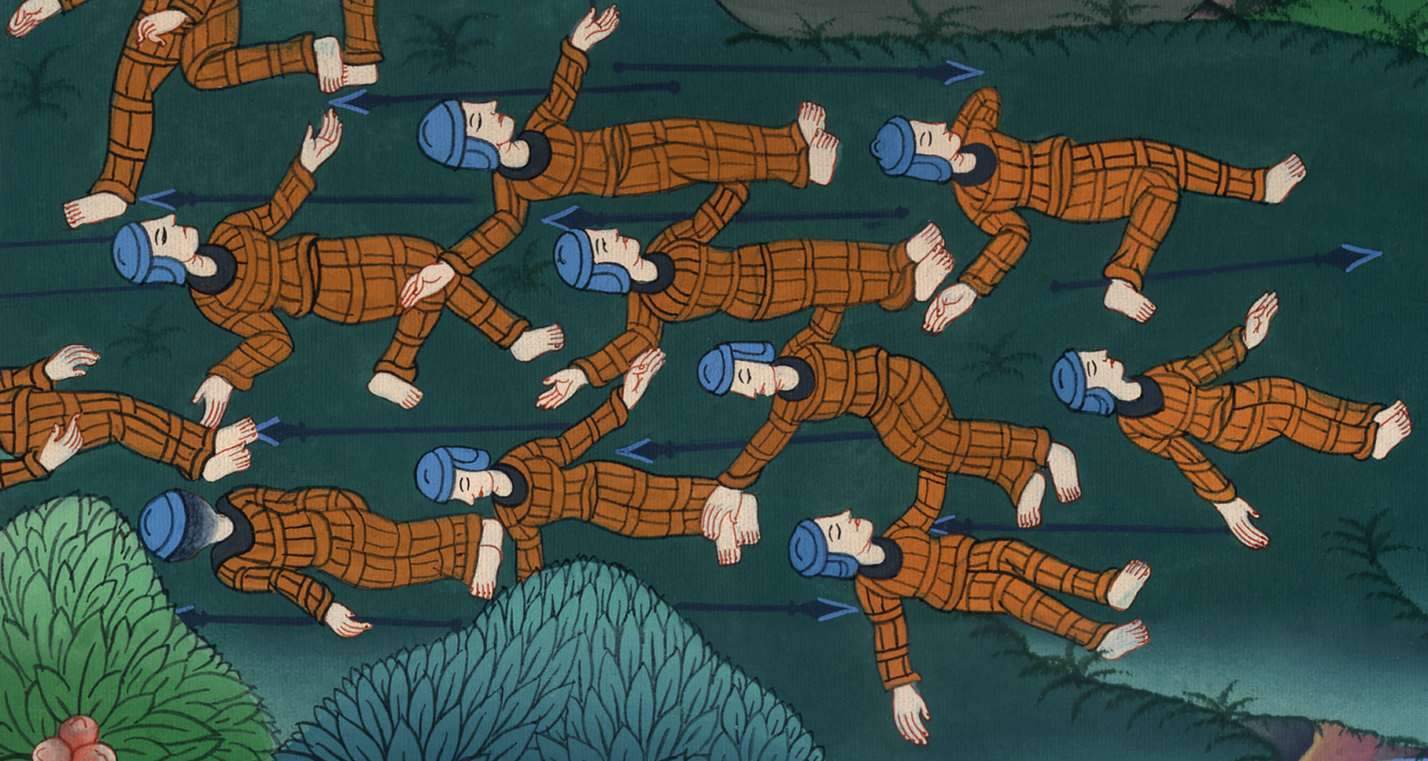
Matthew 28:4

Slide 13
5The angel answered the women, “Don’t be afraid, for I know that you seek Jesus, who has been crucified.
John

Slide 14
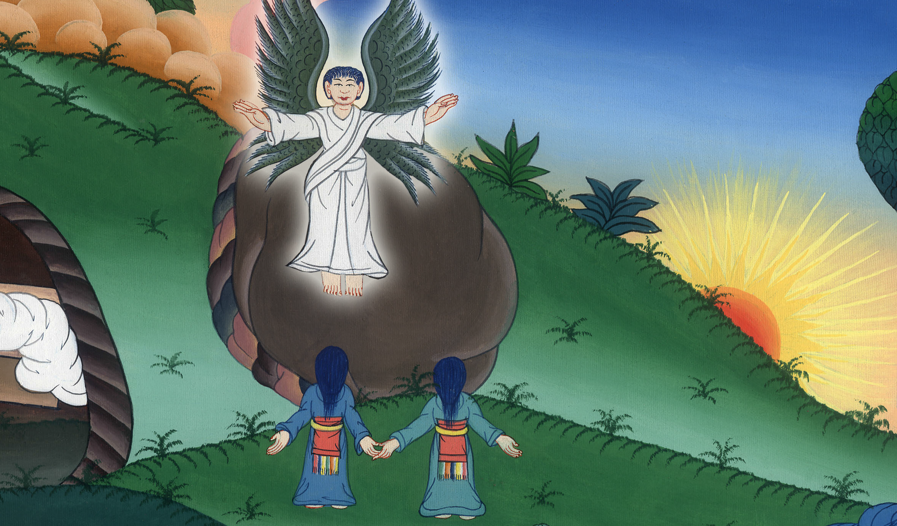
Matthew 28:5

Slide 15
6He is not here, for he has risen, just like he said. Come, see the place where the Lord was lying.
John

Slide 16
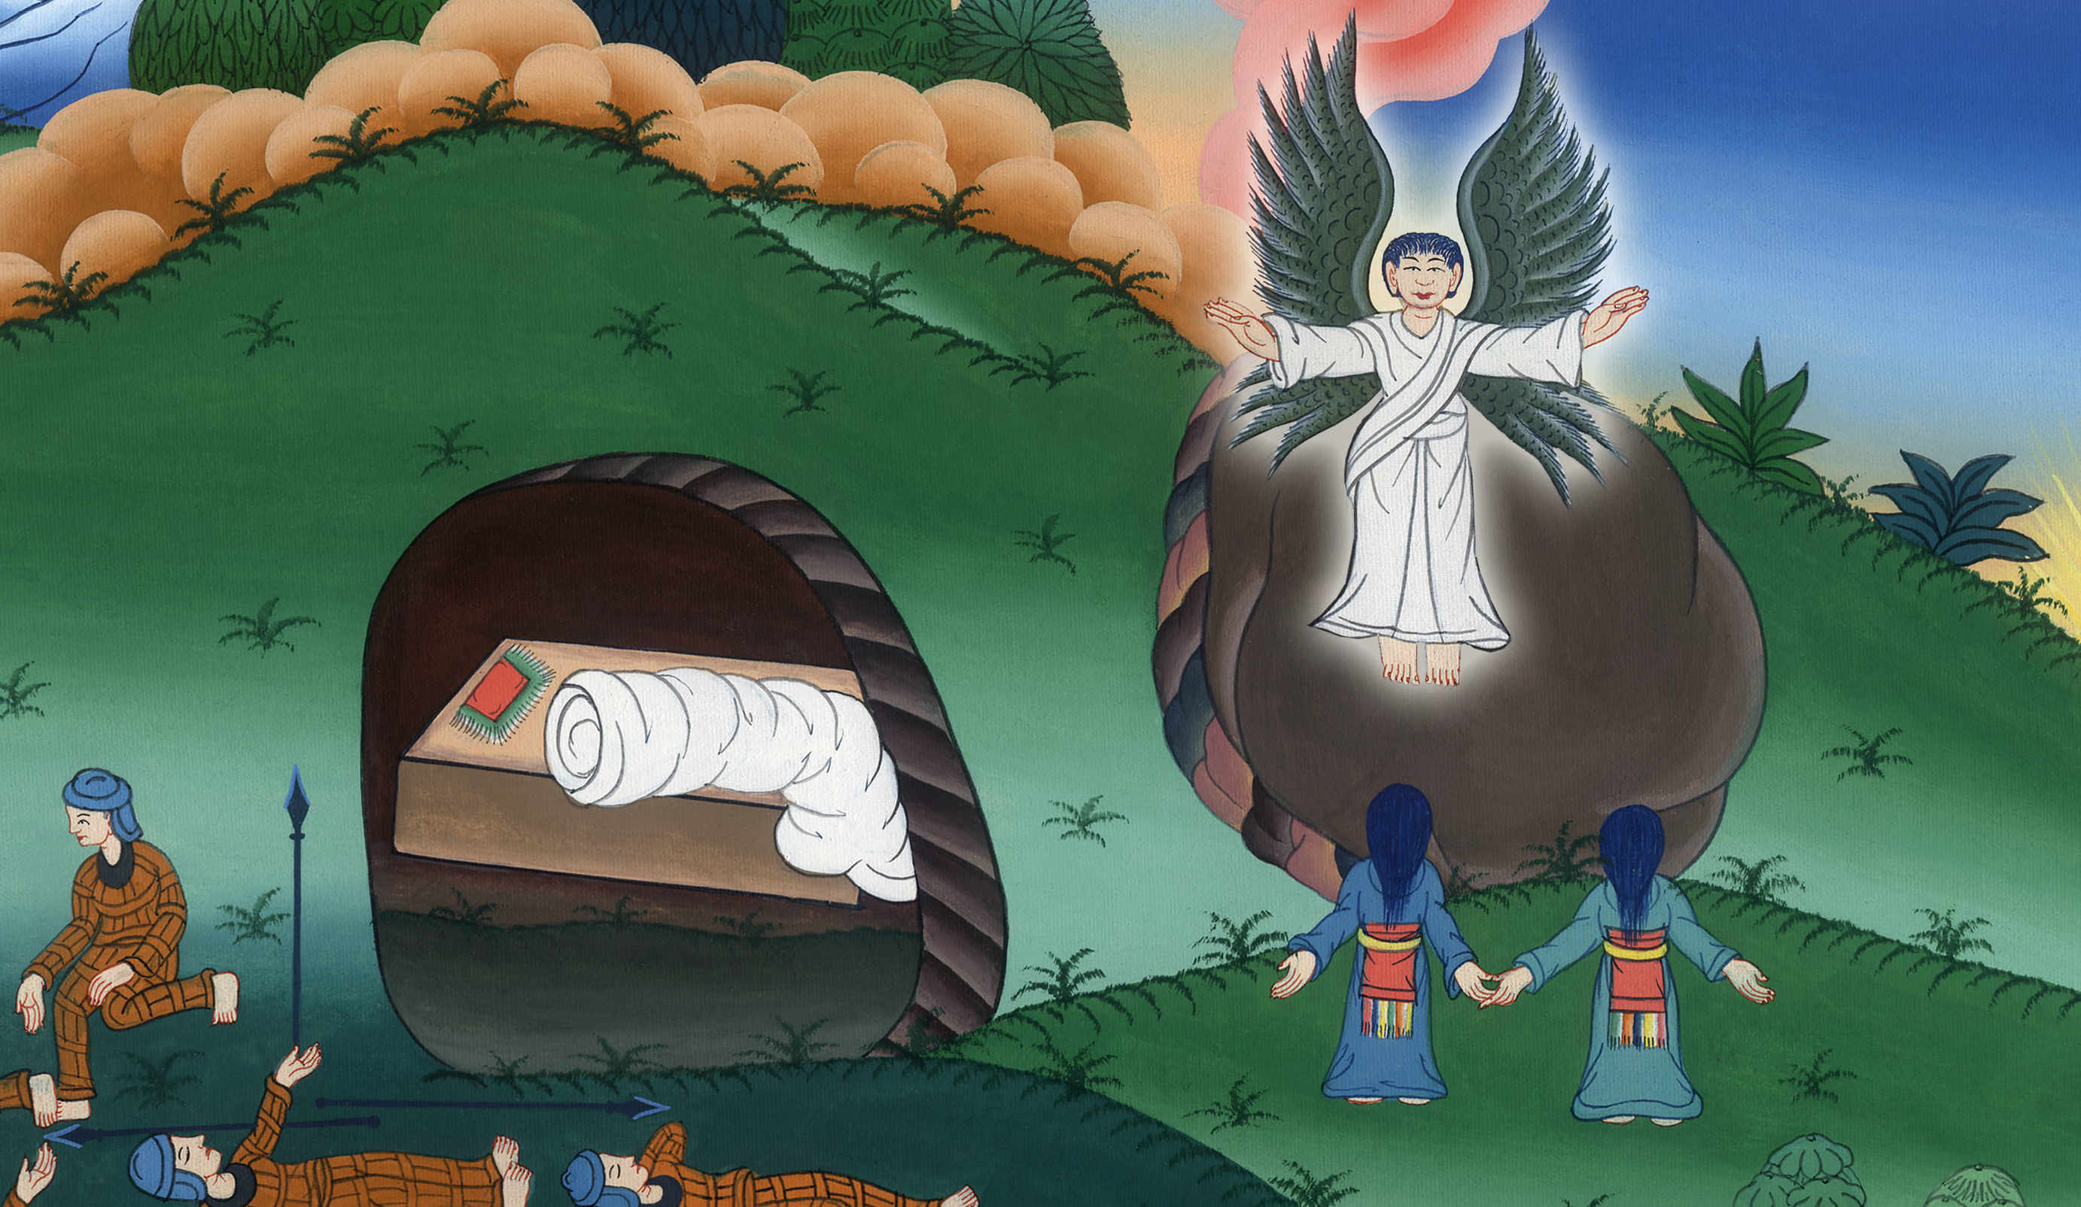
Matthew 28:6

Slide 17
7Go quickly and tell his disciples, ‘He has risen from the dead, and behold, he goes before you into Galilee; there you will see him.’ Behold, I have told you.”
John

Slide 18
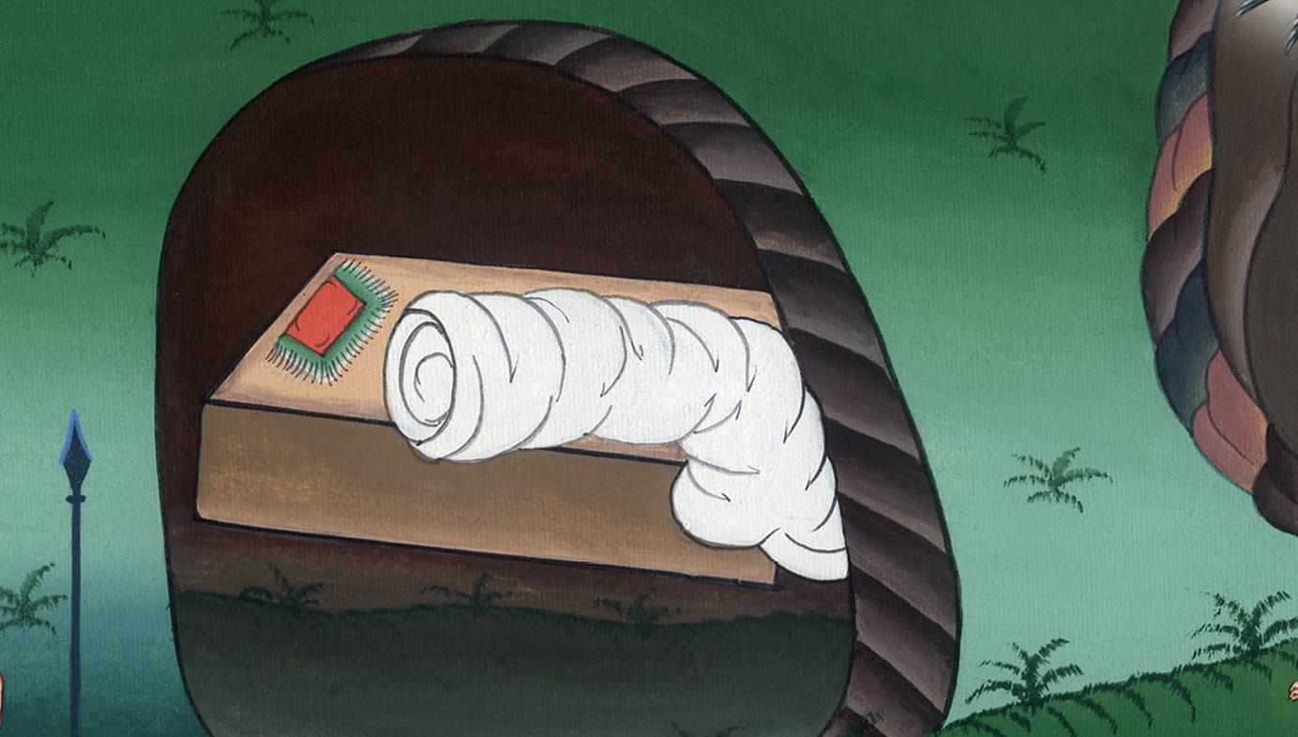
Matthew 28:7

Slide 19
8They departed quickly from the tomb with fear and great joy, and ran to bring his disciples word.
John

Slide 20
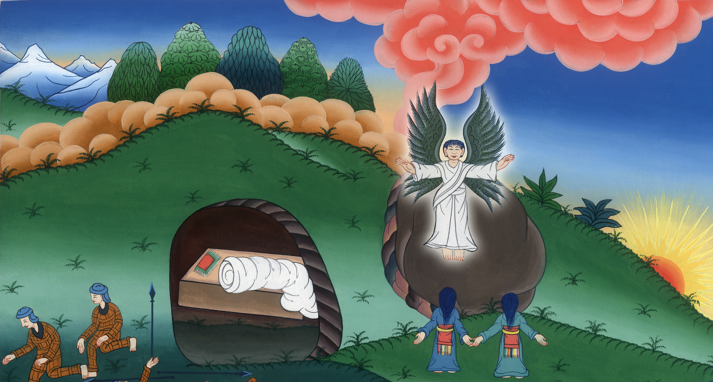
Matthew 28:8

Slide 21
11Now while they were going, behold, some of the guards came into the city and told the chief priests all the things that had happened.
John

Slide 22
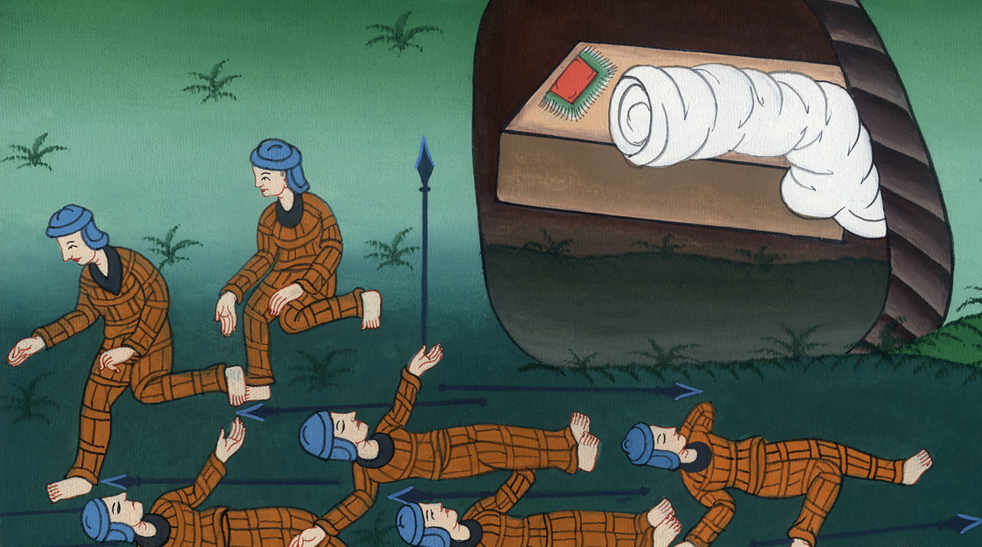
Matthew 28:11

Slide 23
Luke249(The women) returned from the tomb, and told all these things to the eleven and to all the rest.
John

Slide 24
Luke 24:9

