Slide 1
45-2
This work is licensed under a Creative Commons Attribution-ShareAlike 4.0 International License.
Please add this statement to all the videos you create.
English Bible quotes are from the World English Bible US, which is in the public domain.
Notes:
Ch
45 Empty Tomb
1. Empty Tomb - Matt 28:1-8, 11-15; Mark 16:1-11; Luke 24:1-11 (Left Top)
2. Mary Magdalene meets Jesus - John 20:1-18 (Right Top)
3. Road to Emmaus - Luke 24:13-35 (Right Bottom)
4. Jesus & Disciples - Matt 28:16-20; Mrk 16:14-19; Luke 24:36-49; John 20:24-31
(Left Bottom)
5. Sea of Galilee - John 21:1-25 (Center)

Slide 2
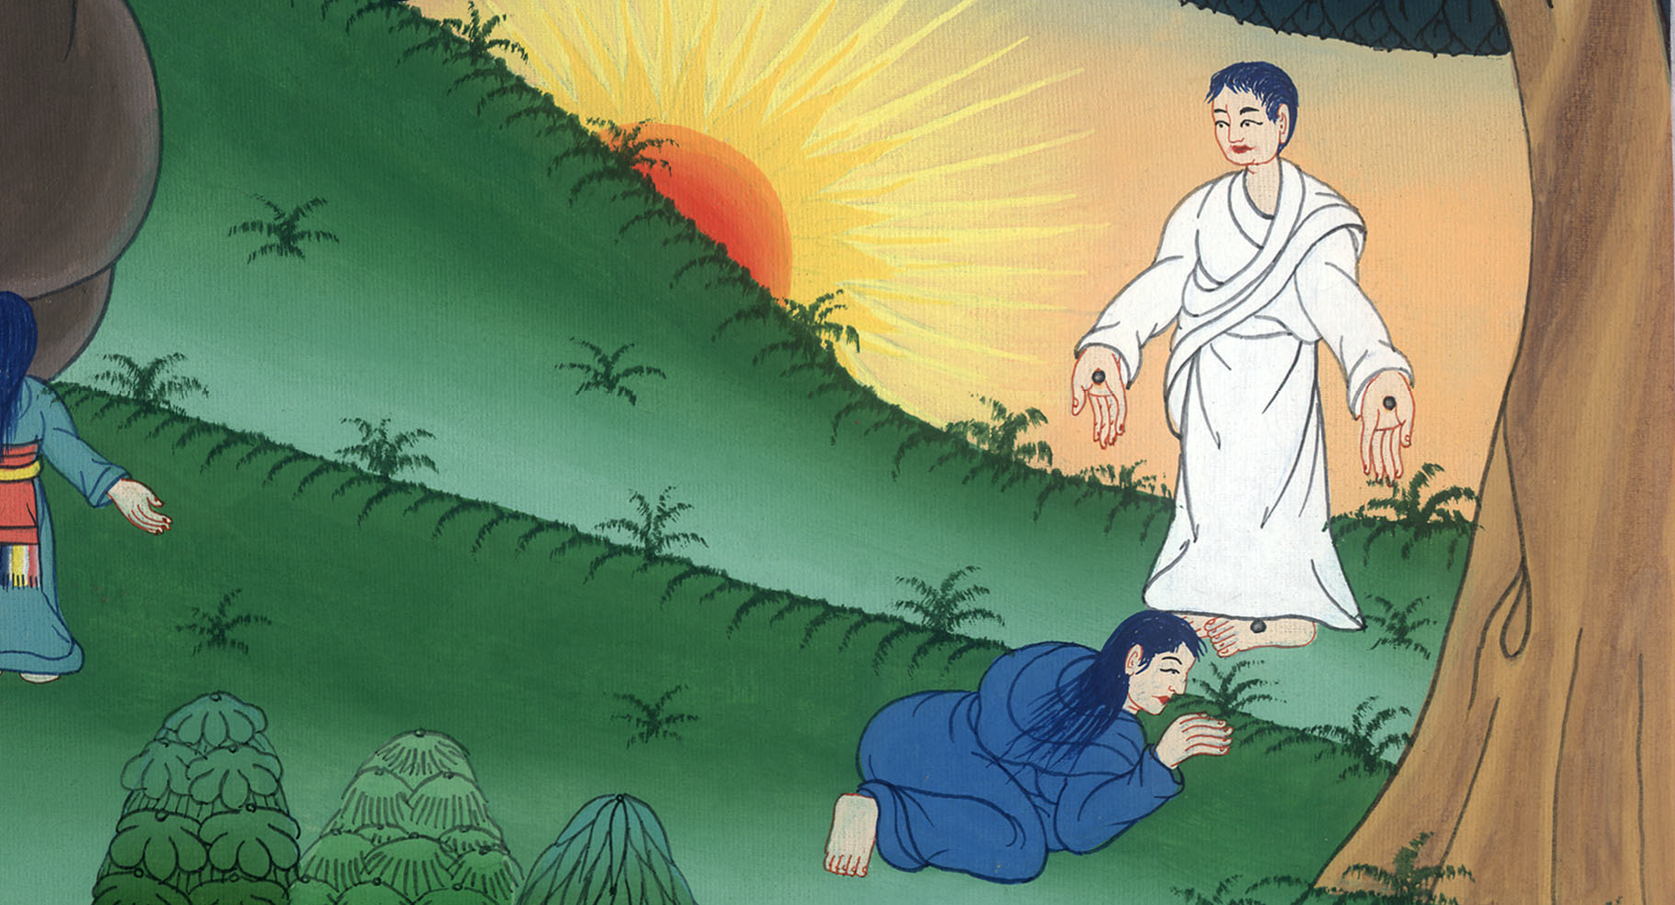
Mary Magdalene meets Jesus –
John 20:1-18

Slide 3
Mary Magdalene meets Jesus - John 20:1-18
John

Slide 4
ཡོ་ཧ་ནན། 20
གཙོ་བོ་ཡེ་ཤུ་མག་རྡལ་མ་མིར་ཡམ་དང་མཇལ་བ།

Slide 5
John 20:1Now on the first day of the week, Mary Magdalene went early, while it was still dark, to the tomb, and saw that the stone had been taken away from the tomb.
John

Slide 6
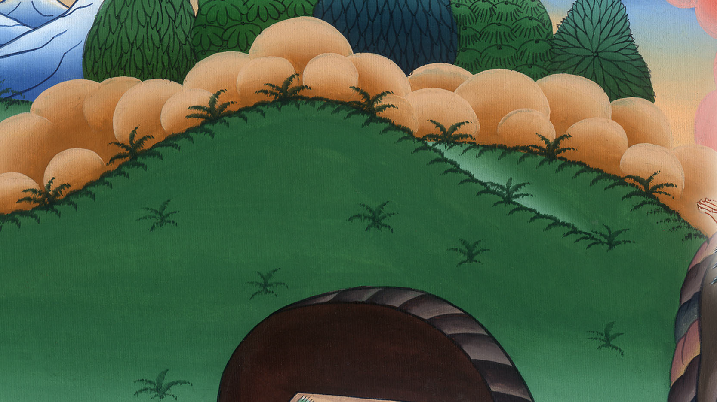
John 20:1

Slide 7
2Therefore she ran and came to Simon Peter and to the other disciple whom Jesus loved, and said to them, “They have taken away the Lord out of the tomb, and we don’t know where they have laid him!”
John

Slide 8
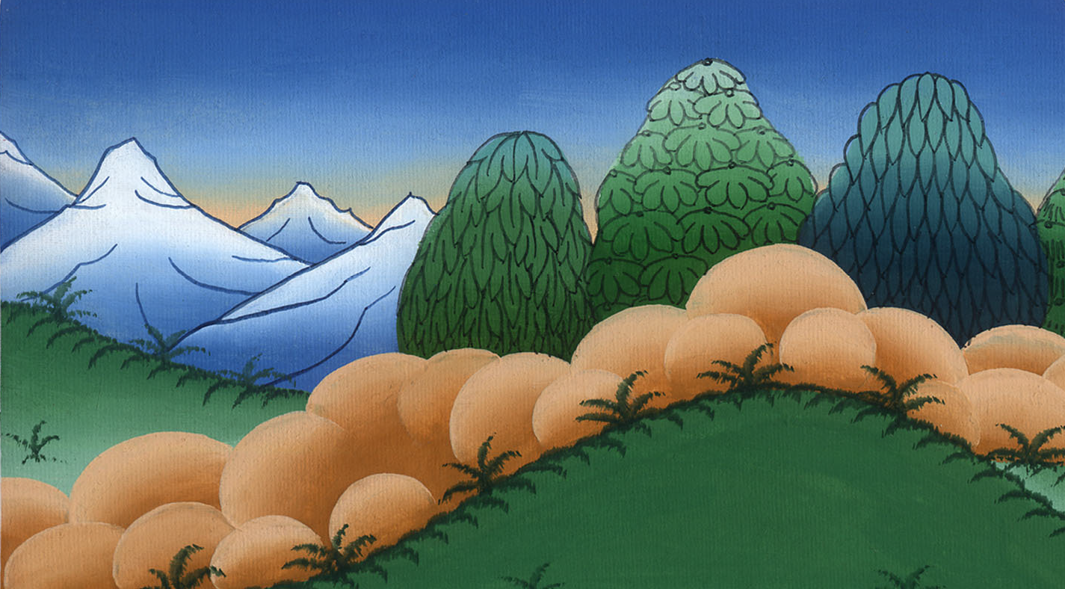
John 20:2

Slide 9
3Therefore Peter and the other disciple went out, and they went toward the tomb. 4They both ran together. The other disciple outran Peter and came to the tomb first.
John

Slide 10
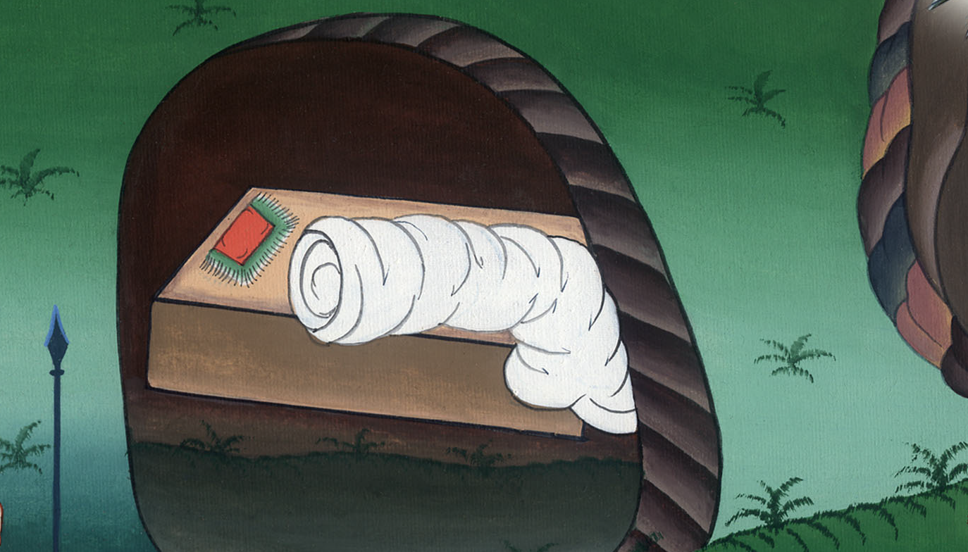
John 20:3,4

Slide 11
5Stooping and looking in, he saw the linen cloths lying there; yet he didn’t enter in.
John

Slide 12
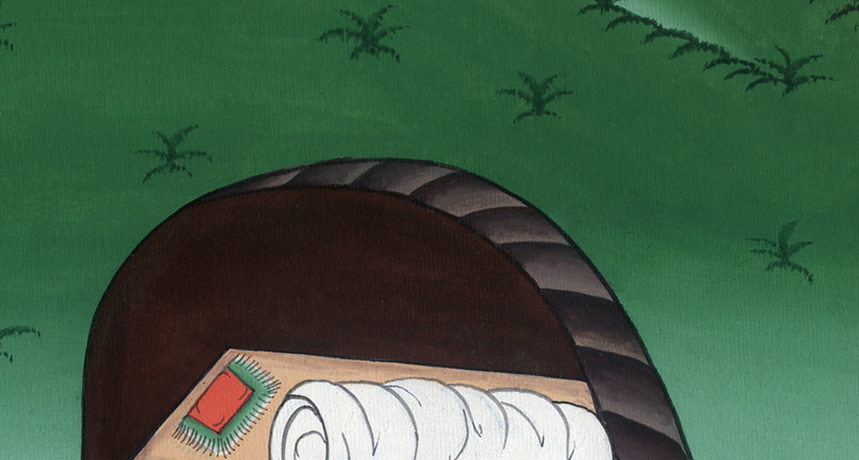
John 20:5

Slide 13
6Then Simon Peter came, following him, and entered into the tomb.
John

Slide 14
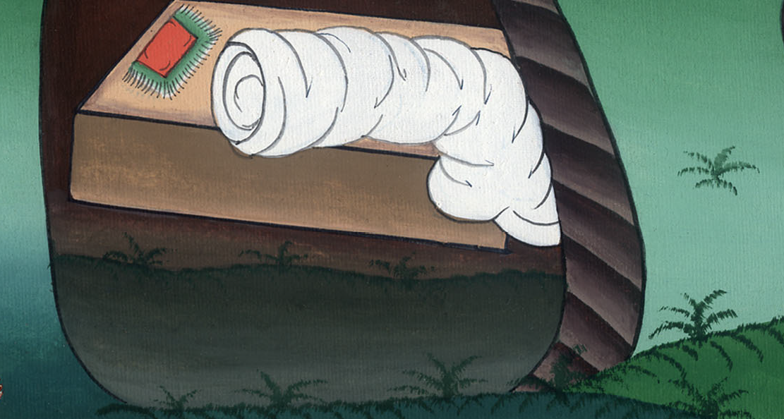
John 20:6

Slide 15
He saw the linen cloths lying, 7and the cloth that had been on his head, not lying with the linen cloths, but rolled up in a place by itself.
John

Slide 16
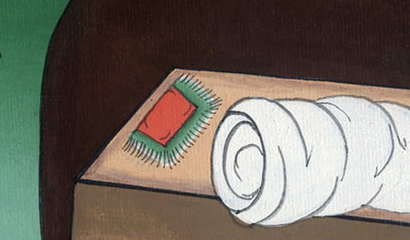
John 20:7

Slide 17
8So then the other disciple who came first to the tomb also entered in, and he saw and believed.
John

Slide 18
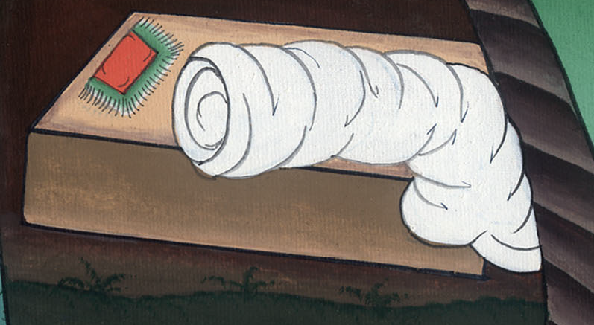
John 20:8

Slide 19
9For as yet they didn’t know the Scripture, that he must rise from the dead. 10So the disciples went away again to their own homes.
John

Slide 20
John 20:9,10

Slide 21
11But Mary was standing outside at the tomb weeping. So as she wept, she stooped and looked into the tomb,
John

Slide 22
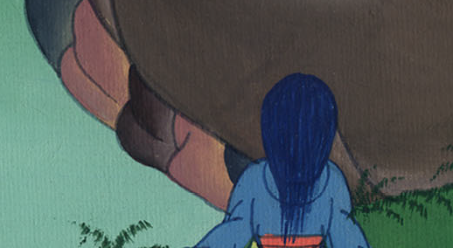
John 20:11

Slide 23
12and she saw two angels in white sitting, one at the head and one at the feet, where the body of Jesus had lain.
John

Slide 24
John 20:12

Slide 25
13They asked her, “Woman, why are you weeping?”
She said to them, “Because they have taken away my Lord, and I don’t know where they have laid him.”
John

Slide 26
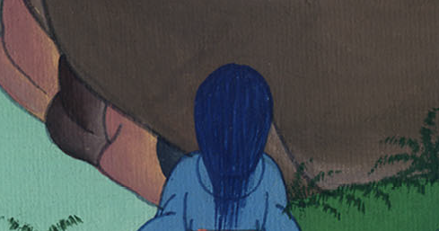
John 20:13

Slide 27
14When she had said this, she turned around and saw Jesus standing, and didn’t know that it was Jesus.
John

Slide 28
John 20:14

Slide 29
15Jesus said to her, “Woman, why are you weeping? Who are you looking for?”
She, supposing him to be the gardener, said to him, “Sir, if you have carried him away, tell me where you have laid him, and I will take him away.”
John

Slide 30
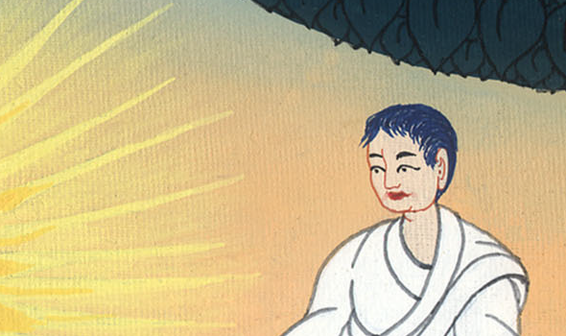
John 20:15

Slide 31
16Jesus said to her, “Mary.”
She turned and said to him, “Rabboni!” which is to say, “Teacher!”
John

Slide 32
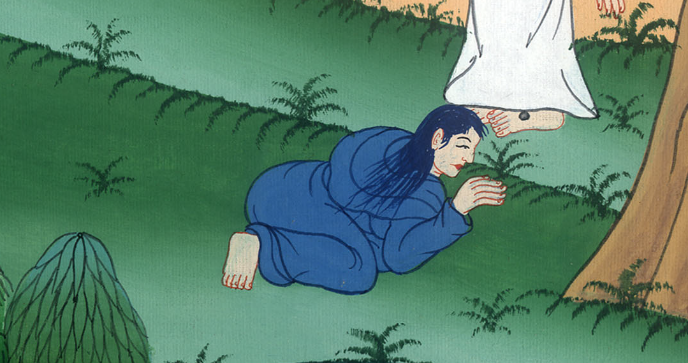
John 20:16

Slide 33
17Jesus said to her, “Don’t hold me, for I haven’t yet ascended to my Father; but go to my brothers and tell them, ‘I am ascending to my Father and your Father, to my God and your God.’”
John

Slide 34
John 20:17

Slide 35
18Mary Magdalene came and told the disciples that she had seen the Lord, and that he had said these things to her.
John

Slide 36
John 20:18

