Slide 1
45-3
This work is licensed under a Creative Commons Attribution-ShareAlike 4.0 International License.
Please add this statement to all the videos you create.
English Bible quotes are from the World English Bible US, which is in the public domain.
Notes:
Ch
45 Empty Tomb
1. Empty Tomb - Matt 28:1-8, 11-15; Mark 16:1-11; Luke 24:1-11 (Left Top)
2. Mary Magdalene meets Jesus - John 20:1-18 (Right Top)
3. Road to Emmaus - Luke 24:13-35 (Right Bottom)
4. Jesus & Disciples - Matt 28:16-20; Mrk 16:14-19; Luke 24:36-49; John 20:24-31
(Left Bottom)
5. Sea of Galilee - John 21:1-25 (Center)

Slide 2
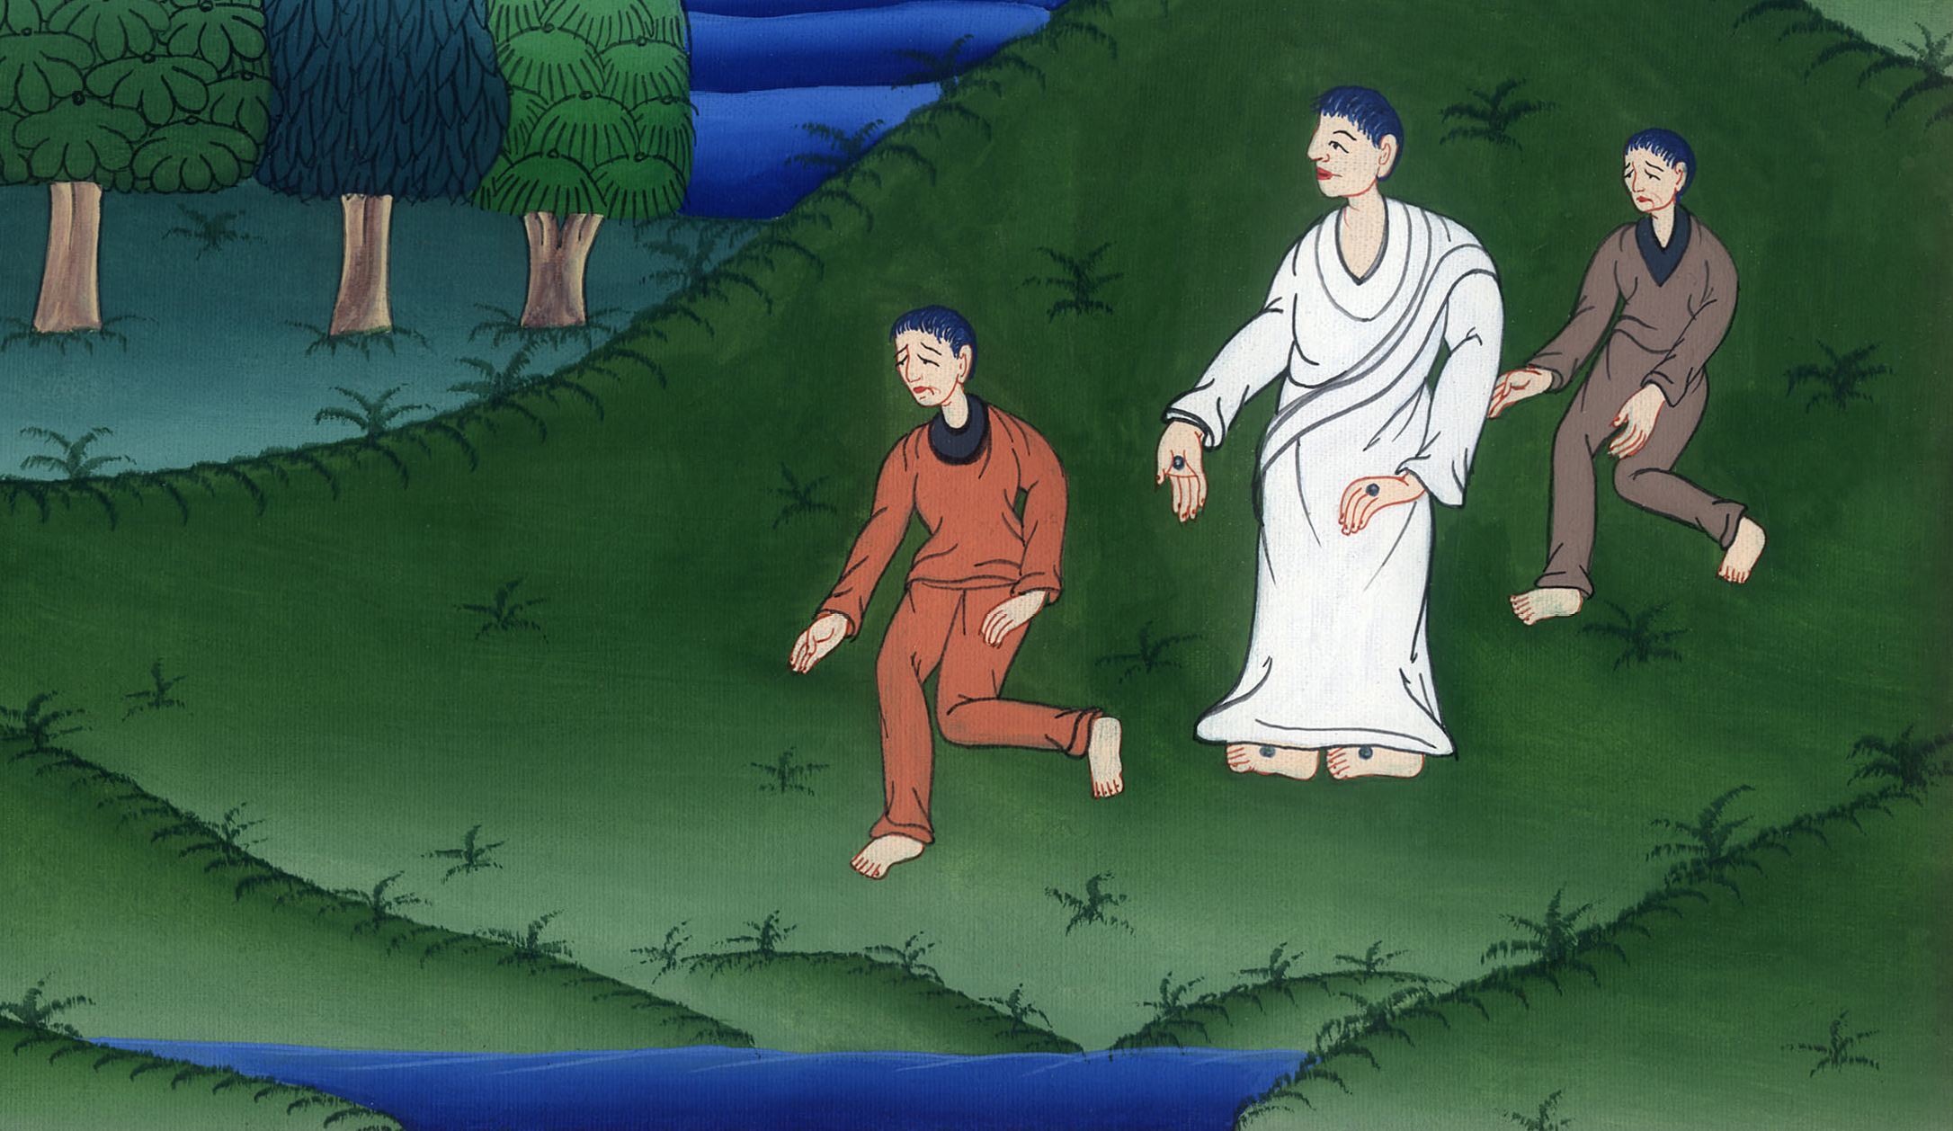
Road to Emmaus - Luke 24:13-35

Slide 3
Road to Emmaus - Luke 24:13-35
John

Slide 4
Road to Emmaus - Luke 24:13-35

Slide 5
Luke 24:13Behold, two of them were going that very day to a village named Emmaus, which was sixty stadia from Jerusalem.
John

Slide 6
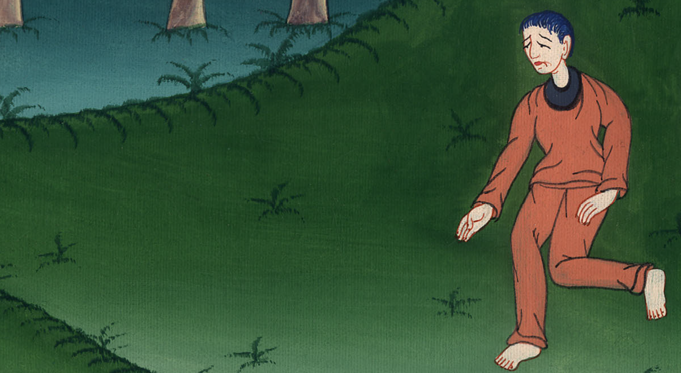
Luke 24:13

Slide 7
14They talked with each other about all of these things which had happened.
John

Slide 8
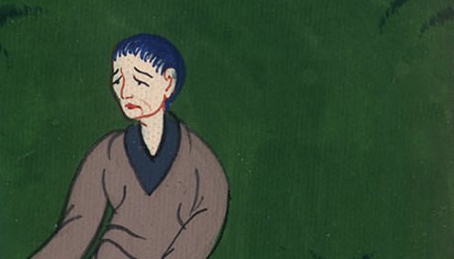
Luke 24:14

Slide 9
15While they talked and questioned together, Jesus himself came near, and went with them. 16But their eyes were kept from recognizing him.
John

Slide 10
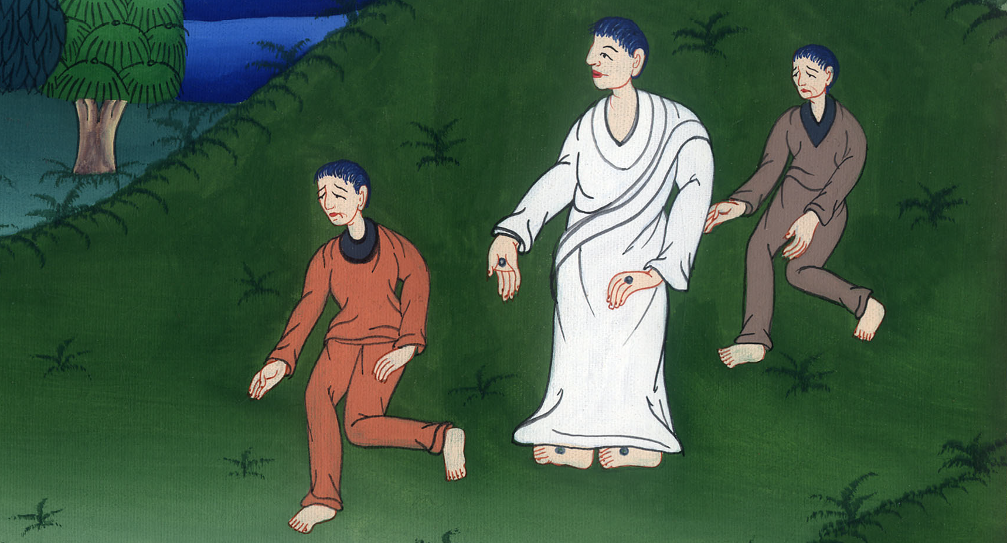
Luke 24:15,16

Slide 11
17He said to them, “What are you talking about as you walk, and are sad?”
John

Slide 12
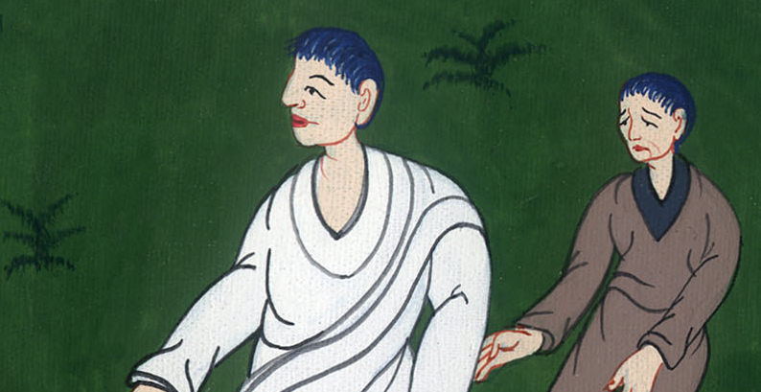
Luke 24:17

Slide 13
18One of them, named Cleopas, answered him, “Are you the only stranger in Jerusalem who doesn’t know the things which have happened there in these days?”
John

Slide 14
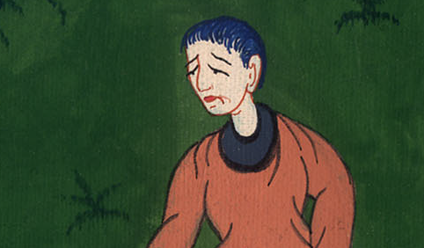
Luke 24:18

Slide 15
19He said to them, “What things?”
They said to him, “The things concerning Jesus the Nazarene, who was a prophet mighty in deed and word before God and all the people;
John

Slide 16
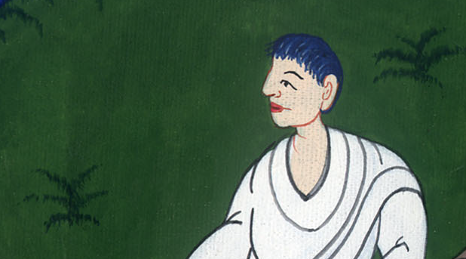
Luke 24:19

Slide 17
20and how the chief priests and our rulers delivered him up to be condemned to death, and crucified him.
John

Slide 18
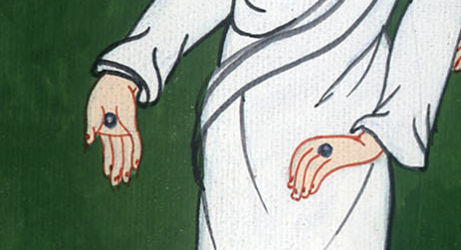
Luke 24:20

Slide 19
21But we were hoping that it was he who would redeem Israel. Yes, and besides all this, it is now the third day since these things happened.
John

Slide 20
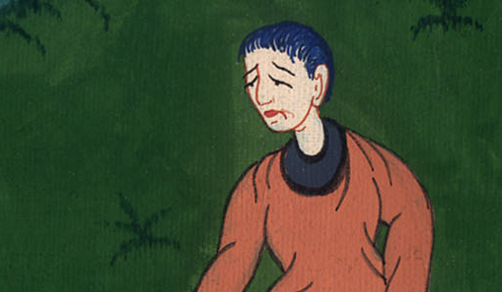
Luke 24:21

Slide 21
22Also, certain women of our company amazed us, having arrived early at the tomb;
John

Slide 22
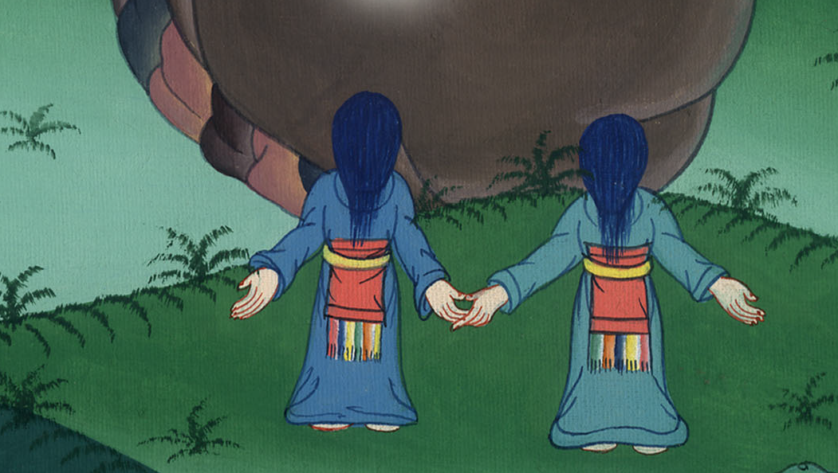
Luke 24:22

Slide 23
23and when they didn’t find his body, they came saying that they had also seen a vision of angels, who said that he was alive.
John

Slide 24
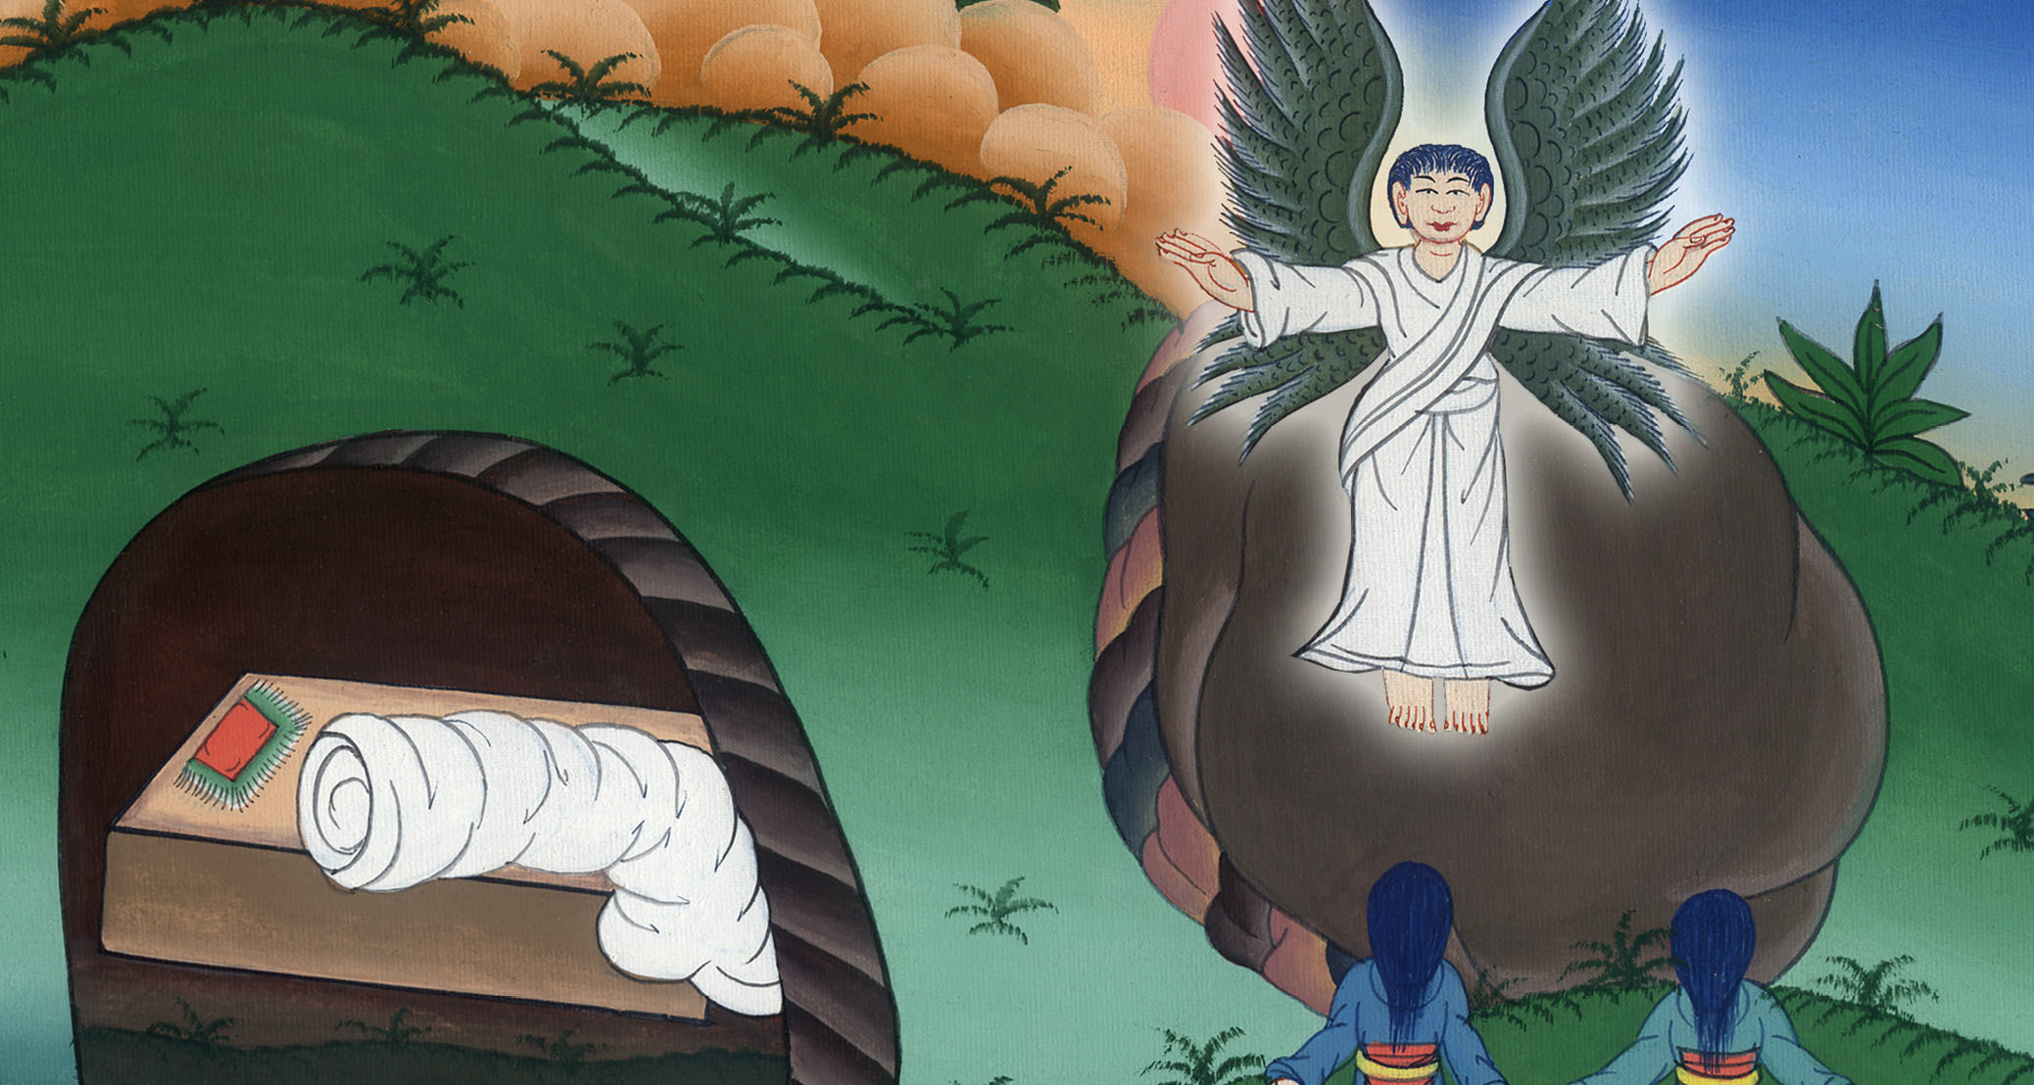
Luke 24:23

Slide 25
24Some of us went to the tomb and found it just like the women had said, but they didn’t see him.”
John

Slide 26
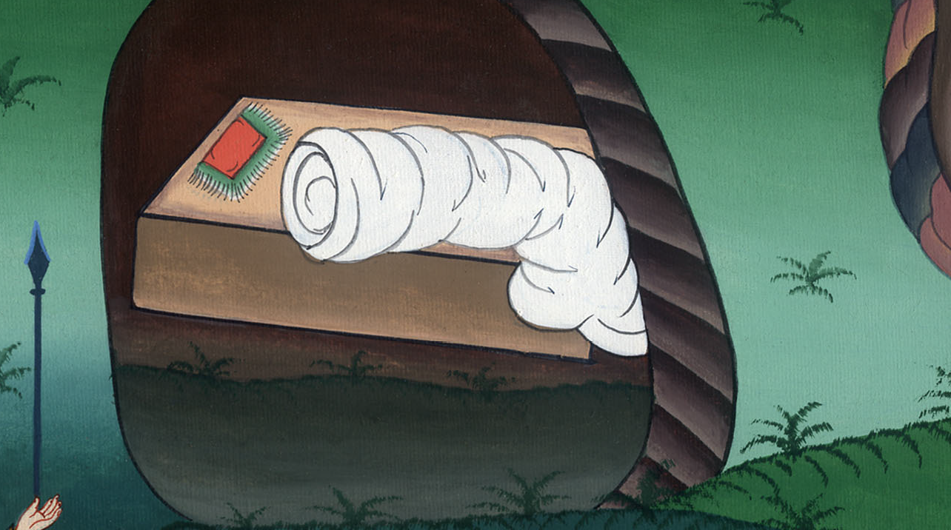
Luke 24:24

Slide 27
25He said to them, “Foolish people, and slow of heart to believe in all that the prophets have spoken! 26Didn’t the Christ have to suffer these things and to enter into his glory?”
John

Slide 28
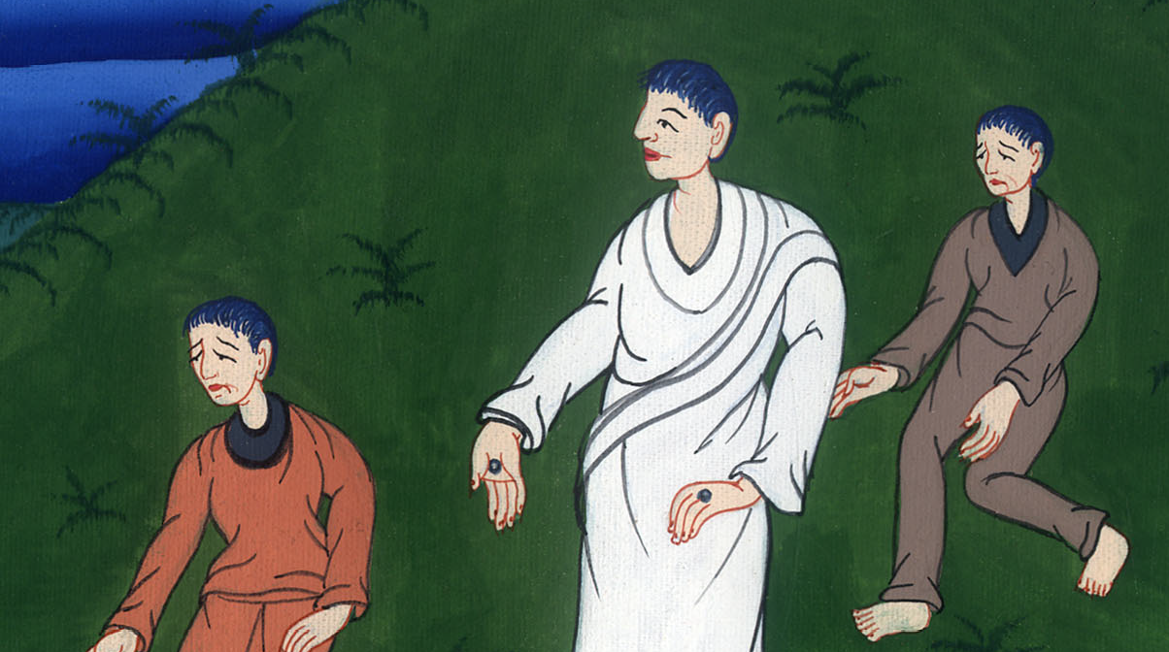
Luke 24:25,26

Slide 29
27Beginning from Moses and from all the prophets, he explained to them in all the Scriptures the things concerning himself.
John

Slide 30
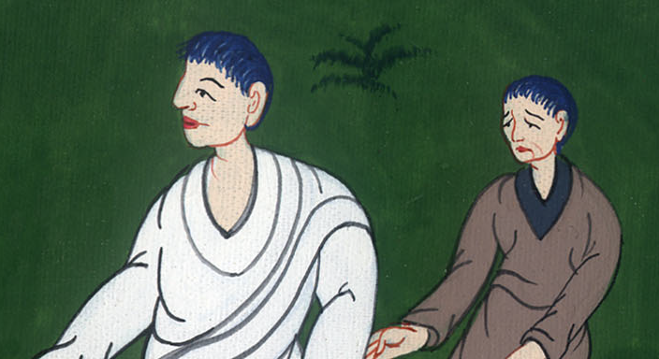
Luke 24:27

Slide 31
28They came near to the village where they were going, and he acted like he would go further.
John

Slide 32
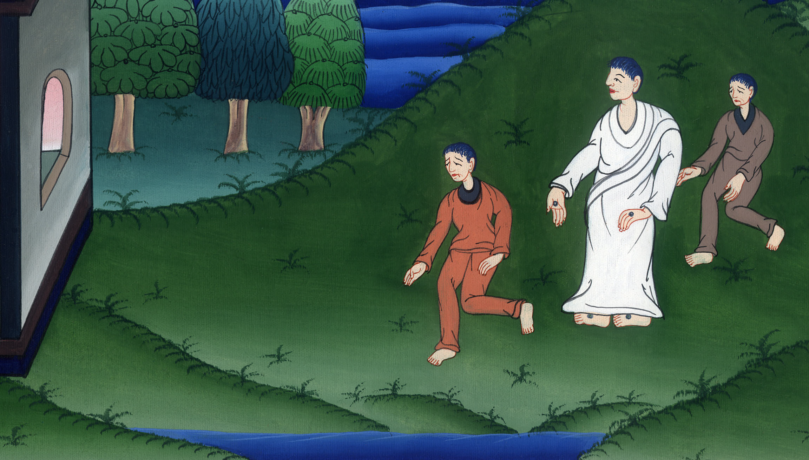
Luke 24:28

Slide 33
29They urged him, saying, “Stay with us, for it is almost evening, and the day is almost over.”
He went in to stay with them.
John

Slide 34
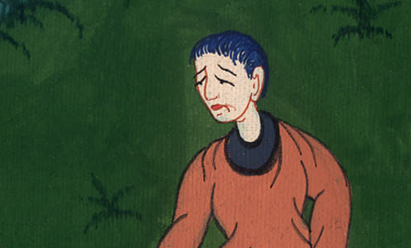
Luke 24:29

Slide 35
30When he had sat down at the table with them, he took the bread and gave thanks. Breaking it, he gave it to them.
John

Slide 36
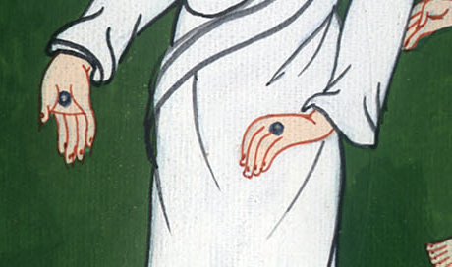
Luke 24:30

Slide 37
31Their eyes were opened and they recognized him; then he vanished out of their sight.
John

Slide 38
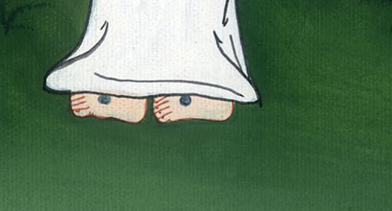
Luke 24:31

Slide 39
32They said to one another, “Weren’t our hearts burning within us while he spoke to us along the way, and while he opened the Scriptures to us?”
John

Slide 40
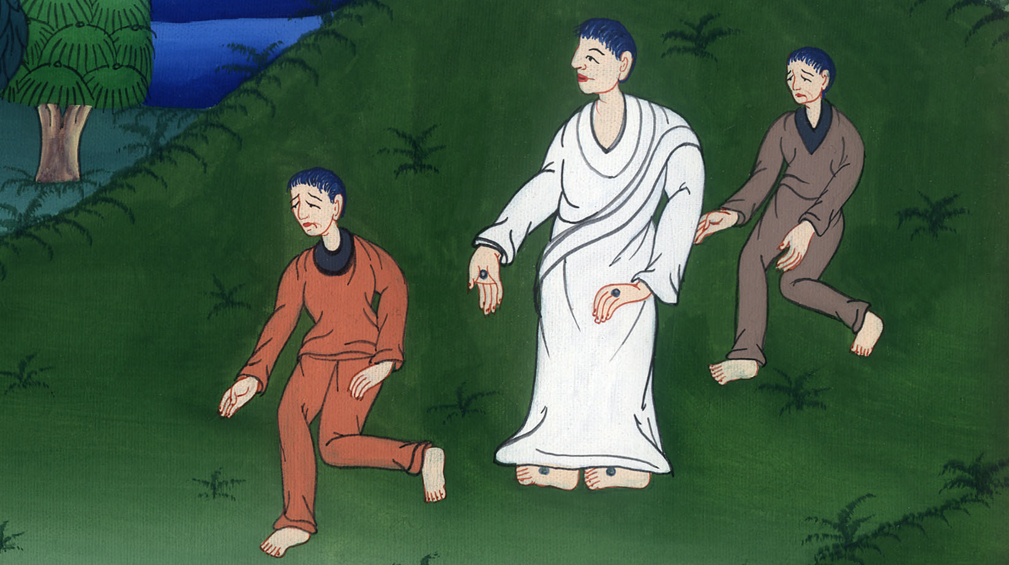
Luke 24:32

Slide 41
33They rose up that very hour, returned to Jerusalem, and found the eleven gathered together, and those who were with them,
John

Slide 42
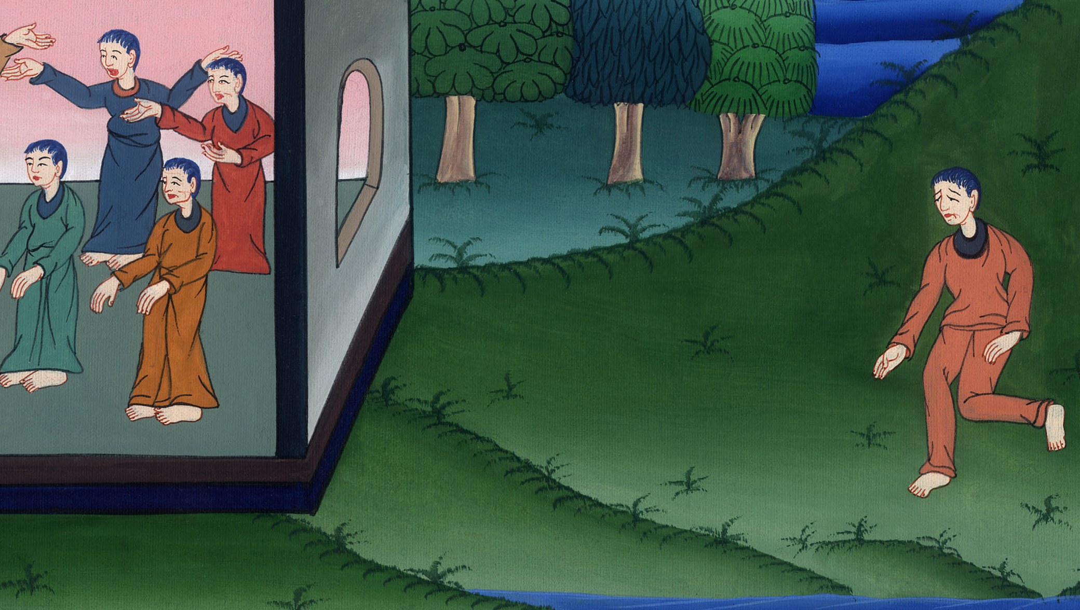
Luke 24:33

Slide 43
34saying, “The Lord is risen indeed, and has appeared to Simon!”
John

Slide 44
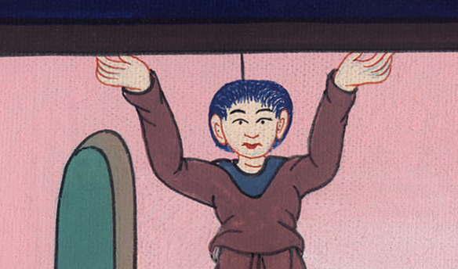
Luke 24:34

Slide 45
35They related the things that happened along the way, and how he was recognized by them in the breaking of the bread.
John

Slide 46
Luke 24:35

