Slide 1
45-4
This work is licensed under a Creative Commons Attribution-ShareAlike 4.0 International License.
Please add this statement to all the videos you create.
English Bible quotes are from the World English Bible US, which is in the public domain.
Notes:
Ch
45 Empty Tomb
1. Empty Tomb - Matt 28:1-8, 11-15; Mark 16:1-11; Luke 24:1-11 (Left Top)
2. Mary Magdalene meets Jesus - John 20:1-18 (Right Top)
3. Road to Emmaus - Luke 24:13-35 (Right Bottom)
4. Jesus & Disciples - Matt 28:16-20; Mrk 16:14-19; Luke 24:36-49; John 20:24-31
(Left Bottom)
5. Sea of Galilee - John 21:1-25 (Center)

Slide 2
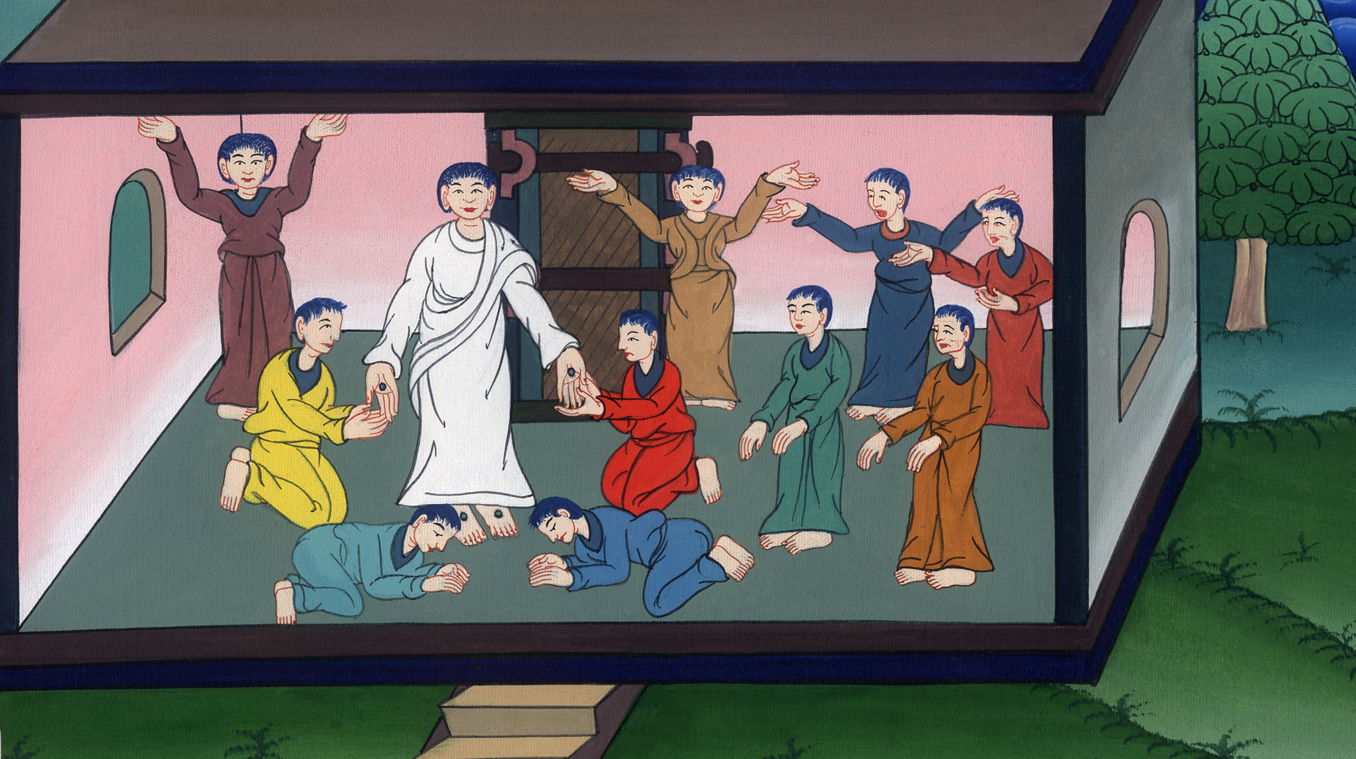
Jesus and Disciples –
Matthew 28:16-20; Mark 16:14-19; Luke 24:36-49

Slide 3
Jesus and Disciples - Matthew 28:16-20; Mark 16:14-19; Luke 24:36-49
John

Slide 4
Jesus and Disciples –
Matthew 28:16-20; Mark 16:14-19; Luke 24:36-49

Slide 5
Luke 24:36As they said these things, Jesus himself stood among them, and said to them, “Peace be to you.”
John

Slide 6
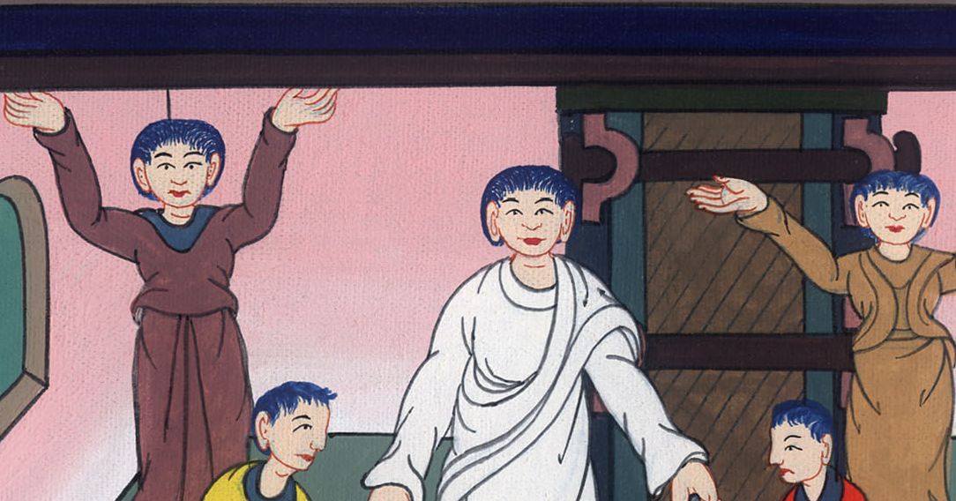
Luke 24:36

Slide 7
37But they were terrified and filled with fear, and supposed that they had seen a spirit.
38He said to them, “Why are you troubled? Why do doubts arise in your hearts?
John

Slide 8
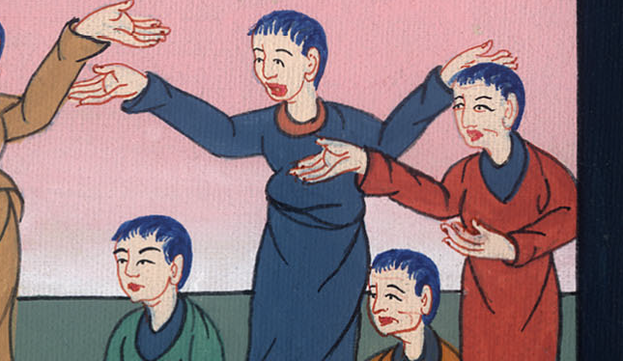
Luke 24:37,38

Slide 9
39See my hands and my feet, that it is truly me. Touch me and see, for a spirit doesn’t have flesh and bones, as you see that I have.” 40When he had said this, he showed them his hands and his feet.
John

Slide 10
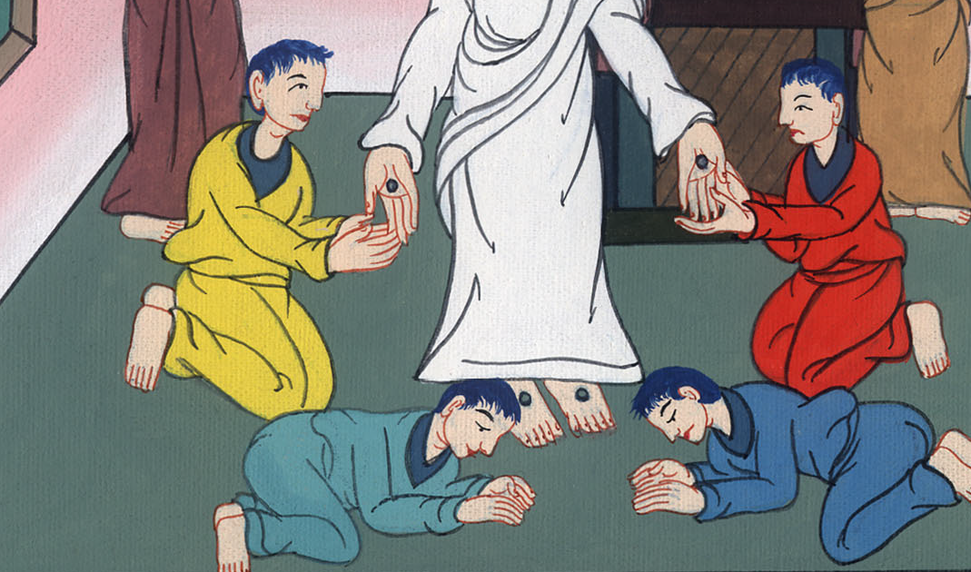
Luke 24:39,40

Slide 11
41While they still didn’t believe for joy, and wondered, he said to them, “Do you have anything here to eat?”
John

Slide 12
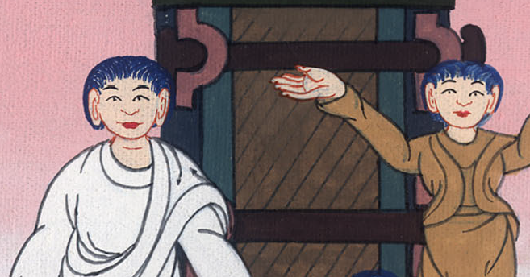
Luke 24:41

Slide 13
42They gave him a piece of a broiled fish and some honeycomb. 43He took them, and ate in front of them.
John

Slide 14
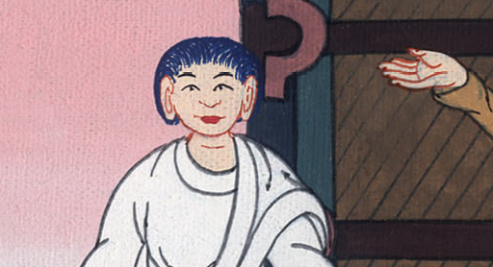
Luke 24:42,43

Slide 15
44He said to them, “This is what I told you while I was still with you, that all things which are written in the law of Moses, the prophets, and the psalms concerning me must be fulfilled.”
John

Slide 16
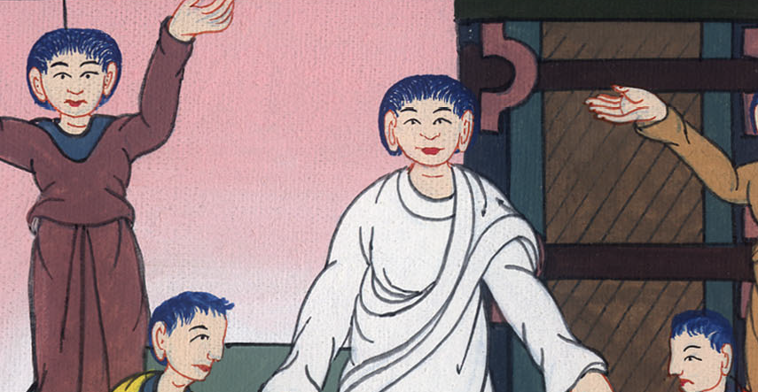
Luke 24:44

Slide 17
45Then he opened their minds, that they might understand the Scriptures. 46He said to them, “Thus it is written, and thus it was necessary for the Christ to suffer and to rise from the dead the third day,
John

Slide 18
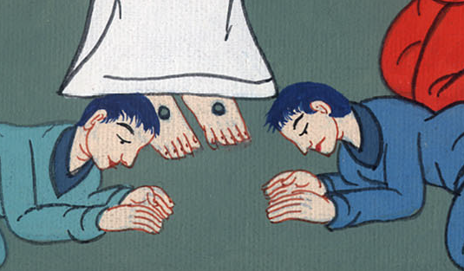
Luke 24:45,46

Slide 19
47and that repentance and remission of sins should be preached in his name to all the nations, beginning at Jerusalem.
John

Slide 20
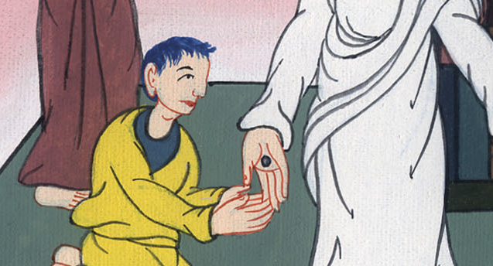
Luke 24:47

Slide 21
48You are witnesses of these things.
John

Slide 22
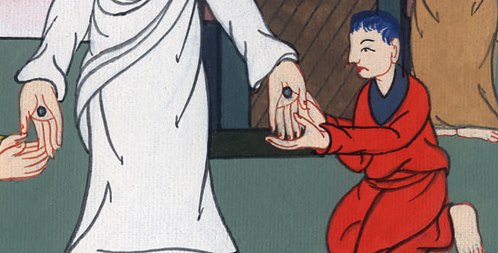
Luke 24:48

Slide 23
49Behold, I send out the promise of my Father on you. But wait in the city of Jerusalem until you are clothed with power from on high.”
John

Slide 24
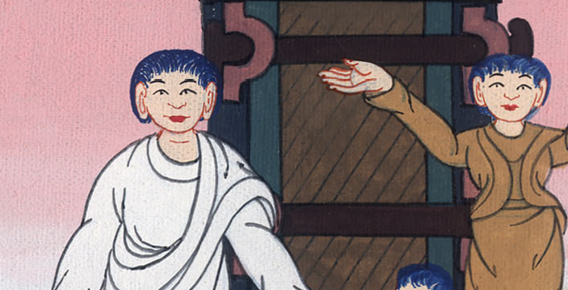
Luke 24:49

Slide 25
Matt 2818…“All authority has been given to me in heaven and on earth.
John

Slide 26
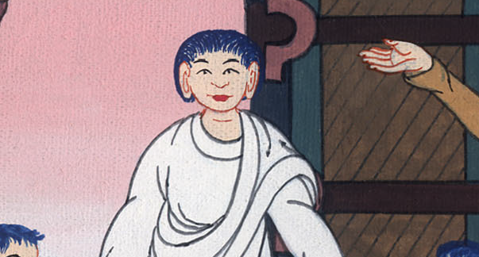
Matthew 28:18

Slide 27
19Go and make disciples of all nations, baptizing them in the name of the Father and of the Son and of the Holy Spirit,
John

Slide 28
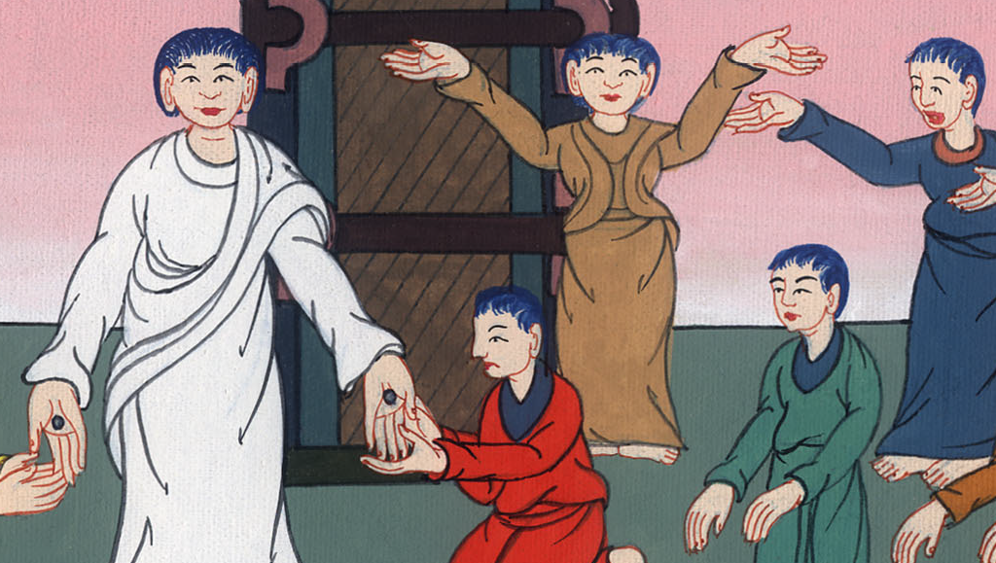
Matthew 28:19

Slide 29
Mark 16:16He who believes and is baptized will be saved; but he who disbelieves will be condemned.
John

Slide 30
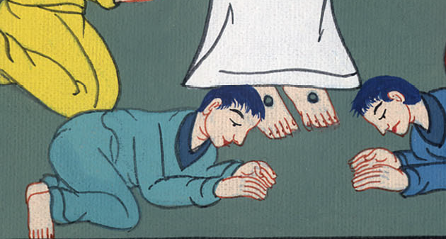
Mark 16:16

Slide 31
17These signs will accompany those who believe: in my name they will cast out demons; they will speak with new languages;
John

Slide 32
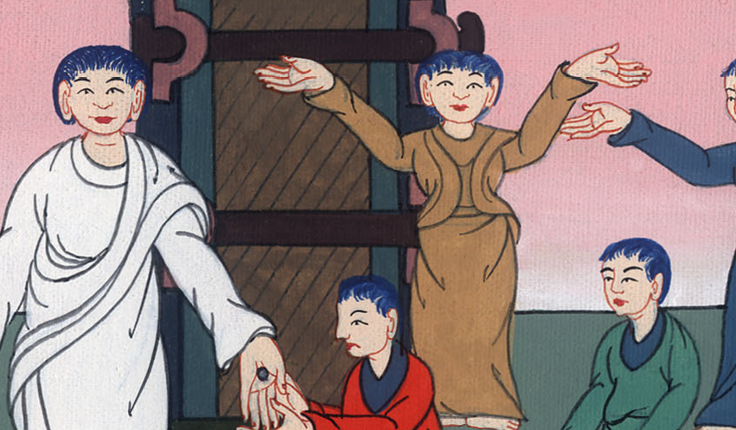
Mark 16:17

Slide 33
Matt 2820teaching them to observe all things that I commanded you. Behold, I am with you always, even to the end of the age.”
John

Slide 34
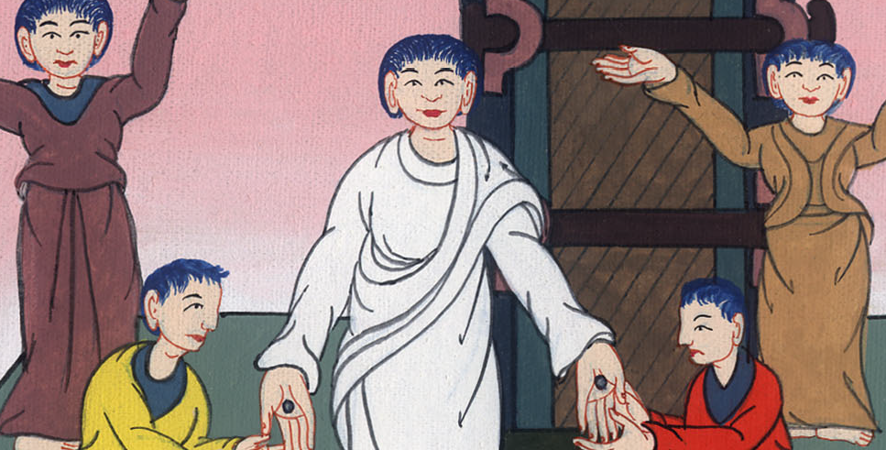
Matthew 28:20

