Slide 1
45-5
This work is licensed under a Creative Commons Attribution-ShareAlike 4.0 International License.
Please add this statement to all the videos you create.
English Bible quotes are from the World English Bible US, which is in the public domain.
Notes:
Ch
45 Empty Tomb
1. Empty Tomb - Matt 28:1-8, 11-15; Mark 16:1-11; Luke 24:1-11 (Left Top)
2. Mary Magdalene meets Jesus - John 20:1-18 (Right Top)
3. Road to Emmaus - Luke 24:13-35 (Right Bottom)
4. Jesus & Disciples - Matt 28:16-20; Mrk 16:14-19; Luke 24:36-49; John 20:24-31
(Left Bottom)
5. Sea of Galilee - John 21:1-25 (Center)

Slide 2
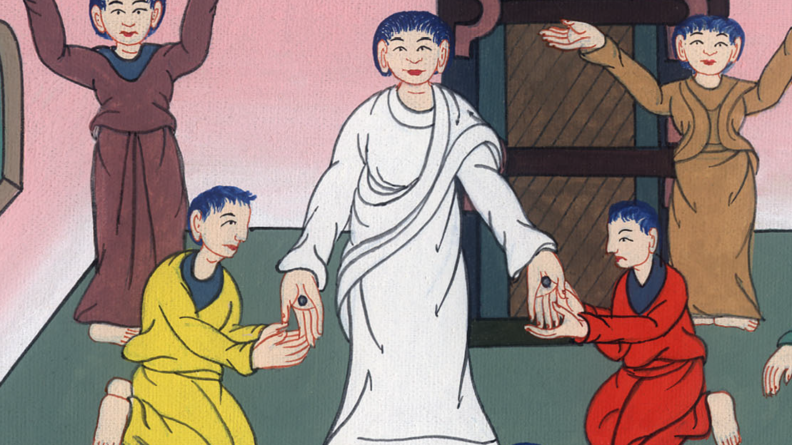
Unbelieving Thomas-
John 20:24-31

Slide 3
Unbelieving Thomas- John 20:24-31
John

Slide 4
Unbelieving Thomas-
John 20:24-31

Slide 5
John 20:24But Thomas, one of the twelve, called Didymus, wasn’t with them when Jesus came.
John

Slide 6
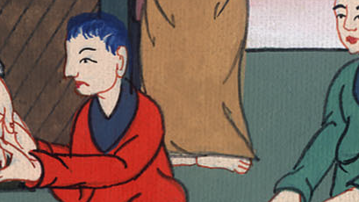
John 20:24

Slide 7
25The other disciples therefore said to him, “We have seen the Lord!”
But he said to them, “Unless I see in his hands the print of the nails, put my finger into the print of the nails, and put my hand into his side, I will not believe.”
John

Slide 8
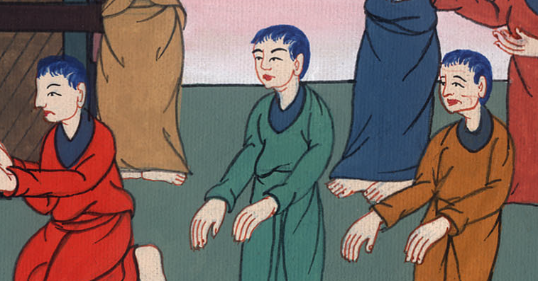
John 20:25

Slide 9
26After eight days, again his disciples were inside and Thomas was with them. Jesus came, the doors being locked, and stood in the middle, and said, “Peace be to you.”
John

Slide 10
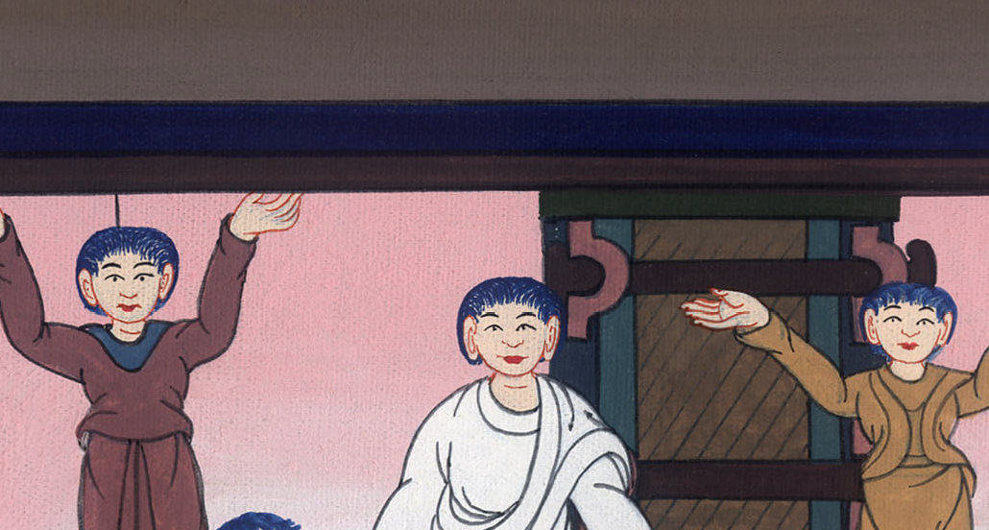
John 20:26

Slide 11
27Then he said to Thomas, “Reach here your finger, and see my hands. Reach here your hand, and put it into my side. Don’t be unbelieving, but believing.”
John

Slide 12
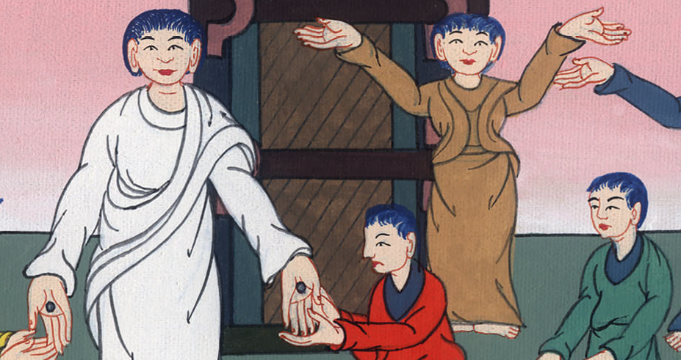
John 20:27

Slide 13
28Thomas answered him, “My Lord and my God!”
John

Slide 14
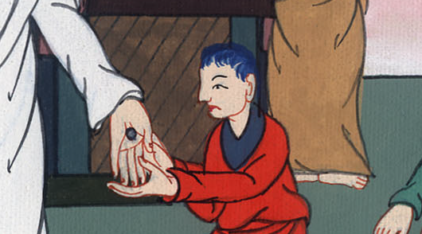
John 20:28

Slide 15
29Jesus said to him, “Because you have seen me, you have believed. Blessed are those who have not seen and have believed.”
John

Slide 16
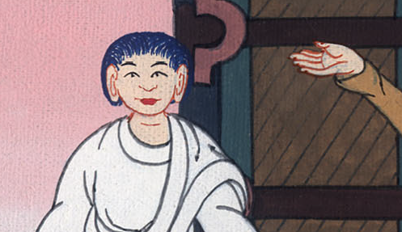
John 20:29

Slide 17
30Therefore Jesus did many other signs in the presence of his disciples, which are not written in this book;
John

Slide 18
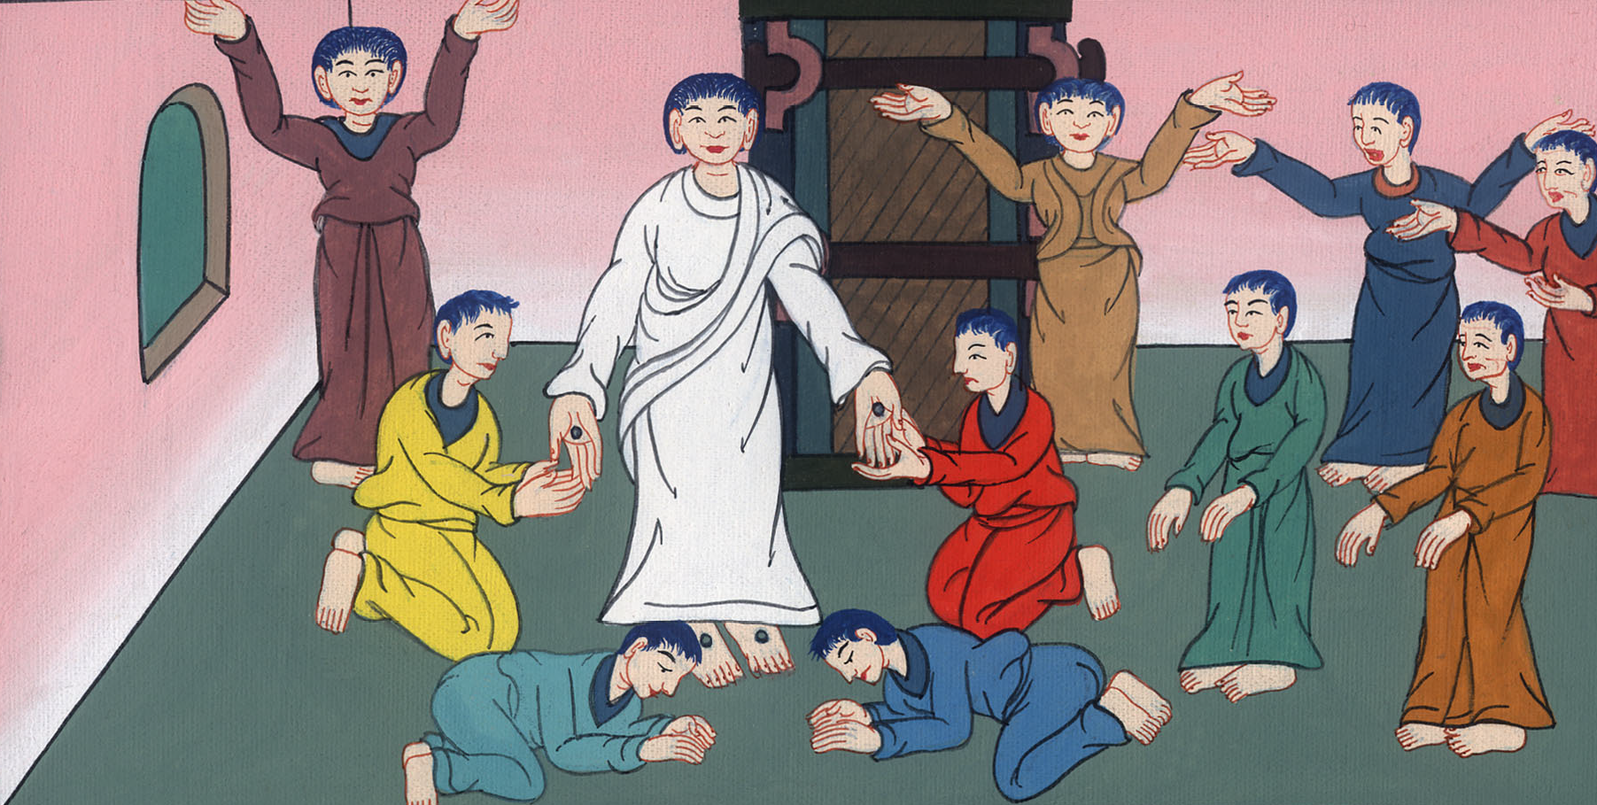
John 20:30

Slide 19
31but these are written that you may believe that Jesus is the Christ, the Son of God, and that believing you may have life in his name.
John

Slide 20
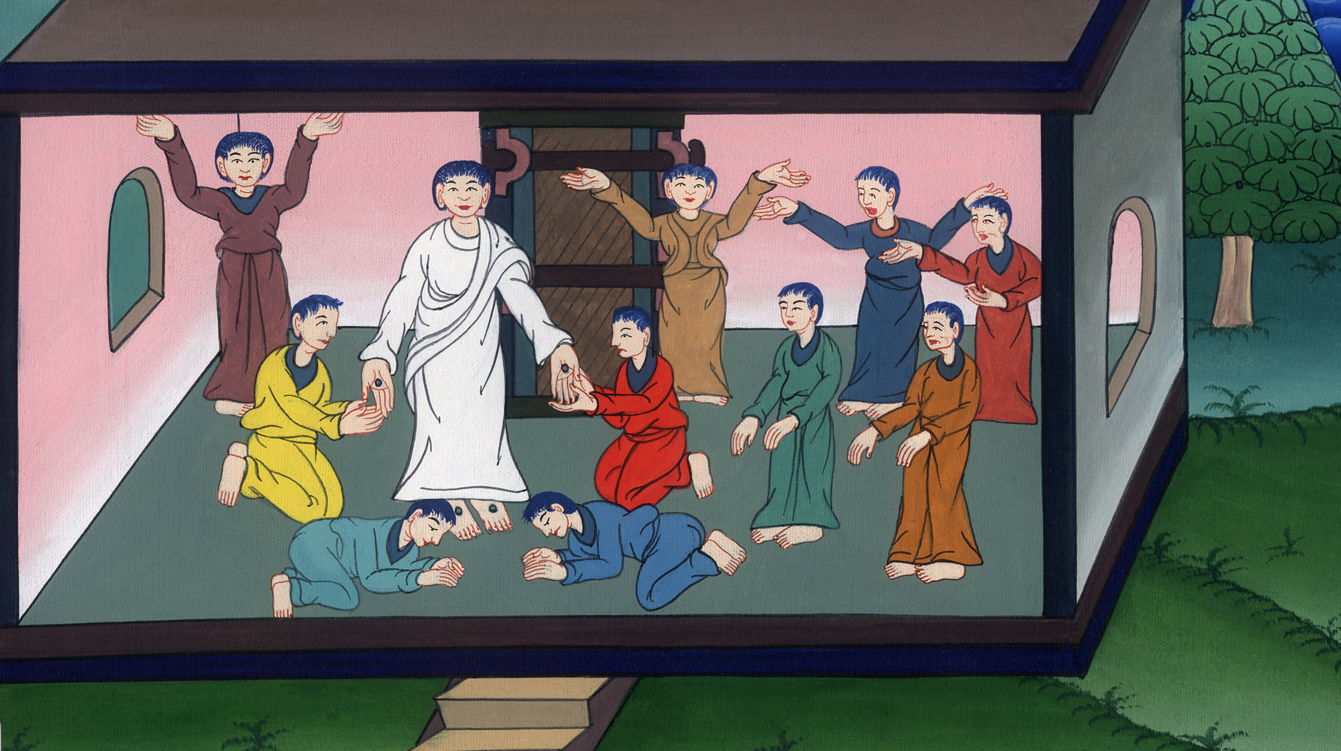
John 20:31

