Slide 1
45-6
This work is licensed under a Creative Commons Attribution 4.0 International License.
Please add this statement to all the videos you create.
English Bible quotes are from the World English Bible US, which is in the public domain.
Notes:
45 Empty Tomb
1. Empty Tomb - Matt 28:1-8, 11-15; Mark 16:1-11; Luke 24:1-11 (Left Top)
2. Mary Magdalene meets Jesus - John 20:1-18 (Right Top)
3. Road to Emmaus - Luke 24:13-35 (Right Bottom)
4. Jesus & Disciples - Matt 28:16-20; Mrk 16:14-19; Luke 24:36-49; John 20:24-31
(Left Bottom)
5. Sea of Galilee - John 21:1-25 (Center)

Slide 2
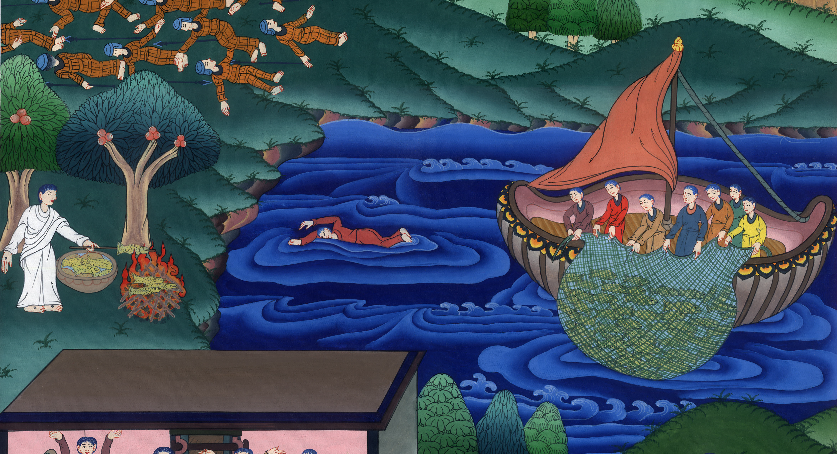
Sea of Galilee –
John 21:1-25

Slide 3
Sea of Galilee - John 21:1-25
John

Slide 4
Sea of Galilee –
John 21:1-25

Slide 5
John 21:1After these things, Jesus revealed himself again to the disciples at the sea of Tiberias. He revealed himself this way.
John

Slide 6
John 21:1

Slide 7
2Simon Peter, Thomas called Didymus, Nathanael of Cana in Galilee, and the sons of Zebedee, and two others of his disciples were together.
John

Slide 8
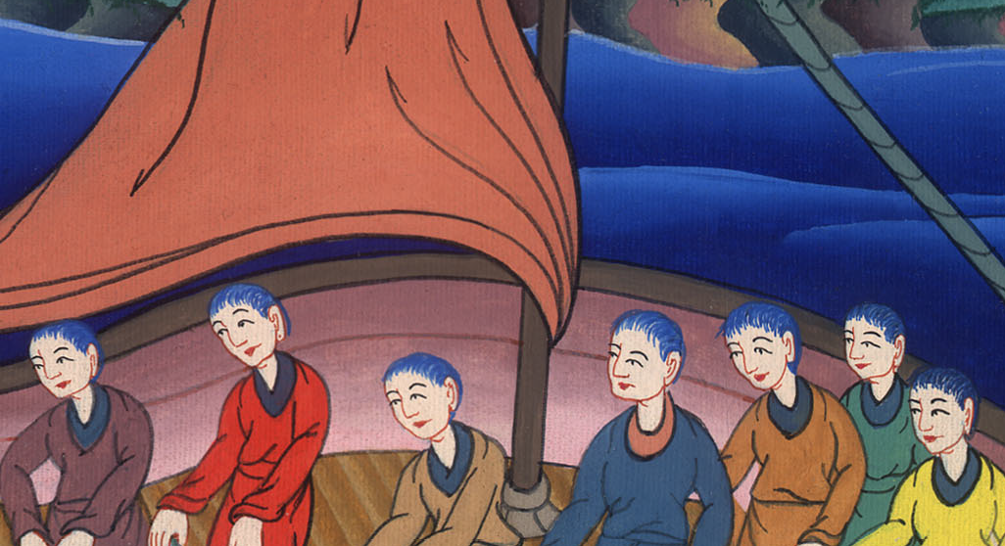
John 21:2

Slide 9
3Simon Peter said to them, “I’m going fishing.”
They told him, “We are also coming with you.” They immediately went out and entered into the boat. That night, they caught nothing.
John

Slide 10
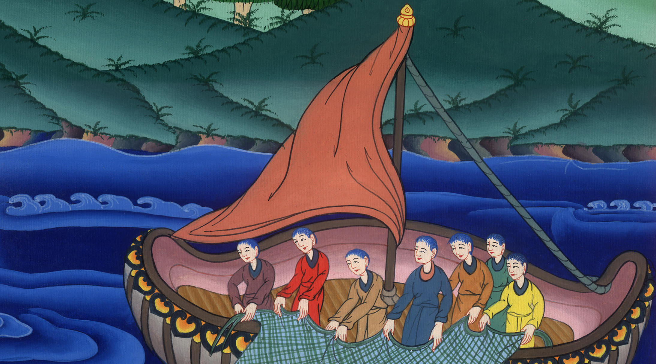
John 21:3

Slide 11
4But when day had already come, Jesus stood on the beach; yet the disciples didn’t know that it was Jesus.
John

Slide 12
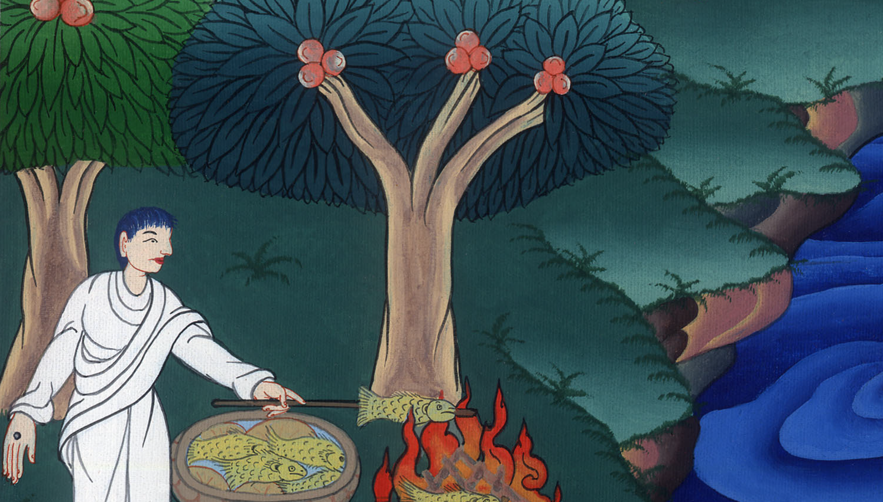
John 21:4

Slide 13
5Jesus therefore said to them, “Children, have you anything to eat?” They answered him, “No.”
John

Slide 14
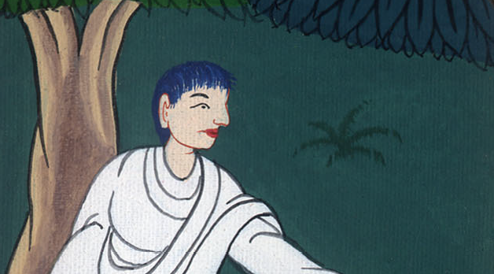
John 21:5

Slide 15
6He said to them, “Cast the net on the right side of the boat, and you will find some.”
They cast it therefore, and now they weren’t able to draw it in for the multitude of fish.
John

Slide 16
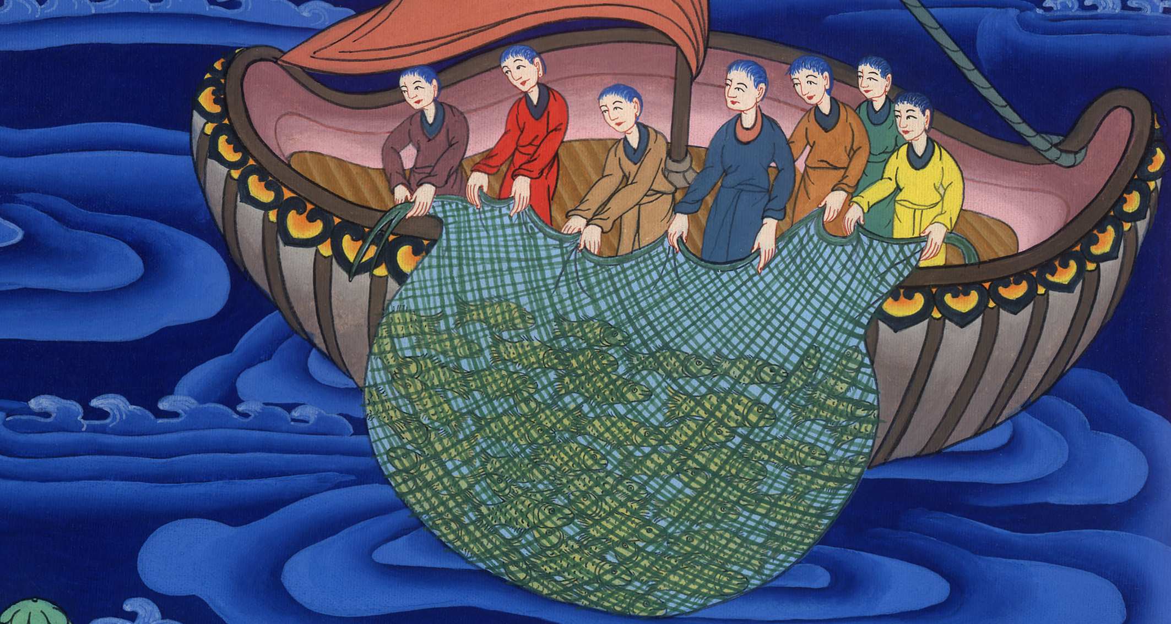
John 21:6

Slide 17
7That disciple therefore whom Jesus loved said to Peter, “It’s the Lord!”
So when Simon Peter heard that it was the Lord, he wrapped his coat around himself (for he was naked), and threw himself into the sea.
John

Slide 18
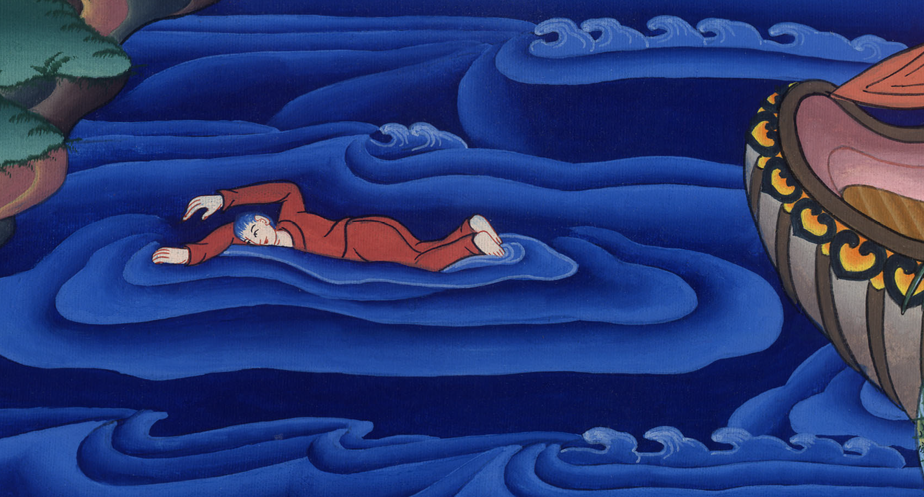
John 21:7

Slide 19
8But the other disciples came in the little boat (for they were not far from the land, but about two hundred cubits away), dragging the net full of fish.
John

Slide 20
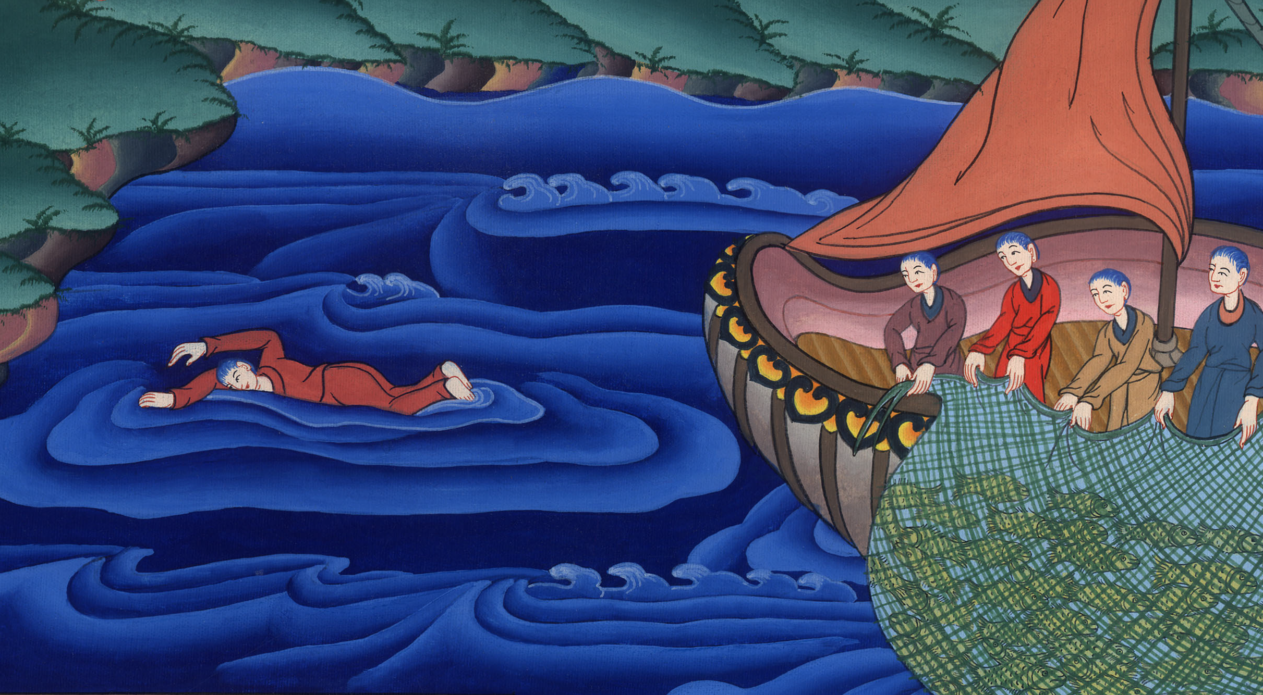
John 21:8

Slide 21
9So when they got out on the land, they saw a fire of coals there, with fish and bread laid on it. 10Jesus said to them, “Bring some of the fish which you have just caught.”
John

Slide 22
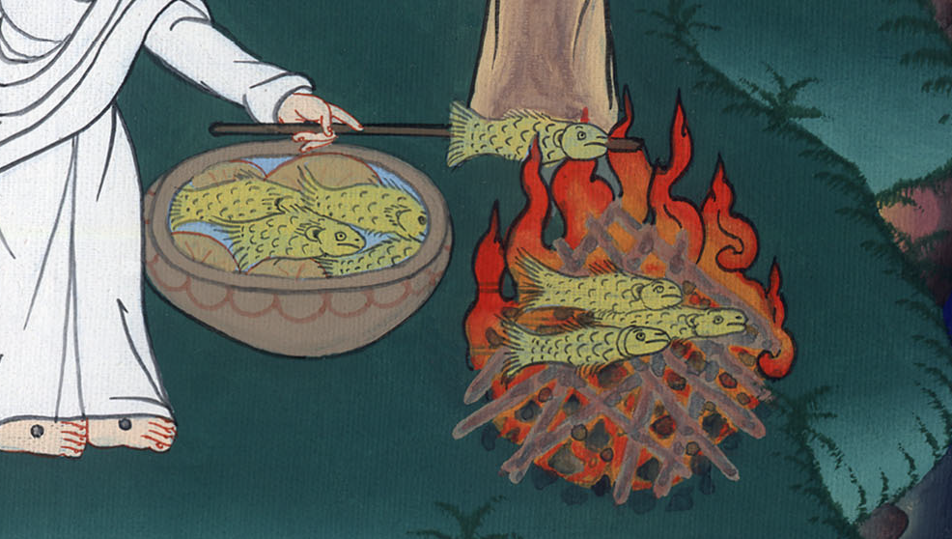
John 21:9,10

Slide 23
11Simon Peter went up, and drew the net to land, full of one hundred fifty-three great fish. Even though there were so many, the net wasn’t torn.
John

Slide 24
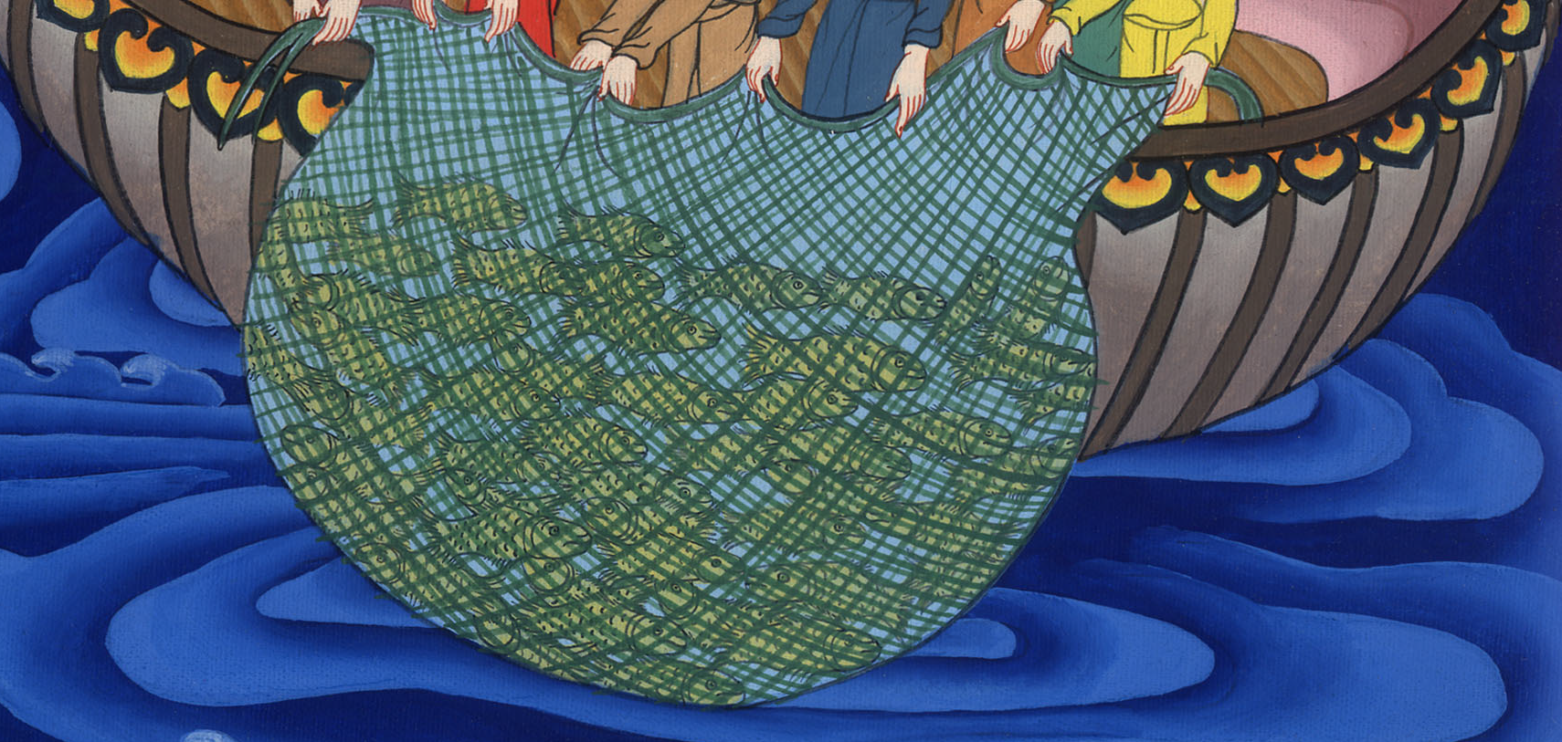
John 21:11

Slide 25
12Jesus said to them, “Come and eat breakfast!”
None of the disciples dared inquire of him, “Who are you?” knowing that it was the Lord.
John

Slide 26
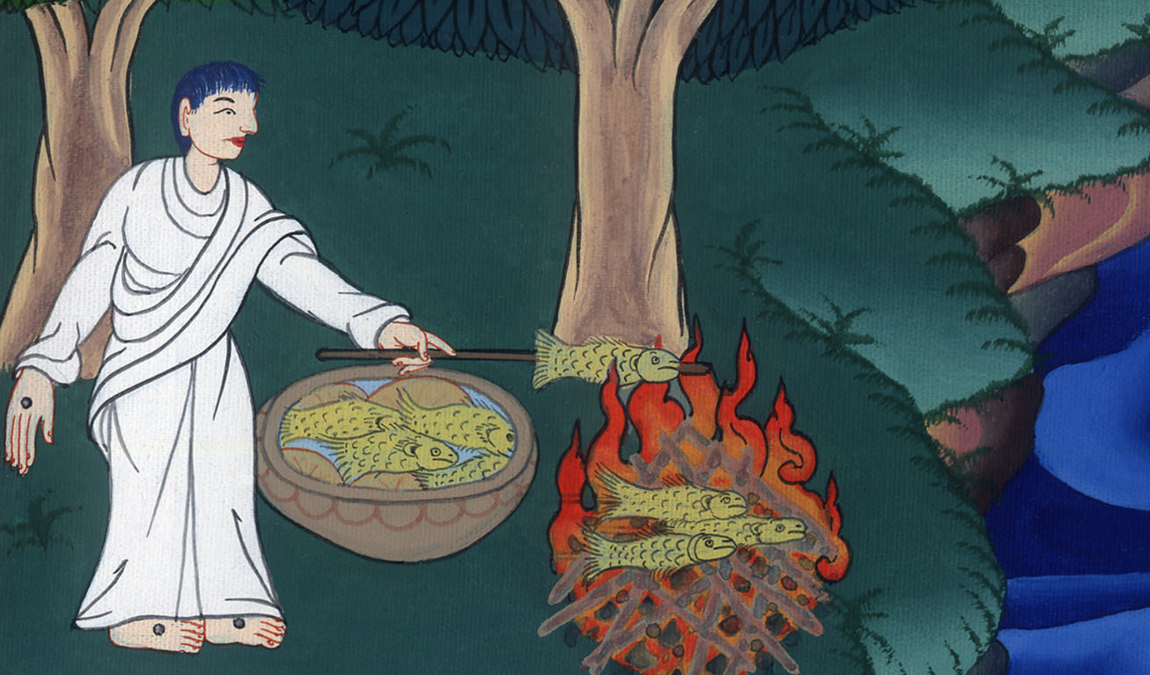
John 21:12

Slide 27
13Then Jesus came and took the bread, gave it to them, and the fish likewise.
John

Slide 28
John 21:13

Slide 29
14This is now the third time that Jesus was revealed to his disciples after he had risen from the dead.
John

Slide 30
John 21:14

