Slide 1
46-1
This work is licensed under a Creative Commons Attribution 4.0 International License.
Please add this statement to all the videos you create.
English Bible quotes are from the World English Bible US, which is in the public domain.
Notes:
Ch
46 Ascention & Pentacost
1. Great Commission/Ascension - Acts 1:1-8; Matthew 28:18-20; Acts 1:9-11 (Left
Top)
2. Receiving Holy Spirit - Acts 2:1-4 (Right Top)
3. Peter Addresses the crowd - Acts 2:5-41 (Right Bottom)
4. Community of Believers - Acts 2:42-47 (Left Bottom)

Slide 2
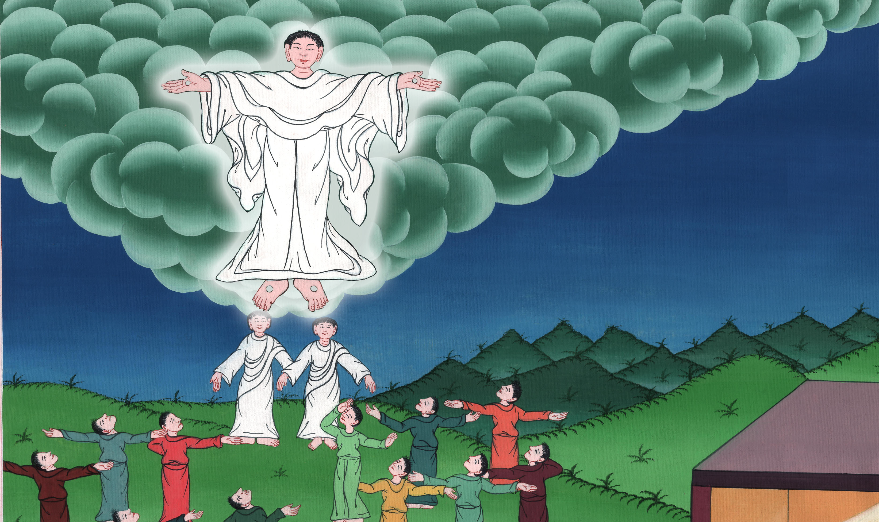
The Ascension
Acts 1:1-1

Slide 3
The Ascension - Acts 1:1-11; Matthew 28:18-20

Slide 4
The Ascension
Acts 1:1-1

Slide 5
The book of Acts is written by the apostle Luke. It tells about what happened after Jesus went to heaven.

Slide 6
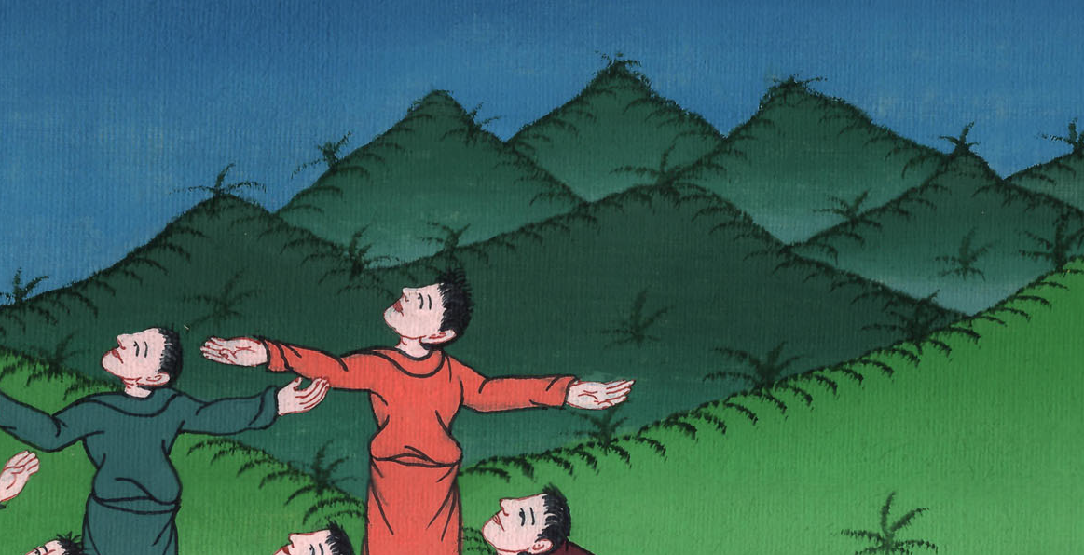

Slide 7
1The first book I wrote, Theophilus, concerned all that Jesus began both to do and to teach, 2until the day in which he was received up, after he had given commandment through the Holy Spirit to the apostles whom he had chosen.

Slide 8
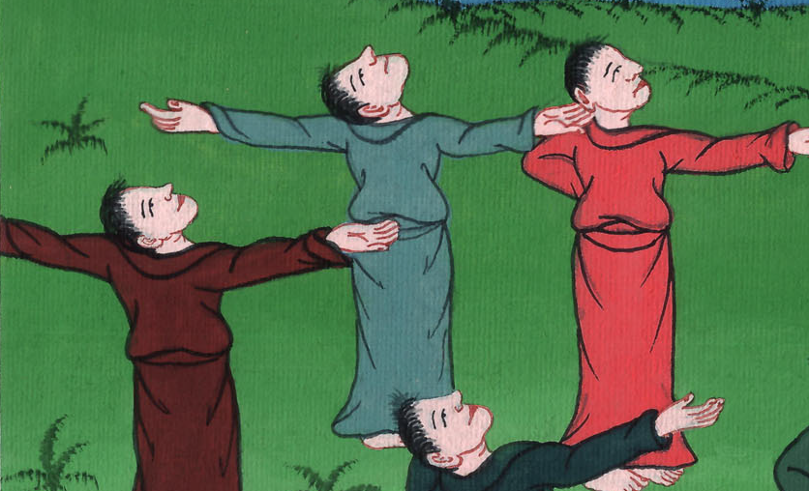
Acts 1:1,2

Slide 9
3To these he also showed himself alive after he suffered, by many proofs, appearing to them over a period of forty days and speaking about God’s Kingdom.

Slide 10
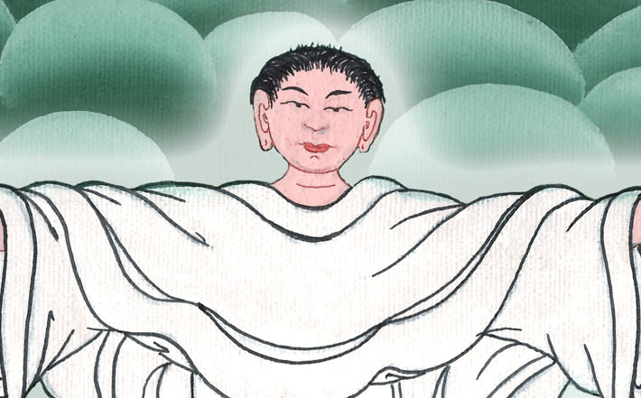
Acts 1:3

Slide 11
4Being assembled together with them, he commanded them, “Don’t depart from Jerusalem, but wait for the promise of the Father, which you heard from me.

Slide 12
Acts 1:4

Slide 13
5For John indeed baptized in water, but you will be baptized in the Holy Spirit not many days from now.”

Slide 14
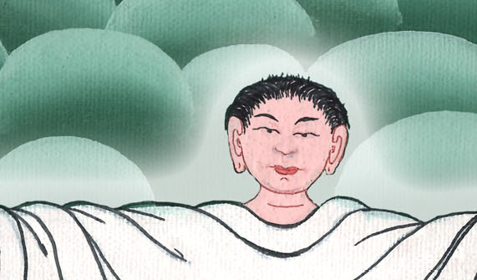
Acts 1:5

Slide 15
6Therefore, when they had come together, they asked him, “Lord, are you now restoring the kingdom to Israel?”

Slide 16
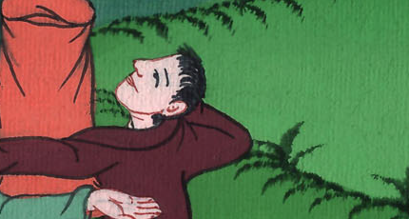
Acts 1:6

Slide 17
7He said to them, “It isn’t for you to know times or seasons which the Father has set within his own authority.

Slide 18
Acts 1:7

Slide 19
8But you will receive power when the Holy Spirit has come upon you. You will be witnesses to me in Jerusalem, in all Judea and Samaria, and to the uttermost parts of the earth.”

Slide 20
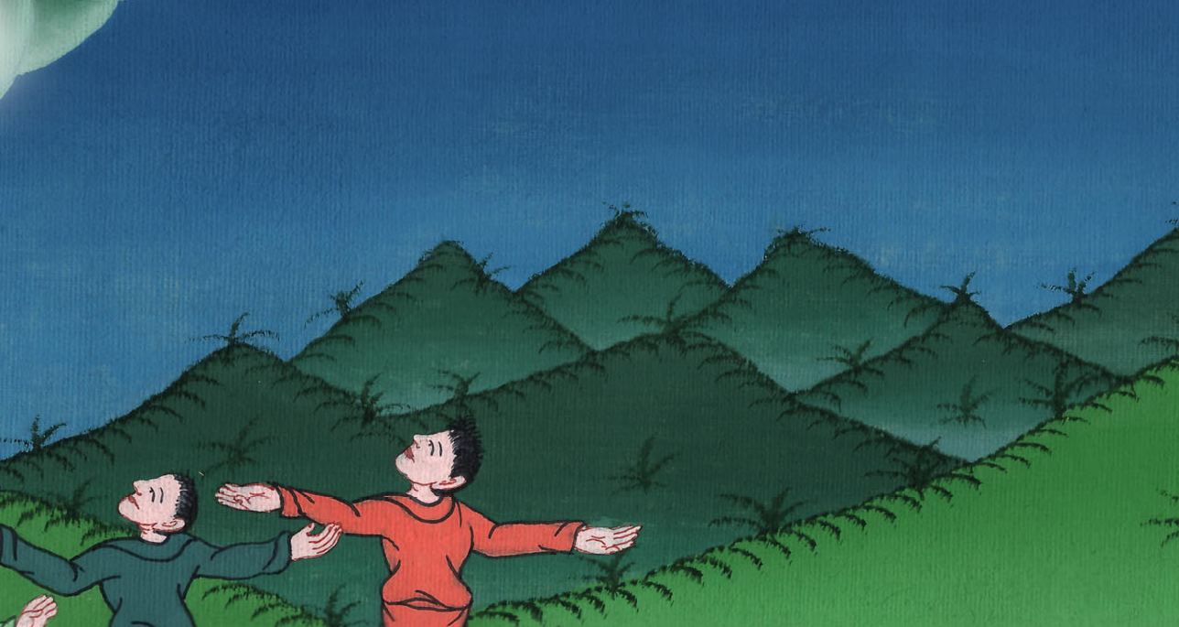
Acts 1:8

Slide 21
9When he had said these things, as they were looking, he was taken up, and a cloud received him out of their sight.

Slide 22
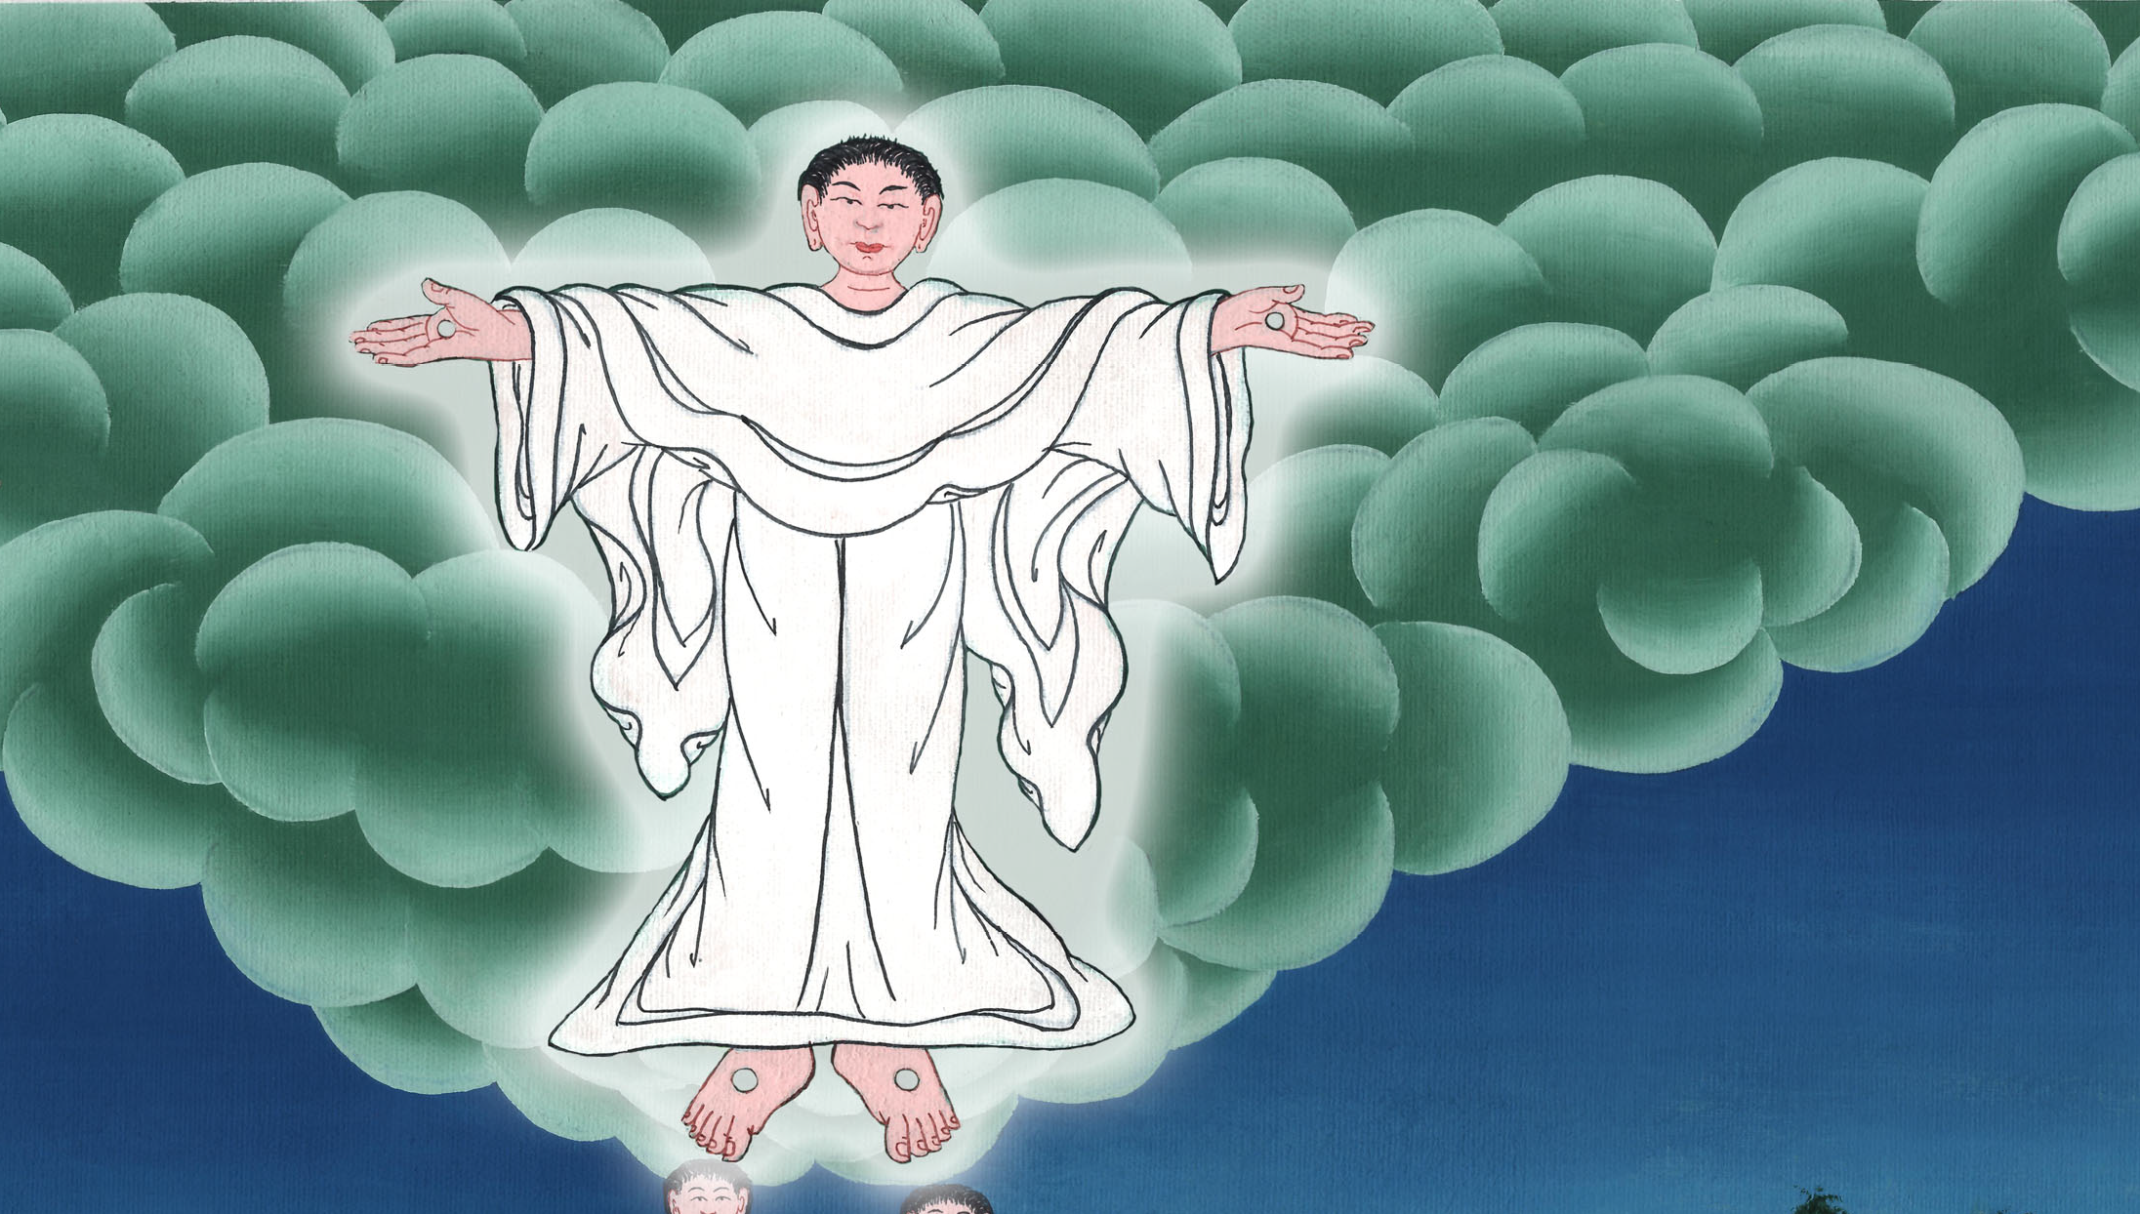
Acts 1:9

Slide 23
10While they were looking steadfastly into the sky as he went, behold, two men stood by them in white clothing,

Slide 24
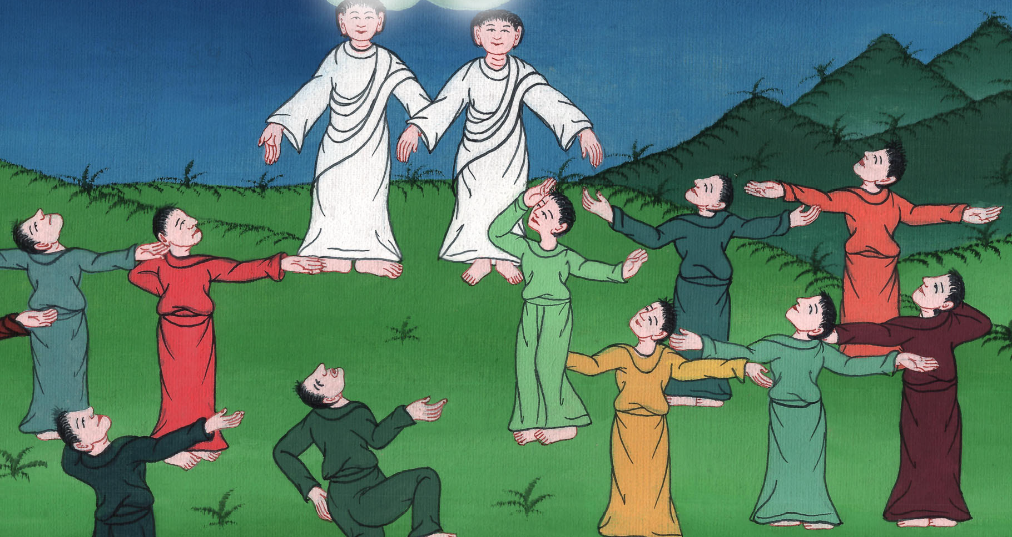
Acts 1:10

Slide 25
11who also said, “You men of Galilee, why do you stand looking into the sky? This Jesus, who was received up from you into the sky, will come back in the same way as you saw him going into the sky.”

Slide 26
Acts 1:11

