Slide 1
46-2
This work is licensed under a Creative Commons Attribution 4.0 International License.
Please add this statement to all the videos you create.
English Bible quotes are from the World English Bible US, which is in the public domain.
Notes:
Ch
46 Ascention & Pentacost
1. Great Commission/Ascension - Acts 1:1-8; Matthew 28:18-20; Acts 1:9-11 (Left
Top)
2. Receiving Holy Spirit - Acts 2:1-4 (Right Top)
3. Peter Addresses the crowd - Acts 2:5-41 (Right Bottom)
4. Community of Believers - Acts 2:42-47 (Left Bottom)

Slide 2
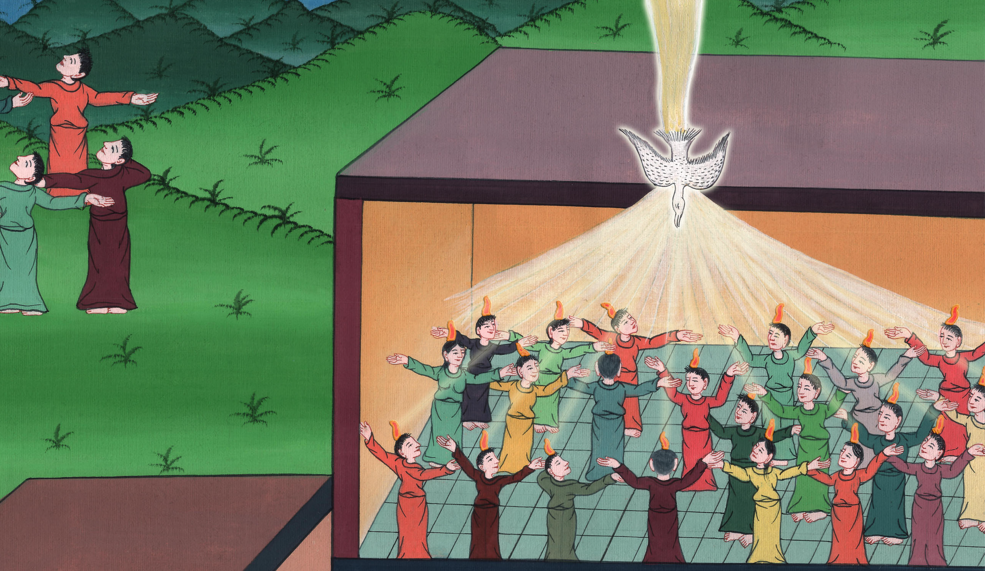
Receiving the Holy Spirit Acts 1:12-14, 2:1-21

Slide 3
Receiving the Holy Spirit - Acts 1:12-14, 2:1-21

Slide 4
Receiving the Holy Spirit Acts 1:12-14, 2:1-21

Slide 5
12Then they returned to Jerusalem from the mountain called Olivet, which is near Jerusalem, a Sabbath day’s journey away.

Slide 6
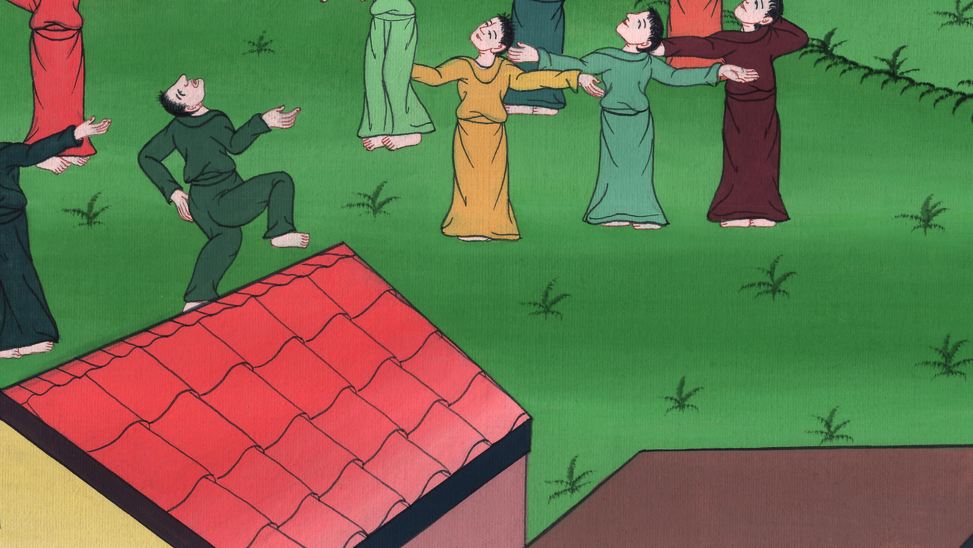
Acts 1:12

Slide 7
13When they arrived, (the 11 disciples) went upstairs to the room where they were staying…. 14All these with one accord continued steadfastly in prayer and supplication, along with the women and Mary the mother of Jesus, and with his brothers.

Slide 8
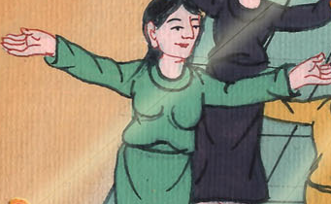
Acts 1:13,14

Slide 9
1(The feast of Pentecost was tend days after Jesus went up to heaven) 1Now when the day of Pentecost had come, they were all with one accord in one place.

Slide 10
Acts 2:1

Slide 11
2Suddenly there came from the sky a sound like the rushing of a mighty wind, and it filled all the house where they were sitting.

Slide 12
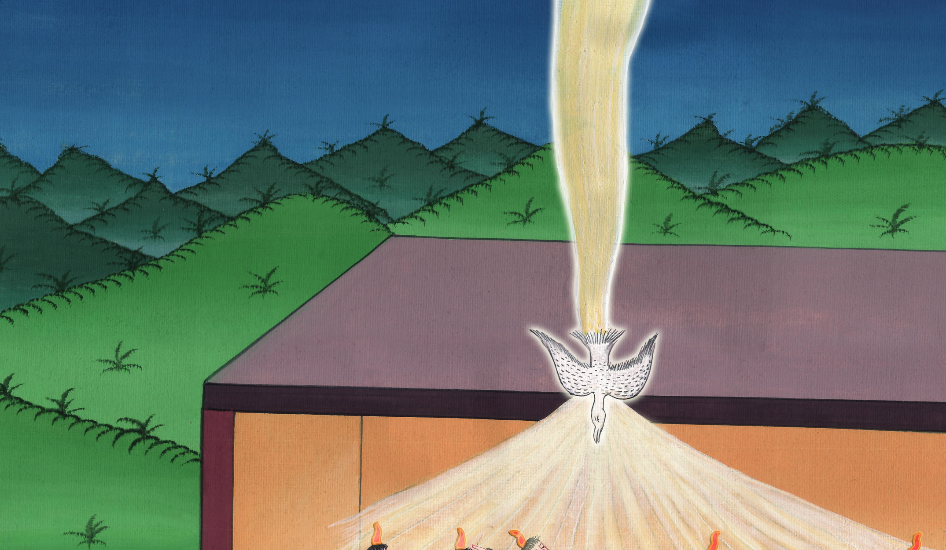
Acts 2:2

Slide 13
3Tongues like fire appeared and were distributed to them, and one sat on each of them.

Slide 14
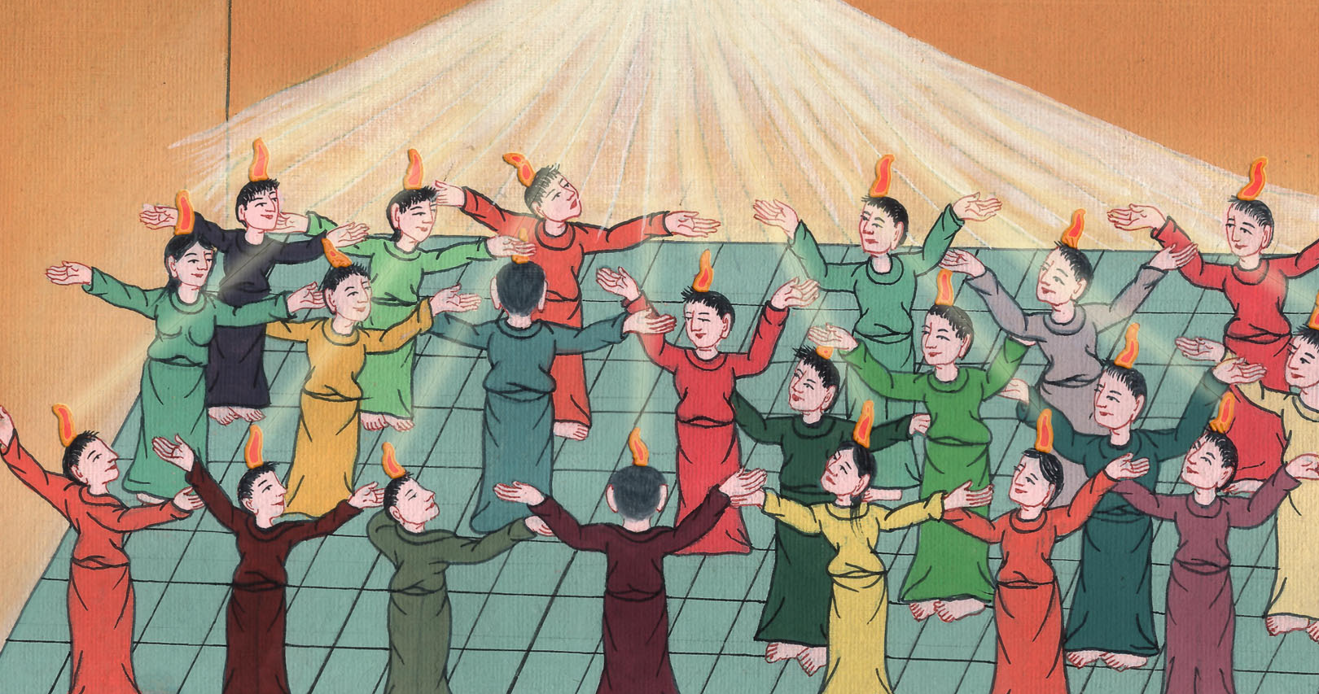
Acts 2:3

Slide 15
4They were all filled with the Holy Spirit and began to speak with other languages, as the Spirit gave them the ability to speak.

Slide 16
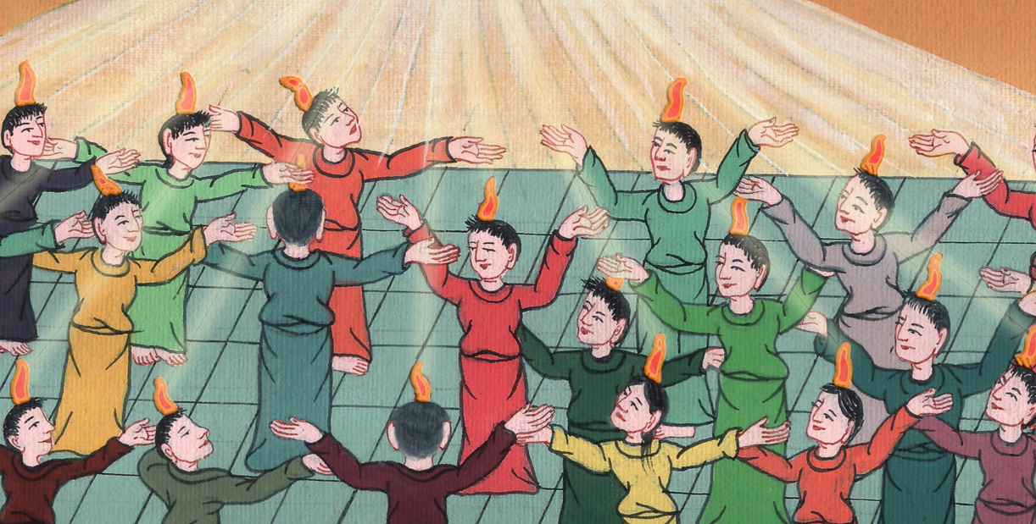
Acts 2:4

Slide 17
5Now there were dwelling in Jerusalem Jews, devout men, from every nation under the sky.

Slide 18
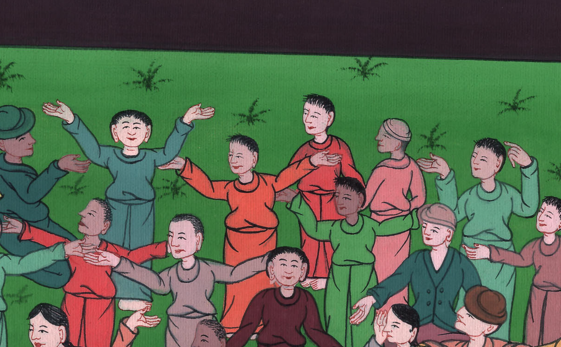
Acts 2:5

Slide 19
6When this sound was heard, the multitude came together and were bewildered, because everyone heard them speaking in his own language.

Slide 20
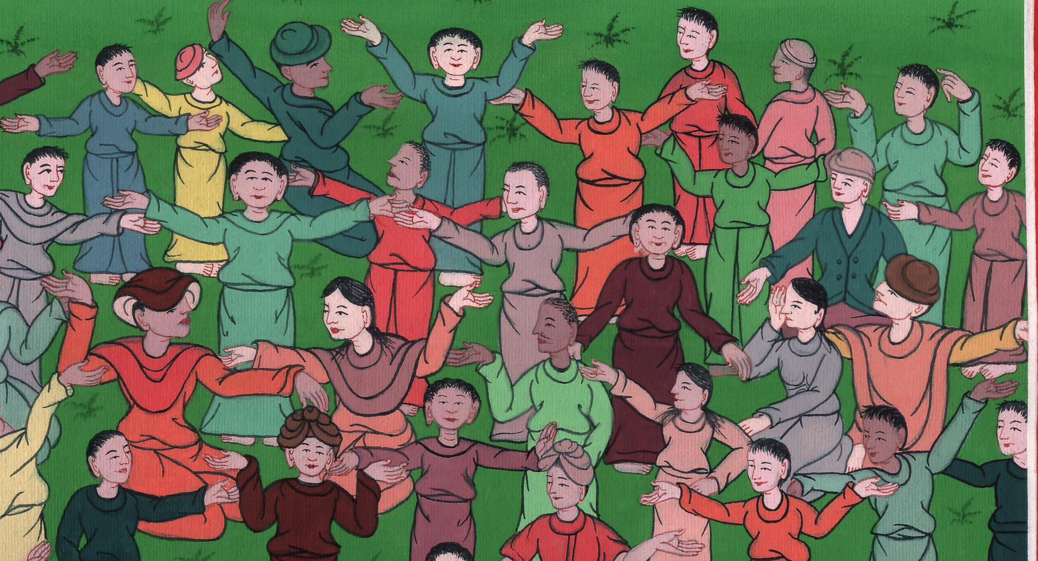
Acts 2:6

Slide 21
7They were all amazed and marveled, saying to one another, “Behold, aren’t all these who speak Galileans? 8How do we hear, everyone in our own native language?

Slide 22
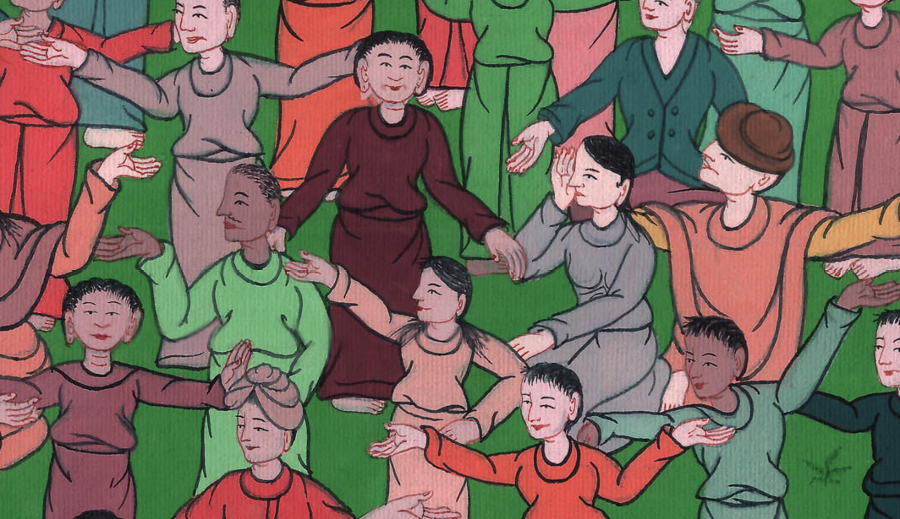
Acts 2:7,8

Slide 23
(We all come from many different countries, and speak many different languages)11… —we hear them speaking in our languages the mighty works of God!”

Slide 24
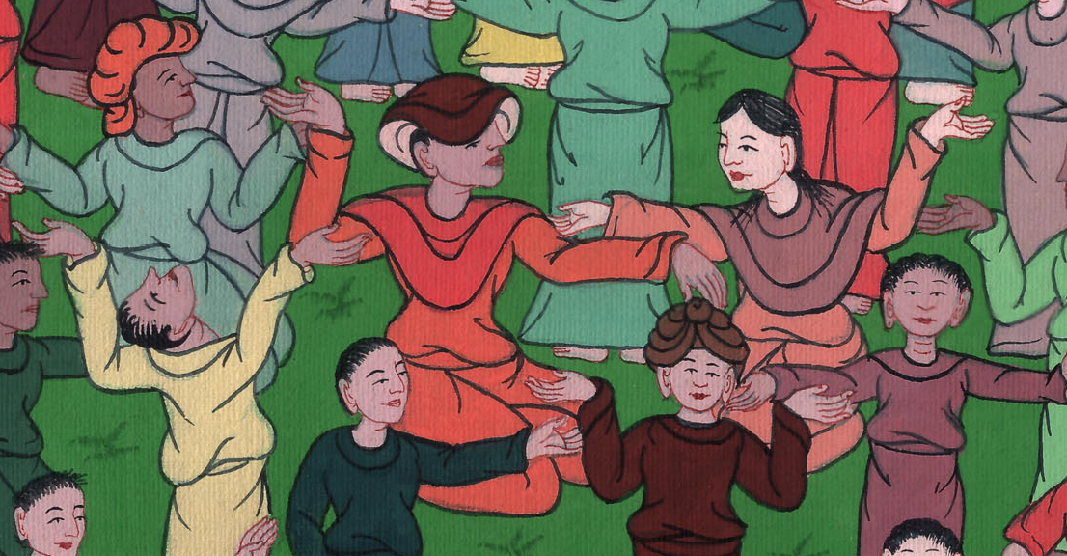
Acts 2:10,11

Slide 25
12They were all amazed and were perplexed, saying to one another, “What does this mean?” 13Others, mocking, said, “They are filled with new wine.”

Slide 26
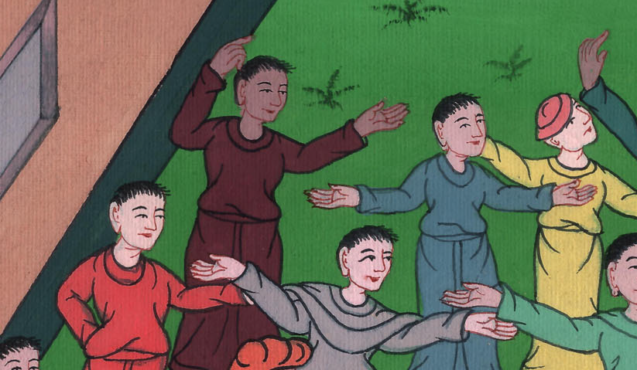
Acts 2:12,13

Slide 27
14But Peter, standing up with the eleven, lifted up his voice and spoke out to them, “You men of Judea and all you who dwell at Jerusalem, let this be known to you, and listen to my words.

Slide 28
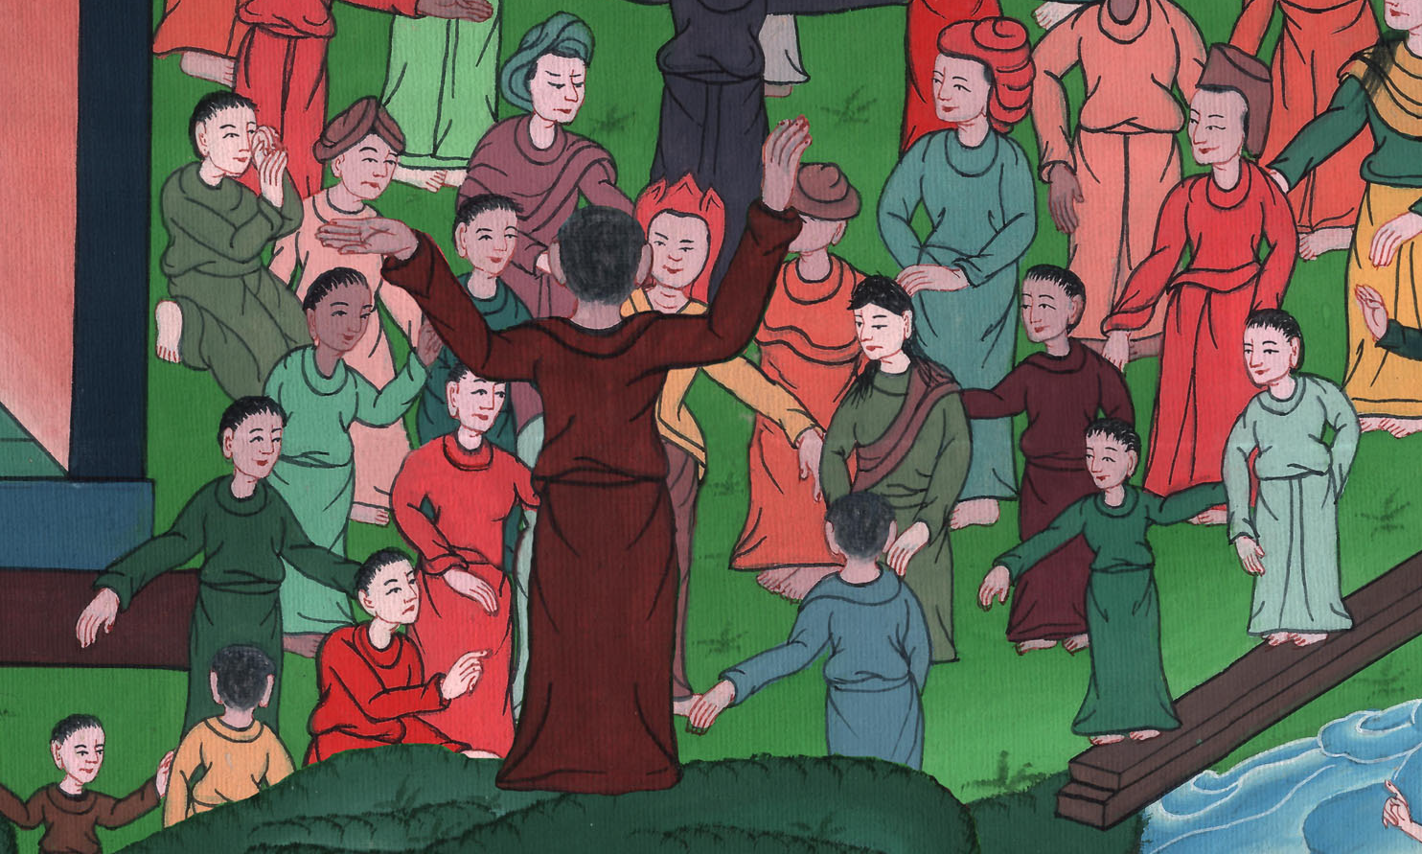
Acts 2:14

Slide 29
15For these aren’t drunken, as you suppose, seeing it is only the third hour of the day. 16But this is what has been spoken through the prophet Joel:

Slide 30
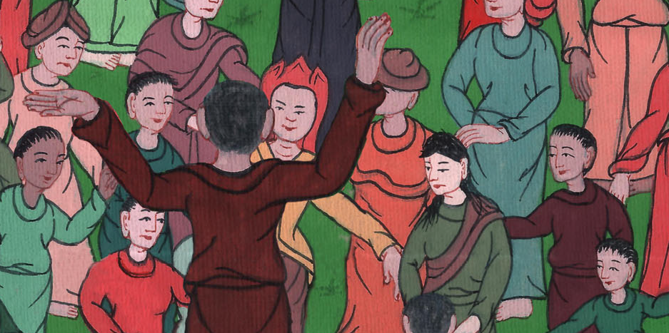
Acts 2:15,16

Slide 31
17‘It will be in the last days, says God,
that I will pour out my Spirit on all flesh.
Your sons and your daughters will prophesy.
Your young men will see visions.
Your old men will dream dreams.

Slide 32
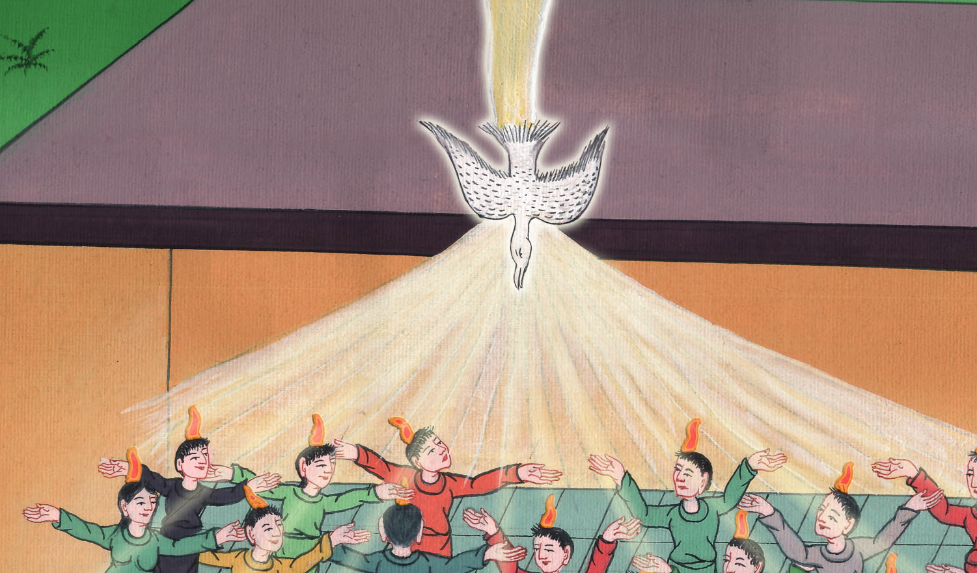
Acts 2:17

Slide 33
18Yes, and on my servants and on my handmaidens in those days,
I will pour out my Spirit, and they will prophesy.

Slide 34
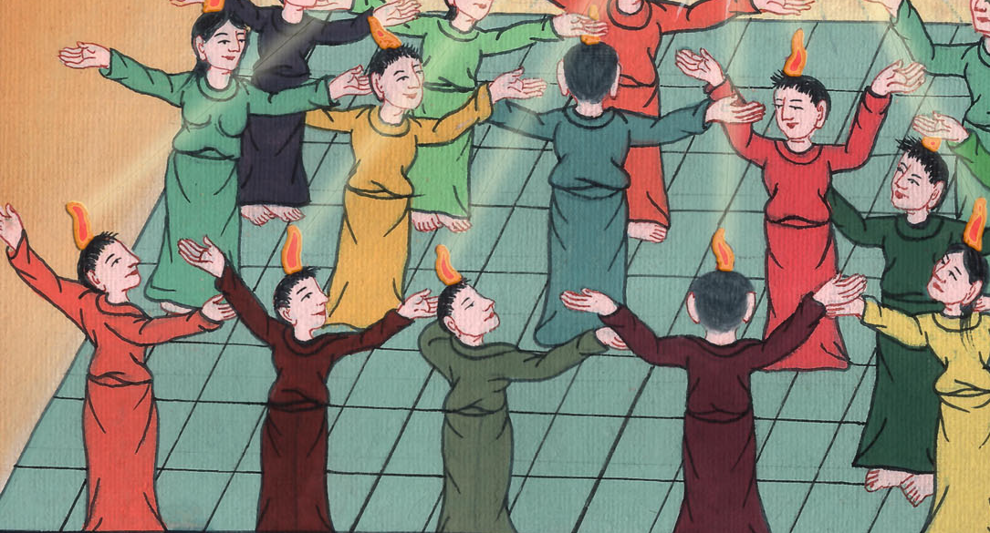
Acts 2:18

Slide 35
19I will show wonders in the sky above,
and signs on the earth beneath:
blood, and fire, and billows of smoke.

Slide 36
Acts 2:19

Slide 37
20The sun will be turned into darkness,
and the moon into blood,
before the great and glorious day of the Lord comes.

Slide 38
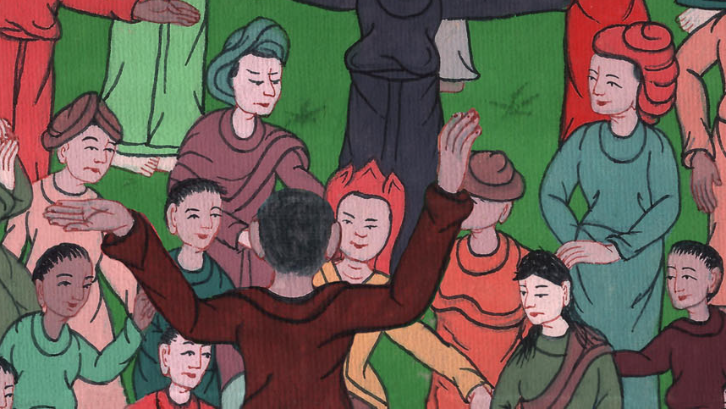
Acts 2:20

Slide 39
21It will be that whoever will call on the name of the Lord will be saved.’

Slide 40
Acts 2:21

