Slide 1
46-3
This work is licensed under a Creative Commons Attribution-ShareAlike 4.0 International License.
Please add this statement to all the videos you create.
English Bible quotes are from the World English Bible US, which is in the public domain.
Notes:
Ch
46 Ascention & Pentacost
1. Great Commission/Ascension - Acts 1:1-8; Matthew 28:18-20; Acts 1:9-11 (Left
Top)
2. Receiving Holy Spirit - Acts 2:1-4 (Right Top)
3. Peter Addresses the crowd - Acts 2:5-41 (Right Bottom)
4. Community of Believers - Acts 2:42-47 (Left Bottom)

Slide 2
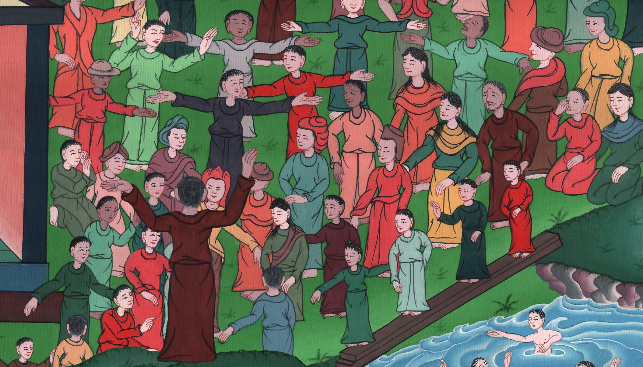
Peter Addresses the crowd
Acts 2:22-41

Slide 3
3. Peter Addresses the crowd
Acts 2:22-41
Notes:
46 Ascention & Pentacost
1. Great Commission/Ascension - Acts 1:1-8; Matthew 28:18-20; Acts 1:9-11 (Left
Top)
2. Receiving Holy Spirit - Acts 2:1-4 (Right Top)
3. Peter Addresses the crowd - Acts 2:5-41 (Right Bottom)
4. Community of Believers - Acts 2:42-47 (Left Bottom)

Slide 4
Peter Addresses the crowd
Acts 2:22-41

Slide 5
(Apostle Peter continues teaching)22“Fellow Israelites, listen to this! Jesus of Nazareth was a man who had God’s approval. God did miracles, wonders and signs among you through Jesus. You yourselves know this.

Slide 6
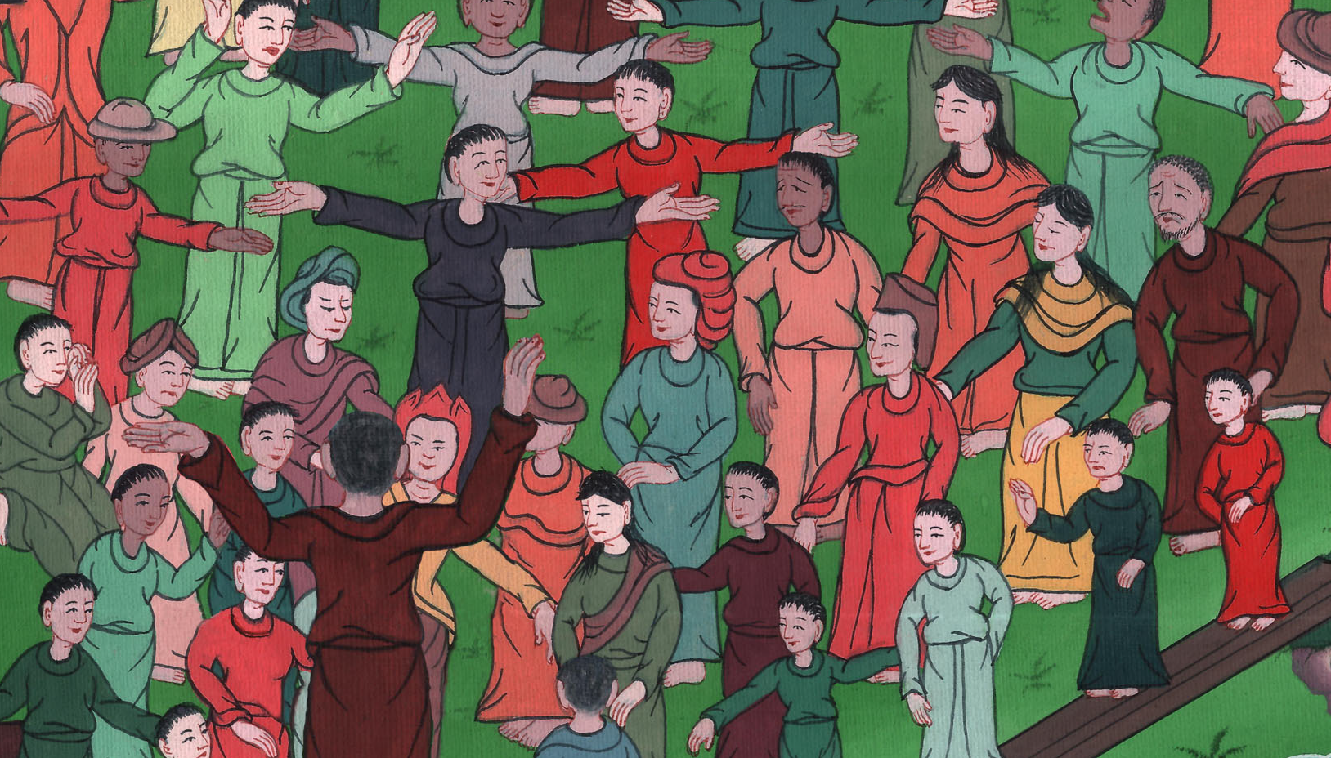
Acts 2:22

Slide 7
23Long ago God planned that Jesus would be handed over to you. With the help of evil people, you put Jesus to death. You nailed him to the cross.

Slide 8
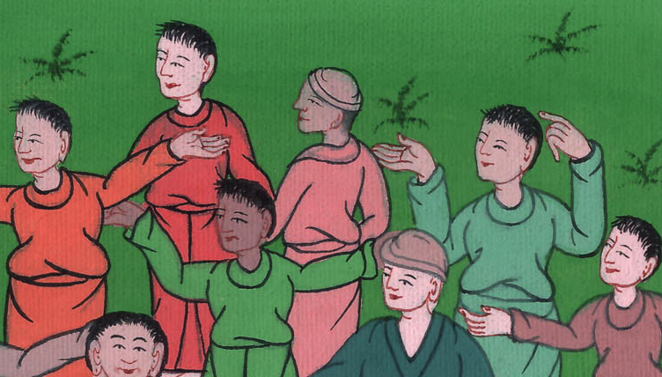
Acts 2:23

Slide 9
24But God raised him from the dead. He set him free from the suffering of death. It wasn’t possible for death to keep its hold on Jesus.

Slide 10
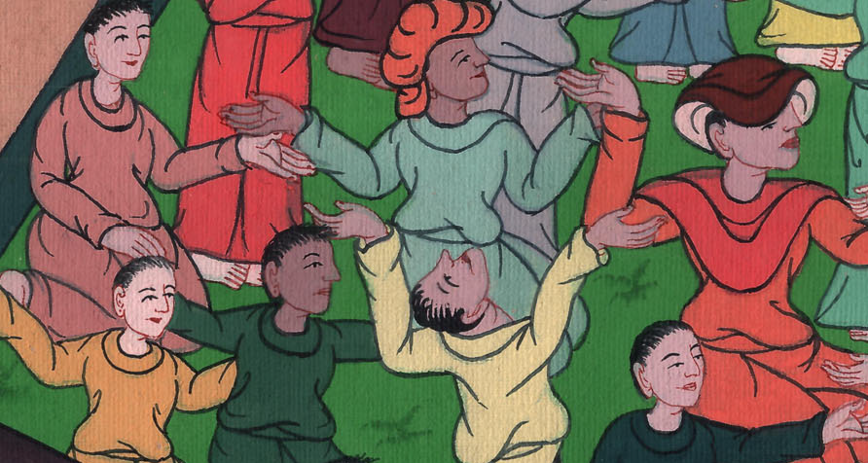
Acts 2:24

Slide 11
25David spoke about him. He said,
“ ‘I know that the Lord is always with me.
Because he is at my right hand,
I will always be secure.

Slide 12
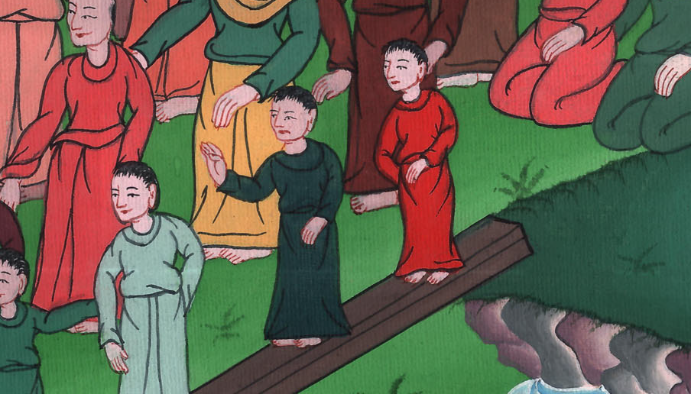
Acts 2:25

Slide 13
26So my heart is glad and joy is on my tongue.
My whole body will be full of hope.
27You will not leave me in the place of the dead.
You will not let your holy one rot away.

Slide 14
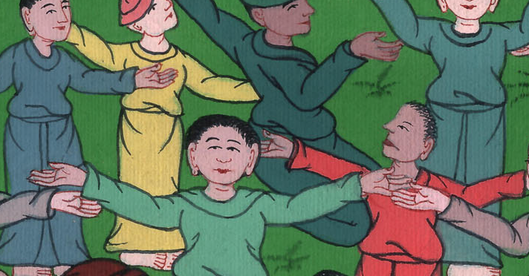
Acts 2:26,27

Slide 15
28You always show me the path that leads to life.
You will fill me with joy when I am with you.’

Slide 16
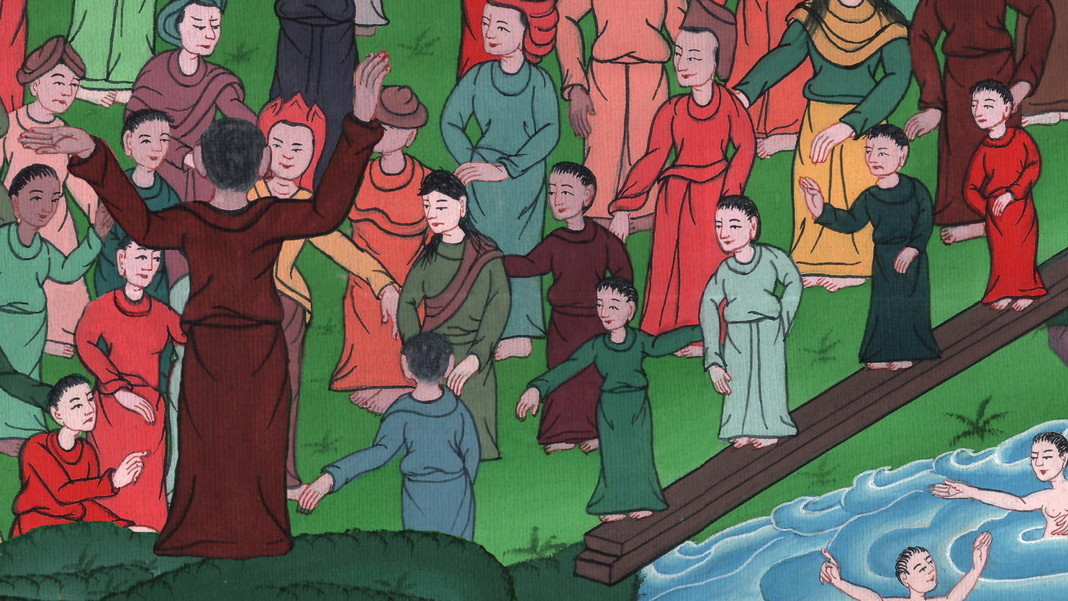
Acts 2:28

Slide 17
29“Fellow Israelites, you can be sure that King David died. He was buried. His tomb is still here today.

Slide 18
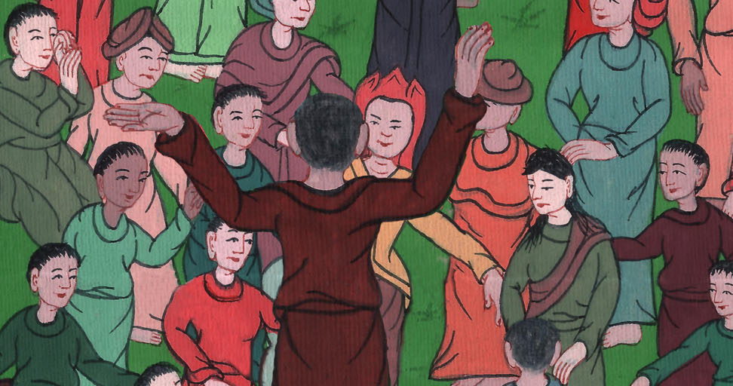
Acts 2:29

Slide 19
30But David was a prophet. He knew that God had made a promise to him. God had promised that he would make someone in David’s family line king after him.

Slide 20
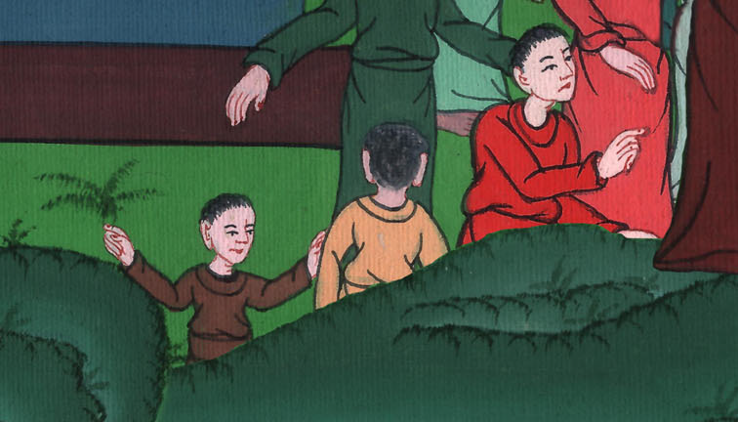
Acts 2:30

Slide 21
31David saw what was coming. So he spoke about the Messiah rising from the dead. He said that the Messiah would not be left in the place of the dead. His body wouldn’t rot in the ground.

Slide 22
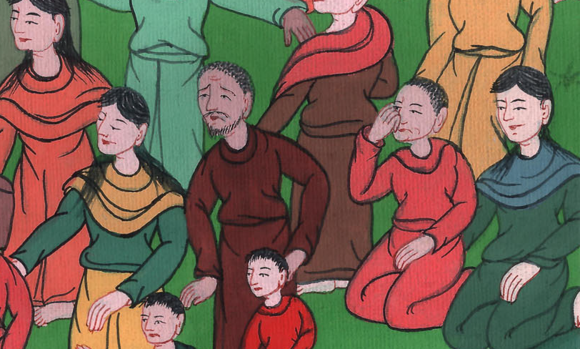
Acts 2:31

Slide 23
32God has raised this same Jesus back to life. We are all witnesses of this.

Slide 24
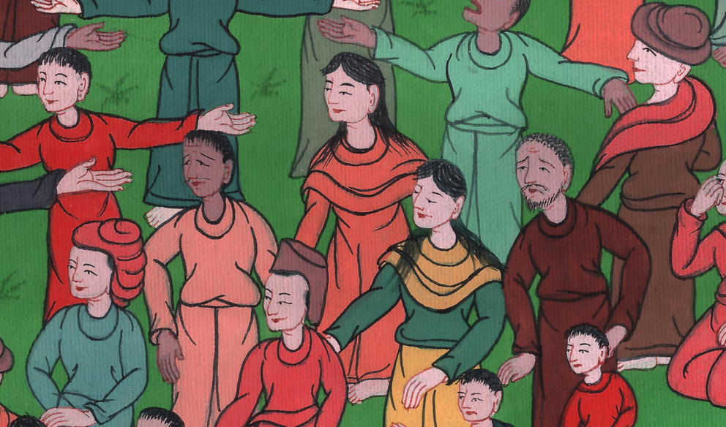
Acts 2:32

Slide 25
33Jesus has been given a place of honor at the right hand of God. He has received the Holy Spirit from the Father. This is what God had promised. It is Jesus who has poured out what you now see and hear.

Slide 26
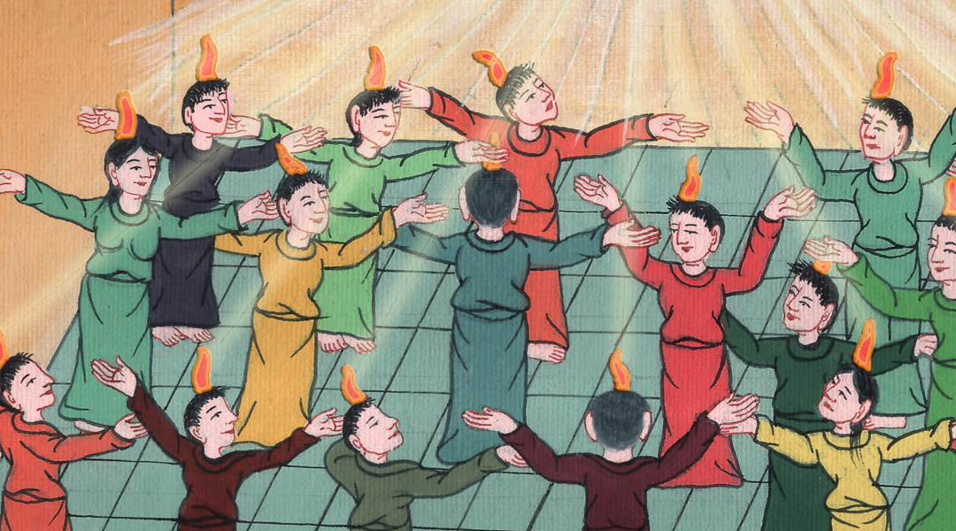
Acts 2:33

Slide 27
34David did not go up to heaven. But he said,
“ ‘The Lord said to my Lord,
“Sit at my right hand.
35I will put your enemies
under your control.” ’

Slide 28
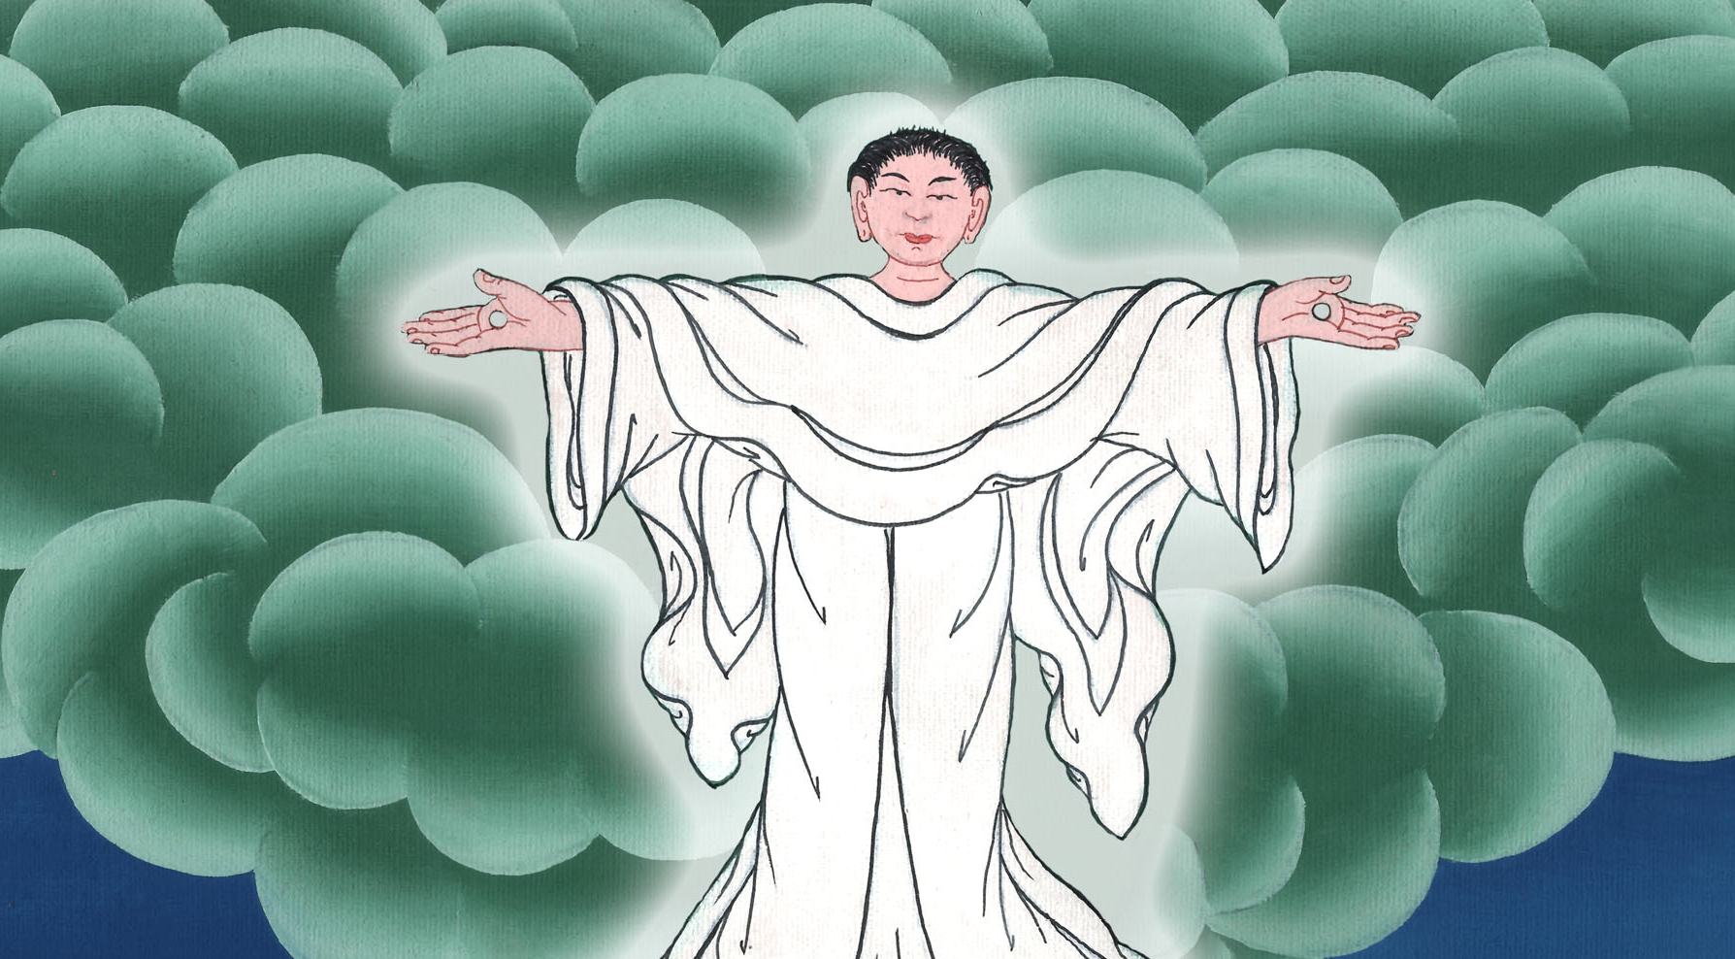
Acts 2:35,35

Slide 29
36“So be sure of this, all you people of Israel. You nailed Jesus to the cross. But God has made him both Lord and Messiah.”

Slide 30
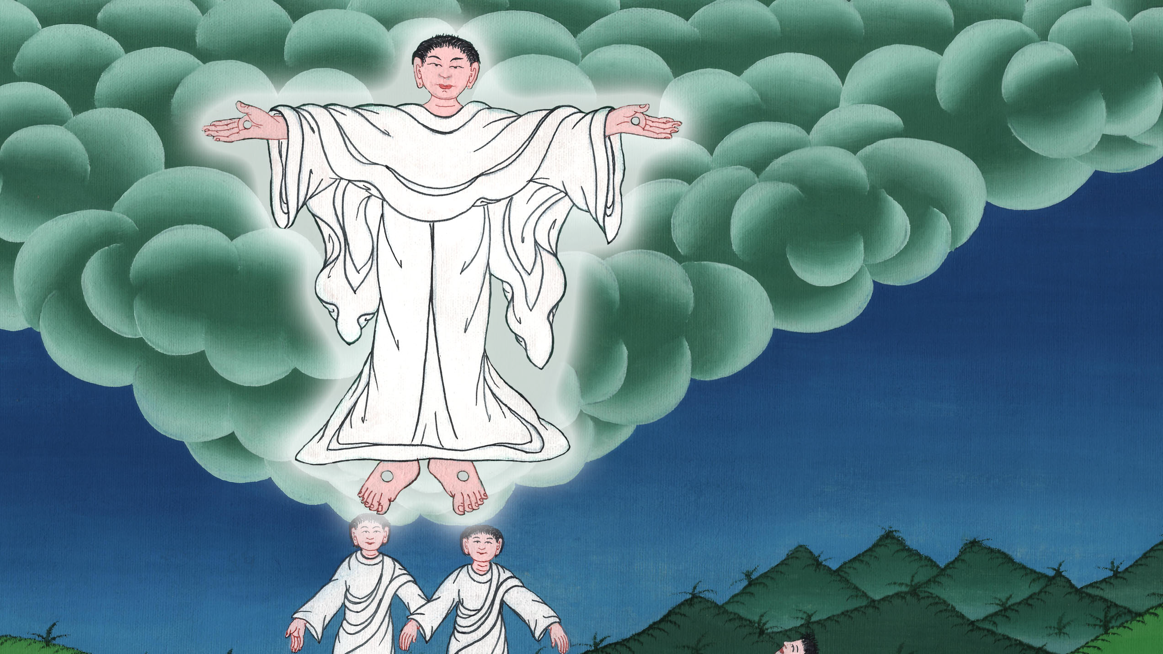
Acts 2:36

Slide 31
37When the people heard this, it had a deep effect on them. They said to Peter and the other apostles, “Brothers, what should we do?”

Slide 32
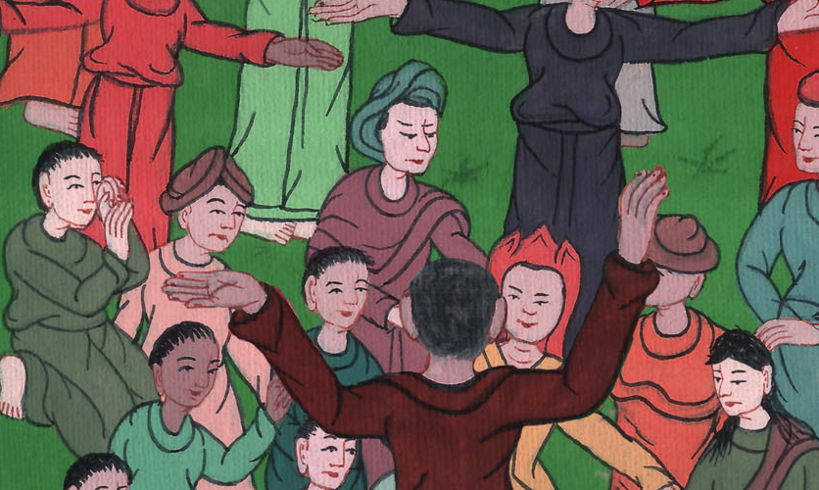
Acts 2:37

Slide 33
38Peter replied, “All of you must turn away from your sins and be baptized in the name of Jesus Christ. Then your sins will be forgiven. You will receive the gift of the Holy Spirit.

Slide 34
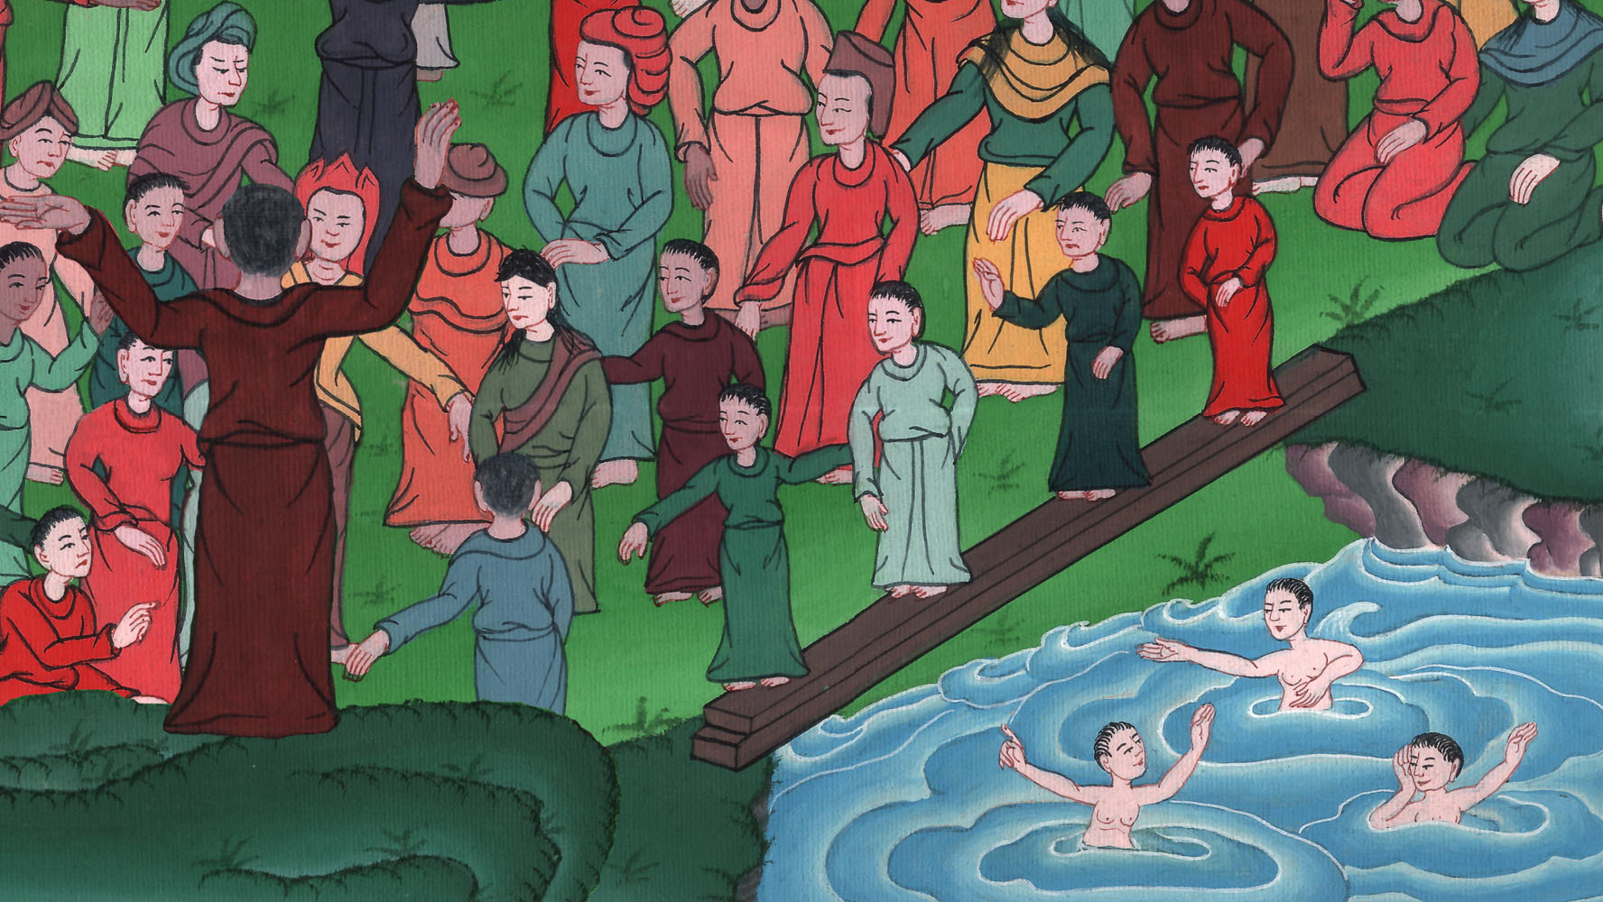
Acts 2:38

Slide 35
39The promise is for you and your children. It is also for all who are far away. It is for all whom the Lord our God will choose.”

Slide 36
Acts 2:39

Slide 37
40Peter said many other things to warn them. He begged them, “Save yourselves from these evil people.”

Slide 38
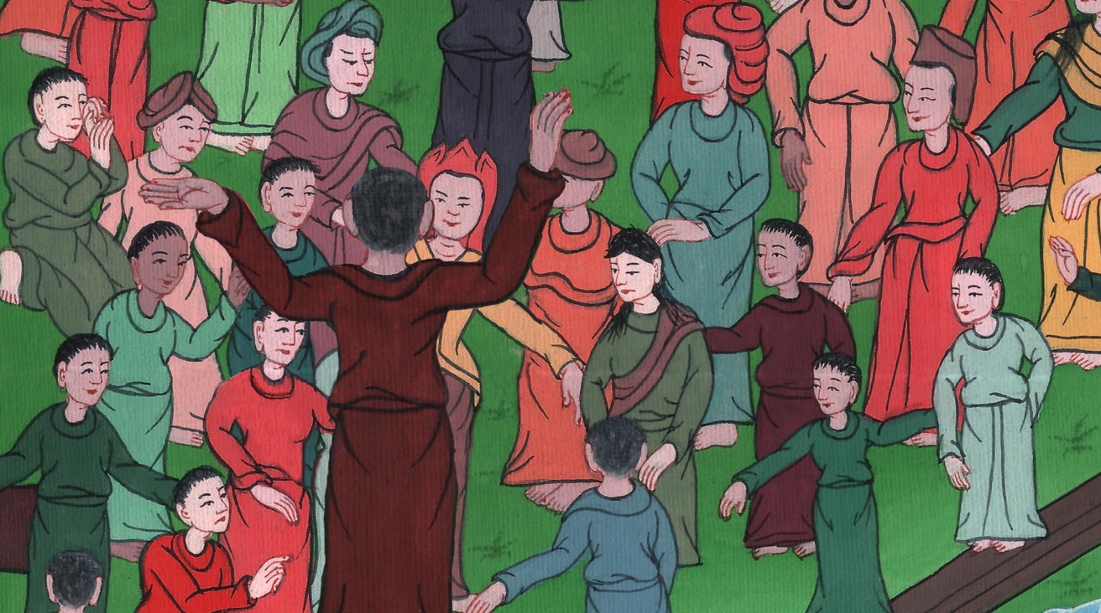
Acts 2:40

Slide 39
41Those who accepted his message were baptized. About 3,000 people joined the believers that day.

Slide 40
Acts 2:41

