Slide 1
46-4
This work is licensed under a Creative Commons Attribution-ShareAlike 4.0 International License.
Please add this statement to all the videos you create.
English Bible quotes are from the World English Bible US, which is in the public domain.
Notes:
Ch
46 Ascention & Pentacost
1. Great Commission/Ascension - Acts 1:1-8; Matthew 28:18-20; Acts 1:9-11 (Left
Top)
2. Receiving Holy Spirit - Acts 2:1-4 (Right Top)
3. Peter Addresses the crowd - Acts 2:5-41 (Right Bottom)
4. Community of Believers - Acts 2:42-47 (Left Bottom)

Slide 2
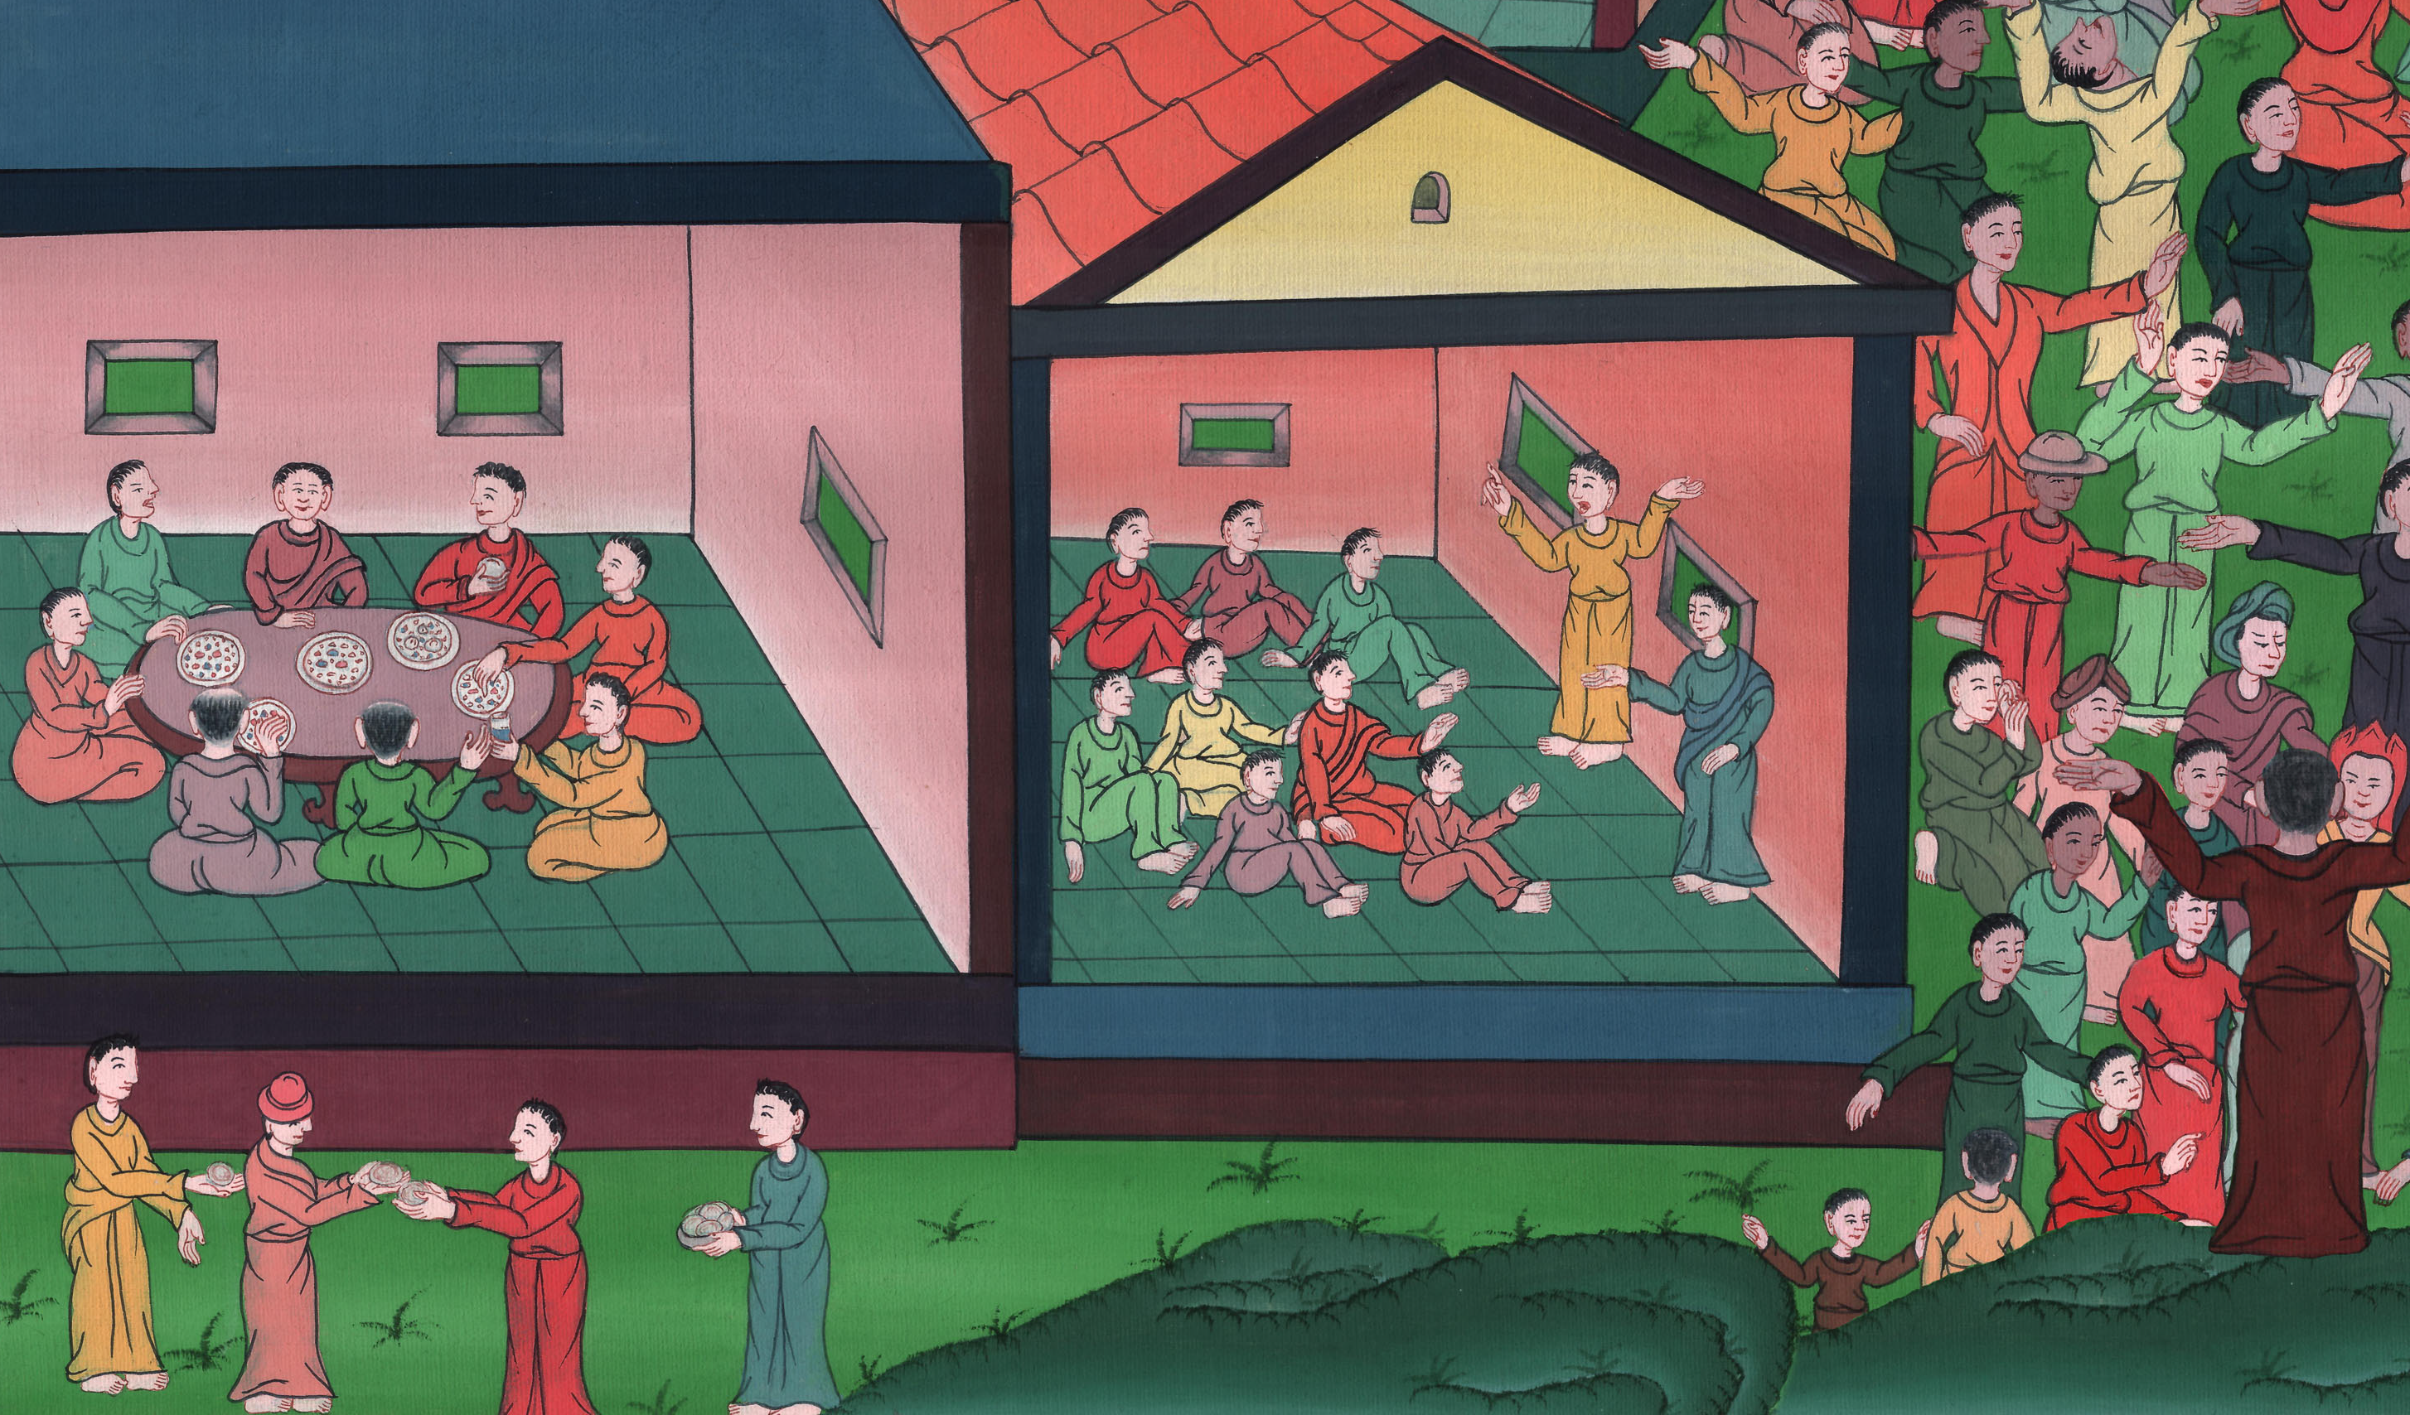
Community of Believers
Acts 2:41-47

Slide 3
Community of Believers
Acts 2:41-47

Slide 4
Community of Believers
Acts 2:41-47

Slide 5
41Then those who gladly received his word were baptized. There were added that day about three thousand souls.

Slide 6
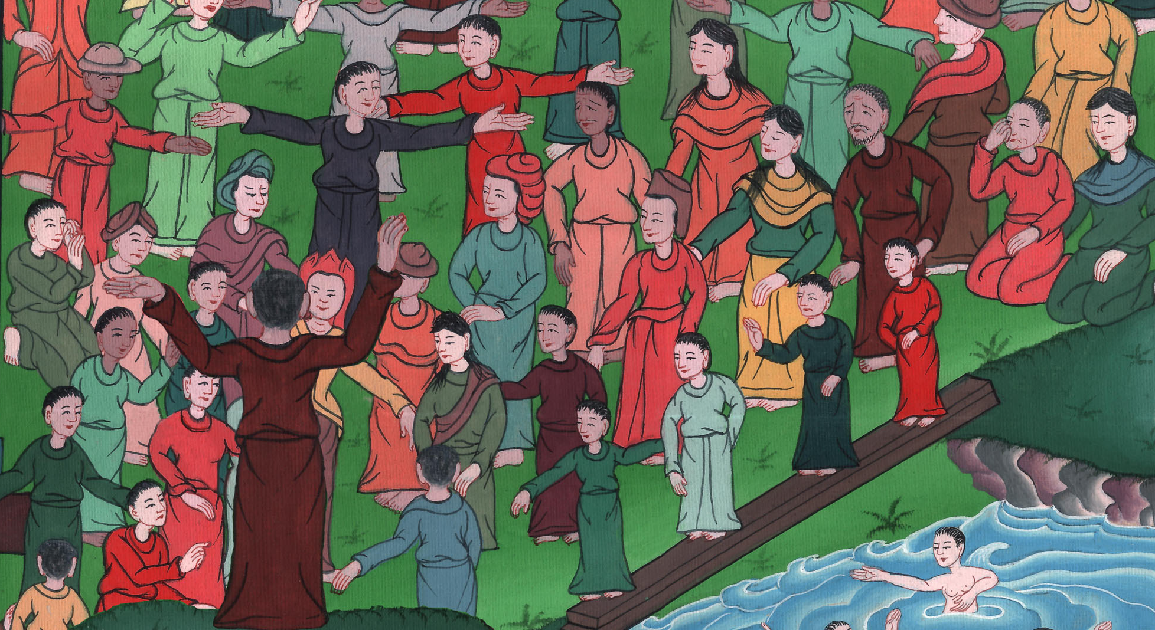
Acts 2:41

Slide 7
42They continued steadfastly in the apostles’ teaching and fellowship, in the breaking of bread, and prayer.

Slide 8
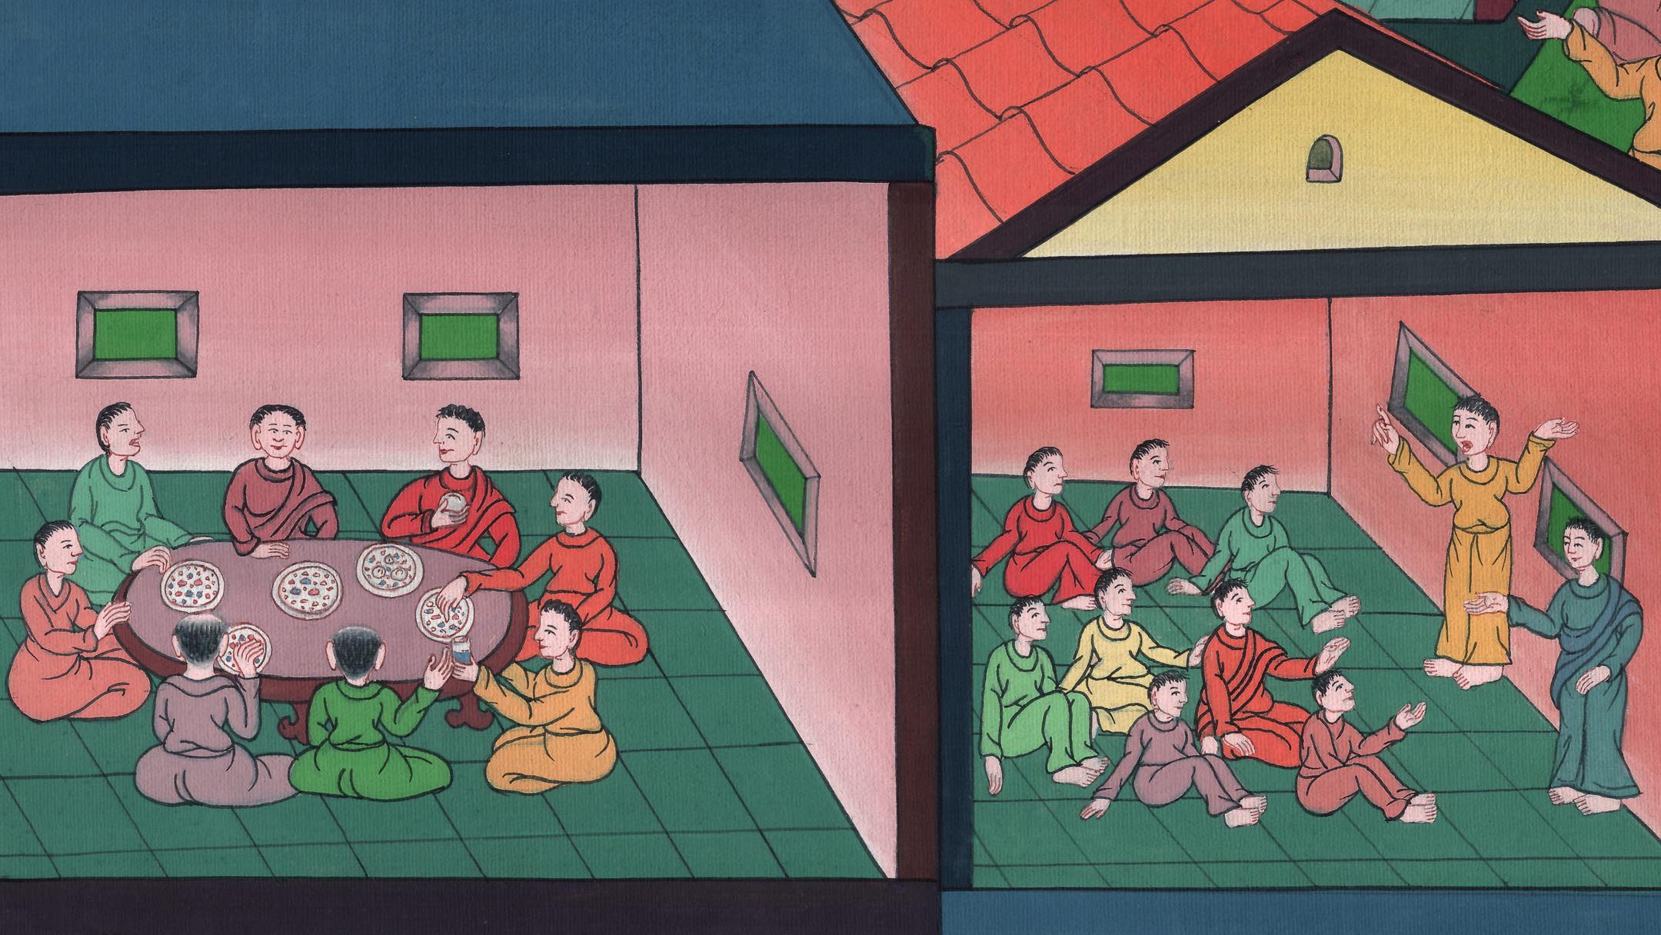
Acts 2:42

Slide 9
43Fear came on every soul, and many wonders and signs were done through the apostles.

Slide 10
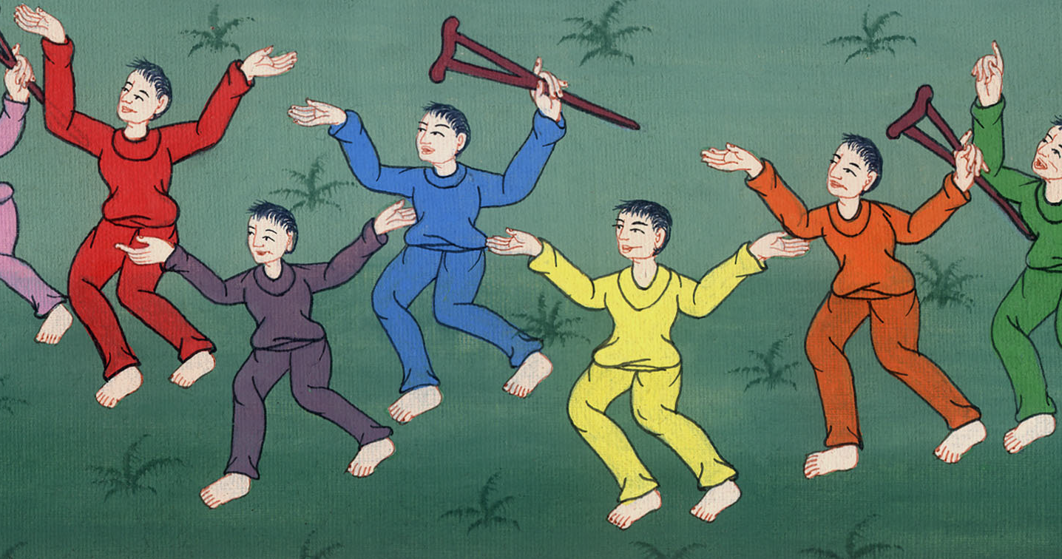
Acts 2:43

Slide 11
44All who believed were together, and had all things in common.

Slide 12
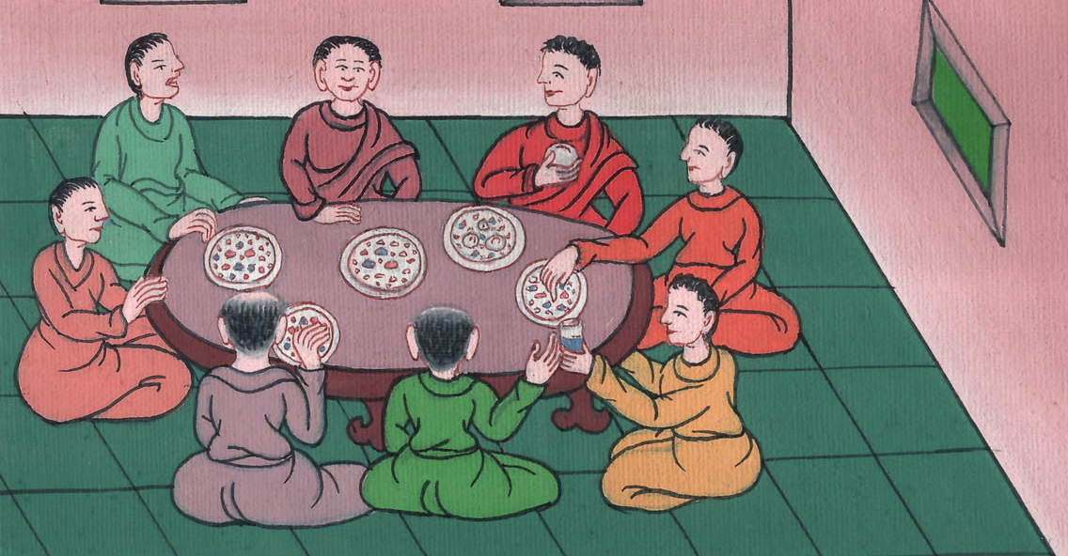
Acts 2:44

Slide 13
45They sold their possessions and goods, and distributed them to all, according as anyone had need.

Slide 14
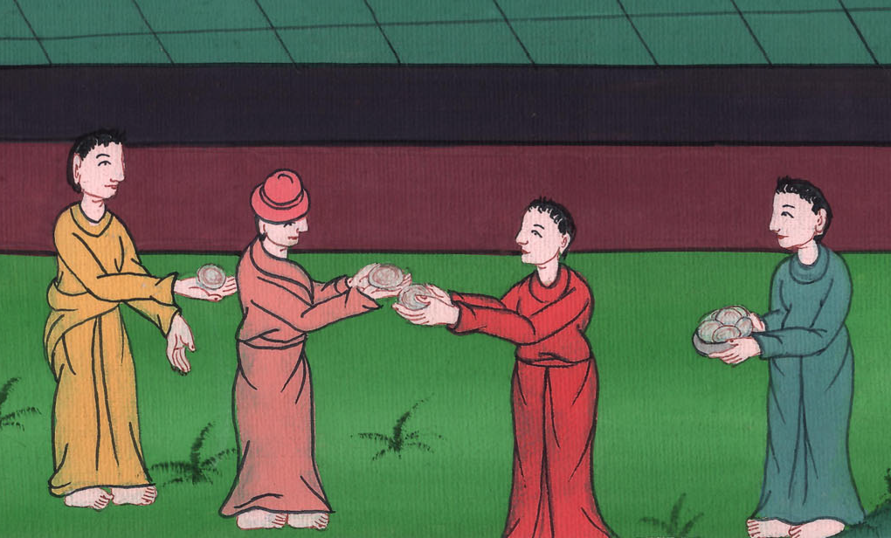
Acts 2:45

Slide 15
46Day by day, continuing steadfastly with one accord in the temple, and breaking bread at home, they took their food with gladness and singleness of heart,

Slide 16
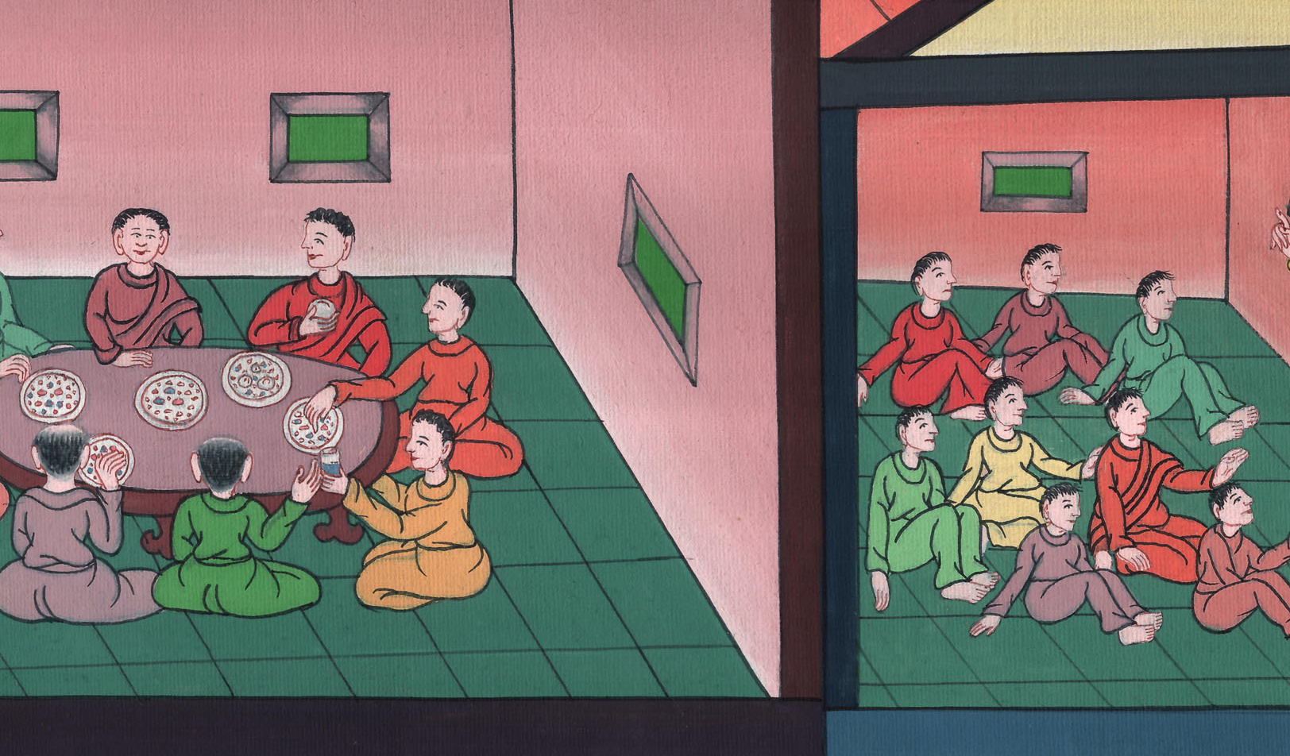
Acts 2:46

Slide 17
47praising God and having favor with all the people. The Lord added to the assembly day by day those who were being saved.

Slide 18
Acts 2:46

