Slide 1
47-1
This work is licensed under a Creative Commons Attribution-ShareAlike 4.0 International License.
Please add this statement to all the videos you create.
English Bible quotes are from the World English Bible US, which is in the public domain.
Notes:
Ch
47 Peter and John Heal Lame Man
1. Peter and John heal lame man - Acts 3:1-26 (Left Top)
2. Peter and John warned - Acts 4:1-31 (Right Top)
3. Believers living in unity/ Ananias and Sapphira - Acts 4:32 – 5:11 (Right
Center)
4. Many Healings – Acts 5:12-16 (Bottom)
5. Apostles arrested – Acts 5:17-42 (Left and Center)

Slide 2
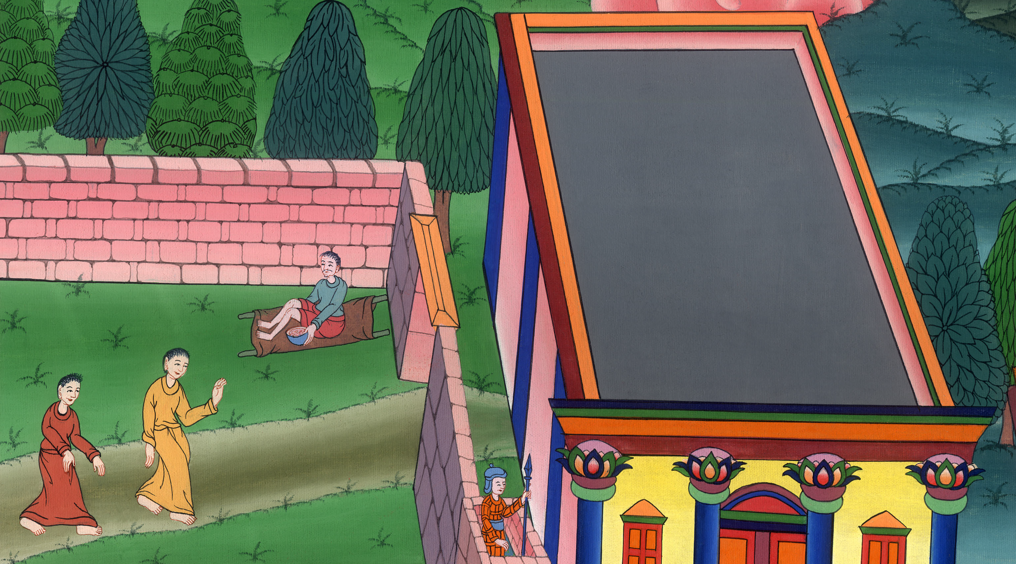
Peter and John heal a lame man Acts 3:1-26

Slide 3
Peter and John heal a lame man Acts 3:1-26

Slide 4
Peter and John heal a lame man Acts 3:1-26

Slide 5
1Peter and John were going up into the temple at the hour of prayer, the ninth hour.

Slide 6
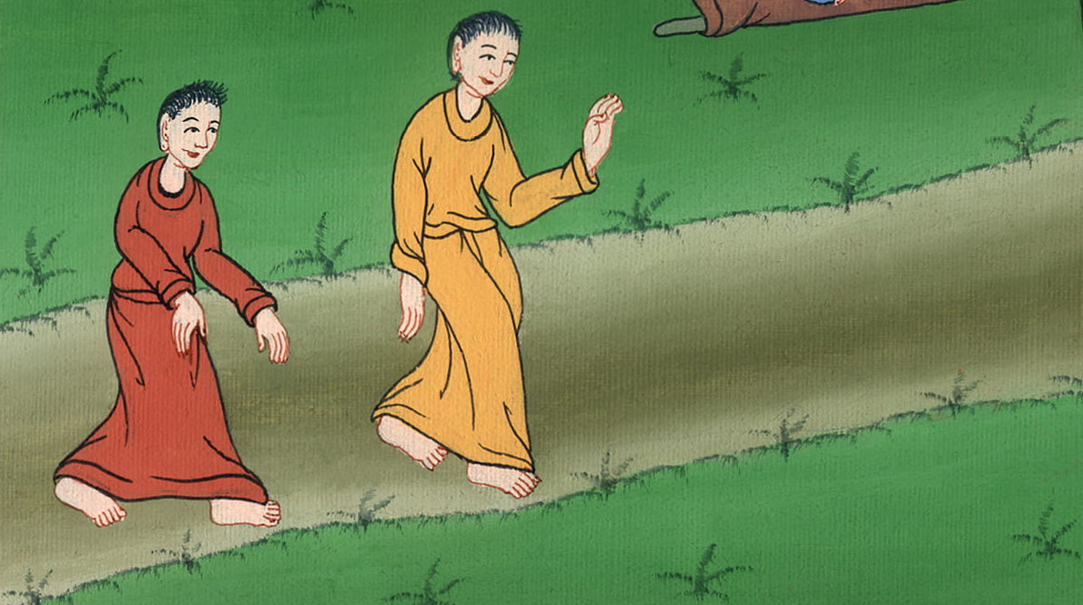
Acts 3:1

Slide 7
2A certain man who was lame from his mother’s womb was being carried, whom they laid daily at the door of the temple which is called Beautiful, to ask gifts for the needy of those who entered into the temple.

Slide 8
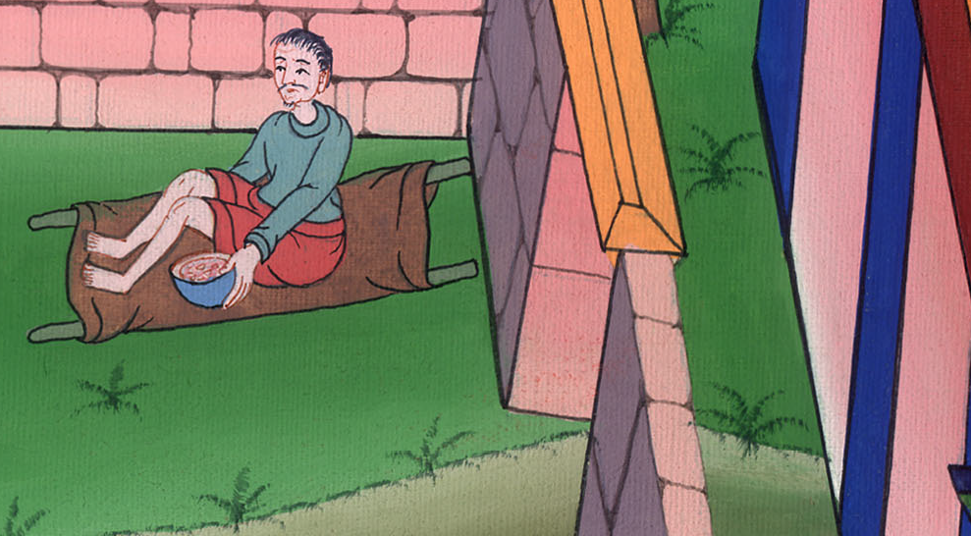
Acts 3:2

Slide 9
3Seeing Peter and John about to go into the temple, he asked to receive gifts for the needy.

Slide 10
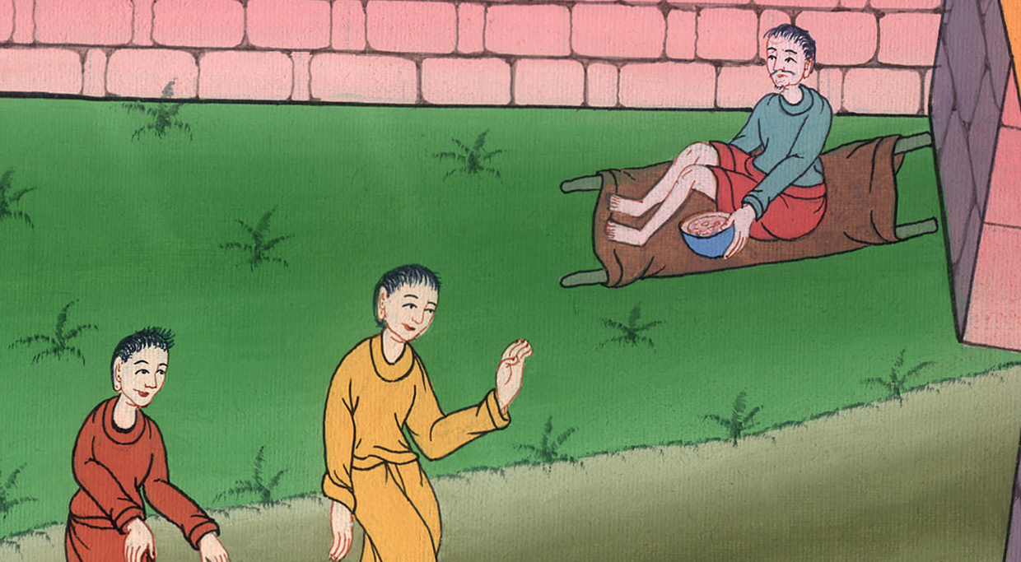
Acts 3:3

Slide 11
4Peter, fastening his eyes on him, with John, said, “Look at us.” 5He listened to them, expecting to receive something from them.

Slide 12
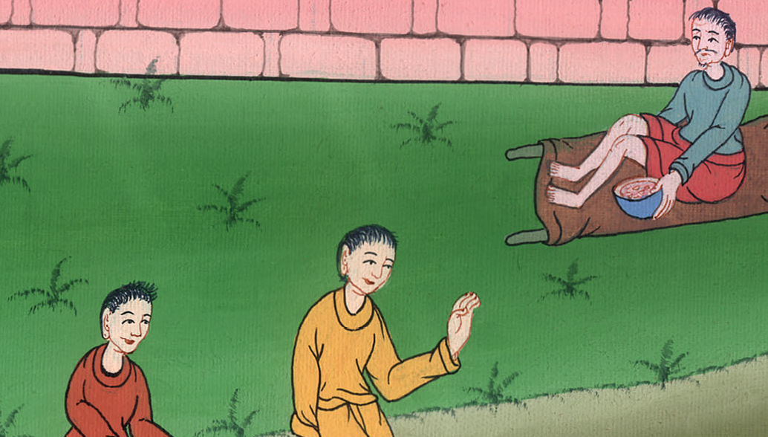
Acts 3:4,5

Slide 13
6But Peter said, “I have no silver or gold, but what I have, that I give you. In the name of Jesus Christ of Nazareth, get up and walk!”

Slide 14
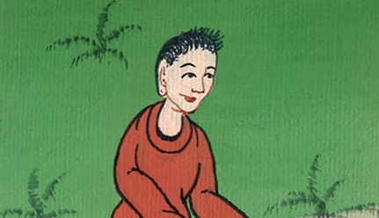
Acts 3:6

Slide 15
7He took him by the right hand and raised him up. Immediately his feet and his ankle bones received strength.

Slide 16
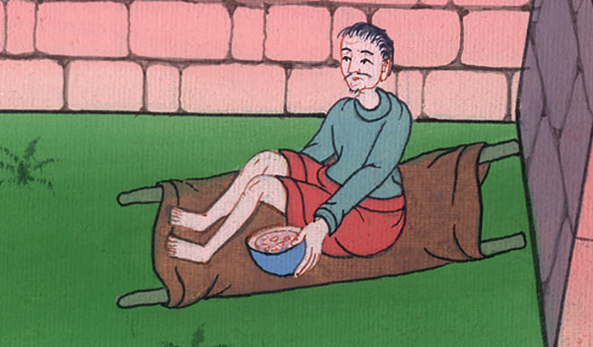
Acts 3:7

Slide 17
8Leaping up, he stood and began to walk. He entered with them into the temple, walking, leaping, and praising God.

Slide 18
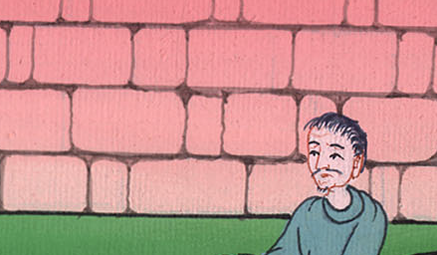
Acts 3:8

Slide 19
9All the people saw him walking and praising God. 10They recognized him, that it was he who used to sit begging for gifts for the needy at the Beautiful Gate of the temple. They were filled with wonder and amazement at what had happened to him.

Slide 20
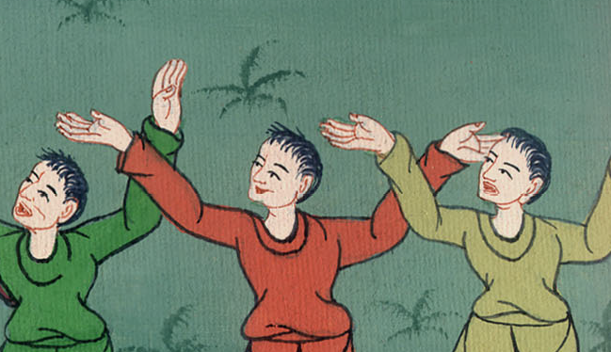
Acts 3:9,10

Slide 21
11As the lame man who was healed held on to Peter and John, all the people ran together to them in the porch that is called Solomon’s, greatly wondering.

Slide 22
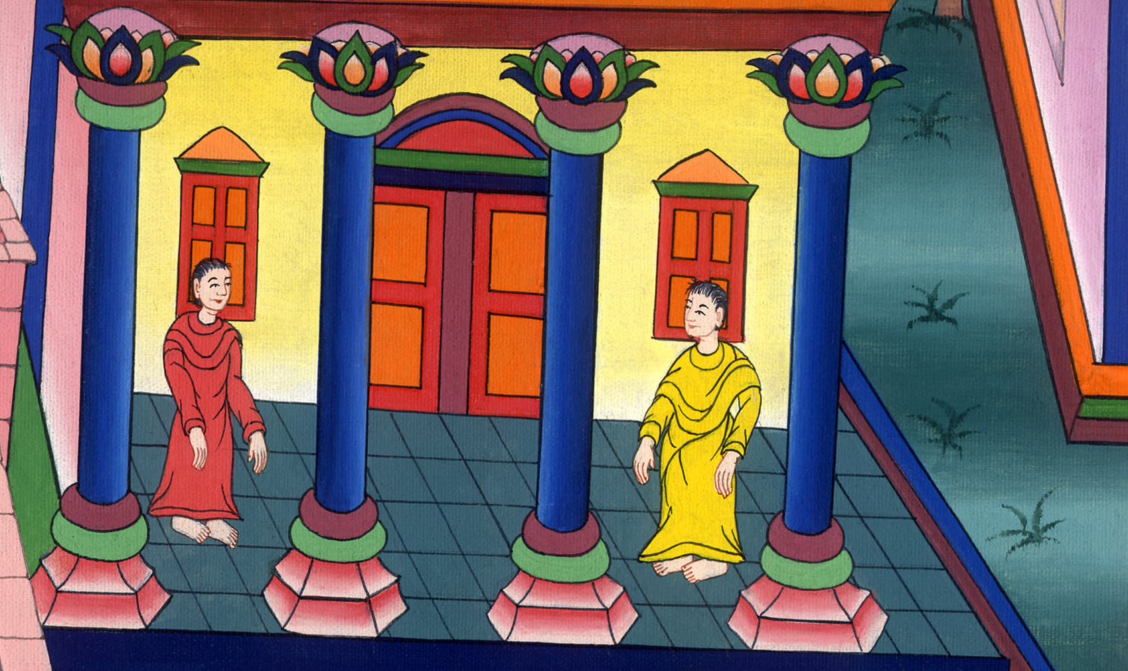
Acts 3:11

Slide 23
12When Peter saw it, he responded to the people, “You men of Israel, why do you marvel at this man? Why do you fasten your eyes on us, as though by our own power or godliness we had made him walk?

Slide 24
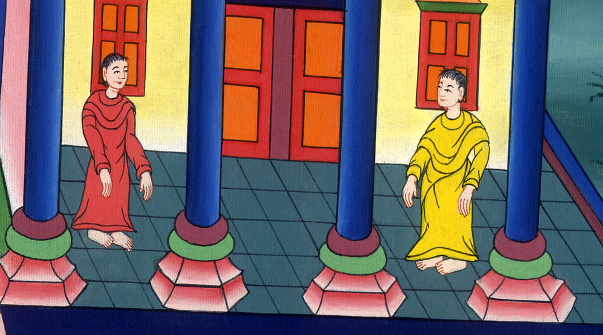
Acts 3:12

Slide 25
13The God of Abraham, Isaac, and Jacob, the God of our fathers, has glorified his Servant Jesus,

Slide 26
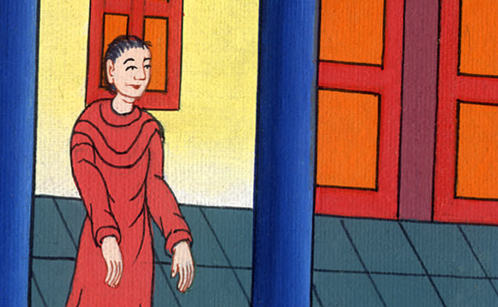
Acts 3:13

Slide 27
whom you delivered up and denied in the presence of Pilate, when he had determined to release him.

Slide 28
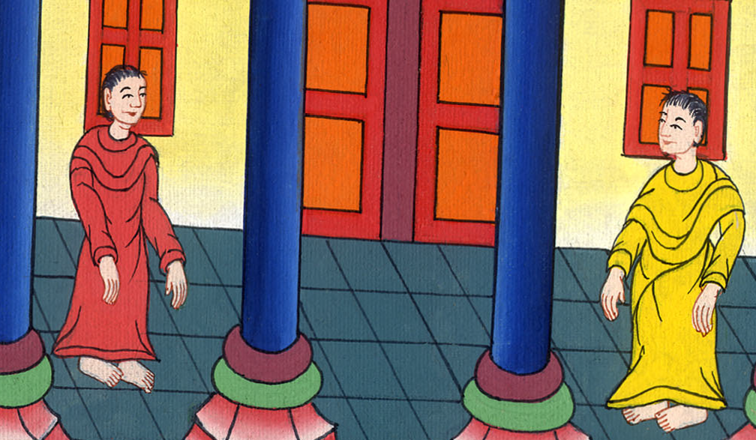
Acts 3:13

Slide 29
14But you denied the Holy and Righteous One and asked for a murderer to be granted to you, 15and killed the Prince of life, whom God raised from the dead, to which we are witnesses.

Slide 30
Acts 3:14,15

Slide 31
16By faith in his name, his name has made this man strong, whom you see and know. Yes, the faith which is through him has given him this perfect soundness in the presence of you all.

Slide 32
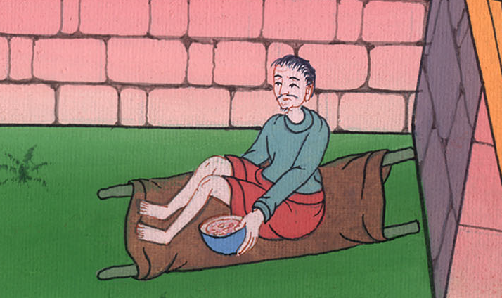
Acts 3:16

Slide 33
17“Now, brothers, I know that you did this in ignorance, as did also your rulers.

Slide 34
Acts 3:17

Slide 35
18But the things which God announced by the mouth of all his prophets, that Christ should suffer, he thus fulfilled.

Slide 36
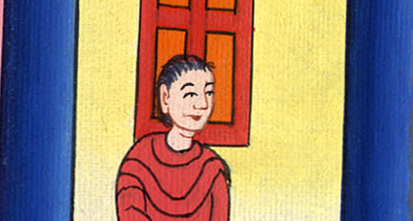
Acts 3:18

Slide 37
19“Repent therefore, and turn again, that your sins may be blotted out,

Slide 38
Acts 3:19

Slide 39
so that there may come times of refreshing from the presence of the Lord, 20and that he may send Christ Jesus, who was ordained for you before,

Slide 40
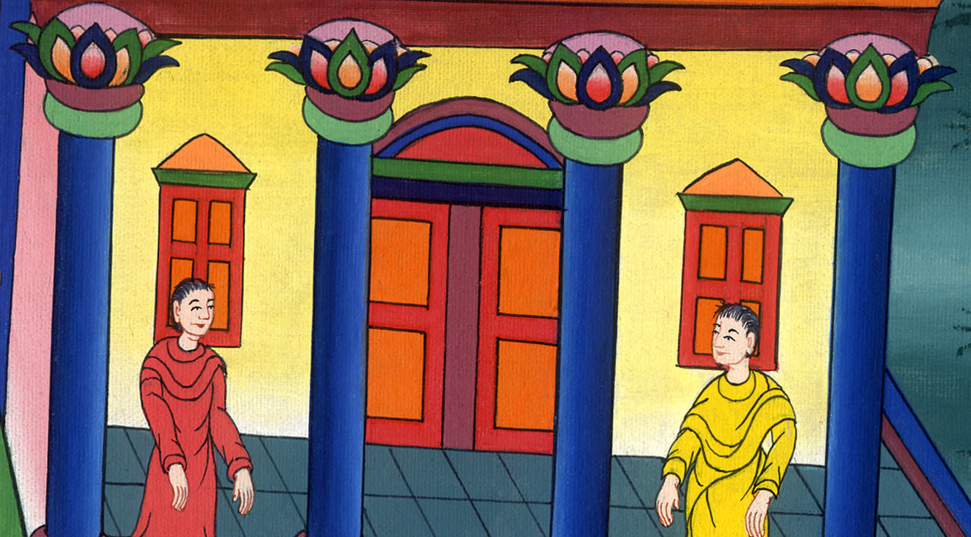
Acts 3:20

Slide 41
21whom heaven must receive until the times of restoration of all things, which God spoke long ago by the mouth of his holy prophets.

Slide 42
Acts 3:21

