Slide 1
47-2
This work is licensed under a Creative Commons Attribution-ShareAlike 4.0 International License.
Please add this statement to all the videos you create.
English Bible quotes are from the World English Bible US, which is in the public domain.
Notes:
Ch
47 Peter and John Heal Lame Man
1. Peter and John heal lame man - Acts 3:1-26 (Left Top)
2. Peter and John warned - Acts 4:1-31 (Right Top)
3. Believers living in unity/ Ananias and Sapphira - Acts 4:32 – 5:11 (Right
Center)
4. Many Healings – Acts 5:12-16 (Bottom)
5. Apostles arrested – Acts 5:17-42 (Left and Center)

Slide 2
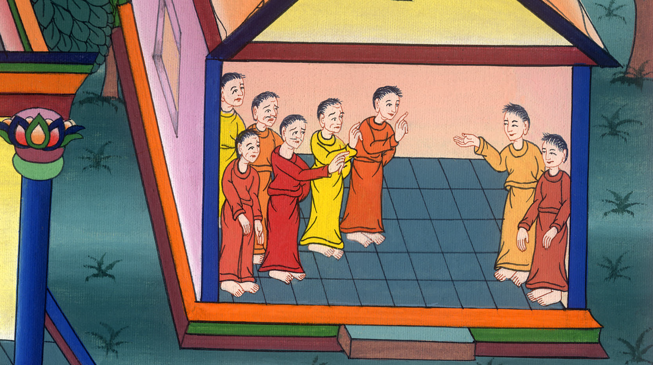
Peter and John warned
Acts 4:1-31

Slide 3
Peter and John warned
Acts 4:1-31

Slide 4
Peter and John warned
Acts 4:1-31

Slide 5
1As they spoke to the people, the priests and the captain of the temple and the Sadducees came to them,

Slide 6
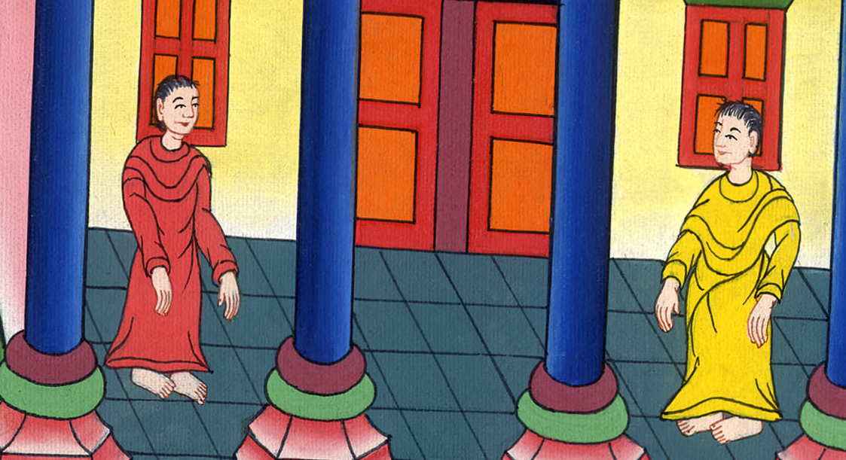
Acts 4:1

Slide 7
2being upset because they taught the people and proclaimed in Jesus the resurrection from the dead.

Slide 8
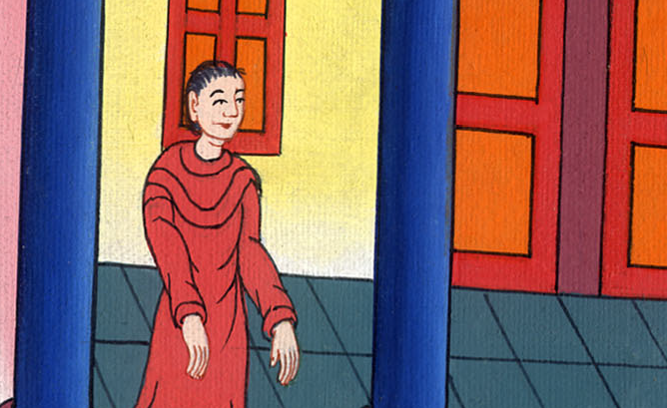
Acts 4:2

Slide 9
3They laid hands on them, and put them in custody until the next day, for it was now evening.

Slide 10
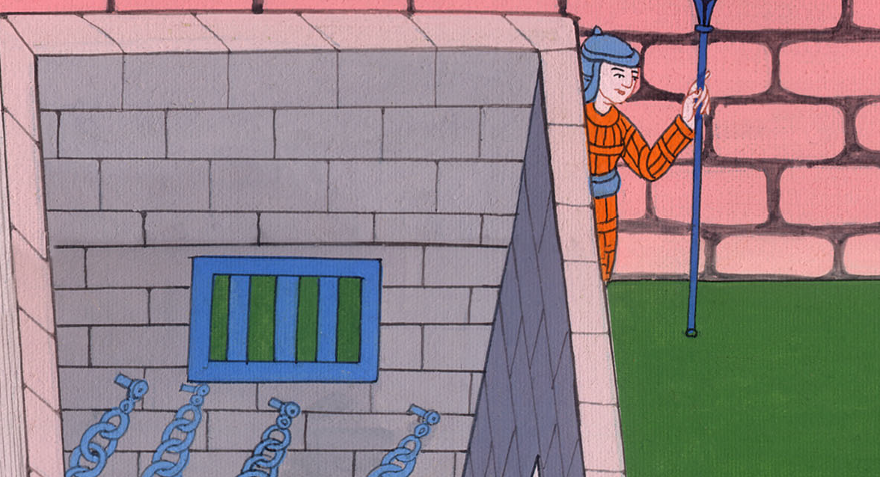
Acts 4:3

Slide 11
4But many of those who heard the word believed, and the number of the men came to be about five thousand.

Slide 12
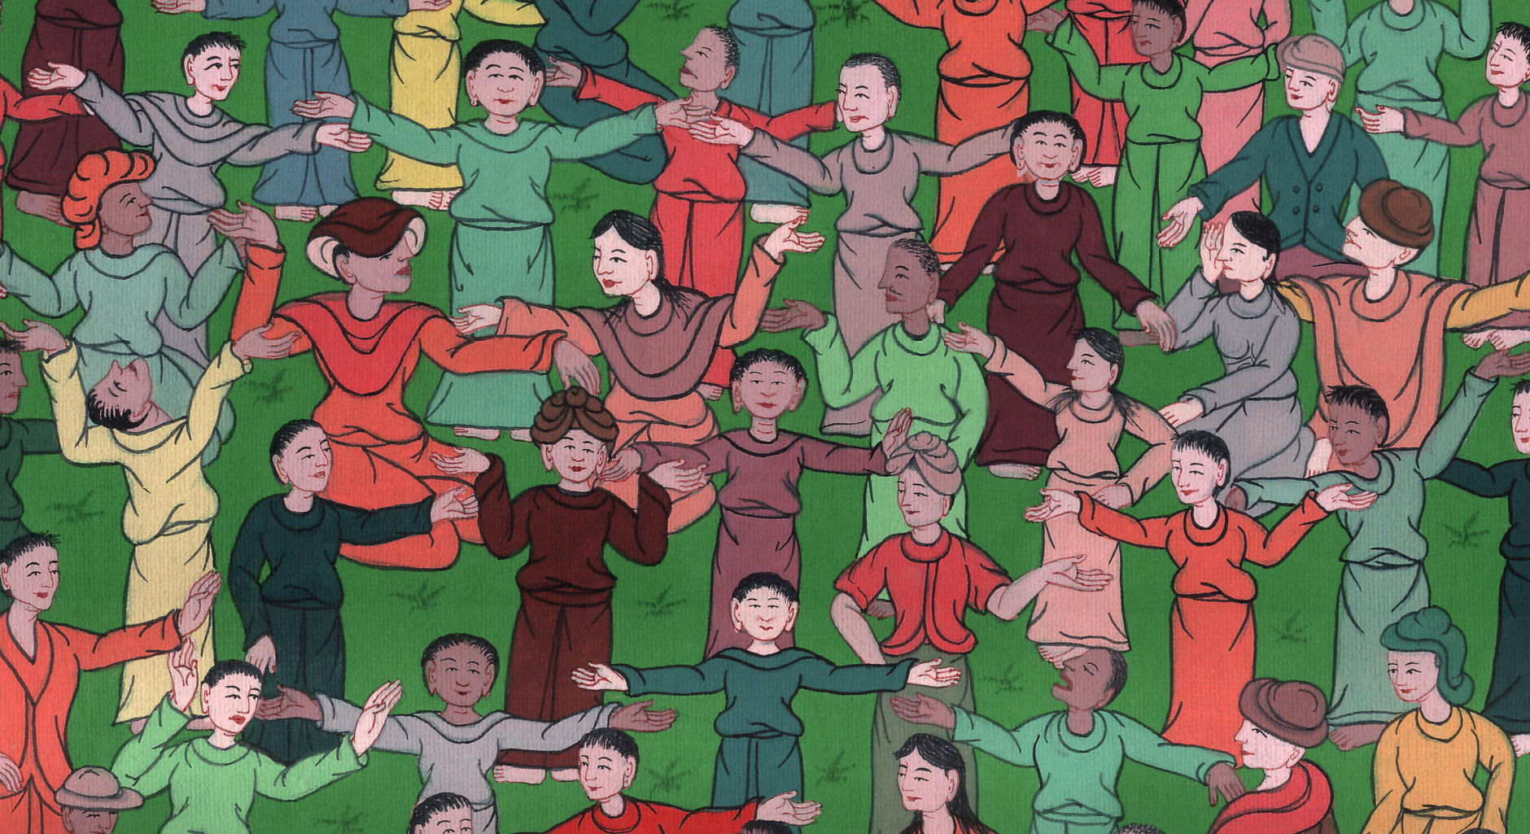
Acts 4:4

Slide 13
5In the morning, their rulers, elders, and scribes were gathered together in Jerusalem. 6Annas the high priest was there, …

Slide 14
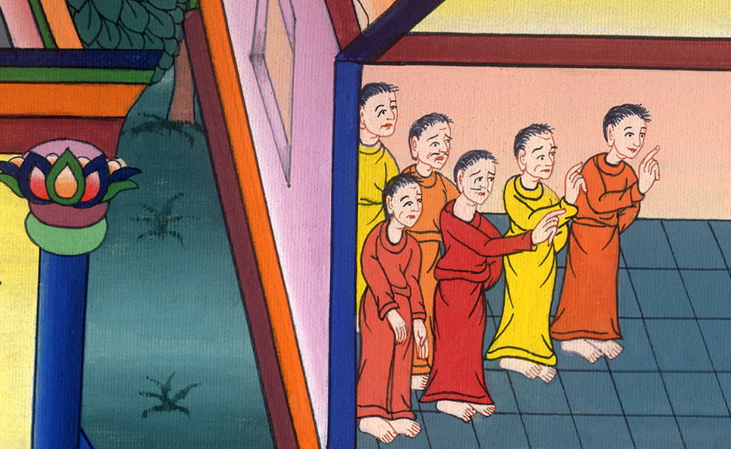
Acts 4:5,6

Slide 15
7When they had stood Peter and John in the middle of them, they inquired, “By what power, or in what name, have you done this?”

Slide 16
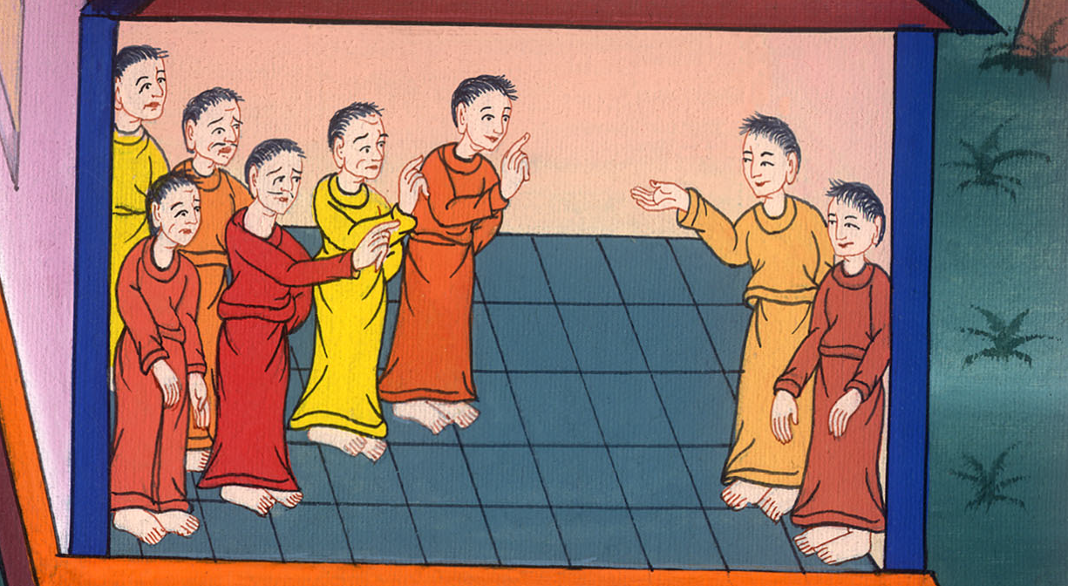
Acts 4:7

Slide 17
8Then Peter, filled with the Holy Spirit, said to them, “You rulers of the people and elders of Israel, 9if we are examined today concerning a good deed done to a crippled man, by what means this man has been healed,

Slide 18
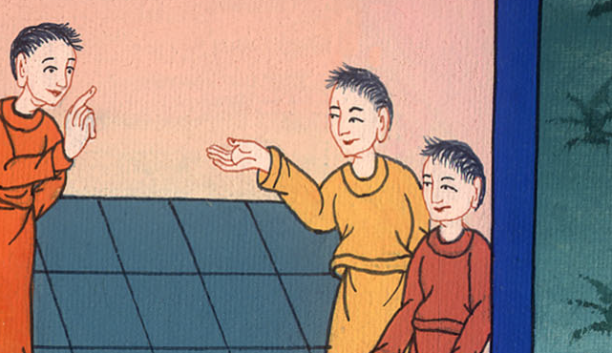
Acts 4:8,9

Slide 19
10may it be known to you all, and to all the people of Israel, that in the name of Jesus Christ of Nazareth, whom you crucified, whom God raised from the dead, this man stands here before you whole in him.

Slide 20
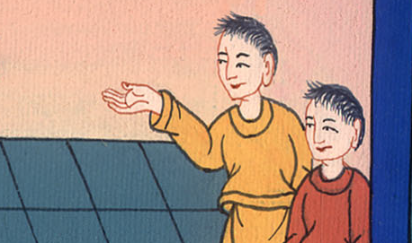
Acts 4:10

Slide 21
12There is salvation in no one else, for there is no other name under heaven that is given among men, by which we must be saved!”

Slide 22
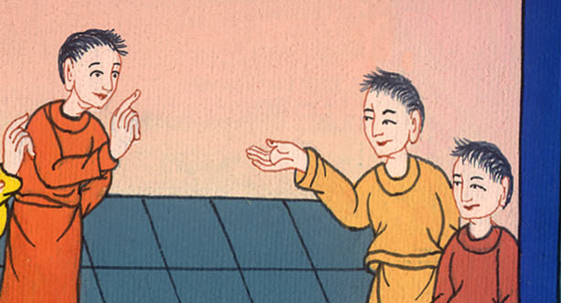
Acts 4:12

Slide 23
13Now when they saw the boldness of Peter and John, and had perceived that they were unlearned and ignorant men, they marveled. They recognized that they had been with Jesus.

Slide 24
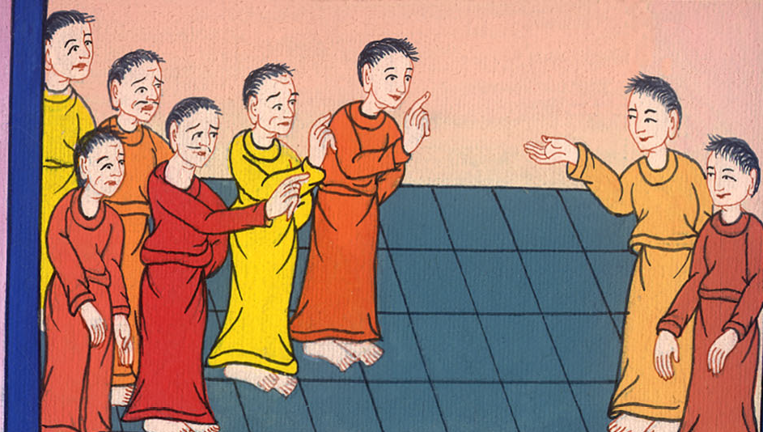
Acts 4:13

Slide 25
14Seeing the man who was healed standing with them, they could say nothing against it. 15But when they had commanded them to go aside out of the council, they conferred among themselves,

Slide 26
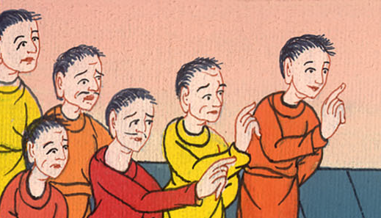
Acts 4:14,15

Slide 27
16saying, “What shall we do to these men? Because indeed a notable miracle has been done through them, as can be plainly seen by all who dwell in Jerusalem, and we can’t deny it.

Slide 28
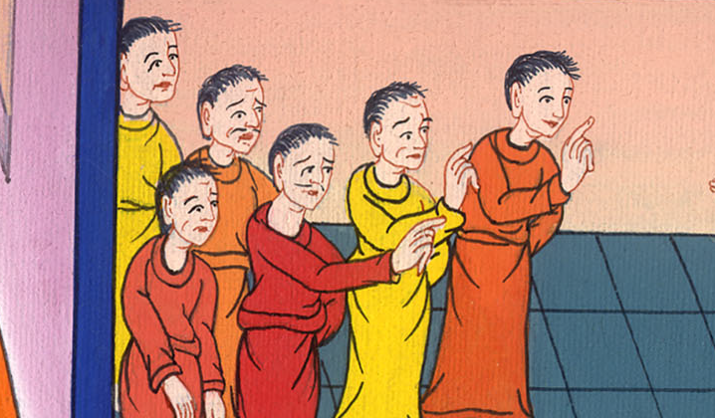
Acts 4:16

Slide 29
17But so that this spreads no further among the people, let’s threaten them, that from now on they don’t speak to anyone in this name.”

Slide 30
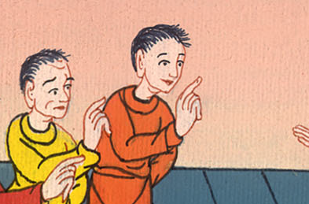
Acts 4:17

Slide 31
18They called them, and commanded them not to speak at all nor teach in the name of Jesus.

Slide 32
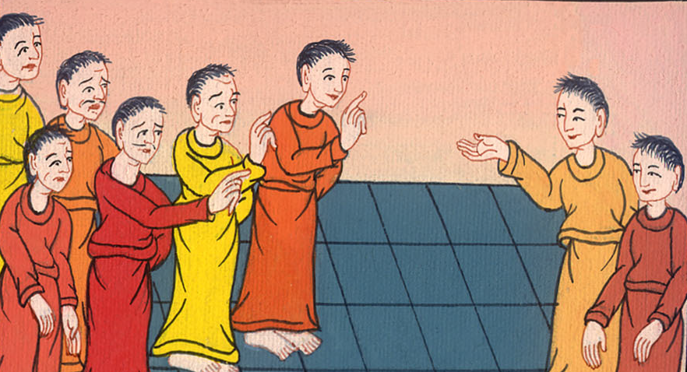
Acts 4:18

Slide 33
19But Peter and John answered them, “Whether it is right in the sight of God to listen to you rather than to God, judge for yourselves,

Slide 34
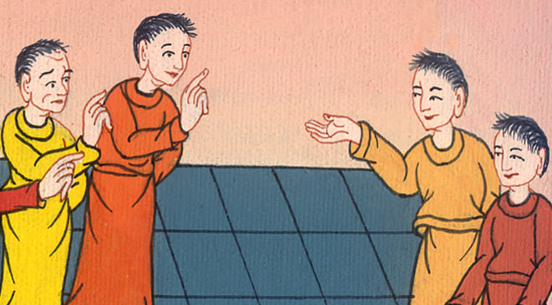
Acts 4:19

Slide 35
20for we can’t help telling the things which we saw and heard.”

Slide 36
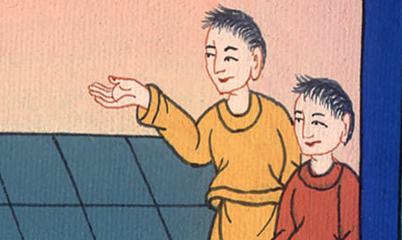
Acts 4:20

Slide 37
23Being let go, they came to their own company and reported all that the chief priests and the elders had said to them.

Slide 38
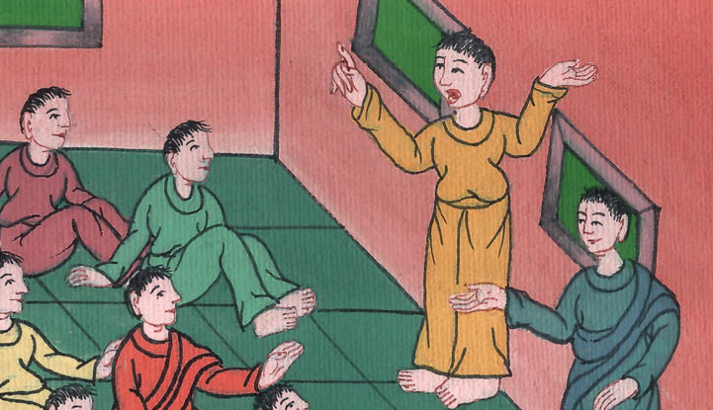
Acts 4:23

Slide 39
24When they heard it, they lifted up their voice to God with one accord and said, “O Lord, you are God, who made the heaven, the earth, the sea, and all that is in them;

Slide 40
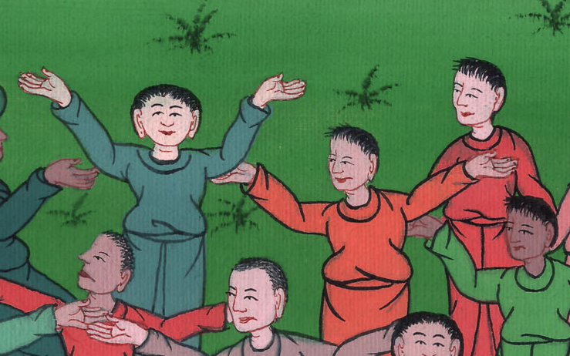
Acts 4:24

Slide 41
29Now, Lord, look at their threats, and grant to your servants to speak your word with all boldness,

Slide 42
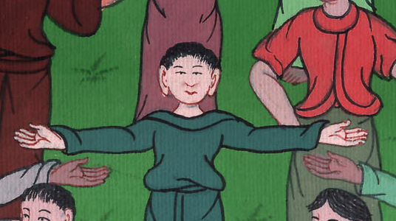
Acts 4:29

Slide 43
30while you stretch out your hand to heal; and that signs and wonders may be done through the name of your holy Servant Jesus.”

Slide 44
Acts 4:30

Slide 45
31When they had prayed, the place was shaken where they were gathered together. They were all filled with the Holy Spirit, and they spoke the word of God with boldness.

Slide 46
Acts 4:31

