Slide 1
47-3
This work is licensed under a Creative Commons Attribution-ShareAlike 4.0 International License.
Please add this statement to all the videos you create.
English Bible quotes are from the World English Bible US, which is in the public domain.
Notes:
Ch
47 Peter and John Heal Lame Man
1. Peter and John heal lame man - Acts 3:1-26 (Left Top)
2. Peter and John warned - Acts 4:1-31 (Right Top)
3. Believers living in unity/ Ananias and Sapphira - Acts 4:32 – 5:11 (Right
Center)
4. Many Healings – Acts 5:12-16 (Bottom)
5. Apostles arrested – Acts 5:17-42 (Left and Center)

Slide 2
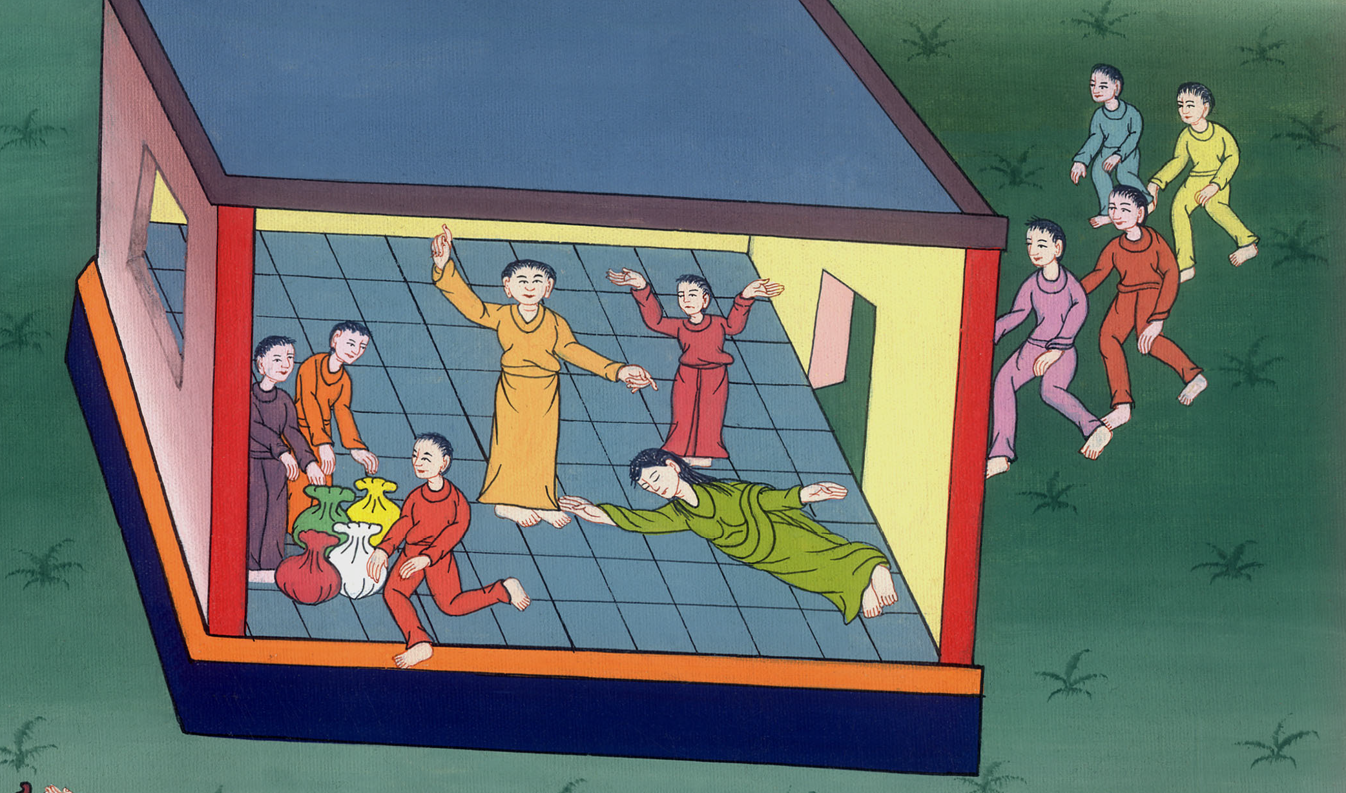
Ananias and Sapphira Acts 4:32 – 5:11

Slide 3
Ananias and Sapphira - Acts 4:32 – 5:11

Slide 4
Ananias and Sapphira Acts 4:32 – 5:11

Slide 5
32All the believers were agreed in heart and mind. They didn’t claim that anything they had was their own. Instead, they shared everything they owned.

Slide 6
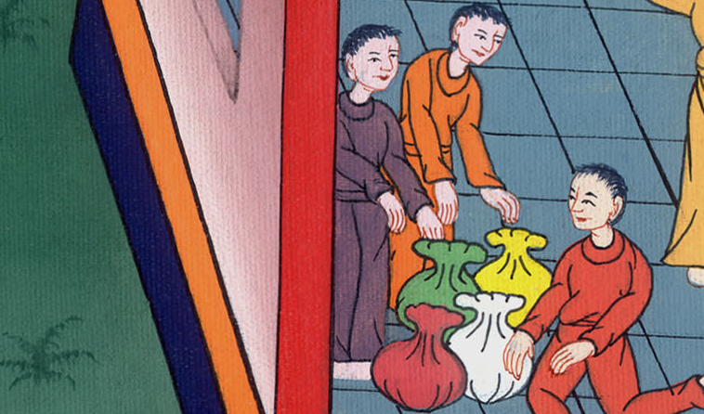
Acts 4:32

Slide 7
33With great power the apostles continued their teaching. They were telling people that the Lord Jesus had risen from the dead. And God’s grace was working powerfully in all of them.

Slide 8
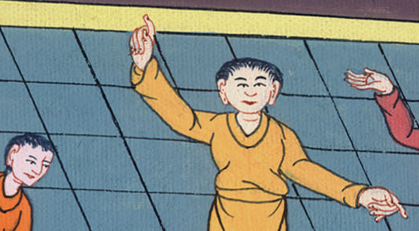
Acts 4:33

Slide 9
34So there were no needy persons among them. From time to time, those who owned land or houses sold them. They brought the money from the sales. 35They put it down at the apostles’ feet. It was then given out to anyone who needed it.

Slide 10
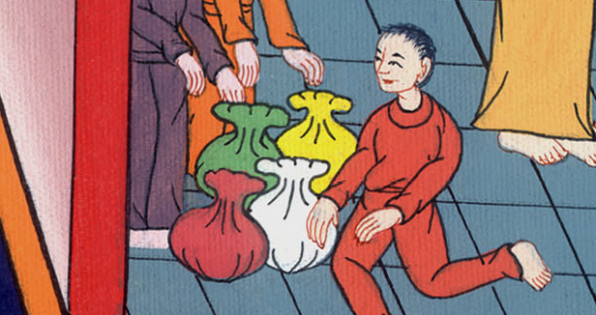
Acts 4:34

Slide 11
37Barnabas sold a field he owned. He brought the money from the sale. He put it down at the apostles’ feet.

Slide 12
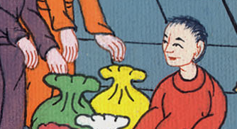
Acts 4:37

Slide 13
1A man named Ananias and his wife, Sapphira, also sold some land.

Slide 14
Acts 5:1

Slide 15
2He kept part of the money for himself. Sapphira knew he had kept it. He brought the rest of it and put it down at the apostles’ feet.

Slide 16
Acts 5:2

Slide 17
3Then Peter said, “Ananias, why did you let Satan fill your heart? He made you lie to the Holy Spirit. You have kept some of the money you received for the land.

Slide 18
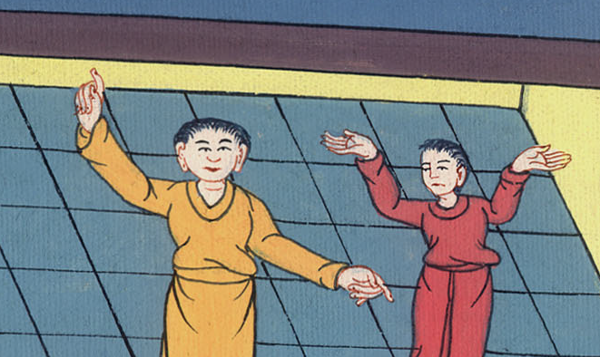
Acts 5:3

Slide 19
4Didn’t the land belong to you before it was sold? After it was sold, you could have used the money as you wished. What made you think of doing such a thing? You haven’t lied just to people. You’ve also lied to God.”

Slide 20
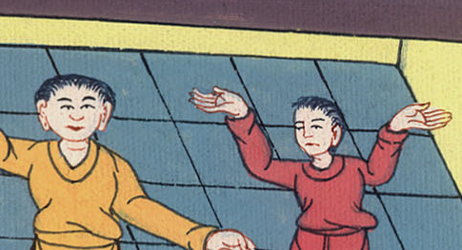
Acts 5:4

Slide 21
5When Ananias heard this, he fell down and died. All who heard what had happened were filled with fear. 6Some young men came and wrapped up his body. They carried him out and buried him.

Slide 22
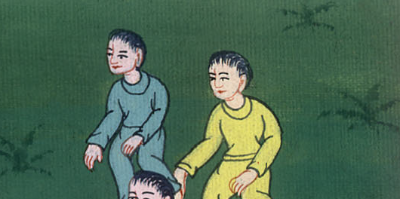
Acts 5:5

Slide 23
7About three hours later, the wife of Ananias came in. She didn’t know what had happened. 8Peter asked her, “Tell me. Is this the price you and Ananias sold the land for?”
“Yes,” she said. “That’s the price.”

Slide 24
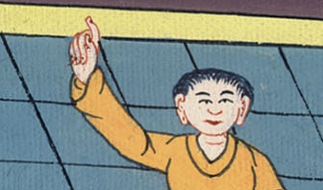
Acts 5:7,8

Slide 25
9Peter asked her, “How could you agree to test the Spirit of the Lord? Listen! You can hear the steps of the men who buried your husband. They are at the door. They will carry you out also.”

Slide 26
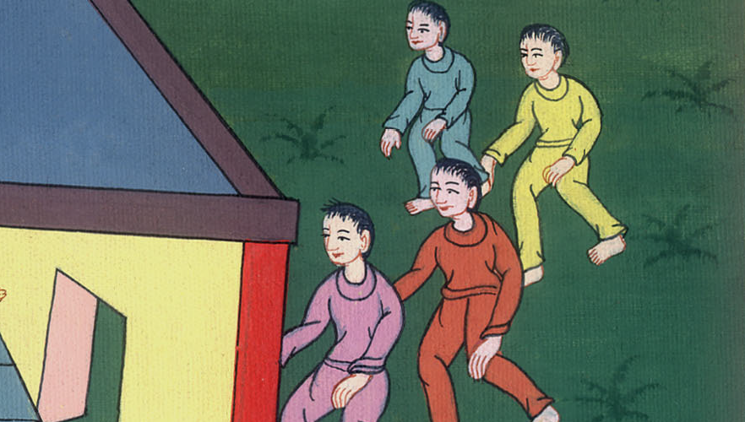
Acts 5:9

Slide 27
10At that moment she fell down at Peter’s feet and died. Then the young men came in. They saw that Sapphira was dead. So they carried her out and buried her beside her husband.

Slide 28
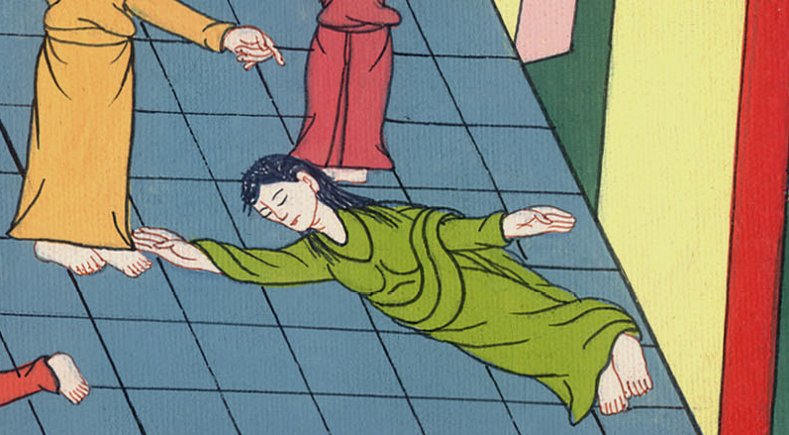
Acts 5:10

Slide 29
11The whole church and all who heard about these things were filled with fear.

Slide 30
Acts 5:11

